Slide 1

OBSESSIVE COMPULSIVE DISORDER
By: Dr. Jenish Vanparia
Department of Psychiatry

Slide 2

OCD
OBSESSIONS
COMPULSIONS
It is a recurrent & intrusive thought, feeling, idea, or sensation.
It is a conscious, standardized, recurrent behavior, such as counting, checking, or avoiding.
Relation between these two fragments

Slide 3
EPIDEMIOLOGY
The lifetime prevalence of OCD in general population – 2-3%.
4th most common psychiatric diagnosis after PHOBIAS, SUBSTANCE RELATED DISORDER, & MAJOR DEPRESSION.
Among adults men & women equally affected.
Among adolescents boys are affected more.
Mean age of onset – 20 years
Single persons –more prone to it.
More among WHITES.

Slide 4
ETIOLOGY
Problems identified in cognitive processing
Childhood trauma, abuse and neglect, low socio-economic status, low IQ more common.
Dysregulation of serotonin subsystems, particularly in the basal ganglia and orbit frontal cortex.
Sub cortical brain changes are reversible with treatment .
Model -Pediatric Autoimmune Neuropsychiatic disorder. (PANDAS)
- Onset of disorder follows strep infection. (strep infection also known to precede another disorder known as Syndenham’s chorea)
- Sub cortical structures affected in both diseases

Slide 5
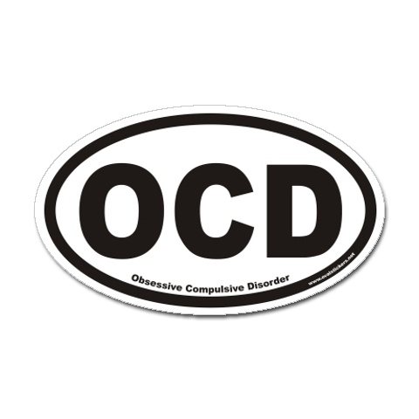
ETIOLOGY
Familial/Genetic component
-Generalized anxiety disorder, agoraphobia found more
commonly in first degree relatives.
-Another subtype sees Tourettes syndrome, tic disorders more commonly in first degree relatives.
Summary - There appears to be diverse causes including multiple possible genetic causes, insults to the developing brain, and risk factors that bring out these vulnerabilities (including low SES, abuse and neglect)

Slide 6

DSM-IV-TR Diagnostic Criteria For
OCD
Either obsessions or compulsion
Obsessions
Reccurent & persistent thoughts, impulses, or images that are experienced, at sometime during the disturbance, as intrusive & inappropriate &that cause marked anxiety or distress.
The thoughts, impulses, or images are not simply excessive worries about real life problems.
The person attempts to ignore or suppress such thoughts, impulses, or images or to neutralize them with some other thought or action.
The person recognizes that the obsessional thoughts, impulses, or images are a product of his or her own mind (not imposed from without as in thought insertion)

Slide 7
compulsions
Repetitive behaviors (e.g., praying, counting, repeating words silently) that the person feels driven to perform in response to an obsession, or according to rules that must be applied rigidly.
The behaviors or mental acts are aimed at preventing or reducing distress or preventing some dreaded event or situation; however, these behaviors or mental acts either are not connected in a realistic way with what they are designed to neutralize or prevent or are clearly excessive.

Slide 8
At some point during the course of the disorder, the person has recognize that the obsession or compulsions are excessive or unreasonable.
The obsessions or compulsions cause marked distress, are time consuming (take more than 1 hour a day), or significantly interfere with the person’s normal routine, occupational functioning, or usual social activities or relationships.
If another Axis1 disorder is present the of obsessions or compulsions is not restricted to it.
The disturbance is not due to the direct physiological effects of a substance (e.g., a drug of abuse, a medication) or a general medical condition

Slide 9

MAJOR PRESENTING SYMPTOMS
OBSESSIONS
COMPULSIONS
Concern with bodily wastes or secretions(urine, stool, saliva), dirt, germs, environmental toxins.
Fear something terrible may happen (fire, death, illness of loved one, self, or others)
Scrupulosity (excessive praying or religious concern out of keeping with patients background).
Lucky & unlucky numbers.
Perverse sexual thoughts, images, or impulses.
Intrusive nonsense sounds, words, or music.
Excessive hand washing, showering, bathing, tooth brushing, or grooming.
Repeating rituals (going in & out of door, up & down from chair)
Checking doors, locks, stove, appliances, car breaks.
Touching
Ordering & arranging
Counting
Hoarding & collecting

Slide 10

Spectrum Disorder
• Obsessive Compulsive phenomena can be conceptualized as
a spectrum disorder which includes
– Obsessive-Compulsive Disorder (OCD)
– Trichotilomania
– Eating disorders
– Body Dysmorphic disorder
– Tics and Tourette's Syndrome
– Paediatric Autoimmune Neuropsychiatic Disorder (PANDAS)
– Agoraphobia
– Generalized Anxiety

Slide 11

TRICHOTILOMANIA
EATING DISORDER
AGORAPHOBIA
BODY DISMORPHIC DISORDER
GENERALISED ANXIETY
OCD
TICS DISORDER
PANDAS
TOURETTE’S SYNDROME
SPECTRUM DISORDER

Slide 12
COURSE & PROGNOSIS
More than half of patients have sudden onset of symptoms which occurs after a stressful event.
Delay of 5-10 years before patient come to psychiatric attention.
About one third of OCD patients have major depressive disorder & suicidal tendency.
POOR PROGNOSIS is indicated by
- yielding to compulsion
- childhood onset
- bizarre compulsion
- the need for hospitalization
- coexisting major depressive disorder
- presence of personality disorder

Slide 13
OBSESSIVE COMPULSIVE PERSONALITY DISORDER
Pervasive pattern of preoccupation with orderliness, perfectionism, and mental and interpersonal control, at the expense of flexibility, openness, and efficiency, beginning by early adult hood and present in a variety of contexts, as indicated by four or more of the following:
1. Preoccupation with details, rules, lists
2. Perfectionism that interferes with task completion
3. Excessively devoted to work and productivity to the exclusion of leisure activities and friendships
4. Overly conscientious, scrupulous and inflexible about matters of morality, ethics or values.
5. Is unable to discard worn-out or worthless objects
6. Is reluctant to delegate tasks or to work with others
7. A miserly spending style toward both self and others
8. Shows with rigidity and stubbornness
No major obsessions and does not see senselessness

Slide 14
TREATMENT
Pharmacotherapy
Behavior Therapy
Psychotherapy
Other Therapies

Slide 15
Pharmacotherapy
Initial effect seen after 4-6 weeks.
8-16 weeks needed to get max therapeutic benefit.
Serotonin specific reuptake inhibitors.
Clomipramine.
Other drugs.

Slide 16

SSRIs.
FLUOXETINE (Prozac)
FLUVOXAMINE (Luvox)
PAROXETINE (Paxil)
SERTRALINE (Zoloft)
ADVERSE EFFECTS
sleep disturbance
nausea
diarrhea
headache
anxiety
restlessness
Ssri + behavioral therapy = best cinical outcomes.

Slide 17
CLOMIPRAMINE
It was the 1st drug to be FDA approved for the treatment of OCD.
Dosing must be titrated upwards over 2-3 weeks to avoid GI side effects & Orthostatic hypotension.
Other side effects – dry mouth, constipation

Slide 18
OTHER DRUGS
If treatment with clomipramine or an SSRI is unsuccessful, many therapists augment the 1st drug by addition of VALPROATE, LITHIUM, or CARBAMAZEPINE.
VENLAFAXINE
PINDOLOL
MONOAMINE OXYDASE INHIBITORS – PHENELZINE
BUSPIRON
5- HYDROXY TRYPTAMINE
L- TRYPTOPHAN
CLONAZEPAM

Slide 19
BEHAVIOR THERAPY
As effective as pharmacotherapy, in fact having more long lasting effects.
PRINCIPAL BEHAVIORAL TREATMENT
Exposure & response prevention
Desensitization
Thought stopping
Flooding
Implosion therapy
Aversive conditioning

Slide 20
OTHER THERAPIES
PSYCHOTHERAPY
FAMILY THERAPY
GROUP THERAPY
ECT
PSYCHOSURGERY – CINGULOTOMY
- most common Cx – seizures
Rx – phenytoin.

Slide 21
TREATMENT OF OCD
Also consider
PHARMACOTHERAPY
BEHAVIORAL THERAPY
1st line SSRIs;
SERTRALINE-200mg
FLUVOXAMINE-300mg
2nd line SSRIs;
CLOMIPRAMINE-250mg
FLUOXETINE-80mg
PAROXETINE-60mg
Exposure with response prevention
Augmentors if partial response;
BUSPIRON, LITHIUM,
CLONAZEPAM, TRAZODONE,
ALPRAZOLAM, LIOTHYRONINE
Reasons of poor response;
Poor compliance
Comorbid depression
Use/abuse of cns depressants
Delusions
Try a 2nd SSRIs/behavior therapy
Still unresponsive

Slide 22
STILL UNRESPONSIVE
For personality disorder
For severely disabled patients
Psychotherapy
Day program
Halfway houses
Consider neurosurgery;
After a minimum two adequate medication trials with augmentation
After behavioral treatment
Without severe personality disorder

Slide 23


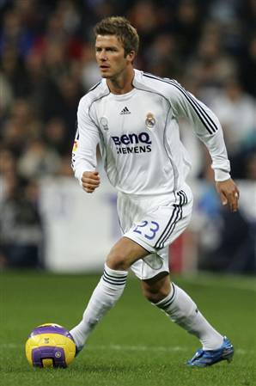
JUSTINE TIMBERLAKE
DAVID BACKHAM
JESICA ALBA
SUFFERING FROM OCD

Slide 24

THANK YOU

