Slide 1
Vitamin B1 (Thiamine)
Dr. Tejas Shah

Slide 2

©2003 Wadsworth, a division of Thomson Learning, Inc. Thomson Learning™ is a trademark used herein under license.
Vitamins fall into two categories—
fat soluble and water soluble.

Slide 3
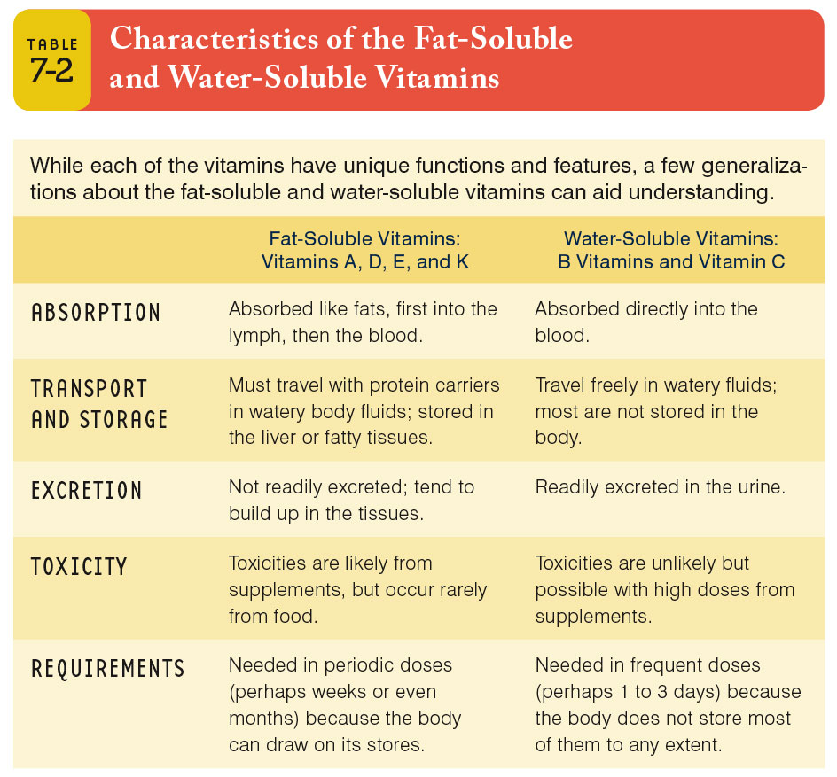

Slide 4
CLASSIFICATION
VITAMINS
Water Soluble Fat Soluble
Vit A, D, E, K
Non B-complex B-complex
e.g. Vitamin C
Energy-releasing | Hematopoietic | Others
Vit B₁(Thiamine), Vit B₂ (Riboflavin), Vit B₃ (Niacin), Vit B₅(Pantothenic acid), Vit B₇(Biotin) | Vit B₉ (Folic acid), B₁₂ (Cyanocobalamin) | Vit B ₆ - Pyridoxine Pyridoxal Pyridoxamine

Slide 5
Water Soluble Vitamins
B - complex
  Thiamin B1 (TENDER)
  Riboflavin B2 (ROMANCE)
  Niacin B3 (NEVER)
  Folate (FAILS)
  Pyridoxine B6 (PUT)
  Cobalamine B12 (COMBINED)
  Biotin (BEAUTIFUL)
  Pantothenic acid (PEARLS)

Slide 6
Water Soluble Vitamins
0
B - complex
Family of vitamins which commonly work as coenzymes in metabolism
Vitamin C

Slide 8
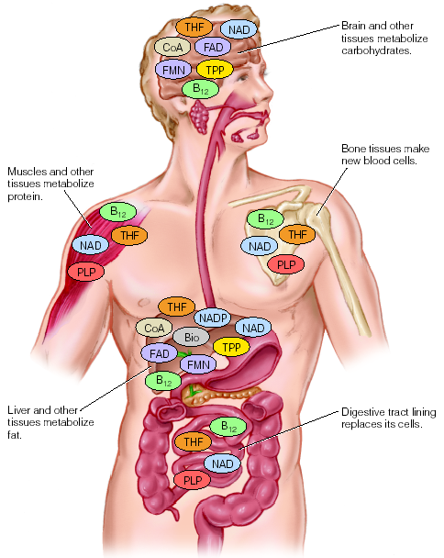
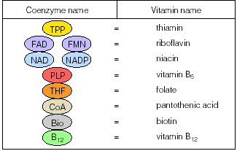
0
©2003 Wadsworth, a division of Thomson Learning, Inc. Thomson Learning™ is a trademark used herein under license.
Some Roles of the B Vitamins in Metabolism: Examples

Slide 9
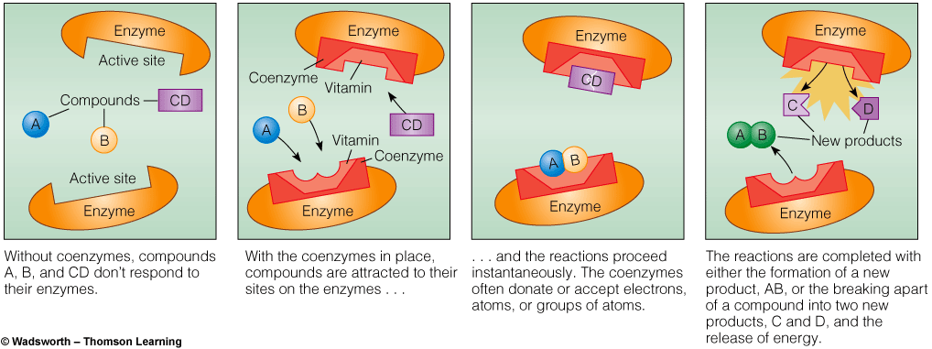
The B Vitamins
Coenzymes

Slide 10
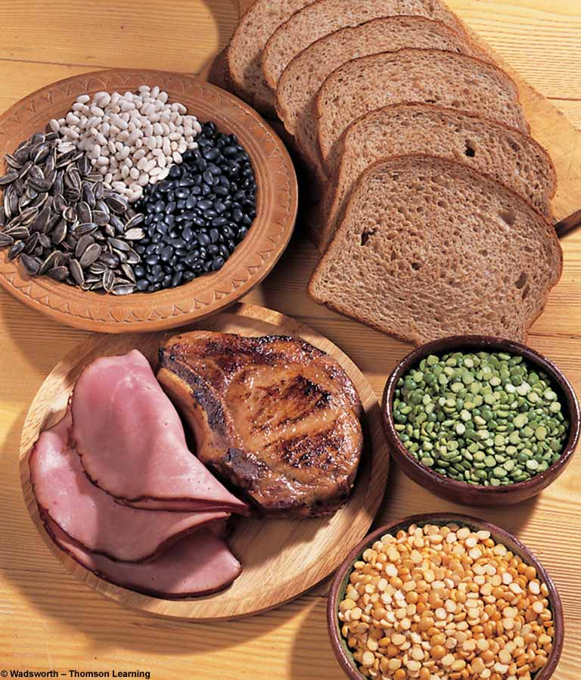
Thiamin
B-1
(Vitamin F)

Slide 11

Sources
Pork
Fish
Liver
Legumes
Nuts
Whole grain or enriched breads and cereals

Slide 12
FUNCTIONS
Important in:
  Producing energy from carbohydrates
  Proper nerve function
  Stabilizing the appetite
  Promoting growth and good muscle tone
  ATP production

Slide 13
RDA
Depends on calorie intake
  Men: 1.5 mg/day
  Women: 1.1 mg/day
  ABSORPTION : INTESTINE

Slide 14
THIAMIN DEFICIENCY
Beriberi: anorexia, dyspepsia, heaviness, weakness
  Dry beriberi: CNS manifestations (peripheral neuritis, paralysis)
  Wet beriberi: CVS manifestations (edema of legs, face, trunk, palpitation, breathlessness, distended neck veins). Death can occur due to heart failure.
  Infantile beriberi: in child with mother of vit.B1 def.
  restlessness and sleeplessness are there.
Cerebral beriberi (Wernicke-korsakoff syndrome):
  Wernicke’s encephalopathy:ophthalmoplegia, nystagmus, cerebellar ataxia
  Korsakoff psychosis

Slide 15
Thiamin deficiency
Deficiency disease
  Beriberi
    Wet, with edema
    Dry, with muscle wasting
    Infantile, occuring in infants
Deficiency symptoms
  Enlarged heart, cardiac failure
  Muscular weakness
  Apathy, poor short-term memory, confusion, irritability
  Anorexia, weight loss

Slide 16
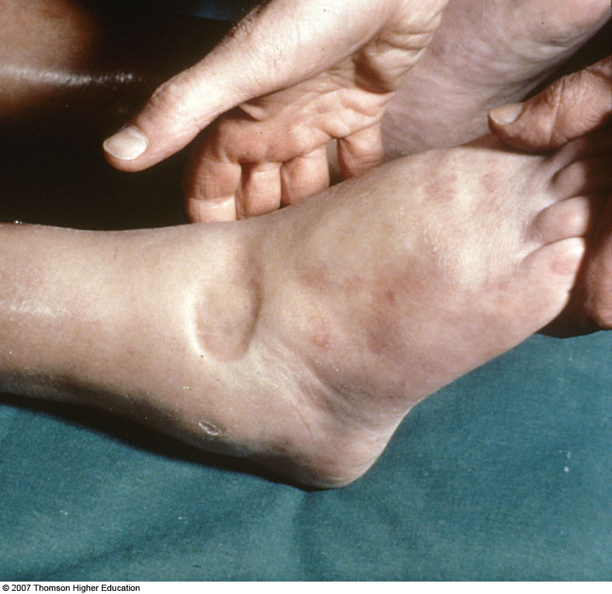

Slide 17
Author/year | Study design | Level | Results | Outcome
Chisolm-Straker M¹, Cherkas D. J Emerg Med. 2013 Sep;45(3):341-4. | Case Control study | IV | We present a case of an altered and unstable woman who presented to our busy ED and had rapid improvement after the administration of vitamin B1. A middle-aged woman presented to our ED with unstable vital signs and an alteration in her mental status. She was unable to provide a history. Empiric treatment with thiamine resulted in the resolution of her hemodynamic instability and improvement in her mental status. | Our patient benefited from the swift administration of thiamine and illustrates the importance of thiamine administration in the altered or hemodynamically unstable emergency patient with an elevated lactate.

Slide 18
Who’s at Risk?
Homeless & Malnourished
Alcoholics
People with malabsorption conditions
B-1 is nontoxic even at high dosages

