Slide 1
PARKINSON’S DISEASE
By: Dr. Jenish Vanparia
Department of Psychiatry

Slide 2
Primary (idiopathic) parkinsonism
Parkinson's disease
Juvenile parkinsonism
Secondary (acquired,symptomatic) parkinsonism
infectious: postencephalitic, slow virus
Drugs:dopamine receptor blocking drugs (antipsychotic. antiemetic drugs),
reserpine, tetrabenazine, alpha-methyl-dopa, lithium. flunarizine,
cinnarizine
Toxins:MPTP, CO, Mn, Hg. CS2, methanol, ethanol
Vascular:multi-infarct
Trauma:pugilistic encephalopathy
Other:parathyroid abnormalities, hypothyroidism. hepatocerebral degeneration.
brain tumor, normal pressure hydrocephalus. syringomesencephatia
Heredodegenerative parkinsonism
Huntington's disease
Wilson's disease
Hallervorden-Spatz disease
Olivopontocerebellar and spinocerebellar degenerations
Familial basal ganglia calcification
Familial parkinsonism with peripheral neuropathy
Neuroacanthocytosis
Multiple system degenerations (parkinsonism plus)
Progressive supranuclear palsy
Multiple system atrophy( Shy-Drager syndrome)
Striatonigral degeneration
Parkinsonism-dementia-ALS complex
Corticobasat ganglionic degeneration
Autos dominant Lewy body disease
ALZHEIMERS disease

Slide 3
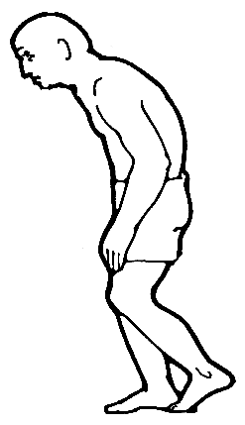
INTRODUCTION
Parkinson’s disease is a progressive neurodegenerative disorder associated with loss of dopaminergic neurons in the substantia nigra pars compacta
It is characterised by triad of motor features
resting tremor, rigidity &
akinesia/bradykinesia

Slide 4
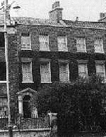
Historical Perspective
Jean-Martin Charcot proposed its current name
Dr. James Parkinson (1755-1828)
  First described in 1817 by an English physician, James Parkinson, in “An Essay on the Shaking Palsy.”
    “involuntary tremulous motion”
    “pass from a walking to a running pace”
    “shaking palsy”
    Paralysis agitans-misnomer

Slide 5
Epidemiology
Average incidence is 20 per 100,000 in North America
1 Million affected in the United States
50,000 new cases per year
Cost estimated to exceed $5.6 Billion annually
Caffeine and smoking shows some protective effects, Vit C & E also
African-Americans and Asians less likely than Caucasians to develop Parkinson’s disease
Average age of onset is 60 yrs
National centre for biotechnology information(NCBI)www.ncbi.com

Slide 6
  The most common movement disorder affecting 1-2 % of the general population over the age of 55 years.
  Juvenile onset < 1% cases(< 21 yrs)
  Young onset 20-40yrs
  Prevalence highest in Europe & North America
  Men > Women(1.5 times)
  The second most common neurodegenerative disorder after Alzheimer´s disease (AD).

Slide 7

Risk factors for PD
Age- the most important risk factor
Positive family history(risk doubled)
Male gender
Higher education
Environmental exposure: Herbicide and pesticide exposure, metals (manganese, iron), well water, farming, rural residence, wood pulp mills; and steel alloy industries
Race
Life experiences (emotional stress,parkinsonian personality)?
?Head trauma(Punch drunk syndrome)
An inverse correlation between cigarette smoking and caffeine intake in case-control studies.
Kaplan and saddock’s CTB
American Psychiatric Association. Practice Guidelines for the Treatment of Psychiatric Disorders. Fourth edition, text revised. Washington, DC: American Psychiatric Association, 2000.

Slide 8
Etiology
Loss of dopaminergic neurons in the ventral tier of substantia niagra pars compacta(SNpc) nigrostriatal pathway.
Neuronal degeneration due to oxidative stress, mitochondrial dysfunction, excitotoxicity, calcium induced injury, apoptosis
Toxins –viral infections of CNS, industrial exposures (Mn,CO,MPTP,OP)
Kaplan and saddock’s CTB
Clinical desk referance parkinsons disease by donald grosset,katherine grosset

Slide 9
Genetic Factors
Majority sporadic (>95%), rest genetic
Functional imaging-reduced basal ganglia 18-fluorodopa uptake in monozygotic twins than dizygotic twins.
Gene mutations- PARK 1 to 11
Alpha Synuclein gene(SNCA) mutation -1st mutation associated with AD PD.
Most common genetic risk factor G2385R LRRK2 among asians.
LRRK2 (locus PARK8 on chr 12q12) most prevelant with familial & sporadic cases

Slide 10
Gene Mutations
Autosomal Dominant
- PARK 1,3,4,8,11
Autosomal Recessive
- PARK2,6,7,9
Parkin gene mutation associated with juvenile AR early onset PD
Other genes – oncogene DJ-1, the MAPT(tau) gene, progranulin (PGRN), & PINK1
Kaplan and saddock’s CTB
Clinical desk referance parkinsons disease by donald grosset,katherine grosset

Slide 11

Neuropathology of PD
Spindle like (Lewy neurites) or Globular form(Lewy bodies-intracytoplasmic eosinophilic areas with densely staining core with surrounding halo& large outer body) – prerequisite for postmortem diagnosis
Extranigral damage includes dorsal motor nucleus(9th & 10th nerve, coeruleus-subcoeruleus
complex, magnocellular
nuclei of forebrain,neocortex)

Slide 12
Braak proposed 6 stages related to sporadic PD:
Stage 1-involvement confined to the medulla oblongata(inclusion bodiesconfined to the dorsal IX & X and /or intermediate reticular zone
Stage 2- medulla oblongata and pontine tegmentum.
Stage 3- stage 2 plus midbrain, in particular the pars compacta of the substantia nigra.
Stage 4- stage 3 plus basal proencephalon and mesocortex.
Stage 5- stage 4 plus lesions in high-order sensory association areas of the neocortex & prefrontal neocortex
Stage 6- stage 5 plus premotor area.
Clinical desk referance parkinsons disease by donald grosset,katherine grosset

Slide 13
Functional neuroanatomy of PD
Substantia nigra: The major origin of the dopaminergic innervation of the striatum.
Part of extrapyramidal system which processes information coming from the cortex to the striatum, returning it back to the cortex through the thalamus.
One major function of the striatum is the regulation of posture and muscle tonus.
PD symptoms become manifest when about 50-60 % of the DA-containing neurons in the substantia nigra and 70-80 % of striatal DA are lost.

Slide 14
Substantia nigra and the extrapyramidal system
CORTEX
+
+
STRIATUM
D1
D2
D1
SNc
GPe
−
SNr
STN
GPi
+
+
THALAMUS
Kaplan and saddock’s CTB
.
NORMAL MOTOR CONTROL
Notes:
Substantia nigra is the major origin of the dopaminergic innervation of the striatum and is part of so called extrapyramidal system which processes information coming from the cortex to the striatum, and returns it back to the cortex through the thalamus. One major function of the striatum, which is under the control of substantia nigra, is the regulation of posture and muscle tonus.
Source: Marsden, C. D. Parkinson's disease. Lancet 335, 948-952, 1990. Reprinted with permission from Elsevier.

Slide 15
Dopamine pathways in human brain
Google images

Slide 16
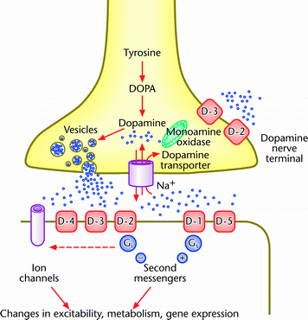
Dopamine synthesis

Slide 17
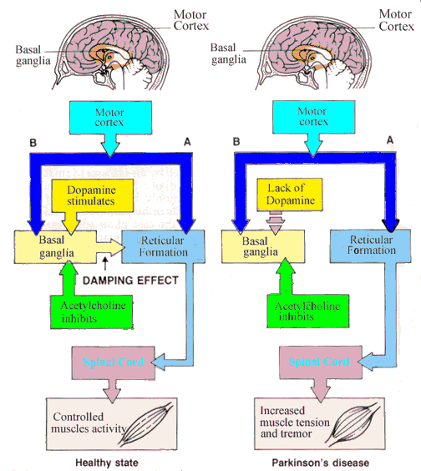

Slide 18
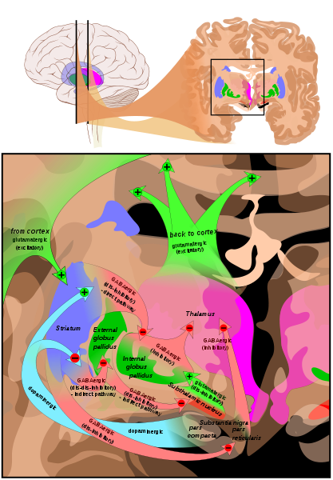

Slide 19
Circuits of the basal ganglia. Picture shows 2 coronal slices that have been superimposed to include the involved basal ganglia structures. + and - signs at the point of the arrows indicate respectively whether the pathway is excitatory or inhibitory in effect. Green arrows refer to excitatory glutamatergic pathways, red arrows refer to inhibitory GABAergic pathways and turquoise arrows refer to dopaminergic pathways that are excitatory on the direct pathway and inhibitory on the indirect pathway. Note that dis-inhibitory pathways in effect are excitatory on the feedback to the cortex, while dis-dis-inhibitory pathways in effect are inhibitory

Slide 20
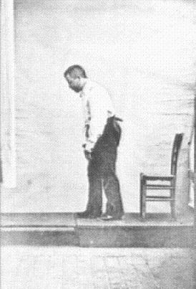
Diagnostic Features
Four Cardinal Signs
  T remor
  R igidity
  A kinesia and bradykinesia
  P ostural instability

Slide 21
Resting tremor
Most common first symptom(50-70%), usually asymmetric and most evident in one hand with the arm at rest.
Rhythmic involuntary oscillatory movement of body part
Disappears during sleep
Can be tested by distraction tecnique
Frequency 4-6 hz, pill-rolling

Slide 22
Starts in one hand & arm progressing to ipsilateral leg & then contralaterally
Postural tremor often present(reemergent tremor)
Chin,jaw,eyelid tremor may present
Worsening of tremor in the first 20 mins after dose-wearing off
Tremor dominance – good prognosis
Clinical desk referance parkinsons disease by donald grosset,katherine grosset

Slide 23
Bradykinesia
Slowness of initiating voluntary movements & sustaining repetitive movements with progressive reduction in speed & amplitude.
Loss of arm swing
Difficulty in walking, tendency to drag a leg in early disease
Micrographia
Difficulty turning in bed
Hypophonia
Difficulty with daily activities such as writing, shaving, using a knife and fork, and opening buttons; decreased blinking, masked facies, slowed chewing and swallowing.

Slide 24
Rigidity
Involuntary increase in muscle tone affecting all muscle groups.
Rigidity present throughout the range of movement, described as lead-pipe if smooth
Cogwheel tremor is movement like ratchet co-existing with tremor
Pain may be caused by dystonia
Stooped posture, anteroflexed head, and flexed knees and elbows.
Clinical desk referance parkinsons disease by donald grosset,katherine grosset

Slide 25
Additional clinical features of PD
Postural instability: Due to loss of postural reflexes. Poor balance, unsteadiness,falls. Examined using Pull test.
Frontal lobe reflexes i.e palmomental & glabellar tap positive
Dysfunction of the autonomic nervous system: Impaired
gastrointestinal motility, bladder dysfunction, sialorrhea, excessive head and neck sweating, and orthostatic hypotension.
Depression: Mild to moderate depression in 50 % of patients.
Cognitive impairment: Mild cognitive decline including impaired visual-spatial perception and attention, slowness in execution of motor tasks, and impaired concentration in most patients; at least 1/3 become demented during the course of the disease.

Slide 26

Characteristic Problems
Olfactory dysfunction
Micrographia-small handwriting
Hypomimia-decreased facial animation
Hypophonia-soft speech
Dysarthria-unclear pronunciation
Dyspnea-labored breathing
Festination-Shuffling gait

Slide 27
Diagnosis
3 or more of supporting criteria are required for diagnosis of definite PD(UK Brain Bank criteria)
Unilateral onset
Resting tremor
Progressive disorder
Persisting asymmetry affecting onset side most
Excellent response to Levodopa
Severe levodopa induced chorea
Levodopa response for at least five years
Clinical course over 10 yrs
Clinical desk referance parkinsons disease by donald grosset,katherine grosset

Slide 28

Can you ride a bicycle?
A
T
Y
P
I
C
A
L
P
D
Bastiaan R. Bloem, MD, PhD, medical director of the Parkinson Center Nijmegen at Radboud University Nijmegen Medical Center, the Netherlands
Medscape medical news

Slide 29
Exclusion Criteria
  Postencephalitic
  Drug-Induced(neuroleptic exposure,neg response to L-dopa,MPTP)
  Toxic
  Stroke
  Trauma /head injury
  Neoplasm or communating hydrocephalus
  Other neurodegenerative conditions
    Wilson’s disease
    Alzheimer’s
    Lewy Body dementia
Clinical desk referance parkinsons disease by donald grosset,katherine grosset

Slide 30
Red flags(alerts)
Early falls-parkinson-plus syndrome(usuallyPSP or MSA)
Early dementia-DLB, PSP, corticobasal degeneration,Alzheimer’s disease.
Apraxia & alien limb-corticobasal degeneration
Early pronounced autonomic features(impotence, postural hypotension)- MSA
Sudden onset of symptoms-cerebrovascular event
No rest tremor – essential tremor,dystonic tremor
Symmetrical onset & signs
Predominance of axial symptoms

Slide 31
Poor therapy response
Rapid progression
Alzheimer’s disease patients have parkinsonian symptoms
Clinical desk referance parkinsons disease by donald grosset,katherine grosset

Slide 32
Hoehn and Yahr Staging of Severity of Parkinson’s Disease
Stage | Description
0 | No clinical signs evident
I | Unilateral involvement
II | Bilateral involvement but no postural abnormalities
III | Bilateral involvement with mild postural imbalance on examination or history of poor balance or falls; patient leads independent life
IV | Bilateral involvement with postural instability; patient requires substantial help
V | Sever, fully developed disease; patient restricted to bed or wheelchair

Slide 33
Schwab & England Activities of Daily Living Scale
100% Completely independent. Able to do all chores without slowness, difficulty or impairment. Essentially normal. Unaware of any difficulty
80% Completely independent in most chores. Takes twice as long. Conscious of difficulty and slowness
60% Some dependency. Can do most chores, but exceeding slowly and with much effort. Error; sometimes impossible
40% Very dependent. Can assist with all chores, but few alone
20% Nothing alone. Can be slight help with some chores.
0% Cannot swallow, bladder and bowel not functioning, Bed-ridden.
Pubmed.com

Slide 34
Parkinsonism plus syndromes
Progressive Supranuclear Palsy(PSP)
Age of onset - 60 to 65 yrs
2nd most common parkinsonian neurodegeneratrive disorder(4% of all cases of PD)
Taupathy
Parkinsonism(axial rigidity mainly) plus early falls, gaze paresis, dysarthria, dysphagia,dementia, UMN signs
Apathy & disinhibitions, emotional incontinence. Schizophreniform psychotic symptoms occassionally

Slide 35
PET studies-decreased cortical metabolism in frontal areas
MRI helps in diagnosis
Broader involvement of basal ganglia
D/d – Frontotemporal dementia, corticobasal degeneration,Alzheimer’s disease, Dementia with Lewy bodies, MSA,Vascular parkinsonism, Cjd, whipples disease
Life expectancy 5-9 yrs after onset.
Treatment- Levodopa is ineffective. Cholinergic- enhancing agents provide little benefit. Physical & speech therapy may be given.
Kaplan and saddock’s CTB
Clinical desk referance parkinsons disease by donald grosset,katherine grosset

Slide 36
Corticobasal degeneration
PD occurs along with cortical dysfunction
Manifests as an akinetic rigid syndrome unresponsive to levodopa
Cognitive impairment dominant feature
Usually starts after age of 60.death within 2 to 12 yrs.
Unilateral bradykinesia & rigidity with or without tremor
Irregular jerky arm is typical
Progressive gait disturbance, dystonia, dysphagia & dysarthria may occur
Apraxia, cortical sensory loss & memory loss

Slide 37
Other signs- myoclonus, corticospinal signs, choreoathetosis, supranuclear gaze abnormalities & blepharospasm
Symptoms spread contralaterally within 1 yr
May have an alien limb
Cause unknown but accumulation of Tau protein
Structural neuroimaging shows cortical atrophy & functional neuroimaging shows reduced cortical blood flow in fronto-parieto-temporal area- sometimes asymmetrical.
No specific treatment, supportive multidisciplinary care required
Antidepressants & a trial of dopaminergic therapy may help.Clonazepam may help myoclonus. Baclofen helps in muscle spasm
Kaplan and saddock’s CTB
Clinical desk referance parkinsons disease by donald grosset,katherine grosset

Slide 38
Dementia with lewy bodies
Primary dementia with lewy bodies in cerebral cortex,brainstem,thalamus,striatum.
2nd most common form of dementia after Alzheimers disease.
Onset after 50 yrs.men>women
Dementia with EPS or initially parkinsonism with early onset dementia
Cognitive decline is progressive but may fluctuate.
Dramatic visual hallucinations,depression or paranoid delusions

Slide 39
Motor features include myoclonus & parkinsonian signs of bradykinesia, rigidity & gait difficulties with early falls in about 2/3 patients.
Inclusion criteria to reach possible diagnosis:
Progressive cognitive decline of sufficient magnitudeto interfere with normal social or occupationalfunction.
One of three core features:1) fluctuating cognition with pronounced variations in attention & alertness 2)recurrent visual hallucinations 3) parkinsonism

Slide 40
Supportive criteria include:
repeated falls, syncope, transient loss of consciousness, neuroleptic sensitivity, depression, rapid eye movement (REM) sleep behaviour disorder, systematic delusions, hallucinations in other modalities.
Autopsy is required to reach a definite diagnosis
Management often includes reduction & sometimes discontinuation of antiparkinson medication – particularly anticholinergics, selegiline, amantadine,& DAs
Antidepressants & stimulants can also be helpful.
Kaplan and saddock’s CTB
Clinical desk referance parkinsons disease by donald grosset,katherine grosset

Slide 41
Multiple system atrophy
Clinically a combination of parkinsonism, autonomic dysfunction & cerebellar features. Age adjusted prevalence 4 per 100,000.
MSA now used in place of three older diagnosis,olivopontocerebellar atrophy(OPCA), Shy-Drager syndrome & striatonigral degeneration.
Parkinsonism:
Bradykinesia plus one of rigidity,postural instability or tremor.
Tremor of MSA irregular jerky type, noted during both posture & action and may be due to mypclonic jerks, which are sometimes touch or stretch sensitive.

Slide 42
Autonomic problems:
Falls relating to orthostatic hypotension, impotence, bladder instability .
Cerebellar signs:
Gait ataxia, speech problems, nystagmus, incoordination.
Pyramidal signs can also occur:
Brisk reflexes, upgoing planter reflexes
Patients with predominantly parkinsonian presentation are classified as having MSA-P subtype of MSA(formerly striatonigral degeneration) & those with stronger cerebellar features are labelled as MSA-C(formerly sporadic olivopontocerebellar atrophy)

Slide 43
Glial cytoplasmic inclusions(GCIs) are pathological hallmark of MSA. GCIs display alpha-synuclein immunoreactivity.
Mean age on onset 54 yrs.
Dyskinesia can develop especially orofacial.
Levodopa may be useful
Kaplan and saddock’s CTB
Clinical desk referance parkinsons disease by donald grosset,katherine grosset

Slide 44
Olivopontocerebellar atrophy
It is characterized by progressive parkinsonism and cerebellar ataxia and pathologically by neuronal loss in the ventral pons, inferior olives, and cerebellar cortex. Age at onset is infancy to 66 years.
Cerebellar ataxia is the presenting symptom in 73% of all patients.
Dementia, gaze impairment, dysarthria, dysphagia, incontinence, and upper and lower motor neuron signs usually become apparent within a few years after onset and loss of vestibular-ocular responses.
Autopsy-degeneration of the oculomotor nucleus with sparing of the Edinger- Westphal nucleus.

Slide 45
Neuropsychologic evaluation in patients with clinically diagnosed OPCArevealed emotionality,anxiety and a tendency toward depression.
dementia in up to 80% of patients.
Neurodiagnostic Studies CT and MRI scans in patients with OPCA typically show pancerebellar and brain stem atrophy, enlarged 4th ventricle and cerebellopontine angle cisterns, and demyelination of transverse pontine fibers on T2-weighted MRl images.
PET scans show reduced metabolic rate in the brain stem and cerebellum.In one study, 73% of brain stem auditory evoked responses were abnormal
Clinical desk referance parkinsons disease by donald grosset,katherine grosset

Slide 46
Other parkinsonian conditions
Vascular parkinsonism
Increases with age, commoner in men
Mpore typically lower body involvement
Predominant gait disorder(short steps-marche apetit pas) with additonal features of dementia & pyramidal signs.
Some suggestion that there may be two types of vascular parkinsonism: 1) acute onset possibly associated with basal ganglia infarction. 2)a more insidious onset possibly associated with more diffuse subcortical white matter ischemia
Vascular risk factors include hypertension & diabetes, family history, hypercholesterolaemia & smoking.

Slide 47
Structural imaging may show basal ganglia infarcts,subcortical ischaemia or more diffuse small vessel changes.
Three pathological patterns of vascular parkinsonism:
1) Multiple lacunar infarcts clinically associated with gait disorders, pyramidal deficits, cognitive impairment & pseudobulbar palsy
2) Subcortical anterioscelerotic encephalopathy ( Binswanger disease) clinically associated with progressive gait disorder & dementia
3) Basal ganglia infarct(usually lacunar) – this type is rare.

Slide 48
Addressing vascular risk- control of hypertension, diabetes, hypercholesterolaemia, anti-platlet therapy & smoking cessation.
Try levodopa at a sufficient dose(where tolerated) & continue treatment if there is benefit.
Clinical desk referance parkinsons disease by donald grosset,katherine grosset

Slide 49
Wilsons Disease
Autosomal recessive disorder with deficiency of a copper-carrier membrane protein.
Abnormal gene located on chr 13.
Considered in young (<50 yrs) presenting with parkinsonism
50% present with neurological or psychiatric symptoms, rest with symptoms of liver disease
Serum ceruloplasmin is low & urinary copper is raised.
Kayser-Fleischer rings in cornea
Penicillamine or other copper chelating agents benefit.

Slide 50
Drug induced parkinsonism
Neuroleptics
Anti nausea agents (prochlorperazine, metaclopromide, cinnarizine)
Sodium valproate
Quinine
Halothane
Tetrabenazine
Drug induced or drug unmasked

Slide 51
A 36-year-old who had undergone an appendicectomy was referred to neurology unit with tremor at rest and bradykinesia. The surgery had been uneventful, and patient had not taken any medication likely to affect the central nervous system for six weeks before his surgery. His only medication had been the halothane that was used as general anaesthetic for his appendicectomy, along with preoperative medications consisting of 5 mg diazepam injections, 1 mg starting dose of atropine, and 50 mg of pethidine. Postoperatively, he received intravenous ampicillin and cloxacillin at a dose of 1 g every six hours for one week, and 50 mg of tramadol every 12 hours for five days

Slide 52
He has no family history of PD.
A careful neurological evaluation revealed asymmetrical rigidity, affecting the right side more than the left, with hypokinesia and tremor. Laboratory investigations, including full blood count, electrolytes and urea, and testing for malaria parasite, HIV and syphilis were essentially normal.
Our patient was diagnosed with drug-induced parkinsonism (DIP) and started on levodopa/carbidopa (250 mg) daily. After three days of treatment, the symptoms resolved completely and six weeks after he remained healthy.
;J Med Case Reports. 2011;5 © 2011 BioMed Central, Ltd.

Slide 53
Pharmacotherapy
Levodopa
Dopamine agonists
COMT inhibitors
Amantadine
Anticholinergics
Selegiline

Slide 54
Levodopa
L-Dopa (Larodopa by Roche)
This neurotransmitter Is converted by the neurons (cells) in the brain into dopamine Which is stored within the cells until needed by the body for movement.
The dopamine is then released into the synapse (space between the cells) and attaches to the dopamine receptor of another cell. This process permits proper Control and modulation of body movement. Levodopa, the precursor of dopamine Is used because dopamine is unable to enter the brain.
Adverse effects such as nausea, vomiting, postural hypotension, involuntary movements, restlessness, and cardiac arrhythmias

Slide 55
Levodopa
levodopa is almost always given in combination with a medication called carbidopa, which blocks dopa-decarboxylase outside the brain, allowing more levodopa to enter the brain.This dramatically decreases the occurrence of the side effects like nausea,orthostatic hypotension and loss of appetite.
Initial dose of 25/100mg ½ QD for 7 days, increase by ½ tab daily for 7 days until up to 1 tablet TID. Maximum dose of L-dopa is 800mg/day. To be taken empty stomach
Preparations: IR, MD(parcopa),SR(sinemet) & CR

Slide 56

Advantages of using carbidopa in combination with levodopa include:
• minimizing dopamine side effects such as nausea
• decreasing the required total daily dose of levodopa
• allowing individuals to take vitamin B6 (which would otherwise decrease the effectiveness of levodopa
On-off effect
End of dose deterioration.
s/e-nausea,insomnia,dyskinesias,hallucinations,
vivid dreams,orthostatic hypotension

Slide 57
Dopamine Agonists
“Synthetic Dopamine”
Bromocriptine Mesylate (Parlodel)
Pergolide Mesylate (Permax)
Pramipexol (Mirapex)
Ropinirole HCL (Requip)

Slide 58
Dopamine Agonists
Monotherapy or combination
Direct action on post-synaptic dopamine receptors.These drugs activate dopamine receptor
Are particulary usefull for:
  Prolonging the effective treatment period in patients with deteriorating response.
  Delaying the onset of L-dopa therapy. Particularly in younger patients.
  Treating patients who cannot tolerate high doses of L-dopa.
Associated with more side effects than L-dopa
Potential adverse effects include somnolence, dyskinesias, nausea, vomiting, orthostatic hypotension, nightmares, hallucinations, confusion, dizziness, hypersexuality, compulsive gambling

Slide 59
Ergot Agonist Dosing
Bromocriptine (Parlodel)
  Partial agonist
  Initial 1.25mg QD-BID
  Titrate 1.25mg to 2.5mg/d every week
  Average dose <30mg/day. Some patients may require up to 120mg/day
Pergolide (Permax)
  Full agonist
  13 times more potent than bromocriptine
  Initial 0.05mg/d for 2 days, increasing by 0.1 to 0.15mg/d every 3 days over a 12 day period
  May increase by 0.25mg every 3 days until symptoms are eliminated or adverse effects occur
  Mean dose 3mg/d
  Linked to fibrotic heart valve changes

Slide 60
Nonergot Agonist Dosing
Pramipexole (Mirapex)
  Monotherapy or Adjunct
  Initial dose of 0.125 mg TID and increased every 5 to 7 days as tolerated up to 3 to 4.5mg/d
  Higher doses are not more effective than 1.5mg/d and are associated with more side effects
  Mean 27% reduction of L-Dopa
  Antidepressant effect due to D3 activity
  Decrease dose with renal function impairment
  Drugs that are secreted by the cationic transport system may decrease the clearance of pramipexole by 20%. These include cimetidine, diltiazem, quinidine, quinine, ranitidine, triamterene, and verapamil.

Slide 61
Nonergot Agonist Dosing
Ropinirole (Requip)
  Monotherpy or Adjunct
  Initial dose of 0.25mg TID and increased by 0.25mg TID on a weekly basis. After the fourth week doses may be increased by 1.5mg/d up to 9mg/d. Further adjustment may be obtained by 3mg/d increases up to 24mg/day
  Mean 19% reduction of L-dopa
  Drugs that inhibit or induce CYP1A2 will affect the clearance of ropinirole. Inhibitors such as cimetidine, ciprofloxacin, clarithromycin, diltiazem, enoxacin, erythromycin, fluvoxamine, mexiletine, norfloxain, omeprazole, ritonavir, and troleandomycin. Inducers such as carbamazepine, phenobarbital, phenytoin, and rifampin.
  If therapy is stopped, discontinue over seven days

Slide 62
Nonergot Agonist Dosing
Apomorphine
Non-ergot DA with extensive FPM.
Given SC. Rescue therapy for wearing off.
Reduce oral drugs gradually before shifting to apomorphine monotherapy in daytime( levodopa at night)
Domperidone premedication for GI side effects
Rotigotine - D3/D2/D1 DA.
Transdermal 2, 4, 6 mg patches.
Starting dose 2 mg /24 hrs.Top dose 16 mg/24 hrs.
Skin reactions may happen

Slide 63
COMT Inhibitor Dosing
Entacapone (Comtan)
  Decreases metabolic loss of dopamine to 3-o-methyl dopa thus increaseing the effectiveness of levodopa
  Particularly indicated for wearing off.
  Initial dose of 200mg with each dose of levodopa up to 8 times daily
  Exacerbation of L-dopa side effects , diarrhea, urine discoloration, abdominal pain

Slide 64
Inhibition of peripheral COMT by entacapone increases the amount of L-DOPA and dopamine in the brain and improves the alleviation of PD symptoms.
Notes:
Catechol-O-methyl-transferase (COMT) inhibitors, like entacapone, which increase the bioavailability of levodopa by inhibiting COMT enzyme peripherally and thus slow down the breakdown of levodopa, can be used as adjunctive therapy to levodopa to reduce some of the adverse effects related to long-term levodopa treatment (results in smoother levodopa plasma levels, and a decrease in motor fluctuations in patients).

Slide 65
COMT Inhibitor Dosing
Tolcapone (Tasmar)
  Adjunct therapy
  Initial 100mg TID up to 200mg TID
  More potent and longer acting than entacapone
  Decrease L-dopa by 25 to 50%
  Exacerbation of L-dopa side effects, diarrhea, urine discoloration, liver toxicity.
  Monitor LFTs every 2 weeks for 1 year, every 4 weeks for 6 months, then every 8 weeks

Slide 66
Amantadine
Amantadine HCL (Symmetrel)
  Inhibits dopamine recapture thus increasing the amount of dopamine available in brain
  Blocks acetylcholine and glutamate receptors
  Dose 100mg BID to TID
  Caution in renal failure patients
  Currently used to reduce choreic movements/dyskinesia
  Narrow therapeutic range
  Unpleasant side effects such as nausea, dizziness, confusion, hallucinations, nightmares, dry mouth peripheral edema, and livedo reticularis

Slide 67
Anticholinergics
Trihexyphenidyl HCL (Artane)
Benztropine Mesylate (Cogentin)
  Monotherapy or adjunct
  Predopaminergic therapy
  Long touted as most effective for reducing tremor & rigidity
  Restores balance between DA & ACH by decreasing ACH
  Can be used in drug-induced parkinsonism
  Use Limited by side effects especially in the elderly(memory problems).

Slide 68
Selegiline
Selegiline HCL (Eldepryl)
  Prevent breakdown of dopamine in brain & inhibit reuptake of dopamine at pre-synaptic receptor.
  Monotherapy or adjunct
  MOA-inhibits monoamine oxidase-B (MAO-B)
  Used for end of dose deterioration
  Dosage of 5 mg BID with breakfast and lunch
  When used as monotherapy delays the need of L-dopa by an average of nine months.
  Possible adverse effects include nausea, dizziness, abdominal pain, confusion, and exacerbation of L-dopa side effects

Slide 69
Rasagiline
MAO-B inhibitor
2nd generation. 5 times potent than selegiline
Dosage 1 mg/day
Can be used as monotherapy or adjunct with levodopa

Slide 70
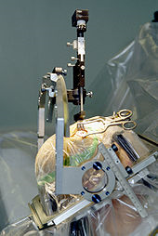
Surgical Options
Pallidotomy and Pallidal Stimulation
Thalamotomy and Thalamic Stimulation
  Introduced in 1950
  Pallidotomy improves tremor, rigidity, and bradykinesia
  Thalamotomy relieves tremor, rigidity, but not bradykinesia
  Neurosurgical treatment came to a end with the introduction of L-dopa in late 1960s
  Resurgence of neurosurgical intervention with the failure of pharmacological treatments after 10 to 15 years of disease progression
  Two methods: Ablation and deep brain stimulation

Slide 71
REHABILITATION
Regular physical exercise with or without physiotherapy can be beneficial to maintain and improve mobility, flexibility, strength, gait speed, and quality of life.
For rigidity, generalized relaxation techniques such as gentle rocking ,slow rotational movements of the extremities and trunk, rhythmic initiation, diaphragmatic breathing, and meditation techniques.
for gait and hypokinesia (slowness of movement), shuffling and decreased arm swing utilizing assistive equipment (pole walking and treadmill walking)
Strengthening exercises have shown improvements in strength and motor function.
Deep diaphragmatic breathing exercises
Exercise may improve constipation.
Lee Silverman voice treatment (LSVT)

Slide 72
DIET
Muscles and nerves that control the digestive process may be affected by PD, resulting in constipation and gastroparesis
A balanced diet, based on periodical nutritional assessments, is recommended.
For dysphagia it may be helpful to use thickening agents for liquid intake and an upright posture when eating, both measures reducing the risk of choking.
Gastrostomy to deliver food directly into the stomach is possible in severe cases.
To minimize interaction with proteins, levodopa should be taken 30 minutes before meals.

Slide 73
Under Investigation
Implantable pumps
Implantable capsules containing dopamine-producing cells
New medications to target one of the five individual brain receptors for dopamine
Continued genetic researcssh

Slide 74
NON MOTOR FEATURES OF PARKINSON’S DISEASE
COGNITIVE MANIFESTATIONS
PSYCHIATRIC MANIFESTATIONS
BEHAVIOURAL DYSFUNCTION
SLEEPDISTURBANCES
AUTONOMIC DYSFUNCTION

Slide 75
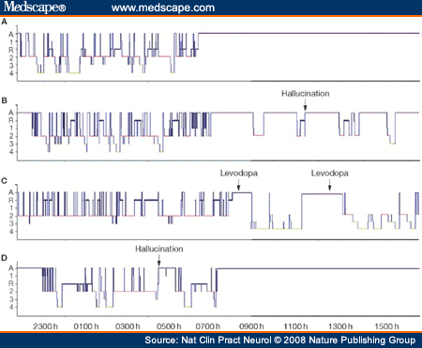

Slide 76


THANK YOU

