Slide 1
PSYCHOTHERAPIES
By: Dr Jenish Vanparia
Department of Psychiatry
SBKS MI & RC

Slide 2
PSYCHOTHERAPY
Psychotherapy can be defined (modified from Wolberg) as, the treatment by psychological means, of the problems of an emotional nature, in which a therapist deliberately establishes a professional relationship with the patient to,
1. Remove, modify or retard existing symptoms,
2. Mediate disturbed patterns of behaviour, and/or
3. Promote positive personality growth and development.
Psychotherapy can be conducted by either verbal
or non-verbal means.

Slide 3
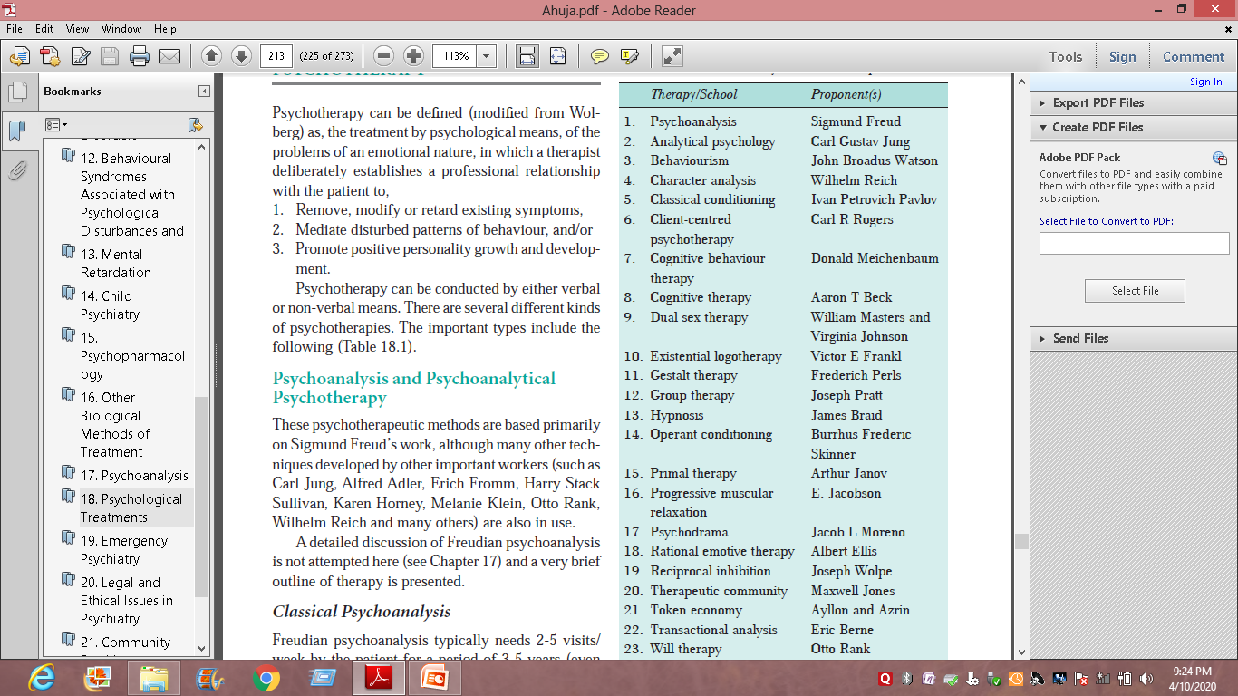
Types

Slide 4
Classical Psychoanalysis
Freudian psychoanalysis typically needs 2-5 visits/week by the patient for a period of 3-5 years (even longer).
No detailed history taking, mental status examination, or formalised psychiatric diagnosis is attempted.
The patient is allowed to communicate unguided, by using ‘free association’.

Slide 5
Psychoanalytically-oriented
(Psychodynamic) Psychotherapy
Psychoanalytically-oriented, psychodynamic psychotherapy is a much more direct form of psychoanalysis.
The duration of therapy is much briefer and advice is given to the patient occasionally.
The patient and the therapist may sit face-to-face or else couch is used.
The rest of technique is nearly the same as psychoanalysis.
How ever, additional modes of treatment, including drug therapy can be used.

Slide 6
Behaviour Therapy
Behaviour therapy is a type of psychotherapy (broadly defined) which is based on theories of learning, and aims at modifying maladaptive behaviour and substituting it with adaptive behaviour.
The behaviour that is followed by a reward is more likely to occur again (operant model), and that behaviour is learned more easily if taught in small steps.

Slide 7
One of the simplest methods of behaviour analysis is called as ABC charting, which involves a close look at the:
i. Antecedent (e.g. circumstances under which the behaviour began; who, if any, were present other details),
ii. Behaviour (description of the behaviour in detail), and
iii. Consequence (what happened afterwards; what factors helped to maintain behaviour).

Slide 8
Systematic Desensitisation
based on the principle of reciprocal inhibition
The principle states that if a response incompatible with anxiety is made to occur at the same time as an anxiety-provoking stimulus,
anxiety is reduced by reciprocal inhibition.
This consists of three main steps:
i. Relaxation training
ii. Hierarchy construction
iii.Systematic desensitisation proper:SD is a treatment of choice in phobias and obsessive- compulsive disorders

Slide 9
Aversion Therapy
Aversion therapy is used for the treatment of conditions which are pleasant but felt undesirable by the patient,
e.g. alcohol dependence, transvestism, ego dystonic homosexuality, other sexual deviations.
The underlying principle is pairing of the pleasant stimulus (such as alcohol) with an unplea sant response (such as brief electrical stimulus), so that even in absence of unpleasant response (after the therapy is over), the pleasant stimulus becomes unpleasant by association.

Slide 10
Operant Conditioning Procedures
for Increasing Behaviour
The common methods for augmenting an adaptive behaviour include:
Positive reinforcement: Here, the desirable behaviour is reinforced by a reward, either material or symbolic.
Negative reinforcement: Here, on performance of the desirable behaviour, punishment can be avoided.
Modelling: The person is exposed to ‘model’ behaviour and is induced to copy it.

Slide 11
Flooding
This is usually the method used in the treatment of phobias.
Here, the person is directly exposed to the phobic stimulus, but escape is made impossible.
By prolonged contact with the phobic stimulus, therapist’s guidance and encouragement, and therapist’s modelling behaviour, anxiety decreases and the phobic behaviour diminishes.

Slide 12
Operant Conditioning Procedures for
Decreasing Behaviour
i. Time-out: Here, the reinforcement is withdrawn for some time, contingent upon the undesired response. Time-out is often used in therapy with children.
ii. Punishment: Aversive stimulus is here presented, contingent upon undesired response (i.e. whenever undesired response occurs, punishment is given).
iii. Satiation: The undesired response is positively reinforced, so that tiring occurs. A similar technique is negative practice procedure.

Slide 13
Cognitive Therapy or Cognitive
Behaviour Therapy
Cognitive behaviour therapy (CBT) is a type of psychotherapy which aims at correcting the maladaptive methods of thinking, thus providing relief from consequent symptoms.
used for treatment of depression, anxiety disorder, panic disorder, phobias, eating disorders, anticipatory anxiety, and also for teaching problem-solving methods.

Slide 14
A typical cognitive therapy schedule consists of about 15 visits over a three-month period.
Some important techniques in CBT are:
i. Cognitive techniques such as recognising and correcting negative automatic thoughts, teaching reattribution techniques, increasing objectivity in perspectives, identifying and testing maladaptive assumptions, and decentering,
ii. Behavioural techniques such as activity scheduling, homework assignments, graded task assignment, behavioural rehearsal, role playing, and diversion techniques, and
iii. Teaching problem-solving skills.
iv. Mindfulness, originally a Buddhist technique, can also be combined with CBT.

Slide 15
Supportive Psychotherapy
This is a very directive method of psychotherapy, with the focus clearly on existing symptoms and/or current life situations. The aims of the therapy are:
i. Correction of the situational problem.
ii. Symptom rectification.
iii. Restoring or strengthening defenses. Prevention of emotional breakdown.
v. Teaching new coping skills.

Slide 16
Family and Marital Therapy
In family therapy and marital therapy (also called as couples therapy), the focus of intervention is not on the individual but is instead on the family as a unit or the marital unit.
Whenever there are relational problems within a family or marital unit (either primarily or secondary to a psychiatric disorder), family and/or marital therapy is indicated.

Slide 17
Group Therapy
Group therapy (or group psychotherapy) is a less time-consuming procedure, in which usually 8-10 people can be treated at one time.
Group therapy offers patients (and their relatives) an opportunity to realise that many others have and share problems which are very similar to their own problems, and that they are not alone in their suffering

Slide 18
Over the years, many types of group therapies have emerged such as self-help groups (Alcoholics Anonymous for alcoholics,
Weight Watchers for obese,
Phoenix-House for opiate dependent individuals),
Transactional Analysis groups (Eric Berne),
Training groups (Kurt Lewin),
Psychodrama (Jacob Moreno) and the like.

Slide 19
Suggestion
Although an integral part of supportive psychotherapy, it is often used alone.
It is used by nearly all medical practitioners, without realising or naming it as such.
It is suggestion, which is in part responsible for the placebo response.
A placebo prescribed confidently by an ‘impressive’ physician can lead to some improvement in about 33% of patients with most conditions

Slide 20
Thank You!!

