Slide 1
Vit B5 and Vit B12 and Vit B6
Dr Tejas Shah

Slide 2
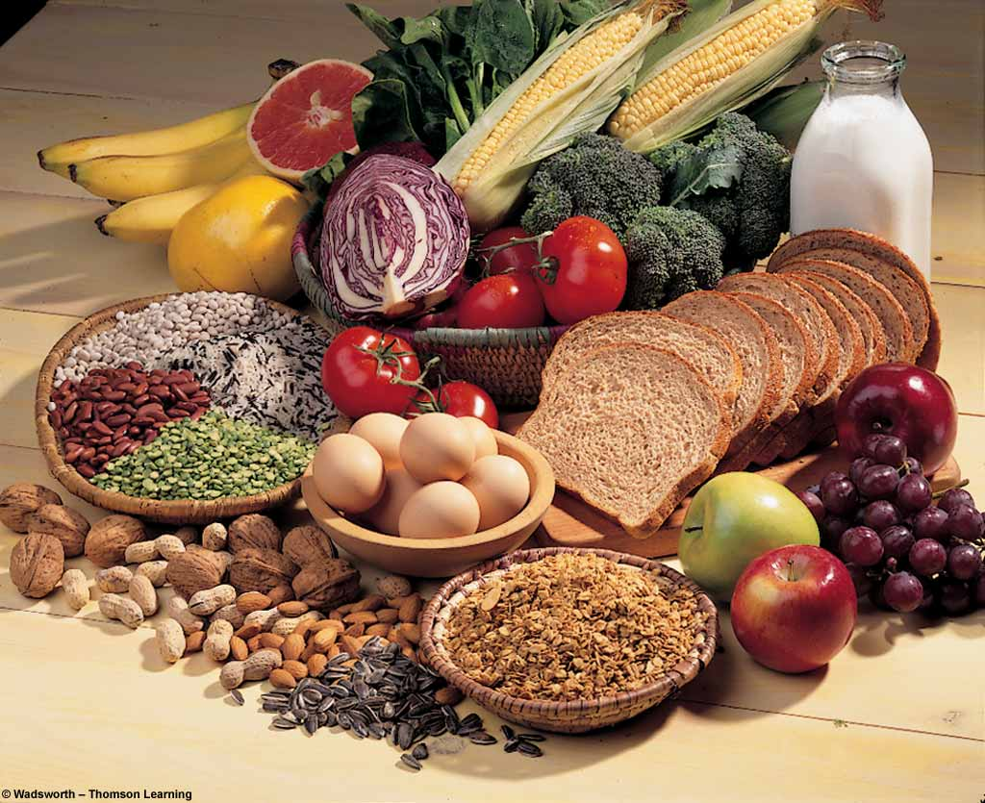

Pantothenic Acid (VIT B-5)

Slide 3
SOURCES
Widespread in foods
Organ meats
Mushrooms
Avacado
Broccoli
Whole grains

Slide 4
  Pantos- Everywhere (distributed in nature)
    RDA : Adults - 10 mg/day
    Children- 2-3 mg/day
    Pregnancy- 2.5 mg/day
Absorption: jejunum
Excretion – primarily urine

Slide 5
Coenzyme A – important component of fatty acid synthase complex
1) The acyl groups are transferred to other acceptors
[acetyl CoA + choline Acetylcholine+ CoA]
2) Acyl groups from other substrate accepted by CoA during metabolism
[pyruvate+CoA+NAD AcetylCoA+CO2+NADH]

Slide 6
DEFICIENCY
  Rare : chronic alcoholics, renal dialysis pt
  Deficiency Symptoms
    Vomiting, nausea and stomach cramps
    Insomnia and fatigue
    Depression, irritability, restlessness and apathy
    Gopalan’s burning foot syndrome – paresthesia in lower extremities, sleep disturbances
  No reported toxicities

Slide 7
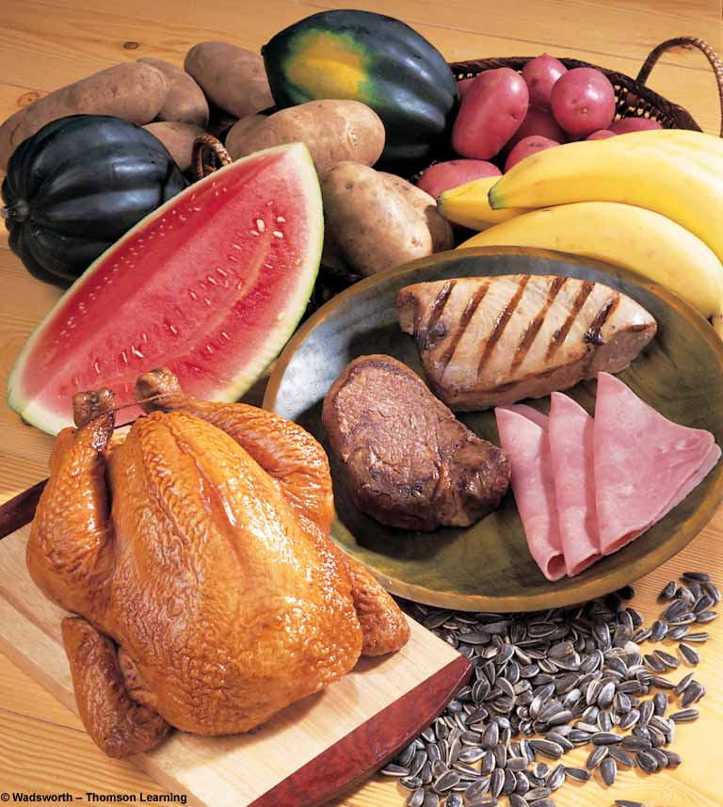
PYRIDOXIN
VIT - B₆

Slide 8
VITAMIN B-6
Other names
  Pyridoxine
  Pyridoxal
  Pyridoxamine

Slide 9
FUNCTIONS
Important in:
  Production of red blood cells
  conversion of tryptophan to niacin (B-3)
  (60 mg of tryptophan = 1 mg of B-3 )
  immunity
  nervous system functions
  reducing muscle spasms, cramps and numbness
  maintaining proper balance of sodium and phosphorous in the body

Slide 10
RECOMMENDATIONS
Men and women 1-2 mg/day
Additionally during pregnancy and lactation it is 2.5

Slide 11
Warnings
High doses of B-6 may be recommended to treat carpal tunnel syndrome and sleep disorders, but continued use of high doses may result in permanent nerve damage.
Pregnant women should always consult their doctor before taking this supplement and all others.

Slide 12
B-6 Deficiency
  nervousness, insomnia
  loss of muscle control, muscle weakness
  arm and leg cramps
  water retention
  skin lesions

Slide 13
Who’s at Risk?
very rare
alcoholics
patients with kidney failure
women using oral contraceptives pills

Slide 14
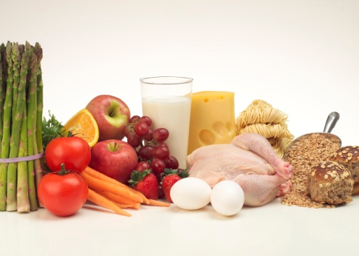
BIOTIN
OR
VIT B-7

Slide 15
SOURCES
Widespread in foods
Organ meats, fish
Egg yolks
Soybeans
Whole grains
Biotin can also be synthesized by intestinal bacteria.
RDA
  Adults: 30 μg/day
  Absorption : jejunum and ileum

Slide 16
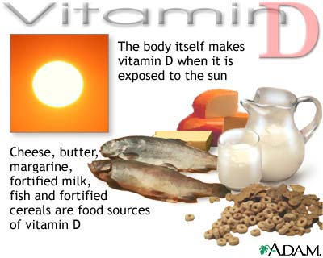

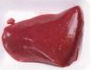
Daily requirement: 12-25 μg/day

Slide 17
FUNCTIONS : Coenzyme activity
1) Acetyl CoA carboxylase - add CO2 to acetyl CoA to form malonyl CoA, rate limiting step in fatty acid synthesis.
Acetyl-CoA+CO2+ATP malonyl CoA+ ADP + Pi
2) Propionyl CoA carboxylase-
Propionyl-CoA+CO2+ATP methyl malonyl CoA+
ADP + Pi
3) Pyruvate carboxylase-
Pyruvate +CO2+ATP oxaloacetate + ADP + Pi
* Provides oxaloacetate (TCA cycle), enzyme of gluconeogenic pathway

Slide 18
Biotin independent carboxylation reactions:-
-Carbamoyl phosphate synthetase- urea synthesis
pyrimidine synthesis
- Addition of CO2 to form C6 in purine ring
- Malic enzyme (pyruvate malate)
Biotin antagonists-
-Avidin (egg white)- heat labile, neutralized by heating
1 molecule bound with 4 molecules
of biotin
[biotin- egg yolk, avidin- egg white]

Slide 19
DEFICIENCY SYMPTOMS
Rare : pregnancy and alcoholics
    Depression, lethargy, and hallucinations
    Numb or tingling sensation in the arms and legs
    Red, scaly rash around the eyes, nose and mouth
    Hair loss
  Biotin can be bound with an raw egg-white protein called avidin.
  No reported toxicities

Slide 20
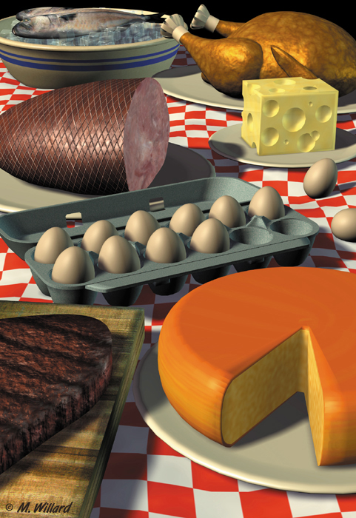
VITAMIN B₁₂

Slide 21
VITAMIN B-12
COBALAMIN (COBALT ATOM IN CORRIN RING)
EXTRINSIC FACTOR OF CASTLE (EF)
ANTIPERNICIOUS ANEMIA FACTOR
DEPENDING ON R GROUP
CYANIDE-CYANOCOBALAMIN
OH-HYDROXYCOBALAMIN
CH3- METHYL COBALAMIN

Slide 22
SOURCES
Animal products
  Meat, poultry fish, shellfish
  Milk, cheese
  Eggs
Fortified cereals

Slide 23
RDA
  Adults: 1 - 2 μg/day
  Pregnancy and lactation – 2 μg/day
Absorption requires : HCl, Pepsin, Intrinsic factor
Easily destroyed by microwave cooking

Slide 24
ABSORPTION & TRANSPORT
Vitamin B₁₂ binds a glycoprotein (intrinsic factor) in stomach.
I.F. is secreted by the parietal cells.
Vitamin-IF complex recognises surface receptors of mucosal cells in ileum and is absorbed.
(require calcium)
Transport - bound to specific B₁₂ binding protein
(transcobalamin).
Stored mainly in the liver (2 mg) sufficient to last for 2-3 years (exception).

Slide 25
FUNCTIONS
  Part of coenzymes methylcobalamin and deoxyadenosylcobalamin used in new cell synthesis
  Helps to maintain nerve cells
  Reforms folate coenzyme (Activates Folate)
  Helps to break down some fatty acids and amino acids

Slide 26
CAUSES
NUTRITIONAL
DECREASE IN ABSORPTION
ELDERLY PEOPLE
ADDISONIAN PERNISICIOUS ANEMIA
GASTRIC ATROPHY
FISH TAPEWORM
PREGNANCY
INHERITED DEFECTS

Slide 27
DEFICIENCY
ALSO CAUSES FOLIC ACID DEFICIENCY DUE TO FOLATE TRAP
BLOOD – MEGALOBLAST, IMMATURE RBC (F)
NS – SUBACUTE COMBINED DEGENERATION,
DEMYELINATION AND NEURONAL DEATH
ACHLORHYDRIA (ABSENCE OF GASTRIC JUICE)

Slide 28
Author/year | Study design | Level | Results | Outcome
den Elzen WP¹, van der Weele GM, Gussekloo J, Westendorp RG, Assendelft WJ. BMC Geriatr. 2010 Jun 23;10:42. doi: 10.1186/1471-2318-10-42. | RCT | L-II | 25 studies met the inclusion criteria. Twenty-one observational cross-sectional studies showed inconsistent results. In one longitudinal observational study, low vitamin B12 concentrations were not associated with an increased risk of anaemia. The 3 RCTs were well-designed and showed no effect of vitamin B12 supplementation on haemoglobin concentrations during follow-up in subjects with subnormal vitamin B12 concentrations at the start of the study. | Evidence of a positive association between a subnormal serum vitamin B12 concentration and anaemia in older people is limited and inconclusive. Further well-designed studies are needed to determine whether subnormal vitamin B12 is a risk factor for anaemia in older people.

Slide 29
SYMPTOMS
PARESTHESIA OF EXTREMITIES
ALTERATIONS OF TENDON AND DEEP SENSES AND REFLEXES
LOSS OF POSITION SENSE
POSITIVE ROMBERG’S SIGN (FALLING WHEN EYES ARE CLOSED)
POSITIVE BABINSKI’S SIGN (EXTENSOR PLANTAR REFLEX)
LATER LOSS OF MEMORY, CONFUSION,

Slide 30
ASSESSMENT OF B12 DEFICIENCY
Serum Vit B12- quantitated by immunoassay or by ELISA
Schilling test- for reduced absorption in gastric atrophy
Methyl malonic acid- in urine
FIGLU excretion test (also along with folate deficiency)
Peripheral smear
Homocysteinuria

Slide 31
Vitamin B-12 can give you the energy
Boost your energy levels
Reduce the level of harmful homocysteine in your body
Lower your risk of heart disease and stroke
Combat depression and the blues
Diminish your risk of developing Alzheimers Disease
Restore mental clarity and emotional balance

Slide 32
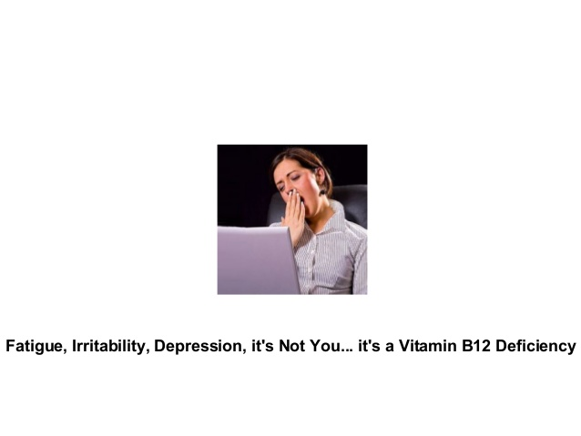

Slide 33
Author/year | Study design | Level | Results | Outcome
Gonin JM¹, Nguyen H, Gonin R, Sarna A, Michels A, Masri-Imad F, Bommareddy G, Chassaing C, Wainer I, Loya A, Cary D, Barker LF, Assefi A, Greenspan R,Mahoney D, Wilcox CS. J Nephrol. 2003 Jul-Aug;16(4):522-34. | Clinical control trial | II | Two prospective studies were undertaken in hemodialysis patients. All patients received the standard of care treatment with a multivitamin tablet before and throughout the protocol to test the hypothesis that additional therapy is required over and above the routine therapy for maximum reduction in total homocysteine (tHcy). In neither study was there any significant change in tHcy comparing before and during any treatment intervention. | In our studies high dose oral folic acid, intravenous folinic acid, vitamins B6 and B12 and oral serine were ineffective at lowering tHcy in patients on hemodialysis when given folic acid, folinic acid serine or B vitamins in addition to routine folic acid and B vitamin supplements.

