Slide 1
Vitamin E
Dr. Tejas Shah

Slide 2

CURIOSITY ????
WHAT ?
WHERE ?
WHY ?
DISORDES ?

Slide 3

CURIOSITY = ANSWER TO FIND
WHAT ARE VITAMINS AND THERE REQUIREMENTS ?
WHERE THEY ARE SYNTHESISED, ABORSPED, METABOLISED, TRANSPORTED,
WHY- ITS ROLE AND NORMAL VALUE
DISORDERS –SIGNIFICANCE OR IMPORTANCE

Slide 4
VITAMIN E
  Vitamin E is described as a “ Vitamin in search of a Disease”.
  Vitamin E also called as TOCOPHEROL
  Alpha tocopherol has greatest biological activity
  About eight tocopherols have been identified: α, β, γ, δ, etc.
  Other name is anti-sterility vitamin.

Slide 5
Vitamin E - CHEMISTRY
Tocopherols
α-tocopherol
β-tocopherol
Tocotrienols
α-tocotrienols
β-tocotrienols
γ-tocopherol
δ-tocopherol
γ-tocotrienols
δ-tocotrienols

Slide 6
Vitamin E [TOCOPHEROL]
Chemistry
Sources
RDA
Metabolism
Functions
Deficiency
Toxicity

Slide 7
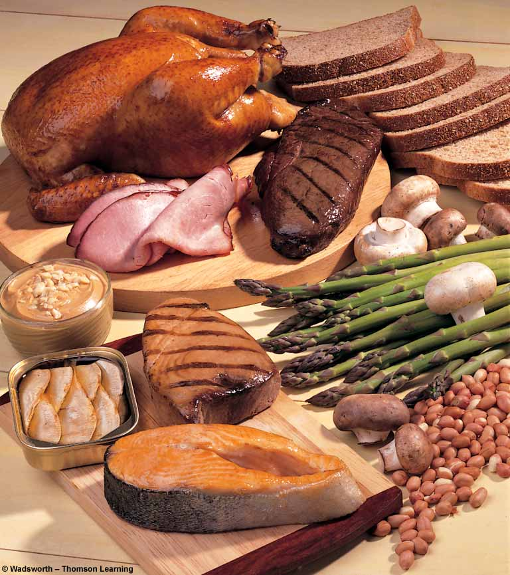
DIETARY SOURCES:
Vegetable & seed oils: Sunflower oil, corn oil, soybean oil, wheat germ oil safflower seed oil, Cottonseed oil etc.
Also – meat, milk, butter & egg.

Slide 8
Vitamin E – rda
RDA
8 – 10 mg/day
The daily requirement increases with increase in dietary intake of PUFA

Slide 9
RECOMMENDED DAILY ALLOWANCE(RDA)
Males : 10 mg/dl
Females : 8 mg/dl
Pregnancy : 10 mg/dl
Lactation : 12 mg/dl
SERUM NORMAL VALUE:
The normal plasma level of tocopherol is less than 1 mg/ dl.

Slide 10
ABSORPTION, TRANSPORT & STORAGE
ABSORPTION: Require bile salt & get absorbed along with chylomicron.
TRANSPORT: Lipoproteins chylomicrons.
Liver : LDL, VLDL
STORED: Liver, Adipose tissue & muscle

Slide 11

Biochemical functions

Slide 12
BIOCHEMICAL FUNCTIONS
1) Essential for membrane structure and integrity of the cell.
2) It protects RBC from hemolysis by oxidizing agents (e.g H2O2)
3) Reproductive functions and prevents sterility.
4) Cellular respiration.
5) ↑ synthesis of heme by ↑ δ ALA synthase.
6) Synthesis of nucleic acids.
7) Absorption of amino acids from the intestine.
8) Protect liver from toxic substance.
9) Prevention of Cancer and heart disease (prevention of oxidation of LDL).

Slide 13
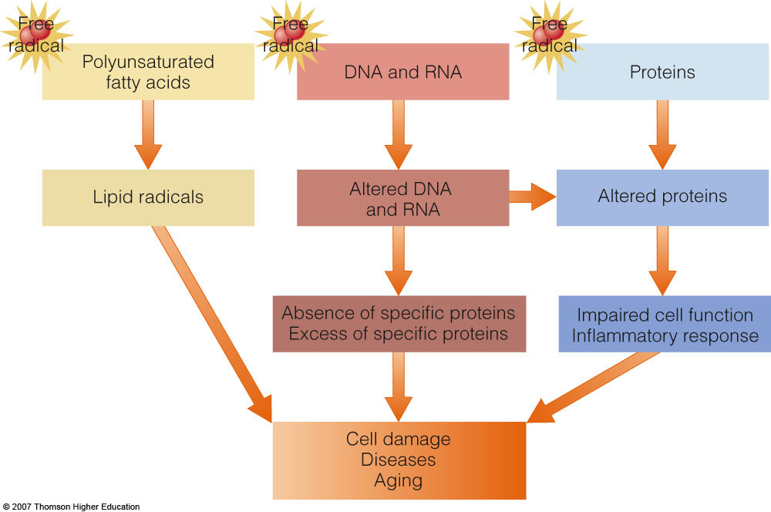

Slide 14
DEFICIENCY Of VITAMIN E
1) Loss of motility of spermatozoa
2) Hemolysis of red cells.
3) Acute hepatic necrosis.
4) Muscular dystrophy.
5) Recent studies have shown that high intake of Vitamin E protects against the development of heart disease.

Slide 15
Deficiency of Vitamin E
Vitamin E deficiency is almost entirely restricted to premature infants.
When observed in adults, it is usually associated with defective lipid absorption or transport.
The signs of human vitamin E deficiency include sensitivity of erythrocytes to peroxide, and the appearance of abnormal cellular membranes.

Slide 16
Vitamin E Deficiency
Deficiency is rare
Erythrocyte hemolysis (rupturing of red blood cells) leads to anemia
Anemia in premature infants
Symptoms: loss of muscle coordination and reflexes; impaired vision or speech
Impaired immunity (with low selenium)
Associated with fat malabsorption

Slide 17
Author/year | Study design | Level | Results | Outcome
Michaëlsson K¹, Wolk A, Byberg L, Ärnlöv J, Melhus H. Am J Clin Nutr. 2014 Jan;99(1):107-14. doi: 10.3945/ajcn.113.064691. Epub 2013 Nov 13. . | Cohort study | 3 | During 19 y of follow-up, 14,738 women in the SMC experienced a first fracture at any site . A higher hip fracture rate was observed with lower intakes of α-tocopherol. Compared with the highest quintile of intake, the lowest quintile had a multivariable-adjusted HR of 1.86. The HR of any fracture was 1.2. α-Tocopherol-containing supplement use was associated with a reduced rate of hip fracture) and any fracture Compared with the highest quintile of α-tocopherol intake in ULSAM, lower intakes were associated with a higher rate of hip fracture and any fracture. The HR for hip fracture in men for each 1-SD decrease in serum α-tocopherol was 1.58 and for any fracture was 1.23 (95% CI: 1.02, 1.48). | Low intakes and low serum concentrations of α-tocopherol are associated with an increased rate of fracture in elderly women and men.

Slide 18
Vitamin E toxicity
High supplemental doses of vitamin E may be harmful for certain individuals
Side effects: nausea, intestinal distress and diarrhea
Interacts with anticoagulants (Aspirin, Coumadin)
Long-term use may cause hemorrhagic stroke

Slide 19


Slide 20
VITAMIN - K
Vitamin K mean : “KOAGULATION VITAMIN”

Slide 21
Vitamin k - chemistry
Vitamin K₁
Pylloquinone
Present in plants
Vitamin K₂
Menaquinone
Produced by intestinal bacteria
Vitamin K₃
Menadione
Synthetic form

Slide 22
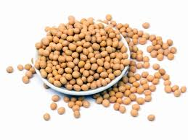
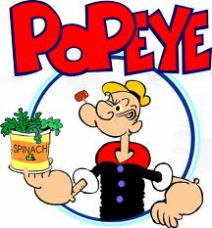
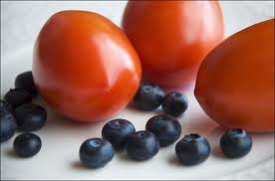
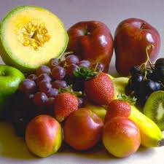
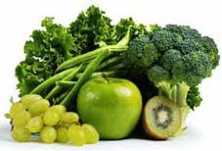
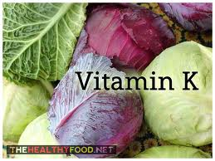
Dietary Sources

Slide 23
SOURCES AND RDA
DAILY REQUIREMENT
50 to 100 mg/day
Cabbage,
Cauliflower,
Spinach,
Egg yolk
Liver.

Slide 24
ABSORPTION, STORAGE, TRANSPORT AND EXCRETION
ABSORPTION
In Intestine, along with chylomicrons
STORAGE
In Liver
TRANSPORT
Along with beta lipoproteins.
EXCRETION :
Faeces

Slide 25
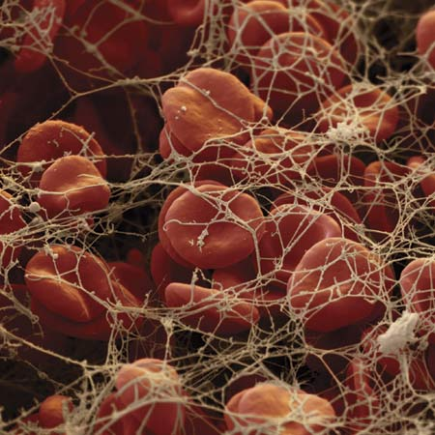
FUNCTIONS
COAGULATION
The transformation of liquid blood into a solid gel
Stops blood flow in the damaged area
Fibrin is the final protein which produces a meshwork to trap RBC and other cells

Slide 26

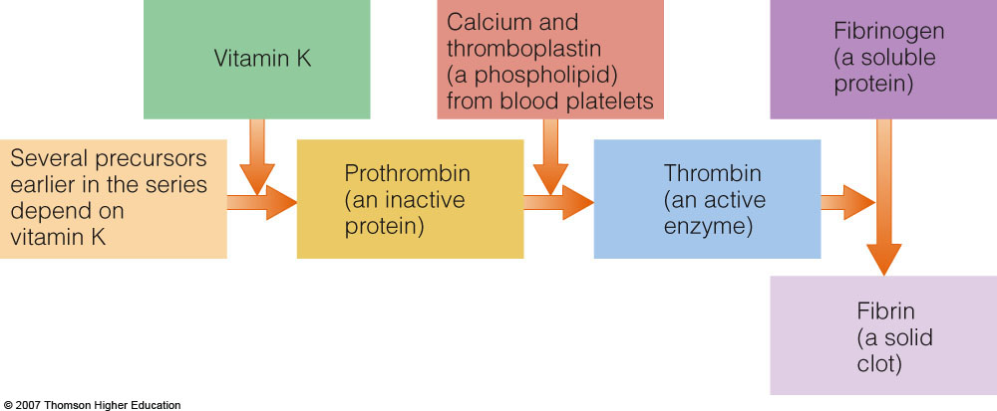

Slide 27
Vitamin K Dependent Coagulation
Certain clotting factors/proteins require calcium to bind for activation
Calcium can only bind after gamma carboxylation of specific glutamic acid residues in these proteins
The reduced form of vitamin K₂ (vitamin KH₂) acts as a cofactor for this carboxylation reaction.
These proteins are known as “Vitamin K dependent” proteins

Slide 28
VITAMIN K CYCLE
Vitamin KH2
Glutamic Acid
Reductase
Vitamin K
Vitamin K Dependent
Carboxylase
Warfarin Inhibits
Epoxide
Reductase
Vitamin K Epoxide
Gamma Carboxy
Glutamic Acid

Slide 29
Vitamin K Deficiency
Results in impaired blood clotting and potentially bleeding.
Vitamin K deficiency can result from:
A lack of vitamin - k in the diet
Disorders that reduce fat absorption
Taking certain drugs, including anticonvulsants and some antibiotics
Use of Coumarin anticoagulants
Salicylates
Large doses of vitamin E
Hepatic insufficiency

Slide 30
SYMPTOMS OF VITAMIN K DEFICIENCY
  Bruising from bleeding into the skin
  Bleeding nose (Nosebleeds)
  Bleeding gums
  Bleeding in stomach
  Blood in urine
  Blood in stool
  Black stool
  Bleeding is heavy in menstrual cycle
  In infants, may result in intracranial hemorrhage

Slide 31
VITAMIN K DEFICIENCY
Easy Bruisability

Slide 32
Vitamin K - Toxicity
Not common except with over-supplementation
  Phylloquinone and menaquinone are relatively nontoxic
  Jaundice and hemolytic anaemia (in infants)
  Menadione toxic to skin and respiratory tract in high doses

Slide 33
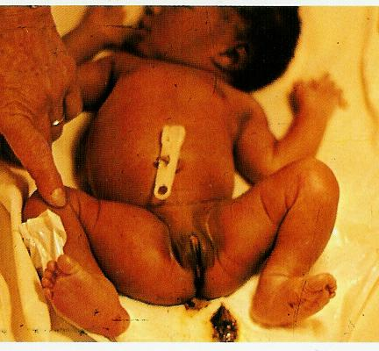
VITAMIN K
Hemolytic disease of the newborn:
The most common sites for bleeding are the gut, producing melaena neonatorum, large cephalohemotomas, the umbilical stump, and from circumcision. Generalized ecchymoses, often without petechiae, intracranial bleeding and large intramuscular hemorrhages may develop less commonly .

Slide 34
PREVENTION/TREATMENT
In the case of someone who improperly absorbs fat or is at high risk of bleeding, Vitamin K can be injected under the skin.
If a drug is causing Vitamin K deficiency, the dose is altered or extra Vitamin K is given.
In people who suffer from both severe liver disorders and Vitamin K deficiency, Vitamin K injections may be insufficient so blood transfusions may be necessary to replenish clotting factors.
It is recommended that all newborns are given an injection of phylloquinone (Vitamin K₁) into the muscle to prevent intracranial bleeding after delivery.

Slide 35
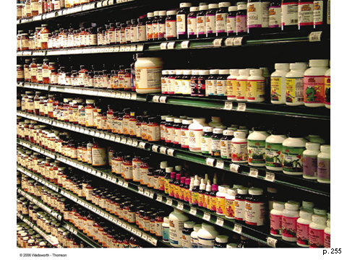

Slide 36

0
©2003 Wadsworth, a division of Thomson Learning, Inc. Thomson Learning™ is a trademark used herein under license.
Dietary Antioxidants—best from food or best form pills?

Slide 37
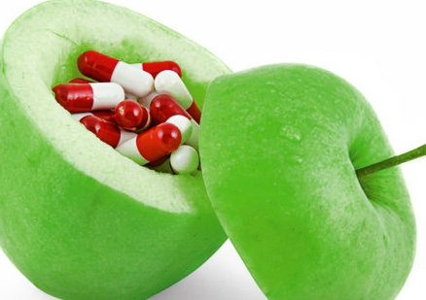
IMPORTANT POINT
Unless recommended, avoid taking Vitamin tablets.
Try to get as much of nutrients as possible through the daily diet or naturally.

Slide 38
THANK YOU

