Slide 1
Riboflavin and Vit B3
Mr. Pavan Toshnival

Slide 2
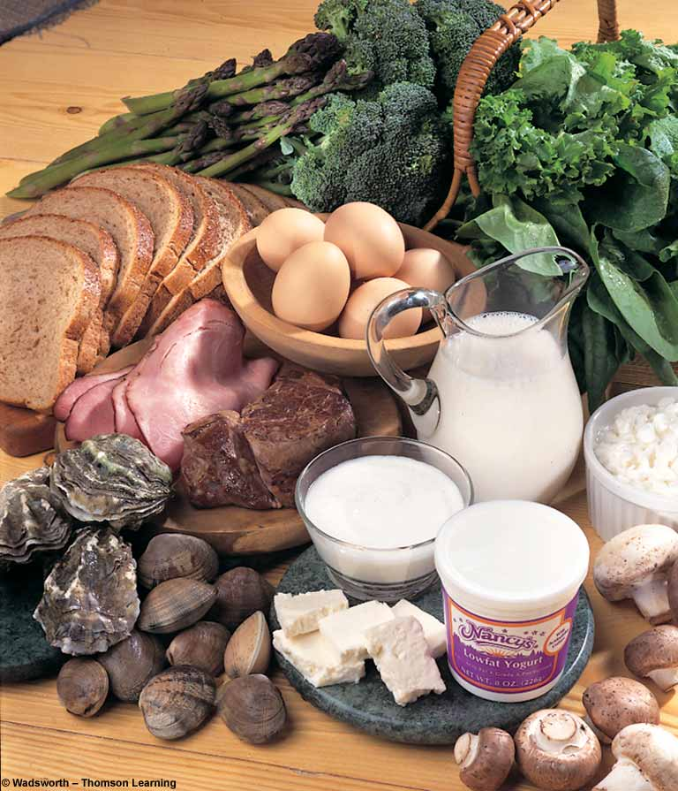
Riboflavin
B-2

Slide 3

Sources
Large amounts in
  Dairy products
  eggs
  meats
Small amounts in
  leafy green vegetables
  enriched grains

Slide 4
Recommendations
Men
1.5 mg/day
Women
1.0 mg/day
Additional 0.2
During pregnancy and lactation

Slide 5
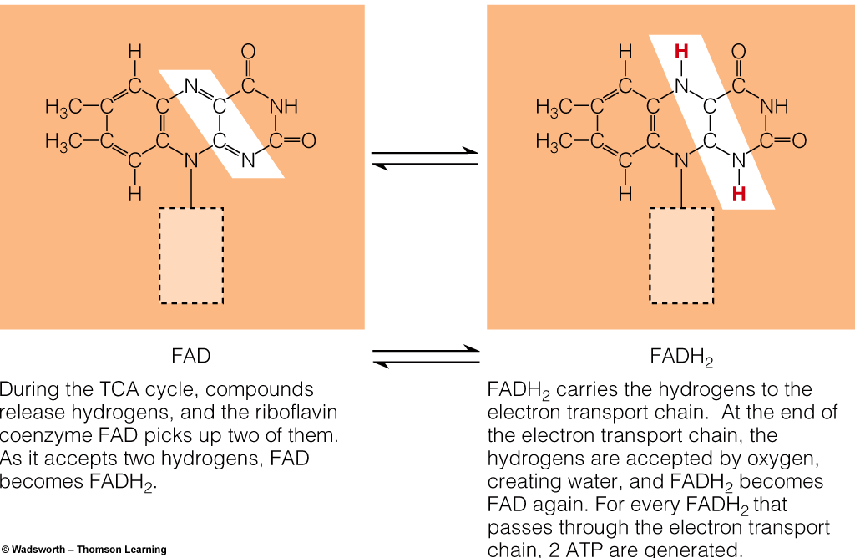
Riboflavin

Slide 6
FUNCTIONS
Important in:
  energy production
  carbohydrate, fat and protein metabolism
  formation of antibodies and red blood cells
  cell respiration
  maintenance of good vision, skin, nails and hair
  alleviating eye fatigue

Slide 7
B-2 Deficiency
Itching and burning eyes
Cracks and sores in mouth and lips
Bloodshot eyes
Dermatitis
Oily skin
Digestive disturbances

Slide 8
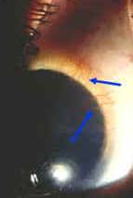
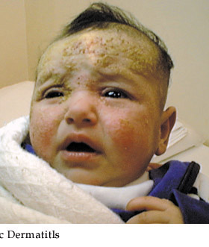
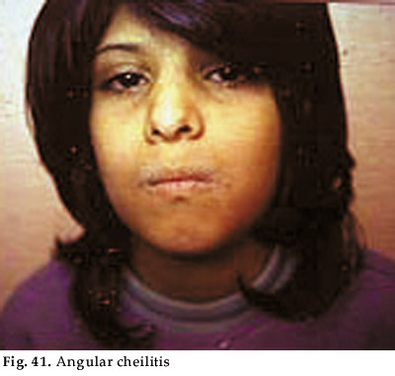
Deficiency
  Ariboflavinosis
    Cheliosis, angular stomatitis, magenta tongue,
    vascularization of the cornea
    Normochromic normocytic anemia
  Preeclampsia
Notes:
Ariboflavinosis is the medical name for clinical riboflavin deficiency. Riboflavin deficiency is rarely found in isolation; it occurs frequently in combination with deficiencies of other water-soluble vitamins. Symptoms of riboflavin deficiency include sore throat, redness and swelling of the lining of the mouth and throat, cracks or sores on the outsides of the lips (cheliosis) and at the corners of the mouth (angular stomatitis), inflammation and redness of the tongue (magenta tongue), a moist, scaly skin inflammation (seborrheic dermatitis), the formation of blood vessels in the clear covering of the eye (vascularization of the cornea), and decreased red blood cell count in which the existing red blood cells contain normal levels of hemoglobin and are of normal size (normochromic normocytic anemia) (1, 3). Severe riboflavin deficiency may result in decreased conversion of vitamin B6 to its coenzyme form (PLP) and decreased conversion of tryptophan to niacin (see Nutrient Interactions).
Preeclampsia is defined as the presence of elevated blood pressure, protein in the urine, and edema (significant swelling) during pregnancy. About 5 % of women with preeclampsia may progress to eclampsia, a significant cause of maternal death. Eclampsia is characterized by seizures, in addition to high blood pressure and increased risk of hemorrhage (severe bleeding) (13). A study of 154 pregnant women at increased risk of preeclampsia found that those who were riboflavin deficient were 4.7 times more likely to develop preeclampsia than those who had adequate riboflavin nutritional status. The cause of preeclampsia-eclampsia is not known. Decreased intracellular levels of flavin coenzymes could affect mitochondrial function, oxidative stress, and blood vessel dilation, which have all been associated with preeclampsia (14).
Risk factors for riboflavin deficiency
The use of specialized light therapy to treat jaundice in newborns increases the destruction of riboflavin and is a recognized cause of riboflavin deficiency (6). Alcoholics are at increased risk for riboflavin deficiency due to decreased intake, decreased absorption, and impaired utilization of riboflavin. Anorexic individuals rarely consume adequate riboflavin. Lactose intolerance may prevent people from consuming milk or dairy products, which are good sources of riboflavin. The conversion of riboflavin into FAD and FMN is impaired by hypothyroidism and adrenal insufficiency (3, 4). People who are very active physically (athletes, laborers) may have a slightly increased riboflavin requirement. However, riboflavin supplementation has not generally been found to increase exercise tolerance or performance (15).

Slide 9
Who’s at Risk?
People with cataracts
People with Sickle Cell Anemia
Alcoholics
B-2 is nontoxic at supplemental and dietary levels.

Slide 10
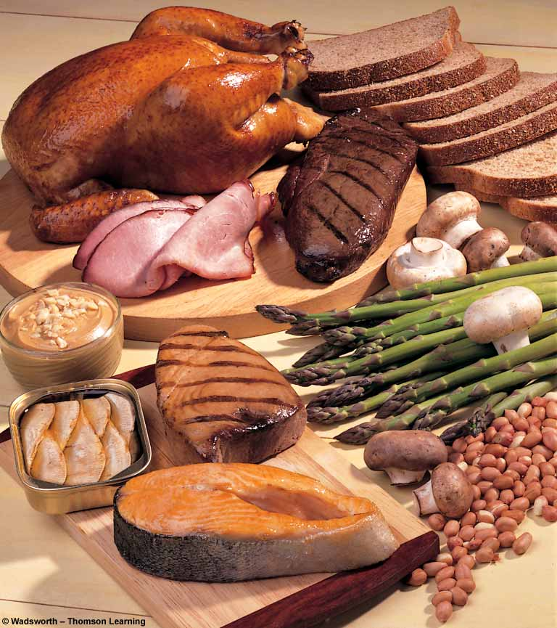
Niacin
B3

Slide 11

Sources
  Milk, eggs, meat, poultry, fish
  Whole-grain and enriched breads and cereals
  Nuts
  All protein-containing foods
  ABSORPTION: stomach and small intestine;

Slide 12
NIACIN
Other names
  Nicotinic acid (Niacin)
  Niacinamide (Nicotinamide)
  Part of coenzymes NAD (nicotinamide adenine dinucleotide) and NADP (its phosphate form) used in energy metabolism

Slide 13
Recommendations
Men and women
20 mg/day
Additional
During pregnancy 2.0 and lactation 5.0 mg/day

Slide 14
Who’s at Risk?
People with cataracts
People with Sickle Cell Anemia
Alcoholics

Slide 15
FUNCTIONS
Important in:
  energy production
  maintenance of skin and tongue
  improves circulation
  maintenance of nervous system
  health of the digestive track

Slide 16
B-3 Deficiency
Pellegra (THREE D’S DISEASES)
Dermatitis
Dementia
Diarrhea
Death if not treated
gastrointestinal disturbance, loss of appetite
headache, insomnia, mental depression
fatigue and pains
nervousness, irritability

Slide 17
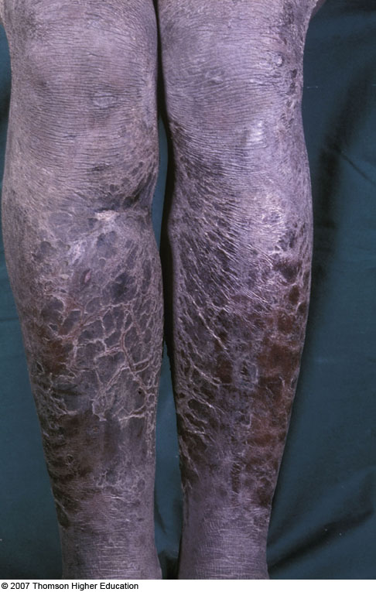
  Bilateral symmetrical rash (sunlight exposure) of pellagra
  can be disturbing!

Slide 18
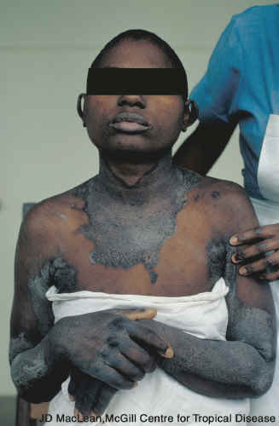
Pellagra

Slide 19
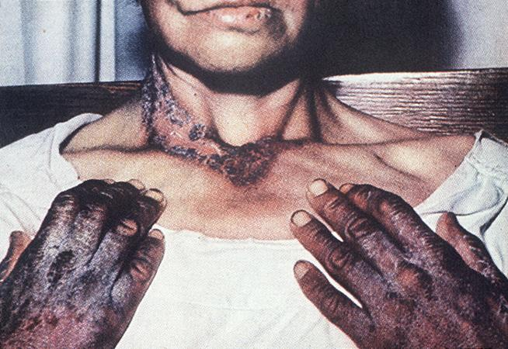
PELLAGRA

Slide 20
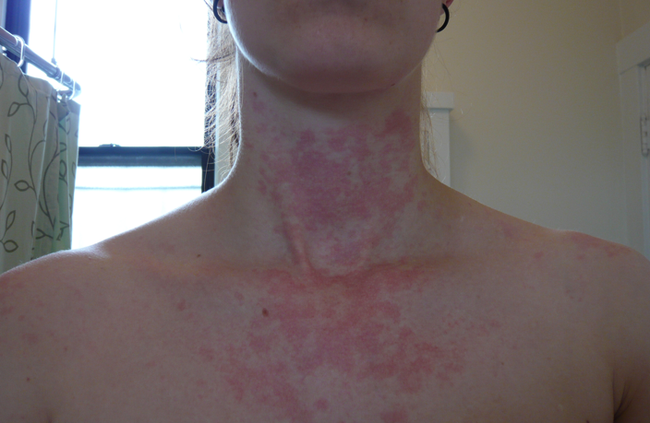
Niacin
Toxicity symptoms
  Painful flush, hives, and rash (“niacin flush”)
  Excessive sweating
  Blurred vision
  Liver damage,
  impaired glucose
  tolerance

Slide 21
Who’s at Risk?
Most people get plenty of B-3 from their diet because it is added to white flour.
Nicotinamide is almost always safe to take, although a few cases of liver damage have been reported in doses of over 1000 mg/day.

Slide 22
Author/year | Study design | Level | Results | Outcome
Bruno MC¹, Vilela MA, de Oliveira CA. 2013 May-Jun;88(3):368-75. | Case Control study | IV | To verify the prevalence of dermatoses in alcoholics,also, to compare the results obtained with a non-alcoholic control group and with the data found in medical literature. Pellagra, nummular eczema, purpura pigmentosa chronica and psoriasis were more frequent in the group of alcoholics and, apparently, occurred in parallel with alcoholism that seems to play a role in the evolution of these dermatoses. | The association of dermatoses and alcoholism was extremely significant according to the statistical data. Alcoholism can be considered a risk factor for pellagra, psoriasis, nummular eczema and purpura pigmentosa chronica dermatoses, which can, as well, be considered alcoholism indicators.

