Slide 1
Scabies

Slide 2
Definition
Scabies is a common parasitic infection caused by the mite, arthropod-acarina, Sarcoptesscabieivarhominis

Slide 3
Incidence and prevalence
300 million cases yearly world wide
Incidence common in all ages, sexes, ethnic & socio-economic groups, urban > rural.
Throughout the year, more in winter
Overcrowding, poor socio-economic conditions, institutions, immuno-compromised, mental retardation
Ref. :- IADVL Textbook of Dermatology

Slide 4
Mite
Fertilized female mite: 300 microns
Eggs → larva → nymph → adults
male: dies after fertilization
female: lays 2-3 eggs/day (max 20-25), mature by 2-3 weeks

Slide 5
Transmission
Skin to skin : predominantly.
? Fomites, clothing, furniture-rare
Sexually transmitted
Incubation period in new cases : 1 month
Symptoms due to hypersensitivity to mite and products
Reinfection- incubation period: 1-3 days
Ref. :- Burgess I. Sarcoptes scabiei and scabies. Adv Parasitol 1994;33:235-92

Slide 6
Clinical features
Symptoms
- Itching-worse at night, with skin rash
- Family members affected
Signs
- Characteristic distribution along the circle of
Herba.
- Papules, vesicles
- Burrow- grey-brown line 5mm, seen on webs &
genitalia with mite as black dot at the end
- Burrow may be a dot, dotted line, curve or curved line

Slide 7
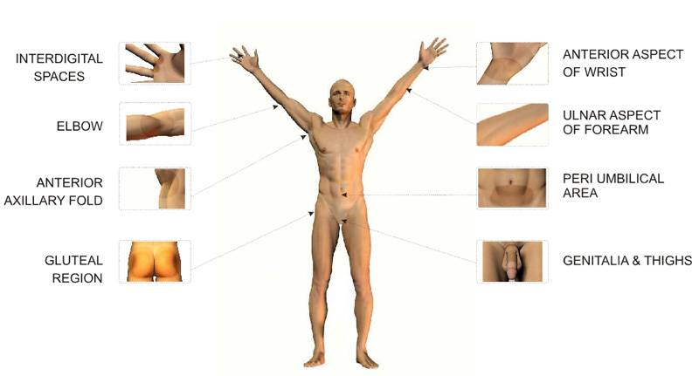

Slide 8
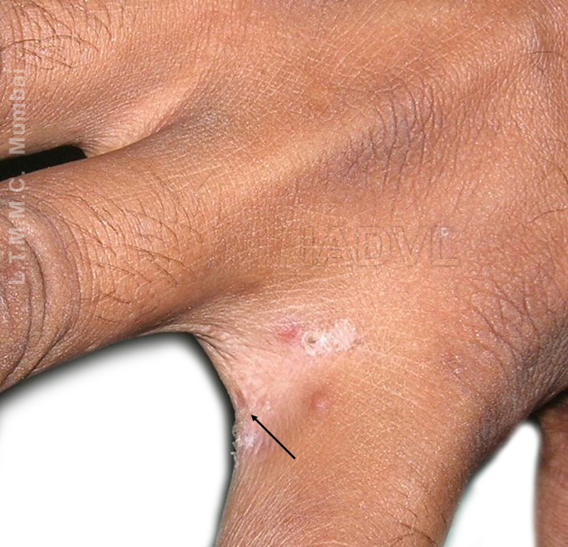
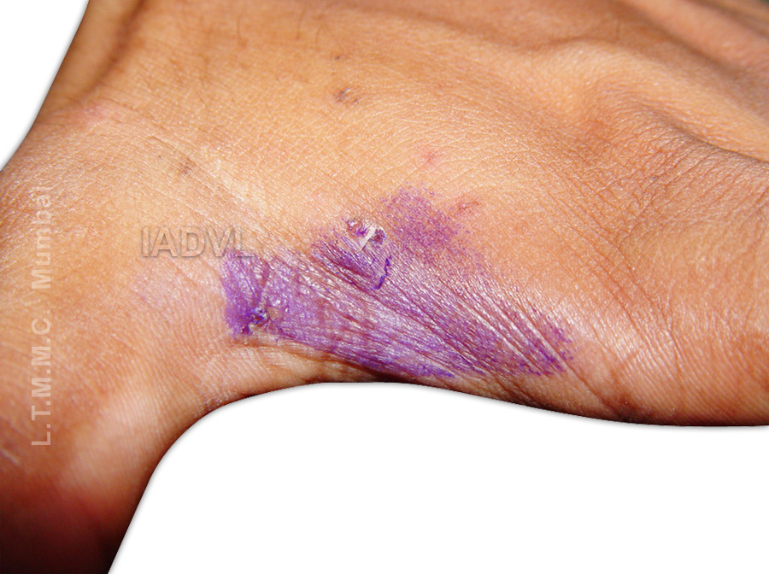

Slide 9
Clinical types
Classical Scabies: characteristic distribution of lesions along the circle of Hebra
Genital Scabies: sexually transmitted
Scabies in clean: fewer, atypical, severe itching
Incognito: who has applied topical/systemic steroids
Infants: scalp, palms, soles
Nodular (sensitization): scrotum, penis, elbows, axillary folds, periareolar

Slide 10
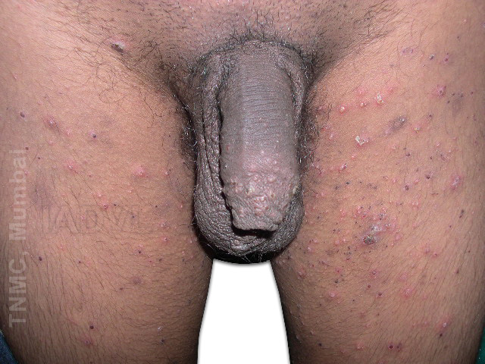
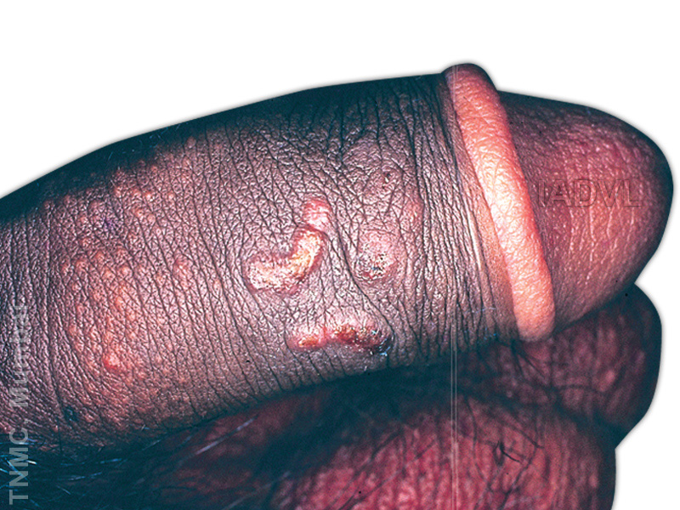

Slide 11
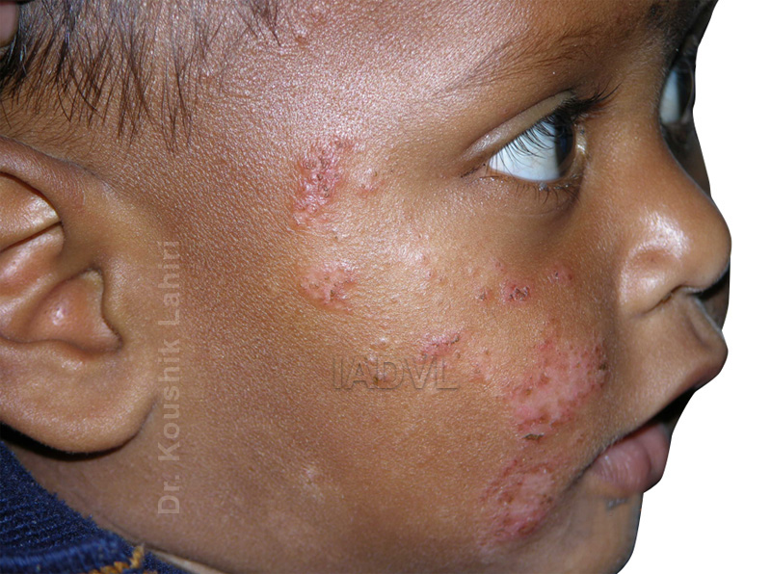

Slide 12
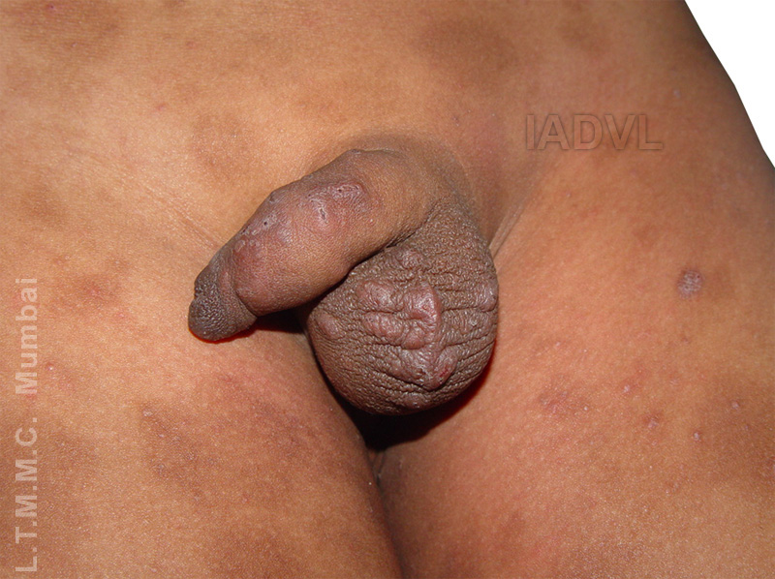

Slide 13
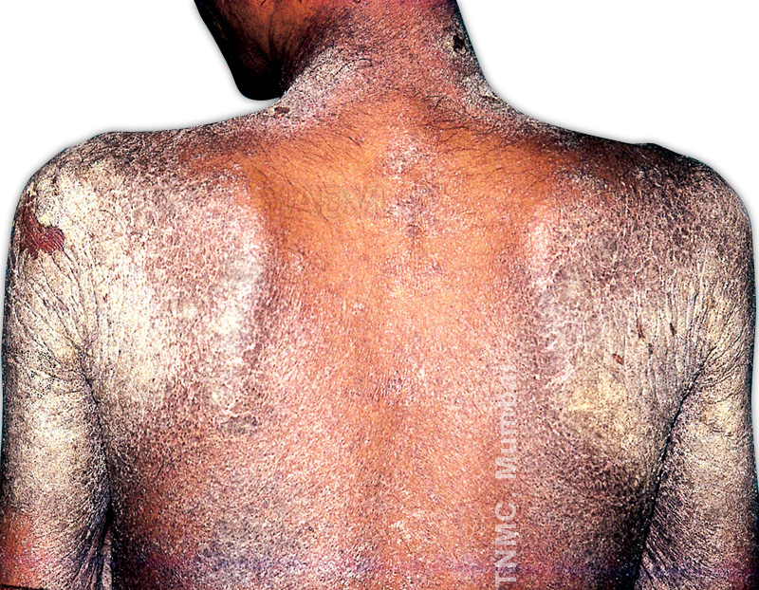

Slide 14
Clinical types
Crusted (Norwegian scabies):
mentally retarded, paralysis, immuno-compromised, leprosy; highly infectious, millions of mites
Animal scabies

Slide 15
Complications
Secondary infection
Eczematization
Glomerulonephritis
Phimosis, Paraphimosis
Urticaria
Erythroderma
Immunologic sequelae?
Drug reactions: irritation, eczematization

Slide 16
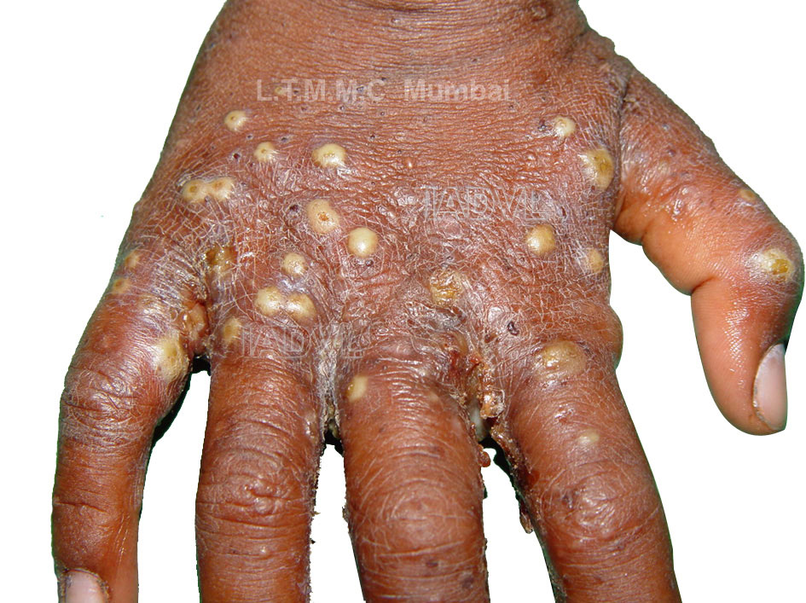

Slide 17
Investigations
Scraping: from papule, burrow to demonstrate mite, egg, scyballa
Ig E- specific levels

Slide 18
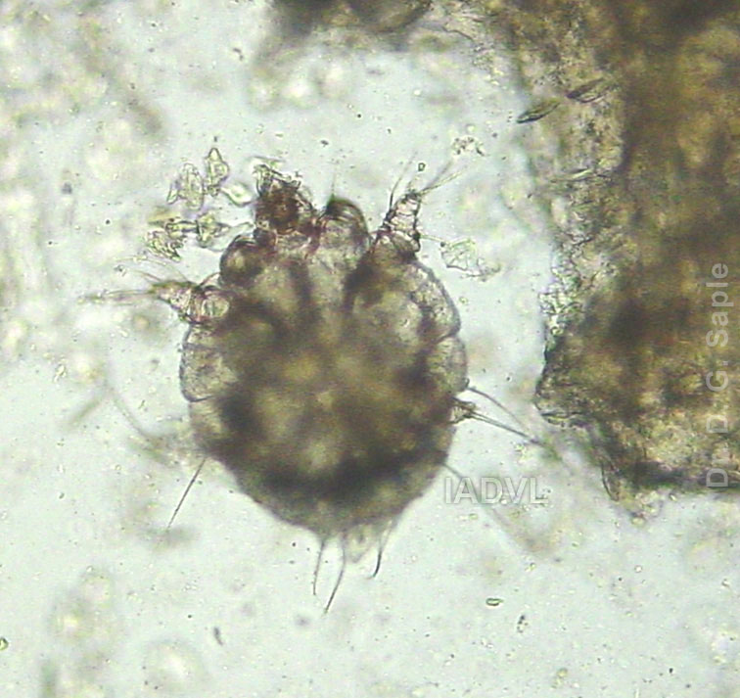

Slide 19
Treatment-principles
Treat secondary complications first
Treat all household members
Treat all inmates and caretakers in institution
Treat fomites by putting in hot water, insecticides for 2-4 days
Scabicides to be applied throughly behind ears and from neck to toes; repeat application depending upon scabicides used

Slide 20
Topical Treatment
Drug | Application/ Duration | Pregnancy | Side effects
Permethrin 5% | 8-14 hrs | B | Expensive
Lindane / GBH 1% | 8 hrs, repeat after 1week | B | Seizures
Benzoyl benzoate 10-25% | 3 consecutive nights | none | Burning, dryness

Slide 21
Topical Treatment
Drug | Application/ Duration | Pregnancy | Remarks
Crotamiton 10% | 2 application in 48hr period | C | Not very effective
Precipitated sulphur 3-6% | 3 consecutive nights

Slide 22
Systemic treatment
Ivermectin: 200 microgms/kg
single dose; 56% cure; repeat 14 days later, 96% cure
Act by interrupting glutamate and aminobutyric acid induced neurotransmission in parasite causing paralysis & death
Lacks ovicidal action
Better with eczematised patients

Slide 23
Supportive treatment
Antihistaminics
Antibiotics: systemic, local
Emollients
Soaps?
Steroids: Topical /Systemic (in eczematised scabies)
Keratolytics in crusted scabies
Future trends: Local Ivermectin, tea tree oil

Slide 24
Failure of treatment
Improper treatment
Poor compliance
House hold and/or institutions contacts not treated
Resistance to drugs

Slide 25
Causes of itching even after treatment
Re-infection/relapse
Eczematous reaction
Contact irritation to drugs
Sensitization
Delusion of parasitosis (acarophobia)
Other skin problems
Itching persists for few days even after successful treatment

Slide 26
Ref. :- Walker GJ, Johnstone PW. Interventions for treating scabies. Cochrane Database Syst Rev 2000;(3):CD000320

Slide 27
Multiple choice questions
1.name the causative organism of scabies.
A)streptocooci
B)fungi
C)sarcoptesscabii
D)leptospira
2.the parasite dies after copulation.
A)male
B)female
C)both
D)none
3.pruritus in scabies is
A)paroxysmal nocturnal
B)whole day
C)nopruritus

Slide 28
4.Drug for topical application is
a)Clotrimazole
b)Fusidic acid
c)5% permethrin
d)Keratolytic
5.Oral antiscabetic drug is
a)Azithromycin
b)Ivermectol
c)Terbinafine
d)Azelic acid

Slide 29
Thank you

