Slide 1
MUSCLE

Slide 2
MUSCLES………………….
Muscle is a soft tissue found in most animals.
Muscle cells contain actin and myosin
Producing a contraction that changes both the length and the shape of the cell.
Muscles function to produce force and motion
Primarily responsible for maintaining and changing posture and locomotion,
Movement of internal organs, such as the contraction of the heart and the movement of food.

Slide 3
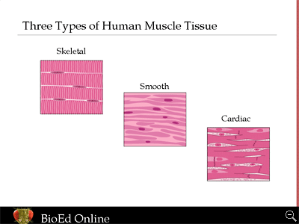
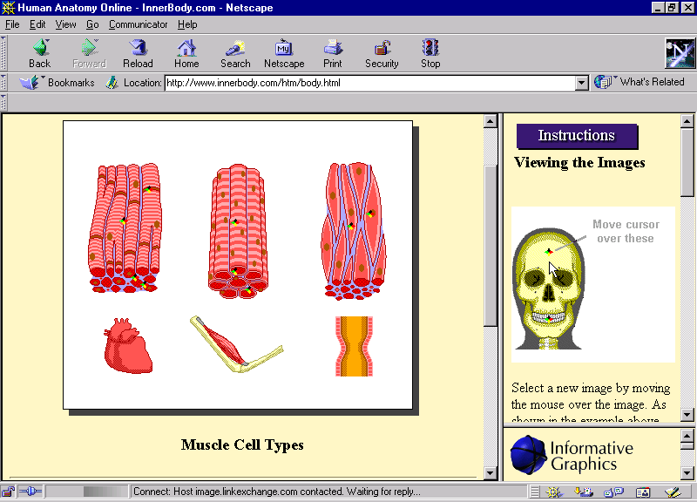

Slide 4
STRUCTURE OF SKELETAL MUSCLE
Skeletal muscles are mainly responsible for locomotion, and voluntary contraction and relaxation.

Slide 5
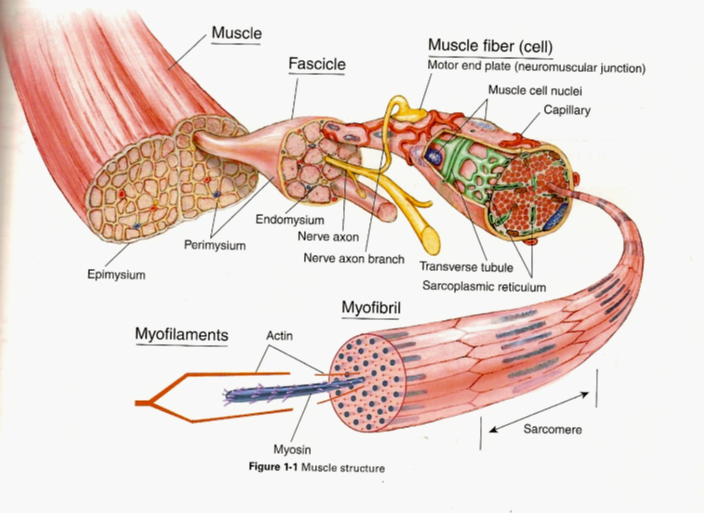

Slide 6
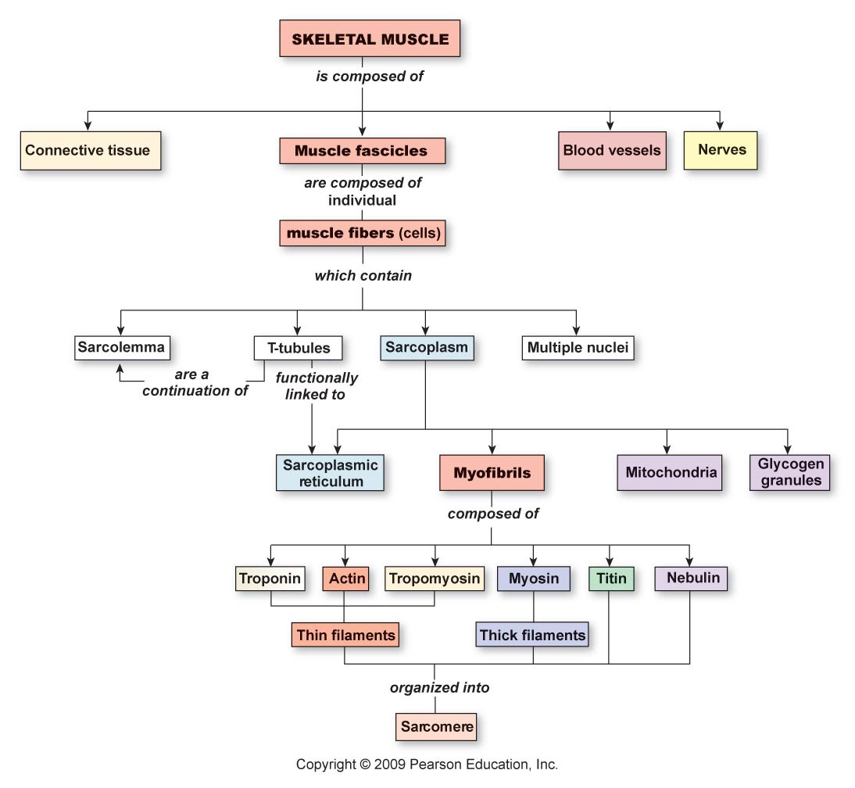

Slide 7
MYOFIBRIL………….
These are the fine parallel filaments present in the Sarcoplasm of the muscle cell.
It consists of protein chains called myofilaments.
Under microscope, it shows to be consists of light and dark bands.

Slide 8
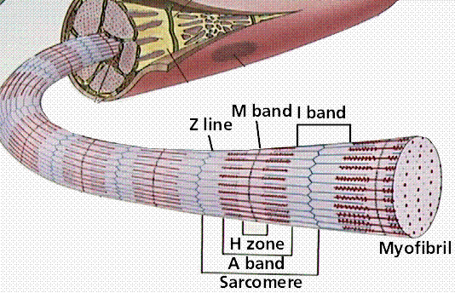

Slide 9
SARCOMERE…………….
The structural and functional unit of skeletal muscle/Contraction
Extent between two Z lines.
When in relaxed state the average length of sarcomere is 2-3 microns.

Slide 10
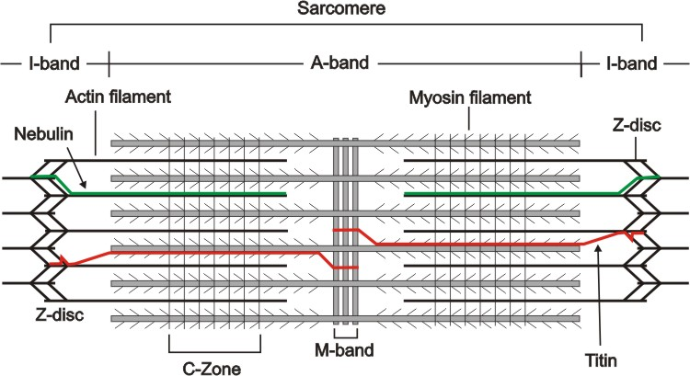

Slide 11
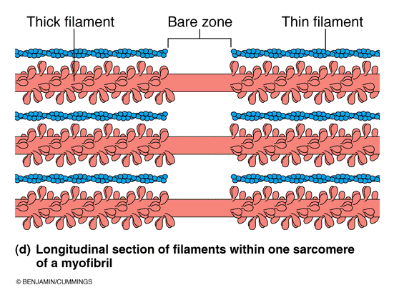
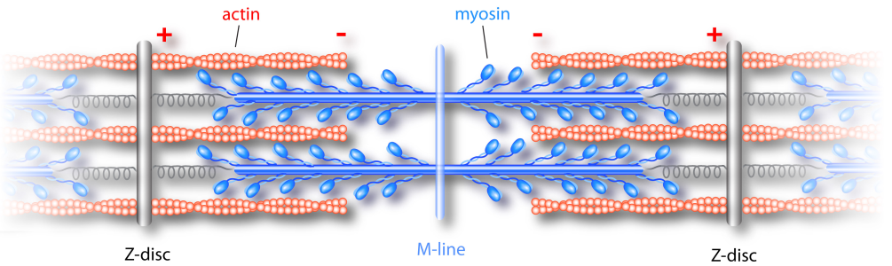

H Band
A
Notes:
Here is a sarcomere illustrating the thin actin and thick myosin filaments. The area of the sarcomere has only myosin is called the H band.

Slide 12
LIGHT BAND or ‘I’ BAND…….
Isotropic to polarized light(when the polarized light is passed through this area the light rays are refracted at the same angle)
Extends from A band of one sarcomere to A band of the next sarcomere
  Z line: German "Zwischenscheibe", the disc in between the I bands. Serves as attachment for actin myofilaments

Slide 13
DARK BAND or ‘A’ BAND
Anisotropic to polarized light (when the polarized light is passed through this area the light rays are refracted at the different angles)
Full length of thick (myosin) filament
H zone : German "heller“ (Brighter)
M line: German "Mittelscheibe“. M line is the attachment site for the thick filaments.

Slide 14
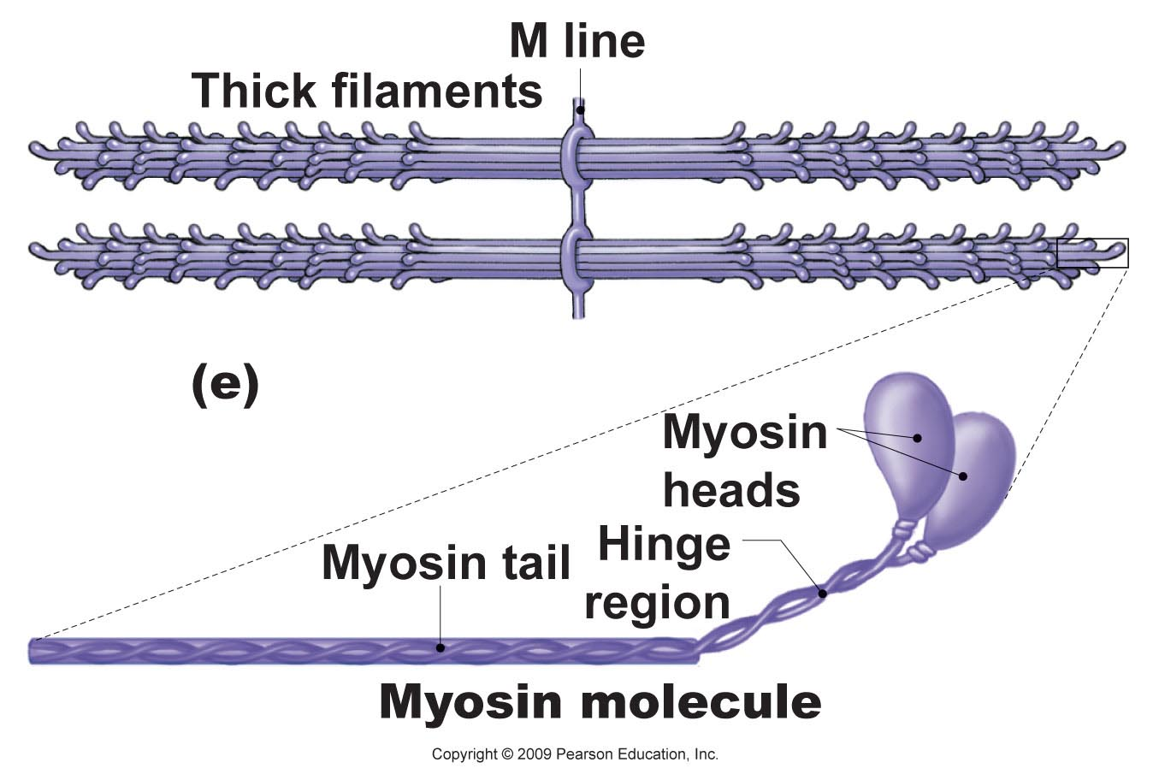
Myosin molecule consists of tail, hinge and heads
  Heads contain active sites for
    Actin
    ATP
M-line consists of myomesin and skelemin proteins
  stabilize the myosin filaments
  theorized to aid in transmission of force from sarcomere to cytoskeletal intermediate filaments

Slide 15
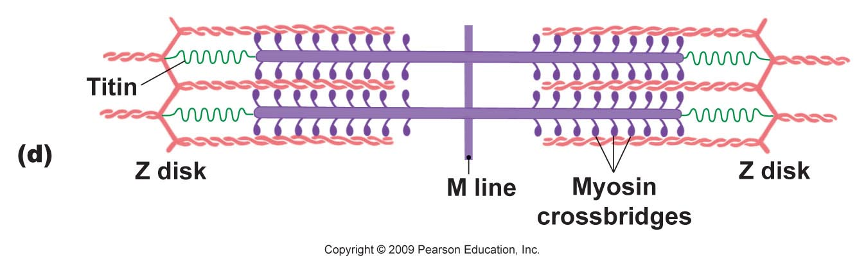
Sarcomere is composed of various microfilaments and supporting structures
Titin
  largest known elastomeric protein
  Connects myosin to z-disc
  thought to be critical in the development of sarcomeres

Slide 16
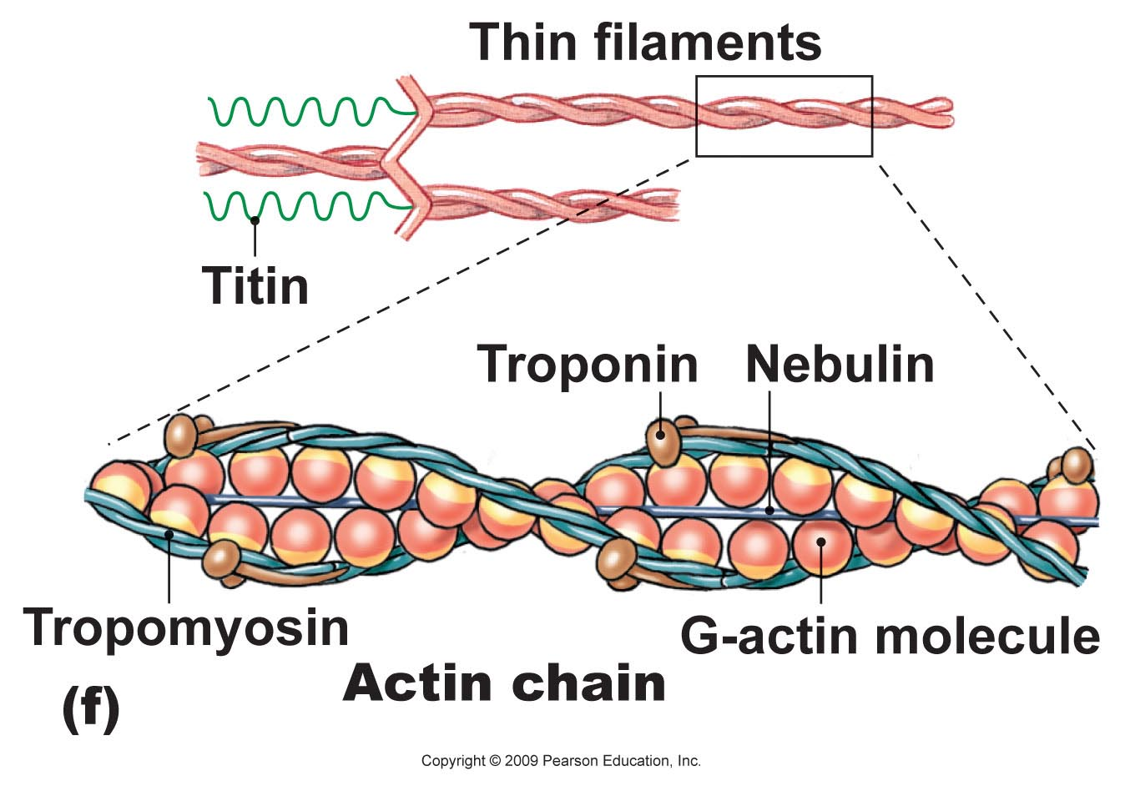
Thin filaments are composed of
  g-actin molecules in
  a helical arrangement
    Contain myosin binding
    sites
  Nebulin
    Filament that forms
    internal support and
    attachment for actin
  tropomyosin filaments
  troponin (complex of 3 molecules) attached to tropomyosin
  Tn-A or I : binds to actin
  Tn-T :binds to tropomyosin,
  Tn-C :binds to calcium ions.

Slide 17
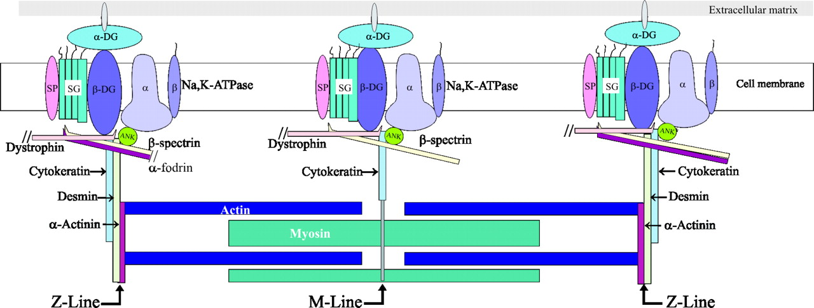
The Z-disc - Anchors the filaments and interacts with cytoskeletal framework

Slide 18
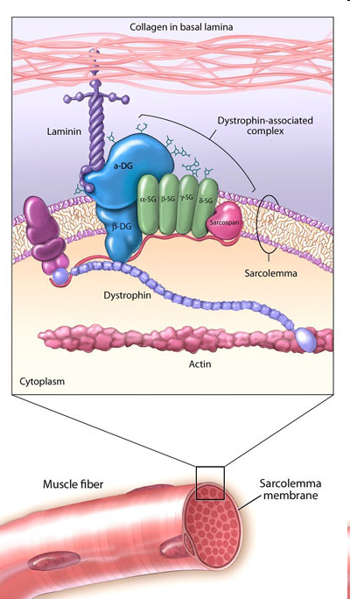
Transmission of force from the sarcomere to the tissue
  Sarcomeres linked by dystrophin to sarcolemma, then via membrane proteins (Laminin) interacting with cytoskeletal framework
  Muscular Dystrophy?
MUSCLE DYSTROPHY- progressive degeneration of muscle fibers without the involvement of nervous system.
1. Duchenne: No formation of dystrophin protein.
2. Becker’s: Altered formation of dystrophin protein.

Slide 19
  Nebulin: Anchors actin to Z disc
  Titin: Creates passive tension within the stretched sarcomeres
  -Acts as molecular “Springs”
  Desmin: Helps to stabilize longitudinal and lateral alignments of the adjacent sarcomere
  Dystrophin: provide structural stability to cytoskeleton and sarcolemma of muscle fibre
  Skelemin: Helps to stabilize M line
  Myosin Heavy chain: Acts as molecular motor, binds with actin to generate contractile force
  Actin: Binds with myosin to translate the force and Shortened the sarcomere
Active: Contractile
Structural
  Myosin light chain: Influence contraction ability of sarcomere
  Tropomyosin: Regulates interaction between actin and myosin
  Stabilize actin filaments
  Troponin: influence position of tropomyosin
        Binds with Ca⁺ ion
Active: Regulatory

Slide 20
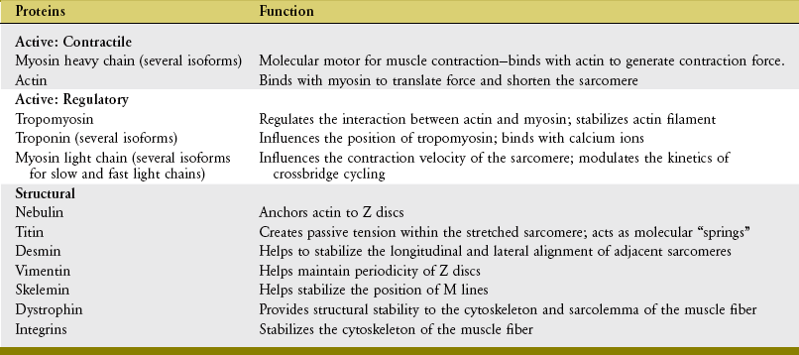

Slide 21
Sarcotubular system
It is a system of membranous structures in the form of vesicles and tubules in the sarcoplasm of the muscle fiber. It surrounds the muscle fibrils.
Made up of:
  T tubules
  L tubules ( sarcoplasmic reticulum)

Slide 22
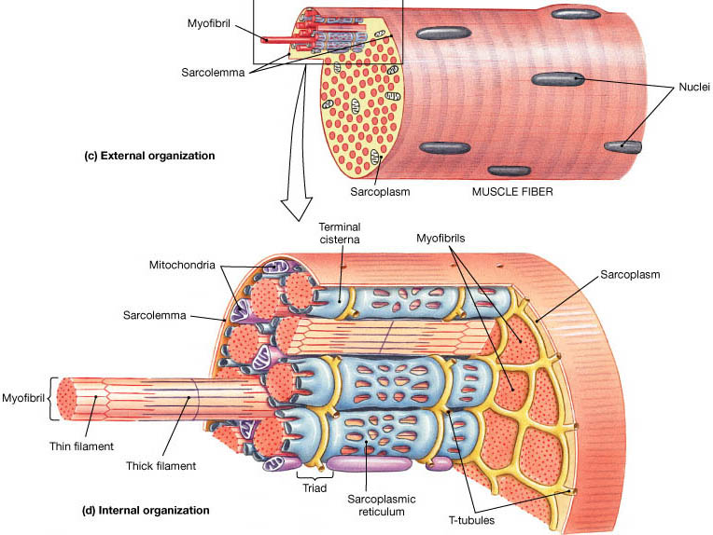

Slide 23
T TUBULES
Formed by invagination of the sarcolemma. Open to the exterior of the muscle cell.(ECF)
It penetrate/ invaginates at A-I junction of sarcomere in skeletal muscle
Function:
  Responsible for rapid transmission of impulse from sarcolemma to the myofibrils.
  The Ca⁺² receptor present are DHP receptor

Slide 24
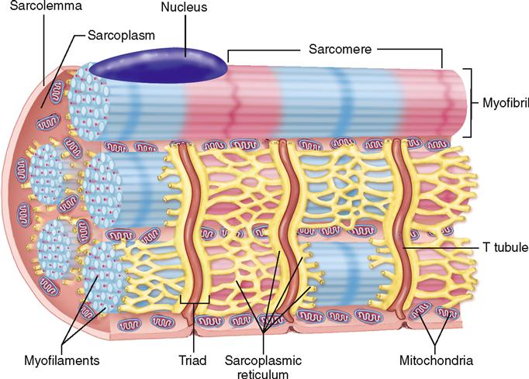

Slide 25
L TUBULES
Correspond to the sarcoplasmic reticulum. It forms a closed tubular system around each myofibril and do not open to exterior.
At regular intervals, the ‘L’ tubules dilate to form a pair of lateral sacs called terminal cisterns.
‘L’ tubules store a large quantity of calcium ions.
Ca⁺ receptor are Ryanodine receptor

Slide 26
TRIAD: 2 in 1
The T tubules along with two L tubules (terminal cisternae) on either side are called triad of skeletal muscle.
In a sarcomere two triads are present as T tubule invaginated at A-I junction.

Slide 27
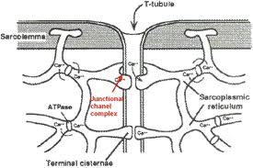

Slide 28
1. A band is formed by
a.actin b. myosin c. tropomyosin d. troponin
2. Structural and functional unit of muscle contraction is known as
a. sarcomere b. sarcotere c. sarcolemma d. sarcoma
3. Receptors present on T tubules are
a. DHP b. RyR c. Na+ d. K+
4. Receptors present on L tubules are
a. DHP b. RyR c. Na+ d. K+
5. Triad in one sarcomere in skeletal muscle is
a. 2 b. 1 c. 3 d. 5

Slide 29
EBES
EVIDENCE 1
The variation in isometric tension with sarcomere length in vertebrate muscle fibres
A. M. Gordon, A. F. Huxley, F. J. Julian.
May 1, 1966 The Journal of Physiology, 184, 170-192.

Slide 30
The variation in isometric tension with sarcomere length in vertebrate muscle fibres
Ref. | PROBLEM | intervention | CONCLUSION | OUTCOME
A. M. Gordon, A. F. Huxley, F. J. Julian. May 1, 1966 The Journal of Physiology, 184, 170-192. | The variation in isometric tension with sarcomere length in vertebrate muscle fibres | The variation of isometric tetanus tension with sarcomere length in single fibres from frog striated muscle has been re-investigated with special precautions to ensure uniformity of sarcomere length within the part of the fibre being studied. | In most respects the results of Ramsey & Street (1940) were confirmed, but (a) the peak of the curve was found to consist of a plateau between sarcomere lengths of 2·05 and 2·2 μ, (b) the decline of tension above this plateau is steeper than found by Ramsey & Street, and (c) the decline of tension below the plateau becomes suddenly steeper at a sarcomere length of about 1·67 μ. | Many features of this length—tension relation are simply explained on the sliding-filament theory. in the plateau and at greater lengths, the tension on each thin filament is made up of equal contributions from each bridge which it overlaps on adjacent thick filaments. Internal resistance to shortening is negligible in this range but becomes progressively more important with shortening below the plateau.

Slide 31
