Slide 1
NERve-INJURY

Slide 2
Causes of Nerve injury
Obstruction to blood flow.
Toxin or poison/ chemical injury.
Compression of nerve.
Crushing/ transection (cutting) of the nerve.

Slide 3
SEDDON’s CLASSIFICATION (1942)………
Neuropraxia (Transient block)- Pressure is the most common cause. Paralysis is incomplete, recovery is rapid & complete, & there is no nerve degeneration.
Axonotemesis- The term applied to a nerve lesion in which the axons are damaged but the surrounding connective tissue sheaths remain intact.
  Most common causes are: Crush injuries, traction, & compression
  Neurotemesis- The term applied to complete section of the nerve trunk
  occur on severe contusion, stretch, laceration

Slide 4
Sunderland classification….. (1951)
First-degree : Seddon’s neuropraxia
(Pressure is the most common cause)
Second-degree: Seddon’s axonotmesis
(Ischemia)
Third-degree : Nerve fiber interruption, there is a lesion of the Endoneurium, but the epineurium & perineurium remain intact
Fourth-degree: Disorganization of nerve fasciculi
  surgical repair is required
Fifth-degree: lesion of complete transaction of the nerve
  Recovery is not possible without an appropriate surgical treatment

Slide 5
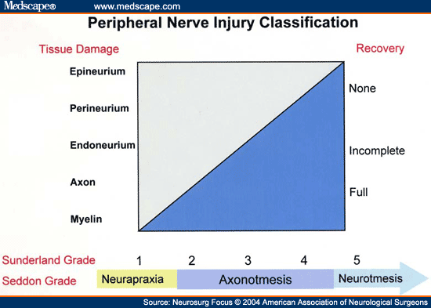

Slide 6
DEGENERATION OF NERVE FIBER

Slide 7
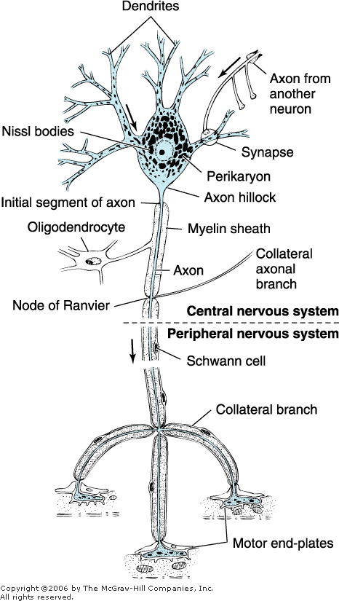

Slide 8
DEGENERATIVE CHANGES :
At 3 level:
Changes in the nerve cell body
Changes in distal stump
Changes at the site of injury

Slide 9
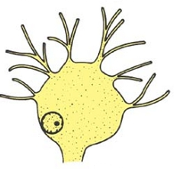
1. Changes in the soma (Retrograde degeneration)
Changes begin within 48 hours to maximum of 15-20 days of the nerve section
Chromatolysis: Nissl’s granules breakdown
Cell become colorless
Dissolution of nissl’s substance ---- mobilization of protein manufacturing process for survival of neuron
Cell organelles fragmented
Swelling of soma
Nucleus: increase in size, displaced at periphery**

Slide 10
Degree of damage and chromatolysis depends on:
1. Variety of neuron affected:
i.e. in PNS changes are same as above.
in CNS regeneration of soma doesn't takes place as nucleus leave the cell**
in ANS: Difficult to demonstrate as Nissl’s granules are less
2. Lesion nearer to soma is more harmful
3. Nature of injury:

Slide 11
2. Changes in the Distal stump:
Changes begin within 24 hours of the nerve section
Changes in the AP observed within 2 days
After 3rd day conduction of impulse slow down
After 5th day no impulse can be produced
Changes are as follows:
  Axis cylinder swells and breaks into pieces
  Myelin sheath slowly disintegrate into fat droplets. (Start 8th day up to 32nd to 35th day)
  Neurilemmal sheath unaffected
  Schwann cell rapidly multiply.
  Macrophages invade from outside.

Slide 12
Severe damage of the nerve cell body may result in degeneration of the entire neuron
In the CNS, the tissue macrophages (microglial cells) remove the debris, & the neighboring astrocytes replace the neuron with scar tissue
In the PNS, the tissue macrophages remove the debris, & the local fibroblasts replace the neuron with scar tissue

Slide 13
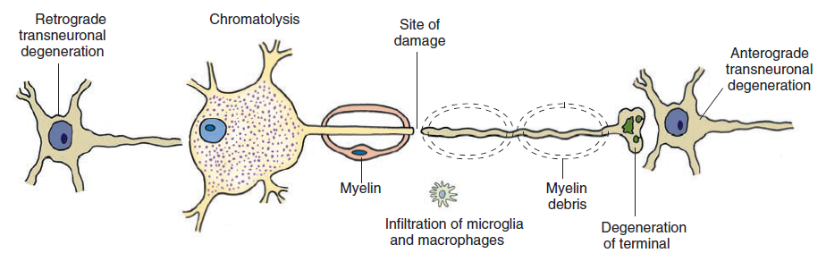

Slide 14
3. Changes at the site of injury :
in PNS Schwann cells differentiated in to thin elongated cells
rate of progress of growth is 1-2 mm/day.

Slide 15
REACTIONS TO INJURY WITHIN THE NEURON:
Immediately -
1. Synaptic transmission off
2. Cut ends pull apart and seal up, and swell,
    due to axonal transport in both directions

Slide 16
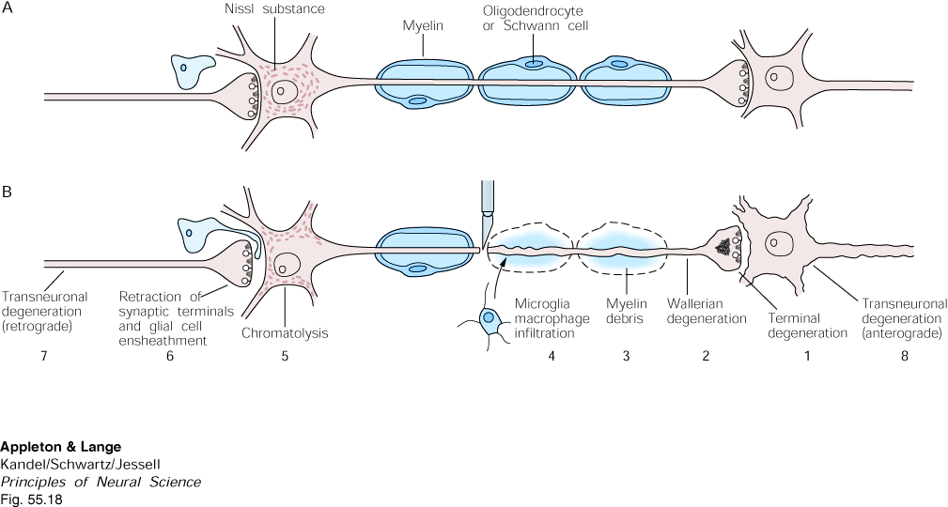
MINUTES after injury…
-synaptic transmission off
-cut ends swell

Slide 17
REACTIONS TO INJURY WITHIN THE NEURON:
Immediately -
1. Synaptic transmission off
2. Cut ends pull apart and seal up, and swell,
    due to axonal transport in both directions
Hours -
Synaptic terminal degenerates - accumulation of neurofilaments, vesicles.
Astroglia surround terminal normally;
  After axotomy
  astroglia interpose between terminal and target
  cause terminal to be pulled away from postsynaptic cell.

Slide 18
HOURS after…
synaptic terminal degenerates

Slide 19
REACTIONS TO INJURY WITHIN THE NEURON:
Immediately -
1. Synaptic transmission off
2. Cut ends pull apart and seal up, and swell,
    due to axonal transport in both directions
Hours later -
Synaptic terminal degenerates - accumulation of NF, vesicles.
Astroglia suround terminal normally;
  After axotomy
  astroglia interpose between terminal and target
  cause terminal to be pulled away from postsynaptic cell.
days - weeks -
5. Myelin breaks up and leaves debris (myelin hard to break down).
6. Axon undergoes Wallerian degeneration
7. Chromatolysis - cell body swells; nissl and nucleus eccentric.

Slide 20
Days to weeks after…

Slide 21
The damaged neuron is affected by injury
as well as the neuron pre- and postsynaptic to it
TRANSNEURAL DEGENERATION

Slide 22
Severing the axon causes degenerative changes in the
injured neuron AND in the cells that have synaptic
connections with the injured neuron.
Importance for lab experiments:
Classically, degeneration of fibers and their targets
has been used to trace neuronal circuits experimentally.

Slide 23
Fibers from the
temporal retina*
project laterally
in the optic tract and
terminate in layers of
the Lateral Geniculate Nucleus
*

Slide 24
REGENERATION
OF
NERVE FIBER
Re-growth of lost or destroyed part of a nerve tissue.

Slide 25
The recovery will be started within 4 days only but becomes active in 30days
Can extends up to one year for full recovery.
This recovery or regeneration process depends on some factors:

Slide 26
Criteria of Nerve Regeneration
Chances of regeneration are considerably increased if the two cut ends are near each other (<3mm)
Two cut ends are in same line
Must have presence of neurilemma
Nucleus has to be present in soma

Slide 27
REGENERATIVE CHANGES:
Anatomical regeneration
Changes in the axon:
  Stage of fibres formation: From cut ends 100 of fibrils elongates in all direction
  fibrils grow in CT to reach out distal cut end
  Stage of entry of fibrils in to Endoneural tube:
  In PNS schwann cell directs fibrils to reach out cut end
  Only one fibrils enter in Endoneural tube of cut end it grows rapidly
  Rate of growth initially only 0.25 mm/day and reach maximum up to 3-4 mm/day

Slide 28
Stage of active growth:
  That axonal fibre which was entered in to Endoneural tube get enlarged
  Establish contacts with an appropriate peripheral end organ.
  Regeneration up to this stage takes 3 months
Stage of myelination: Take 1 year to complete myelination.
Changes in the soma: Starts within 20 days & completed in 80 days
  Nissl granules followed by Golgi apparatus appear in the soma
  Soma attains its normal size
  Centrally placed nucleus

Slide 29
2. Functional regeneration:
It takes long period for neuron to be functionally active.
Only 80% to 82% recovery takes place after injury.

Slide 30
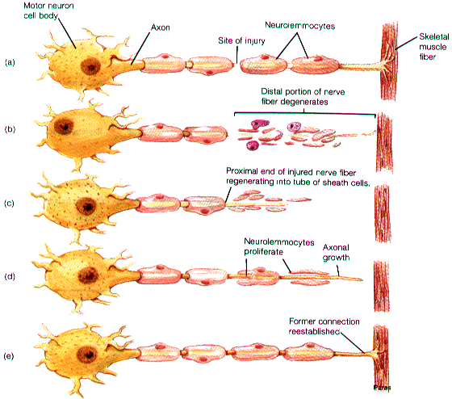

Slide 31
SUMMARY

Slide 32
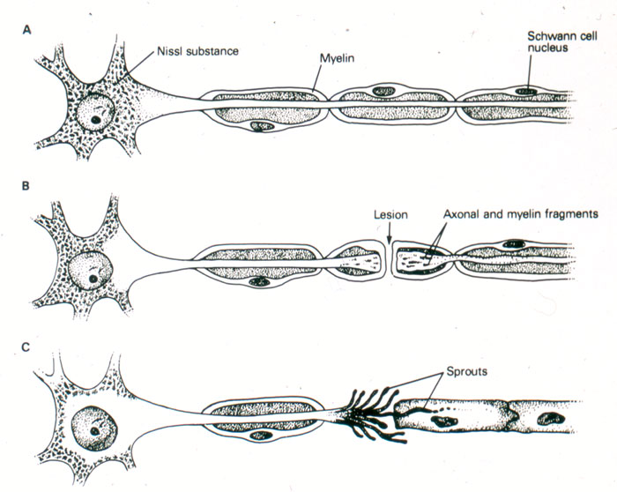
PNS neuron
Reaction to injury
Axons sprout into Schwann cells

Slide 33
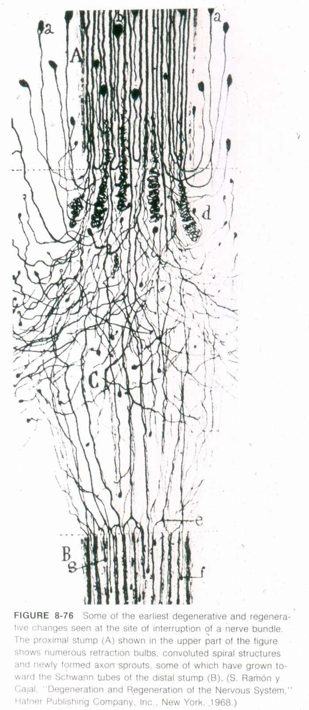
Regenerating axons
form many sprouts,
some of which find
Schwann cell tubes
-Ramon y Cajal

Slide 34
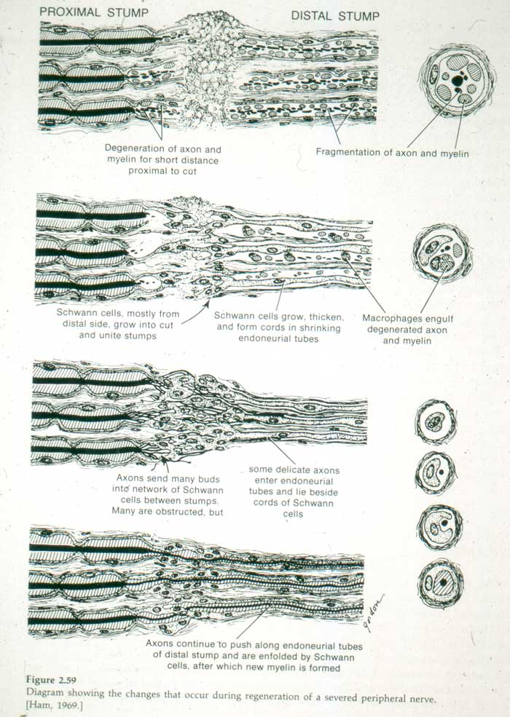
Changes in the distal stump during
degeneration and regeneration (PNS)
1
3
2
4

Slide 35
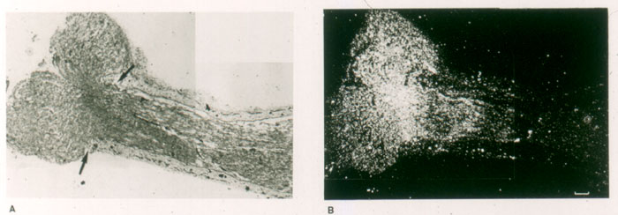
*
Radioactive
nerve growth factor
Cut nerve stump
Macrophages clean debris, release mitogens for Schwann cells
New Schwann cells form tubes, a conducive environment for growth
Schwann cells make laminin (growth-supportive extracellular matrix)
Macrophages release interleukin; interleukin stimulates Schwann cell to make Nerve Growth Factor *
Nerve growth factor stimulates axon regeneration

Slide 36
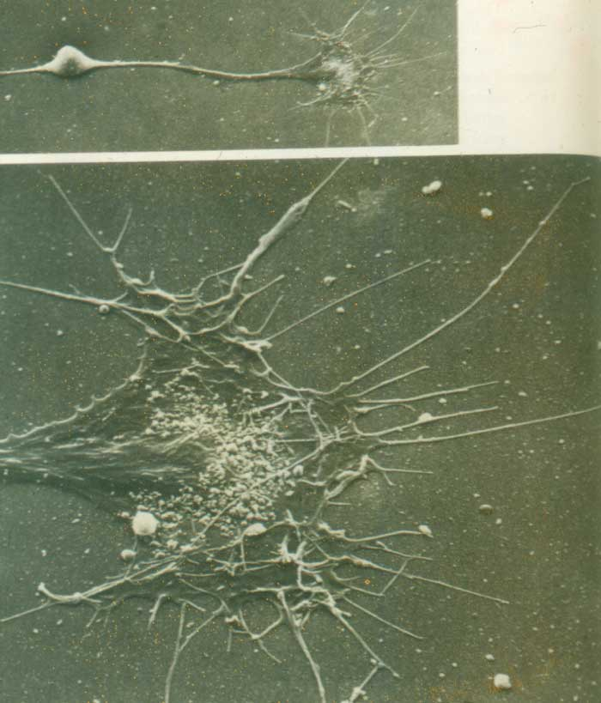
Growth cone
Cell body

Slide 37
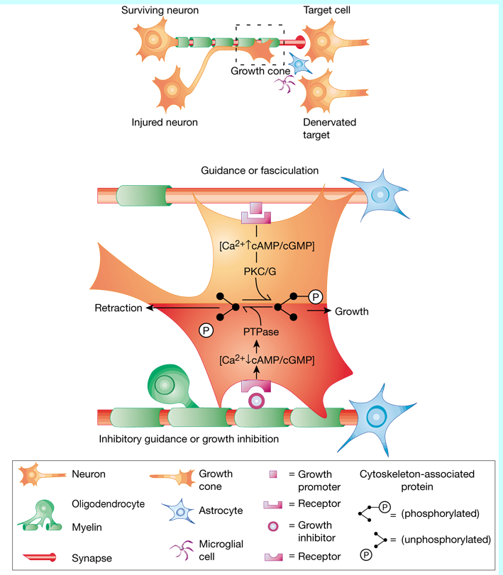
growth cones
on regenerating
axons:
Growth
Retraction

Slide 38
Neurons in the mature CNS have a limited capacity to regenerate axons. CNS axons can regrow, but…
Growth is impeded by negative elements in the environment
-myelin proteins (NOGO- neurite out growth inhibitor,
-MAG- myelin associated glycoprotein,
-Omgp- Oligodendrocyte myelin glycoprotein) increase
- inhibitory proteoglycans increase
Intracellular growth factors such as GAP-43 (growth or plasticity associated protein) important for intracellular signaling/growth cone advance are low
-growth factors have different distributions compared to young brain
-normally growth-supporting extracellular matrix (laminin) is sparse

Slide 39
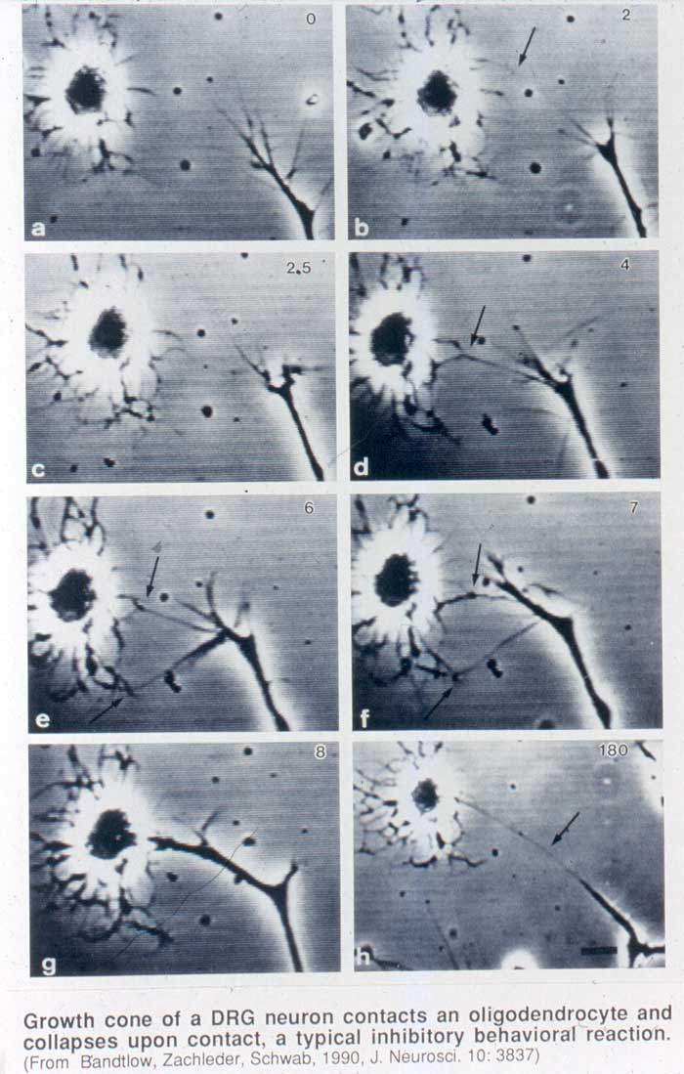
oligodendrocyte
(in culture)
CNS
growth cone
growth cone
retracts

Slide 40
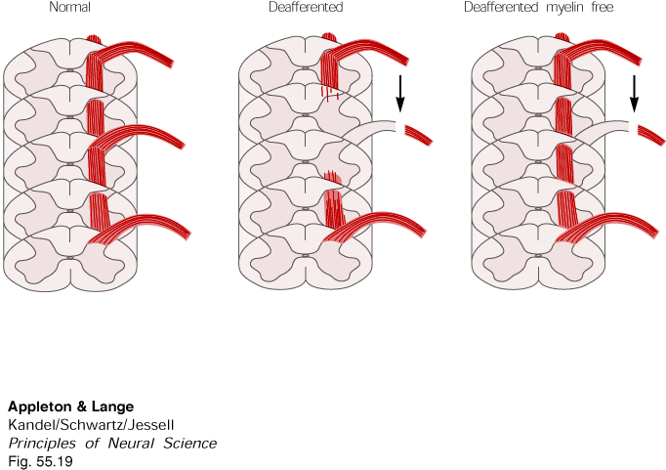
CNS myelin, from oligodendrocytes, is inhibitory to axon growth

Slide 41
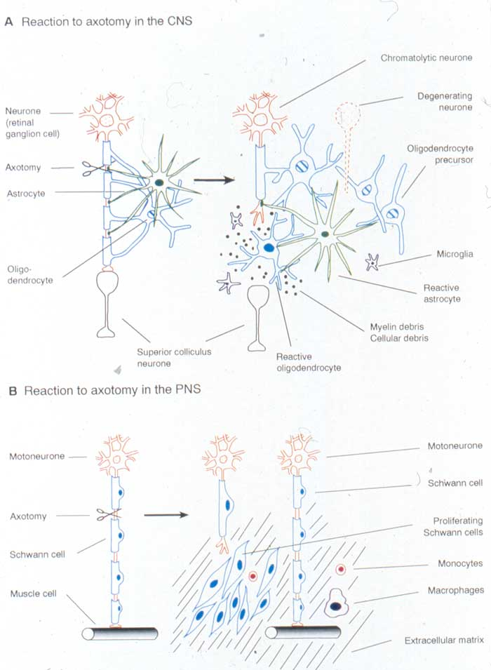
CNS
PNS

Slide 42
Clinical Aspects
Neuroma, Trigeminal neuralgia

Slide 43
Neuroma……..
Neuroma is growth or tumor of nerve tissue or used to refer to any swelling of a nerve.
Neuromas can arise from different types of nervous tissue, including the nerve fibers and their myelin sheath.
Traumatic neuroma results from trauma to a nerve, often during a surgical procedure.

Slide 44
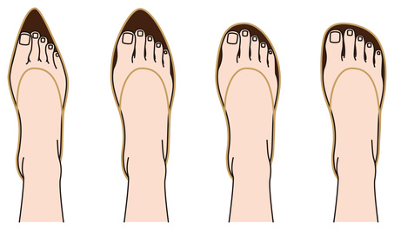
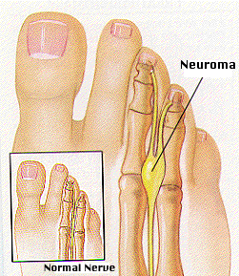

Slide 45

Trigeminal Neuralgia
A severe facial pain syndrome
Trigeminal neuralgia (TN or TGN) is a chronic pain disorder that affects the trigeminal nerve
Develops in middle to later life
Uncertain cause. Micro-vascular compression is common cause. Also believed to involve loss of the myelin around the trigeminal nerve.

Slide 46
1. The gap b/w two cut ends of a nerve fiber, which can be filled up by natural process is
a. 7 mm b. 6 mm c. 3mm d. 5 mm
2. Chemicals help in nerve growth are
a. Neurotrophins b. GH c Insulin d. None
3. Structural and functional unit of nervous system known as
a. Nodes of Ranvier b. neuron c. dendrites d. t tubules
4. Changes occur in the distal stump of cut nerve k/as
a. Wallerian b. Retrograde
c. Transneural d. axonal sprouting
5. Complete transection of nerve known as __ degree injury:
a. 1st b. 2nd c. 3rd d. 5th

Slide 47
1. Recovery in a nerve is completed approx. by __ after the
section:
a. 1 year b. 3 months c. 6 months d. 9 months
2. Wallerian degeneration of ruptured nerve begins within
a. 2 days b. 6 hours c. 24 days d. None
3. First change to occur in the distal segment of cut nerve
a. myelin sheath degeneration b. axonal degeneration
c. mitosis of schwann cells d. axonal sprouting
4. Thickness of given nerve fibre is inversely related to:
a. duration of spike b. threshold of excitation
c. refractory period d. all of the given options
5. Which is not glial cell?
a. microglia b. oligodendrocyte
c. schwann cell d. astrocyte

Slide 48
EBES
EVIDENCE 1
Sodium and potassium currents in acutely demyelinated internodes of rabbit sciatic nerves.
Chiu SY, Schwarz W. J Physiol. 1987 Oct;391:631-49. PubMed PMID: 3443960; PubMed Central PMCID: PMC1192236

Slide 49
Sodium and potassium currents in acutely demyelinated internodes of rabbit sciatic nerves.
REFERENCE | INTERVENTION | SUBJECT | RESULT | CONCLUSION
Chiu SY, Schwarz W. J Physiol. 1987 Oct;391:631-49. PubMed PMID: 3443960; PubMed Central PMCID: PMC1192236. | The extent of demyelination was monitored by a gradual increase in the internodal leak conductance and capacitance. Voltage- and time-dependent inward and outward currents, absent during the early phase of detergent treatment,appeared during the final phase of treatment.The internodal ionic currents elicited by depolarizations consisted of 3 components (a) a transient sodium current (b) a delayed rectifying potassium current (c) a time-dependent current | Voltage-clamp experiments were performed on single internodes isolated from rabbit sciatic nerve fibres acutely demyelinated with the detergent lysolecithin or a synthetic, lysophosphatidyl choline palmitoyl. | The current-voltage relations and h. curves for the internodal Na currentwere similar in shapes to those of the nodal sodium current. The amplitudes of the three internodal currents increased with the increase in the measured internodal capacity during the final phase of demyelination. At high degrees of demyelination a peak sodium current of about 90 nA could be observed in an internodal segment. | the membrane capacity measured at the time of such a large sodium current was about 10 times larger than the axonal membrane in the recording pool alone. This represents lysolecithin-inducedmembrane fusion between the Schwann cell and the internodal axon.

Slide 50
EBES
EVIDENCE 2
The distribution of sodium and potassium channels in single demyelinated axons of the frog
P Shrager. November 1, 1987 The Journal of Physiology, 392, 587-602.

Slide 51
The distribution of sodium and potassium channels in single demyelinated axons of the frog
REFERENCE | INTERVENTION | SUBJECT | RESULT | CONCLUSION
P Shrager. November 1, 1987 The Journal of Physiology, 392, 587-602. | The loose patch clamp technique was used to measure ionic currents in the demyelinated axolemma in both internodal and paranodal regions | Frog sciatic nerves were focally demyelinated by intraneural injection of lysolecithin. Fibres were examined 1-8 days later. At early times axons contained zones just a few micrometres long that were covered by myelin debris. These zones lengthened and the debris was cleared over the next several days. | Transient inward currents that have been identified as Na+ currents on thebasis of voltage dependence and sensitivity to tetrodotoxin were recorded at all stages tested. There was no significant increase in internodal peak Na+ current withtime over the first 8 days after injection. Peak inward currents varied relatively little with distance along the internodeat 1 day post-injection. However, sharp gradients were detected at demyelinatedparanodal and nodal membranes.The ratio of K+ conductance to Na+ conductance is much higher in demyelinated internodes than in normal nodes of Ranvier. | Na+ channels are likely to be present in normal internodes. The total number of these internodal channels may be about 40 times the total number at nodes. Steep gradients of Na+ channel density remain at nodal regions at least up to 6 days following demyelination.

