Slide 1
MYCOBACTERIAL INFECTIONS

Slide 2
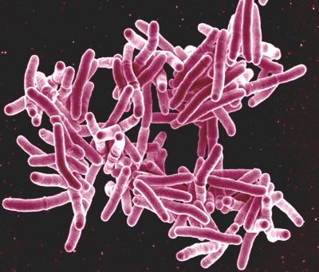
Mycobacteria are non-motile, aerobic rods, non spore forming.
Possess a lipophilic cell envelope and are difficult to stain.
Once stained, however, they cannot be easily decolorized by acid – ACID FAST BACILLI.

Slide 3
Major Species of Mycobacterium
The first three groups are classified as "Slowly growing Mycobacteria".
Runyon I: Photochromogens
Produce a yellow-orange pigment when exposed to light. Mycobacterium kansasii, Mycobacterium marinum, Mycobacterium simiae.
Runyon II: Scotochromogens
Produce a yellow-orange pigment in light or in the dark. Mycobacterium scrofulaceum, Mycobacterium gordonae, Mycobacterium szulgai, Mycobacterium xenopi
Runyon III: Nonchromogenic
Do not produce pigment. Mycobacterium avium-intracellulare, Mycobacterium tuberculosis, Mycobacterium ulcerans
Runyon IV: Rapid Growers
Rapid growing for mycobacteria (colonies in 5 days). They do not produce pigment. Mycobacterium fortuitum, Mycobacterium abscessus, Mycobacterium chelonae,

Slide 4
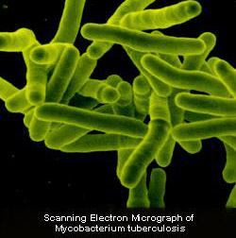
Mycobacterium tuberculosis complex
M. Tuberculosis
M. Leprae
M. Africanum
M. Ulcerans
M. Bovis

Slide 5
Epidemiology
TB is a global health problem.
One-third of world’s population is thought to be infected with 9 million new infections per year.
Now rarely encountered in western countries; but seen in developing countries.
Decline in proportion of cutaneous TB patients in india, from 2% in 1950s to < 0.1% in 1991.
In developed countries incidence of NTM infections has relatively increased as that of TB has declined.

Slide 6
Mycobacteria & AIDS pandemic
Pandemic has led to resurgence of TB & recognition of new mycobacterial pathogens.
Incidence of TB in AIDS is almost 500 times that in general population.
M.avium intracellulare complex is the most common cause of disseminated bacterial infection in AIDS patient in US.
Sharp increase in pulmonary & disseminated TB has not been paralleled by an equal increase in skin disease.
Cutaneous disease is frequently caused by MOTT(mycobacteria other than TB).

Slide 7
Tuberculin test
The Mantoux tuberculin skin test (TST) is the standard method of determining whether a person is infected with Mycobacterium tuberculosis.
It is due to delayed type of hypersensitivity to M. tuberculosis.
It is performed by injecting 0.1 ml of purified protein derivative (PPD) intradermally into the inner surface of the forearm with a tuberculin syringe, with the needle bevel facing upward.
The injection should produce a wheal, 6 to 10 mm in diameter.

Slide 8
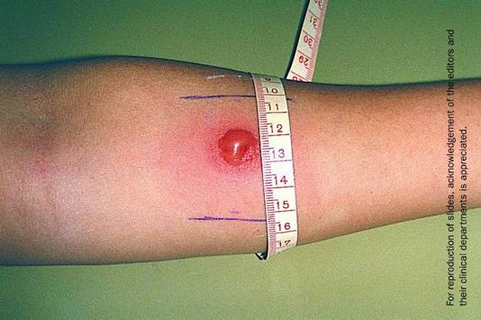
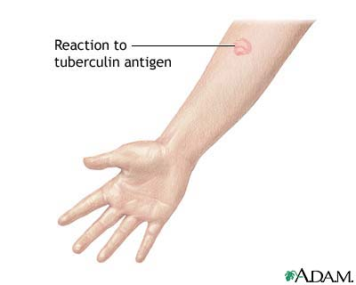
The reaction should be read between 48 and 72 hours after administration.
The reaction should be measured in millimeters of the induration & not the erythema .
The diameter of the indurated area should be measured across the forearm (perpendicular to the long axis).

Slide 9
An induration of 5 or more millimeters is considered positive in:
-HIV-infected persons
-A recent contact of a person with TB disease
-Persons with fibrotic changes on chest radiograph consistent with prior TB
-Patients with organ transplants
-Persons who are immunosuppressed for other reasons (e.g., taking the equivalent of >15 mg/day of prednisone for 1 month or longer, taking TNF-a antagonists)

Slide 10
An induration of 10 or more millimeters is considered positive in:
-Recent immigrants (< 5 years) from high-prevalence countries
-Injection drug users
-Residents and employees of high-risk congregate settings
-Mycobacteriology laboratory personnel
-Children < 4 years of age
- Infants, children, and adolescents exposed to adults in high-risk categories

Slide 11
An induration of 15 or more millimeters is considered positive in any person, including persons with no known risk factors for TB.

Slide 12
False-Positive Reactions
Infection with nontuberculosis mycobacteria
Previous BCG vaccination
Incorrect method of TST administration
Incorrect interpretation of reaction
Incorrect bottle of antigen used

Slide 13
False-Negative Reactions
Cutaneous anergy (inability to react because of a weakened immune system)
Recent TB infection (within 8-10 weeks of exposure)
Very old TB infection (many years)
Very young age (less than 6 months old)
Sarcoidosis
Overwhelming TB disease( miliary TB)
Some viral illnesses (e.g., measles and chicken pox)
Incorrect method of TST administration
Incorrect interpretation of reaction

Slide 14
Classification of cutaneous tuberculosis
Route Disease Immunity
I.Inoculation tuberculosis • Lupus vulgaris Present
(exogenous source) • Tuberculosis verrucosa cutis Present
• Primary inoculation tuberculosis Absent
II. Secondary tuberculosis • Scrofuloderma Equivocal
(endogenous) • Orificial tuberculosis Absent
III. Haematogenous • Acute miliary tuberculosis Absent
tuberculosis • Tuberculous gumma Absent
• Some cases of lupus vulgaris Present
IV. Tuberculids
Micropapular • Lichen scrofulosorum
Papular • Papulonecrotic tuberculid
Nodular • Erythema induratum

Slide 15
Primary-inoculation TB (tuberculous chancre)
It results from direct introduction of mycobacteria into the skin or mucosa of an individual who was not previously infected with TB or was immunized with BCG.
Initiation of infection almost always follows an injury, usually in children.
Common sites include the face and other exposed sites.
Tuberculous chancres are reported after ritual circumcision, tattooing, ear piercing, venipuncture, sexual intercourse, tooth extraction, and after ingestion of milk contaminated with M bovis.

Slide 16
After mycobacteria gain entry into the skin, they multiply in tissue macrophages and spread to regional lymph nodes.
An inflammatory papule develops in 2-4 weeks at the inoculation site that breaks down into a firm, nonhealing, shallow, nontender, undermined ulcer with a granulomatous base.
Painless regional lymphadenopathy is evident at 3-8 weeks.
Numerous bacilli are present at the inoculation site and regional node.
This ulceroglandular complex is the skin analog to the primary complex.

Slide 17
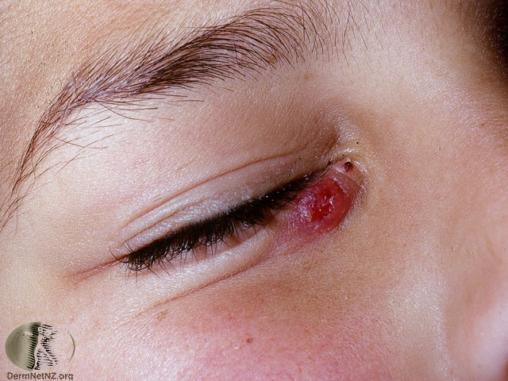

Slide 18
Tuberculin sensitivity usually is coincident with the development of lymphadenopathy.
Epithelioid granulomas are evident in the skin and lymph nodes.
Numbers of tubercle bacilli progressively decrease.
The primary lesion heals with scarring after 1-3 months.
With a less effective host-immune response, bacterial load remains high and healing is delayed for up to 12 months.

Slide 19
Complications
Regional nodes may suppurate, erode, and perforate the surface of overlying skin (scrofuloderma).
Latent foci of infection can remain at the site and progress to lupus vulgaris or TB verrucosa cutis.
Hematogenous dissemination of mycobacteria from skin can result in TB at other sites (particularly bones and joints) or progress catastrophically to acute miliary disease with a fatal outcome.

Slide 20
TB verrucosa cutis
It is an indolent warty plaque that occurs after direct inoculation of TB into the skin of individuals previously infected with M tuberculosis or M bovis.
Can result from accidental exposure to tuberculous tissue in high-risk groups, such as physicians, pathologists, and laboratory workers (anatomists’ wart, prosectors’ wart, verruca necrogenica).
Individuals, especially children, also can contract this lesion after contact with tuberculous sputum.
In India, walking barefoot and the habit of spitting associated with betel leaf (paan) chewing are worth noting.

Slide 21
Lesions most commonly occur on the hands and, in children, the lower extremities.
Infection starts as an asymptomatic warty papule often mistaken for verruca vulgaris.
Slow growth and irregular peripheral extension occur.
The lesion may show central involution with an atrophic scar or form massive papillary excrescence with fissures.
Pus and keratinous material may extrude from these fissures.
Lesions usually are solitary, and regional nodes are not affected.
Lesions may evolve and persist for years.
Spontaneous resolution with scarring can occur.

Slide 22
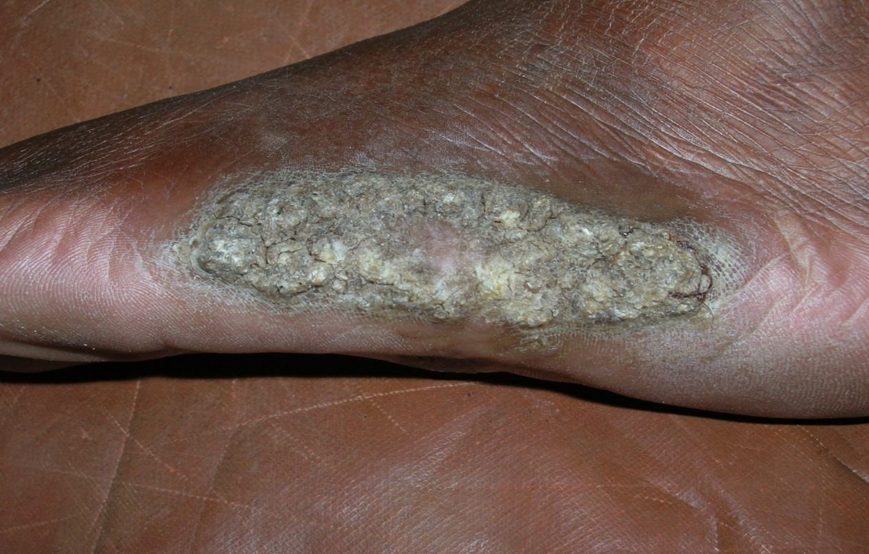
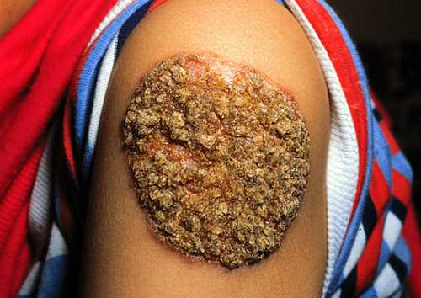

Slide 23
Histology
Histology shows pseudoepitheliomatous hyperplasia with marked hyperkeratosis and a dense inflammatory infiltrate of neutrophils and lymphocytes.
Abscesses form in the superficial dermis and epidermis.
Epithelioid giant cells occur, but typical tubercles and acid-fast bacilli are rare.

Slide 24
Scrofuloderma
It results from breakdown of skin overlying a tuberculous focus, usually at a lymph node but also at the skin over infected bones or joints.
Lesions present as firm, painless, subcutaneous nodules that gradually enlarge and suppurate and then form ulcers and sinus tracts in overlying skin.
Typical ulcers have undermined edges and a floor of granulation tissue.
Typical tubercles with acid-fast bacilli are found in the lower dermis and walls of the ulcer or abscess.

Slide 25
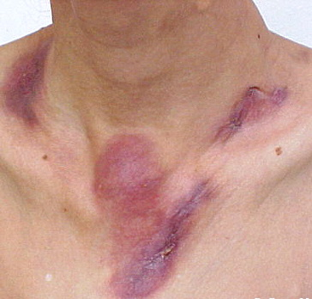
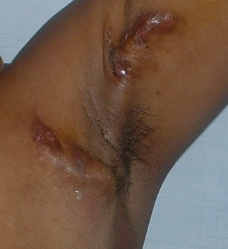
painless, subcutaneous nodules that gradually enlarge and suppurate and form ulcers and sinus tracts

Slide 26
Tubercle bacilli usually can be isolated from the purulent discharge.
Tuberculin sensitivity usually is marked.
Spontaneous healing can occur but often takes years and is accompanied by the formation of hypertrophic scars.
Lupus vulgaris may develop in the vicinity of healing scrofuloderma.

Slide 27
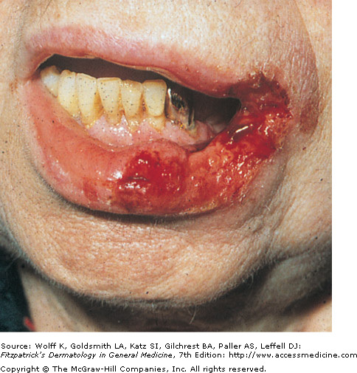
TB cutis orificialis
Orificial TB results from autoinoculation
of mycobacteria into the periorificial skin
and mucous membranes in patients with
advanced TB.
Underlying disease can be pulmonary,
intestinal, or genitourinary TB.
Infectious mycobacteria shed from these foci are inoculated into surrounding mucous membranes and skin.
Patients typically are older men.
Tuberculin sensitivity is strong.

Slide 28
Tip and lateral margins of the tongue are affected most frequently.
Hard and soft palate lesions also are common.
Other sites-Perianal skin, the vulva, the urinary meatus, and the glans penis .
Lesions start as red papules that evolve into painful, soft, punched-out, shallow ulcers.
Tubercles with acid-fast bacilli can be found in the deep dermis and ulcer walls.
Usually, patients that develop orificial TB have severe internal organ disease and the appearance of these lesions portends a poor prognosis.

Slide 29
Miliary TB of the skin
Rare manifestation of fulminant miliary TB resulting from hematogenous spread of mycobacteria to multiple organs, including skin.
The initial site of infection usually is pulmonary or meningeal.
Occurs predominantly in children or immunosuppressed individuals .
Tuberculin sensitivity is absent and bacillary load is high.

Slide 30
Disseminated lesions occur on all parts of the body, especially the trunk.
Lesions erupt as small (millet-sized) red macules or papules.
Purpura, vesicles, and central necrosis are common.
Histologically, lesions show microabscesses with tissue necrosis and nonspecific inflammatory infiltrates.
Tubercle bacilli are numerous and are demonstrated in tissue and intravascular spaces.
Affected patients are gravely ill, and the prognosis is poor.

Slide 31
Lupus vulgaris
It is a chronic and progressive form of cutaneous TB that occurs in tuberculin-sensitive patients.
Most common form of cutaneous TB and has the most variable presentation.
Lesions appear in normal skin as a result of direct extension of underlying tuberculous foci, of lymphatic or hematogenous spread, after primary inoculation, BCG vaccination, or in scars of old scrofuloderma.
Affected females outnumber males by 2-3:1.

Slide 32
Lesions usually are solitary.
more than 90% involve the head and neck.
Small, sharply marginated, red-brown papules of gelatinous consistency (apple-jelly nodules on Diascopy) slowly evolve by peripheral extension and central atrophy into large plaques.
However “apple jelly nodules” is not seen in many pigmented patients.
Reappearance of new nodules within previously atrophic or scarred lesions is characteristic.
Cartilage (nose, ears) within the affected area is progressively destroyed (lupus vorax).
Buccal, nasal, and conjunctival mucosae may be involved primarily or by extension.

Slide 33
Clinical variants :
Plaque forms: Disease extension occurs with little central atrophy. Scaling can occur. Irregular scarring is common and the active edge may be thickened and hyperkeratotic.
Ulcerating form: Scarring and ulceration predominate. Crusts form over areas of necrosis. Deep tissues and cartilage are invaded by eventual scarring that produces contractures and deformity.
Vegetative form: characterized by necrosis, ulceration, and proliferative and papillomatous granulation tissue.
Nodular form: characterized by a relative absence of ulceration and scarring. Large soft tumors occur, especially on ear lobes.

Slide 34
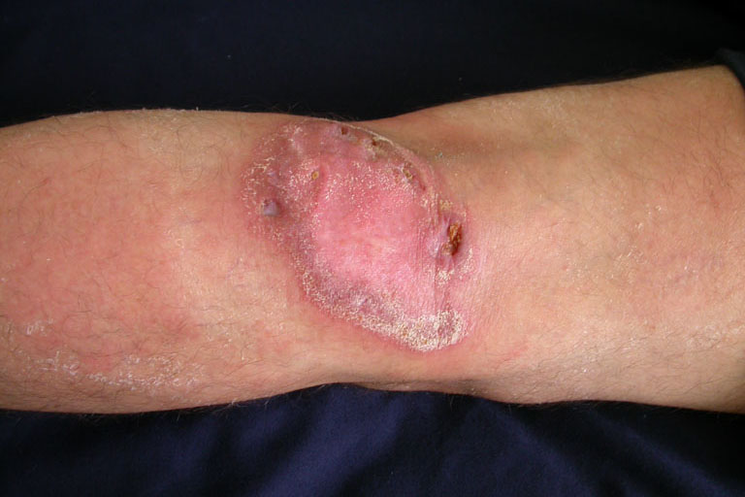
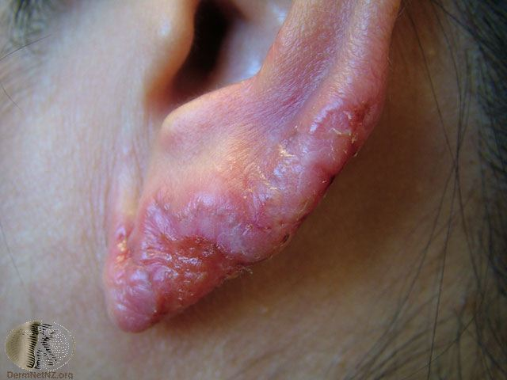
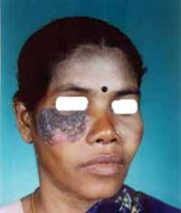

Slide 35
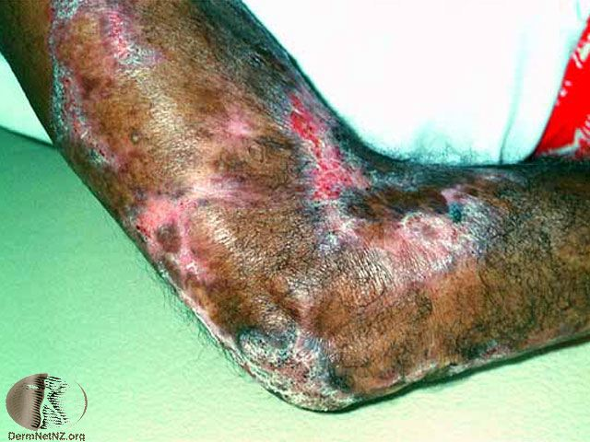
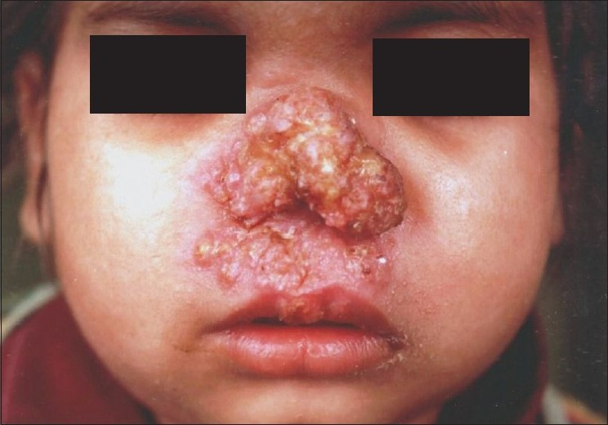

Slide 36
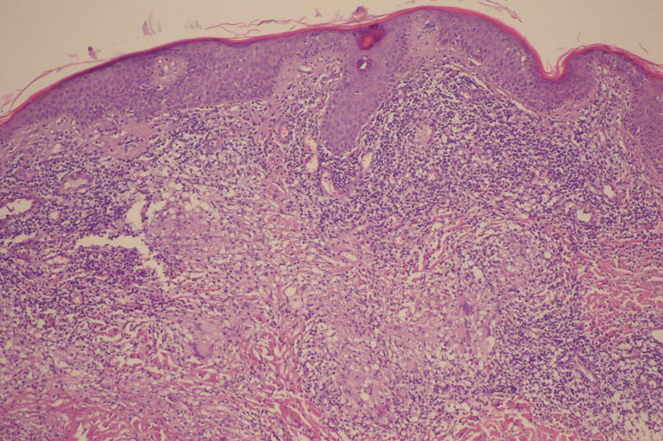
Histology
Histologically, the most prominent feature is a typical granulomatous tubercle with epithelioid cells, Langhans giant cells, and a mononuclear infiltrate.
Caseation necrosis is minimal, and acid-fast bacilli are rare.

Slide 37
Clinical course
Lesions often persist for years before diagnosis and can be disfiguring.
Patients with lupus vulgaris and pulmonary TB have a 4- to 10-fold higher mortality than with pulmonary TB alone.
In long-standing lupus vulgaris, squamous cell carcinoma can occur and be confused with the disease itself.

Slide 38
Tuberculous gumma
Metastatic tuberculous abscess (tuberculous gumma) occurs following hematogenous spread of mycobacteria to skin in tuberculin-sensitive individuals.
Painless, fluctuant, subcutaneous abscesses form singly or at multiple sites, then break down into fistulas and ulcers.
Typically, these lesions occur in malnourished children or in severely immunosuppressed patients.

Slide 39
Tuberculids
Tuberculids are symmetric generalized exanthems in the skin of tuberculous patients, possibly resulting from hypersensitivity reactions to tubercle bacillus.
Typically, patients with tuberculids are in relatively good health and show
  (1) positive tuberculin sensitivity,
  (2) tuberculous involvement (usually inactive) of viscera or lymph nodes,
  (3) negative staining and culture for pathogenic mycobacteria, and
  (4) skin lesions that heal with remission or treatment of TB.
They are manifestations of hematogenous spread of bacilli in patients with tuberculin immunity.

Slide 40
Erythema induratum (Bazin disease)
Erythema induratum is a persistent or recurring condition associated with past or active TB.
Inflammatory cutaneous and subcutaneous nodules that may ulcerate and scar occur in the posterior calves of women’s legs (<10% of affected patients are men).
Preexisting erythrocyanotic circulatory disease may predispose patients to lesions.

Slide 41
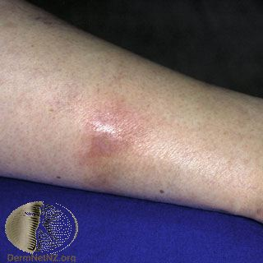
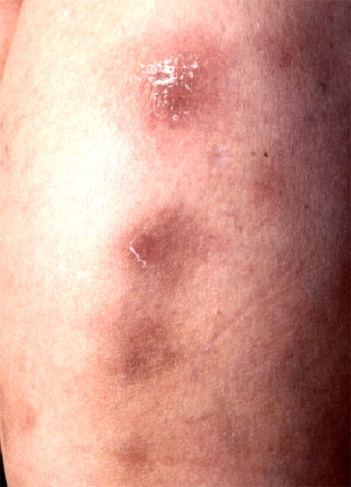
Lesions arise in small numbers as tender indurated plaques and nodules that may progress to ulceration and scarring.
Tubercle bacilli are not seen, and mycobacterial cultures usually are negative.

Slide 42
Papulonecrotic tuberculid
Chronic and recurrent symmetric eruption of necrotizing skin papules appearing in clusters and healing with varioliform scars.
Tubercle bacilli are difficult to demonstrate.
Patients usually have an internal focus of TB and are tuberculin sensitive.
Skin lesions resolve after anti-TB therapy.

Slide 43
Clinical features
Lesions appear on the extensor aspects of extremities (knees, elbows, buttocks, lower trunk) in a symmetric distribution, often in clusters.
Individual lesions are asymptomatic, small, dusky red papules with a central punctum or crust.
Involution is common after 6-8 weeks and leaves pitted scars.

Slide 44
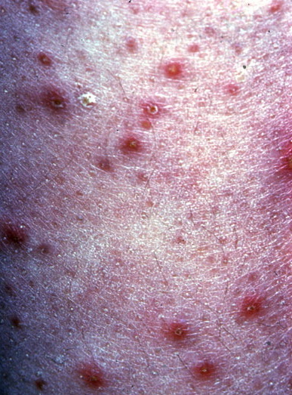
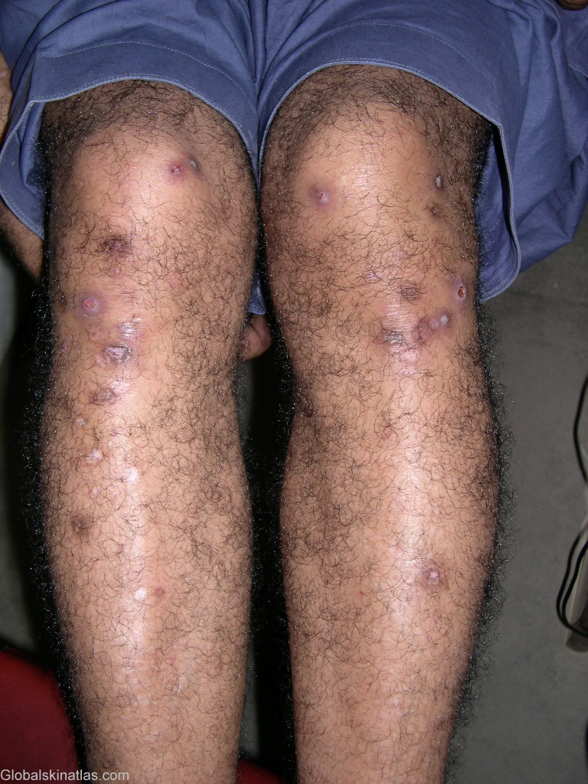
dusky red papules with a central punctum or crust

Slide 45
Histology
Histologically, these lesions show a wedge-shaped necrosis of the upper dermis extending to and involving the epidermis.
Epithelioid cells and, infrequently, Langhans giant cells are seen.
An obliterative granulomatous vasculitis with fibrin present in vessel walls and lumen is typical.

Slide 46
Lichen scrofulosorum
Asymptomatic, grouped, closely set, 1-2 mm, perifollicular, lichenoid papules affecting children and young adults with underlying TB.
The eruption becomes more extensive for weeks and then slowly regresses for months without scarring.
Histologically, tuberculoid granulomas can be seen surrounding hair follicles and sweat ducts.
Caseation necrosis usually is absent.
No acid-fast bacilli are seen.
Should be differentiated from lichen nitidus.

Slide 47
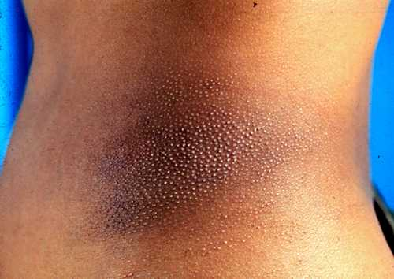
Lichen scrofulosorum

Slide 48
BCG vaccination and tuberculosis of the skin
BCG vaccination has been associated with cutaneous tuberculosis:
i) Lupus Vulgaris, Scrofuloderma may develop at the injection site.
ii) Severe regional lymphadenitis is the most common complication and affects younger patients.
iii) Generalised tuberculid-like reactions have been reported on rare occasions.
iv)Local abscess after deep infection.

Slide 49
Diagnosis
I. Absolute criteria
Culture
The only absolute criteria in confirming a diagnosis of cutaneous tuberculosis is a positive culture on Lowenstein Jensen's media. However, it requires up to four to six weeks, leading to considerable delay in diagnosis.
II. Relative criteria
In the absence of positive cultures, relative criteria are used for diagnosis:
i) Evidence or history of active tuberculosis at other sites.
ii) Clinical history and physical appearance.
iii) The presence of acid-fast bacilli.
iv) Tuberculous granulomas seen on histology.
v) Positive Mantoux test.
vi) Response to anti-tuberculosis therapy.

Slide 50
III. Polymerase chain reaction
PCR can aid in the diagnosis of cutaneous tuberculosis.
However, PCR is not always positive in paucibacillary cases (Lupus Vulgaris, Tb Verrucosa Cutis)

Slide 51
Treatment
The aim is to eradicate all viable mycobacteria in the patient, which can be divided into three groups:
i) Freely dividing extracellular bacilli.
ii) Dormant bacilli within cells and caseous material.
iii) Slowly dividing bacilli within the macrophages and in inflammatory lesions.

Slide 52
The treatment of cutaneous tuberculosis is similar to that of pulmonary tuberculosis.
This consists of two phases:
Phase I targets rapidly dividing bacilli and consists of an initial phase of intensive therapy with three or four drugs for two months.
Phase II is directed at the remaining dormant bacilli (maintenance therapy) and consists of isoniazid and rifampicin for four further months.

Slide 53
In patients with HIV, treatment with isoniazid and rifampicin is continued for seven months after the initial two months of quadruple therapy.
Surgical measures may complement medical therapy.
For example, localised lesions of LV or TVC may be excised while continuing on medical therapy and surgical correction of deformity may be required.

Slide 54
Dosage regime of the first-line antituberculous drugs
Drug Child Adult
Isoniazid 5 mg/kg/day 300 mg/day
Rifampicin 10 mg/kg/day 450 mg/day
(<50 kg)
600mg/day
(>50 kg)
Ethambutol 15 mg/kg/day 15 mg/kg/day
Pyrazinamide 30 mg/kg/day 1.5 g/day
(<50 kg)
2 g/day
(>50 kg)

Slide 55
Diseases caused by MOTT

Slide 56
Swimming pool granuloma
Rare, Chronic skin infection caused by Mycobacterium marinum.
The bacteria are found in fresh, aquarium and sea waters and in some fish species.
They cause an infection in fish and humans.
There are two types of lesions – single painless granulomas or a lymphangitic type of skin lesion.
Risk factors: HIV infection, leukemia, lymphoma, immunosuppresive therapy

Slide 57
Clinical features
M marinum infection often follows abrasions to an extremity occurring in nonchlorinated water.
Fishermen, oyster workers, swimmers, and aquarium workers are predisposed to infection.
Incubation period of approximately 2-3 weeks
A mildly tender papule or nodule initially appears at the site of trauma, slowly enlarges, and then suppurates or ulcerates.

Slide 58
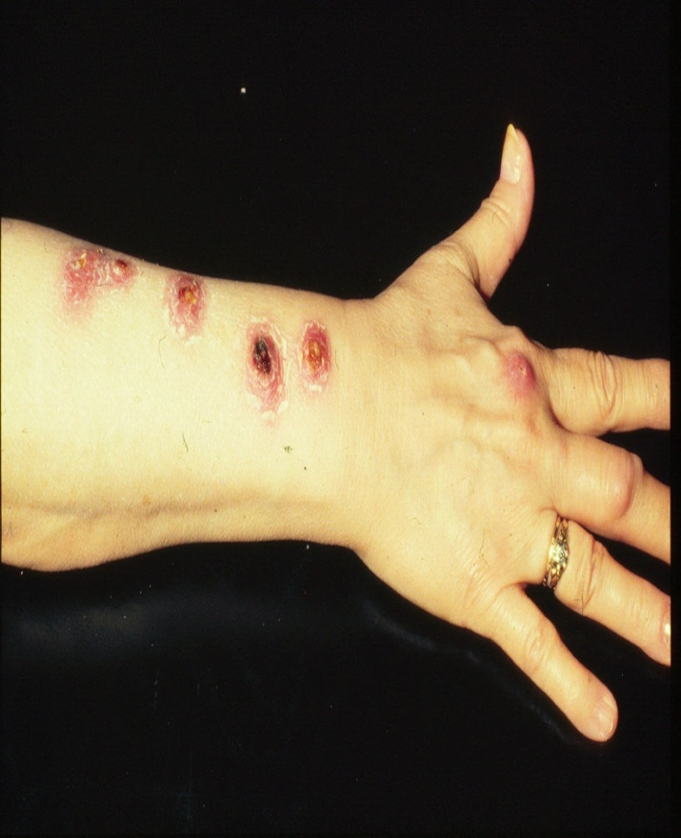
Localized pain and induration are
common.
Further nodular lesions may develop
along the lymphatic channels,
resulting in ascending nodular
lymphangitis.
Regional lymphadenitis and
systemic symptoms are uncommon.
Contiguous spread to deeper structures (eg, tendons, joints, or even bones) occurs in up to one third of individuals.

Slide 59
Treatment
The mainstay of treatment in M marinum infection is antimicrobial therapy (rifampicin, ethambutol, cotrimoxazole, tetracyclines) .
Treatment should be continued for 1-2 months after resolution of symptoms and lesions (3-4 months).
Combination treatment with 2 active agents is preferred.

Slide 60
Buruli ulcer
Buruli ulcer, also known as Bairnsdale ulcer, is a chronic, indolent, necrotizing disease of the skin and soft tissue.
It is the third most common mycobacterial disease of the immunocompetent host, after tuberculosis and leprosy.
Caused by toxin-producing mycobacteria, Mycobacterium ulcerans.
Begins as a painless dermal papule or subcutaneous nodule, which, over a period of weeks to months, breaks down to form a necrotic ulcer with extensively undermined edges.
Lesions heal with scarring.

Slide 61
Pathophysiology
M ulcerans are slow-growing mycobacteria that affect the skin and the mucous membranes.
The organism produces a soluble polypeptide toxin called mycolactone that induces cellular apoptosis and immunosuppression.
Ulcers contain numerous bacilli, but tissue reaction is not tuberculoid.

Slide 62
Clinical features
Lesions usually begin as a single, painless, occasionally pruritic, dermal papule or subcutaneous nodule.
Suppuration and ulceration occur within 1-2 months.
Ulcerations are generally painless unless complicated by secondary infection.
Systemic symptoms such as fever or lymphadenopathy are rare.
Metastatic lesions may occur in skin, soft tissue, or bone via spread through the vasculature or lymphatics.
Healing is a slow process that often results in cosmetically disfiguring scars and functional disabilities.

Slide 63
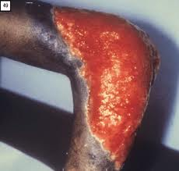
Treatment
Excision & plastic repair.
Rifampicin, clofazimine & cotrimoxazole may be effective.

Slide 64
THANK YOU

