Slide 1
Neuro-muscular junction

Slide 2
Neuromuscular junction
(example of chemical synapse)
Neuromuscular junction : The synapse between motor neuron and muscle fiber is called the neuromuscular junction
Motor unit : single motor neuron and the muscle fibers it innervate

Slide 3
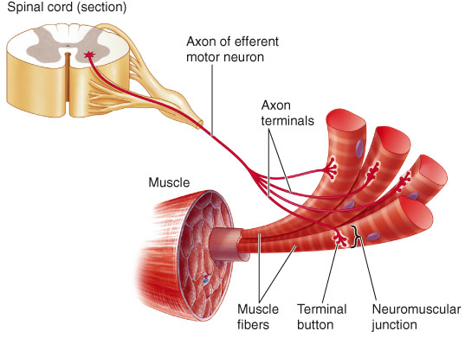

Slide 4
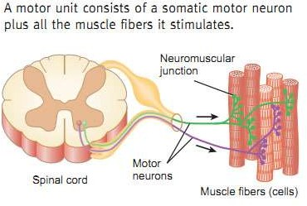
Motor unit
Motor neuron, axon terminal and muscle fibers together called as motor unit

Slide 5
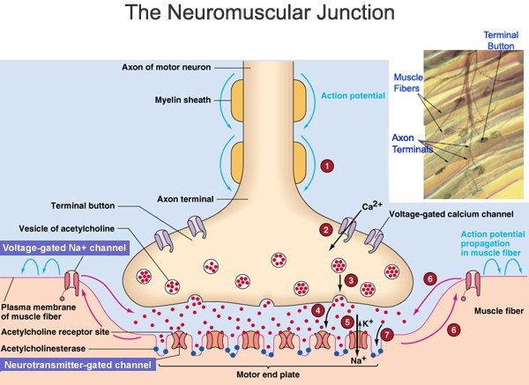

Slide 6
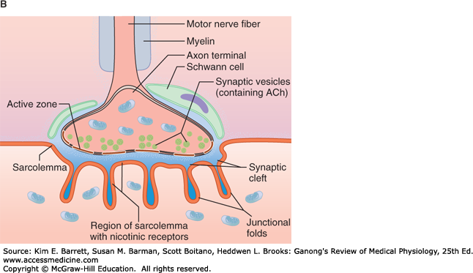
Teloglia

Slide 7
Key points in presynaptic terminal

Slide 8
Ca⁺²
Ca⁺²
Ca⁺²
Vesicular Ach transporter
Ca⁺²
Ca⁺²
Choline uptake channels
Synapto brevin
choline
clathrin
Teloglia
Teloglia
Syntaxin

Slide 9
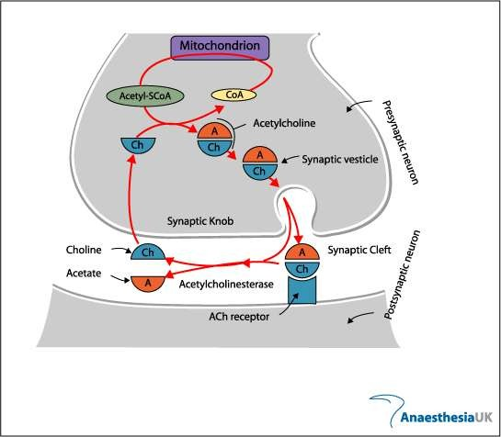
Synthesis of Acetyl choline
Choline uptake receptor

Slide 10
Key points in postsynaptic membrane/ motor end plate

Slide 11
ACh esterase
Presynaptic membrane
Voltage gated Na⁺ channels
Na⁺
K⁺
Nicotinic receptors
Postsynaptic membrane
Or
Motor end plate
Na⁺
K⁺

Slide 12
Axon terminal- terminal branch of nerve fiber
Motor end plate-thick sarcolemma of muscle fibre
Synaptic trough/ gutter- depression on the muscle fiber due to invagination of Axon terminal
Subneural cleft- numerous folds of post synaptic membrane

Slide 13
Presynaptic membrane- membrane of nerve ending
Postsynaptic membrane- membrane of muscle fiber
Synaptic cleft- space between post and presynaptic membrane
Basal lamina- thin spongy layer of reticular matrix in synaptic cleft

Slide 14
Mechanism
of
Neuromuscular transmission

Slide 15
1. Action potentials arriving at the presynaptic terminal cause voltage-gated Ca²⁺ channels to open.

Slide 16
2. Ca2+ uptake into the terminal causes release of the neurotransmitter acetylcholine into synaptic cleft , which has been synthesized and stored into synaptic vesicles

Slide 17
Mitochondria
Vesicular Ach transporter
Acetyl Co A
ACh transferase
ACh
Choline uptake channels
Synapto brevin
choline
Empty vesicle
clathrin
Ach
Ach
10⁴
Syntaxin
clathrin
Ach

Slide 18
3. Ach travels across the synaptic cleft to postsynaptic membrane which is also known as motor end plate.

Slide 19
4. Ach binds with nicotinic cholinergic receptor

Slide 20
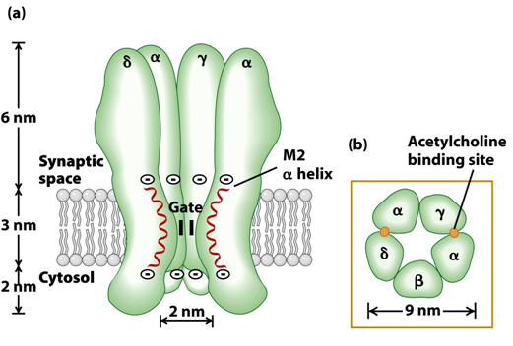
Structure of Nicotinic cholinergic receptors:
15- 40 millions receptor or 10000 AchR/μm²
large pore diameter (0.8nm)
Passage of Na⁺ and K⁺

Slide 21
6. Binding will causes conformational change as central core of channels opens & permeability of motor end plate to Na⁺ increases

Slide 22
End plate potential
7. When Ach triggers opening of these channels which cause more Na⁺ moves inwards than K⁺ out wards, depolarizing the end plate. this potential change is called end plate potential (EPP).

Slide 23
End plate potential
Small quanta (packets) of Ach are released randomly from nerve cell at rest, each producing smallest possible change in membrane potential of motor end plate, the MINIATURE EPP.
When nerve impulse reaches at the ending, the number of quanta release increases by several folds (60-200 vesicles) and result in large EPP.
EPP is not an action potential but it is simply depolarization of specialized motor end plate
EPP than spread by local current to adjacent muscle fibers which are depolarized to threshold & fire action potential

Slide 24
From MEPP to EPP
&
EPP to Action Potential
Vm
0.5
mV
Vm
5
mV
Vm
5
mV
Stimulate
nerve
Stimulate
nerve
Miniature EPP
(spontaneous, 1 vesicle
aka 1 quantum)
EPP
(evoked, ~200 quanta)
EPP brings membrane
to threshold and initiates
action potential

Slide 25
8.Acetyl cholinesterase ends Ach activity at NM junction
Muscle cell electrical response is turned off by acetylcholinestrase (AchE), which degrade Ach to choline & acetate
About 50% of choline is returned to the presynaptic terminal by Na⁺ choline transport to be reused for Ach synthesis.
Now muscle fiber can relax ,if sustained contraction is needed for the desired movement another motor neuron AP leads to release of more Ach

Slide 26
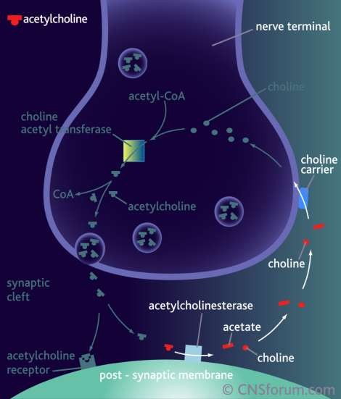
Destruction of acetyl choline

Slide 27
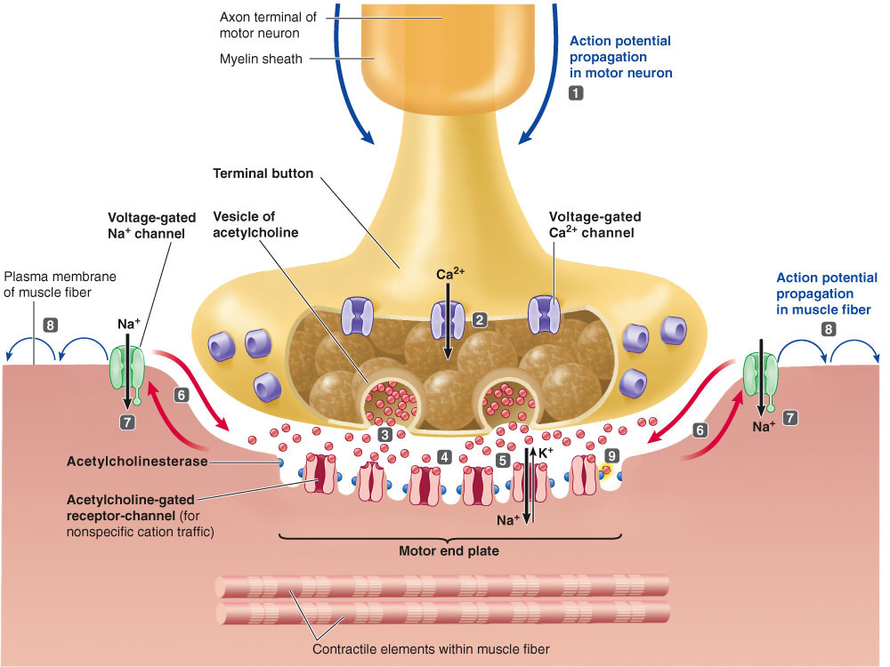

Slide 28
Effect of different type of substances on NMJ
Blocker and stimulators at neuromuscular junction

Slide 29
Blocker of NMJ
Presynaptic and postsynaptic blockers

Slide 30
Presynaptic blockers
Botulinum toxin: inactivate Synapto-brevin and syntaxin
Floppy baby syndrome
Cosmetic use: Botox treatment (Therapeutic dose)
i.e. < 2- 3µg
Death is due to reparatory failure caused by inability to contract diaphragm
2. Hemicholinium: inhibit choline uptake
3. Vesamicole:

Slide 31
Mitochondria
Vesicular Ach transporter
Acetyl Co A
ACh transferase
2
3
ACh
Choline uptake channels
Synapto brevin
choline
1
Syntaxin

Slide 32
Post-synaptic blockers
Competitive blockers:
Curare:
In past it was used as deadly arrowhead poison
competitively binds to Ach receptor
sever poisoning person dies of respiratory failure
Persistent depolarizing agent:
Succinylcholine:
Binds with N Ach Receptors
Cant be hydrolyzed by Ach Esterase

Slide 33
Stimulators on NMJ
Black widow spider venom:
The venom of black widow spider exerts its effect by triggering explosive release of Ach from the storage vesicles, not only at N.M junction but all cholinergic sites. all cholinergic sites undergoes prolong depolarization.
The most harmful result is respiratory failure

Slide 34
Myasthenia Gravis
A disease involving N.M junction is characterized by the extreme muscular weakness
(Myasthenia=muscular & Gravis=severe)
It is an auto immune condition in which antibodies are formed against its own motor end plate ach receptors.
Thus not all Ach molecules can find functioning receptors site with which to bind.
As a results , AChE destroys much of Ach before it ever has a chance to interact with receptor site & contribute to EPP.

Slide 35
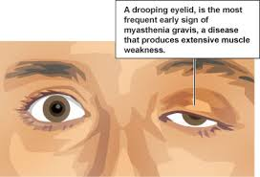
Slow and weak contraction,
quick fatigue,
double vision,
difficulty in swallowing and speech
Patient dies mostly due to the paralysis of respiratory muscles

Slide 36
Management…..
Blockers of Anticholinesterase drugs (pyridostigmine, neostigmine or physostigmine), Which maintains the Ach levels at N.M junction at high levels thus prolonging the time available for Ach to activate its receptors.

Slide 37
Lambert – Eaton Myasthenic syndrome
Auto antibodies against Voltage gated Ca⁺² channels

Slide 39
Action potential (AP) is initiated in the presynaptic motor neuron (MN) and invades the endplate region
Depolarization of terminal buttons, resulting in the opening of voltage-dependent calcium channels
Influx of Ca²⁺, down its concentration gradient
Rise of intracellular free [Ca²⁺] initiates fusion of vesicles containing acetylcholine (ACh) to the membrane of the terminal boutons, resulting in exocytosis of ACh
Diffusion of ACh across synaptic cleft to the muscle cell

Slide 40
Binding of ACh to nicotinic ACh-receptors at endplate
Receptor binding causes opening of cation channels, leading to influx of Na⁺ (ACh is then degraded by ACh esterase present in the synaptic cleft)
The resulting depolarization of muscle cell membrane at the endplate is referred to as the endplate potential (EPP)
The local depolarization causes adjacent regions to be depolarized, causing an AP in the muscle cell membrane
AP spreads out in all directions from the endplate, propagates along muscle cell, initiating contraction

Slide 41
1. Junction between neuron and muscle is k/as
a. NM junction b. MN junction
c. MM junction d. NN junction
2. Ach receptor present at NM junction are
a. Nicotinic b. Muscarinic c. α d. β
3. Neurotransmitter released at NM junction is
a. Ach b. Epinephrine c. serotonin d. histamin
4. Potential develop at motor end plate during nerve muscle transmission is k/as
a. EPP b. MEPP c. AP d None
5. Single motor neuron and the muscle fibers it innervate, k/as
a. motor unit b. motor nerve c. motor d. sensory unit

Slide 42
6 . Anticholinesterase inhibiter neostigmine is
a. NM junction stimulator b. NM junction inhibiter
c. Both d. none
7.Disease where antibodies formed against Ach receptors is
a. myasthenia gravis b. Lambert Eaton syndrome
c. dystrophy d. hypotonia
8. Disease where antibodies formed against Ca++ receptors is
a. Myesthenia gravis b. lambert eaton syndrome
c. dystrophy d. hypotonia
9. Small quanta (packets) of Ach are released randomly from nerve cell at rest generates
a. EPP b. MEPP c. AP d None
10. Curare is
a. Competitive inhibitor of Ach receptor b. blocker of Ach receptor
c. Stimulator of Ach receptor d. modulator of Ach receptor

Slide 43
Thank you

