Slide 1
Epidermal naevi

Slide 2
Naevus /nevus
Latin- birthmark/maternal impression
Visible, circumscribed, long standing lesions of the skin/neighbouring mucosa, reflecting genetic mosaicism
Circumscribed ,non-neoplastic skin/mucosal lesions usually present at/soon after birth
Genetic mosaicism denotes presence of 2/more genetically different cell populations in an individual derived from a single zygote.

Slide 3
Blashcko’s lines
Characteristic of mosaic conditions of the epidermis and probably represent the routes of ectodermal cell migration from the neural crest.
Lines of normal cell development in the skin
Become apparent when some diseases of the skin/mucosa manifest themselves according to these patterns
The lines are believed to trace migration of embryonic cells, a type of genetic mosaicism , do not correspond to nervous, muscular, lymphatic systems
V- shape over back, s- shaped swirls over chest & sides, wavy on head, inverted-u-shaped from breast area to upper arm & perpendicular down the front & back of lower extremities
Never cross anterior midline ,but run along it.

Slide 4
1a. Narrow bands; 1b. Broad bands; 2. Checkerboard; 3. Phylloid pattern; and 4. Patchy
pattern without midline separation.

Slide 5
Examples of patterns of Blashko’s lines
Pattern | Example
Narrow bands | X-linked incontinentia pigmenti Hypomelanosis of Ito
Broad bands | Mc cune Albright syndrome
Checkerboard | Segmental nevus spilus X-linked congenital generalised hypertricosis Becker’s nevus
Phylloid | Phylloid hypomelanosis
Patch pattern without midline seperation | Giant melanocytic nevus
Lateralised pattern | CHILD nevus

Slide 6
Aetiology
Environmental
– Intrauterine Infections
– Ionizing Radiation
– Teratogenic Drugs
– Alcohol / Smoking
– Nutritional Deficiencies
– Maternal Disease
– Parental Exposure
Genetic
– Microdeletion
– Chromosomal Syndromes
– Mutations
– Genetic Mosaicism

Slide 7
Classification
Based on level of defect
Epidermal / Dermal / Subcutaneous
• Based on Component Cell
Vascular / Connective Tissue / Melanocytic
• Congenital / Acquired

Slide 8
Histological classification
Based on the predominant cell type seen on histology:
• Keratinocytic naevi.
• Sebaceous naevi.
• Follicular naevi.
• Eccrine/apocrine naevi.

Slide 9
Classification : Epidermal
Keratinocyte naevi
• Verrucous epidermal naevus (VEN)
– Epidermolytic VEN
– Non-epidermolytic VEN
Sebaceous naevi
• Naevus sebaceous
Follicular naevi
• True hair-follicle naevus
• Comedo naevus
• ‘Acne-free’ naevus
• Basaloid follicular hamartoma
• Dilated pore naevus
• Hairy malformation of the palms and soles

Slide 10
Apocrine naevi
• True apocrine naevus
• Syringocystadenoma papilliferum
Eccrine naevi
• True eccrine naevus
• Eccrine angiomatous hamartoma
• Porokeratotic eccrine ostial and dermal duct naevus
Becker’s naevus
Inflammatory epidermal naevi
• CHILD naevus
• ILVEN

Slide 11
Other naevoid epidermal disorders
• Naevoid psoriasis
• Linear lichen planus
• Darier-like epidermal naevus
• Hailey–Hailey-like epidermal naevus
• Linear porokeratosis
• Atrophoderma of Moulin
• ‘Blaschkitis’
Epidermal naevus syndrome

Slide 12
Keratinocytic nevi
Verrucous epidermal naevus , syn Naevus verrucosus/Naevus unius lateris
Congenital, non-inflammatory,cutaneous hamartomas composed of keratinocytes.
Prevalence 0.1–0.5%
M:F = 1:1
Epidermolytic / Non-Epidermolytic types

Slide 13
Epidermolytic VEN
Mutations on genes KRT1 / KRT10
Associated with BIE
Insignificant Malignant Potential
No association with extracutaneous abnormalities as keratin genes are expressed only in epithelia.
Sporadic. But a parent with VEN may have gonadal as well as cutaneous mosaicism; can have offspring with gen. BIE

Slide 14
Pathology
Hyperkeratosis,acanthosis,papillomatosis with epidermolytic hyperkeratosis.
Perinuclear vacuolization of keratinocytes.
Premature & excessive formation of irregular keratohyaline granules,indistinct cell borders& hyperkeratosis

Slide 16
Clinical Features
Single/multiple; site/size variable
Slightly pigmented brown velvety or warty streaks or plaques
Hyperpigmented and more warty with age
Flexural lesions → macerated and foul smelling
Rarely :- blisters at birth →verrucous with age
Striate palmoplantar keratoderma / Ainhum reported in a child with extensive systematized VEN

Slide 17
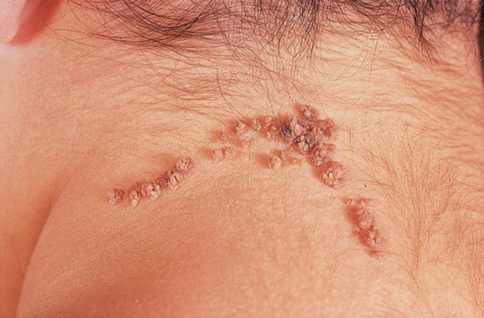
Verrucous epidermal nevus on neck

Slide 18
Diagnosis
Lack of inflammation
Presence at birth
Warty ; brown appearance
Persistent

Slide 19
Non-Epidermolytic VEN
Mosaic Chr 06 Trisomy
FGFR3 Mutation
Assoc with PIC3CA and PTEN mutations
Significant Malignant Potential > 40 yrs
Associated with extracutaneous manifestations

Slide 20
Clinical Features
Present at birth / childhood / 55 yrs of age
Crusted, hyperkeratotic plaques on the head and upper trunk
Birth white macerated appearance pink /slightly pigmented, velvety streaks or plaques→ darken and the surface becomes more warty
Flexural lesions → macerated and foul smelling

Slide 21
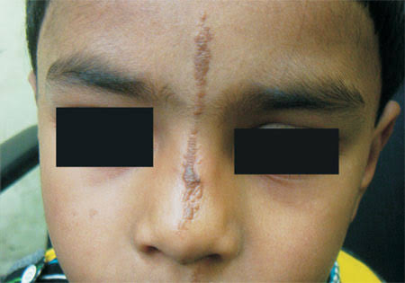

Slide 22
Associations
Nail fold → Paronychia / ridging / splitting / discoloration or dystrophy
Wooly-Hair
Megalopinna
Aplasia Cutis
Epidermal Nevus Syndrome
Proteus Syndrome

Slide 23
HPE
Hyperkeratosis ; Columns of Parakeratosis
Acanthosis, Papillomatosis, Focal hypergranulosis
10% of lesions show a distinctive ‘church-spire’ pattern of acanthosis and hyperkeratosis, resembling acrokeratosis
verruciformis
5% show features resembling seborrhoeic keratoses, that is hyperkeratosis, papillomatosis, acanthosis and horn pseudocysts
Immature adnexae (hair follicles, sebaceous, eccrine or apocrine glands)

Slide 24
Differential diagnosis
Naevoid psoriasis
Lichen striatus

Slide 25
Topical applications
SA / LA / RA preparations → Decrease Hyperkeratosis
Podophyllum
5-fluorouracil
calcipotriol and calcitriol
Systemic retinoid therapy. Isotretinoin / etretinate / Acitretin can →
reduction of hyperkeratosis (in epidermolytic lesions)
Dermabrasion

Slide 26
Lasers
overcomes problems such as hypertrophic scarring, pigmentary changes and partial recurrence
Argon laser is helpful for softer, less hyperkeratotic lesions
Continuous-wave CO2 laser vaporization → Extensive VEN
Pulsed CO2 → thinner and softer VEN
Er:YAG lasers with greater coagulative capacity – Lower recurrence
Pulsed Ruby Laser
Surgery
Multi-modal, Multi-stage Dermis removal only effective

Slide 27
Nevus sebaceous
Epidermal hamartomas comprised predominantly of sebaceous glands.
Syn: Nevus sebaceous of jaddasohn
Most common site head & neck
Most commonly sporadic ;may be inherited.
The etiology is unknown, but recent studies point to a possible link with mothers positive for the human papilloma virus (4) or mutations in the pat-ched gene (PTCH).

Slide 28
clinical stages
1.Prepubertal : Hairless solitary, circumscribed, yellowish- orange ,smooth,velvety plaques on the scalp/face
Remain unchanged till puberty
2.Postpubertal: Pubertal expansion, characterized by rapid growth of the nevus due to hormonally driven development of sebaceous glands and maturation of apocrine glands
Nevus becomes thickened, larger, waxy/greasy & more nodular
3.Neoplastic change.:Benign & malignant lesions can occur

Slide 29
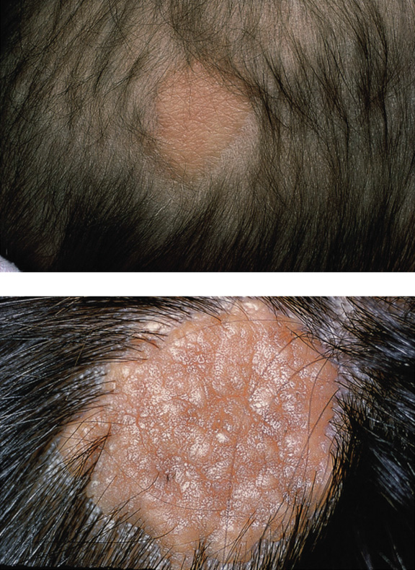
Nevus sebaceous in an infant & adult

Slide 30
Neoplastic change
10-30% of lesions.
Syringocystadenoma papilliferum n trichoblastoma is the most common benign tumour
Verruca 2% cases ,Syringoma, apocrine cystadenoma, trichilemmoma , pilomatricoma,nodular hidradenoma,keratoacanthoma
Malignancy seen in 5%,usually in the middle age
BCC most common malignant neoplasm as followed by SCC, sebaceous apocrine & eccrine carcinomas have all been documented
Rapid increase in size,nodulation,ulceration lead to suspicion of malignancy

Slide 31
Histopathology
Stage1:prepubertal lesions
Shows multiple underdeveloped sebaceous glands & hair follicles
↓
Stage 2: post pubertal lesions
There is massive development of sebaceous glands & maturation of apocrine glands
Malformed hair roots seen as buds of basaloid cells ↓
Stage3: neoplastic change
Characterised by benign & malignant tumours

Slide 32
Epithelial hyperplasia is associated with poorly formed hair follicles and prominent, but mature, sebaceous glands. Apocrine glands are seen focally.

Slide 33
Differential Diagnosis
In early infancy, lesions in the scalp must be distinguished from aplasia cutis, which has a smoother papyraceous surface
Syringocystadenoma papilliferum.
Juvenile xanthogranulomas ( generally develop rapidly into distinctive domed, papular or nodular lesions.)
Solitary mastocytomas.
Viral warts

Slide 34
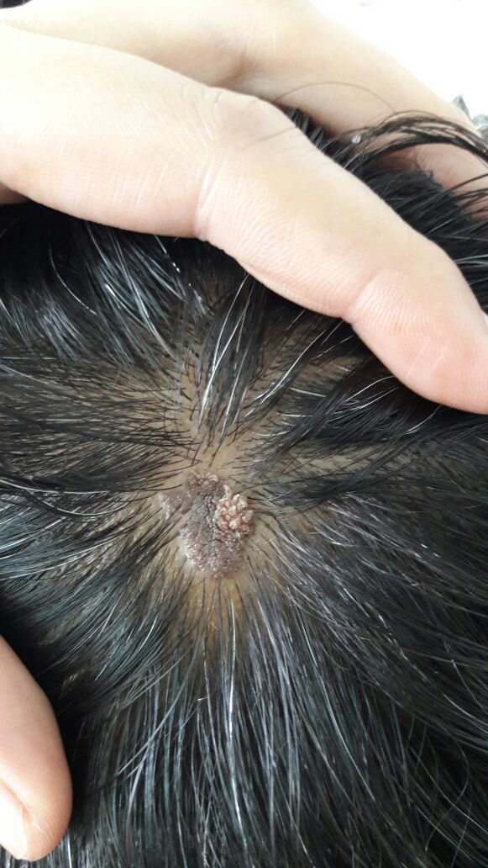
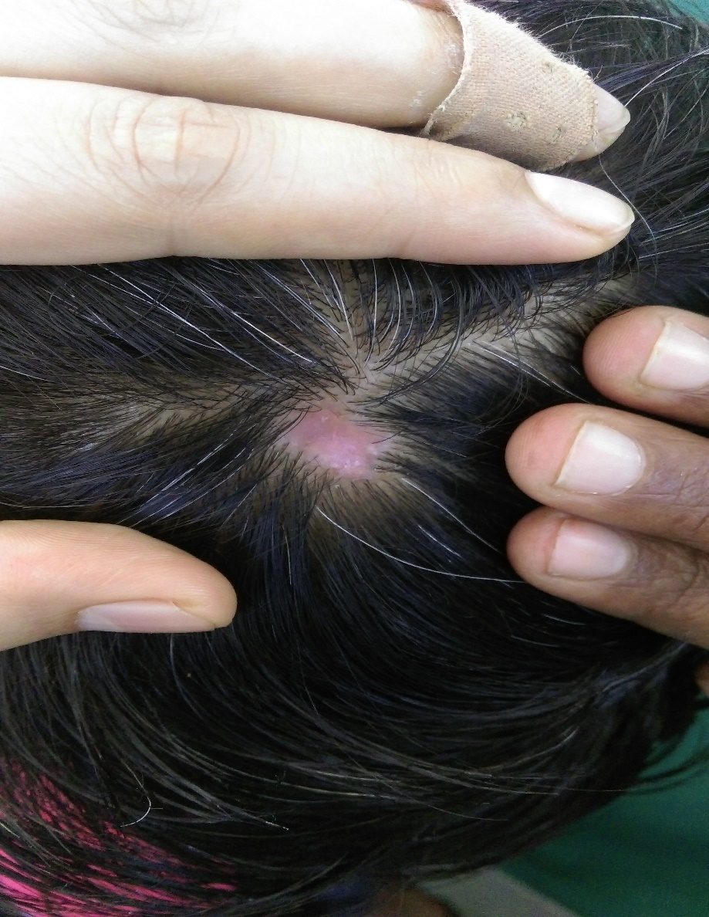

Slide 35
Treatment
Mainly for cosmetic purposes
Prophylactic surgical excision is often recommended b/c of potential for neoplastic transformation

Slide 36
True hair follicle nevus
Congenital vellous hamartoma
Congenital hamartoma comprising excessive concentration of normal hair follicles
Small skin colored papule over face present since birth
Histologically: well differentiated small but numerous vellous hairs in dermis ,& some sebaceous glands & eccrine glands
Treatment is by simple excision

Slide 37
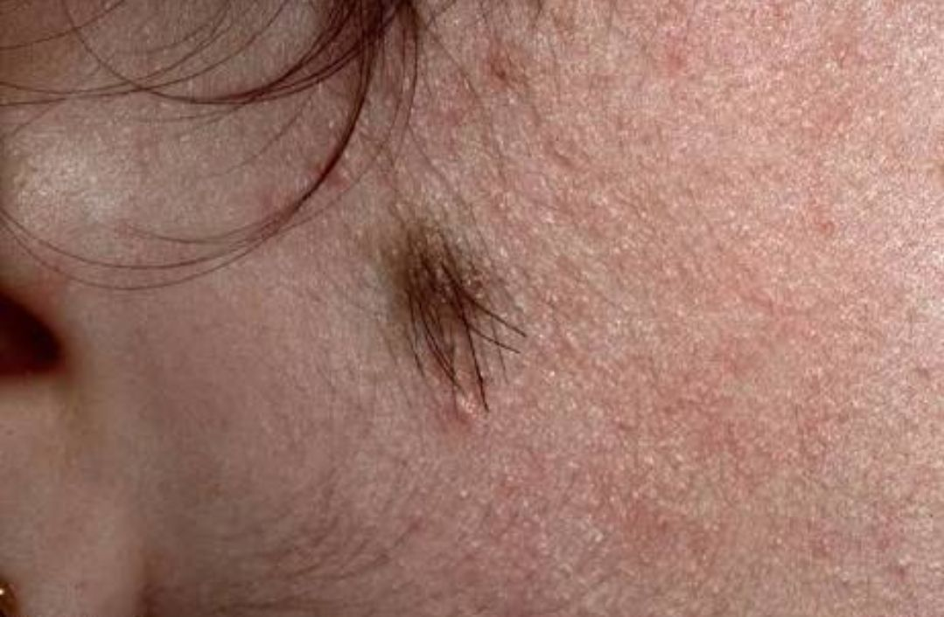

Slide 38
Comedone nevus
Follicular nevus,nevus comedonicus,ance nevus, comedone nevus
First described by Koffman in 1895
Linear lesion comprising numerous keratin filled pits ,sometimes with acneiform pustules
Developmental defect of the pilosebaceous apparatus characterised by inability to produce properly formed hair matrix cells or sebaceous glands

Slide 39
Individual lesions are large comedones often arranged in groups or in linear pattern
Usually present at birth ,can be located anywhere on the body
Lesions can be linear, segmental, unilateral or bilateral ,and rarely extensive
Palmar /plantar comedo nevi are usually contigous with lesions on the hair bearing areas
M=F ,no change in the lesion with menstruation ,pregnancy / menopause
May be familial with AD inheritance, ass .with epidermal nevus syndrome

Slide 40
Comedone nevus

Slide 41
Histology
Aggregation of deep, wide, invagination of acanthotic epidermis filled with concentrated lamellae of keratin.
Dilatation of hair follicles with rudimentary sebaceous glands.
Arrector pili muscles are absent.
The interfollicular epidermis may be histologically normal, acanthotic and hyperkeratotic .

Slide 42
Differential diagnosis
Basal cell nevus with comedones
Linear basal cell nevus
Hair follicle nevus/trichofolliculoma
Basaloid follicular hamartoma
Nevus sebaceous
Scarring following herpes zoster & atrophoderma vermiculatum.
Extensive comedones due to chloracne and sun damage are distinguishable from comedo naevus by their non-linearity

Slide 43
Treatment
Topical keratolytic agents
Comedone extraction
Dermabrasion
Excision of smaller lesions
Co2 laser ablation
Tissue expansion in extensive lesions.
Tacalcitol, and tazarotene 0.05% with calcipotriene 0.005% .
Oral isotretinoin
Intralesional steroids for inflammed lesions

Slide 44
Basal cell nevus with comedones
AD disorder characterized by multiple basaloid follicular hamartomas present at birth or appearing in childhood that resemble BCCs .
Multiple milia-like and comedo-like lesions, ﬂesh-colored to hyperpigmented papules, hypotrichosis, hypohidrosis, and palmar and/or plantar pits.
The pits are tinier than those of NBCCS; predominantly concentrated in the central palms/soles and microscopically characterized by focal thinning of the stratum corneum overlying malformed acrosyringium.

Slide 45
Clinical features
Benign,localised / extensive nevus generally present at birth.
Linear forms consist of numerous ,transluscent/brown nodules/plaques which demonstrate central ulceration with areas of macular hypopigmentation ,cyst, verrucous papules, BCC, stria like areas of cutaneous atrophy.
Solitary plaque like lesion occur in scalp with focal alopecia

Slide 46
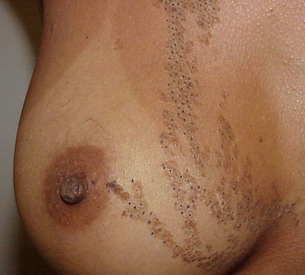

Slide 47
Pathology
Anastomosing strands of well defferentiated basaloid /squamoid cells extending from upper portions of follicles into loose connective tissue
Basaloid cells are mature with well developed tonofilaments & desmosomes on EM
Trichoblastomatous proliferation can be distinguished from basal cell carcinoma by its low proliferative index (Ki-67 expression) and by circumferential expression of CD34 around the epithelial strands.

Slide 48
Linear basal cell nevus
Basal cell nevus with comedones
Linear collection of macules & papules .
Histologically similar to BCC
May reflect mosaicism for Gorlin’s syndrome
Clinical features: U/L smooth /warty papules;skin tag like lesions & occasionally comedones;occur in linear distribution
Site-trunk/limb
Pathology: basaloid proliferation; peripheral palisading & surface erosion as seen in BCC

Slide 49
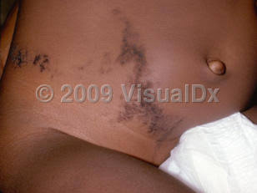
Linear basal cell nevus

Slide 50
True apocrine naevi
Apocrine gland hamartoma
Variable clinical appearance: solitary nodules on the scalp
Pigmented vulval papules,plaque on face
B/l soft tumors in axillae/upper chest.
In a patient with focal dermal hypoplasia, the lesions comprised multiple papules in the sternal area.
Hitology: mature apocrine glands extending from upper dermis to subcutaneous fat ,
Decapitation secretion & PAS +VE diastase resistant differentiate apocrine from eccrine gland differentiation

Slide 51
Syringocystadenoma papilliferum
(Naevus cystadenomatous papilliferus)
Uncommon adnexal hamartoma of sweat duct origin-apocrine+eccrine
Mutations in PTAH & P16 tumour suppresor gene.
Presents as solitary plaques /papules in a linear arrangement
Site-scalp;head & neck
50% present at birth; 15% develop in infancy
1/3 lesions develop along with nevus sebaceous on the scalp.

Slide 52
A mature lesion comprises clusters of pinkish brown nodules 2–10 mm in diameter, which are domed, umbilicated or pedunculated, often with a friable or crusted surface.
Several lesions may be scattered over an area.
Papillimatous/verrucous changes may occur at puberty

Slide 53
Syringocystadenoma papilliferum

Slide 54
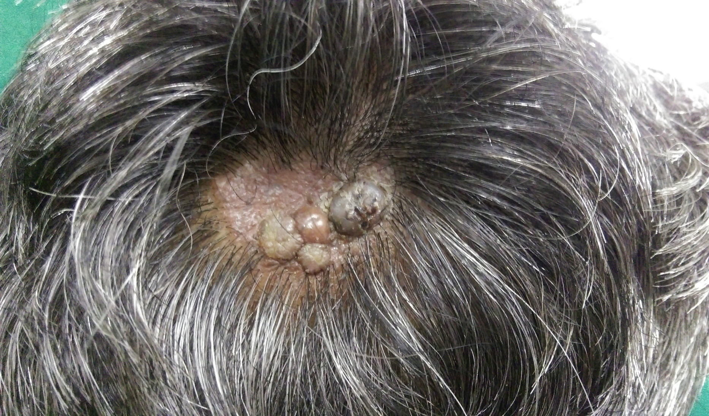

Slide 55
PATHOLOGY
Cystic invaginations extend downwards from a papillomatous epidermis, with numerous villous projections extending into the lumen.
A plasma cell infiltrate in the stroma of the papillary projections.
Syringocystadenoma papilliferum shows focal positivity to CK15, a relatively specific marker of hair follicle stem cells in the bulge

Slide 56
Eccrine naevi
True eccrine naevi
Nevus sudoriferous; sudoriferous hamartoma
Present as solitary pore discharging mucus; a localised area of diffusely increased sweat production; a single plaque or multiple depressed brown patches; all showing prominent eccrine structures on biopsy

Slide 57
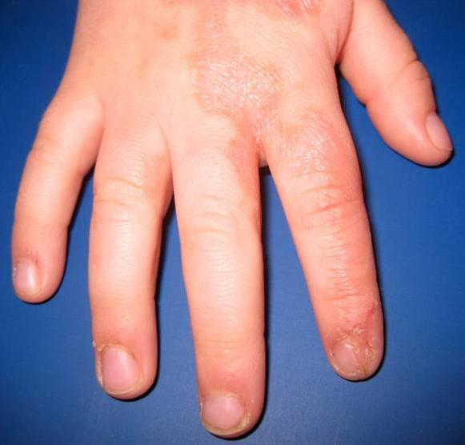
True eccrine nevus

Slide 58
Eccrine angiomatous hamartoma[nevus]
Present at birth/later in life
Proliferation of eccrine secretory coils & ducts,surrounding capillary angiomatous channels& occasionally other elements
Single/multiple; flesh to reddish brown coloured/bluish or violaceous subcutaneous nodules on the trunk &extremities with or without hyperhidrosis
Painful on pressure.
Hyperhydrosis/hypertricosis may be seen

Slide 59
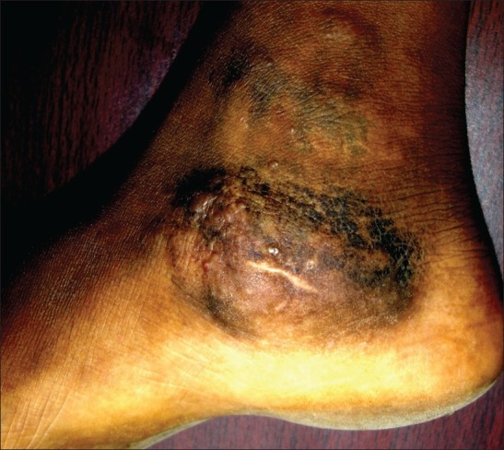
Eccrine angiomatous hamartoma

Slide 60
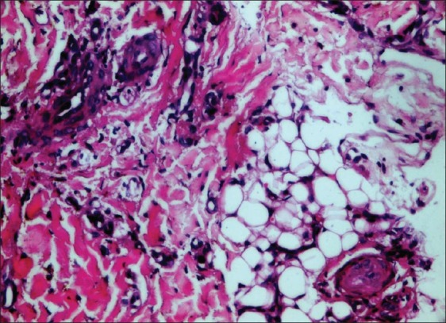
Sites: palms ,soles,face,trunk
Histopathologically
large eccrine glands lie in loose fibrous tissue in association with enlarged vascular elements

Slide 61
Porokeratotic eccrine ostial and dermal duct naevus
It usually appears in the first year of life and is considered a
form of linear porokeratosis involving the acrosyringium and
acrotrichium.
Typical sites :palms and soles.
Lesions may be verrucous, extensive, anhidrotic/ hyperhidrotic.
Palmoplantar PAON : asymptomatic persistent punctate pits with keratotic plugging resembling nevus comedonicus.
PAON association :breast hypoplasia, scoliosis, deafness, developmental delay, polyneuropathy, and palmoplantar kerato- derma

Slide 62
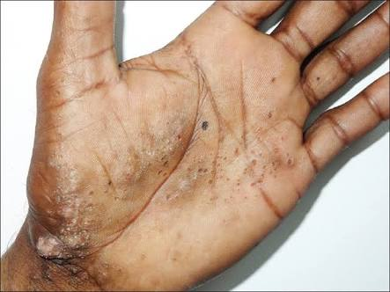
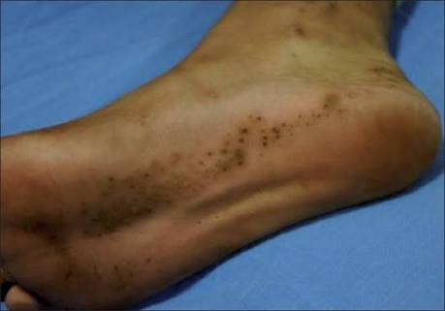

Slide 63
Filiform keratinous plugs that represent cornoid lamellae overlying dilated infundibula of eccrine ducts are a distinctive feature and abnormal dermal ducts are frequently present.
Histologically :
Focal cornoid lamellae are seen to overlie eccrine ostia and enlarged eccrine ducts with no involvement of glandular structures.
Another condition, ‘porokeratotic eccrine duct and hair follicle nevus’, is probably similar but with hair follicle involvement.
This condition should be differentiated from porokeratosis of Mibelli and comedo nevus.
No treatment is required except for cosmetic purposes.

Slide 64
Becker’s nevus
Becker’s melanosis; pigmented hairy epidermal nevus
Acquired & persistent area of skin pigmentation, sometimes showing evidence of increased androgen sensitivity & co-localizing with other developmental anomalies
Prone to acne/hypertrichosis
Familial occurance may be seen
May be pathologically related to congenital smooth muscle hamartoma ( hypertrichosis ,increase smooth muscle hyperpigmentation)

Slide 65
Becker’s nevus

Slide 66
Clinical feature
M:F=5:1
Rarely congenital/childhood;but usually first noticed in adolescence
Site: shoulders, anterior chest, scapular region. rarely face, neck, distal limbs
Starts as an area of irregular macular pigmentation, which spreads to a diameter of several cms; new macules developing beyond margin & fusing with it giving a geographical contour.
Skin may thicken towards centre of lesion
Increased terminal hairs appear on & around lesion

Slide 67
More prone to acne vulgaris, PV ,eczema, granuloma annulare, BCC, Lymphangioma, Hypohydrosis.
Lesion on face associated with asymmetric growth of scalp/beard hair.
Associated systemic developmental anomalies : Breast hypoplasia, supernumerary nipples, aplasia of PM, Limb reduction, segmental odontomaxillary dysplasia, lipoatrophy

Slide 68
Becker nevus syndrome-Becker nevus syndrome+ I/L non-cutaneous anomalies
Increades risk of Malignant melanoma

Slide 69
Pathology
Hyperkeratosis, acanthosis, papillomatosis with hyperplasia of hair follicles & sebaceous glands.
Basal & suprabasal keratinocytes are heavily pigmented
Melanocytes density increases/normal in upper dermis
Increased melanocyte activity and increased numbers of melanosome complexes in keratinocytes
Dermis thickened ,contains bundles of smooth muscle fibres.
Increase in number of androgen receptors

Slide 70
Regular elongation and widening of the bottoms of the rete ridges. The basal layer is hyperpigmented .

Slide 71
Treatment
Q-swithched LASER
Er-YAG LASER

Slide 72
Other naevoid epidermal disorders

Slide 73
Linear LP
Resembles LP in all respects but distribution.
Clone of susceptibility mutation
Any age & resolves leaving PIH.
If extends to end of digit-nail dystrophy
May have mucosal involvement
Unifocal/multifocal
Histology-lichenoid band like lymphohistiocytic infiltrate at DEJ + civatte bodies & dermal melanophages
Severe epidermal apoptosis

Slide 74
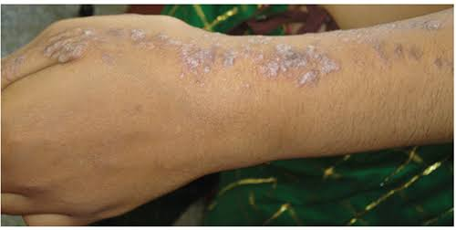
Linear lichen planus

Slide 75
Naevoid psoriasis
Reflecting mosaicism for gene responsible for psoriasis
Linear+ generalised psoriasis- loss of heterozygosity for psoriasis gene/invasion of VEN by psoriasis as a result of isomorphic phenomenon
Onset-childhood/congenital
Clinically & histologically similar to psoriasis
Associated with nail pits & psoriatic arthritis
Differentiated from ILVEN :less pruritic & therapeutic
responsiveness.

Slide 76
Treatment
Dithranol
Ultraviolet rays therapy
Infliximab

Slide 77
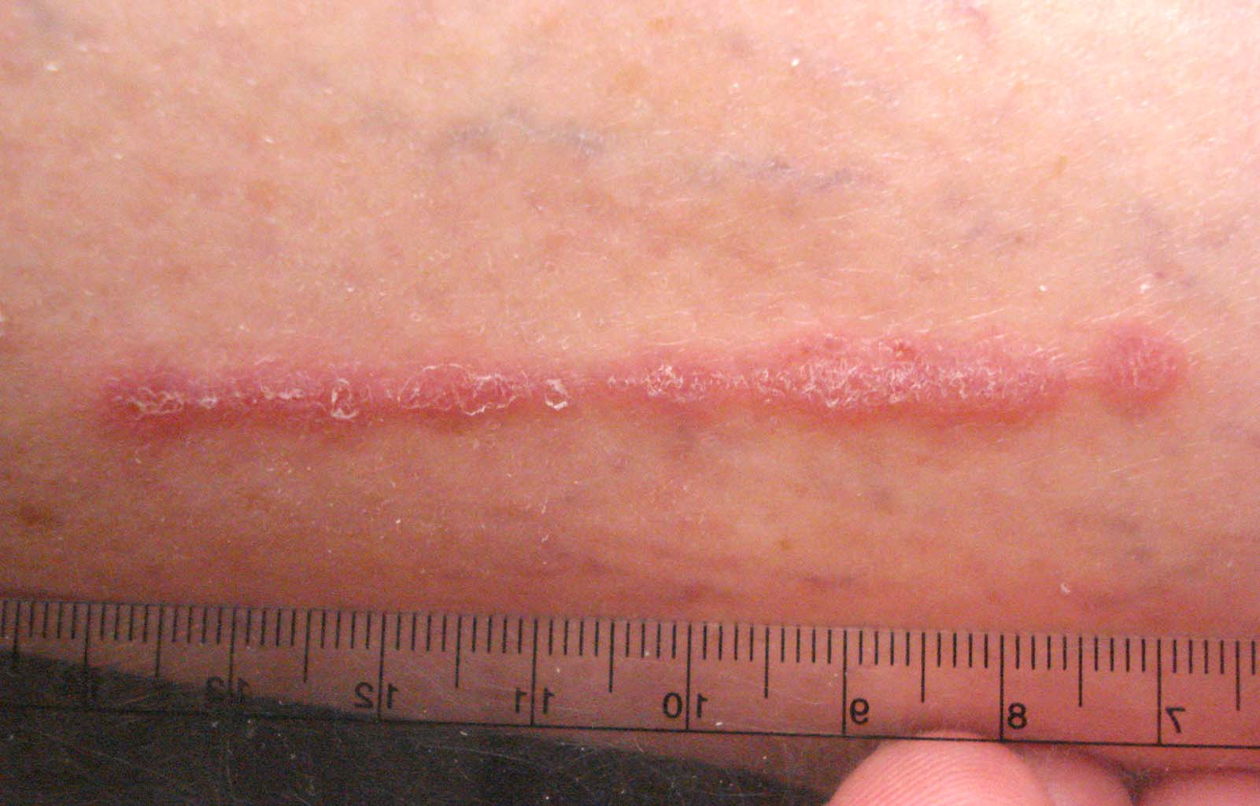
Naevoid psoriasis

Slide 78
Linear Darier’s disease
Acantholytic epidermal naevi comprising crusted keratotic papules clinically & histologically similar to Darier’s disease with no family history.
Usual age of presentation > 20years
Lesions extend over many years
Aggravated by UV rays
If affected area includes nails- typical nail changes of Darier’s may be seen

Slide 79
If hands affected-pits ,keratoses observed within involved gene
Represents mosaicism for Darier’s- mutation in ATP 2A2
TREATMENT
Topical retinoids
Oral acitretin

Slide 80
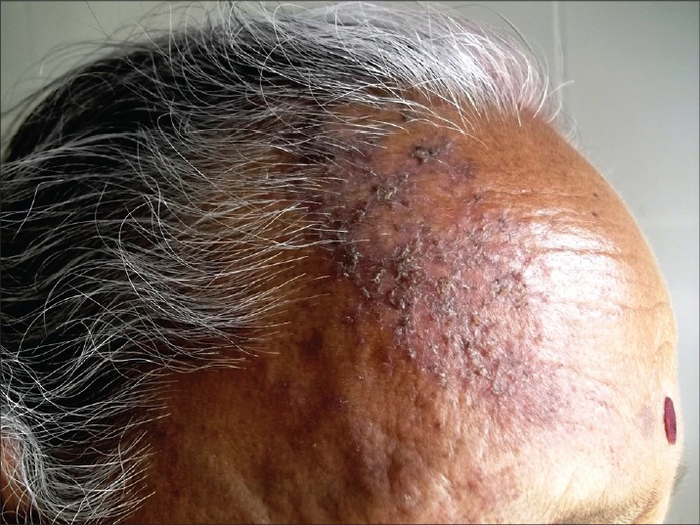
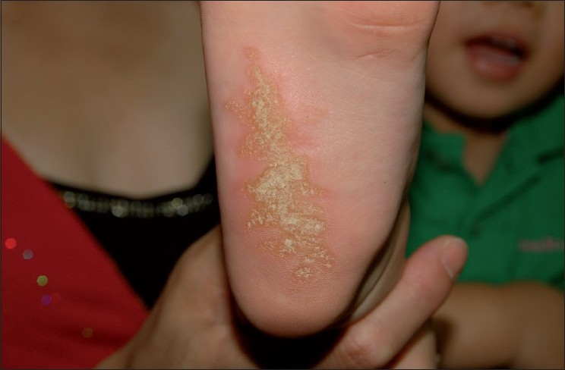
Linear darier’s disease
right side of forehead extending into scalp

Slide 81
Linear Hailey-Hailey disease
linear acantholytic dermatoses,linear benign familial chronic pemphigus
Mosaicism for mutation in Hailey-Hailey gene ATP2C1
More severe and earlier onset disease
More common in flexures/perianal area
Well defined linear erythematous plaques demonstrating vesiculation ,erosion ,crusting ,& typical histological features of benign familial chronic pemphigus

Slide 82
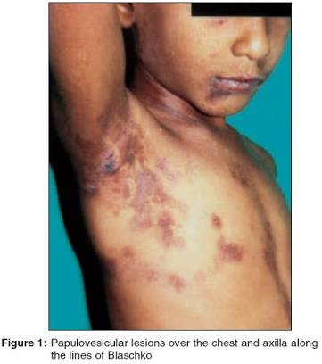
Linear Hailey-Hailey disease

Slide 83
Linear porokeratosis
Annular plaques distributed along blascko lines; clinically & histologically similar to lesions of porokeratosis
Mosaicism for gene responsible for porokeratosis
Generalised porokeratosis is AD but linear is sporadic
Individual with inherited generalised porokeratosis undergoes somatic mutation affecting normal allele resulting in clonal loss of heterozygosity
Resulting line contrasts with background skin because it has double dose of parakeratosis

Slide 84
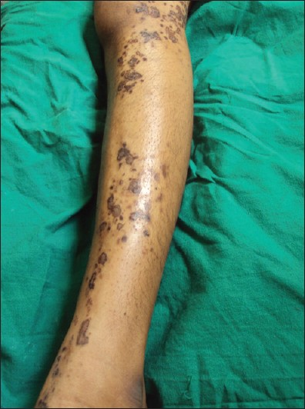
Linear porokeratosis

Slide 85
skin cancers associated with linear porokeratosis-SCC,Bowen’s
Generalised porokeratosis provoked by immune suppression
Linear porokeratosis exacerbated by liver failure

Slide 86
Clinical features
Grouped ,confluent hyperkeratotic plaques each with a fine rounded annular rim & atrophic centre.
Lesions hypo/hyper pigmented & erythematous, disposed in an interrupted linear fashion along Blaschko’s lines.
Widespread /soles / face.
Lesions on distal limb associated with nail dystrophy( pterygium & long ridging,bony narrowing of digits)
At birth-ulcerated lesions
Course lifelong with increasing hyperkeratosis

Slide 87
Treatment
Surgical excision
Ablation with the carbon dioxide laser
Cryotherapy
Dermabrasion
Topical
5-FU
Tretinoin
5% imiquimod
VitaminD anologues
Urea
Dithranol

Slide 88
Linear atrophoderma of Moulin
Clearly demarcated cutaneous atrophy & hyper/hypo pigmentation with minimal inflammation & sclerosis distributed along Blaschko’s lines.
Histology-variable atrophy+ some inflammation.
Childhood/adolescence
Variability in presentation- some cases are linear variant of atrophoderma of Pierini & Pasini, mosicism for COL3A1 mutation[EDS type 4 ], late burnt out stage of linear morphea

Slide 89
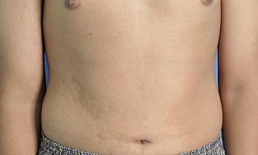
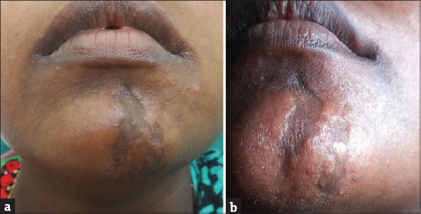
Linear atrophoderma of moulin

Slide 90
Acute blaschkitis
BLAISE , Blaschko Linear Acquired Inflammatory Skin Eruption
Remitting/relapsing eruption of itchy inflammatory vesicles & papules usually on trunk in adults
Histology- eczematous [spongiotic]> lichenoid
May appear after treament with metronidazole

Slide 91
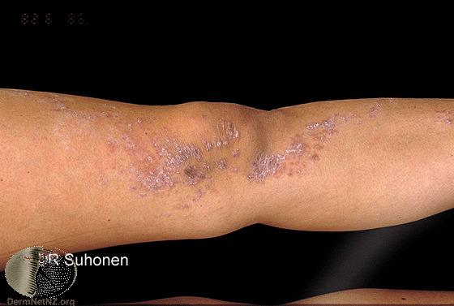
Acute blaschkitis

Slide 92
Epidermal nevus syndromes

Slide 93
Epidermal nevus syndromes
Hopple –Described 9 distinct epidermal nevus syndromes differentiated by associated epidermal nevi & presence or absensce of heritability
A correct diagnosis of these various phenotypes is important for the recognition & treatment of associated anomalies as well as for genetic counselling
Syndromes with organoid epidermal nevi-
1.Schmmelpenning syndromes
2. Phakomatosis pigmentokerotica
3. Nevus comedonicus syndrome
4. Angora hair nevus syndrome
5. Becker nevus syndrome

Slide 94
syndromes with keratinocytic[non-organoid] nevi-
1.CHILD syndrome
2. Type -2 segmental cowden disease
3.Fibroblast growth factor receptor syndrome
3 Epidermal nevus syndrome
Proteus syndrome is still of unknown origin
Less well –defined epidermal nevus syndromes :
CLOVE syndrome
Nevus trichilemmocysticus
Didymosis aplasticosebacea
Balverstedt syndrome
SCALP syndrome
NEVADA syndrome

Slide 95
schimmelpenning,’s syndrome
Fennerstein –mims syndrome ; Nevus sebaceous syndrome ; Jaddasohn’s naevus phakomatosis
First reported by Feurstein & Mims & Schimmelpenning
Describes association of sebaceous / VEN with other developmental defects , particularly CNS , eye & skeleton

Slide 96
Etiology
Sporadic disorder reflecting genetic mosaicism for an AD mutation which would be lethal if not rescued by mosaicism
Occurence in successive generations explained by inheritance of a premutation, or by loss of heterozygosity for a recessive mutation [paradominant inheritance]

Slide 97
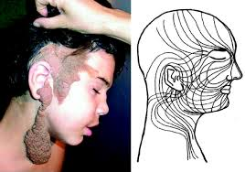

Slide 98
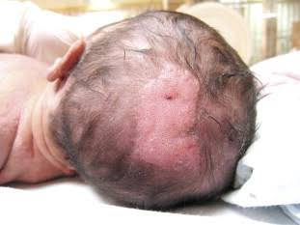

Slide 99
Cutaneous | Extrautaneous
Nevus sebaceous | Skeletal - craniofacial defects, frontal bossing, Kyphoscoliosis, Dislocation of hip,deformitis of limbs, Hypophosphatemic rickets
 | Neurological -MR[50%], Seizures , Hemimegancephaly , Spastic paralysis, Cerebral angiomas , Agenesis of corpus callosum
 | Ocular- Epibulbar lipodermoid Coloboma , Corneal opacity , cataract micro & macro-ophthalmia defects of optic nerve

Slide 100
Diagnosis
Epidermal nevus syndrome overlaps with other syndromes characterised by VEN such as Proteus syndrome, nevus comedonicus syndrome & phakomatosis pigmentokerotica
CNS lipomas may lead to confusion with encephalocraniocutaneous lipomatosis

Slide 101
Phakomatosis pigmentokerotica
Sebaceous nevus & a contralateral speckeled lentiginous nevus of papular type, associated with skeletal or neurological abnormalities
Hemiatrophy is a common finding in all cases
Hyperpathia ,dysesthesia, hyperhydrosis,mental deficiency, seizures,& other neurological defects may be present.
Concept of melanocytic epidermal twin spotting explains pathogenesis of this entity

Slide 102
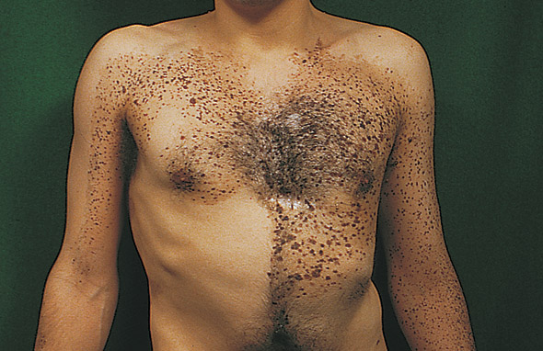
Phakometosis pigmentokerotica

Slide 103
Nevus comedonicus syndrme
Ipsilateral ocular ,skeletal or neurological syndromes
Cataract on affected side is diagnostic
Syndactyly ,polydactyly
Verebral defects ,scoliosis
Less frequently microcephaly can be noted

Slide 104
Angora hair nevus syndrome
Broad ,band- like orientation of linear epidermal nevus covered with smooth .long, white-pale hairs & growing out from dilated follicular pores
Extracutaneous feature include skeletal, neurological ,& ocular defects

Slide 105
Type-2 segmental cowden disease
Associated with linear cowden nevus & multisystem manifestations
PTEN mutation
Nevus is thick,soft, & papillimatous
Connective tissue nevi & vascular nevi.
Association: hemihypertrophy , asymmetrical limb growth ballooning of toes , macrocephaly , seizures , intestinal polyps & focal glomerulosclerosis

Slide 106
Garcia –Hafner-Happle syndrome
Fibroblast growth factor receptor 3 epidermal nevus syndrome.
Nevus is a systematized non-epidermolytic soft , velvety epidermal nevus.
Extracutaneous manifestations are cerebral with cortical atrophy, seizures & MR
Caused by mosaic R 48C mutation of FGFR3 gene
Management-careful clinical assessment of all involved systems.
Basic IQ & DQ testing & radiological tests to be done

Slide 107
Thank you

