Slide 1
Molecular basis of muscle contraction

Slide 2
Excitation of muscle fiber causes development of action potential (ELECTRICAL PHENOMENON)
which through sequence of events produces muscle contraction (MECHENICAL PHENOMENON).
These two phenomenon are couples together by coupling agent Ca⁺⁺
Therefore, the process by which depolarization of muscle fiber initiates contraction is called as
Excitation-Contraction Coupling

Slide 3
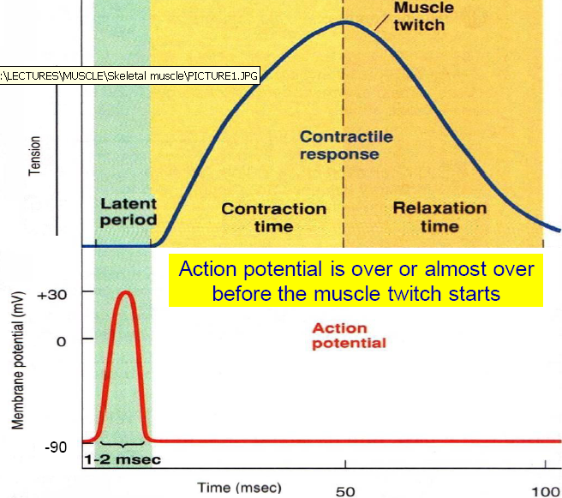
Ca++
Ca++
Ca++
Ca++

Slide 4
Actin and myosin are often called contractile proteins.
Active sites on the normal actin filament of relaxed muscle are inhibited or actually physically covered by the troponin- tropomyosin complex.
A pure actin filament without the presence of troponin-tropomyosin complex binds strongly with myosin molecules, in the presence of Magnesium and ATP.

Slide 5
For contraction to take place the inhibitory effect of the T-T complex must itself be inhibited, done by Calcium ions
Calcium ion combines with troponin-C, the Troponin complex undergoes conformational change allowing the contraction to proceed.

Slide 6
Cross-bridge interaction between actin and myosin brings about muscle contraction by means of the
“Sliding Filament theory”
of
A F Huxley and H E Huxley-1954
“Walk-Along Theory of Contraction”

Slide 7
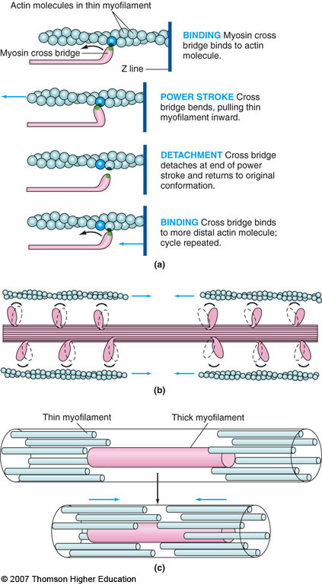

Slide 8
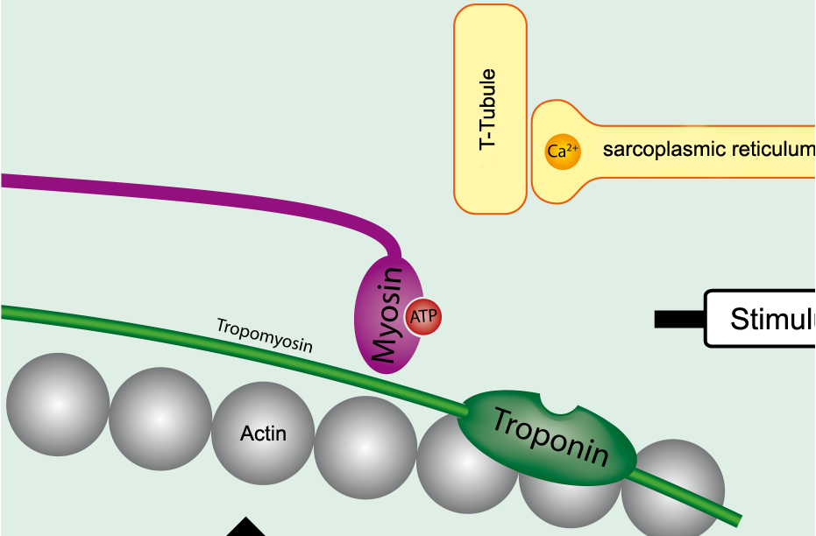
1. Resting Muscle

Slide 9
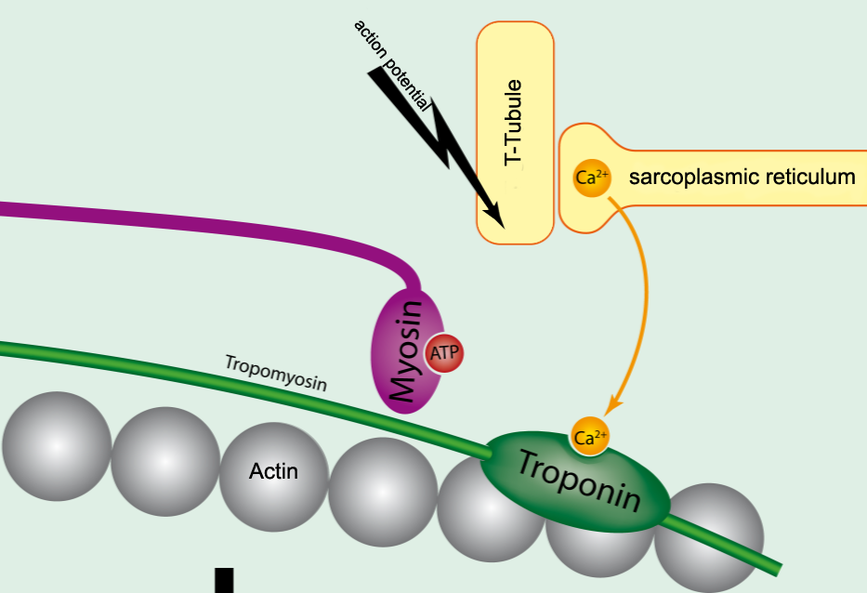
2. Excitation at NM junction

Slide 10
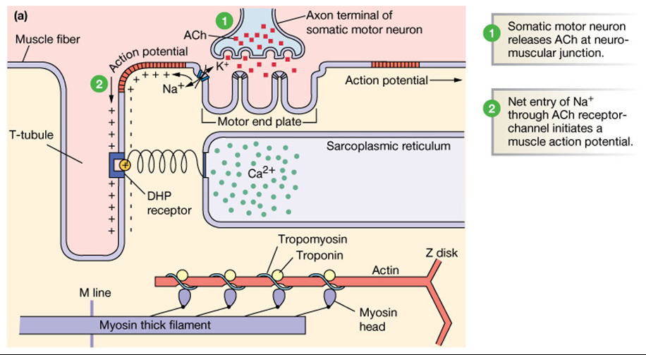
Notes:
Excitation-contraction coupling….

Slide 11
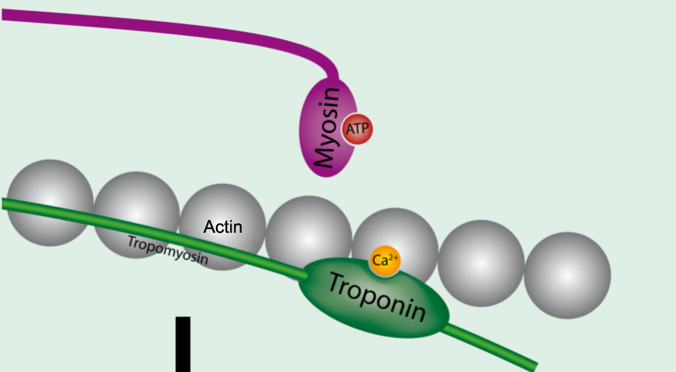
3. Conformational change in T-T complex

Slide 12
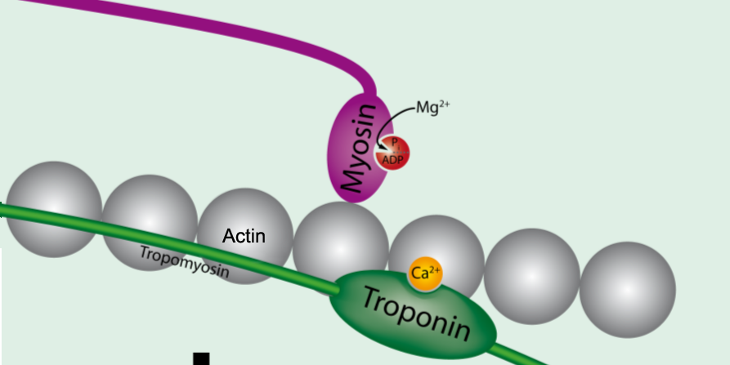
4. Binding of Actin-Myosin
ATP

Slide 13
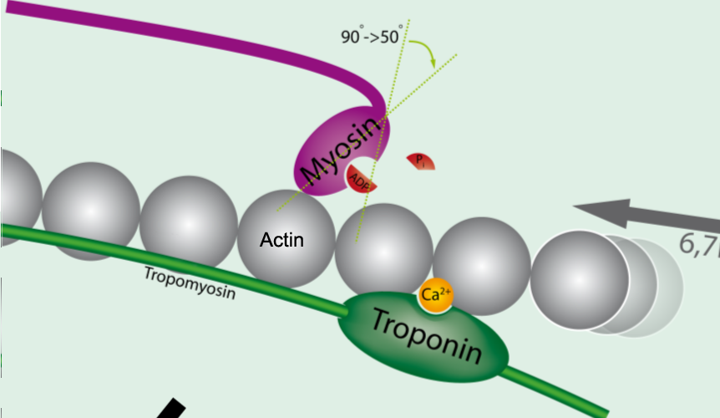
5. Power Stroke

Slide 14
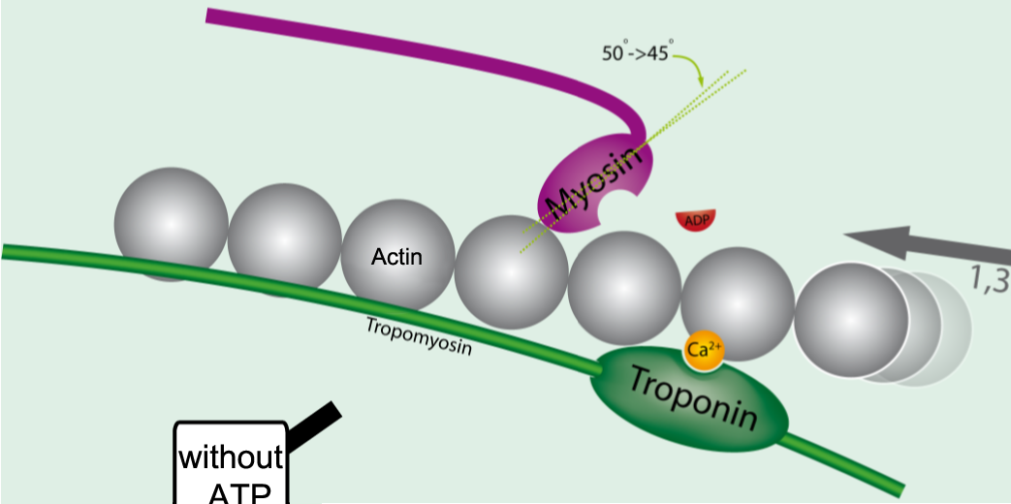

Slide 15
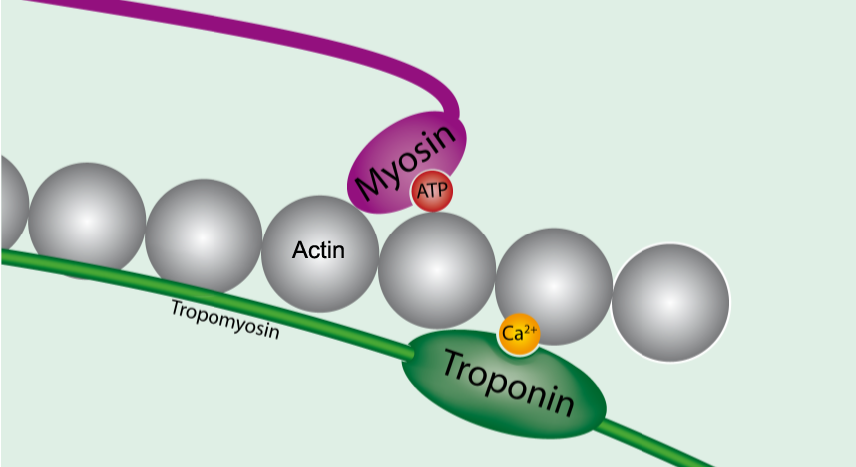
6. Binding of ATP

Slide 16
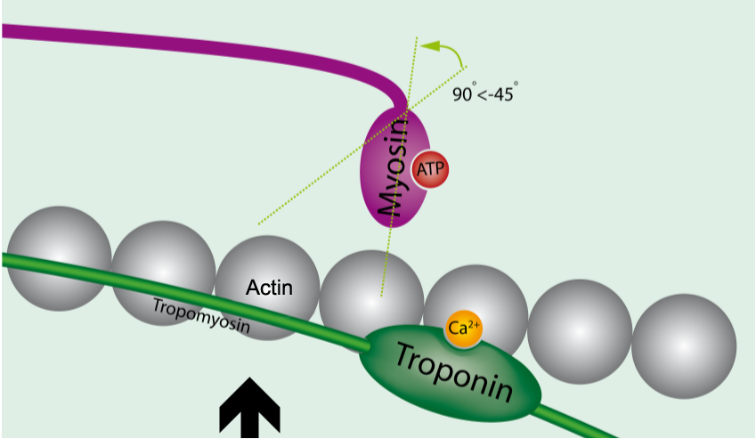
7.Detachment of Myosin and Actin

Slide 17
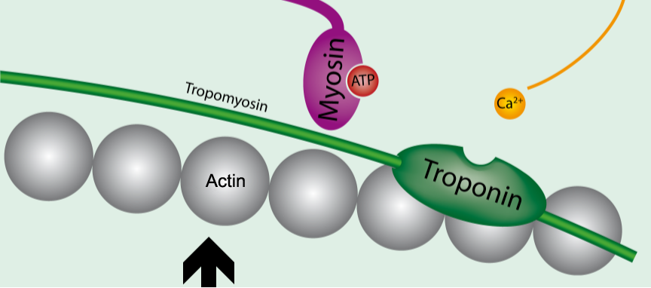
8. Calcium Detachment

Slide 18
9. Calcium back to L-tubule

Slide 19
Increase in Ca²⁺ starts filament sliding
Decrease in Ca²⁺ turns off sliding process
Thin filaments on each side of sarcomere slide inward over stationary thick filaments toward center of A band during contraction
As thin filaments slide inward, they pull Z lines closer together
Sarcomere shortens

Slide 20
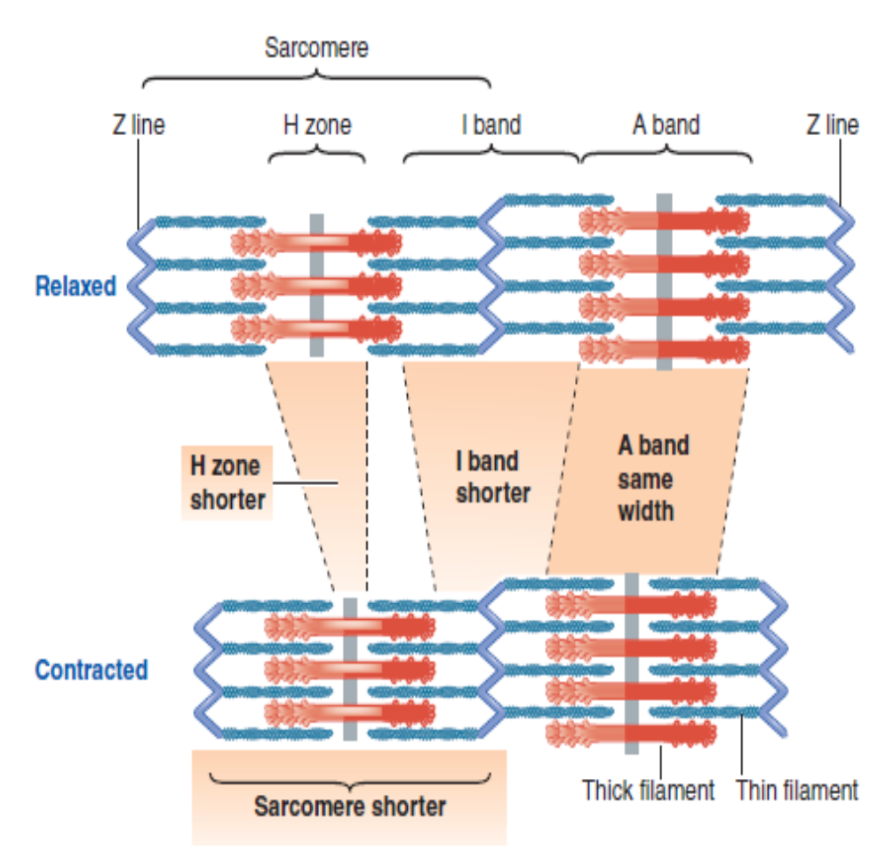

Slide 21
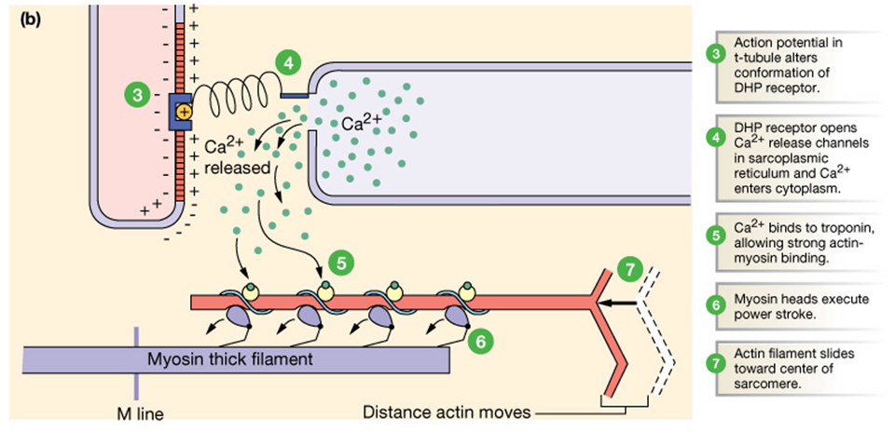

Slide 22
Steps in relaxation:
Ca²⁺ pumped back into Sarcoplasmic Reticulum (SR) by the ATP-dependant Ca²⁺ pump in SR membrane.
Release of Ca²⁺ from troponin C.
A new ATP binds to the myosin head
↓
interaction between actin and myosin STOPS and RELAXATION of the muscle fiber takes place.

Slide 23
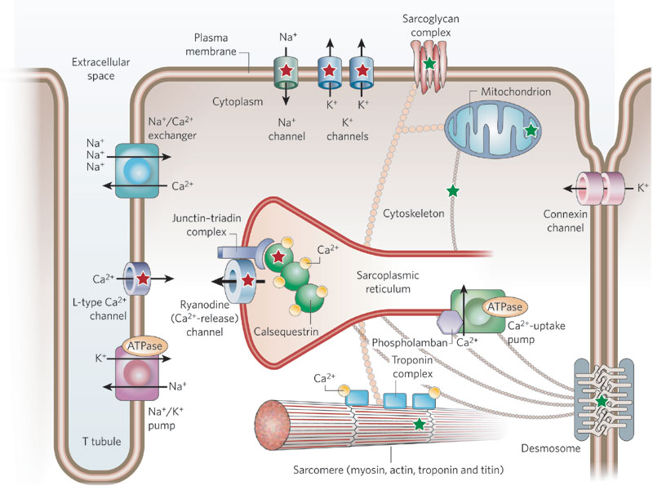
Notes:
The t-tubule and the cistern of the SR….

Slide 25
RIGOR MORTIS

Slide 26
RIGOR MORTIS
Definition:
It is one of the recognizable signs of death in which several hours after death, all the muscles of the body go into a state of irreversible rigidity and contracture called Rigor Mortis. The body then becomes difficult to move or manipulate.
On Microscopy:
Continuous Actin-Myosin interaction.

Slide 27
Mechanism:
Absence of ATP→ No reuptake of Ca²⁺ into the SR as Ca²⁺ uptake also requires ATP-dependant Ca²⁺ pump → Ca²⁺ level of sarcoplasm ↑ →continued binding of Ca²⁺ to Troponin C →Abnormal, rigid and uninterrupted contraction.
No ATP →No relaxation a new molecule of ATP must attach to the myosin head for detachment of actin- myosin interaction →thus, when NO ATP is present, then myosin heads cannot detach themselves from actin.

Slide 28
Time Taken:
In humans, it commences after about three to four hours after death,
reaches maximum stiffness after 12 hours, and gradually dissipates until approximately 48 to 60 hours (three days) after death.
Warm conditions can speed up the process of rigor mortis.
When does Rigor Mortis end:
when contractile proteins of the muscle like other body tissues undergo autolysis caused by enzymes released by lysosomes.

Slide 29
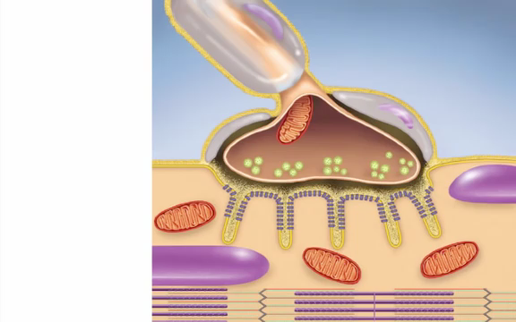

Slide 30
1. How many ATP’s are required in one cross bridge cycle formation during muscle contraction
a.1 b. 2 c. 3 d.5
2. During contraction angle between myosin head and tail reduced with the use of one ATP K/as
a. Power stroke b. power kick c. power hit d none
3. What for is the ATP molecule required in a sliding filament mechanism
a. Contraction b Relaxation
c. contraction and relaxation d after relaxation
4. Excitation and Contraction in muscle fibre coupled by
a. Ca⁺⁺ b. Na⁺ c. K⁺ d. Cl⁻
5. Theory of Cross-bridge interaction between actin and myosin brings about muscle contraction is
a. Huxeley Theory b. Walk along theory
c. sliding filament theory d all

Slide 31
EBES
EVIDENCE 2
How muscle fiber lengths and velocities affect muscle force generation as humans walk and run at different speeds
Edith M. Arnold,
Samuel R. Hamner,
Ajay Seth,
Matthew Millard,
Scott L. Delp. J Exp Biol . June 2013, 216, 2150-60

Slide 32
How muscle fiber lengths and velocities affect muscle force generation as humans walk and run at different speeds
Ref. | Problem | intervention | outcome | result
Edith M. Arnold, Samuel R. Hamner, Ajay Seth, Matthew Millard, Scott L. Delp. J Exp Biol . June 2013, 216, 2150-60 | It is unknown, however, whether the lengths and velocities of lower limb muscle fibers substantially affect the ability of muscles to generate force during walking and running. | they examined by developing simulations of muscle–tendon dynamics to calculate the lengths and velocities of muscle fibers from electromyographic recordings of 11 lower limb muscles and kinematic measurements of the hip, knee and ankle made as five subjects walked at speeds of 1.0–1.75 m s⁻¹ and ran at speeds of 2.0–5.0 m s⁻¹. they analyzed the simulated fiber lengths, fiber velocities and forces to evaluate the influence of force–length and force–velocity properties on force generation at different walking and running speeds. | The simulations revealed that force generation ability (i.e. the force generated per unit of activation) of eight of the 11 muscles was significantly affected by walking or running speed. Soleus force generation ability decreased with increasing walking speed, but the transition from walking to running increased the force generation ability by reducing fiber velocities. | The influence of soleus muscle architecture on the walk-to-run transition and the effects of muscle–tendon compliance on the plantarflexors' ability to generate ankle moment and power. The study presents data that permit lower limb muscles to be studied in detail by relating muscle fiber dynamics and force generation to the mechanical demands of walking and running

Slide 33
Thank you

