Slide 1
Hidradenitis suppurativa

Slide 2
Hidradenitis suppurativa, also known as acne inversa, is a chronic, often debilitating disease primarily affecting the axillae, perineum, and inframammary regions.
HS is a recurrent, inflammatory disease presenting as painful subcutaneous nodules

Slide 3
It is a disease of apocrine glands with prevalence rates of up to 4%.
Hidradenitis begins after puberty, when the apocrine glands are fully developed.
More common in females with a ratio of 2:1 to 5:1

Slide 4
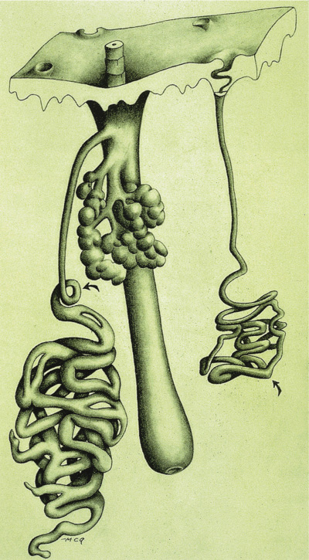
Etiopathogenesis..
Comedonal occlusion of the ‘apocrine gland follicle’ unit obstructs the outflow of the apocrine gland in addition to that of the sebaceous gland, and is believed to be the initiating event in hidradenitis

Slide 5
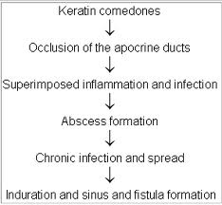

Slide 6
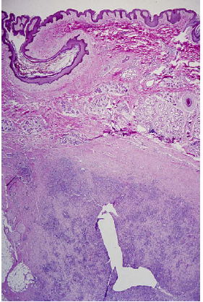
Typical histologic changes seen in a patient with hidradenitis suppurativa. Note follicular plugging consistent with comedo formation and underlying deep fibrosis with mixed suppurative and granulomatous inflammatory
infiltrates with plasma cells.

Slide 7
Genetic factors..
AD inheritance has been suggested
It has been found that 34% of first-degree relatives of
probands also had HS.
Transmission rate is less than 50% which might be because of their rigid disease definition, incomplete penetrance, and hormonal influences

Slide 8
Bacterial factors…
HS is primarily a disease of the follicular epithelium that is secondarily colonized and infected by bacteria.
Many bacterial species are recovered and no single species is dominant
Bacteria implicated in cultures-
Streptococcus viridans,
Staphylococcus aureus,
S milleri,
anaerobes (Peptostreptococcus species)
Gram-negative bacteria, such as Escherichia coli, Klebsiella, and Proteus, may be more common in perineal HS.

Slide 9
Endocrinological factors..
The effect of androgens on HS is unclear
The tendency of HS to develop at puberty suggests an androgen influence
Disease flares have been reported postpartum, in association with OCPs & in the premenstrual period in around 50% of the patients.

Slide 10
Environmental factors..
A retrospective study of 45 patients showed that 10 had a history of mechanical irritation before onset of the disease.
The causes of trauma can range from shaving to friction from a prosthesis.
Antiperspirants may also trigger HS via chemical irritation inducing poral closure or altering axillary flora.
Using safety razors may increase HS susceptibility, enhancing bacterial access via transection of the follicular infundibulum
Smoking & obesity are known to exacerbate HS.

Slide 11
Follicular occlusion triad..
Hidranetis suppurativa
Acne conglobata
Dissecting cellulitis of the scalp

Slide 12
Follicular occlusion tetrad..
Hidradenitis suppurativa
Acne conglobata
Pilonidal cyst
Dissecting cellulitis of the scalp

Slide 13
Clinical features..
HS lesions occur most frequently in the intertriginous apocrine gland bearing areas of the :
axillary, inguinal, perianal, perineal, mammary, inframammary, buttock, pubic, chest, scalp, retroauricular, and eyelid areas.
most common site- axillary
This distribution pattern corresponds for the most part with the ‘‘milk line’’ distribution of apocrine-related mammary tissue in mammals.

Slide 14
Patients with anogenital HS may also have disease in the anal canal .
HS in the anal canal lies superficial to the internal sphincter and begins in the lower two-thirds of the canal, distal to the dentate line (the transition zone from columnar epithelium to squamous epithelium).
This corresponds with the distribution of apocrine glands and hair follicles in the anal canal.

Slide 15
HS is characterized initially by the presence of tender subcutaneous nodules.
With time, the nodules may rupture, resulting in painful, deep dermal abcesses.
After rupture, the lesions often extrude a purulent, foul smelling discharge.
As the disease process continues, fibrosis, dermal contractures, and induration of the skin occur.

Slide 16
Another lesion typical in HS is the double comedone, a blackhead with multiple apertures that communicate below the skin.

Slide 17
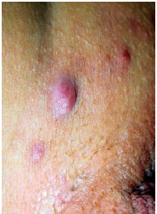
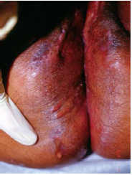
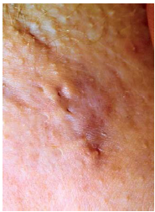


Slide 18
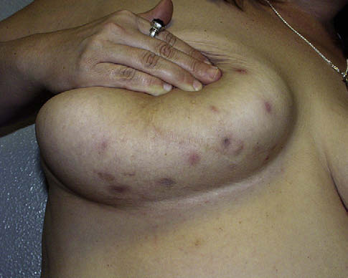
Fig 1. Inflammatory papules and nodules in the inframammary
area typical of hidradenitis suppurativa.

Slide 19
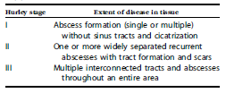
Hurley staging system…

Slide 20
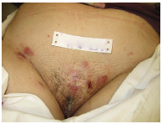
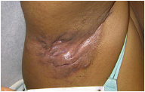
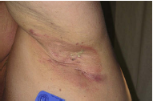
Hurley stage I—single or multiple abscesses without cicatrization and sinus tracts.
Hurley stage III—multiple interconnected tracts
and abscesses throughout an entire area.
Hurley stage II—one or more widely separated recurrent abscesses, with tract formation and scars.

Slide 21
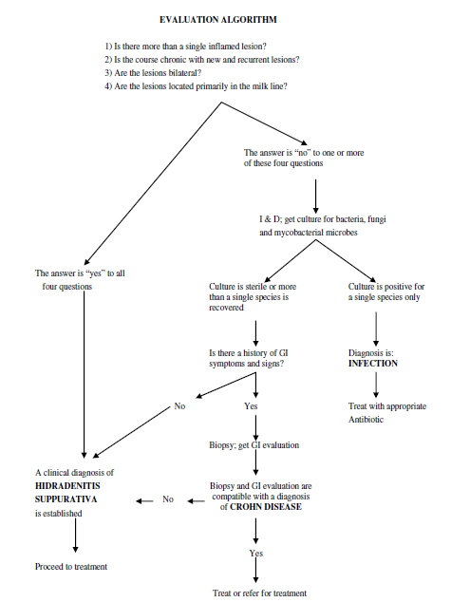

Slide 22
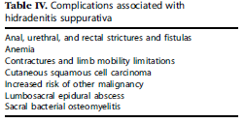
Complications..

Slide 23
HS & malignancy…
A large retrospective study revealed that patients with HS had 50% increased risk in overall incidence of malignancy.
A 4.6-fold increase in cutaneous SCC was observed in these patients.
The ratio of SCC in HS favors males (4:1).
Sixty-one percent of cases are located in the perineum or buttocks; there are no reports of SCC in axillary HS.
The mean duration of HS before SCC diagnosis is 25 years

Slide 24
Differential diagnosis…
Common | Rare
Acne | Actinomycosis
Carbuncle | Anal fistula
Cellulitis | Crohn disease
Dermoid cyst | Lymphogranuloma venereum
Furuncles | Pilonidal disease
Lymphadenopathy | Tubercular abscess
Perirectal abscess
Pilonidal cyst

Slide 25
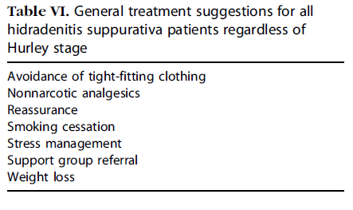
Treatment..
There is no uniformly effective single therapy for HS; therefore, clinicians will likely have to try an array of different treatment modalities depending on the patient’s disease

Slide 26
Medical : antibiotics
retinoids
hormones
immunosuppressives
antiinflammatory agents
neurotoxins
Surgical
Others : radiotherapy
cryotherapy
lasers

Slide 27
Antibiotics..
Acute episodes and relapses should be treated as bacterial infections.
Repeated cultures & Plausible pathogens should be treated
with full doses of appropriate antibiotics, probably for 2 weeks in most cases.
Erythromycin, combined with metronidazole if tolerated, may be a suitable initial choice.
Clindamycin and minocycline are each useful in some cases.
Topical clindamycin 1% & 500 mg of tetracycline twice daily was found to have similar efficacy
Dapsone in doses of 25 & 150 mg daily has also been seen to show improvement

Slide 28
Retinoids..
Retinoids have effect on inflammation and on epithelial differentiation which may be relevant in treatment
Isotretinoin in a dose of about 1 mg/kg/day for 4 months was accompanied by improvement in four out of eight patients .
Acitretin may be more useful in a dose of 0.5 mg/kg daily for 6 months

Slide 29
Hormones..
In a randomized trial comparing ethinyloestradiol 50 mg/cyproterone acetate 50 mg to ethinyloestradiol 50 mg/norgestrel 500 mg in 24 patients, both regimens produced improvement in disease activity with a disease free interval of 18 months.
Also cyproterone acetate 100mg daily is effective.
Finasteride 5mg daily has also been shown to cause complete healing of lesions.

Slide 30
Immunosuppresives..
Are useful when HS is associated with other diseases
intractable pyoderma gangrenosum and HS has been treated with cyclosporine 4.5 mg/kg/day.
Another case report describes a patient with CD and HS treated with azathioprine, methylprednisolone, and isotretionoin
The TNF-alfa (TNFa) inhibitors infliximab and etanercept are the emerging options in HS

Slide 31
Botulinum toxin may decrease apocrine gland secretion,
thereby limiting tendency towards follicular rupture
A series of intradermal injections have been shown to cause resolution for 10 months
Radiotherapy:
Radiotherapy has been suggested as efficacious for early lesions of HS but not for sinuses
Hair follicle destruction is the suggested mechanism of action.
Cryosurgery has been studied as a potential HS treatment.
However patients are at increased risk of infection & ulceration

Slide 32
Carbon dioxide laser therapy has been used successfully in HS.
However increased rate of recurrence at adjacent & distant metastatic sites has been reported
Photodynamic therapy also helps in resolution but relapse has been reported

Slide 33
Surgery..
Surgery is regarded as one of the most effective treatments for intractable HS
Relatively minor techniques include exteriorization, curettage and electrocoagulation of sinus tracts , and simple excision of troublesome areas with direct closure or grafting.
Radical treatment involves deep and wide excision of the whole of the disease-bearing skin along with a margin of at least 1.5 cm followed by grafting or healing by secondary intention

Slide 34
Recurrence rate is 3% in the perineal & axillary area.
The inframammary and inguinoperineal areas, however, suffered from recurrence rates of 37% and 50%, respectively
Operative complications include skin graft failure (45% of applied grafts), ischemic necrosis of a myocutaneous flap, limb vein thrombosis, anemia, transient edema, and hypertrophic scarring

Slide 35
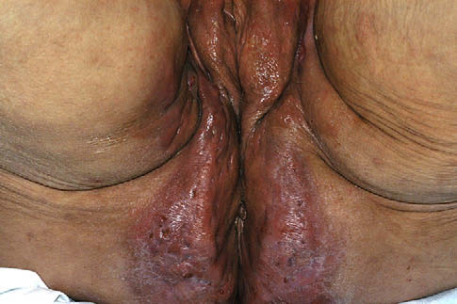
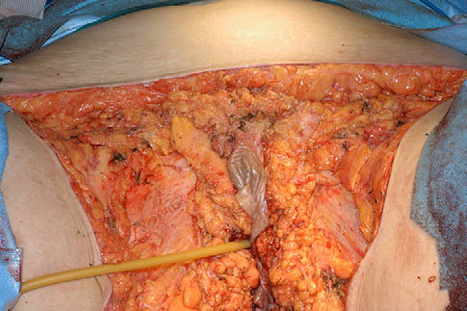
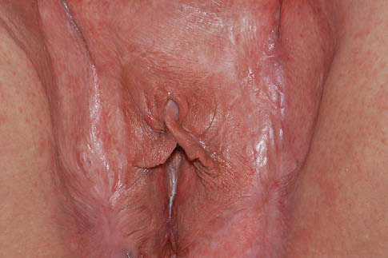
Patient with Hurley stage III hidradenitis suppurativa
before wide excision.
Same patient immediately following wide excision
Same patient as seen 7 months after wide excision and split-thickness grafting.

Slide 36
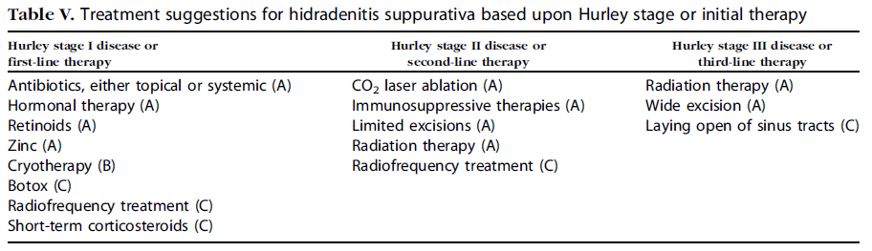

Slide 37
THANK YOU…

