Slide 1
Properties of skeletal muscle

Slide 2
PROPERTIES OF SKELETAL MUSCLE
Excitability: capacity of muscle to respond to a stimulus
Refractory period
Contractility: ability of a muscle to shorten and generate pulling force
All or None phenomenon
Extensibility: muscle can be stretched
Elasticity: Ability of muscle to recoil to original resting length after stretched
Fatigue

Slide 3
Excitability…………
It is the change in potential and the consequence response inherent to the tissue in relation to the stimulus
Stimulus means change in external environment bringing about an excitation in an excitable tissues
Electrical- commonly used in labs
Mechanical
Thermal
Chemical
Electro-magnetic

Slide 4
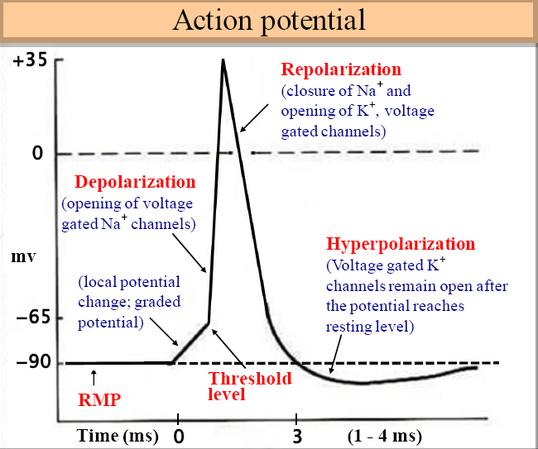

Slide 5
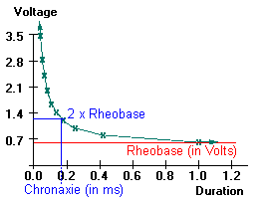
Strength Duration Curve

Slide 6
Rheobase: the minimum strength of the current acting on the muscle for a variable period that can bring about a response.
Utilization time: the minimum duration for which a current of rheobase strength is applied to excite an excitable tissue
Chronaxie: is defined as the shortest duration of stimulus required to excite a tissue by a current strength equal to twice of rheobase voltage.

Slide 7
Refractory period……
Refractory period is the period at which the muscle does not show any response to a stimulus.
It is of two types
Absolute RP:
Relative RP:

Slide 8
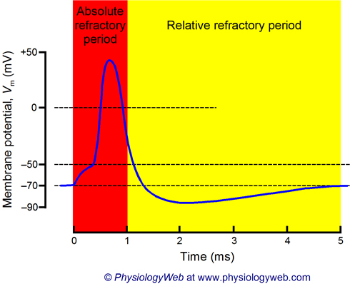

Slide 9
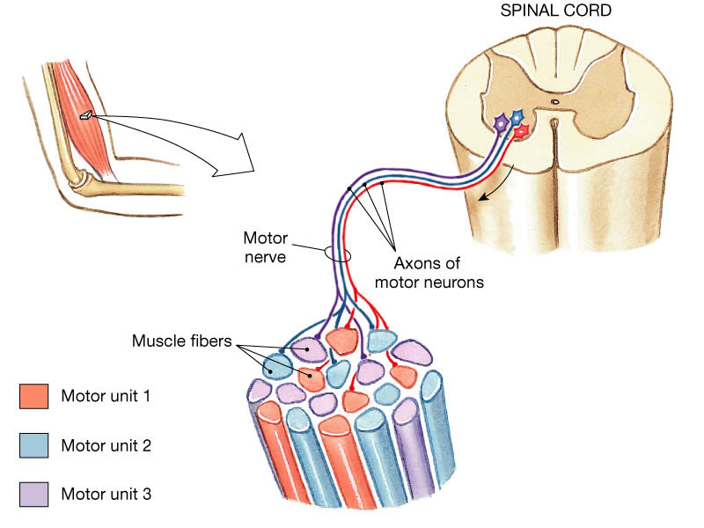
Contractility ……………

Slide 10
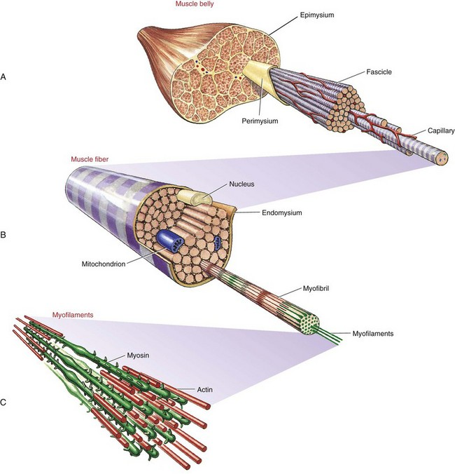

Slide 11
Def : internal events of the muscle which are manifested by shortening or development of tension or both.
Two primary types
  Isotonic
    Muscle tension remains constant as muscle changes length
  Isometric
    Muscle is prevented from shortening
    Tension develops at constant muscle length

Slide 12
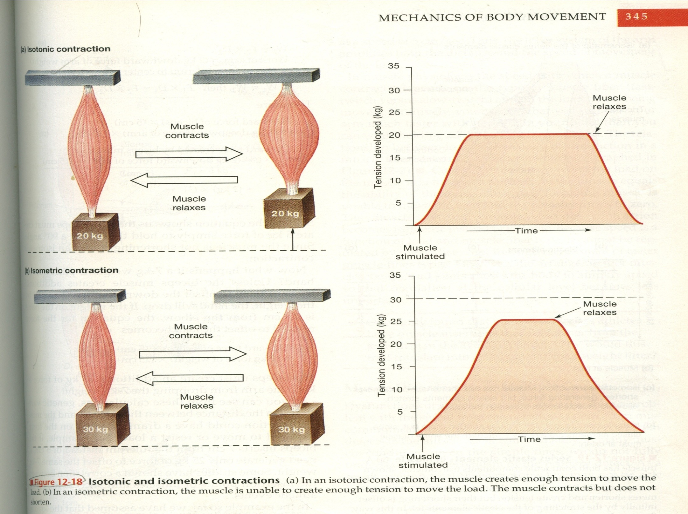

Slide 13
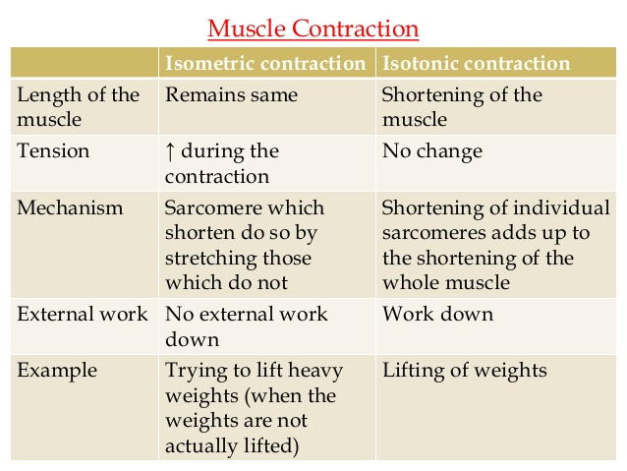

Slide 14
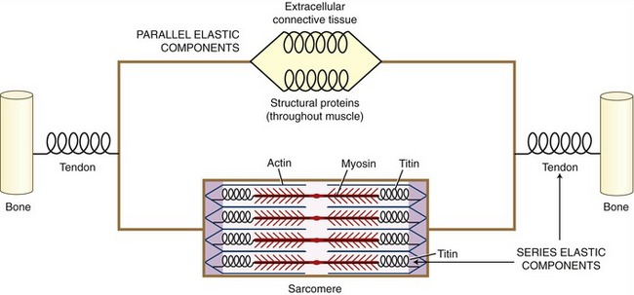

Slide 15
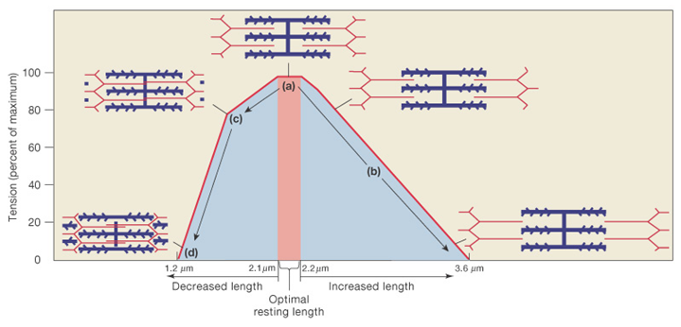
Length-Tension of sarcomere.

Slide 16
Length–Tension Relationship
  The forcefulness of muscle contraction depends on the length of the sarcomeres
  When a muscle fiber is stretched there is less overlap between the thick and thin filaments and tension (forcefulness) is diminished
  When a muscle fiber is shortened the filaments are compressed and fewer myosin heads make contact with thin filaments and tension is diminished

Slide 17
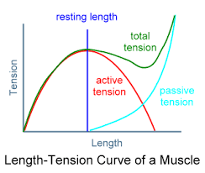

Slide 18
FACTORS AFFECTING CONTRACTION……..
Strength of stimuli- Quantal summation
Number of Stimuli:
1) effect of 2 successive stimuli:
i) Beneficial effect
ii) Summation
2)more than two stimuli:
i) Clonus, Tetanus
ii) Treppe
iii) Fatigue
C. Effect of temperature
D. Load (Preload & Afterload)

Slide 19
Major Types of Muscle Fibers
Classified based on differences in ATP hydrolysis and synthesis
Two major types
  Slow-oxidative (type I) fibers
  Fast-oxidative (type IIa) fibers
  Fast-glycolytic (type IIx) fibers

Slide 20
Property Slow Intermediate Fast
Contraction speed Slow Fast Fast
Tension Low Intermediate High
Fatigue resistance High Intermediate Low
Colour Red White White
Myoglobin content High Low Low
Capillary supply Dense Intermediate Scarce
Mitochondria Many Intermediate Few
Glycolytic enzyme Low High High
Substrates used for Lipids, CHO, Primarily CHO
ATP generation (aerobic) CHO (anaerobic) (anaerobic) Alternative names Type I, S (slow), Type IIa, FOG Type IIb/x, SO (slow oxidative) FR (fast resistant) FF (Fast fatigue)

Slide 21
Muscle-twitch (simple muscle curve):
The contraction and relaxation of skeletal muscle in response to a single adequate stimulus
All or None response
An individual muscle fiber exhibits contraction of an uniform intensity once their particular threshold has been reached

Slide 22
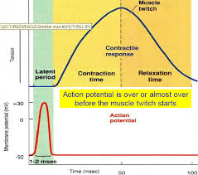
Single muscle twitch

Slide 23
Muscle Fatigue………
Faliure of a muscle to maintain tension as a result of previous contractile activity is known as muscle fatigue. Occurs when exercising muscle can no longer respond to stimulation with same degree of contractile activity.
Defense mechanism that protects muscle from reaching point at which it can no longer produce ATP
Underlying causes of muscle fatigue are unclear
It depends upon
1. intensity and duration of exercise
2. Type of muscle fibers.

Slide 24
Causes of muscle fatigue have been classified into central and peripheral
Central - includes CNS, motivation and psychological factors
  restoration of force with external stimulation of muscle -indicates central fatigue
  NH₃, hypoglycemia, reticular formation
Peripheral - PNS to muscle - EC coupling, energy supply and force generation

Slide 25
  Depletion of creatine phosphate
  Insufficient oxygen
  Depletion of glycogen and other nutrients
  Buildup of lactic acid and ADP
  Failure of the motor neuron to release enough acetylcholine

Slide 26
Rigor mortis
Several hours after death, all the muscles of the body go to a state of conracture called Rigor Mortis.
Results from loss of all ATP’s required to cause separation of cross bridges from the actin filaments during relaxation
The degree of rigor mortis may be used in forensic pathology to determine the approximate time of death.
Heat Rigor: similar changes when exposed to 50 degree, due to coagulation of proteins..

Slide 27
s
1. How many triad are there in one sarcomere of Sk. Muscle
a.1 b.2 c. 3 d. 4
2. Refractory period of skeletal muscle is
a. 0.01 sec b. 0.04 sec c. 0.05 sec d. 0.06 sec
3. In isotonic contraction
a. tone remains same b. length remains same c. both d. none
4. In isometric contraction
a. tone remains same b. length remains same c. both d. none
5. All or none law in sk. Muscle is followed by
a. single muscle fib. b. whole muscle c. tendon d. none of the above

Slide 28
Energy Sources for Contraction…
Transfer of high-energy phosphate from creatine phosphate to ADP, First energy storehouse tapped at onset of contractile activity
Oxidative phosphorylation (citric acid cycle and electron transport system). Takes place within muscle mitochondria if sufficient O₂ is present
Glycolysis
  Supports anaerobic or high-intensity exercise

Slide 29
Thermal changes during muscle contraction………
Resting heat: muscle is in rest, not contracting
Initial heat: heat generated in excess of resting heat during muscular contraction
Recovery heat: heat produced in excess of resting heat, following muscle contraction
Relaxation heat: extra heat, in addition to the recovery heat, which is produced during relaxation of the isotonically contracted muscle.

Slide 30
Muscle Metabolism
Oxygen Consumption After Exercise
After exercise, heavy breathing continues and oxygen consumption remains above the resting level
  Oxygen debt
  The added oxygen that is taken into the body after exercise
  This added oxygen is used to restore muscle cells to the resting level in three ways
    1) to convert lactic acid into glycogen
    2) to synthesize creatine phosphate and ATP
    3) to replace the oxygen removed from myoglobin

Slide 31
EMG and Disorders of skeletal muscle
The recording of muscle APs is called electromyography. The record is known as an electromyogram
Electomyography is the study of electrical activity of the muscle.
EMG is the graphical representation of electrical activity of muscle.
Useful in diagnosis of neuromuscular diseases and myopathies.

Slide 32
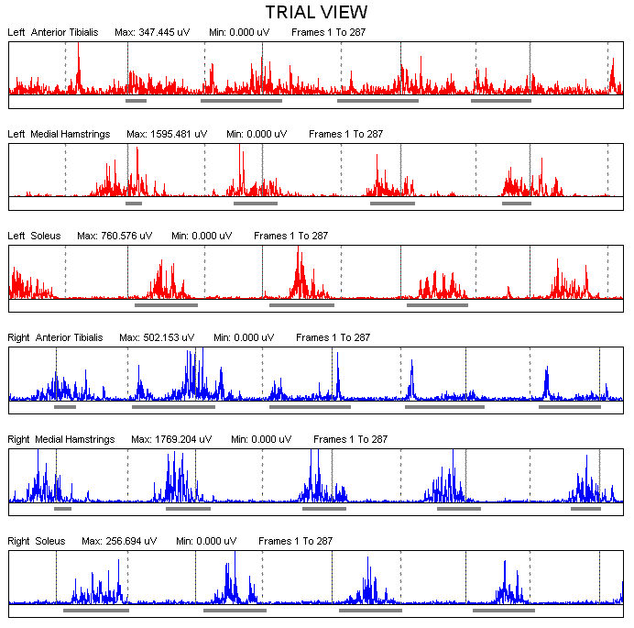
Sweep of AP → similar to a wave
Height of wave and the density of the wave can be recorded

Slide 33
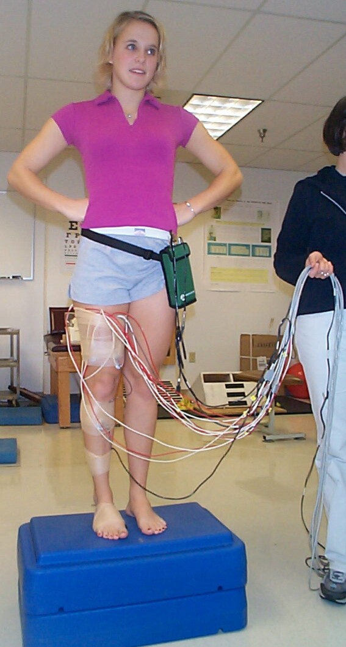
Recording Methodology: basis is motor unit. Potential. One motor unit potential is last for 0.5 mV.
Electrical potential difference measured between two points → bipolar electrode configuration used
Bipolar Electrode Types
    Fine Wire
    Needle
    Surface
Electrode Placement
    Overlying the muscle of interest in the direction of predominant fiber direction
    Subject is GROUNDED by placing an electrode in an inactive region of body
http://www.hhdev.psu.edu/atlab/EMG.jpg

Slide 34
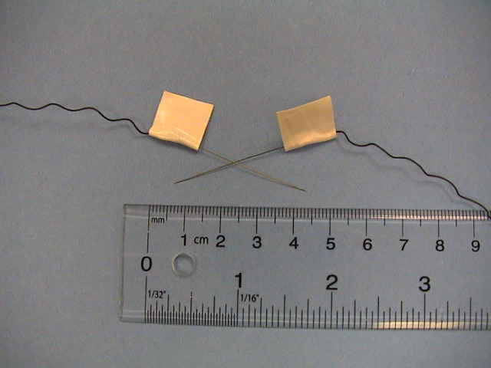
Fine Wire
http://educ.ubc.ca/faculty/sanderson/EMG/Index.htm

Slide 35
DISORDERS OF SKELETAL MUSCLE.
MUSCLE DYSTROPHY- progressive degeneration of muscle fibers without the involvement of nervous system.
1. Duchenne: No formation of dystrophin protein.
2. Becker’s: Altered formation of dystrophin protein.
MUSCLE TONE DISEASES- hyper or hypotonia
DENERVATION HYPERSENSITIVITY AND FIBRILLATION
McARDLE’S DISEASE-Glycogen storage diseases
NEMALINE MYOPATHY-small rod like structures in the muscle fiber.

Slide 36
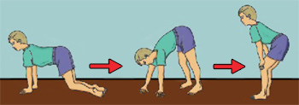
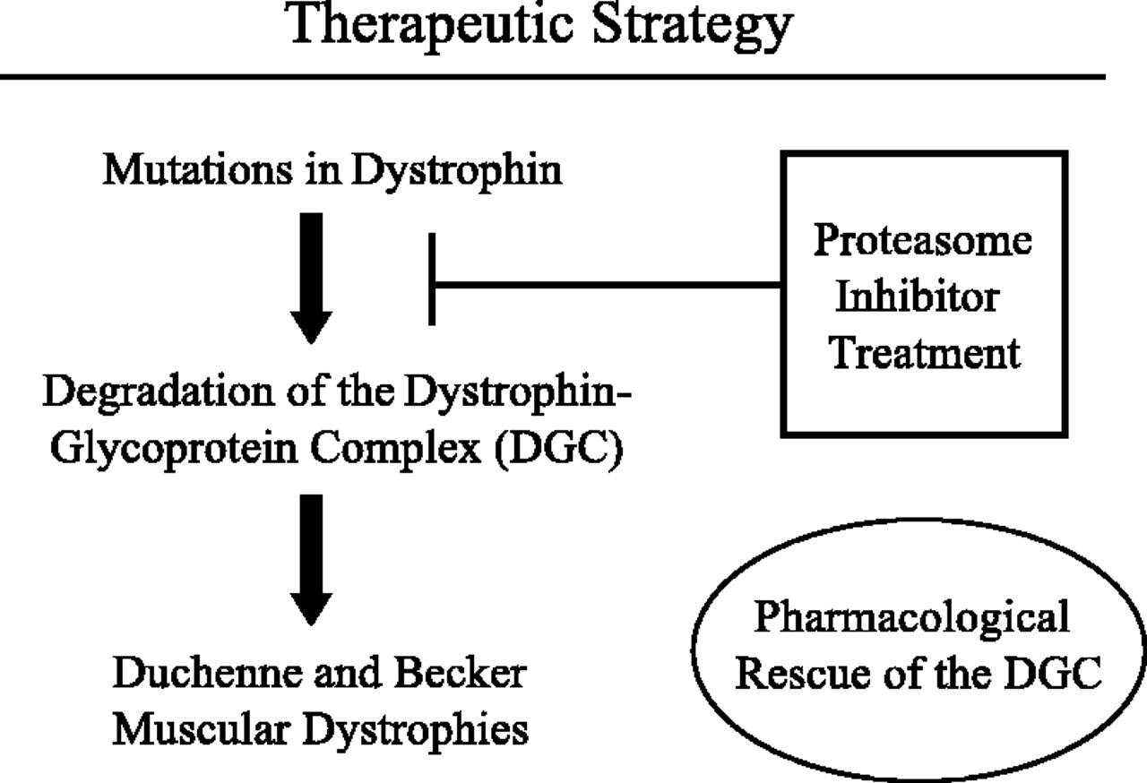
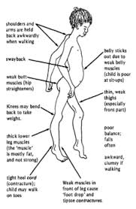
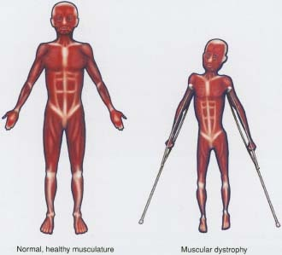

Slide 37
1.Graphical representation of muscle activity is k/as
a. EMG b. ECG c. ETG d. ESG
2. Duchenne muscle dystrophy is because of mutation of
a. dystrophin b. titin c. myosin d. actin
3. Several hours after death, all the muscles of the body go to a state of contracture called
a.Heat rigor 2, rigor c rigor mortis d. none
4. The length of sarcomere at the highest tension develop is k/as
a. optimal length b. minimum length c resting length d none
In humen beings the site of fatigue is
a. syanaps of CNS b. NM junction c. sarcomere d none

