Slide 1
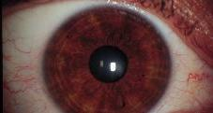
Central Neurophysiology of Vision

Slide 2
INTRODUCTION
Visual pathway or optic pathway is the nervous pathway that transmits impulses from retina visual center in cerebral cortex.
VISUAL RECEPTORS
Rods and cones which are present in the retina of eye form the visual receptors. Fibers from the visual receptors synapse with dendrites of bipolar cells of inner nuclear layer of the retina

Slide 3
FIRST ORDER NEURONS
First order neurons (primary neurons) are bipolar cells in the retina. Axons from the bipolar cells synapse with dendrites of ganglionic cells.
SECOND ORDER NEURONS
Second order neurons (secondary neurons) are the ganglionic cells in ganglionic cell layer of retina. Axons of the ganglionic cells form optic nerve. Optic nerve leaves the eye and terminates in lateral geniculate body.

Slide 4
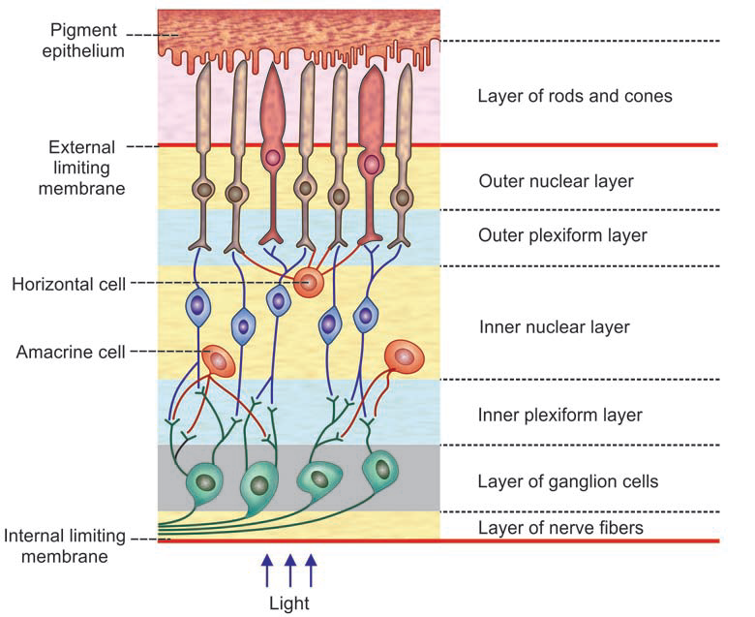

Slide 5
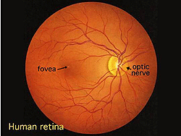
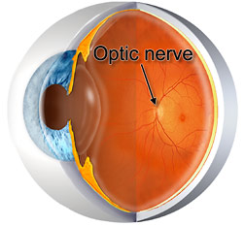
Optic Nerve
Finally the optic nerve fibers transmits electrical impulses from the retina to the brain.
A portion of the optic nerve called the optic disc can be seen by fundoscopy which is known as blind spot.
This is not normally noticeable because the vision of both eyes overlaps.

Slide 6
THIRD ORDER NEURONS
Third order neurons are in the lateral geniculate body, Fibers arising from here, reach the visual cortex.
The optic tract wraps around the cerebral peduncles of the midbrain to get to the lateral geniculate nucleus (LGN).

Slide 7
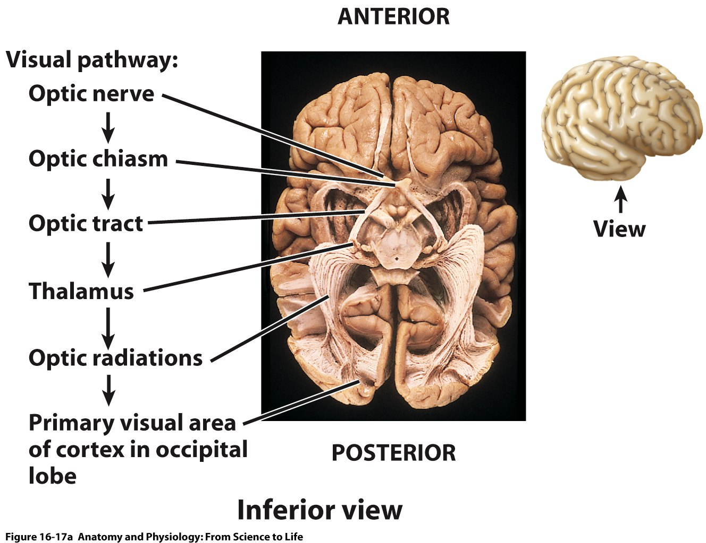
Figure 16.17a

Slide 8
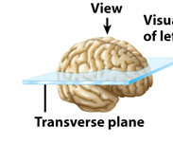
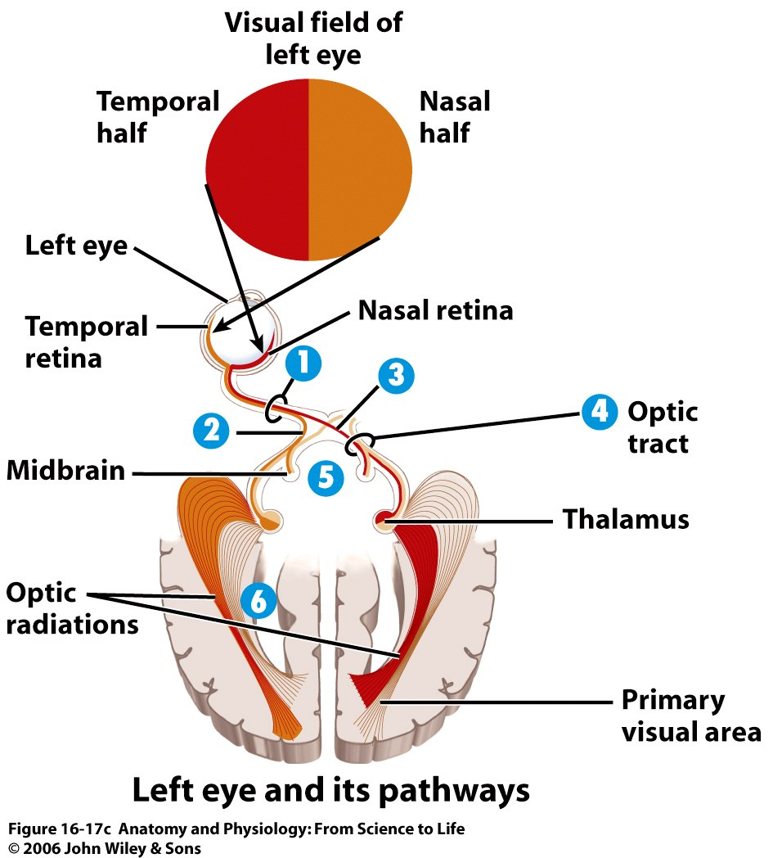
Figure 16.17c

Slide 9
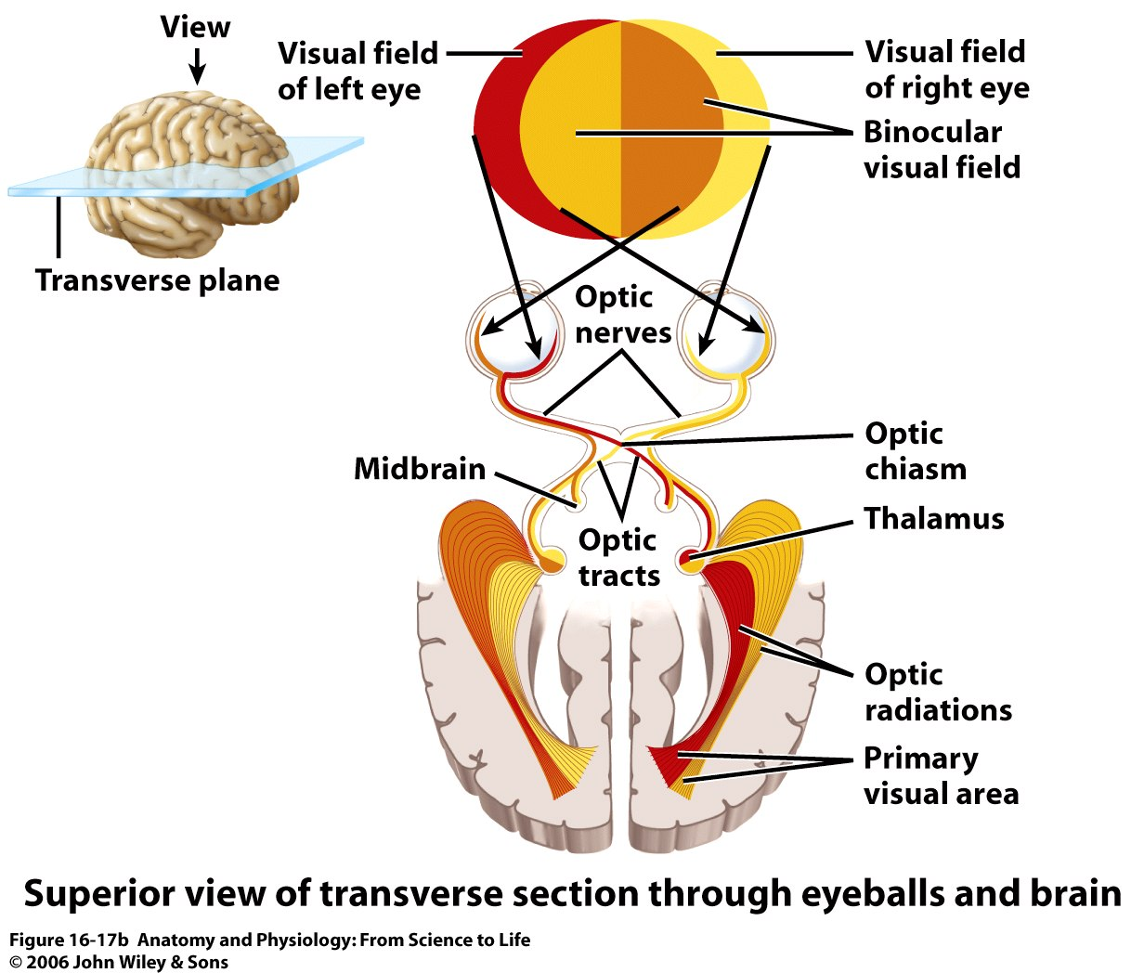
Figure 16.17b

Slide 10
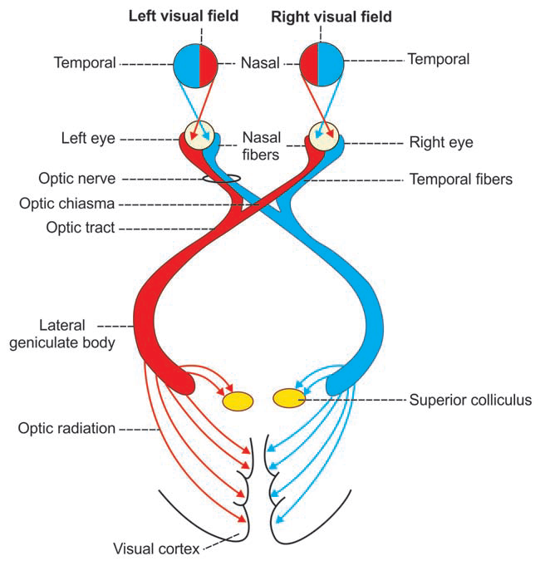

Slide 11
Fibers to other areas of brain
For different functions:
Suprachiasmatic nucleus of the hypothalamus :- for controlling circadian rhythms which changes with night and day
Pretectal nuclei in the midbrain :- to elicit reflex movements of the eyes to focus on objects of importance and to activate the pupillary light reflex
Superior colliculus :- to control rapid directional movements of eyes
Ventral lateral geniculate nucleus of the thalamus :- control behavioral functions

Slide 12
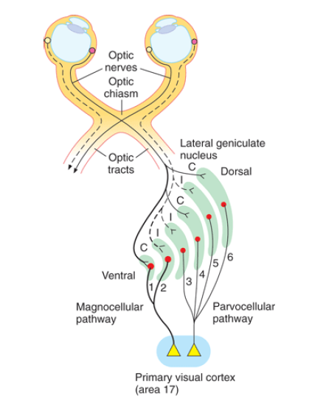
Dorsal Lateral Geniculate Nucleus of the Thalamus (LGN)
Location:-
the dorsal end of the thalamus (the lateral geniculate body)
6 nuclear layers
Layers 2, 3, & 5 :-
receive signals from the temporal portion of the ipsilateral retina
Layers 1, 4, & 6
receive signals from the nasal halve of the retina of the opposite eye

Slide 13
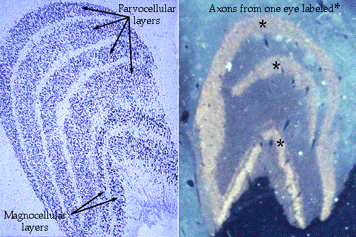
Other way of dividing layers
 | magnocellular layers | parvocellular layers
 | Layers I & II | Layers III → VI
size of neurons | large neurons | small to medium-sized neurons
Inputs from | large type Y retinal ganglion cells | Type X retinal ganglion cells
Velocity of conduction | provides a rapidly conducting pathway to the visual cortex | moderate velocity of conduction
Type of vision | only black-and-white information | transmit color
point-to-point transmission | poor because there are not many Y ganglion cells, and their dendrites spread widely in the retina. | accurate point-to-point spatial information
Recent advancement | Signals for detection of movement, depth and flicker | Colour vision, texture and finer details

Slide 14
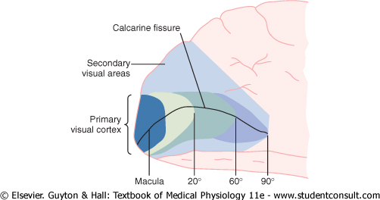
The Visual Cortex
On the medial aspect of the occipital lobes
primary visual cortex
secondary visual areas
Just look at the pic. It is like the chart of perimetry

Slide 15
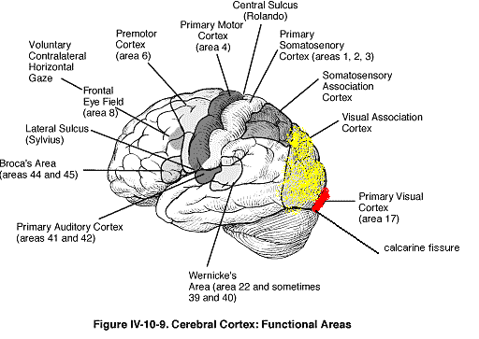

Slide 16
Primary Visual Cortex
Also called…
Brodmann cortical area 17
visual area I
The striate cortex :- grossly striated appearance
Lies in the calcarine fissure area, extending forward from the occipital pole on the medial aspect of each occipital cortex

Slide 17
representation of retina in this area…
Signals from the macula of retina : terminate near the occipital pole
Fovea of retina has a large representation in the primary visual cortex
signals from peripheral retina : terminate at or in concentric half circles anterior to the pole and along the calcarine fissure
The upper portion of the retina → superiorly
the lower portion → inferiorly

Slide 18
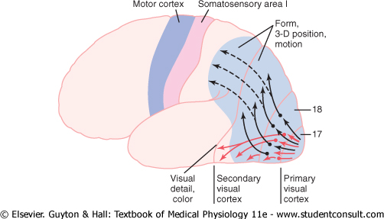
Secondary Visual Areas
also called
visual association areas
Brodmann's area 18
visual area II (V-2)
lie lateral, anterior, superior, and inferior to the primary visual cortex
Surrounding primary visual cortex

Slide 19
Function of primary cortex
Analysis of Contrasts in the Visual Image
Detection of Color
Secondary Visual Areas
Analysis of visual meanings

Slide 20
Destruction of Area 18, 19
↓se ability …..
interprete the shapes and sizes of the different objects
word blindness :-
destruction in dominant hemisphere → the person can read but can not interpret the meaning of the word

Slide 21
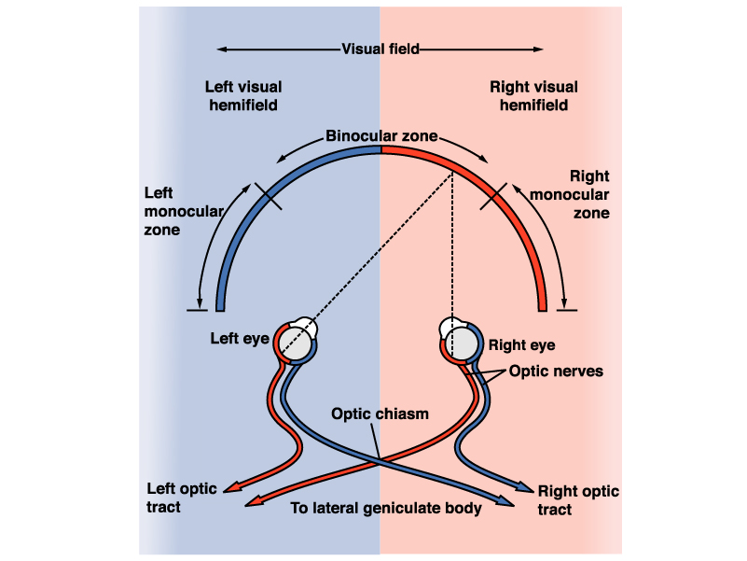
Binocular vision
The central parts of the visual fields of two eyes coincides and seen with both the eyes → Binocular vision
Important for perception of depth and proportion of objects
monocular zone : 2D
Light rays fused at the cortical level into a single image

Slide 22
corresponding points :- Points on the retina on which the image of an object must if it is to be seen binocularly
if one eye is gently pushed out of the line while gaze is fixed at an object in the center of the visual field, double vision (diplopia) results, the image on the retina of the eye that is displaced no longer falls on the corresponding points.

Slide 23
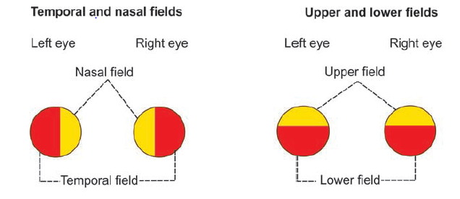
Fields of Vision
Part of the external world seen by one eye, when it is fixed in one direction is called field of vision or visual field of that eye..
The area of the nasal side is the nasal field of vision, on the lateral side is the temporal field of vision

Slide 24
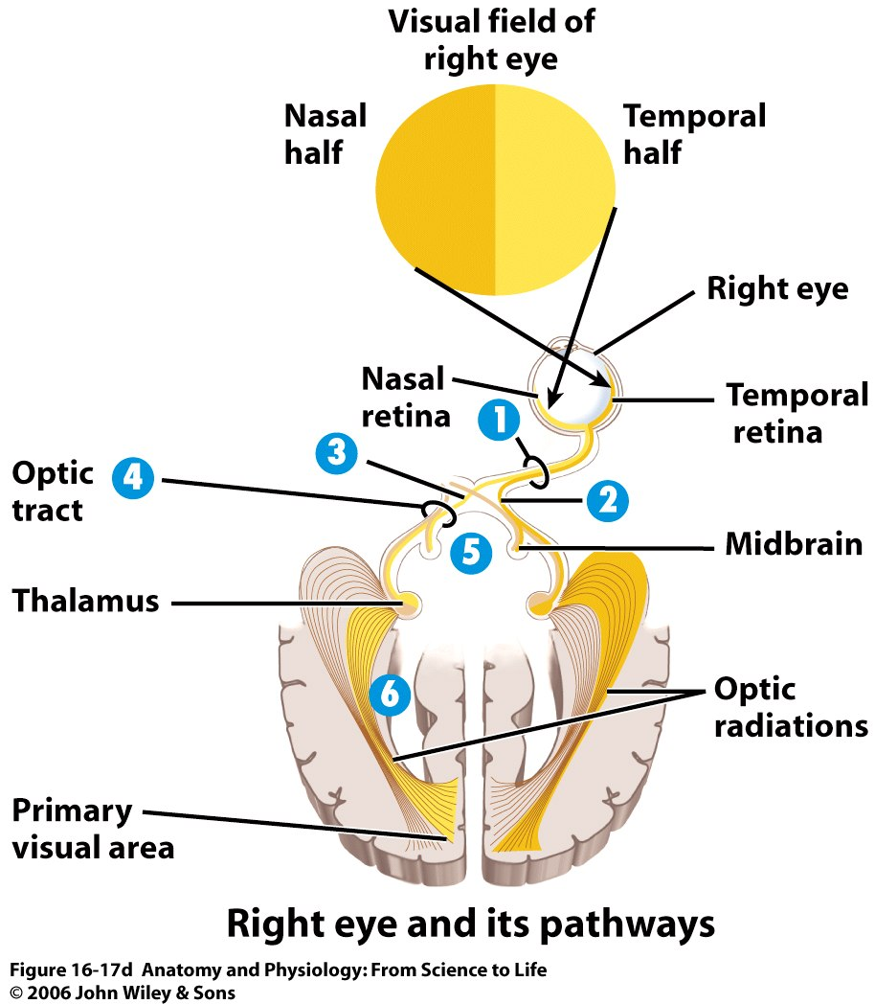
Temporal field of vision represents nasal part of the retina & vice versa
superior field of vision represents inferior part of retina & vice versa

Slide 25
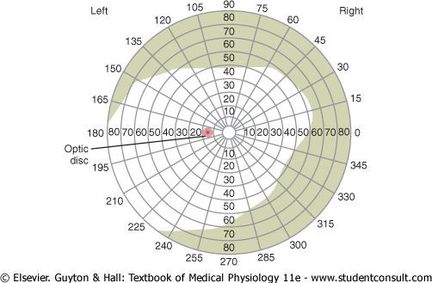
Field of vision is plotted on the charts with the help of perimeter by a process called perimetry

Slide 26
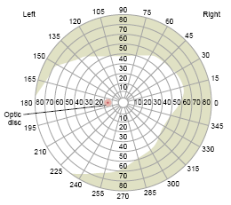
Field of vision
Extent of normal visual field with a 5 mm white colour object:-
Superiorly- 60 °
Inferiorly- 70 °
Nasally- 60 °
Temporally- 90°
Measured by confrontation
method, Lister’s, Priestley
smith’s, Goldman's or computer
assisted automated perimeters

Slide 27
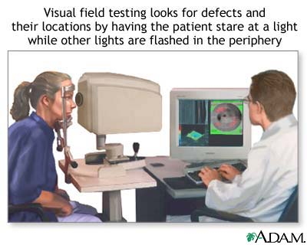

Slide 28
Blind spot
lack of rods and cones in the retina over the optic disc
15 degrees lateral to the central point of vision

Slide 29
Scotomata :-
blind spots are found in portions of the field of vision other than the optic disc area
Causes:-
damage to the optic nerve resulting from glaucoma (too much fluid pressure in the eyeball)
allergic reactions in the retina
lead poisoning
excessive use of tobacco

Slide 30
Lesions in the Optic Pathway

Slide 31
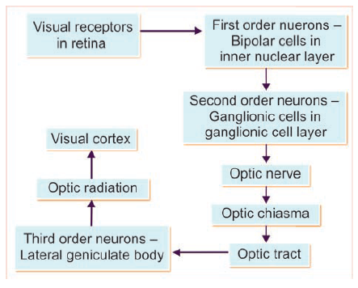

Slide 32
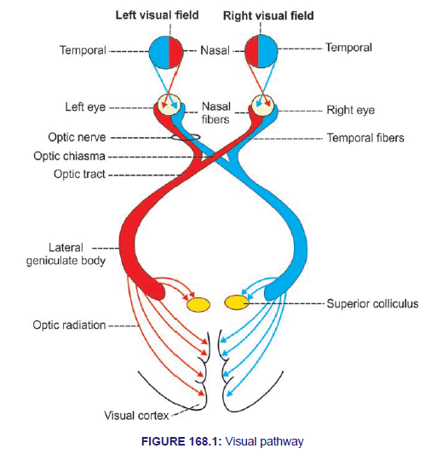

Slide 33
Lesions in the Optic Pathway
Anopia: Complete loss of vision
Hemianopia: loss of vision in one half of visual field
Homonymous hemianopia: when similar half of both the fields are blind
Ex: loss of the right or the left half of the field of the vision in both the eyes
Heteronymous hemianopia: when different half of the field of vision are lost in two eyes
Ex: bitemporal or binasal
Quadrantanopia: 1/4th of the visual field is lost

Slide 34
Ipsilateral = same side
Contralateral = opposite side
Hemianopia = loss of half of the visual field
Homonymous = same visual field defect in both the eyes (e.g. defect in right half of visual field of both the eyes)
Heteronymous = opposite visual field defect (e.g. defect in right half of visual field in one eye and left half of visual field in the other eye)

Slide 35
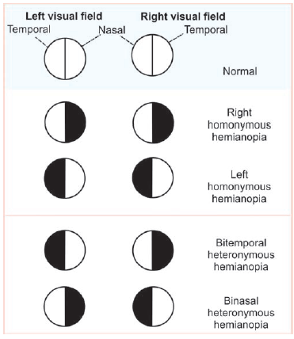

Slide 36
Lesion in lateral geniculate body (LGB):-
  LGB has 6 layers.
  Fibers from Ipsilateral retina terminate on layers 2, 3 and 5.
  Fibers from opposite retina terminate on layers 1, 4 and 6.
  In addition, layers 1 and 2 are magnocellular, concerned with motion detecting fibers.
  Layers 3, 4, 5 and 6 are parvocellular, concerned with colour detecting fibers.
  So lesion of LGB involving particular layer(s) produces corresponding defect in field of vision of same/opposite eye.

Slide 38
“Pie in the sky” and “Pie on the floor” phenomenon:-
  Fibers of optic radiation can be divided into superior and inferior fascicles.
  Superior fascicular fibers pass through parietal lobe to the superior calcarine cortex (primary visual cortex).
  Inferior fascicular fibers pass through temporal lobe to inferior calcarine cortex.
  Lesion in the inferior fascicular fibers (temporal lobe) produces contralateral homonymous quadrantanopia (upper quadrant of the opposite half of the visual field of both eyes), which is known as ‘pie in the sky’ phenomenon.

Slide 39
  Lesion in the superior fascicular fibers (parietal lobe) produces contralateral homonymous quadrantanopia (lower quadrant of the opposite half of the visual field of both eyes), which is known as ‘pie on the floor’ phenomenon.
Macular sparing:-
  Central or macular vision is spared in one sided visual cortical lesion or lesion in optic radiation (high-up lesion) because macula of each eye is represented bilaterally and extensively and macular fibers run deep and posterior.

Slide 40
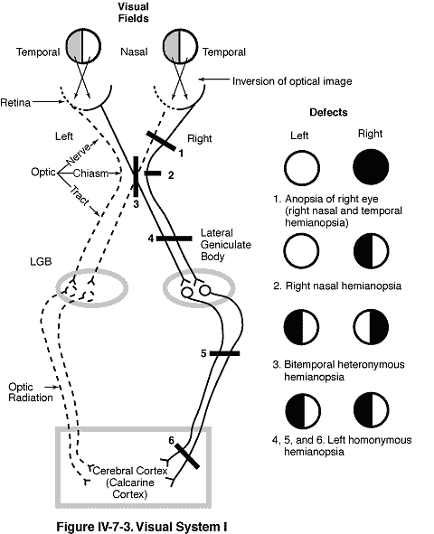

Slide 41
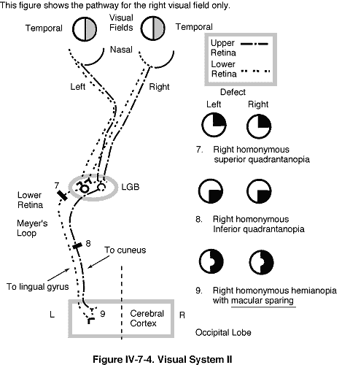

Slide 42
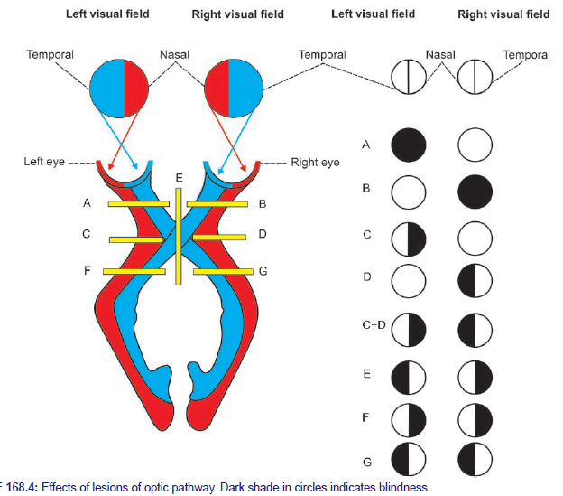

Slide 43
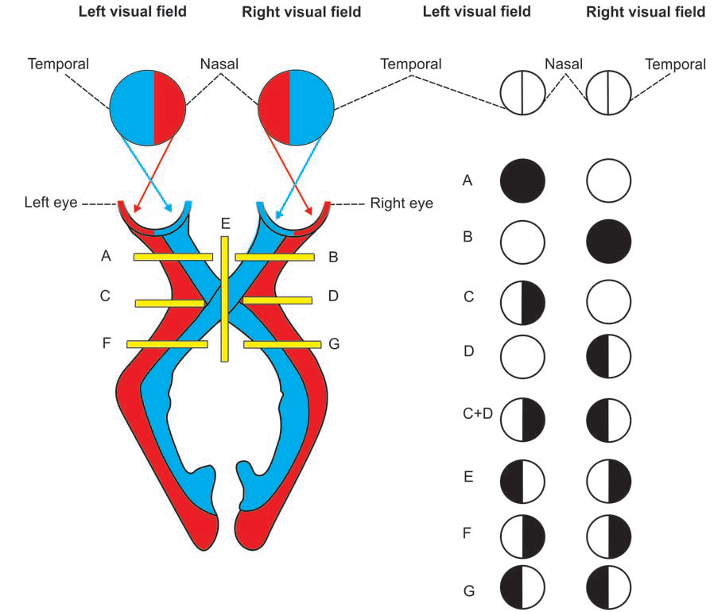
Lesion of left optic nerve: Total blindness of left eye
Lesion of right optic nerve: Total blindness of right eye
Lesion of lateral fibers in left side of optic chiasma: Left nasal hemianopia
Lesion of lateral fibers in right side of optic chiasma: right nasal hemianopia
Lesion of lateral fibers in both sides of optic chiasma: Binasal hemianopia
Lesion of medial fibers in optic chiasma: Bitemporal hemianopia
Lesion of left optic radiation: Right homonymous hemianopia
Lesion of right optic radiation: left homonymous hemianopia

Slide 44
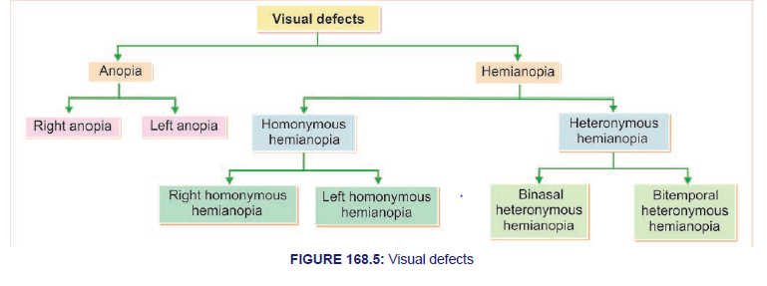

Slide 45
Site of the lesion | Defect in vision
Optic nerve | Unilateral blindness (Ipsilateral)
Optic chiasma (central crossed fibers) | Bitemporal heteronymous hemianopia
Optic chiasma (uncrossed fibers) | Binasal heteronymous hemianopia
Optic tract | Contralateral homonymous hemianopia
Optic radiation (involving both, superior and inferior fascicles) | Contralateral homonymous hemianopia with macular sparing
Optic radiation (involving superior fascicles only- parietal lobe lesion) | Contralateral homonymous quadrantanopia (lower quadrant- ‘pie on the floor’) with macular sparing
Optic radiation (involving inferior fascicles only- temporal lobe lesion) | Contralateral homonymous quadrantanopia (upper quadrant- ‘pie in the sky’) with macular sparing

Slide 46
Collaterals of Visual pathway:-
  Superior Colliculus:-
    Responsible for rapid conjugate eye movements.
  Pre-tectal nuclei:-
    Responsible for light reflex.
  Ventral LGB:-
    Responsible for emotion and behavior.
  Suprachiasmatic nucleus of hypothalamus:-
    Responsible for circadian rhythm.

Slide 47
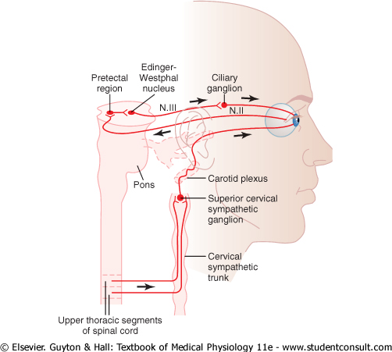
The Parasympathetic

Slide 48
preganglionic fibers (the Edinger-Westphal nucleus - the visceral nucleus portion of 3rd CN)
↓
pass in 3rd nerve
↓
ciliary ganglion (behind the eye)
↓
synapse with postganglionic parasympathetic neurons
↓
send fibers through ciliary nerves into the eyeball
↓
excite
Ciliary muscle that controls focusing of the eye lens
Sphincter pupillae muscle of the iris that constricts the pupil

Slide 49
The Sympathetic Supply
intermediolateral horn cells of T1 of the Spinal cord
↓
sympathetic chain
↓
upward to the superior cervical ganglion
↓
synapse with postganglionic neurons
↓
innervate
The radial fibers of the iris (which open the pupil) and extraocular muscles of the eye

Slide 50
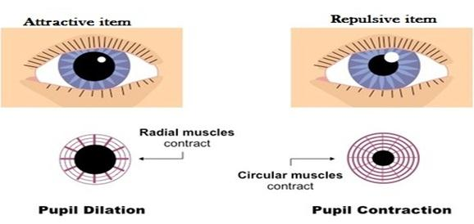
Control of Pupillary Diameter
MYDRIASIS
MIOSIS
stimulation of the sympathetic nerves
excites the radial fibers of the iris
Stimulation of the parasympathetic nerves
excites the pupillary sphincter muscle

Slide 51
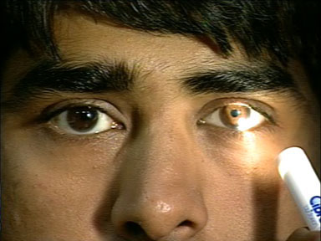
Constriction Reflexes
  1. Light reflex-
    Light is thrown in one eye → Constriction of pupil of the same eye (direct light reflex)
    → Constriction of pupil of the opposite eye (indirect or consensual light reflex)

Slide 52
Clinical importance:
During day light constriction so light to macula only and good vision
Certain head injury and alcoholism

Slide 53
Pathway of light reflex
Receptors of retina
↓
Optic nerve
↓
Optic chiasma
↓
Optic tract
↓
Pretectal nucleus
↓
Edinger Wastphal nucleus
↓
Oculomotor nerve (parasympathetic)
↓
Ciliary ganglion
↓
Short ciliary nerve
↓
Sphincter pupillae muscle causing constriction of pupil

Slide 54
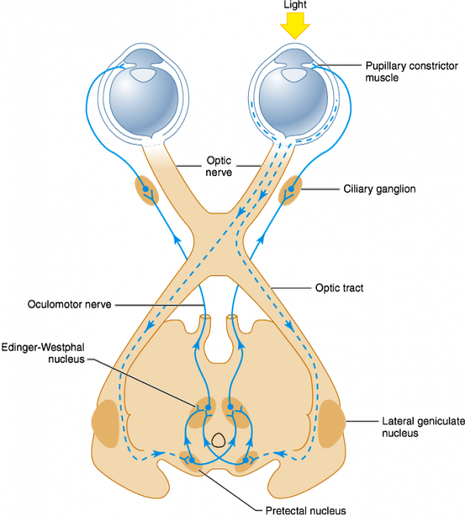

Slide 55
Accommodation reflex:-
  It’s the ability of eye to focus distant object as well as near object.
  It is necessary for highest degree of visual acuity.
  When one focuses on nearby object 3 reactions occur called accommodation convergence reaction (near response)
    Constriction of both the pupils
    Convergence of both the eyes
    Contraction of ciliary muscle → increased curvature of lens → increased diopteric power

Slide 56
Pathway for accommodation reflex
Receptors (of retina)
↓
Optic nerve
↓
Optic chiasma
↓
Optic tract
↓
Lateral geniculate body
↓
Visual cortex
↓
Frontal eye field (area 8)
↓
Internal capsule to opposite side Edinger Westphal Nucleus
↓
Oculomotor nerve
↓
Ciliary ganglion
↓
Ciliary nerves
↓
Ciliary muscles, Sphincter pupillae muscle, Medial Recti

Slide 57
Dilatation reflexes:-
  Light withdrawal reflex
  Psycho sensory reflex: due to fear, anxiety (sympathetic stimulation)
  Cilio-spinal reflex: pinching the nape of neck → pressure on cervical sympathetic trunk → Dilatation of pupil

Slide 58
Abnormal reflexes:-
      Argyll Robertson pupil: Light reflex absent; accommodation reflex present
      Size of pupil is less than normal, pupil dilates poorly to atropine
      Lesion at pretectal region, optic pathway but EW nucleus is normal.
      Causes: Tabes dorsalis (CNS syphilis), alcoholism, encephalitis
Opposite of AR pupil:- Light reflex present; accommodation reflex absent
  Causes: Diphtheria, uncontrolled DM, meningitis

Slide 59
3. Horner’s syndrome:-
Damage to cervical sympathetic fibers leading to
Ptosis
Miosis
Anhydrosis
Dilatation of blood vessels on the same side (face + head)
Enophthalmos (sunken eye)
Loss of cilio-spinal reflex.

Slide 60
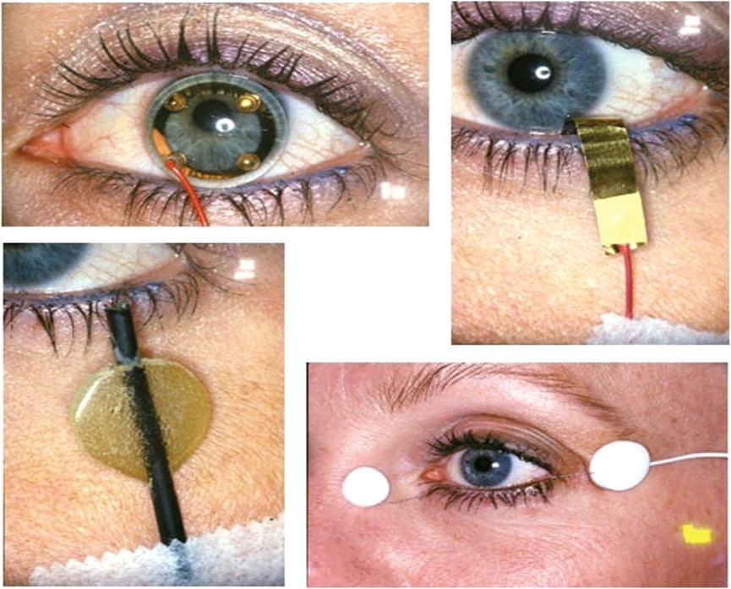
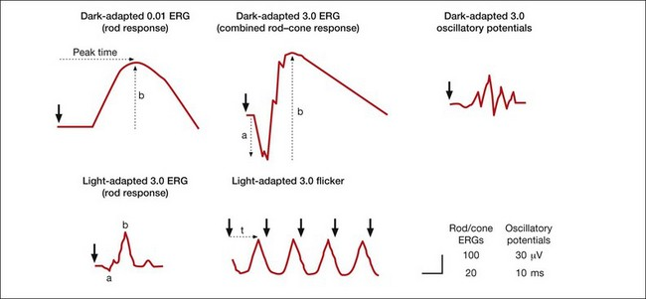
Electroretinogram
recording of electrical activity of retina
used to investigate retinal physiology and its disorders

Slide 61
CCES

Slide 62
“Trichromatic Theory” of color vision given by
Thomas and Helmholtz
John Dalton
Ewald Hering
Jan Purkinje

Slide 63
2. Function of “X type” of ganglionic cells
Detecting directional movement
Detecting color sense
Detecting Light Intensity
Lateral Inhibition

Slide 64
Red green color blindness is
Autosomal Dominant
Autosomal Recessive
X- linked Dominant
X- linked Recessive

Slide 65
4. Person with Deuternopia have following
symptom
Red color blindness
Green color blindness
Yellow color blindness
Blue color blindness

Slide 66
5. Human eye is able to see the ____ wavelength of
light
320 nm
450 nm
780 nm
850 nm

Slide 67
CCES

Slide 68
Third order neuron in the visual pathway is
Bipolar cells
Ganglionic cells
Lateral Geniculate body
Medial Geniculate body

Slide 69
2. Physiological scotoma is located ____ degree
lateral to the central point of vision.
10
15
20
52

Slide 70
3. Lesions of medial fibers of optic chiasma
leads to
Bitemporal Hemianopia
Binasal Hemianopia
Right Homonymas Hemianopia
Left Homonymas Hemianopia

Slide 71
4. Primary Visual Cortex is located in
Area 19
Area 18
Area 17
Area 7

Slide 72
5. Layers of Lateral Geniculate Body which
receives the nerve fibers from Temporal part
of Ipsilateral Retina
1,4,6
2,3,5
2,3,4
1,5,6

