Slide 1
DIFFERENT KINDS OF TRACTION
DR PRESH P GOLWAL
PROFESSOR & HOD
DEPT OF ORTHOPAEDICS
DHIRAJ HOSPITAL, SBKS MIRC
SUMANDEEP VIDYAPEETH
VADODARA

Slide 2
Traction Technique

Slide 3
TRACTIN
Traction Technique
What is TRACTION??????
Traction means to give pull and push at the same time to achieve the pre fracture state and maintain its Anatomical position as well as to avoid rubbing of the cartilage to relieve pain and to maintain this continuously till you achieve the goal....

Slide 4
TRACTION
SKIN TRACTION
SKELETAL TRACTION

Slide 5
SKIN TRACTION
BINDERS
GALLOS\
BRAYANT’S
TRACTION
OVERHEAD TRACTION
BUCK
TRACTION
DUNLOP TRACTION
HAMILTON RUSSEL TRACTION

Slide 6
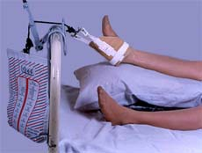
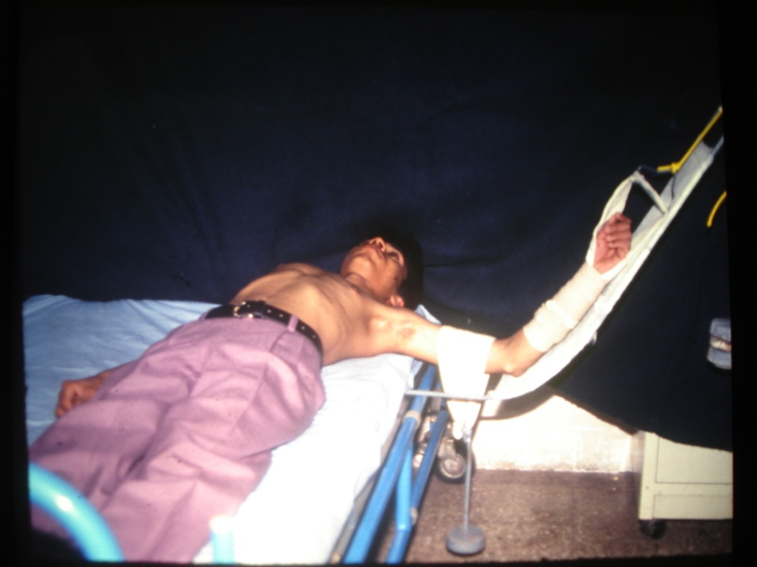
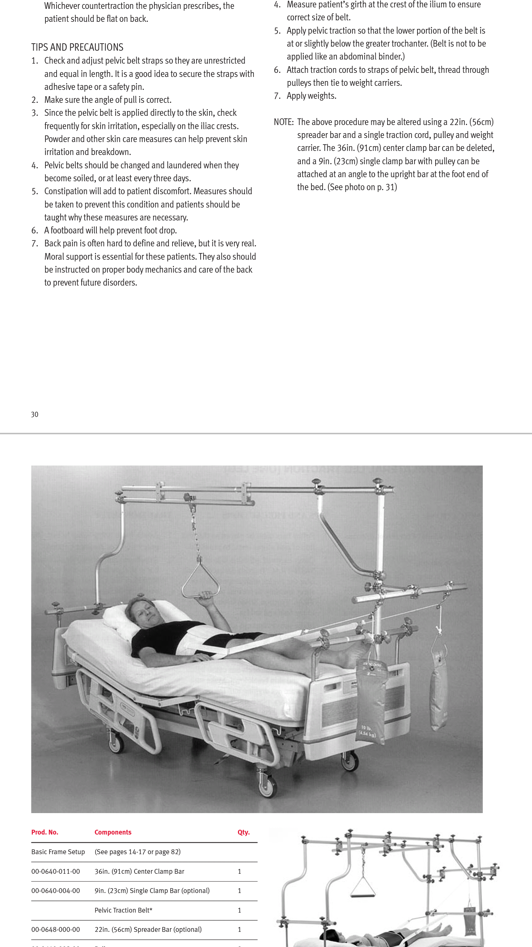
BINDERS
ANKLE BINDERS
SLINGS
PELVIC BINDERS

Slide 7
BINDERS
Binders are used for applying traction via taking advantage of joint or bony prominence which prevents slipping and act on the extremity.
Easy to apply
Get the advantage of traction
Avoiding surgical intervention
ADVANTAGE:
DISADVANTAGE:
Pressure sore because of traction acting on small surface
Weight can be put according to the tolerability of the area
Easy to remove by patient himself

Slide 8
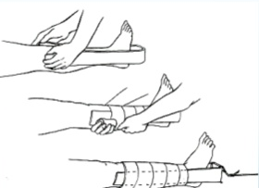
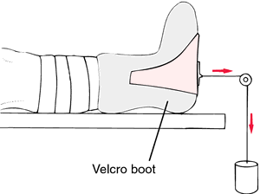
BUCK TRACTION
Used in temporary managment of fractures of
Can use tape or premade boot
Not more than 4.5 kg
Not used to obtain or hold reduction
Femur neck
Femur shaft in older children
Undisplaced fracture of acetabulum
After reduction of a hip dislocation
To correct minor flexed deformity
In place of pelvic traction in management of low back pain

Slide 9
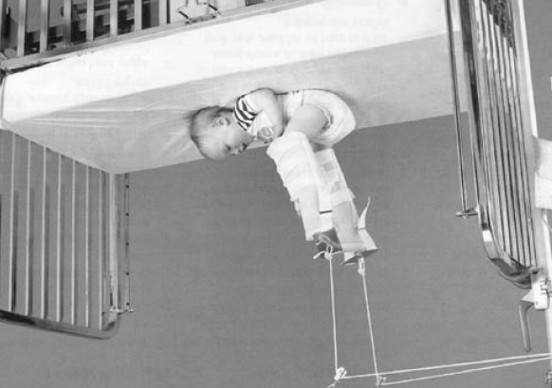
SKIN TRACTION
GALLOS\BRAYANTS TRACTION
Its a type of skin traction applied in both limb for fracture shaft femur in upper third or upper third middle third junction in infants and traction is given via long rope via two pulleys on balkan frame and the weight is to be adjusted in such a way the buttocks of patient remains slightly higher than the mattress and head end is to be raised to give counter-traction. Traction should be continued till radiological evidence of union.
ADVANTAGE
Reduced the fracture well particularly in upper third when proximal fragment is gone into flexion due to iliopsoas pull
No anaesthesia required.
Cosmetically well accepted as there is no scar.
DISADVANTAGE
Skin blisters
Less accuracy of reduction
At time requires goose splint.
Circulatory Disorders

Slide 10
TYPES
DUNLOP TRACTION
This traction is only meant for comminuted intraarticular fracture of lower end of humerus at any age when patient is not medically fit for anaesthesia
In this skin traction is applied over the forearm with big spreader to keep hand and wrist free and then with the rope traction is applied via pulley over the frame and sling is applied over the arm with weight to give counter traction.
Weight should be adjusted at both the sides to keep the fragments in proper alignment and when fracture is glued or become sticky then chances of displacement is less and then plaster is applied or as minimally invasive k wire are passed for maintaing reduction.
ADVANTAGES
Cosmetically very well accepted
Post operatively serviceable range of movement achieved
No anaesthesia
DISADVANTAGES
Skin blisters
Over all alignment via ligamentotaxis but exact anatomical reduction not possible.

Slide 11
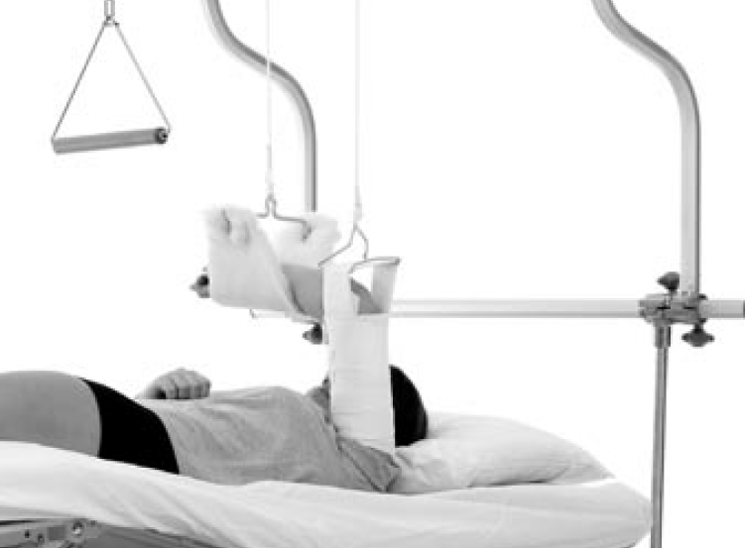
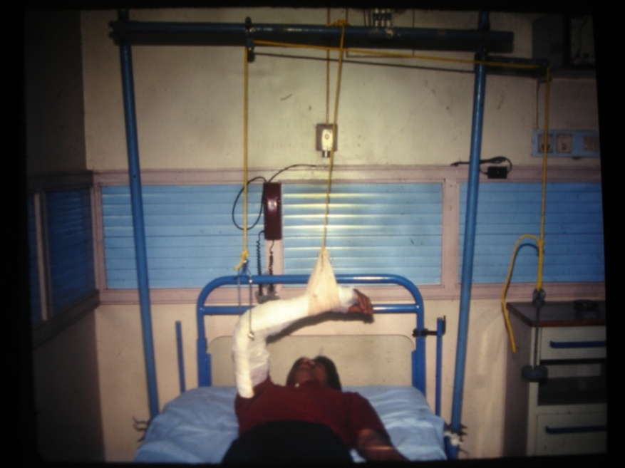
ADHESIVE SKIN TRACTION
OVERHEAD TRACTION
The purpose of overhead traction is also same dunlop traction where skin traction given via arm with spreader and weight is put via over head pulley in the balkan frame. forearm is supported with the sling.
Can be used for comminuted fracture of shoulder .
ADVANTAGES and DISADVANTAGES are same as that of Dunlop traction
Same traction can be given with skeleton traction on olecranon for comminuted fracture of humerus
DISADVANTAGE
The only disadvantage is that of pintract infection and loosening of the pin
Same traction is used for pelvic fracture with pelvic sling

Slide 12
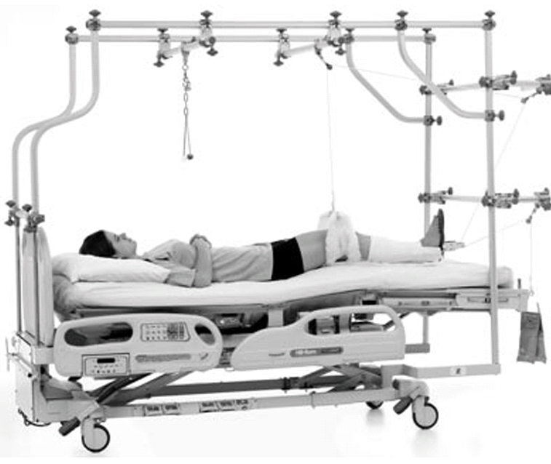
HAMILTON RUSSEL TRACTION
INDICATIONS:
Mainly for the supracondylar femur fractures
Treatment of certain type of knee injuries
Treatment of shaft femur or pelvic fractures
Position is supine ,with buck traction over leg and sling proximal to knee over supracondylar region which is to be given over pulley on a balkan frame
Same traction can be used for mobilisation of knee with longitudinal traction on balkan frame
ADVANTAGES
DISADVANTAGES
No anaesthesia – when patient not fit
No scar so cosmetically effective – longitudinal alignment via ligamentotaxis
Use for conservative management
Skin blisters
Not very accurate reduction
Bed sores
And others

Slide 13
SKELETAL TRACTION
This type of traction is used when skin traction is contraindicated or old malunited fractures
In this type of traction STEINMANN PIN, DENHAM PIN, HIP SOCIETY SCREW or KRISHNERS WIRE is used
These pins are inserted in the bone and traction is given
More frequently used in lower limb fractures

Slide 14
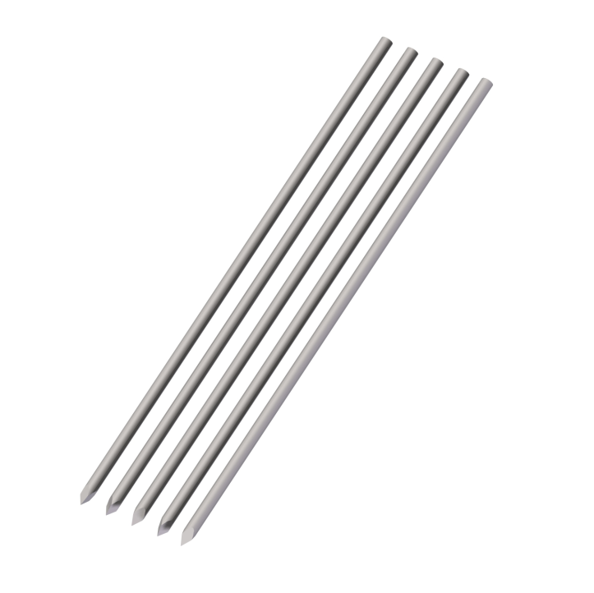
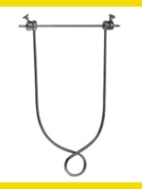
  Steinmann Pin
  Rigid stainless steel pins of varying lengths 4 – 6 mm in diameter. Bohler stirrup is attached to steinmann pin which allows the direction of the traction to be varied without turning the pin in the bone

Slide 15
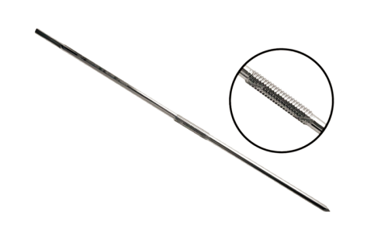
Denham Pin
Identical to stienmann pin except for a short threaded length in the center .
This threaded portion engages the bony cortex and reduce the risk of the pin sliding.
Used in cancellous bone like calcaneum and osteoporitic bones.

Slide 16
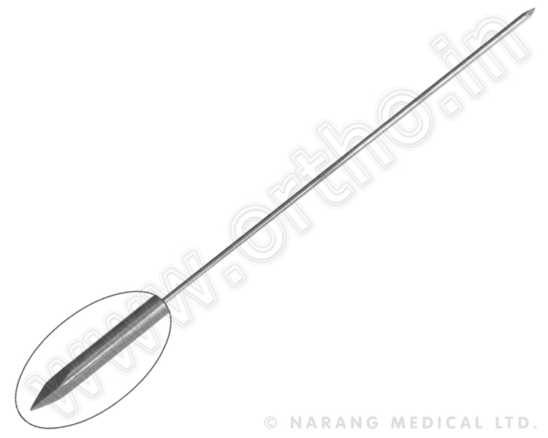
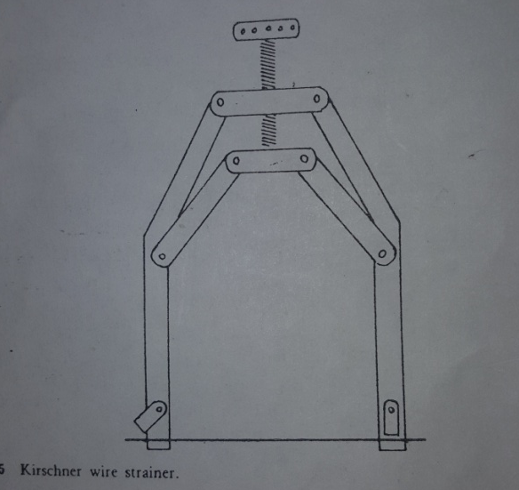
Kirschner wire
They are easy to insert and minimize the chance of soft tissue damage and infections,
It easily cuts out of the bone if a heavy traction weight is applied, Most commonly used in upper limb eg. Olecranon traction

Slide 17
SITES
  Olecranon
  Metacarpal
  Upper end femur
  Lower end of femur
  Upper end of tibia
  Lower end of tibia
  Calcaneum

Slide 18
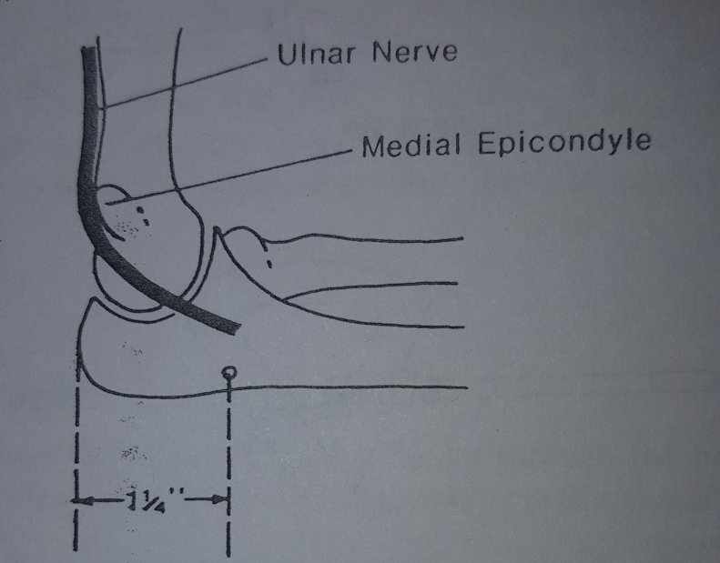
OlECRANON
ENTRY - Just deep to the subcutaneous border of the upper end of the ulna,3 cm distal to the tip of the olecranon.
This avoids the joint.
DIRECTION - MEDIAL to LATERAL
CARE – ULNAR NERVE

Slide 19
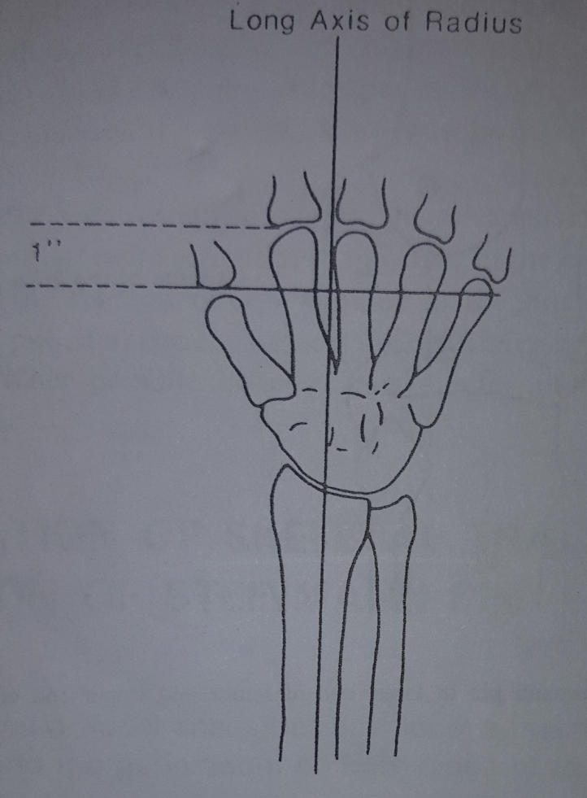
METACARPELS
ENTRY – 2.0-2.5 cm proximal to the distal end of the second metacarpal.
The wire traverses the second and third metacarpals transversely at right angle to the longitudinal axis of the RADIUS

Slide 20
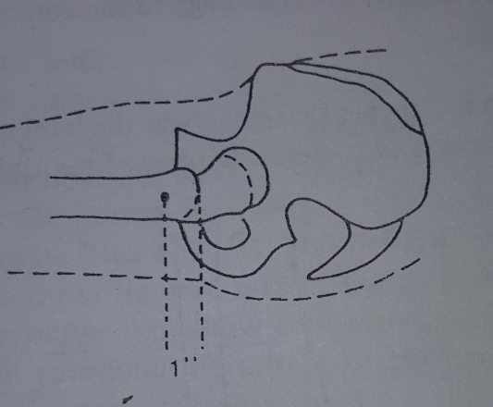
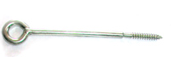
UPPER END OF FEMUR
ENTRY – lateral surface of femur 2.5 cm below the most prominent part of the trochanter, mid-way between the anterior and posterior surface of the femur
HIP SOCIETY SCREW is used.

Slide 21
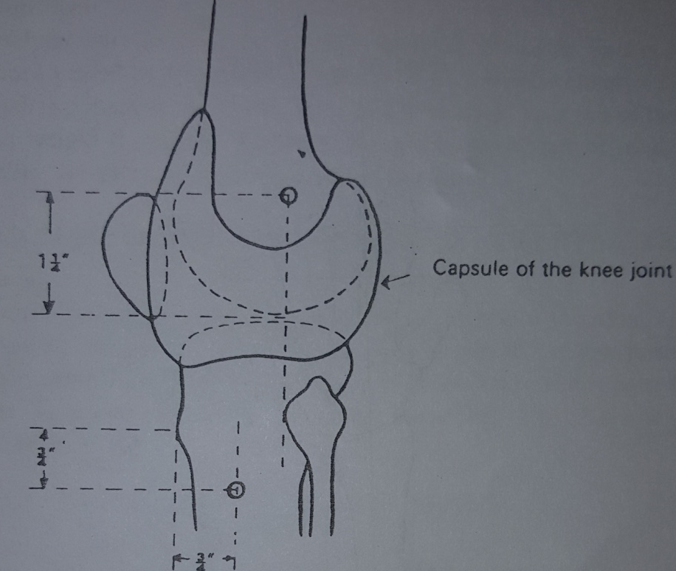
LOWER END OF FEMUR
ENTRY – The point at which line from before backwards at the level of the upper pole of the patella and the second line from below upwards ant. to the head of the fibula meet.
OR
Just proximal to the upper limit of the lateral condyle. In an avg adult this point is 3.0 cm proximal to the articulation between the lateral femoral condyle and the lateral tibial plateau.
OR
2cm anterior and 2cm proximal to the Adductor tubercle.
DIRECTION - Medial to lateral
CARE – Avoid knee joint
Avoid neuro vascular bundle
REMOVE THE ST PIN BY TWO WEEKS AND REPLACE IT BY ST PIN IN UPPER END OF TIBIA BECAUSE IT CAN LEAD TO STIFFNESS IN KNEE JOINT DUE TO PROLONGED TRACTION.

Slide 22

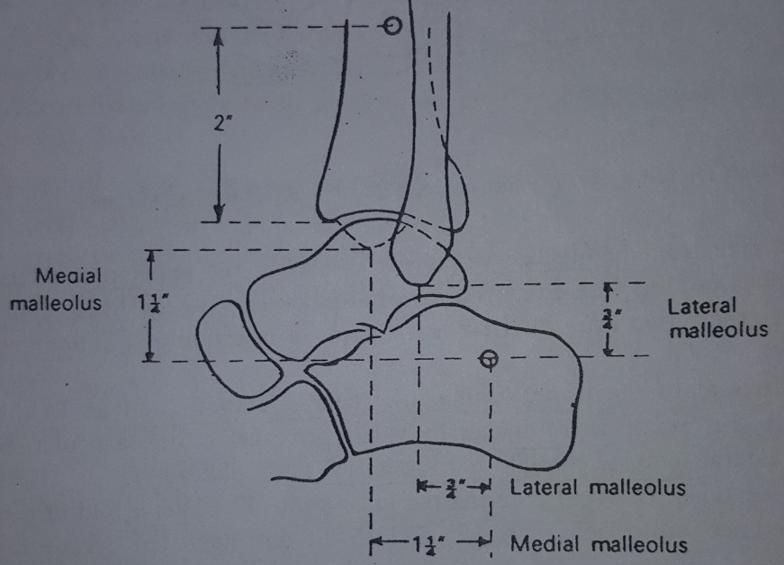
UPPER END OF TIBIA
ENTRY – 2.0 cm behind the crest,just below the level of tubercle of tibia.
DIRECTION – LATERAL to MEDIAL
AVOID – COMMON PERONEAL NERVE.
LOWER END OF TIBIA
ENTRY – 5cm above the level of the ankle joint, mid-way between the ant. and the post. borders of tibia

Slide 23
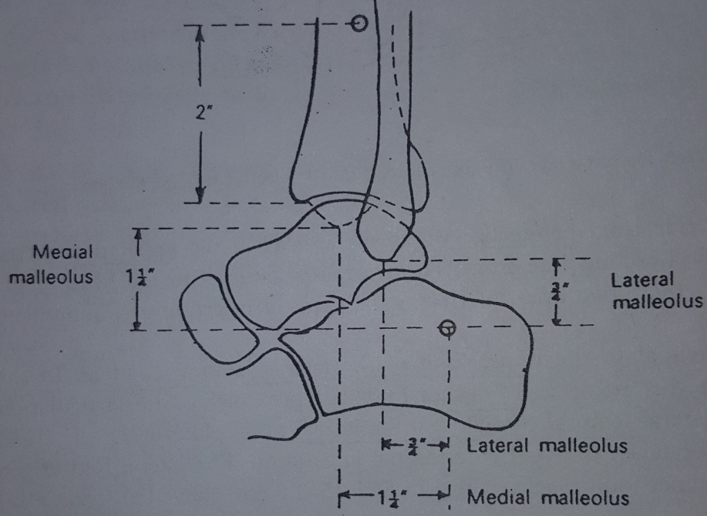
CALCANEUM
ENTRY - 2.0 cm below and 2.0 cm behind the lateral malleolus more posterior and distal than the medial malleolus.
CARE – Avoid SUBTALAR JOINT
INSERTING THE CALCANEAL PIN LEADS TO THE STIFFNESS OF THE SUBTALAR JOINT SO AS FAR AS POSSIBLE INSERT IT IN THE LOWER END OF THE TIBIA

Slide 24
Ninety-Ninety Traction
Useful for subtrochanteric and proximal 3rd femur fracture.
Especially in young children.
Matches flexion of proximal fragment.
Can cause flexion contracture in adult.

Slide 25
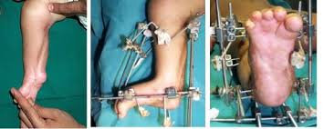
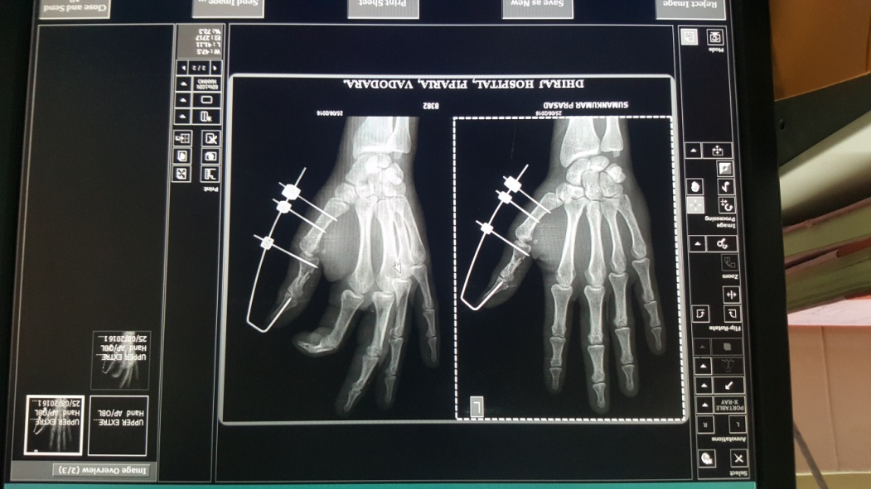
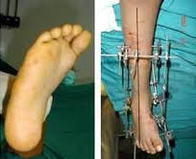
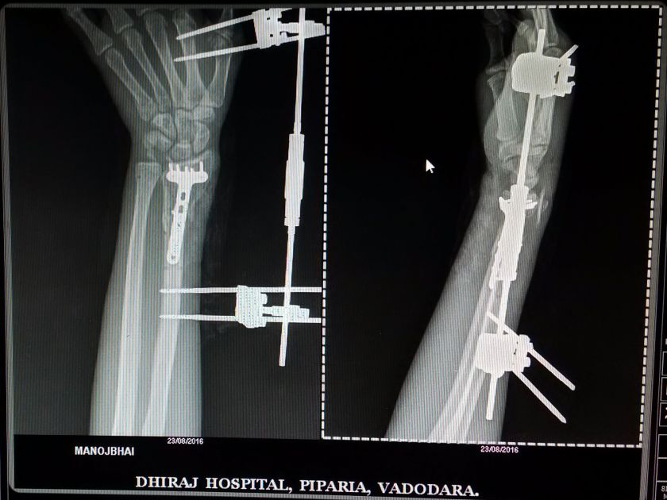
PORTABLE TRACTION
B.B. JOSHI FRAME
This is used in congenital talipo equino varus(CTEV) deformity.
Also in fractures of hand and wrist
RADIAL DISTRACTOR
Used in fractures of distal un of radius.

Slide 26
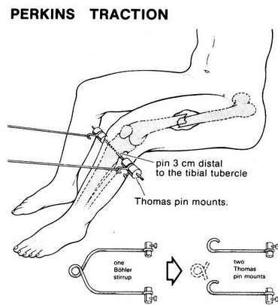
Perkin’s traction
Treatment of fractures of tibia and of the femur from the subtrochanteric region distally.
  Basis of management is the use of skeletal traction coupled with active movements of the injured limb.

Slide 27
Application
  Use GA or LA.
  Paint the skin with BETADINE and spirit.
  Mount the pin/wire on the hand drill.
  Hold the limb in same degree of lateral rotation as the normal limb and with ankle at right angles.
  Identify the site of insertion and make a stab wound.
  Hold the pin horizontally at right angles to the long axis of the limb.
  Apply small cotton woolen pads soaked in betadine around the pins to seal the wound.
  The pin should pass only through skin, SC tissue and bone avoiding muscles and tendons.

Slide 28
COMPLICATIONS
Introduction of infection into bone.
Distraction at fracture site.
Ligamentous damage.
Damage to epiphyseal growth plates.
Depressed scars.

Slide 29
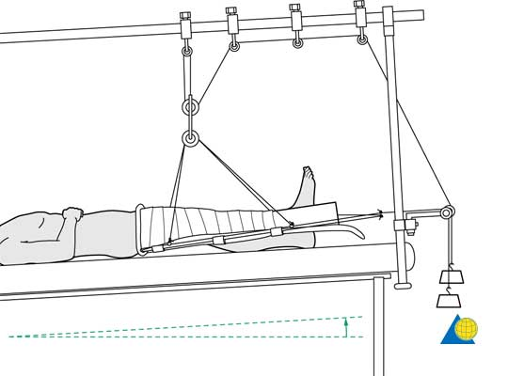
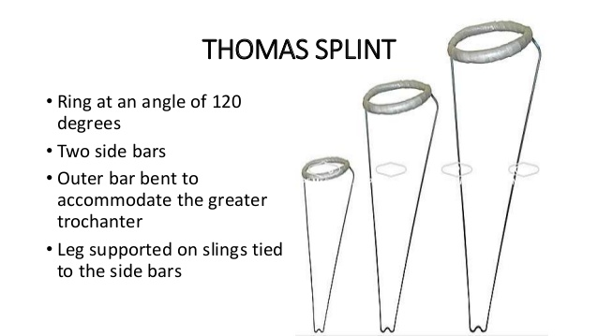
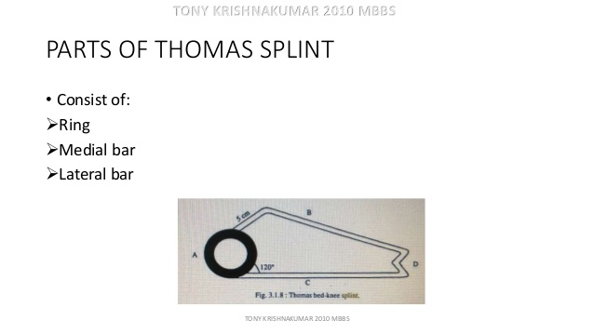
INSTRUMENTS USED FOR TRACTION
THOMAS SPLINT
Most comm0nly used in fractures of shaft of femur

Slide 30
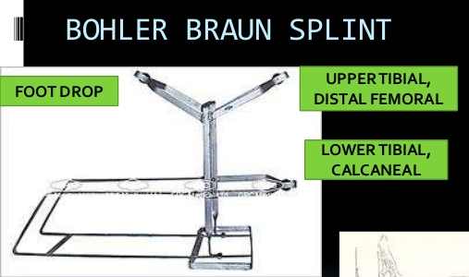
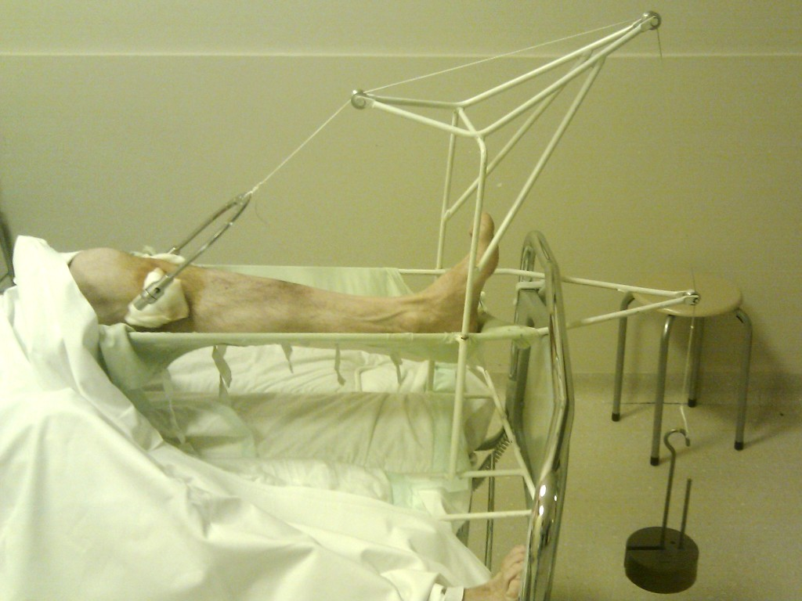
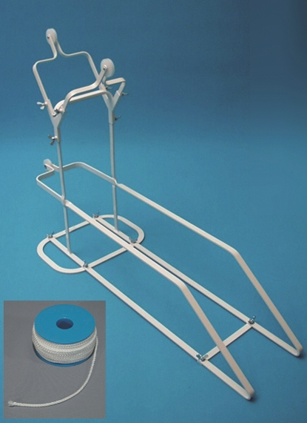
BOHLERS SPLINT
USES – Fractures of distal end
of femur
- Fractures of proximal,
shaft and distal tibia.
- Elevation in post-
operative patients

Slide 31
MCQ 1
Thomas splint is used to immobilise:
Inter-trochanteric femur fractures
Proximal humerus fractures
Forearm fractures
Ankle fractures

Slide 32
MCQ 2
Types of traction include:
Skin traction
Skeletal traction
Both of the above
None of the above

Slide 33

MCQ 3
Name of the traction:
Thomas splint
Bohler braun splint
Dunlop traction
Sugartong splint

Slide 34
MCQ 4
Portable traction includes:
Radius – ulna distractor
Ilizarov
Joshi external stabilisation system
All of the above

Slide 35
MCQ 5
Ninety ninety traction is given for:
Femur shaft fractures in children
Femur shaft fractures in adults
Tibia shaft fractures in children
Tibia shaft fractures in adults

Slide 36
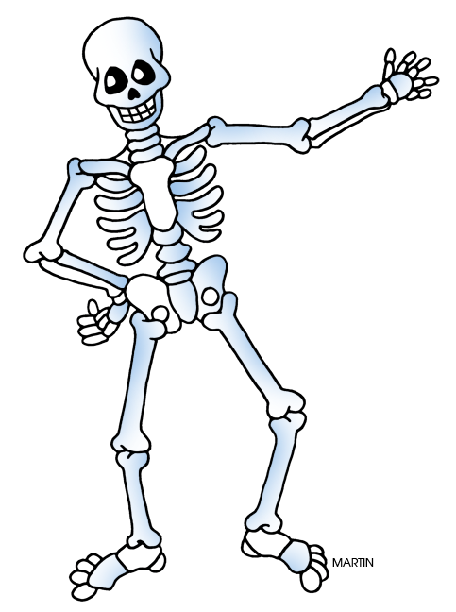
THANK YOU

