Slide 1
PHYSIOLOGY OF MICTURITION

Slide 2
MICTURITION
Process by which urinary bladder empties when it becomes filled.

Slide 3
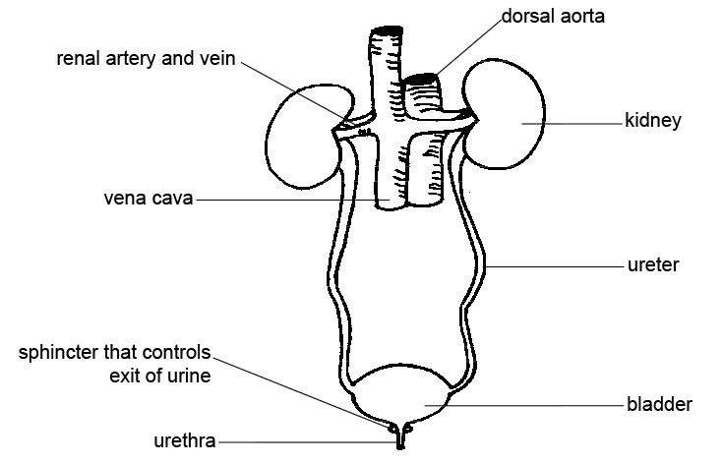
Functional Anatomy

Slide 4
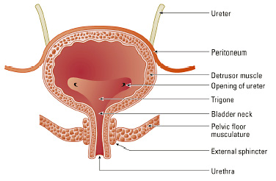
Physiologic anatomy of bladder
Body :
made up of Detrusor muscle, fibres extends in all directions
Contraction of detrusor causes emptying of the bladder
The Trigone : small tringular area at which both ureter and urethra pass
Notes:
(increase pressure in bladder to 40-60 mmHg)

Slide 6
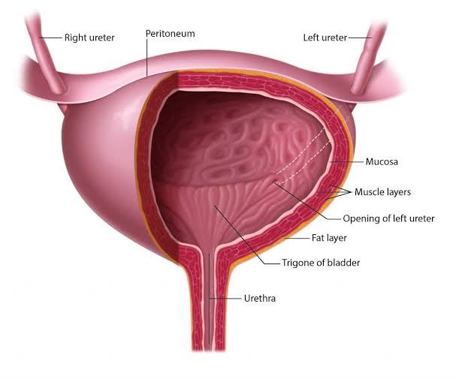

Slide 7
The Internal sphincter : made up of trigonal muscle fiber
Maintain tonic closure of urethral opening
Prevent reflux of semen into bladder during ejaculation
Under autonomic control
The external sphincter : made up of voluntary skeletal muscle and under voluntary control

Slide 8
Interior of the bladder. In an empty bladder, the greater part of the mucosa shows irregular folds due to its loose attachments to the muscular coat. The interior of the base (posterior surface) of the bladder presents a triangular area, the trigone where the mucosa is smooth due to its firm attachment.
Urinary bladder is formed of smooth muscle known as detrusor muscle. It mainly
consists of body and neck. Neck is a funnel-shaped extension of the body that connects with urethra.
Ureters enter the bladder obliquely through the detrusor. This prevents back flow of urine.
Bladder neck is 2 to 3 cm long. Muscle in this area is known as internal sphincter. Its natural tone prevents emptying of bladder until pressure in the bladder rises to a critical level. Beyond the posterior urethra, urethra passes through the urogenital diaphragm which contains a layer of muscle called external sphincter. It is formed of a voluntary (skeletal) muscle and is under voluntary control. (indu-guyton)
Female do not have internal urethral sphincter

Slide 9
Innervation of the Bladder
Parasympathetic fibers(S2,3,4)
Sympathetic fibers(T11,L2)
Somatic fibers(S2,3,4)
Notes:
Parasympathetic fibers originate from the sacral 2,3 and 4 segments of spinal cord and reach the bladder via pelvic nerves
Sympathetic fibers originate from lumbar 1,2 and 3 segment of spinal cord and reach the bladder via hypogastric nerve
Somatic fibers originate from S2,S3 and S4 and innervate bladder and external sphincter via pudendal nerve

Slide 10
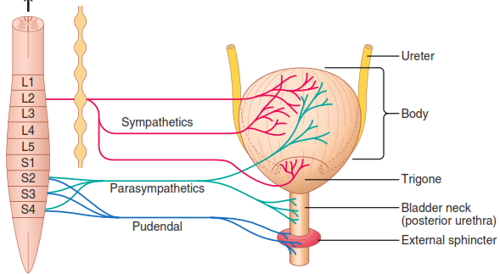
Innervation of the Bladder
Hypogastric nerves

Slide 11
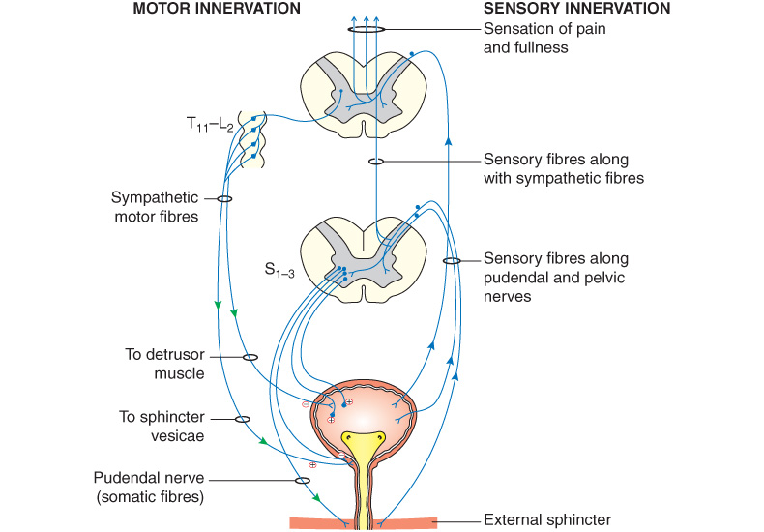

Slide 12
Innervation of the Bladder. The principal nerve supply of the bladder is by way of the pelvic nerves, which connect with the spinal cord through the sacral plexus, mainly connecting with cord segments S2 and S3 (Figure 26-7). Coursing through the pelvic nerves are both sensory nerve fibers and motor nerve fibers. The sensory fibers detect the degree of stretch in the bladder wall. Stretch signals from the posterior urethra are especially strong and are mainly responsible for initiating the reflexes that cause bladder emptying.
The motor nerves transmitted in the pelvic nerves are parasympathetic fibers. These fibers terminate on ganglion cells located in the wall of the bladder. Short postganglionic nerves then innervate the detrusor muscle.
In addition to the pelvic nerves, two other types of innervation are important in bladder function. Most important are the skeletal motor fibers transmitted through the pudendal nerve to the external bladder sphincter. These fibers are somatic nerve fibers that innervate and control the voluntary skeletal muscle of the sphincter. Also, the bladder receives sympathetic innervation from the sympathetic chain through the hypogastric nerves, connecting mainly with the L2 segment of the spinal cord. These sympathetic fibers stimulate mainly the blood vessels and have little to do with bladder contraction.
Some sensory nerve fibers also pass by way of the sympathetic nerves and may be important in the sensation of fullness and, in some instances, pain. (guyton)

Slide 13
Functions of urinary bladder
Storage of urine
Emptying urine

Slide 14
Process of Micturition
Physiological mechanisms:
  Filling of bladder
  Emptying of bladder

Slide 15
FILLING OF URINARY BLADDER
Capacity of the bladder
- Physiological capacity: 250 – 450 ml
[20-50 ml at birth, 200 ml at 1 year]
- Anatomical capacity: 700-800 ml

Slide 16
Transport of urine into urinary bladder through ureters
Urine formed in the kidney collected in the renal pelvis, the pressure in the pelvis increases and initiates a peristaltic contraction beginning in the pelvis and spreading along the ureter to force urine towards the bladder.
Peristaltic waves in ureters originate by a pacemaker tissue located close to the calyces.
Regurgitation of urine back into ureter is prevented by valvular flap
Capacity of the bladder
Physiological capacity of the bladder varies with age, being 20–50 mL at birth, about 200 mL at 1 year, and can be as high as 600 mL in young adult males. In all cases, the physiological capacity is about twice that at which the first desire to void is felt.
Volume and pressure changes in bladder during filling
The normal bladder is completely empty at the end of micturition and the intravesical pressure is equal to the intraabdominal pressure. As the bladder is filled up, it adjusts its tone and a fairly large volume of urine can be accommodated with minimal alterations in the intravesical pressure. This is possible because of the phenomenon of adaptation. The adaptation occurs because of the inherent property of plasticity, the smooth muscles of detrusor and because of law of Laplace(p=t/r).
States that the pressure in spherical viscus is equal to twice the wall tension divided by radius

Slide 17
Cystometry
Process of studying the relationship b/w the intravesical volume and pressure
Cystometrogram: graphical record of this relationship.
Notes:
Process of studying the relationship b/w the intravesical volume and pressure

Slide 18
The normal bladder is completely empty at the end of micturition and the intravesical pressure is equal to the intraabdominal pressure. As the bladder is filled up, it adjusts its tone and a fairly large volume of urine can be accommodated with minimal alterations in the intravesical pressure. This is possible because of the phenomenon of adaptation. The adaptation occurs because of the inherent property of plasticity, the smooth muscles of detrusor and because of law of Laplace(p=t/r).
States that the pressure in spherical viscus is equal to twice the wall tension divided by radius

Slide 19
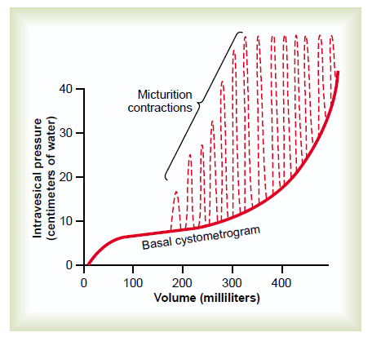
Normal Cystometrogram
ii
ib
ia

Slide 20
Three phases of filling
Phase Ia: It is the initial phase of filling in which pressure rises from 0 to 10 cm H2O, when about 50 mL of fluid is collected in the bladder.
Phase Ib: It is the phase of plateau which lasts till the bladder volume is 400 mL. pressure remains at 10 cm H2O
Phase II: This phase starts beyond 400 mL volume when the pressure begins to rise markedly, triggering the micturition reflex.
Normally, the voiding contraction raises the intravesical pressure by about 20–40 cm H2O. If voiding is avoided , the pressure rises from 10 cm H2O onward, as shown by dotted lines beyond the phase II in
Beyond 600 mL, the urge to void urine becomes almost unbearable.

Slide 21
1.Law of Laplace
The pressure in a spherical organ is equal to twice the wall tension divided by the radius.
P=2T/R
2.Phenomenon of adaptation
i.e property of plasticity
As the bladder is filled up, it adjusts its tone and a fairly large volume of urine can be accommodated with minimal alterations in the intravesical pressure.

Slide 22
Cystometry. This refers to the process of studying the relationship between the intravesical volume and pressure, the cystometrogram refers to a graphical record of this relationship.
Normal cystometrogram shows three phases of filling (Fig. 6.7-3):
Phase Ia. It is the initial phase of filling in which pressure rises from 0 to 10 cm H2O, when about 50 mL of fluid is collected in the bladder.
Phase Ib. It is the phase of plateau which lasts till the bladder volume is 400 mL. During this phase, the pressure in the bladder does not change much and remains approximately at 10 cm H2O. This is because of adaptation of urinary bladder by relaxation, as described above.
Phase II. This phase starts beyond 400 mL volume when the pressure begins to rise markedly, triggering the micturition reflex. Normally, the voiding contraction raises the intravesical pressure by about 20–40 cm H2O. If voiding is avoided (not initiated), the pressure rises from 10 cm H2O onward, as shown by dotted lines beyond the phase II in
Fig. 6.7-3. Beyond 600 mL, the urge to void urine becomes almost unbearable.

Slide 23
EMPTYING OF THE BLADDER
Emptying of the urinary bladder focuses on:
    Micturition reflex,
    Voluntary control of micturition and
    Role of perineal and abdominal muscles in micturition.
Notes:
Emptying of the bladder is basically a reflex action called the micturition reflex, which is controlled by supraspinal centres and is assisted by contraction of perineal and abdominal muscles. Therefore, emptying of the urinary bladder focuses on:

Slide 24
Micturition reflex
Initiation: Stretch receptors in the bladder wall.
Stimulus: About 300mL of urine
First urge to empty the bladder at approx 150ml but it can be easily suppressed
Afferents: Stretch receptors → pelvic nerves → sacral segment of spinal cord → sacral micturition centre
Notes:
Stimulus: Filling of bladder by 300–400 mL of urine in adults constitutes the adequate stimulus for he micturition reflex to occur.
Afferents: The afferents from the stretch receptors in the detrusor muscle and urethra travel along the pelvic nerves and enter the sacral segment of spinal cord through dorsal roots to S 2 , S 3 and S segments to reach the sacral micturition centre
Sacral micturition centre is formed by the sacral detrusor nucleus and sacral pudendal nucleus.
Efferents arising from the sacral detrusor nucleus are the preganglionic parasympathetic fibres, which relay in the ganglia near or within bladder and urethra

Slide 25
Micturition Reflex : Reflex control of Micturition
Efferents: Pre-ganglionic parasympathetic fibres through same nerves.
Post-ganglionic parasympathetic fibres:
- excitatory to the detrusor muscle and
- inhibitory to the internal sphincter.

Slide 26
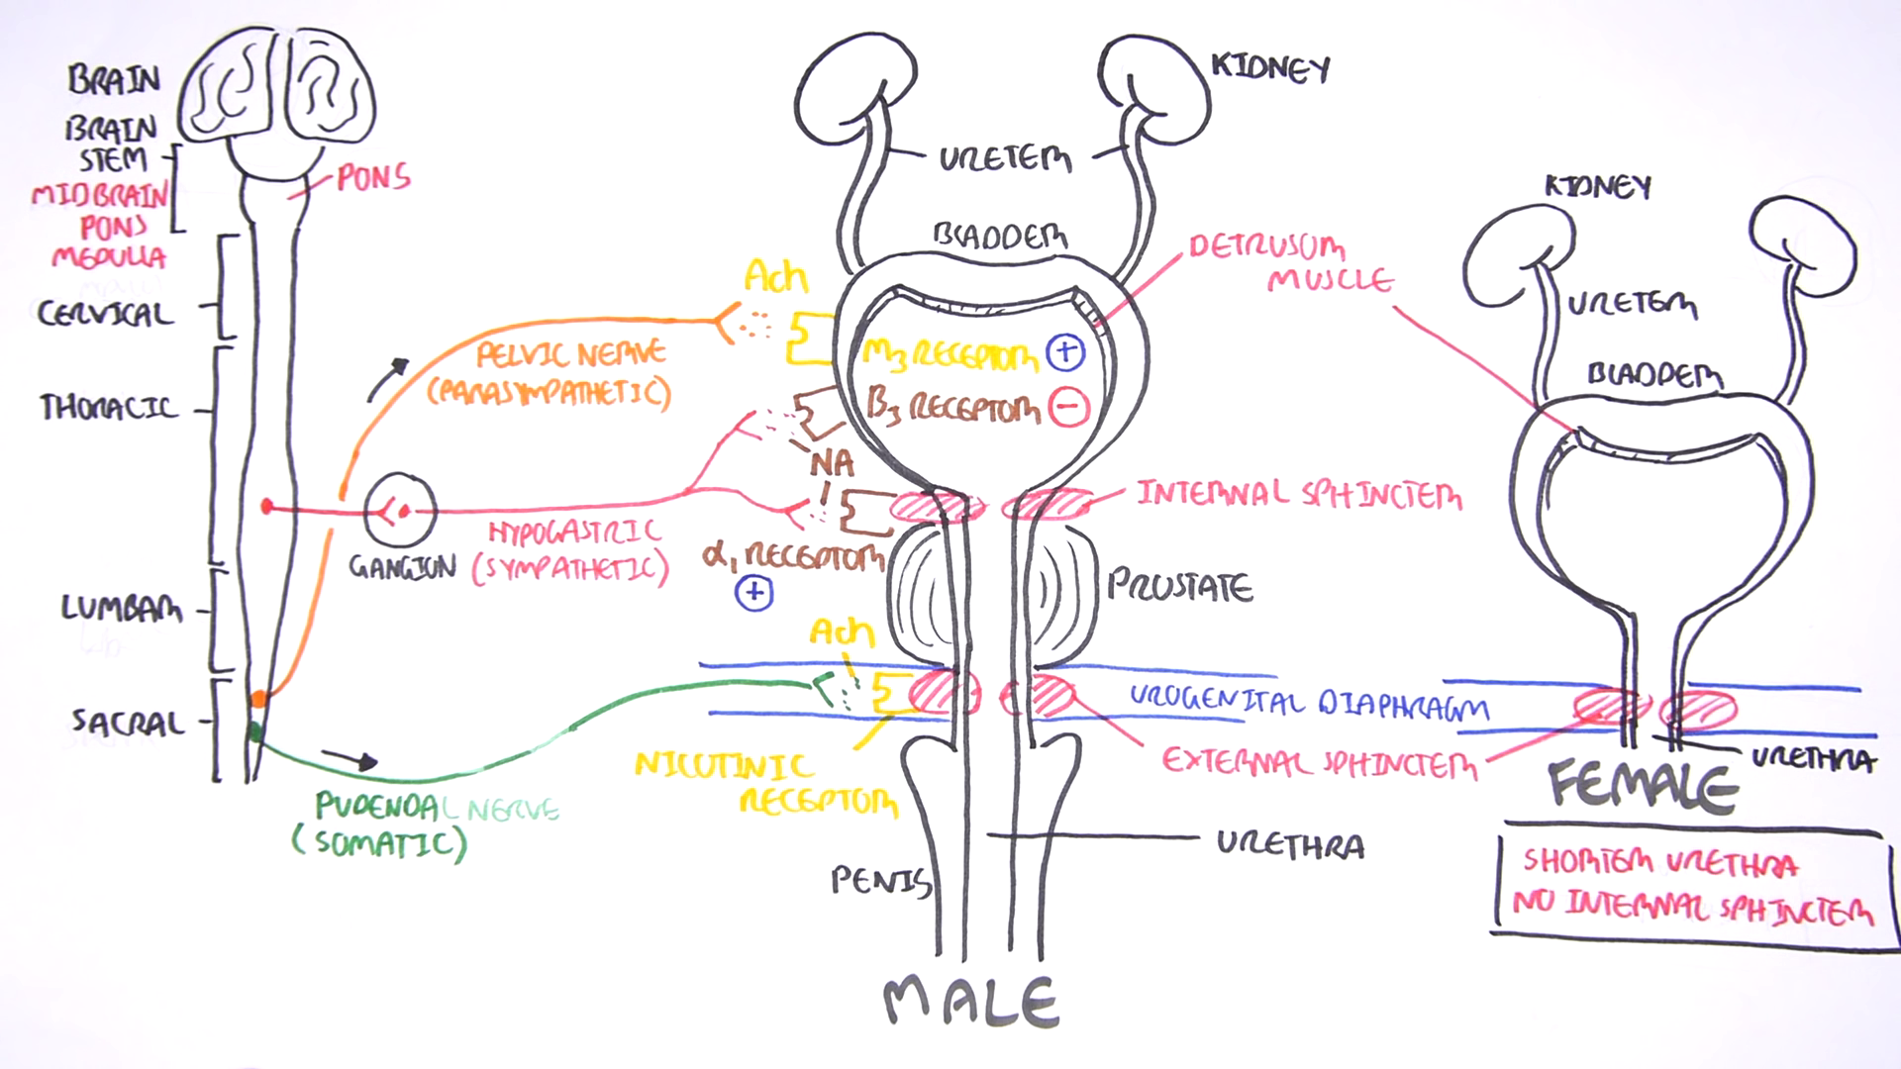
Micturition reflex

Slide 27
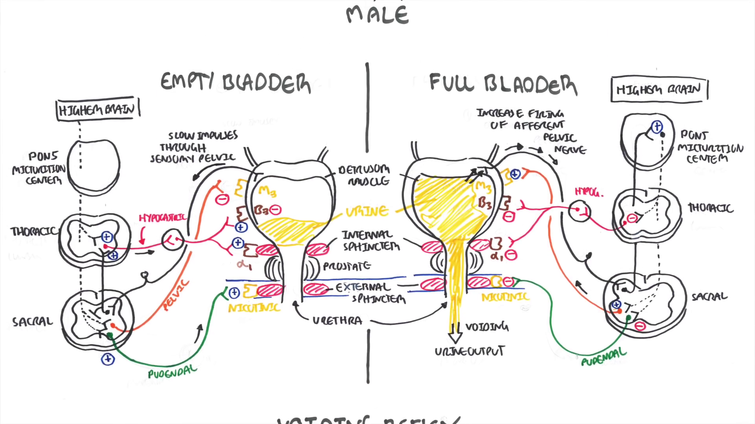

Slide 28
Response. Once initiated, it is self-regenerative
The cycle keeps on repeating until the bladder has reached a strong degree of contraction.
Once the micturition reflex becomes powerful enough, this causes another reflex which passes through pudendal nerves to external sphincter to cause its inhibition.
If this inhibition is more potent than the voluntary constrictor signals from brain, then urination will occur.
If not so, urination will not occur unless the bladder fills still more and micturition reflex becomes more powerful
Notes:
Self-regenerative, i.e. initial contraction of the bladder wall further activates the receptors to increase the sensory impulses (afferents) from the bladder and urethra which cause further increase in the reflex contraction of detrusor muscle of the bladder.

Slide 29
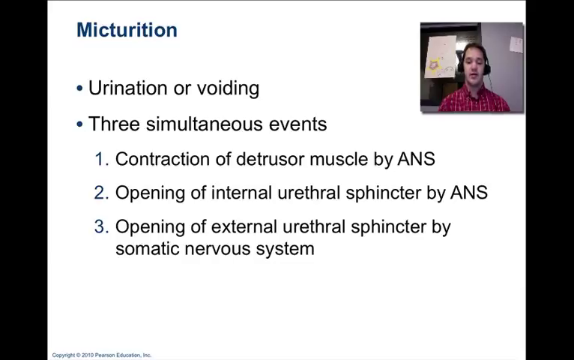
Notes:
[No role of sympathetic fibers in micturition process but sympathetic activation causes contraction of bladder muscle that prevent semen from entering the bladder during ejaculation]

Slide 30
Mechanism of Micturition
Filling of bladder
Urge to pass urine is initiated
Sensed by stretch receptor (bladder wall)
Impulse passes via afferent nerve
Initiate reflex contraction
Parasympathetic stimulation

Slide 31
Contraction of detrusor and relaxation of internal sphincter
Urine passes forcefully into urethra
Contraction of abdominal muscle & Descent of diaphragm
Increase intra abdominal pressure
Pelvic, perineal and levator ani muscle relax
Downward pull of detrusor muscle

Slide 32
Once in urethra, urine empties in female by effect of gravity and pressure from pelvic floor
In male by contraction of bulbocavernous muscle
The voluntary contraction of abdominal muscle help in urination

Slide 33
The micturition reflex is a single complete cycle of:
1. Progressive and rapid increase of pressure
2. A period of sustained pressure
3. Return of the pressure to the basal tone of the bladder
Once a micturition reflex has occurred but has not succeeded in emptying the bladder, the nervous elements of the reflex remain in an inhibited state for 1 minute up to an hour before the reflex occurs again
It is a “self regenerative”
As bladder becomes more and more filled, micturition reflexes occur more and more often and more and more powerfully

Slide 34
Facilitation or Inhibition of Micturition by Brain
Role of Higher center
The micturition reflex is completely autonomic spinal cord reflex but it can be inhibited or facilitated by centres in the Brainstem
Voluntary urination

Slide 35
Facilitation or Inhibition of Micturition by the Brainstem.
1. The higher centers can prevent micturition, even if the micturition reflex occurs, by tonic contraction of the external sphincter until a convenient time presents itself.
2. When it is time to urinate, the cortical centers can facilitate the sacral micturition centers to help initiate a micturition reflex
Notes:
The micturition reflex is the basic cause of micturition, but the higher centers normally exert final control of micturition as follows:
Voluntary urination is usually initiated in the following way: First, a person voluntarily contracts his or her abdominal muscles, which increases the pressure in the bladder and allows extra urine to enter the bladder neck and posterior urethra under pressure, thus stretching their walls. This action stimulates the stretch receptors, which excites the micturition reflex and simultaneously inhibits the external urethral sphincter. Ordinarily, all the urine will be emptied, with rarely more than 5 to 10 milliliters left in the bladder.

Slide 36
Voluntary urination
- Person voluntarily contracts his abdominal muscles
Increases the pressure in the bladder and allows extra urine to enter the bladder neck under pressure
stretching their walls
stimulates the stretch receptors
excites the micturition reflex
simultaneously inhibits the external urethral sphincter
urine will be emptied
no urine is left after urination

Slide 37
Development of reflex
In children, below 3 years of age, cortical inhibition is not well developed, hence they often pass urine without their knowledge.
Control on urination starts to develop at about 2 years of age and completes by 3 years.

Slide 38
ABNORMALITIES OF MICTURITION

Slide 39
Nocturnal enuresis
Also called bedwetting.
Normally seen in infants and children below 3 yrs because cortical inhibition is not well developed.
If it occurs after 3 yrs, considered abnormal and may be due to lumbosacral defects, psychological or impairment in motor area of cerebral cortex.

Slide 40
Deafferentation (Atonic bladder)
Destruction of sensory nerve fibres
-reflex contraction is abolished
despite intact efferent and neurogenic connections
-Bladder is distended ,thin walled and hypotonic
- Overflow dribbling
Causes:
- syphilis, crush injury to spinal cord

Slide 41
Effect of deafferentation or atonic bladder
The destruction of sensory nerve fibres from the bladder to spinal cord prevents transmission of stretch signals from the bladder and therefore, also prevents micturition reflex contractions.
– In these conditions, the person loses all bladder control despite intact efferent fibres from the cord to the bladder and despite intact neurogenic connections with brain.
Instead of emptying periodically, the bladder fills to capacity and overflows a few drops at a time through the urethra. This is called overflow dribbling.

Slide 42
Denervation
When both afferent and efferent fibers are cut
- The bladder is flaccid and distended at the beggining
-however gradually muscle become active and empties urine in form of Dribbling
- later , Bladder shrunken and bladder wall hypertrophies
Cause :tumors of cauda equina
Notes:
Gradually the muscle of the bladder becomes active and the contraction of the bladder muscle removes urine in the form of dribbles.
Later, the bladder shrinks and bladder wall becomes hypertrophied
This is typically seen in the tumors of cauda equina.
The hyperactive bladder suggests denervation hypersensitivity of bladder muscles

Slide 43
Spinal cord transection
Three phases:
- Phase of shock
- Phase of recovery
- Phase of failure

Slide 44
Phase of spinal shock:
- Bladder becomes flaccid and unresponsive
- Overflow incontinence ( dribbling of urine)
Phase of recovery:
- Micturition reflex is the first reflex activity to return
- Voluntary control abolished
- Bladder capacity decreased & muscle hypertrophied
Phase of failure:
- Infection of bladder makes the reflex activity worse

Slide 45
MCQ
1. Emptying of bladder is function of:
A) Sympathetic innervation
B) Parasympathetic
C) Somatic
D) Pudendal nerve

Slide 46
2) The first urge to pass urine is felt at a urinary bladder volume of about---ml
A) 50
B) 100
C) 150
D)250

Slide 47
3) In normal adult sense of fullness or discomfort is felt when urinary bladder volume is about---ml
A)200
b)400
C)700
D)800

Slide 48
4. filling of bladder up to 300-400 ml fluid increases the intra vesicular pressure to:
10 cm H2O
30 cm H2O
50 cm H2O
>100 cm H2O

Slide 49
4). Residual urine is
A) Urine left after micturition
B) A normal phenomenon
C) A common finding of examination anxiety
D) Never seen with bladder dysfunction

Slide 50
5. Pudendal nerve control:
Internal sphincter of urinary bladder
External sphincter of urinary bladder
Contraction of muscle in body of bladder
External sphincter of rectum

Slide 51
5) In young children micturition is;
A)Controlled by higher centre
B)A spinal reflex
C)Voluntarily controlled
D)A perfectly controlled activity

Slide 52
Thank you……

