Slide 1
Lipoproteins & Atherosclerosis
- Dr. Smita Vasava

Slide 2
Lipoproteins
Since lipids are insoluble in water, they need the help of carriers in plasma. Therefore, they are complexed with proteins to form lipoproteins.
The protein part of lipoprotein is called apolipoprotein.
Abbreviated as Lp.

Slide 3
Classification of Lipoproteins
Depending on the density (by ultra centrifugation) or on the electrophoretic mobility, the lipoproteins in plasma are classified into five major types.
1. Chylomicrons. Contains apoprotein B-48.
2. Very low density lipoproteins (VLDL) or prebetalipoproteins. Main apoprotein is B-100.
3. Intermediate density lipoproteins (IDL) or broad-beta lipoproteins

Slide 4
4. Low density lipoproteins (LDL) or betalipoproteins. Major apoprotein in LDL is B-100.
5. High density lipoproteins (HDL) or alphalipoproteins. Major apoprotein in HDL is apo-A.
Free fatty acids (FFA) or nonesterified fatty acids (NEFA) are complexed with albumin. FFAs are not generally included in the classification of lipoproteins, because they are loosely bound to the protein.

Slide 5
The lipoprotein molecules have a polar periphery made of proteins, polar heads of phospholipids and cholesterol.
The inner core consists of the hydrophobic TAGs and tails of phospholipids.
The apoproteins also increase the solubility of lipids.

Slide 6
Separation by Ultracentrifugation
The lipoproteins are characterised on the basis of their density.
Fat is less dense than water; so fat floats on water.
Lipoproteins with high lipid content will have a low density and so float on centrifugation.
Those with high protein content will sediment easily and have a high density.

Slide 7
Separation by Electrophoresis
Those with higher protein content will move faster towards the anode and those with fewer proteins have minimum mobility.

Slide 8
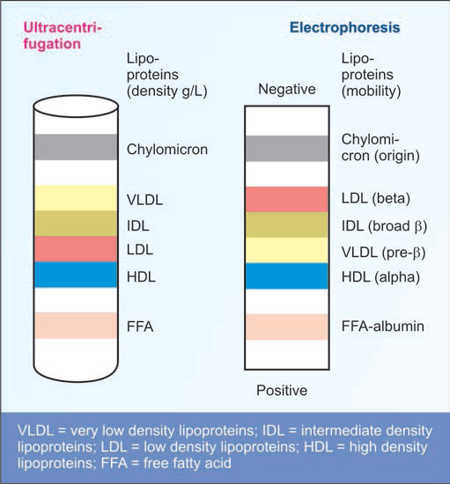

Slide 9
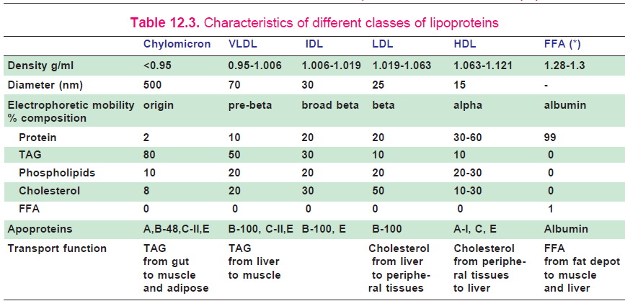

Slide 10
Apo-lipoproteins
The protein part of lipoprotein is called apolipoprotein (apo-Lp) or apoprotein.
All apoproteins are mainly synthesised in liver; but small quantities are produced from almost all organs. Intestinal cells produce small quantities of apo-A.
Apart from solubilising the lipid part, the protein components have specific functions.

Slide 11
1. Apo-A-I. It activates lecithin-cholesterol acyl transferase (LCAT). It is the ligand for HDL receptor. It is anti-atherogenic.
2. Apo-B-100. It is a component of LDL; it binds to LDL receptor on tissues. Apo-B-100 is one of the biggest proteins. It is synthesised in liver.
3. Apo-B-48. It is synthesized in intestinal cells. It is the structural component of chylomicrons.

Slide 12
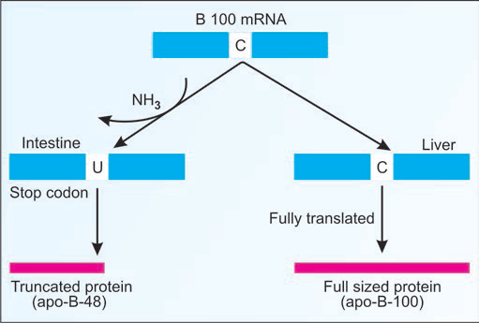
Apo-B-48 and Apo-B-100 are produced from the same gene. In liver, the mRNA is translated as usual (B-100). But in intestine, a particular cytosine residue is de-aminated, to become uracil. So, a stop codon is generated in the middle, and a short protein is produced in intestine (B48). Apo-B-48 is only 48% of the size of B-100

Slide 13
4. Apo-C-II. It activates lipoprotein lipase.
5. Apo-E. It is an arginine-rich protein. It is present in chylomicrons, LDL and VLDL.
Astrocytes also make apo-E; it is involved in cellular transport of lipids in CNS.

Slide 14
Function of Chylomicrons
Chylomicrons are the transport form of dietary triglycerides from intestines to the adipose tissue for storage; and to muscle or heart for their energy needs.
Function of VLDL
VLDL carries triglycerides (endogenous triglycerides) from liver to peripheral tissues for energy needs.

Slide 15
Function of LDL
About 75% of the plasma cholesterol is incorporated into the LDL particles.
LDL transports cholesterol from liver to the peripheral tissues.
The cholesterol thus liberated in the cell has three major fates:
i. It is used for the synthesis of other steroids like steroid hormones.
ii. Cholesterol may be incorporated into the membranes.
iii. Cholesterol may be esterified to a MUFA by acyl cholesterol acyl transferase (ACAT) for storage.

Slide 16
“bad cholesterol”.
LDL, especially oxidized and glycated LDL, creates a pro-coagulant surface on the endothelium, causing blood clot formation.
Oxidized LDL is found in higher levels in cigarette smokers, patients with diabetes mellitus and in insulin resistance.

Slide 17
Functions of HDL - “good cholesterol”.
i. HDL is the main transport form of cholesterol from peripheral tissue to liver, which is later excreted through bile. This is called reverse cholesterol transport by HDL.
ii. The only excretory route of cholesterol from the body is the bile.
iii. Excretion of cholesterol needs prior esterification with PUFA. Thus PUFA will help in lowering of cholesterol in the body, and so PUFA is anti-atherogenic.

Slide 18
Lipoprotein (a)
Lp(a) is very strongly associated with myocardial infarction.
Lp(a) is attached to apo-B-100 by a disulfide bond.
Lp(a) has significant homology with plasminogen.
So it interferes with plasminogen activation and impairs fibrinolysis.
This leads to unopposed intravascular thrombosis and possible myocardial infarction.

Slide 19
FREE FATTY ACID (FFA)
It is also known as nonesterified fatty acids (NEFA). It is complexed with albumin in plasma.
The FFA is derived from lipolysis of triglyceride stored in adipose tissue by hormone sensitive lipase.
The free fatty acids are either oxidised to supply energy or incorporated into tissue lipids by esterification.
During starvation, about 40-50% energy requirement of the body is met by oxidation of FFA.

Slide 20
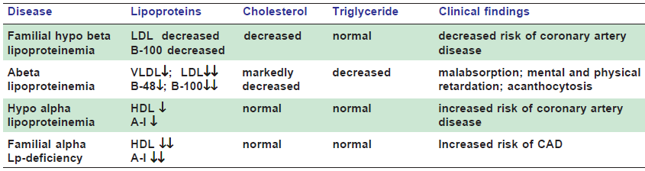
HYPOLIPOPROTEINEMIAS
Classification

Slide 21
HYPERLIPIDEMIAS
In all cases of hyperlipidemias, the elevated lipid fraction is either cholesterol or TAG or both.
Hence hyerlipidemias are classified (Frederickson's classification) into,
Hypercholesterolemia (Type IIa),
hypertriglyceridemia (Type I, IV and V) and
combined hyperlipidemia (Type IIb and Type III).

Slide 22
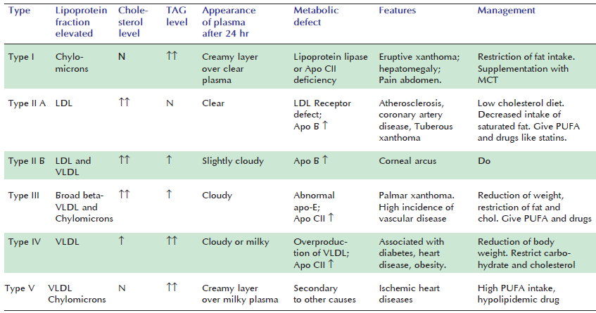
Frederickson’s classification of hyperlipoproteinemias

Slide 23
The elevation of lipids in plasma leads to the deposition of cholesterol on the arterial walls, leading to atherosclerosis.
Thromboembolic episodes in these vessels lead to ischemic heart disease and cerebrovascular accidents.
Notes:
The coronary and cerebral vessels are more commonly affected.

Slide 24
The deposition of lipids in subcutaneous tissue leads to xanthomas.
The type of xanthoma depends on the nature of lipid deposited.
Eruptive xanthomata are small yellow nodules associated with deposition of triglycerides. They disappear when the lipid level falls.
Tuberous xanthomata are yellow plaques containing triglycerides and cholesterol, found mainly over the elbows and knees.
Xanthelasma are lipid deposits under the periorbital skin and contain mainly cholesterol.
Tendinous xanthomata are found over the tendons.
Deposits of lipids in cornea lead to corneal arcus; indicating hyper cholesterolemia.

Slide 25
Type II A (Primary familial hypercholesterolemia):
Highest incident
There is elevation of LDL.
The cause is LDL receptor defect in liver and peripheral tissues will result in the elevation of LDL levels in plasma, leading to hypercholesterolemia.

Slide 26
The LDL receptor defect may be due to the following reasons:
1. LDL receptor deficiency.
2. Defective binding of B-100 to the receptor.
3. Receptor-LDL complex is not internalised.
Secondary type II hyperlipoproteinemia is seen in hypothyroidism, diabetes mellitus, nephrotic syndrome.

Slide 27
Atherosclerosis
Sclerosis means hardening.
Stage I : Formation of foam cells:
Increased levels of cholesterol for prolonged periods will favor deposits in the subintimal region of arteries.
Aorta, coronary arteries and cerebral vessels are predominantly affected.
oxidized LDL particles are deposited in the walls of arteries.
Later, the macrophages become overloaded with cholesterol - foam cells.

Slide 28
Stage II: Progression of atherosclerosis:
During early stages of atherosclerosis, the condition is reversible if plasma lipid levels, especially LDL-cholesterol levels are lowered.
But when lipid is accumulates, the lesion progresses unchecked and the arterial changes become irreversible.

Slide 29
Stage III: Fibrous proliferation:
Due to liberation of various growth factors by macrophages and platelets, lipoproteins, glycosamino glycans and collagen are accumulated and causes inflammation.
This chronic inflammation leads to increased plasma high sensitive C-reactive protein (hs-CRP).

Slide 30
Stage IV: Advancing fibrous plaque:
This leads to narrowing of vessel wall when proliferative changes occur.
The blood flow through the narrow lumen is more turbulent and there is tendency for clot formation.

Slide 31
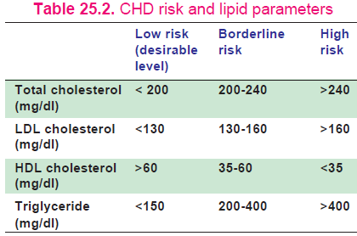
The sample of serum should be taken after 12-14 hours of fasting for lipid profile estimation.

Slide 32
RISK FACTORS FOR ATHEROSCLEROSIS & CHD
Class 1: Modifiable risk factors, Interventions have been proved to lower CAD risk.
1. Cigarette smoking
2. High total cholesterol
3. High LDL cholesterol
4. Low HDL cholesterol
5. High fat/cholesterol diet

Slide 33
Class 2: Modifiable risk factors, Interventions are likely to lower CAD risk.
8. Lipoprotein (a) or Lp(a)
9. Diabetes mellitus
10. Hypertension
11. Physical inactivity
12. Obesity
13. High triglycerides
14. High homocysteine
15. Increased high-sensitivity-CRP (hs-CRP)
16. Stress

Slide 34
Class 3: Nonmodifiable risk factors.
17. Age
18. Male gender
19. Family history of CAD

Slide 35
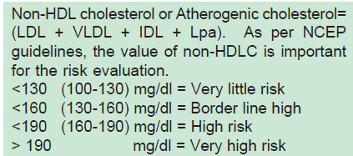
A total cholesterol level below 200 mg/dl;
the LDL cholesterol (direct) below 100 mg/dl and
a non-HDL cholesterol below 130 mg/dl predicts no risk.
HDL-cholesterol should be more than 40 mg/dl in males and >50 mg/dl in females.

Slide 36
If the ratio of total cholesterol / HDL is more than 3.5, it is dangerous.
Similarly, LDL:HDL ratio more than 2.5 is also detrimental.
Apo-A-I is a measure of HDL-cholesterol (good) and apo-B measures LDL-cholesterol (bad).
Lp(a) Levels more than 30 mg/dl increase the risk 3 times; and when increased Lp(a) is associated with increased LDL, the risk is increased 6 times.

Slide 37
Risk from smoking is dose-dependant; depends on the age at which the person started smoking and the number of cigarettes smoked per day.
Smoking enhances oxidation of LDL, reduces HDL, increases CRP and augments aggregation and adhesion of platelets.

Slide 38
Diabetes is associated with an increase in small LDL particles, high TG, high cholesterol and low HDL levels – increased risk for CAD.
Person with truncal obesity are more prone to get myocardial infarction.
Obesity causes glucose intolerance, insulin resistance, hypertension and dyslipidemia.
Plasma homocysteine above 15 micromol/L will increase the risk of coronary artery disease and stroke at a younger age. Increased hs-CRP in blood is a predictor of future coronary events.

Slide 39
PREVENTION OF ATHEROSCLEROSIS
Lifestyle changes are required, which include regular exercise, balanced diet, cessation of smoking, maintaining proper weight, control of hypertension, diabetes and dyslipidemia.
The aim is to reduce total cholesterol below 180 mg/dl; to decrease LDL-cholesterol below 130 mg/dl and to keep HDL-cholesterol above 35 mg/dl.

Slide 40
1. Reduce dietary cholesterol
Cholesterol in the diet should be kept less than 200 mg per day. Eggs and meat contain high cholesterol.
2. Vegetable oils and PUFA
Vegetable oils (e.g. sunflower oil) and fish oils contain polyunsaturated fatty acids (PUFA).
They are required for the esterification and final excretion of cholesterol. So PUFA is helpful to reduce cholesterol level in blood.
Omega-3 fatty acids from fish oils reduce LDL and decrease the risk of CAD.

Slide 41
3. Moderation in fat intake
20% of total calories may be obtained from fat, out of which about one-third from saturated, another one-third from mono-unsaturated and the rest one-third from poly unsaturated fatty acids.
The recommended daily allowance will be about 20-25 g of oils and about 2-3 g of PUFA per day for a normal adult.

Slide 42
4. Green leafy vegetables
Due to their high fiber content, leafy vegetables will increase the motility of bowels and reduce reabsorption of bile salts.
Vegetables also contain plant sterols (sitosterol) which decrease the absorption of cholesterol.
About 400 g/day of fruit and vegetables are desired.

Slide 43
5. Avoid sucrose and cigarette
Cigarette smoking is the most important modifiable risk factor for CAD.
Sucrose will raise plasma triglycerides.
6. Exercise
Regular moderate exercise (30 min per day) will lower LDL and raise HDL levels in blood. It will also reduce obesity.

Slide 44
7. Avoid trans fatty acids (TFA)
Trans fatty acids (with double bonds having trans configuration) are formed during the partial hydrogenation of vegetable oils.
They are widely used in food industry because of their long shelf life.
More atherogenic than saturated fatty acids.
It increases catabolism of apo-A I, decreases HDL and increases LDL levels.

Slide 45
Plant-derived Products having Cholesterol-lowering Action
Plant-derived fiber: Reduces serum cholesterol
Legumes: Reduces cholesterol even on high fat diet
Onion and garlic: Reduce serum cholesterol and TG
Hypolipidemic drugs
HMGCoA reductase inhibitors
Bile acid binding resins
Nicotinic acid
Aspirin
Anti-oxidants such as vitamin E

Slide 46
PUFA, in excess, may be harmful
The optimum ratio of omega-6 to omega-3 fatty acids is 4:1.
Very high intake of omega-6 oils will cause lowering of HDL, elevation of plasma triglycerides, and will promote platelet aggregation.
Vegetable oils, containing PUFA are rich in omega- 6 variety; while ghee and butter are low in omega- 6.

Slide 47
MCQS
1. Major apoprotein in HDL is
A) Apo A-1
B) Apo B – 100
C) Apo B -48
D) None of the above

Slide 48
2. which cholesterol is Bad Cholesterol ?
A) HDL
B) LDL
C) VLDL
D) TGs

Slide 49
3. Apo B 48 is synthesized in
A) Liver
B) pancreas
C) Intestine
D) Kidney

Slide 50
4. Lipoproteins are separated by
A) Electrophoresis
B) Centrifugation
C) Both
D) none

Slide 51
5. Trans fatty acids are less atherogenic
A) True
B) False

