Slide 1
MECHANISM OF CONCENTRATION AND DILUTION OF URINE

Slide 2
INTRODUCTION
Property of regulating the volume and osmolarity
Plasma osmolarity is 290 mOsm/L
Kidney can produce urine with osmolarity as low as 30 mOsm/L H2O to as high as 1400 mOsm/L H2O by changing the water excretion as high as 23 L/day to as low as 0.5 L/day, respectively .
Notes:
Obligatory urine volume :- a normal 70 kg human must excrete about 600 mOsm/L of solute each day. If maximal urine concentrating ability is 1200 mOsm/L, the minimal volume of urine that must be excreted, called the obligatory urine volume, can be calculated as 600 mOsm/day/1200 mOsm/L = 0.5 L/day

Slide 3
INTRODUCTION
The kidneys possess unique property of regulating the volume and osmolarity of the urine by concentrating and diluting it as per need of the body.
Purpose of concentration and dilution of urine.
is to maintain the osmolarity and volume of the body fluids within a narrow range,
The kidney can produce urine with osmolarity as low as 30 mOsm/L H 2O to as high as 1400 mOsm/L H 2O by changing the water excretion as high as 23.3 L/day to as low as 0.5 L/day, respectively .
Principal factors. Principal factors responsible for mecha- nism of concentration and dilution of urine are: Antidiuretic hormones and Hyperosmolarity and osmolarity gradient in medullary interstitium of kidneys.

Slide 4
Q 1. Why kidneys produce sometimes concentrated or diluted urine?
Q 2. How kidneys produce sometimes concentrated or diluted urine?
Ans 1 When blood is getting hypoosmolar urine must have been hypoosmolar
If any condition N/Abn threatens the body fluid to become concentrated/hyperosmolar if kidney system and ADH system working well it will regulate the osmolarity by producing concentrated urine. Thus to maintain the body fluid osmolarity this should happen
Ans 2 Mechanisms which do this: requirements
(A). medullary interstitium should be hyperosmolar (cortico papilary osmolar gradient): Normal osmolarity of body fluid is around 300 mOsm/L(290). Osmolarity of renal cortex is 300 then going towards medula it is increasing.
How med interst get hyperosmolar:
1. counter current multiplier (LOH)
2. urea recycling in medulla
How MIH is maintained :
Vasa recta as CCExchanger
(B) Role of ADH

Slide 5
Why kidneys produce sometimes concentrated or diluted urine?
When blood is getting hypoosmolar urine must have been hypoosmolar and vice versa
Notes:
Thus to maintain the body fluid osmolarity this should happen
Any condition normal/abnormal threatens body fluid to become concentrated/diluted, if kidney system and ADH system working well it will regulate the osmolarity by producing concentrated/diluted urine.

Slide 6
How kidneys produce sometimes concentrated?
COUNTER CURRENT MECHANISM
which refers to a system in which the inflow runs parallel to, counter to, and in close proximity to the outflow for some distance

Slide 7
Principal factors
Principal factors required for mechanism of concentration and dilution of urine are:
1.ADH
2.Hyperosmolality and osmolality gradient in medullary interstitium of Kidneys

Slide 8
A. Hyperosmolar Medullary interstitium
How MI get hyperosmolar?:
1. Counter current multiplier (LOH)
2. Urea recycling in medulla
How MIH is maintained :
Vasa recta as Counter current exchanger
B. Role of ADH
Notes:
Normal osmolarity of body fluid is around 300 mOsm/L(290).
Osmolarity of renal cortex is 300 then going towards medula it is increasing.

Slide 9
COUNTER CURRENT MECHANISM
Consists of two components:
Counter current multiplier
- Formed by LOH
Counter current exchanger
- Formed by Vasa recta
Notes:
Multiplies medullary interstitium osmolarity and responsible for hyperosmolarity and gradient in medulla
Responsible for maintenance of the medullary gradient and hyperosmolarity

Slide 10
Hyperosmolar Medullary interstitium
Created by:
1. Counter current multiplier (LOH)
2. Urea recycling in medulla
Maintained by:
Counter current exchanger
Notes:
thick ascending limb being impermeable to water but looses solute (at luminal surface Na-K-2Cl n at basolateral Na-K ATPase , K pump, Cl pump, Na pump) making med intrstm more hypermolar creating gradient of 200 mos every step with max 1200 mosm/l in med intrstm

Slide 11
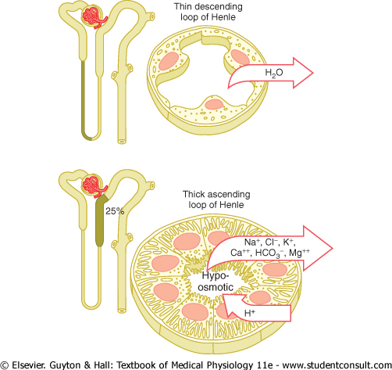
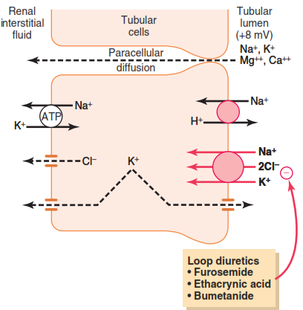

Slide 12
Cortico papilary osmolar gradient
Filtered fluid osm 300mosm/l
65% solute Na,K,Cl,HCO3 and 100%G n AA with same amount of water reabsorbed in PCT, i.e. isoosmotic reabsorption
Thus tubular fluid leaving PCT has same osmolrty
Loop is important b/c if this was straight upto 1200 osmolrty of med inststm is not possible
Descending thin limb by loosing water provides thick asc limb hyperosmolar fluid, thick asc limb being impermeable to water but looses solute (at luminal surface Na-K-2Cl n at basolateral Na-K ATPase , K pump, Cl pump, Na pump) making med intrstm more hypermolar creating gradient of 200 mos every step with max 1200 mosm/l in med intrstm
Counter current as fluid moving down in desc limb and up thru asc limb ↓↑. CC multiplier as multiplies med inrstm osmolarity

Slide 13
CCM depends on the special anatomical arrangement of LOH and the Vasa recta, the specialized peritubular capillaries of the renal medulla.
The major factor that contribute are:
Active transport of solutes out of the thick portion of the ascending limb of LOH into the medullary interstitium
Active transport of ions from the collecting ducts into the medullary interstitium.
Notes:
Active transport of Na+ and co-transport of K+, Cl-, and other ions out of the thick portion of the ascending limb of LOH into the medullary interstitium
Active transport of ions from the collecting ducts into the medullary interstitium.

Slide 14
3. Facilitated diffusion of Urea from the IMCD into the medullary interstitium
4. Diffusion of only small amounts of water from the medullary tubules into the medullary interstitium

Slide 15
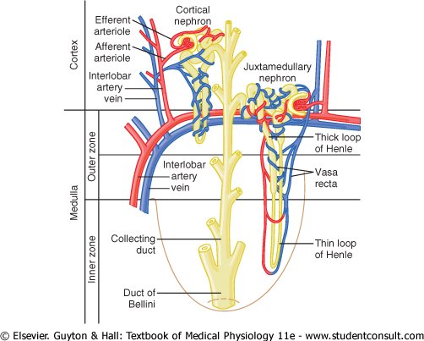

Slide 16
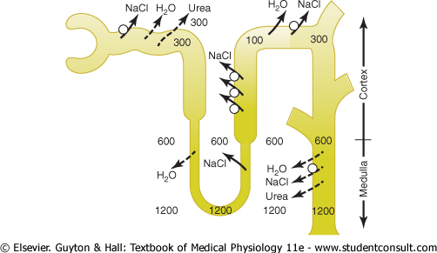

Slide 17
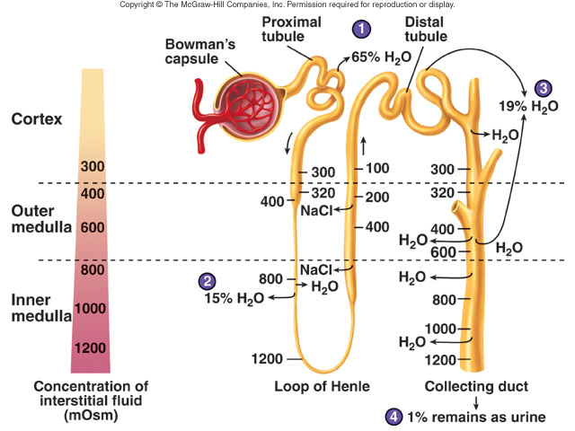

Slide 18
Special characteristics of loop of henle that cause solutes to be trapped in the renal medulla.
Steps involved in causing hyperosmotic renal medullary interstitium
Role of distal tubules and collecting ducts in excreting a concentrated urine.
Urea contributes to hyperosmotic renal medullary interstitium and to a concentrated urine.

Slide 19
Multiplication of the single effect
Main characteristics of the components of counter current multiplier which play role in multiplication of single effect are:
High permeability of descending thin segment to water
Impermeability to water and ability to actively absorb solutes by thick ascending limb
In renal medulla all other tubular structures (except ascending limb) are in osmotic equilibrium.

Slide 20
Process of multiplication
  - Understood by dividing the whole process in hypothetical steps.
Notes:
1. Assume that the loop of Henle is filled with fluid with a concentration of 300mOsm/L, the same as that leaving the proximal tubule

Slide 21
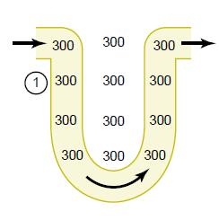
1. LOH is filled with fluid with a concentration of 300mOsm/L

Slide 22
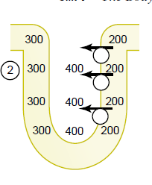
2. Here, the active pump of the thick ascending limb of the LOH is turned on ,
So it reduces concentration inside the tubule and raising interstitial concentration.

Slide 23
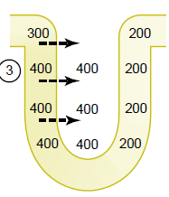
3. Tubular fluid in Descending LOH and the interstitial fluid quickly reach osmotic equilibrium
Because of osmosis of water out of the descending limb, interstitial osmolarity is maintained at 400mOsm/L because continued transport of ions out of thick limb of LOH.

Slide 24
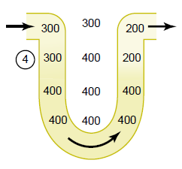
4. Additional flow of fluid into LOH from PCT, causes the hyperosmotic fluid in descending LOH and then ascending LOH
Once fluid is in ascending LOH ,additional ions are pumped into interstitium, with water remaining behind until 200 mOsm/L osmotic gradient is established and interstitial fluid osmolarity rising to 500 mOsm/L

Slide 25
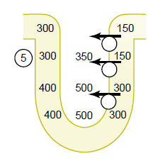
5. Interstitial fluid osmolarity rising to 500 mOsm/L

Slide 26
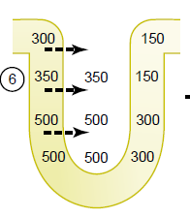
6. In ascending LOH more and more ions are pumped into interstitium and osmotic gradient is established is 150 mOsmol/L

Slide 27
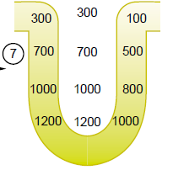
After step 6,as the hyperosmotic tubular fluid from the descending LOH into ascending LOH, still more solute is continuously pumped out of the tubules and deposited into medullary interstitium.
These steps are repeated over and over so medullary interstitium osmolariy is increased upto 1200 to 1400 mOsmol/L

Slide 28
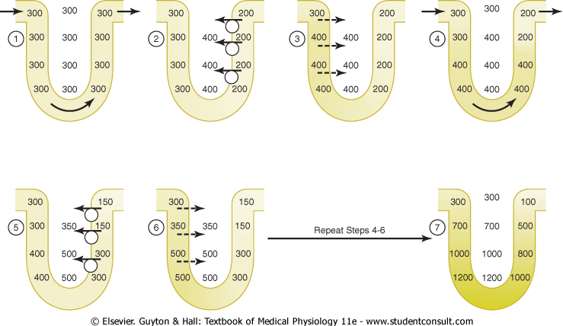

Slide 29
The repetitive reabsorption of sodium chloride by the thick ascending LOH and continued inflow of new sodium chloride from the proximal tubule into the LOH is called the Counter Current Multiplier

Slide 30
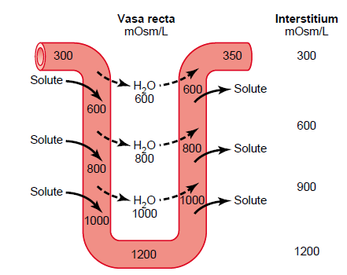
Counter Current Exchanger
Blood moving down in Vasa Recta it will gain solutes loosing water, going upward gain water and loose solutes thus maintaining medullary interstitium hyperosmolar.
At the tip of vasa recta concentration becomes about 1200 mOsmol/L same as medullary interstitium

Slide 31
There are two special features of the renal medullary blood flow :
The medullary flow is low:
Helps to minimize solute loss from the medullary interstitium
Vasa recta serve as countercurrent exchangers :
Minimizing washout of solute from the medullary interstitium

Slide 32
As blood descend into the medulla, it becomes progressively concentrated. It is mainly due to
Solute entry from interstitium
Partly by loss of water into the interstitium
At the tip of vasa recta concentration becomes about 1200 mOsmol/L same as medullary interstitium

Slide 33
As blood ascends back toward the cortex,it becomes progressively less concentrated as solutes diffuse back out into the medullary interstitium and as water moves into the vasa recta
Thus the vasa recta do not create the medullary hyperosmolarity, but they do prevent it from being dissipated.

Slide 34
CCMultiplier | CCExchanger
In LOH | In Vasa Recta
Active transport process | Passive trasport process
Generates hyperosmolarity | Maintains hyperosmolarity

Slide 35
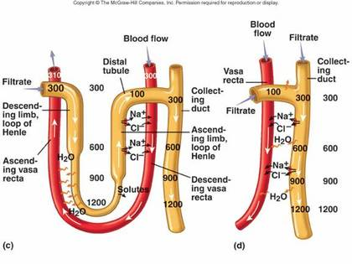

Slide 36
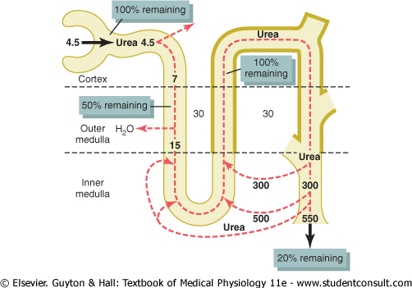
Role of Urea
When ADH is high
Inner Medullary CT absorbs large amount of urea. So development of medullary osmotic gradient

Slide 37
Role of urea
Thick ascending upto OMCD impermeable to urea.
Thus by the time fluid reaches IMCD urea will concentrate it
From IMCD Urea Transporter will transport urea in medullary interstitium making it further hyperosmolar.
From medulary interstitium it will recycle though absorption in thin descending and ascending limb before getting excreted.
Blood flow in cortical part is high while slow and less in medulla also helps in developing medulla hyperosmolar.

Slide 39
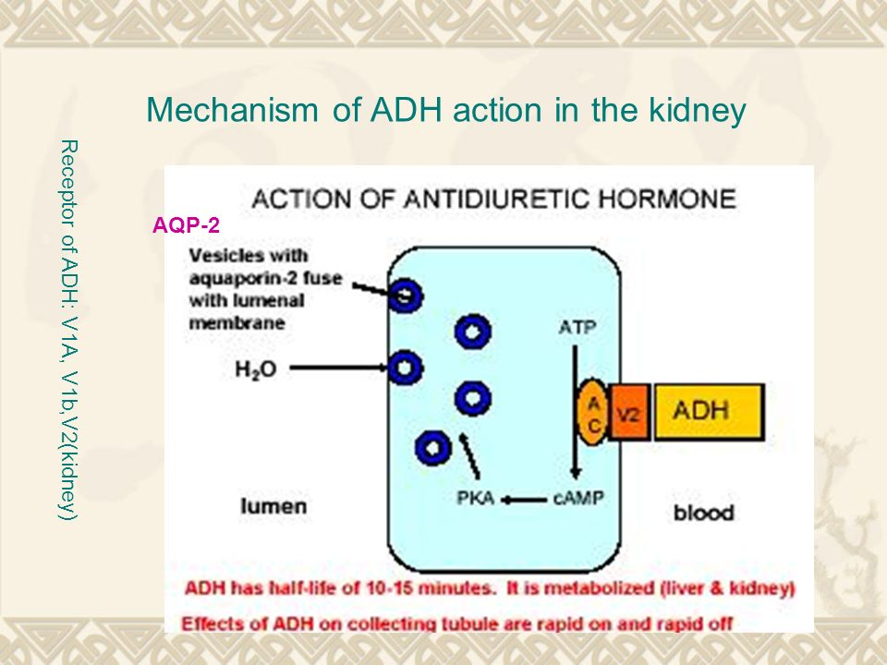
Role of ADH
Stimulate ADH receptor to open AQP channel
Stimulates Na-K-2Cl in thick ascending limb making hyperosmolar interstitium
Stimulates urea transporter from IMCD

Slide 40
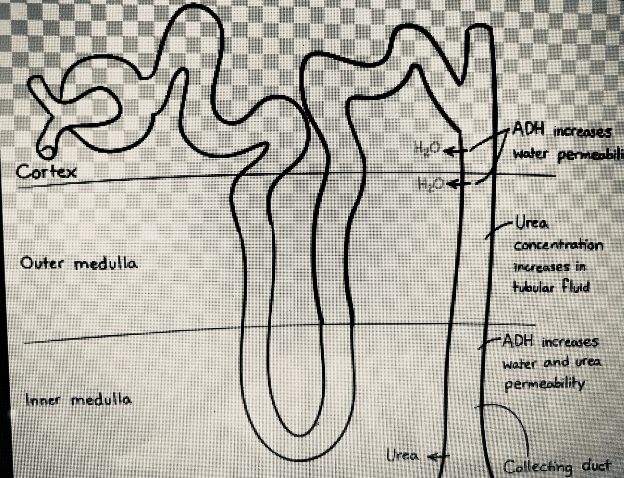

Slide 41

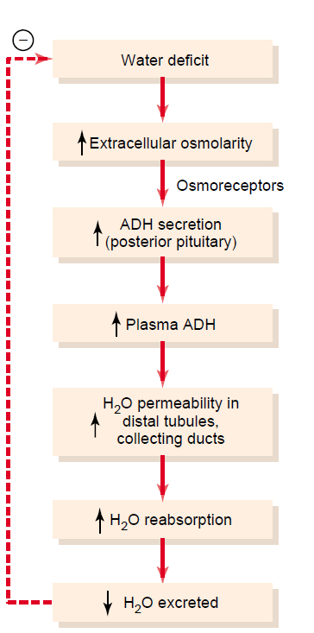

Slide 42
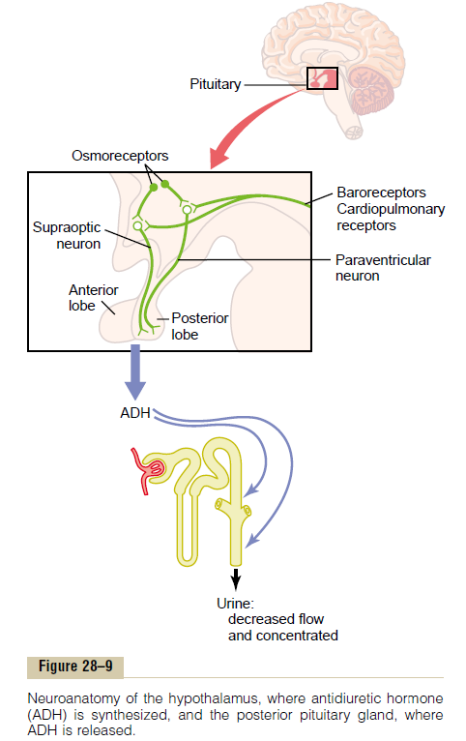

Slide 43
Disorders of urine concentrating ability
Failure to produce ADH. - Central Diabetes Insipidus
Inability of kidney to respond to ADH – Nephrogenic Diabetes Insipidus

Slide 44
Counter current mechanisms

Slide 45
MCQs
1) Counter current system is mainly feature of;
a) Cortical nephron
b) Juxtamedullary nephron
c) a & b
d) Vasa recta

Slide 46
2) . Diluting segment of nephron is ;
PCT
Descending segment of Loop of Henle
Thick ascending segment of Loop of Henle
Thin & Thick ascending segment of Loop of Henle

Slide 47
3). Normally a horizontal osmotic gradient of ___mosmol/L exists between ascending loop and medullary interstitium;
100
200
300
600

Slide 48
4). True about counter current exchange process in kidney
An active process
Depends on diffusion of water out of the Vasa recta
A passive process
Depends on diffusion of solutes into the vasa recta

Slide 49
4.Urinary concentrating ability of kidney is increased by:
A. ECFV contraction( decreased)
B. Increased in RBF
C. Reduction in medullary hyperosmolality
D.Increase in GFR

Slide 50
5). The hyperosmolarity of the renal medulla is due to increased content of ;
Na+ & Urea
K+
Glucose
Na+

Slide 51
THANK YOU….

