Slide 1
Pleural Effusions
Dr. Kusum Shah
Dept of respiretory Medicne

Slide 2
Physiology of the normal lung
The lungs are soft, spongy, cone-shaped organs located in the chest cavity.
They are separated by the mediastinum and the heart.
There are 3 lobes on the right lung and 2 lobes on the left lung.

Slide 3
The normal lung
The lungs are supplied with blood via the pulmonary and bronchial circulations.
Pulmonary circulation: supplied from the pulmonary artery and provides for gas exchange function of the lungs.
Bronchial circulation: distributes blood to the conducting airways and supporting structures of the lung.

Slide 4
The normal lung
Intrapulmonary pressure
-the pressure within the alveoli
-as the chest expands on inspiration the intrapulmonary pressure becomes more negative, which causes air to be sucked into the lungs.
Intrapleural pressure
-Negative pressure is created in the pleural space as the thoracic cage enlarges and the lungs recoil during normal inspiration
-negative pressure may be lost if fluid collects in the pleural space, making the lung unable to expand fully.

Slide 5
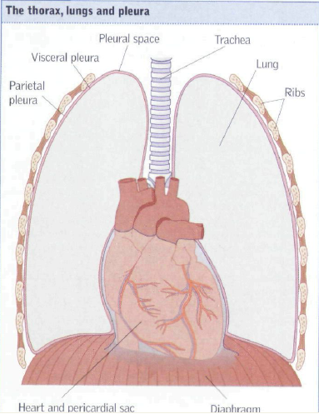
Normal lung pleural effusion

Slide 6

Layers of the lung
Pleural Space
thin, transparent, serous membrane which lines the thoracic cavity
a potential space between the parietal pleura and visceral pleura
Rib Cage
Lung
Picture used with permission Allibone, 2006

Slide 7
Layers of the lung
Visceral Pleura
Lines the entire surface of the lung
Contains NO sensory nerve endings that detect pain
Rib Cage
Lung
Picture used with permission Allibone, 2006

Slide 8
Layers of the lung
Parietal Pleura
Lines the thoracic cavity, including the thoracic cage, mediastinum, and diaphragm
Contains sensory nerve endings that can detect pain
Rib Cage
Lung
Picture used with permission Allibone, 2006

Slide 9

PleuraL FLUID
-Serous fluid that allows for the parietal pleura (outer lining) and visceral pleura (inner lining) to glide over each other without separation
-Contains about 5-15ml of fluid at one time
-Pleural fluid is produced by the parietal pleura and absorbed by the visceral pleura as a continuous process.
-The visceral pleura absorbs fluid, which then drains into the lymphatic system and returns to the blood
-Protein in the circulation and balanced pressures keep excessive amounts of fluid from seeping out of the blood vessels into the pleural space

Slide 10
Review question:
Pleuritic chest pain indicates
inflammation or irritation of the
parietal pleura or visceral pleura?

Slide 11
Pleural effusions result from disruption of thE balance.
(1) hydrostatic and oncotic forces in the visceral and parietal pleural vessels
(2) lymphatic drainage.

Slide 12
CLASSIFICATION
Transudate
  Ultrafiltrate of plasma
  Small group of etiologies
Exudate
  Produced by host of inflammatory conditions
  Large group of etiologies

Slide 13
Transudate
Clear, pale yellow, watery substance
Influenced by systemic factors that alter the formation or absorption of fluid
Increase in Hydrostatic pressure
Decrease in plasma Oncotic pressure

Slide 14
Exudate
Pale yellow and cloudy substance
Influenced by local factors where fluid absorption is altered (inflammation, infection, cancer)
Lights Criteria
Rich in protein (serum protein greater than 0.5)
Ratio of pleural fluid LDH and serum LDH is >0.6
Pleural fluid LDH is more the two-thirds normal upper limit for serum
Common causes: pneumonia, cancer, and trauma

Slide 15
causes of TRaNSUDATE Effusion
Increase Hydrostatic pressure
Congestive cardiac failure
Pericardial effusion
Decreased capillary oncotic pressure
Cirrhosis
Nephrotic syndrome
Malnutrition
Transmission from peritoneum
Ascites
(Meigs syndrome)

Slide 16
Causes of exudative effussion
IMMUNE DISORDERS
SLE
Wegeners granulomatosis
Rheumatic fever
Pulmonary embolism and infarction
  Other causes
Sarcoidosis
Drug reaction
Radiation therapy
Asbestos exposure
Recurrent polyserositis
Oesophageal rupture
NEOPLASMS
Carcinoma lung
Mesotheli0ma
Metastases
ABDOMINAL DISEASES
Pancreatitis
Uraemia
INFECTION
Pneumonia
Tuberculosis
AIDS
Fungal diseases

Slide 17
Pleural fluid types
TRANSUDATE
EXUDATE
PUS(EMPYEMA)
CHYLE(CHYLOTHORAX)
BLOOD(HEMOTHORAX)

Slide 18
EFFECTS OF EFFUSSION ON LUNG
On Vital capacity
On Diaphragm
On V-Q mismatch

Slide 19
Signs and symptoms
Dyspnea
Cough, usually non-productive
Pleuritic chest pain
Chest pressure
Hypoxemia
Decreased breath sounds on the affected side
Some people may exhibit no symptoms!

Slide 20
DIAGNOSIS
Routine
Specific

Slide 21
Diagnosis {imaging}
Chest radiograph (x-ray)
-CXR –Pa view
-Lateral Decubitus
able to distinguish >200ml of fluid
Chest ultrasound
-locates small amounts or isolated loculated pockets of fluid
-able to give precise position of accumulation
Computed Tomography (CT) scan
-Differentiates between fluid collection, lung abcess, or tumor

Slide 22
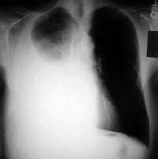
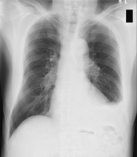
Workup: Imaging

Slide 23
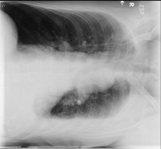
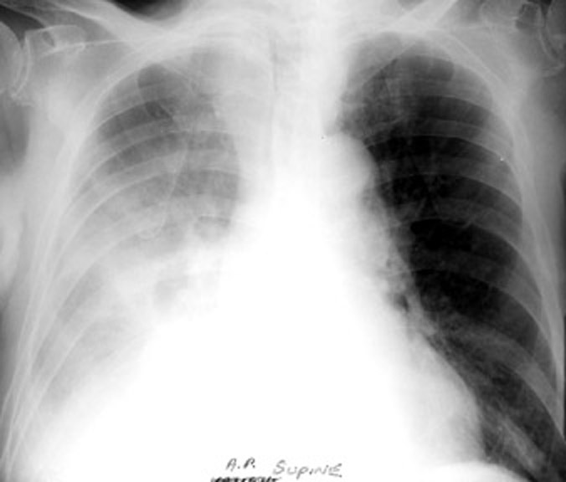

Slide 24
TREATMENT
Thoracocentesis
Diagnostic
Theurapeutic
Treat primary cause (steroids)

Slide 25
Diagnosis
Fluid analysis confirms a pleural effusion
Normal pleural fluid has the following characteristics:
clear ultrafiltrate of plasma
pH 7.60-7.64
protein content less than 2% (1-2 g/dL)
fewer than 1000 WBCs per cubic millimeter
glucose content similar to that of plasma
Adenosine Deaminase (Ada)
lactate dehydrogenase (LDH) level less than 50% of plasma and sodium
potassium and calcium concentration similar to that of the interstitial fluid
(

Slide 26
Evaluation of Adenosine Deaminase (Ada) in Tuberculous Pleurisy American Journal of Medicine and Medical Sciences 2012, 2(1): 1-4
S. S. Haque | Oxford Centre for Evidence-Based Medicine 2011 Levels of Evidence 3Level Evidence | The purpose of this study is to find out the role of ADA levels in differentiation of tuberculous and non-tuberculous exudative pleural effusions of different etiolo-gies. | ADA levels in non-tuberculous exudative pleural effusions rarely exceeded the cutoff; set for tuberculous disease . The pleural fluid ADA levels were significantly higher in tuberculous pleural effusions.

Slide 27
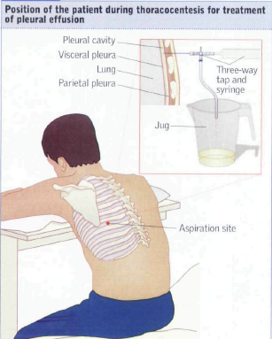
ThoracOCentesis
A needle is inserted into the chest wall to remove the collection of fluid
50-100ml of fluid is sent for analysis
Determines the type of fluid (transudate or exudate)

Slide 28
ThoraCOcentesis
Not a permanent solution, fluid may reaccumulate after a few days
Will temporarily relieve symptoms
Potential complications include bleeding, infection, and pneumothorax

Slide 29
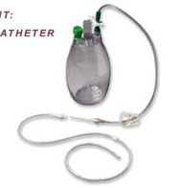
Pleural Catheter (ICD)
Malignant Effussions
Small, flexible tube inserted into the chest to drain fluid from around the lungs
Contains a one-way valve that prevents air from entering and fluid from leaking out when capped
(under water seal drainage)

Slide 30
Chemical Pleurodesis
The goal of chemical pleurodesis is to cause an irritation between the two layers covering the lung.
The sclerosant irritates the pleurae which results in inflammation and causes the pleurae to stick together.
The procedure can be done at the bedside or in the operating room.
Do not administer with any anti-inflammatory agents

Slide 31

Questions?

Slide 32
The pleural fluid lactate dehydrogenase/adenosine deaminase ratio differentiates between tuberculous and parapneumonic pleural effusions.
Wang J¹, Liu J², Xie X¹, Shen P¹, He J², Zeng Y^{3,4}. | Although pleural fluid lactate dehydrogenase (LDH) and adenosine deaminase (ADA) levels are often used to distinguish between tuberculous pleural effusion (TPE) and parapneumonic pleural effusion (PPE), this can be challenging as the LDH level may vary from normal to severely increased in PPE and a significantly elevated ADA is frequently measured in both conditions. In this study, we evaluated use of the pleural fluid LDH/ADA ratio as a new parameter to discriminate TPE from PPE. | A retrospective study was conducted in patients with pathologically-confirmed TPE (n = 72) and PPE (n = 47) to compare pleuralfluid LDH and ADA levels and LDH/ADA ratios between the 2 groups. A receiver operating characteristic (ROC) curve was constructed for identifying TPE. Level III | The pleural fluid LDH/ADA ratio, which can be determined from routine biochemical analysis, is highly predictive of TPE at a cut-off level of 16.20. Measurement of this parameter may be helpful for clinicians in distinguishing between TPE and PPE.

