Slide 1
VISUAL PATHWAY-II

Slide 2
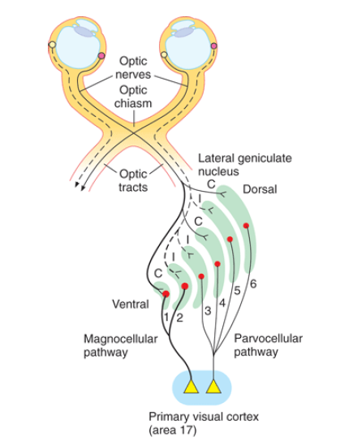

Slide 3
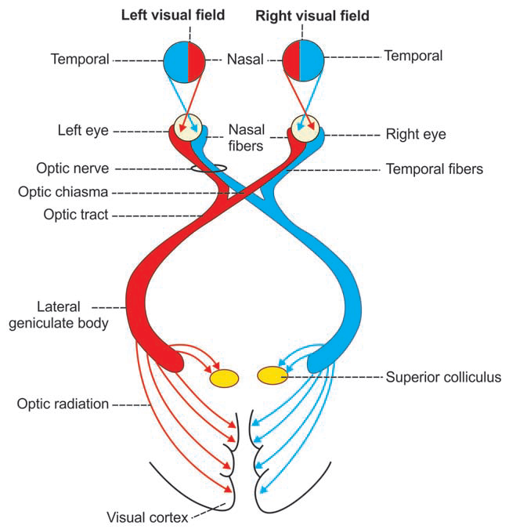

Slide 4
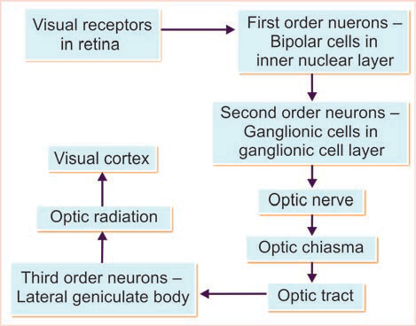

Slide 5
Lesions in the Optic Pathway
Hemianopia: loss of vision in one half of visual field
Homonymous hemianopia: when similar half of both the fields are blind
Ex: loss of the right or the left half of the field of the vision in both the eyes
Heteronymous hemianopia: when different half of the field of vision are lost in two eyes
Ex: bitemporal or binasal
Quadrantanopia: 1/4th of the visual field is lost

Slide 6
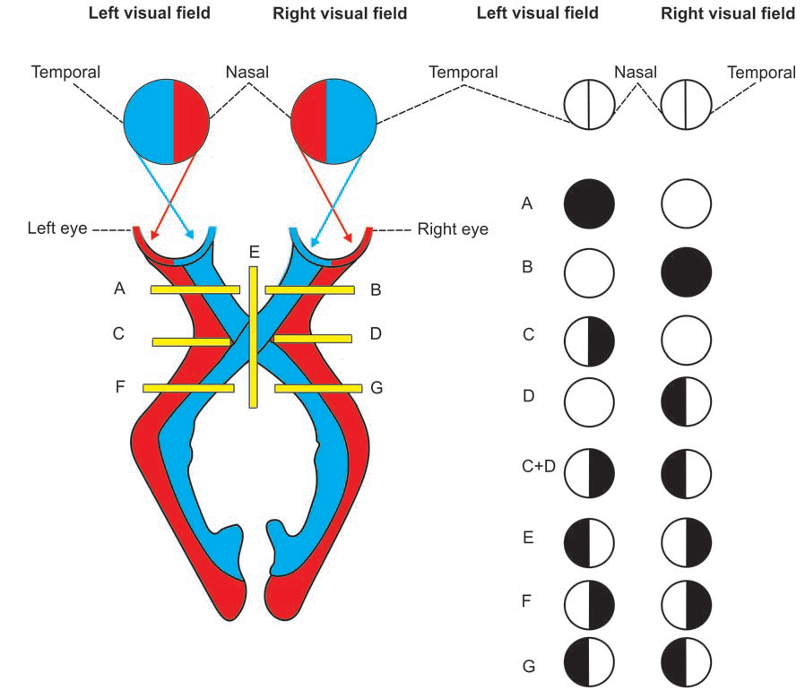
Lesion of left optic nerve: Total blindness of left eye
Lesion of right optic nerve: Total blindness of right eye
Lesion of lateral fibers in left side of optic chiasma: Left nasal hemianopia
Lesion of lateral fibers in right side of optic chiasma: right nasal hemianopia
Lesion of lateral fibers in both sides of optic chiasma: Binasal hemianopia
Lesion of medial fibers in optic chiasma: Bitemporal hemianopia
Lesion of left optic radiation: Right homonymous hemianopia
Lesion of right optic radiation: left homonymous hemianopia

Slide 7
Site of the lesion | Defect in vision
Optic nerve | Unilateral blindness (Ipsilateral)
Optic chiasma (central crossed fibers) | Bitemporal heteronymous hemianopia
Optic chiasma (uncrossed fibers) | Binasal heteronymous hemianopia
Optic tract | Contralateral homonymous hemianopia
Optic radiation (involving both, superior and inferior fascicles) | Contralateral homonymous hemianopia with macular sparing
Optic radiation (involving superior fascicles only- parietal lobe lesion) | Contralateral homonymous quadrantanopia (lower quadrant- ‘pie on the floor’) with macular sparing
Optic radiation (involving inferior fascicles only- temporal lobe lesion) | Contralateral homonymous quadrantanopia (upper quadrant- ‘pie in the sky’) with macular sparing

Slide 8
Collaterals of Visual pathway:-
  Superior Colliculus:-
    Responsible for rapid conjugate eye movements.
  Pre-tectal nuclei:-
    Responsible for light reflex.
  Ventral LGB:-
    Responsible for emotion and behavior.
  Suprachiasmatic nucleus of hypothalamus:-
    Responsible for circadian rhythm.

Slide 9
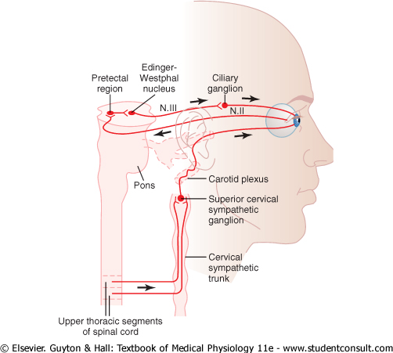
The Parasympathetic

Slide 10
preganglionic fibers (the Edinger-Westphal nucleus - the visceral nucleus portion of 3rd CN)
↓
pass in 3rd nerve
↓
ciliary ganglion (behind the eye)
↓
synapse with postganglionic parasympathetic neurons
↓
send fibers through ciliary nerves into the eyeball
↓
excite
Ciliary muscle that controls focusing of the eye lens
Sphincter pupillae muscle of the iris that constricts the pupil

Slide 11
The Sympathetic Supply
intermediolateral horn cells of T1 of the Spinal cord
↓
sympathetic chain
↓
upward to the superior cervical ganglion
↓
synapse with postganglionic neurons
↓
innervate
The radial fibers of the iris (which open the pupil) and extraocular muscles of the eye

Slide 12
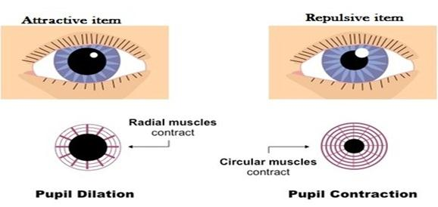
Control of Pupillary Diameter
MYDRIASIS
MIOSIS
stimulation of the sympathetic nerves
excites the radial fibers of the iris
Stimulation of the parasympathetic nerves
excites the pupillary sphincter muscle

Slide 13
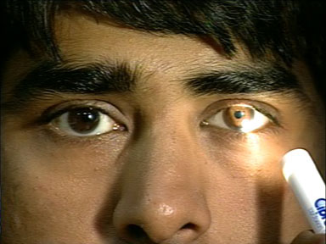
Constriction Reflexes
  1. Light reflex-
    Light is thrown in one eye → Constriction of pupil of the same eye (direct light reflex)
    → Constriction of pupil of the opposite eye (indirect or consensual light reflex)

Slide 14
Clinical importance:
During day light constriction so light to macula only and good vision
Certain head injury and alcoholism

Slide 15
Pathway of light reflex
Receptors of retina
↓
Optic nerve
↓
Optic chiasma
↓
Optic tract
↓
Pretectal nucleus
↓
Edinger Wastphal nucleus
↓
Oculomotor nerve (parasympathetic)
↓
Ciliary ganglion
↓
Short ciliary nerve
↓
Sphincter pupillae muscle causing constriction of pupil

Slide 16
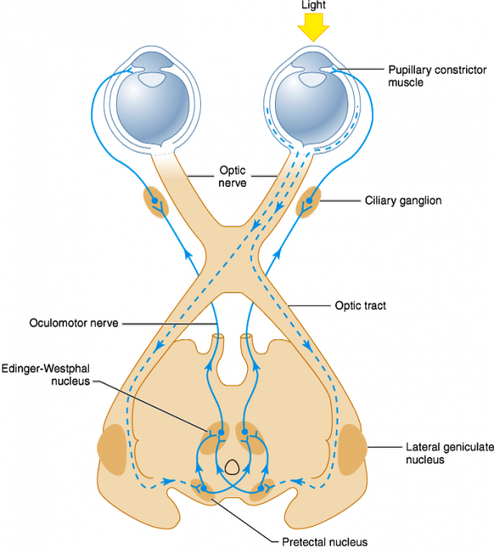

Slide 17
Accommodation reflex:-
  It’s the ability of eye to focus distant object as well as near object.
  It is necessary for highest degree of visual acuity.
  When one focuses on nearby object 3 reactions occur called accommodation convergence reaction (near response)
    Constriction of both the pupils
    Convergence of both the eyes
    Contraction of ciliary muscle → increased curvature of lens → increased diopteric power

Slide 18
Pathway for accommodation reflex
Receptors (of retina)
↓
Optic nerve
↓
Optic chiasma
↓
Optic tract
↓
Lateral geniculate body
↓
Visual cortex
↓
Frontal eye field (area 8)
↓
Internal capsule to opposite side Edinger Westphal Nucleus
↓
Oculomotor nerve
↓
Ciliary ganglion
↓
Ciliary nerves
↓
Ciliary muscles, Sphincter pupillae muscle, Medial Recti

Slide 19
Dilatation reflexes:-
  Light withdrawal reflex
  Psycho sensory reflex: due to fear, anxiety (sympathetic stimulation)
  Cilio-spinal reflex: pinching the nape of neck → pressure on cervical sympathetic trunk → Dilatation of pupil

Slide 20
Abnormal reflexes:-
      Argyll Robertson pupil: Light reflex absent; accommodation reflex present
      Size of pupil is less than normal, pupil dilates poorly to atropine
      Lesion at pretectal region, optic pathway but EW nucleus is normal.
      Causes: Tabes dorsalis (CNS syphilis), alcoholism, encephalitis

Slide 21
Opposite of AR pupil:- Light reflex present; accommodation reflex absent
  Causes: Diphtheria, uncontrolled DM, meningitis
Hutchinsonian pupil:- First pupil constricts and then dilates on the side of lesion
  Causes: Hemorrhage from middle meningeal artery causing raised intra cranial pressure
Wernicke’s hemianopic pupil:- Damage to retina on nasal or temporal side causing loss of light reflex on that side

Slide 22
Myotonic or Holmes Adie pupil:- Unilateral dilatation or constriction of pupil,
  Similar to AR pupil but dilates with atropine
  Females more prone
  Deep reflexes absent
  Cause: Idiopathic
Horner’s syndrome:- Damage to cervical sympathetic fibers leading to ptosis, miosis, anhydrosis, dilatation of blood vessels on the same side (face + head), mild enophthalmos (sunken eye), loss of cilio-spinal reflex.

Slide 23
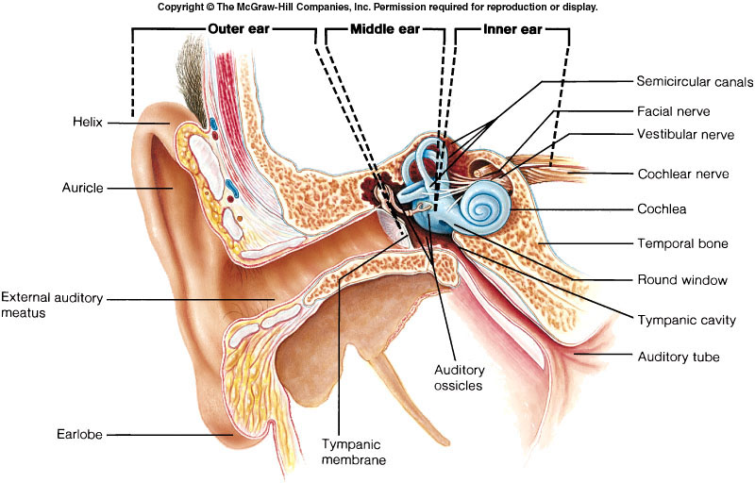
EAR
organ for heARING AND EQUILLIBRIUM

Slide 24
PHYSILOGICAL ANATOMY
It is divided in to THREE parts.
External ear
Middle ear
Internal ear.

Slide 25
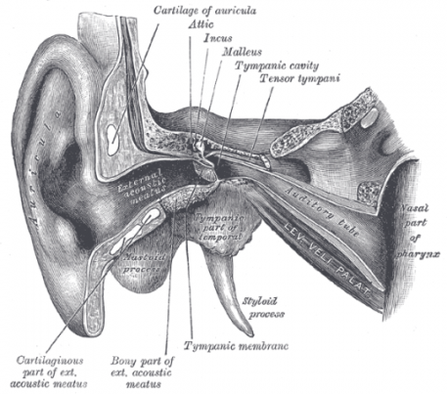
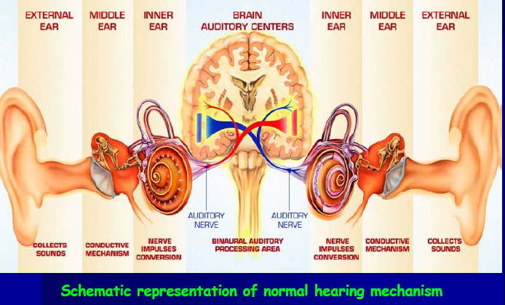
EAR AS A TRANSDUCER
SOUNDENERGY
MECHANICAL ENERGY
ELECTRICAL ENERGY

Slide 26
Sound is a form of energy that propagates in the form of waves
The speed of sound depend on the medium through which the wave pass
The sound frequencies audible to humans range from about 20 to a maximum of 20,000 Hz
The loudness can be measured in decibel: 20-90 db

Slide 28
THE EXTERNAL EAR
The external ear or the outer ear includes the PINNA and EXTERNAL AUDITORY CANAL.
THE PINNA :- it is fibrocartilaginous expanded portion covered with skin projecting from the side of the head.
It helps to COLLECT SOUND WAVES and TO LOCALIZE THE SOURCE OF SOUND.

Slide 29
THE EXTERNAL EAR
The EXTERNAL AUDITORY CANAL OR OUTER EAR CANAL.
It is 2.5 cm long runs forwards and inwards (medially) and helps in TRANSPORTING THE SOUND WAVES TO THE MIDDLE EAR.

Slide 30
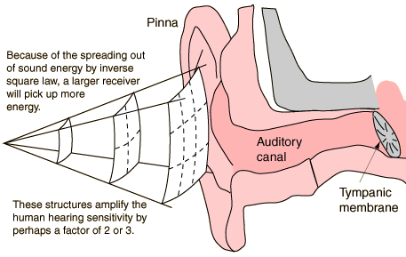
Role of external ear
Pinna- concha system catches sound over large area and concentrate it to smaller area of ext. auditory meatus and increases the total energy available to the tympanic membrane
Sound localization

Slide 31
EXTERNAL AUDITORY CANAL OR OUTER EAR CANAL.
It is lined with skin which secret ear wax from CERUMINOUS GLANDS.
And oil from sebaceous gland which by TRAPPING THE FOREIGN BODIES KEEP THE EAR CANAL CLEAR.

Slide 32
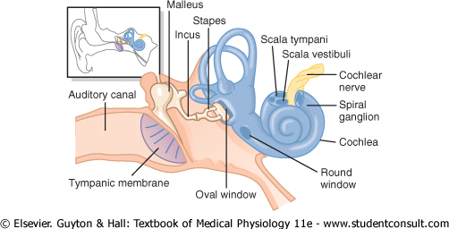

Slide 33
THE MIDDLE EAR
It is a air filled chamber and consists of the following parts:-
1) Tympanic membrane
2) Ear ossicles
3)Phayngotympanic tube or Eustachian tube

Slide 34
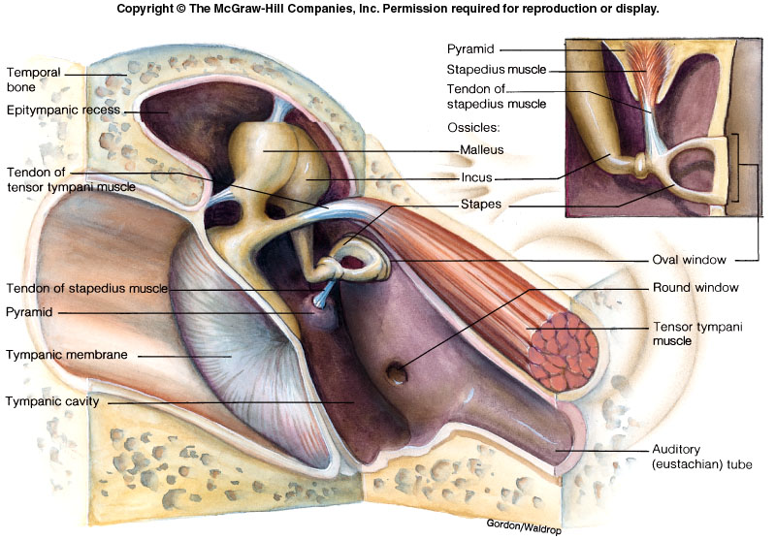

Slide 35
Tympanic membrane
It consists of connective tissue covered with skin on the outside and mucous membrane on the inside.
It has the shape of a swallow funnel with centre (UMBO) pointing inwards and is kept in this position by the handle of the malleus.

Slide 36
It acts as a resonator
i.e. it starts vibrating (in and out movement) when the sound waves strike.
It critically dampens ( stops the vibrations of ) the sound waves i.e. as soon as the sound waves will stop stretching the tympanic membrane its vibrations are stopped almost immediately.

Slide 37
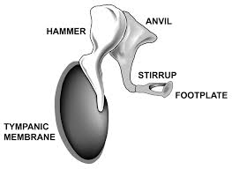
Ear ossicles
There are three minute bony (ear) ossicles
Malleus (hammer)
Incus (anvil)
Stapes (stirrup)
They extend across the cavity from the tympanic membrane to the oval window.

Slide 38
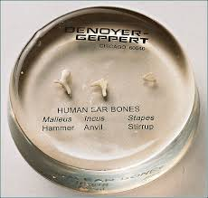
Ear ossicles
FUNCTIONS :-
It acts as pressure receiver i.e. it is extremely sensitive to pressure changes produced by sound waves on its external surface. Ossicles has main role in impedance matching.

Slide 39
EUSTACHIAN TUBE
It is 4-5cm in length and connects the middle ear cavity with the pharynx.
It serves to equalize the pressure on the two sides of the tympanic membrane when atmospheric pressure decrease (high altitude) or increase ( deep sea diving).
In common cold impairment causes the temporary hearing defects

Slide 40
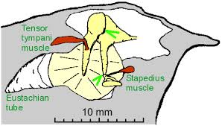
Middle Ear Muscles

Slide 41
TWO SKELETAL MUSCLES
TENSOR TYMPANI :- it is attached to the neck of malleus. Supplied by V CN. It attach with tympanic mem through malleus.
Its contraction increases the tension of tympanic membrane thus it keeps the tympanic membrane firmly attached. Paralysis can cause hearing defects.

Slide 42
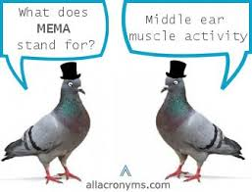
STAPEDIUS:- It is attached to the neck of the stapes. Supplied by VII CN.
On contraction it pulls the foot plate of the stapes out from the oval window. Prevents excess movement of stapes. Paralysis can cause
hyperacusis

Slide 43
FUNCTIONS OF MIDDLE EAR
IMPEDENCE MATCHING
ATTENUATION
PHASE DIFFERENCIAL EFFECT

Slide 44
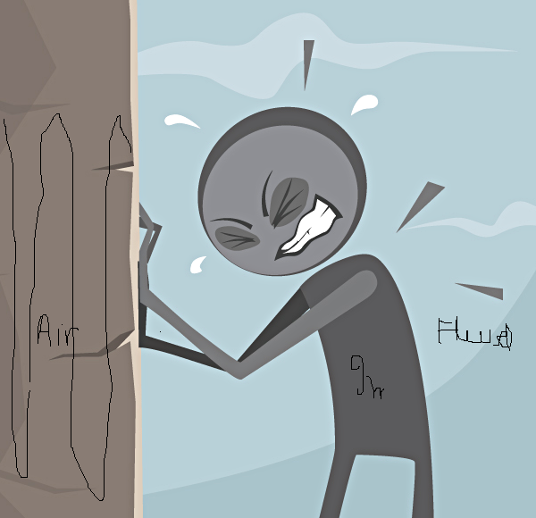
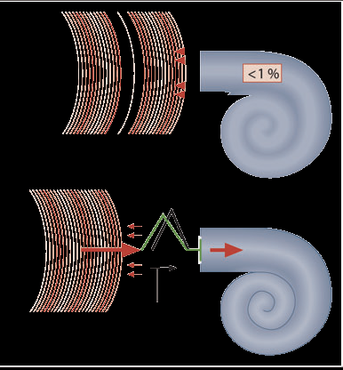
Impedence mismatch
IF THERE WAS NO MIDDLE EAR SYSTEM ,99% OF SOUND WAVES WOULD HAVE REFLECTED BACK FROM OVAL WINDOW
MIDDLE EAR BY ITS IMPEDENCE MATCHING PROPERTY ALLOWS 60% OF SOUND ENERGY TO DISSIPATE IN INNER EAR

Slide 45
“Impedance Matching” by the middle ear System
Area of tympanic membrane relative to oval window
55 mm² is of tympanic membrane
3.2 mm² is of oval window
The lever action of middle ear ossicles
All osscicles combindly Act like a handle of the door
The shape of tympanic membrane
UMBO condense the sound waves to the osscicles

Slide 46
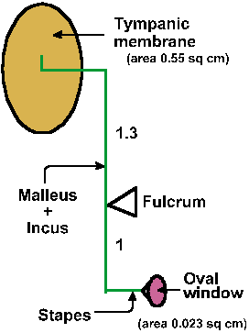
HYDRAULIC ACTION OF TYMPANIC
MEMBRANE
Total area of tympanic membrane 55mm²
Area of stapes footplate is 3.2mm²
Effective areal ratio is 17:1
Thus by focusing sound pressure from large area of tympanic membrane to small area of oval window the effectiveness of energy transfer is increased

Slide 47
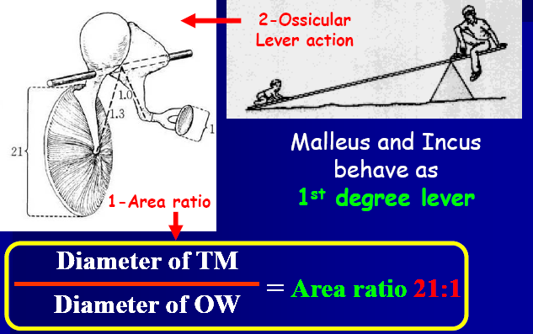
Lever action of ossicles
Handle of malleus is 1.3 times longer than long process of incus
Overall this produces a lever action that converts low pressure with a long lever action to high pressure with a short lever action

Slide 48
Attenuation reflex- Attenuation is a general term that refers to any reduction in the strength of a signal
When loud sounds are transmitted through the ossicular system
The tensor tympani muscle pulls the handle of the malleus inward while the stapedius muscle pulls the stapes outward.
These two forces cause the entire ossicular system to develop increased rigidity, thus greatly reducing the ossicular conduction of loud sound
This is k/as Attenuation reflex.
This occurs after a latent period of only 40 to 80 ms to cause contraction of the middle ear muscles. Sudden loud sound like gut shot, bomb explosion can not protect the ear and causes deafness

Slide 49
Function of attenuation reflex
To protect the cochlea from damaging vibrations caused by excessively loud sound.
To mask low-frequency sounds in loud environments. This usually removes a major share of the background noise
To decrease a person’s hearing sensitivity to his or her own speech

Slide 50
CCES

Slide 51
Stimulation of Parasympathetic pathway to eye leads to
Miosis
Mydriasis
Ptosis
Enophthalmos

Slide 52
2. Absence of Light reflex and presence of
Accomodation reflex is known as
Marcus Gun Pupil
Hutchison’s Pupil
Argyll Robertson pupil
Home Adies Pupil

Slide 53
3. Middle ear infection may follow a throat infection because:
A) Auditory (Eustachian) tube opens into the base of the inner ear
B) Pharyngeal (throat) mucosa is continuous with the mucosa of the middle ear
C) Sphenoid sinus opens into the tympanic cavity of the middle ear
D) Vestibulo cochlear nerve passes through the tympanic cavity

Slide 54
4. The oval window is closed by:
A) Tympanic membrane
B) Handle of Malleus
C) Body of Incus
D) Footplate of Stapes

Slide 55
5. Impedance matching is the function of :
A) Middle ear
B) External Ear
C) Inner ear
D) Ear whole

Slide 56
Thank you

