Slide 1


TB SPINE IN ADULTS
Dr. Rishit Soni
MS ORTHO
ASSISTANT PROFESSOR
DEPT. OF ORTHOPAEDICS
SUMANDEEP VIDYAPEETH, PIPARIA, VADODARA

Slide 2
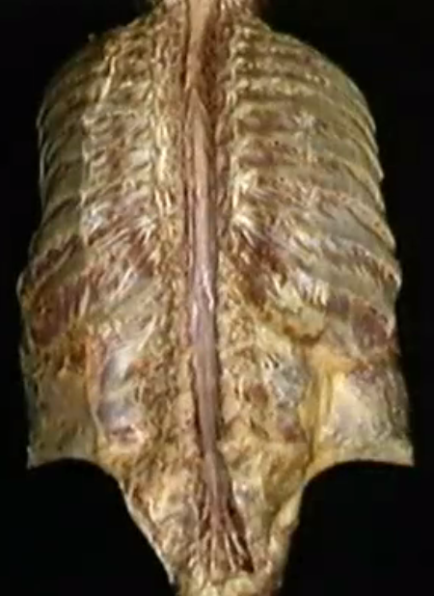
EPIDEMIOLOGY

Slide 3
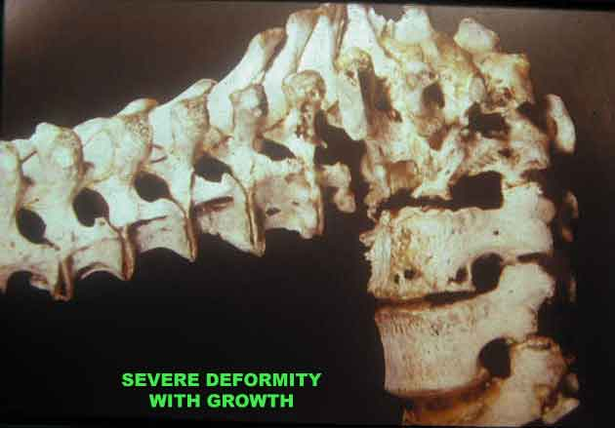
HISTORICAL ASPECTS
TB: Oldest recognised disease of mankind
India: Rigveda and Atharvaveda (3500-1800 BC) : “YASKSHMA”
Greco-Roman – PHTHYSIS / CONSUMPTION
Evidence of spinal TB dates back to Egyptian times and has been documented in 5000-year-old mummies.
In 1779, Percival Pott published the first modern description of spinal deformity and paraplegia resulting from spinal TB.

Slide 4
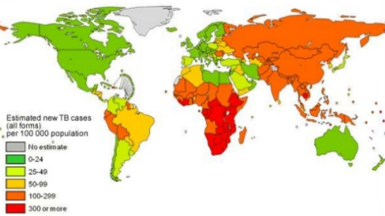
• According to WHO(2006), about one third of the world’s population is infected by Mycobacterium TB,
and 9 million individuals develop TB each year.

Slide 5
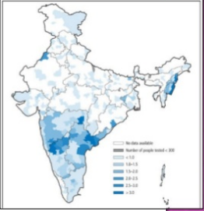
INDIA
1/5TH Of total world population of TB patients
Highest burden in world
3 million radiologically proven cases
1-3% of all involve skeletal system

Slide 6

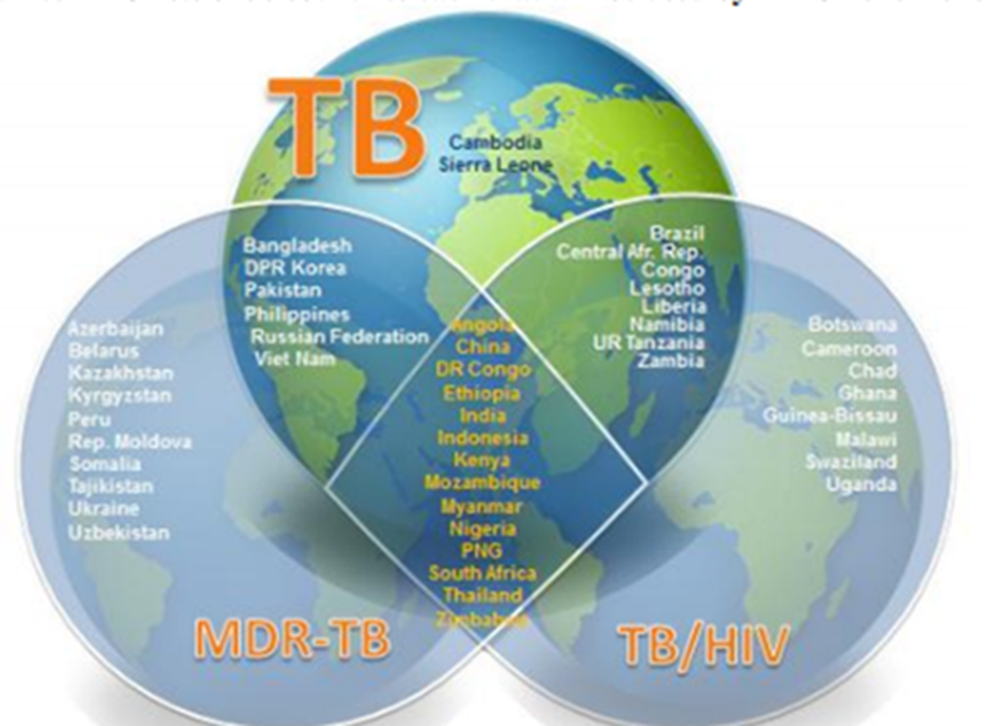
Estimates of TB burden (2016) | Number
Incidence of TB cases | 2.79 million
TB + HIV | 87000
MDR / RR TB | 147000
Mortality of TB cases | 435000
MortalityTB + HIV | 12000

Slide 7
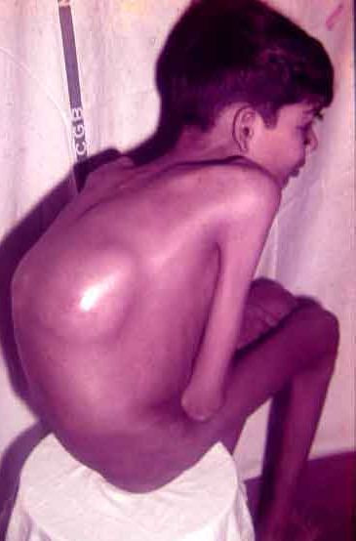
• Vertebral TB is the most common form of skeletal TB and accounts for 50% of all cases of skeletal TB.
• Almost 30% are from pediatric group.
• Every day 100 die of tuberculosis in India.
• Neurological complications are the most crippling
complications of spinal TB ( Incidence : 10 to 43%).

Slide 8
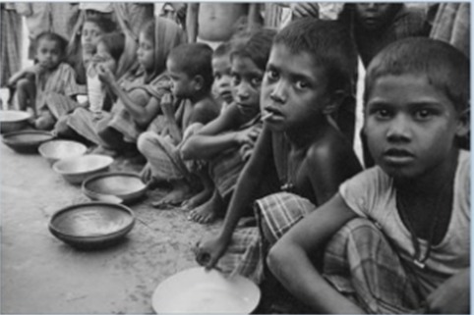
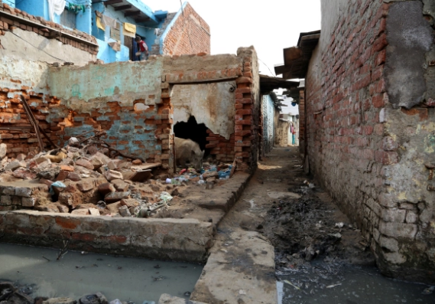
Predisposing factors
GENERAL
MALNUTRITION
POOR SANITATION
OVERCROWDED AREAS
CLOSE CONTACT WITH TB PATIENTS
EXANTHEMATOUS FEVERS
IMMUNODEFECIENCY STATES: HIV
LOCAL – TRAUMA
ISCHEMIC NECROSIS

Slide 9
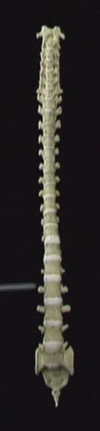
REGIONAL DISTRIBUTION
Sr. No. | Region | Percentage
1 | CERVICAL | 12
2 | CERVICODORSAL | 5
3 | DORSAL | 42
4 | DORSOLUMBAR | 12
5 | LUMBAR | 26
6 | LUMBOSACRAL | 3
7 | SACRUM & SACROILIAC JOINTS | 1

Slide 10
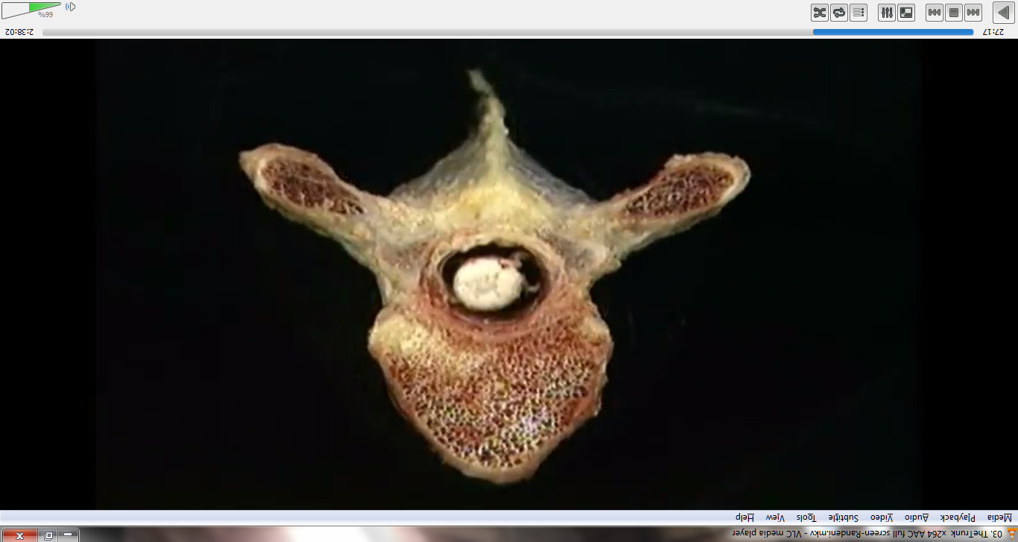
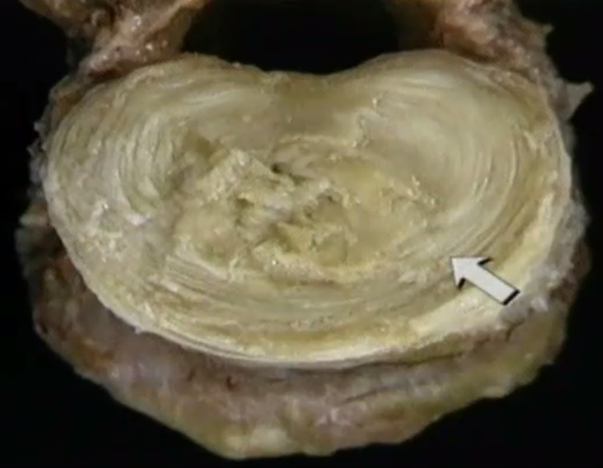
PATHOLOGY

Slide 11
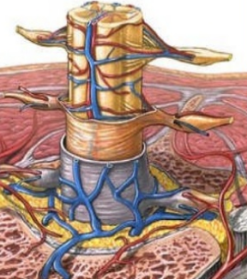
Blood supply
1 anterior spinal artery
2 posterior spinal arteries
Radicular arteries reinforce these
2 segmental arteries on each side supply each vertebrae
Prevertebral venous plexus (Brescet – Batson)
Thrombosis of artery supplying spinal cord (Artery of AdamKiewz) (At D9-10 level)

Slide 12
BOVINE T.B.
Abdomen
Pelvic venous plexus
Vertebrae

Slide 13
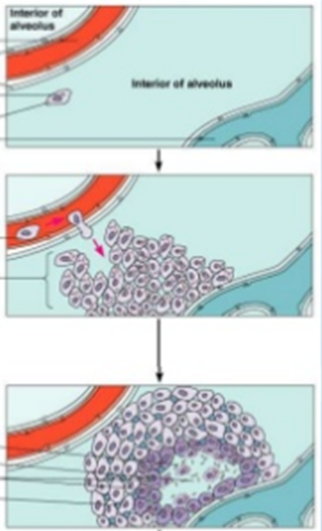
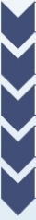
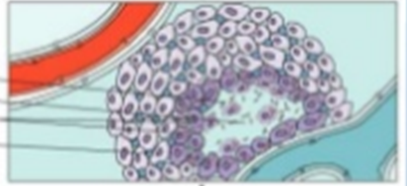
pathology
TB Bacilli phagocytosed by the monnuclear cells
Epitheloid cell formation
Langhans giant cell formation by fusion of epitheliod cells
Lymphocytes form a ring around the lesion
Tubercle formation

Slide 14
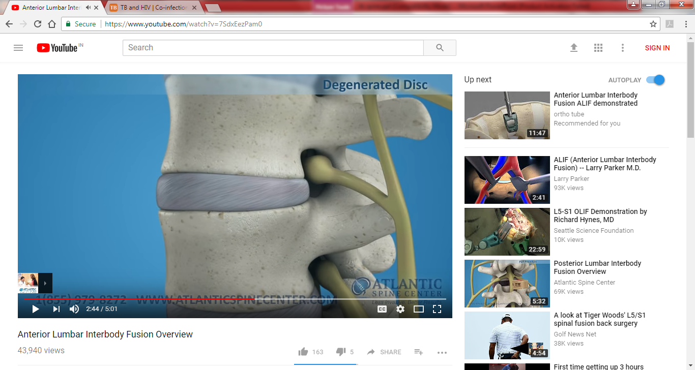
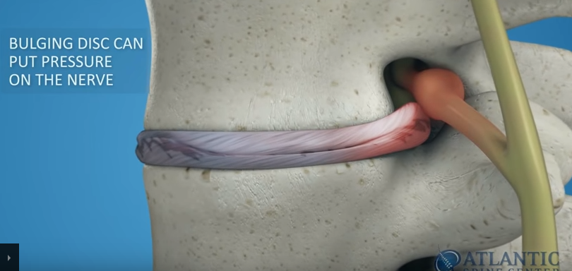
TWO TYPES OF AFFECTION
In children the blood supply is central to the vertebrae. That is why the affection is central.
In adults the blood supply is paradiscal that is why the affection is paradiscal.

Slide 15
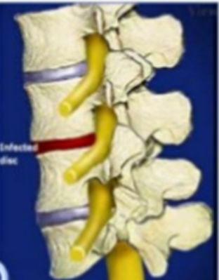
PATHOLOGY
Bacteraemia
Deposition in Bone
Necrosis + Casseation with Hyperemia (increased blood supply)
Cavity in the bone
Surrounding Osteoporosis

Slide 16
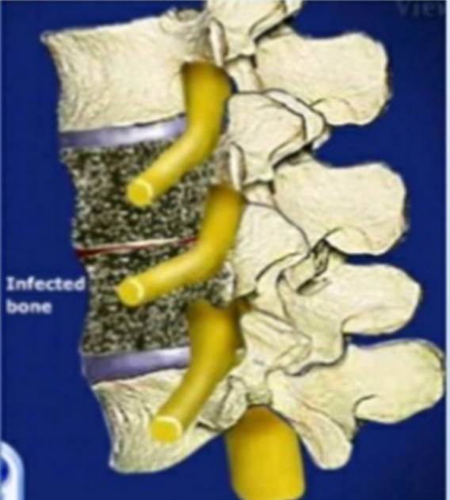
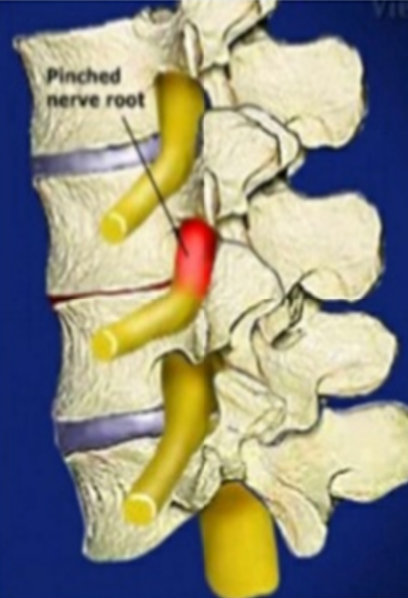
PATHOLOGY CONTD… …
Weight bearing stimulus
Collapse of vertebrae

Slide 17
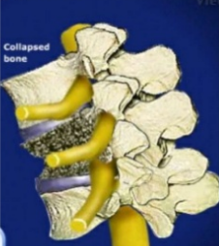
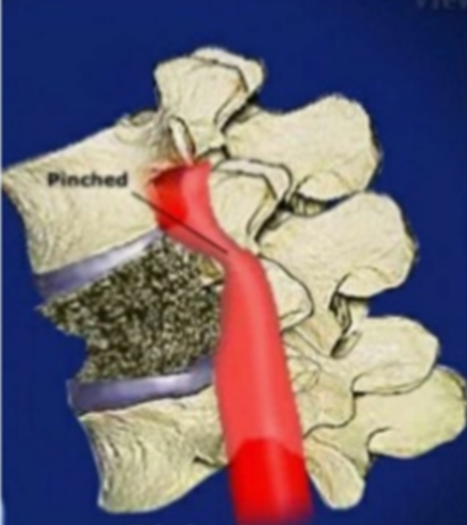

Slide 18
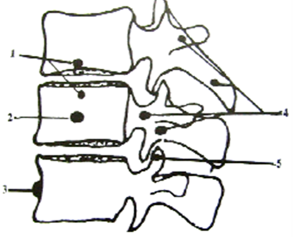
FOUR PATTERNS
PARADISCAL (COMMONEST)
CENTRAL
ANTERIOR
APPENDICEAL
FACETAL

Slide 19
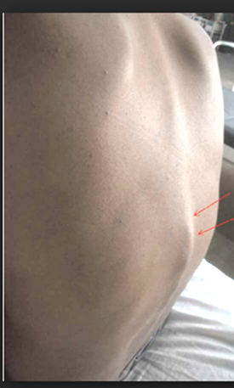
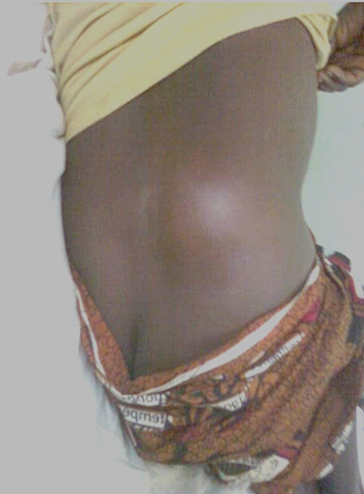
SIGNS & SYMPTOMS

Slide 20
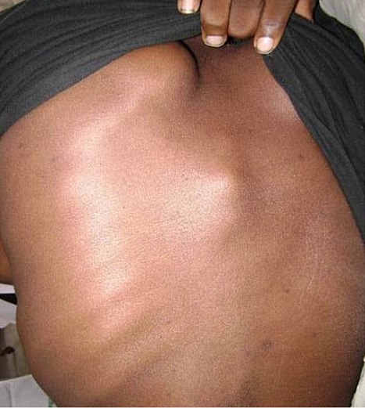
SIGNS & SYMPTOMS
CONSTITUTIONAL: Fever, night pain, weight loss
LOCAL: cold abscess, sinuses, fistula
SPINE DEFORMITY: Kyphosis & Scoliosis
NEUROLOGICAL: Motor deficits & Sensory deficits, flexor spasms, brisk reflexes, bladder involvement

Slide 21
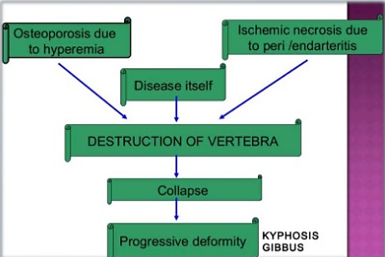
KNUCKLE KYPHOSIS: Forward bending of one or more vertebrae causing small kyphus
ANGULAR KYPHOSIS: Wedge collapse of more than three vertebral bodies

Slide 22
TUBERCULOUS SPINE WITH PARAPLEGIA
INCIDENCE: 10 – 30%
DORSAL SPINE: Most commonly involved
Motor functions affected more than sensory
Sense of position and vibration last to disappear
PATHOLOGY:
INFLAMMATORY EDEMA: vascular stasis, toxins
EXTRADURAL MASS: Vertebral body osteitis, abscess
Extradural granulation → contraction / cicatrization → Peridural fibrosis → recurrent paraplegia

Slide 23
Seddon’s classification of tb paraplegia
GROUP A
EARLY ONSET PARAPLEGIA
ACTIVE DISEASE
< 2 YEARS
PATHOLOGY: INFLAMMATORY EDEMA, CASEOUS ABSCESS, GRANULATION TISSUE, CORD ISCHEMIA
GROUP B
LATE ONSET PARAPLEGIA
HEALED DZ
>2 YRS
RECRUDESCENCE
MECHANICAL PRESSURE
SEQUESTRA, DEBRIS, INTERNAL GIBBUS
CANAL STENOSIS

Slide 24
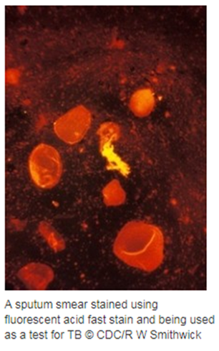
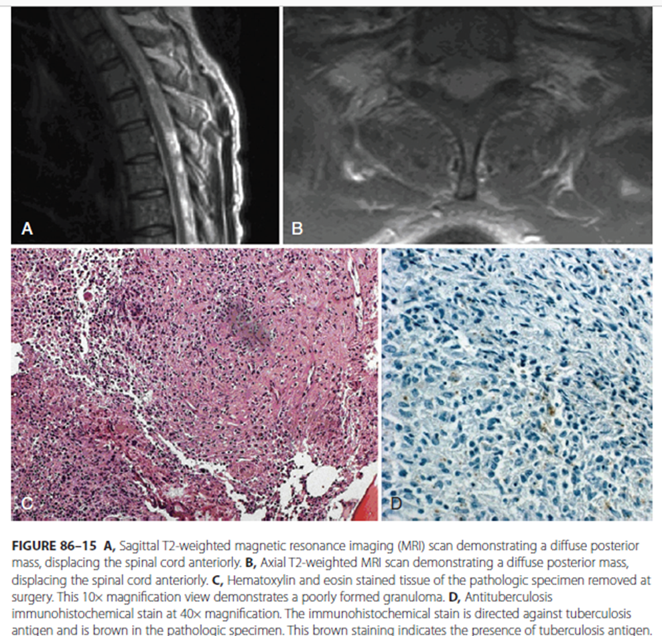
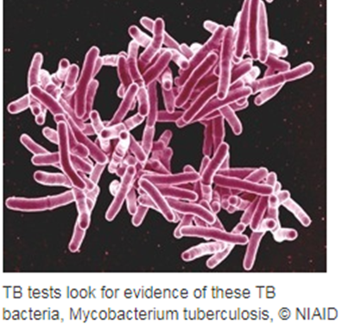
Laboratory investigations

Slide 25
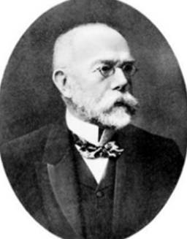
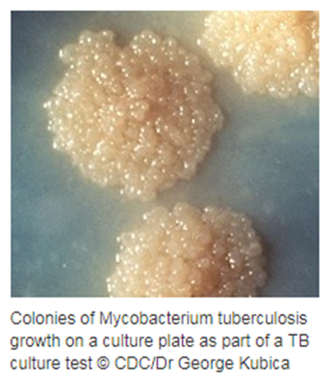
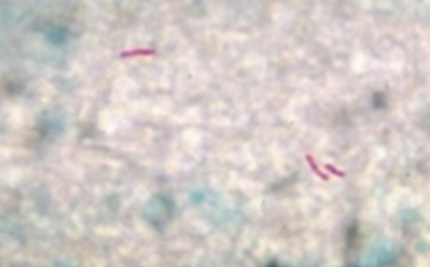
ZIEHL – NEELSEN STAINING
Quick and inexpensive method
Acid fast bacilli
Positive in 50 % of cases
Culture & Drug sensitivity

Slide 26
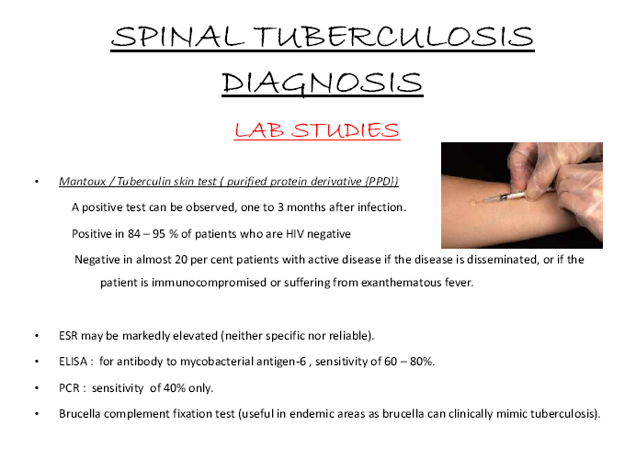
Mantoux test
Tuberculin test
Purified protein derivative PPD
Positive in 84 – 95% patients who are HIV negative
Negative in 20% patients with active dz
ESR: non specific

Slide 27
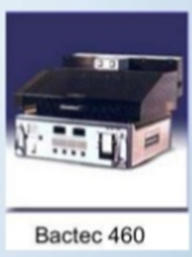
Recent advances
ELISA: mycobacterial antigen 6, sensitivity 60-80%
PCR: sensitivity 40%
Brucella complement fixation test
IFN IGRA (Interferon Gamma Release assays): highly accurate & rapid < 24 hrs
ESAT -6, CFP – 10
Genexpert: MDR TB, XDR TB, RR TB
Truenet: MDR TB, XDR TB, RR TB

Slide 28
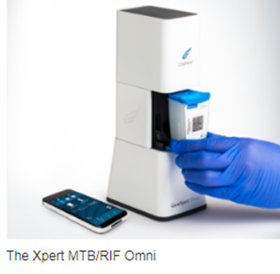
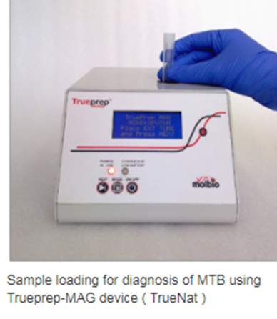
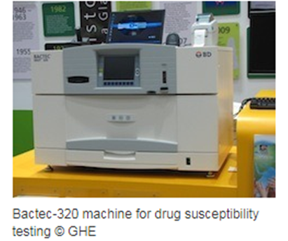
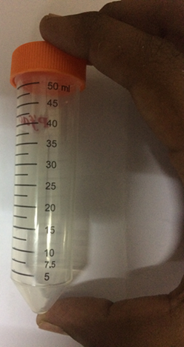
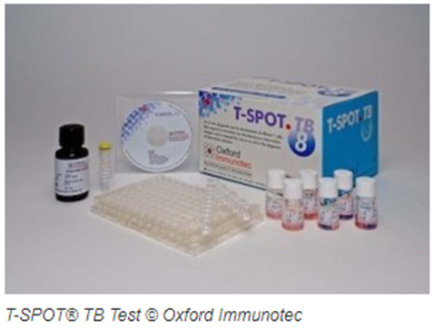
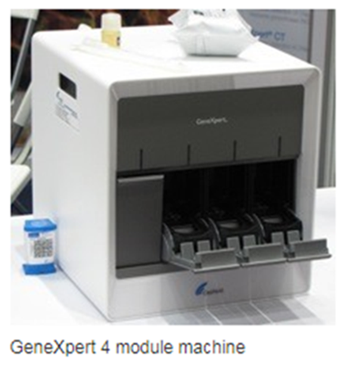

Slide 29
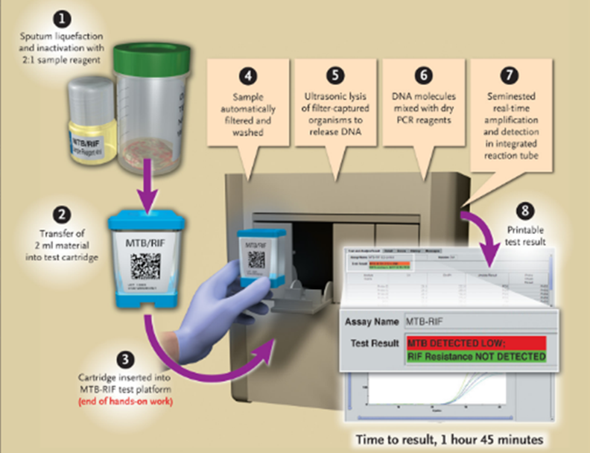

Slide 30
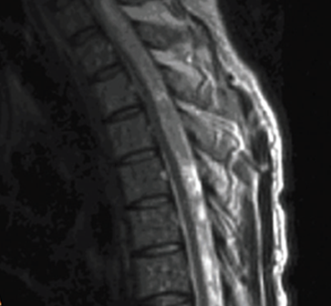
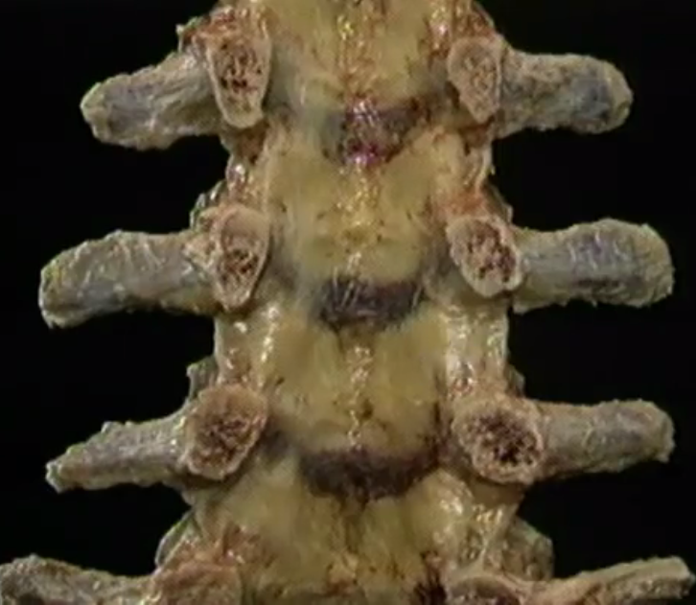
RADIOLOGICAL INVESTIGATIONS

Slide 31
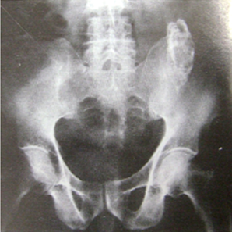
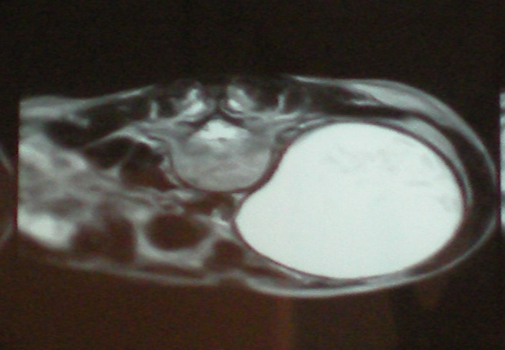
1. PLAIN RADIOGRAPH
2. MRI SPINE
3. CT SCAN
4. BONE SCAN
TB bacilli are rarely found in CSF, therefore imaging plays pivotal role in suggesting the diagnosis.

Slide 32
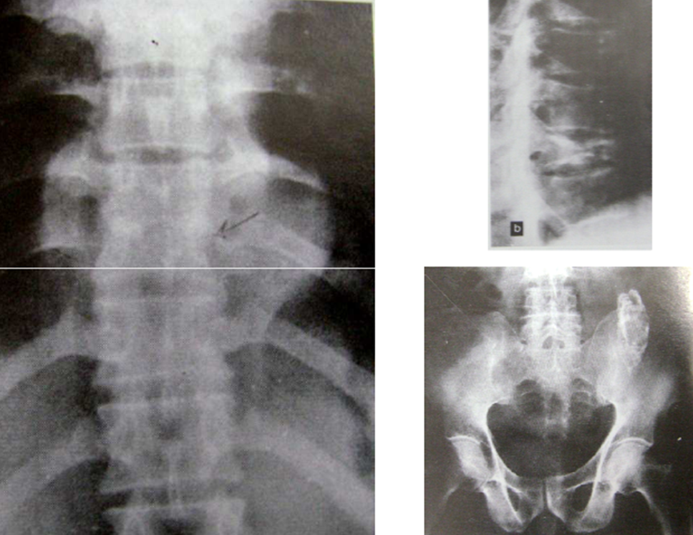
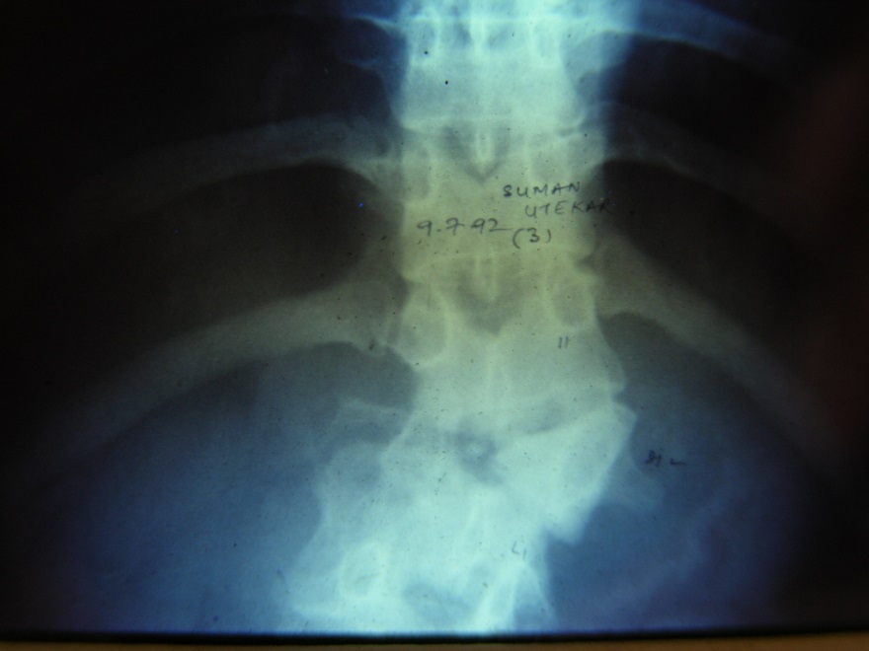
In thoracic region, the longitudinal ligaments limit the abscess
seen in the radiogram as a fusiform radiopaque shadow at or just below the level of the involved vertebra
may reach the anterior chest wall in the parasternal area by tracking via the intercostal vessels.

Slide 33
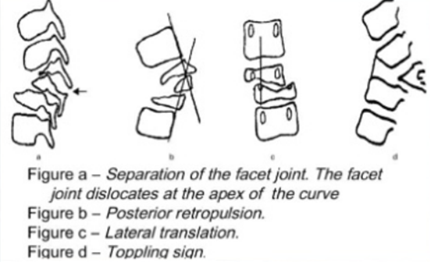
Spine at risk sign
Y = a + bX
Y is the final angle of the deformity,
X is the amount of initial loss of vertebral body,
and a and b are constants (5.5 and 30.5, respectively).
With their formula, the final angle of the gibbus was predictable,
with 90% accuracy in the patients treated nonsurgically.
If the predicted angle is excessive, early operation should be considered.
Rajasekaran and Soundarapandian

Slide 34
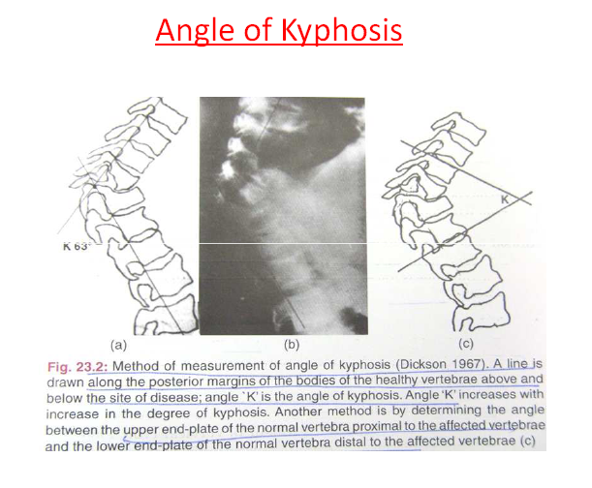

Slide 35


MRI
• MRI is the modality of choice as delineates leptomeningeal disease better, direct evaluation of intramedullary lesions,associated osseous signal change and epidural abscesses.
• Typical (spondylo-discitis) and atypical (spondylitis without discitis) types.

Slide 36

Tuberculous spondylitis
Paraspinal lesion
Abnormal signal intensity
Ring enhancing abscess wall
Subligamentous spread to vertebral bodies
Multiple / skip vertebral bodies involved

Slide 37
Paravertebral abscess
With collapse of the vertebral body, tuberculous granulation tissue, caseous matter, and necrotic bone accumulate beneath the anterior longitudinal ligament.
Gravitate along the fascial planes and present externally at some distance from the site of the original lesion.
In lumbar region, along the psoas fascial sheath points into the groin just below the inguinal ligament.
Cervical --- posterior to esophagus / oropharynx / nasopharynx
Dorsal --- along the ribs
DL / Lumbar --- along psoas sheath --- psoas abscess

Slide 38


Paradiscal lesions
Axial plane
Sagittal plane
Coronal plane

Slide 39


Anterior lesions

Slide 40


Central lesions

Slide 41


Appendicial lesions

Slide 42
1. Intradural extramedullary tuberculoma
2. Spinal Arachnoiditis
3. Secondary intraspinal extension from tuberculous spondylitis.

Slide 43




CT SCAN:
Unilateral + central C1- C2 destructions.

Slide 44
Sr. No. | MRI | CT Scan
1 | Discitis | Craniovertebral junction
2 | Extradural abscesses | Cervico-dorsal region
3 | Skip lesions | Sacrum
4 | Intradural involvement | Sacro-iliac joints
5 | Arachanoiditis | Calcified abscess
6 | Vertebral body involvement | Patterns of bony destruction
7 | No radiation exposure | Radiation exposure

Slide 45
Sr. No. | Stage | Duration | Clinico radiological feature
1 | Pre destructive | < 2 months | Paraspinal muscle spasm
2 | Early destructive | 2-4 months | Reduced disc space MRI: marrow edema CT: marginal vertebral erosion
3 | Mild kyphosis | 4 – 9 months | 2 – 3 vertebrae involved (K: 10 – 30°)
4 | Moderate kyphosis | 6 – 24 months | > 3 vertebrae (K: 30 - 60°)
5 | Severe kyphosis | > 2 years | > 3 vertebrae (K: > 60°)

Slide 46
Differential diagnosis
Infections: pyogenic, brucella, actinomycetes, cryptococcous
Neuropathic
Neoplastic: lymphoma, metastasis
Degenerative
Good disc is a bad news, bad disc is a good news
Biopsy has to be done for confirming the diagnosis

Slide 47
SR NO. | TUBERCULAR | PYOGENIC
1 | Duration of history: months to years | Days to months
2 | Pulmonary TB: 60% | 0%
3 | Dorsal spine | Lumbar spine
4 | > 3 vertebrae | Mostly 1 vertebrae
5 | Disc involved | Disc not involved
6 | Vertebral collapse – 67% | 21 %
7 | Bone destruction: 73% | 48%
8 | Posterior elements involved | Not involved
9 | Skip lesions present | Absent

Slide 48
COMPLICATIONS OF SPINAL TUBERCULOSIS
• Paraplegia
• Cold abscess
• Spinal deformity
• Sinuses
• Secondary infection
• Amyloid disease
• Fatality

