Slide 1
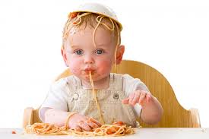
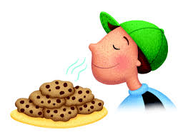
Physiology of Taste and Smell
Dr. Jayna Devalia
(M.B.B.S., M.D. Physiology)
Tutor
Department of Physiology

Slide 2
Taste and Smell Sensation
To separate undesirable or lethal foods from those that are pleasant to eat and nutritious.
They elicit physiological responses that are involved in digestion and utilization of foods.
Allows animals to recognize the proximity of other animals or even individuals among animals.
Finally, both senses are strongly tied to primitive emotional and behavioral functions of our nervous systems.

Slide 3
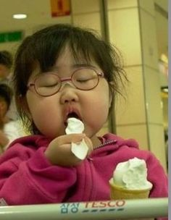
Physiology of taste

Slide 4
Taste is mainly a function of the taste buds in the mouth.
In addition, the texture of food, as detected by tactual senses of the mouth, and the presence of substances in the food that stimulate pain endings, such as pepper, greatly alter the taste experience.
Flavor:
Complex sensation comprising taste, odor, roughness or smoothness, hotness or coldness, pungent or blandness.

Slide 5
Taste is a Function of the Taste Bud
13 possible chemical receptors in taste buds.
  2 for sodium
  2 for potassium
  chloride
  adenosine
  inosine
  2 sweet
  2 bitter
  glutamate
  hydrogen ion

Slide 6
Modalities of Taste
Can perceive hundreds of different tastes
All are various combinations of the five primary taste sensations Similar to the perception of color
1. Sweet
2. Sour
3. Salty
4. Bitter
5. Umami

Slide 7
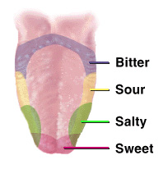

Slide 8
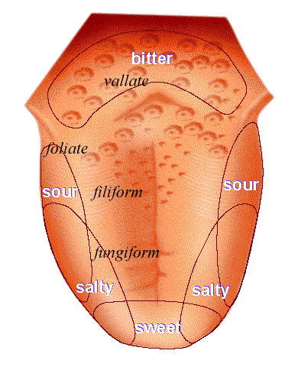

Slide 9
Sweet & salt sensibilities at the tip.
Sour at the sides.
Bitter at the back.
1. Sour :
  Caused by acid concentration (H+ ion concentration)
Degree of sourness is proportional to the H+ ion concentration. More acidic the solution more sourness is there.
Acids increase intracellular H+ ion concentration & cause depolarization.

Slide 10
2. Salt :
  caused by ionized salts
e.g. of pure salty taste is Nacl.
Entry of Na+ intracellular cause depolarization of receptor.
3. Bitter :
Bitter taste produced by many types of substances mainly alkaloids.
e.g. Quinine
Caffeine
Morphine
Nicotine.
Strychnine

Slide 11
4. Sweet taste :
Entirely due to organic compounds.
e.g. glucose
Sucrose
Fructose.
5. Umami Taste.
Umami is a Japanese word (meaning “delicious”) designating a pleasant taste sensation that is qualitatively different from sour, salty, sweet, or bitter.
It is triggered particularly by the monosodium glutamate (MSG) used so extensively in Asian cooking. The taste is pleasant and sweet but differs from the standard sweet taste.
Umami taste is due to the activation of a metabotropic glutamate receptor, mGluR4, in the taste buds.

Slide 12
Sensation of Taste
Receptor for taste sensation is TASTE BUD.
Taste buds are chemoreceptors.
Location:
1. Dorsum & edges of tongue.
2.Epiglottis
3.Soft Palate
4.Pharynx
Taste buds are present on the papillae.
Papillae are small projections present on anterior 2/3rd of tongue.

Slide 13
Location of Taste Buds
Found on Four types of papillae of the tongue.
Fungiform Papillae: Present at the tip of tongue.
2. Circumvallate Papillae: Present in the shape of “v” at the back of tongue.
3. Foliate Papillae: Present at postero lateral aspect of tongue.
4. Filiform papillae: Present as diverging rows to the left & right of midline. Do not contain taste buds.

Slide 14
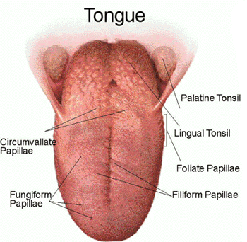

Slide 15
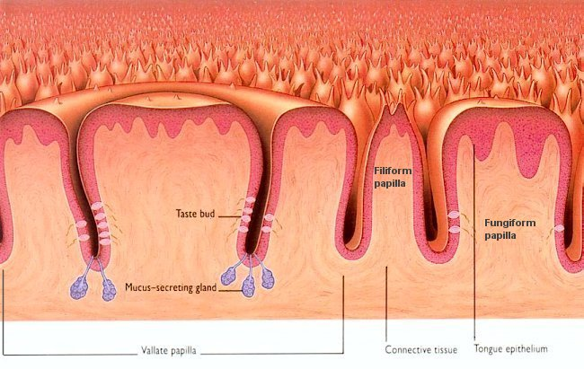

Slide 16
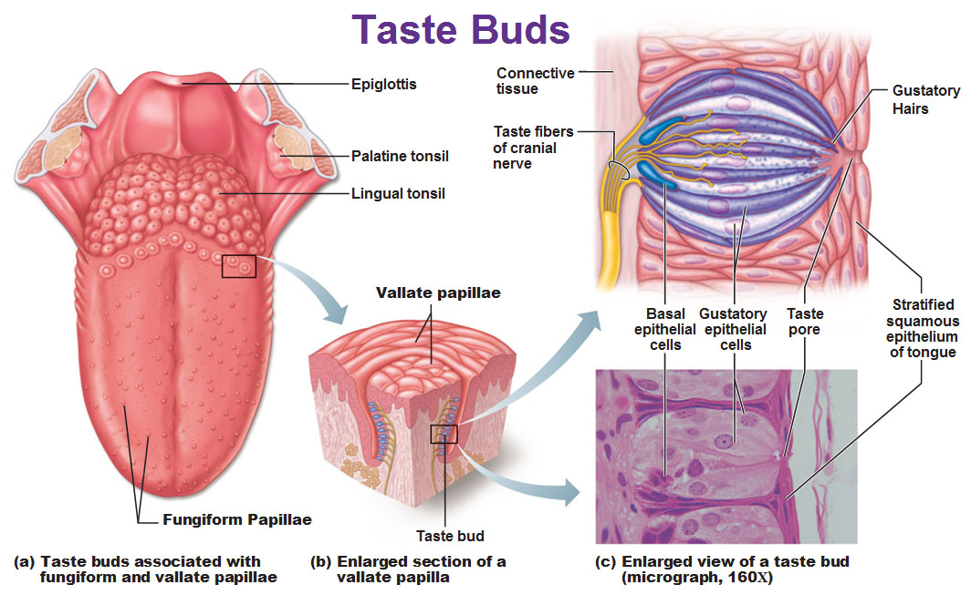
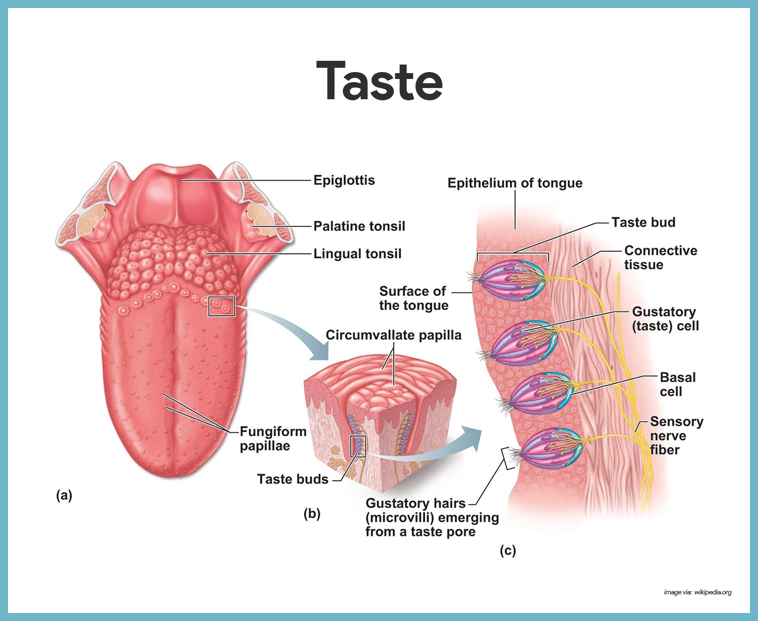

Slide 17
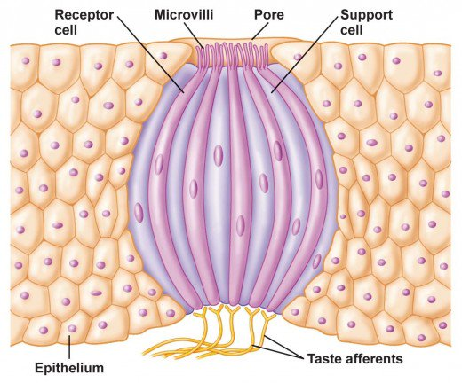

Slide 18
Taste Bud
Taste buds contain the receptors for taste which is present on the walls of papillae.
Human tongue has 3,000–10,000 taste buds.
Average life of a taste bud is 10 days.

Slide 19
The taste bud is composed of about 50 modified epithelial cells, some of which are supporting cells called sustentacular cells and others of which are taste cells.
The outer tips of the taste cells are arranged around a minute taste pore.
From the tip of each taste cell, several microvilli, or taste hairs, protrude outward into the taste pore to approach the cavity of the mouth. These microvilli provide the receptor surface for taste.

Slide 20
Physiology of Taste
Taste producing substance first gets dissolved into the oral fluid.
2. Then forms attachment with the receptor of
gustatory cells.
3. This attachment produces Generator Potential in
the gustatory cells.
4. Action potential is developed in sensory nerves.

Slide 21
Mechanism of Stimulation of Taste Buds
Receptor Potential: The membrane of the taste cell, like that of most other sensory receptor cells, is negatively charged on the inside with respect to the outside.
The mechanism by which taste sensation is produced is by binding of the taste chemical to a protein receptor molecule that lies on the outer surface of the taste receptor cell near to or protruding through a villus membrane.
Application of a taste substance to the taste hairs causes partial loss of this negative potential—that is, the taste cell becomes depolarized.
This change in electrical potential in the taste cell is called the receptor potential for taste.

Slide 22
The type of receptor protein in each taste villus determines the type of taste that will be perceived The receptors are of two major types of receptors:
1. Ligand-gated channels (ionotropic receptors)
2. GPCRs (metabotropic receptors).
Salt and sour tastes are triggered by activation of ionotropic receptors;
Sour, bitter, and umami tastes are triggered by activation of metabotropic receptors.

Slide 23
Ligand-gated channels (inotropic receptors) opens ion channels, which allows positively charged sodium ions or hydrogen ions to enter and depolarize the normal negativity of the cell.
GPCRs (metabotropic receptors): The portions of the receptor protein molecules that protrude through the apical membranes activate second-messenger transmitter substances inside the taste cells, and these second messengers cause intracellular chemical changes that elicit the taste signals.

Slide 24
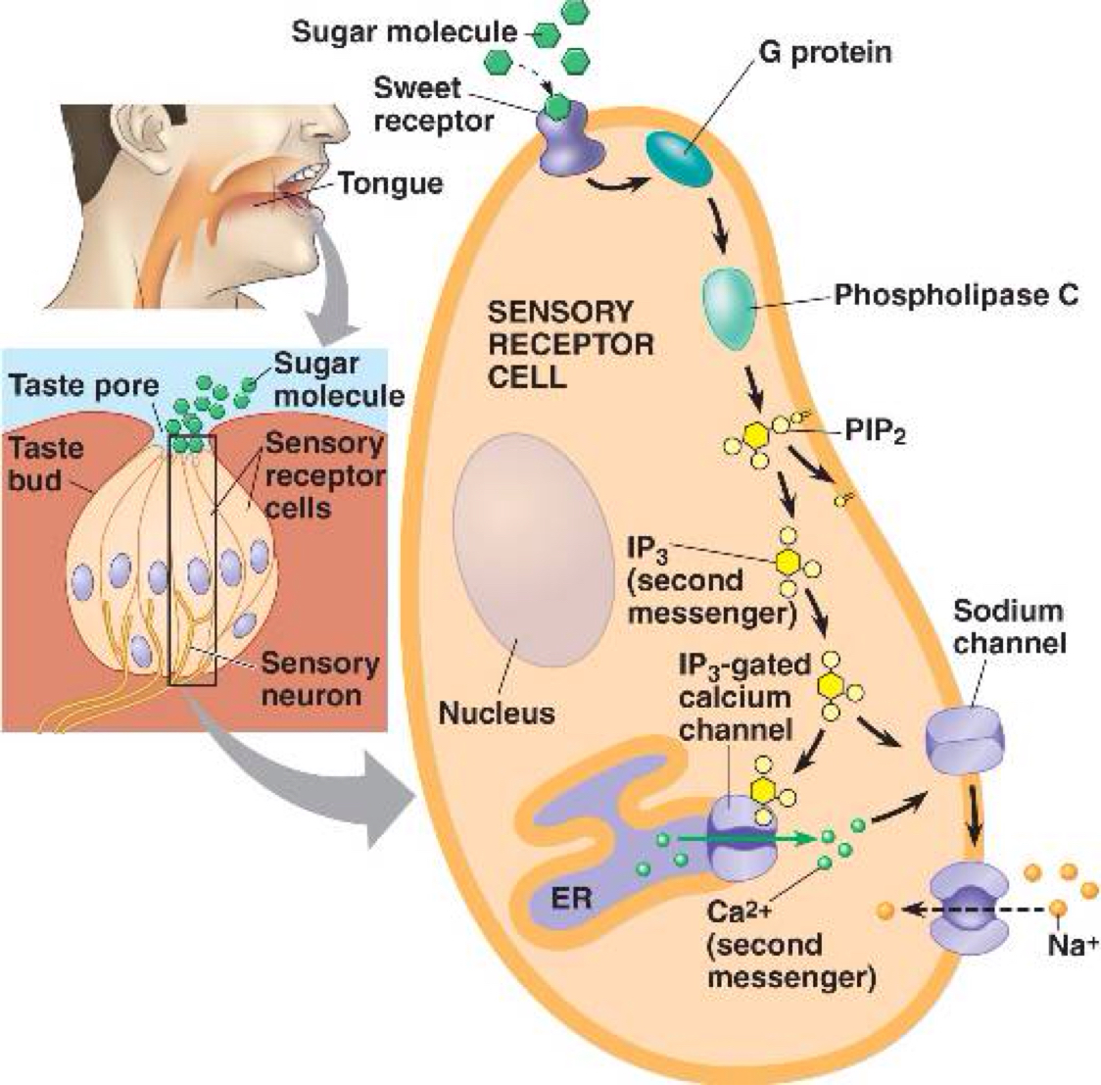
Gustatory Transduction

Slide 25
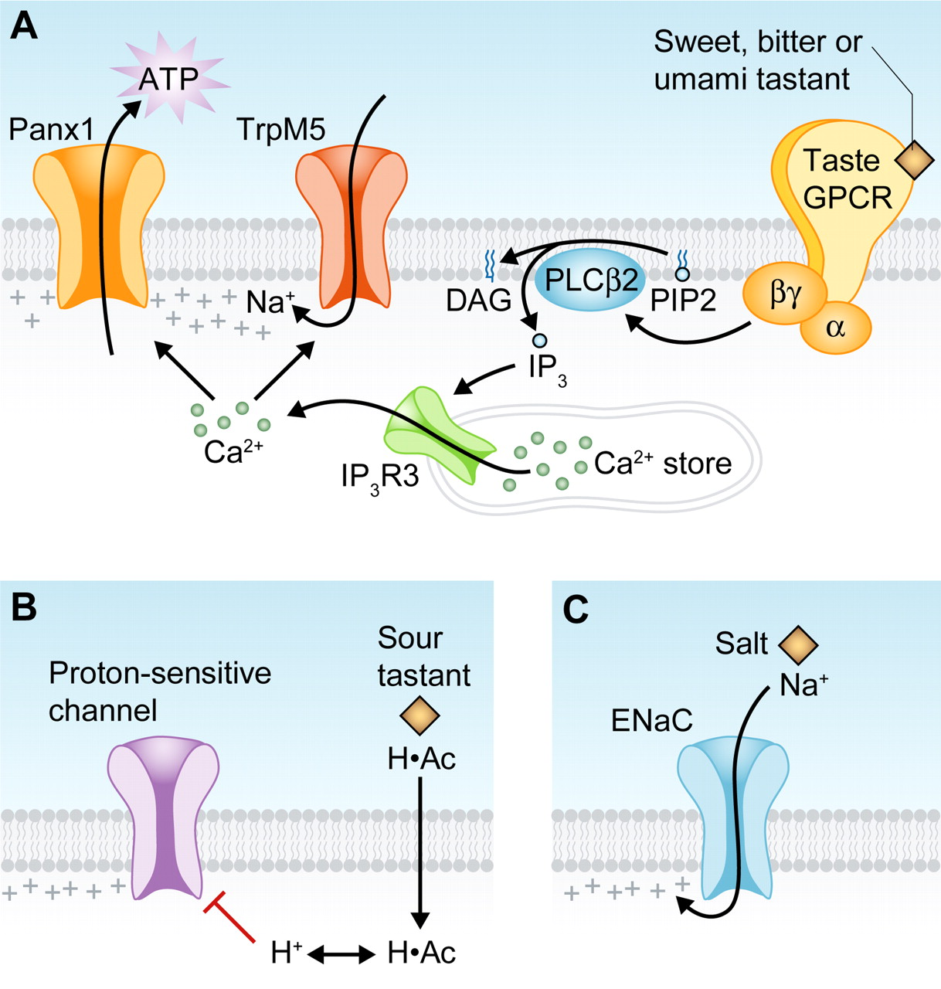

Slide 27
1) Sour
Increase extracellular H+
Increase Na+ & K+ permeability
Depolarization of taste receptor cells
Neurotransmitter secretion
Stimulation of afferent nerve fibers

Slide 28
2) salt
Increase extracellular Na+
Increase Na+ permeability
Depolarization of taste receptor cells
Neurotransmitter secretion
Stimulation of afferent nerve fibers

Slide 29
3) Bitter
Activation of receptors
Dissociation of G-protein
Activation of phospholipase C
Increase IP3
Increase Ca2+

Slide 30
4) Sweet
Activation of receptors
Dissociation of G-protein
Activation of adenylyl cyclase
Increase cyclic AMP
Depolarization & neurotransmitter secretion

Slide 31
TASTE PATHWAY
1. Sensory fibers in anterior 2/3rd of tongue run in Lingual nerve which continued as chorda tympani nerve; Branch of VII nerve.
2. Fibres from posterior 1/3rd of tongue run in IX nerve.
3. From epiglottis & Palate run in X nerve.

Slide 32
All these fibres end in the NTS {nucleus tractus solitarius}in the medulla.
2nd order neuron arise from here & reach the thalamus via medial leminiscus.
From thalamus 3rd order neuron arise & end in the sensory cortex in post central gyrus.

Slide 33
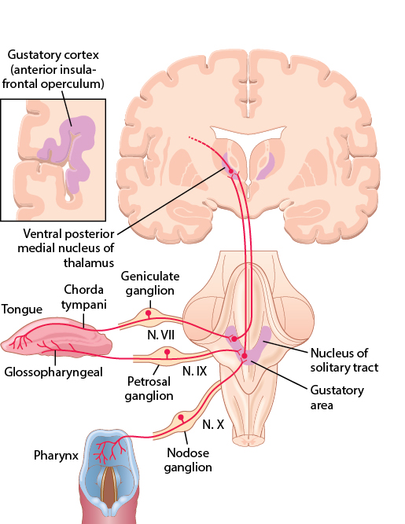

Slide 34
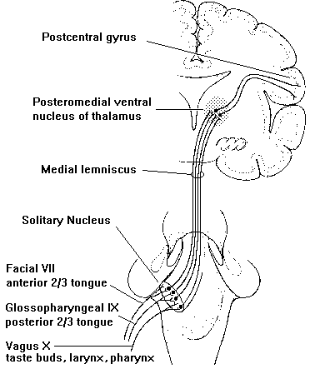

Slide 35
Factors affecting taste sensation

Slide 36
Area of stimulation-
Threshold for taste decreases as area of application of stimulus increases.
2) Temperature of substance-
Maximum sensitivity to taste is obtained at 30-40 degree
3) Olfaction –
As it affects flavor
4) Individual variation-
Decrease in taste sensitivity in older people due to atrophy of taste buds.
5) Sex-
women are more sensitive to sweet and salt and less sensitive to sour than men
6) Affective nature of taste-
Pleasantness and unpleasantness are called affective attributes of a sensation. These make an individual select or reject food.
Example:
Sweet is unpleasant at very low conc but very pleasant at high conc and sour and bitter are pleasant at low conc but very unpleasant at high conc.

Slide 37
7) Taste preference and control of diet-.
Adrenalectomized animals:
As salt and water content is lost so more preference to salt water than to pure water.
b) DM:
An animal given injections of excessive amounts of insulin develops a depleted blood sugar, and the animal automatically chooses the sweetest food from among many samples.
c) Calcium depleted parathyroidectomized animals:
Automatically choose drinking water with a high concentration of calcium chloride.
8) Adaptation-
Taste buds adapt quickly to a particular taste.
9) Interaction between taste producing substances affect taste sensation.
Example :
Very sour lemon juice tastes good when mixed with sugar

Slide 38
APPLIED PHYSIOLOGY
1) Ageusia :loss of taste sensation
Temporary loss due to drugs captopril & pencillamine, vit B12 or zinc defeciency.
Damage to lingual or 9 CN
2) Hypogeusia : decreased sensation due to ageing and tobacco abuse
3) Dysgeusia or Parageusia : Unpleasant and disturbance in taste perception of metallic, rancid taste .

Slide 39
4) Familial dysautonomia-
Inability to recognize by taste even saturated solutions of reference taste producing substances
Postural hypotension, absence of lacrimation, hyporeflexia, insensitivity to temp. & noxious stimulation
5) Selective taste blindness-
Marked rise in threshold to bitter taste of phenythiourea
No taste blindness to other bitter taste substances or sweet, salt or sour substances

Slide 40
MCQ
Taste buds are present in all of the following papillae except:
Fungiform
Circumvillate
Vallate
Filiform

Slide 41
2) Which one of the following structure is not related with taste pathway :
A) Glossopharyngeal
B) Vagus
C) Hypoglossal
D) Postcentral Gyrus

Slide 42
3) Which of the following is not a primary taste sensation??
Pungent
Sweet
Salty
Sour

Slide 43
4) The absence of sense of taste is known as:
A) Anosmia
B) Hypogeusia
C) Ageusia
D) Dysgeusia

Slide 44
5) Not a true match of taste with the substance
Sour: Hydrochloric acid
Salty: Sodium chloride
Bitter: Nicotine
Sweet: Strychnine

Slide 45
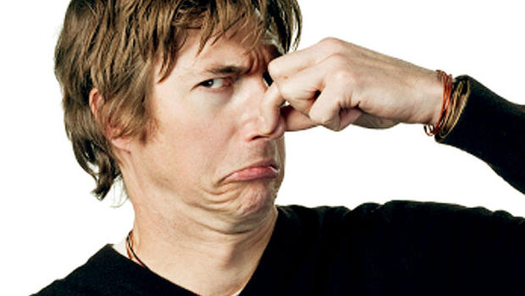
Physiology of olfaction

Slide 46

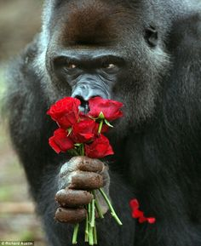
Olfaction
Macrosomatic
Microsomatic

Slide 47
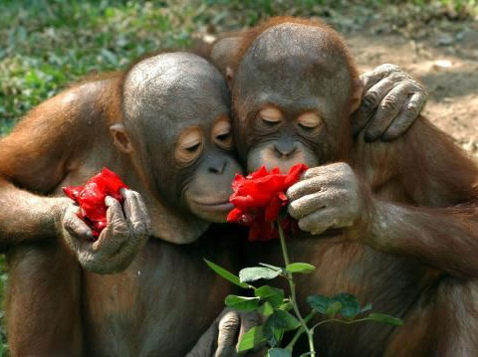

Functions of Smell
Least understood of all senses and poorly developed in humans.
Gatekeepers (good in, bad reject)
Orient in space
Guide to find other animals
Guide to find food
Sex
Humans, perfumes indicate still important
Detect spoiled food
Fire
Anosmia

Slide 48
Contents
1) Olfactory receptors
2) Olfactory transduction
3) Olfactory Pathway
3) Applied

Slide 49
Olfactory receptors situated in olfactory mucus membrane that lines upper part of nostril.
Olfactory mucus membrane consist of 10-20 millions of olfactory receptor cells supported by sustentacular cells.
Olfactory receptors are actual neurons (Bipolar) but they can regenerate every around 30- 45 days and contains the cilia that have odorant-binding proteins.
Mucosa contains mucus secreting Bowman’s glands.

Slide 50
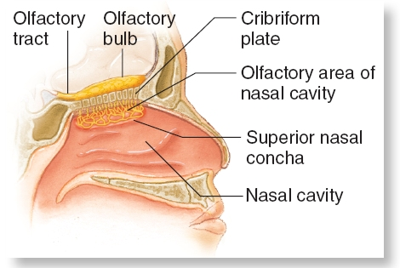
Olfactory Mucosa

Slide 51
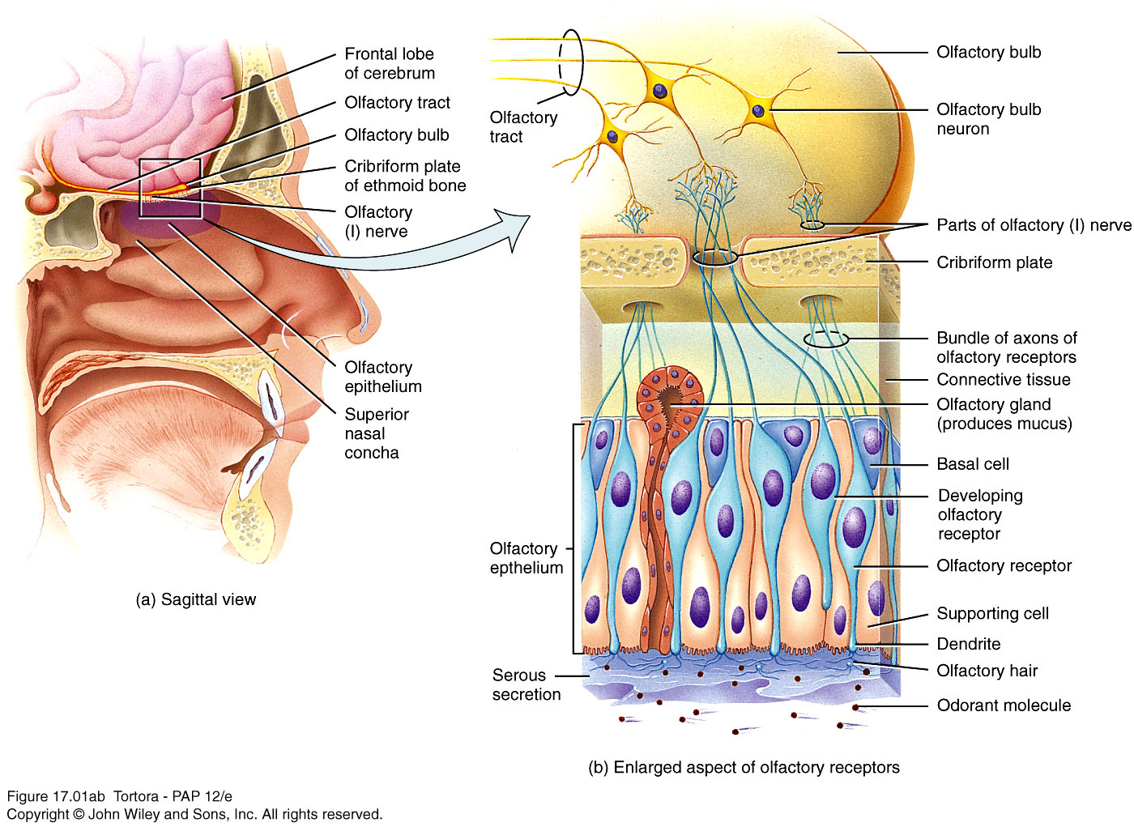
Olfaction: Sense of Smell
Olfactory receptor- a bipolar neuron with cilia called olfactory hairs: Respond to chemical stimulation of an odorant molecule.
Supporting cells- provide support and nourishment.
Basal cells- replace olfactory receptors.

Slide 52
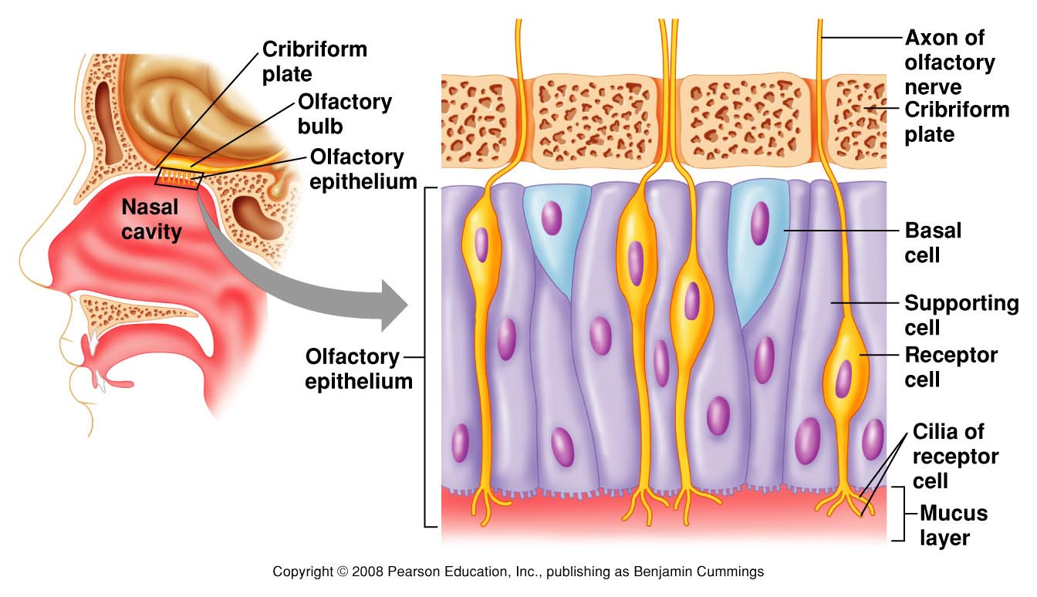
Olfaction

Slide 53
What substances can be smelled?
Substance must be volatile so that it can be sniffed into nostrils.
Substance must be water soluble to penetrate the mucus to reach the olfactory cells.
Substance must be at least slightly lipid soluble to interact with the membrane.
Olfactory receptors adapt very slowly. But olfactory sensation itself adapts rapidly. Hence, must involve a central mechanism.

Slide 54
Primary Sensations of Smell
Camphoraceous
Musky
Floral
Pepperminty
Ethereal
Pungent
Putrid
These are based on psychological testing. It is certain that the list does not represent true primary sensations of smell.

Slide 55
From Odorant To Action Potential
The membrane potential inside unstimulated olfactory cells averages about −55 millivolts.
Most odorants cause depolarization of the olfactory cell membrane, decreasing the negative potential in the cell from the normal level of −55 millivolts to −30 millivolts or less—that is, changing the voltage in the positive direction. Along with this, the number of action potentials increases to 20 to 30 per second, which is a high rate for the minute olfactory nerve fibers.

Slide 56
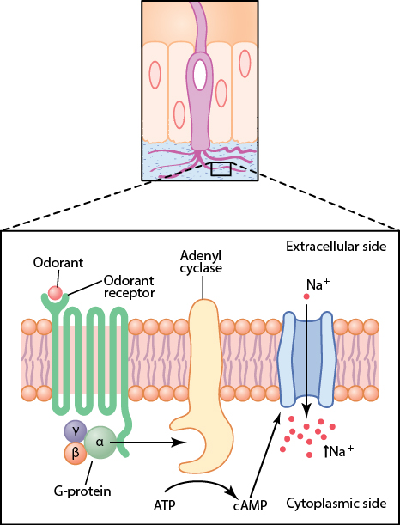
From Odorant To Action Potential
Odorant-binding receptors are located on cilia
Binding induces G-protein activation of adenyl cyclase, which causes formation of cAMP. The cAMP opens sodium channels causing depolarization.

Slide 57
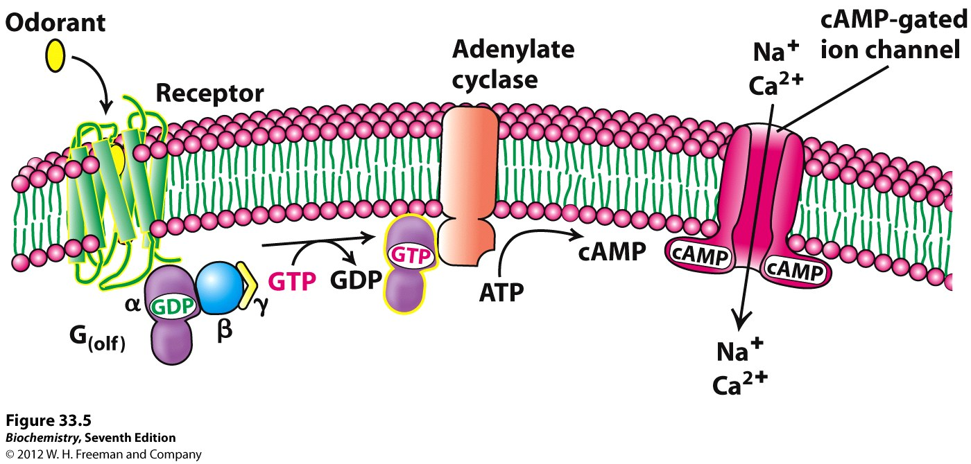

Slide 58
Olfactory pathway

Slide 59
Olfactory Epithelium and Olfactory Receptors

Slide 60
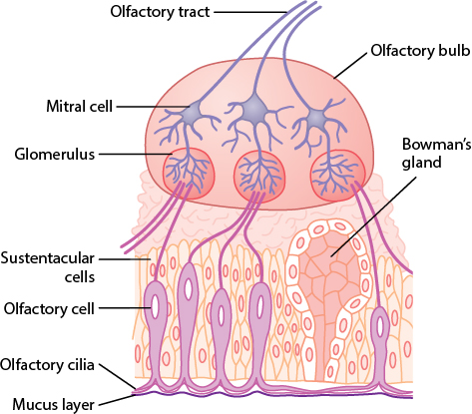
The olfactory membrane and bulb

Slide 61
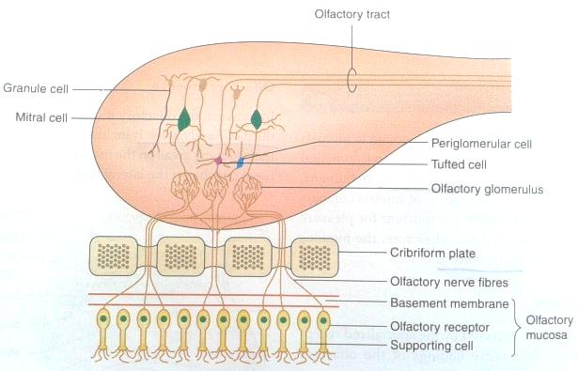

Slide 62
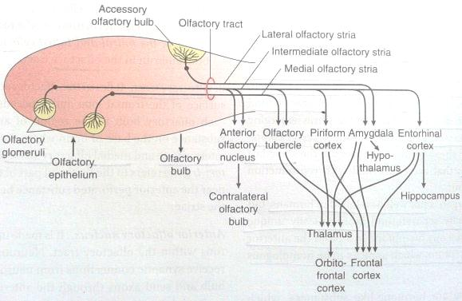

Slide 63
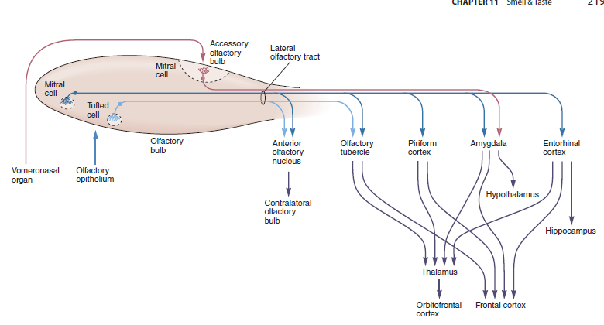

Slide 64
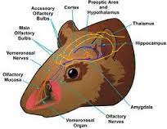
Vomeronasal organ (VNO)

Slide 65
Pouch like structure found along nasal septum in rodents & other animals.
Receptors present are concerned with perception of odour that eliminates from pheromones & foodstuffs
Related to food & sex behavior of animals
Nerve fibers from VNO project to accessory olfactory bulb & then in the amygdala & hypothalamus.
Pheromones:
Hormone like substances which emit odour & produce hormonal, behavior & physiological changes in other animal of same species.
Secretion mainly during mating season only.
So role of pheromones is to provide close relationship between smell & sexual function.

Slide 66
ROLE OF HIGHER CENTERS
Anterior Olfactory nucleus | Transfer olfactory memories from one side to other side
Piriform cortex | Olfactory discrimination Conscious perception
Amygdala | Emotional response to olfactory stimuli
Entorrhinal cortex | Concerned with olfactory memories

Slide 67
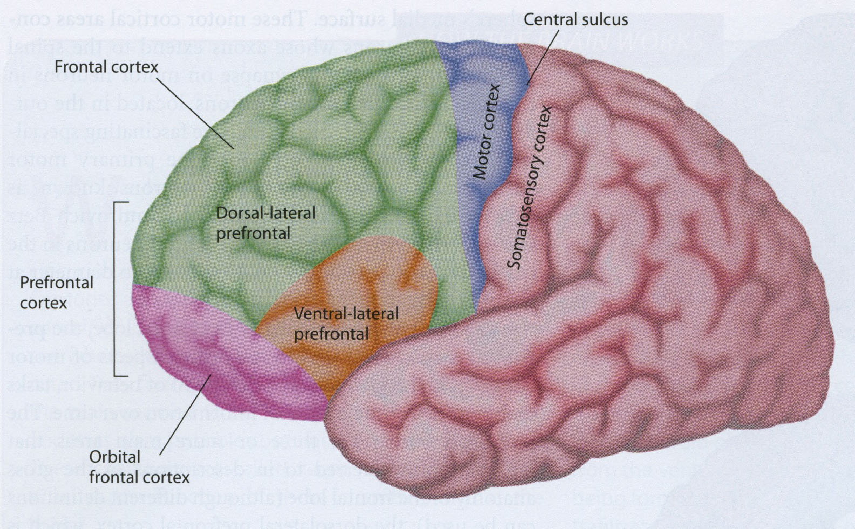
Orbitofrontal Cortex

Slide 68
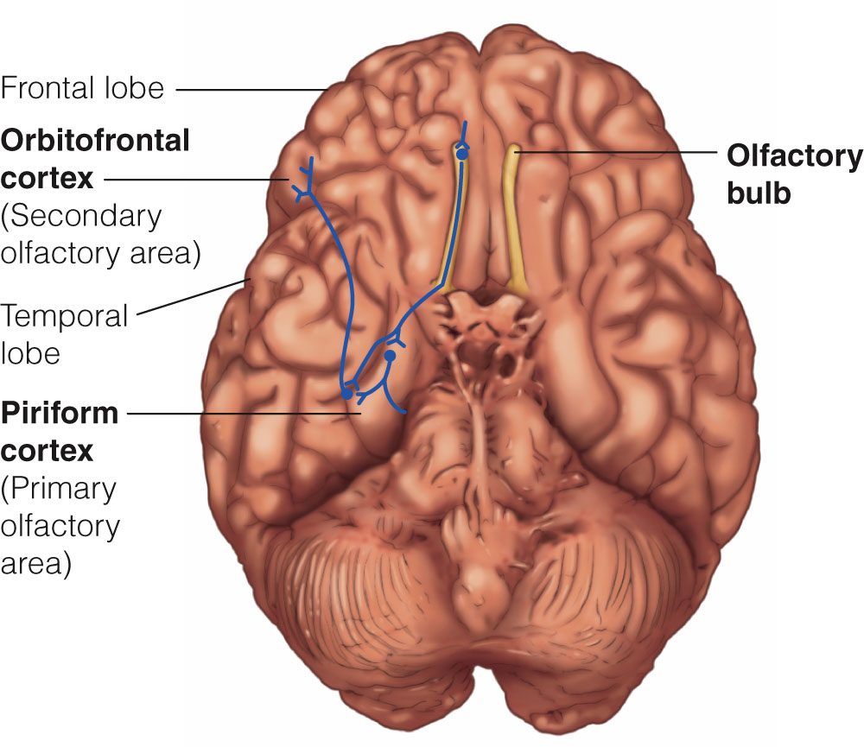
Neural Pathways for Olfaction

Slide 69
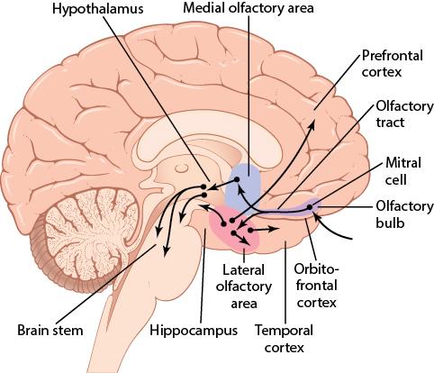
Transmission Of Smell Sensation To CNS
Olfactory nerve is
the first cranial nerve
Medial (old)
and lateral (new)
olfactory area

Slide 70
Neural Pathways for Olfaction
Conscious discrimination
Emotional response
Mitral cells in the olfactory bulb
Piriform cortex
Amygdala
Olfactory receptor neurones
Thalamus
Orbitofrontal cortex

Slide 71
Applied physiology
1. Anosmia – loss of sensation of smell
2. Hyposmia –reduction in olfactory sensation due to constant exposure to a particular odor.
3. Hyperosmia – increased olfactory sensation due to adrenal insufficiency.
Causes:
Simple nasal congestion or nasal polyps.
Damage to the olfactory nerves due to fractures of the cribriform plate or head trauma
Tumors such as neuroblastomas or meningiomas, and respiratory tract infections (such as abscesses)

Slide 72
MCQS
1) Smell, not true is:
It has no relay in thalamus
Its receptors are in direct contact with the external environment
Highly developed in men
Its receptors are telereceptors as well as chemoreceptors

Slide 73
2) Which one of the following brain center Does not receives smell senses:
A) thalamus
B) olfactory cortex via the hypothalamus
C) olfactory cortex via the mitral cells
D) cerebral post central gyrus

Slide 74
3) Types of cells not present in the olfactory bulb
Mitral and tuffed cells
Granule cells
Supporting cells
Periglomerular short axon cells

Slide 75
4) which one of the following terms is used for absence of the sense of smell:
A) Ageusia
B) Anosmia
C) Hyposmia
D) Dysosmia

Slide 76
5) Role of higher centers in all of the following except:
Anterior Olfactory Nucleus: transfers memory from one side to other
Piriform: Discrimination and conscious perception
Amygdala :Emotional responses to olfactory stimuli
Entorrhinal cortex: Initiate sneezing

