Slide 1
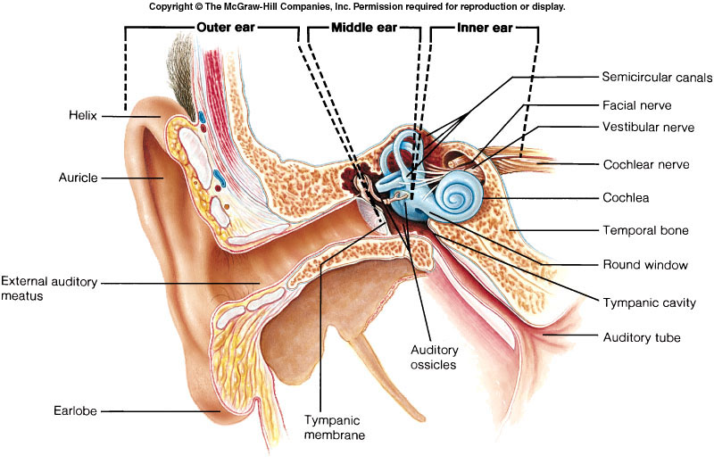
Auditory Pathways
Dr. Jayna Devalia
(M.B.B.S., M.D. Physiology)
Tutor
Department of Physiology
Smt. B. K. Shah Medical Institute & Research Centre
Sumandeep Vidyapeeth

Slide 2
Sound is a form of energy that propagates in the form of waves
The speed of sound depend on the medium through which the wave pass
The sound frequencies audible to humans range from about 20 to a maximum of 20,000 Hz
The loudness can be measured in decibel: 20-90 db

Slide 3
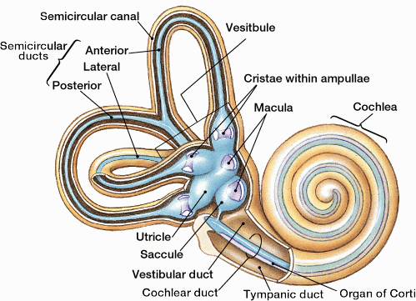

Slide 4
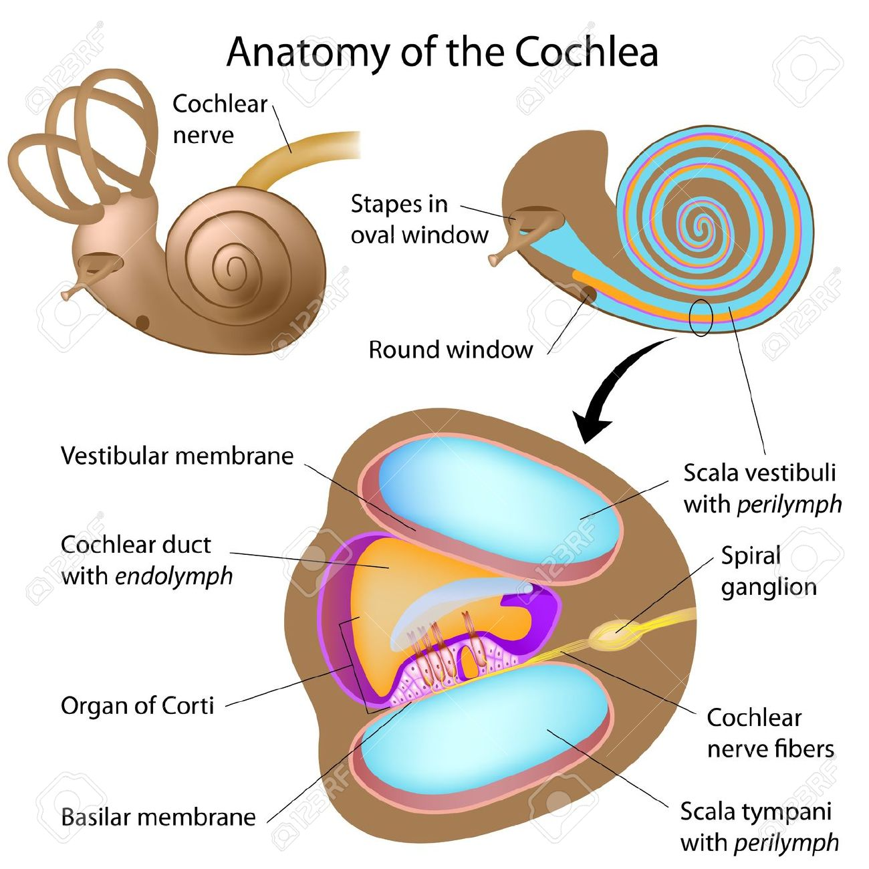

Slide 5
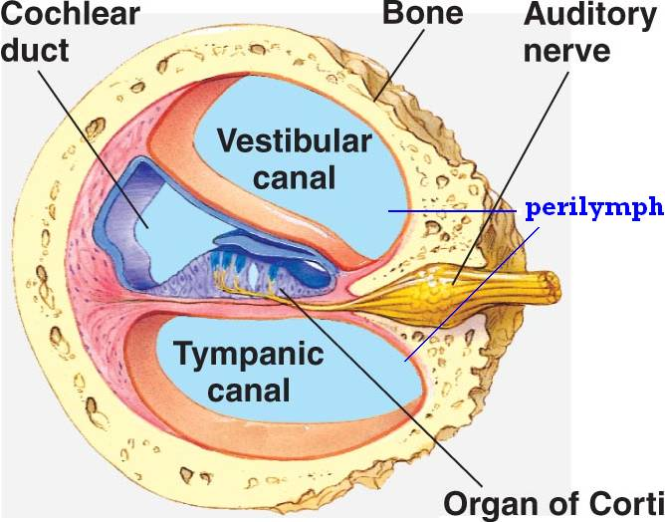
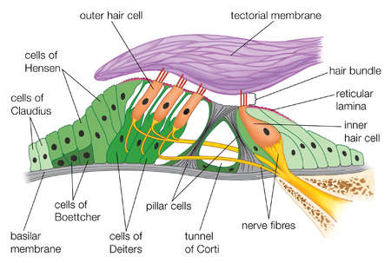
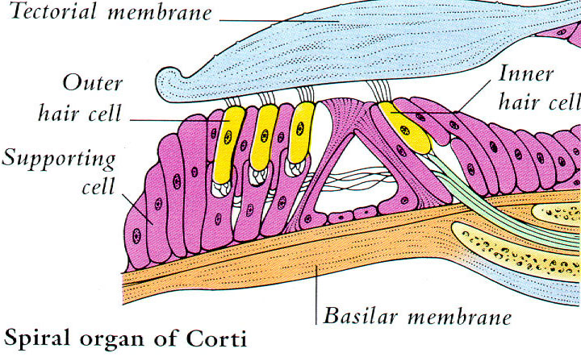

Slide 6
The hairs of the outer hair cells are embedded in the tectorial membrane
The outer ends of the hair cells are fixed tightly in a rigid structure composed of a flat plate, called the reticular lamina, supported by triangular rods of Corti, which are attached tightly to the basilar fibers.
The basilar fibers, the rods of Corti, and the reticular lamina move as a rigid unit.

Slide 7
Upward movement of the basilar fiber rocks the reticular lamina upward and inward, while its downward movement rocks the reticular lamina downward and outward.
The inward and outward motion causes the hairs on the hair cells to shear back and forth against the tectorial membrane. Thus, the hair cells are excited whenever the basilar membrane vibrates

Slide 8
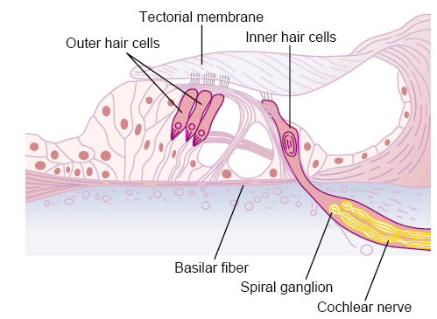
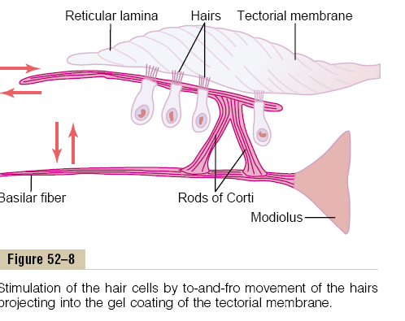

Slide 9
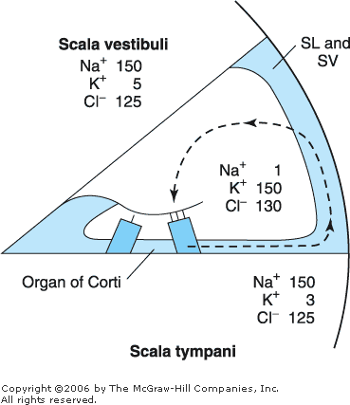
Electrophysiology of hearing
Potentials recorded from the ear under resting condition:-
  Endocochlear/endolymphatic Potential:-
    It is an electrical potential of about +80 mv which exists all the time between endolymph & perilymph, with positivity inside the scala media & negativity outside.
    It is generated by continual secretion of K⁺ ions into the scala media by the stria vascularis.

Slide 10
RMP of hair cells:-
  Lower bodies of hair cells have a negative intracellular potential of -70 mv with respect to the perilymph but -150 mv with respect to the endolymph. (Because endolymphatic potential is +80)
  This -150 mv potential difference at stereocilia make hair cells extremely sensitive to slightest of sound.

Slide 11
Resting potential of hair cells
Hair cell (-70mv)
Scala media (SV secretes K+ ion so it maintains the endochchlear potential (endolymph) of +80 mv
Scala vestibuli (perilymph)
At upper end of hair cell the potential difference between intracellular fluid and endolymph is (-150mV), which make the hair cell very sensitive

Slide 12
Potential recorded from the ear on stimulation:-
  Cochlear Microphonic potential-
    It is local potential developed at tip of inner hair cell at reticular lamina on stimulation.
    It is produced when mechanical energy is converted to electrical energy.
    It was discovered by wever & bray in 1930’s.
    It can be recorded by placing one electrode in scala media and one electrode in scala tympani (both side of basilar membrane).
    The cause of the development of cochlear microphonic potential is not very clear.
    It may be due to vibration in basilar membrane & tension on the hairs of hair cells.

Slide 13
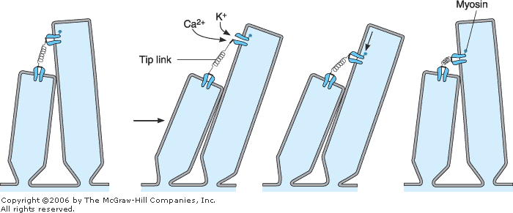
Tip links
The tops of the shorter stereocilia are attached by thin filaments to the back sides of their adjacent longer stereocilia

Slide 14
Depolarization/activation
when the cilia are bent in the direction of the longer ones, the tips of the smaller stereocilia are tugged outward.
This causes a mechanical transduction that opens 200 to 300 cation-conducting channels
Allowing rapid movement of potassium ions from the surrounding scala media fluid into the stereocilia, which causes depolarization of the hair cell membrane

Slide 15
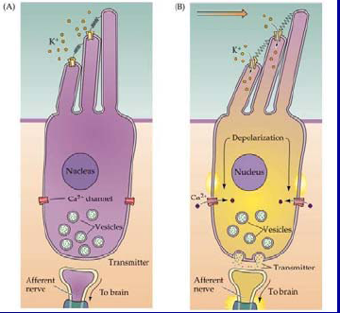

Slide 16
The influx of potassium inside the cell causes activation of calcium channels
This calcium drags the neurotransmitter filled vesicle to fuse with cell membrane at base of cell.
Neurotransmitter (glutamate)releases and excites the dendrites of afferent nerve fibres.

Slide 17
Characteristics of cochlear microphonic potential:-
  Resistant to ischaemia or anaesthesia.
  Do not show any latency or refractory period.
  Potentials recorded have the same form and polarity as that of the sound wave which is stimulating the ear.
  It precedes AP.
  Do not obey all or none law.

Slide 18
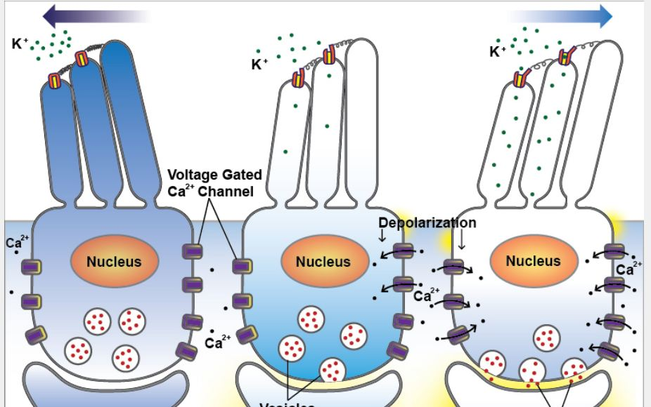
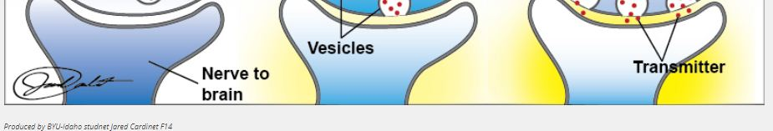

Slide 19
Action potential in 8th cranial nerve:-
  When the hair cell depolarizes a calcium channel opens allowing calcium to enter the cell.
  Calcium initiates the release of a synaptic transmitter, which activates receptor sites on the terminals of the afferent neurons and cause the generation of the action potential in the neuron.

Slide 20
AUDITORY PATHWAYS
The axons of the spiral ganglion of internal ear that innervates the hair cells from the cochlear division of the VII nerve.
The auditory nerve enters the medulla and ends in ventral and dorsal cochlear nuclei the sites of the first synapse.

Slide 21
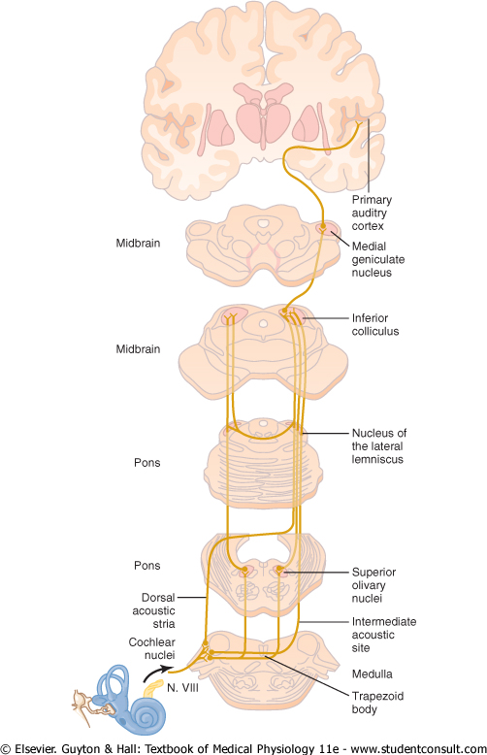

Slide 22
AUDITORY PATHWAYS
Second order neurons from the cochlear nuclei end in SUPERIOR OLIVE AND TRAPEZOID BODY on both sides of the brain stem from where third order neurons take origin.
Third order neurons pass up to the INFERIROR COLLICULI (centre for auditory reflexes) of both sides.

Slide 23
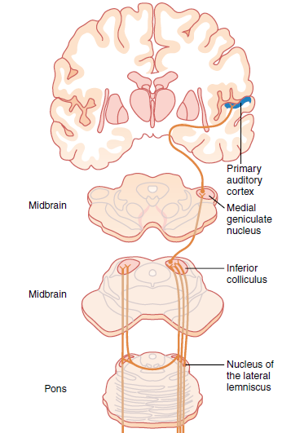
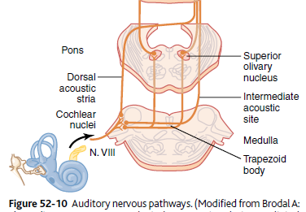

Slide 24
AUDITORY PATHWAYS
From the inferior colliculi many fibers projects and rely in the MEDIAL GENICULATE BODIES and finally projects to the primary auditory cortex.
Primary auditory cortex lies in the superior temporal lobe.
Here nerve impulses are perceived as sound i.e. it receives and perceives auditory information such as loudness , pitch , source and direction of sounds.

Slide 25
AUDITORY PATHWAYS
Auditory association area 22 , 21 , and 20
Area 22 : Wernicke's area.
It is located in superior temporal gyrus in the dominant hemisphere. It is concerned with comprehension i.e. interpretation and understanding of auditory and visual information.
AREA 21 and 20 :
These areas are located in the middle and inferior temporal gyrus and are concerned with interpretation and integration of auditory impulses.

Slide 27
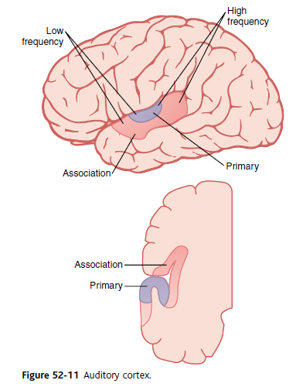

Slide 28
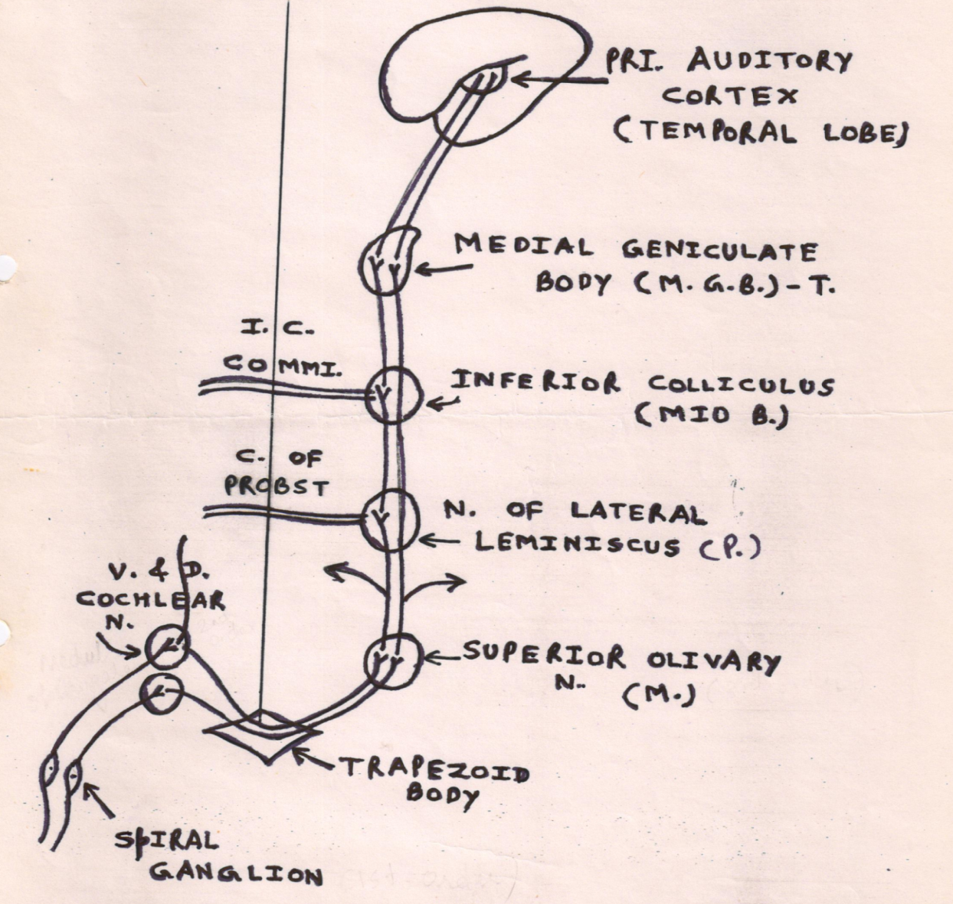

Slide 30
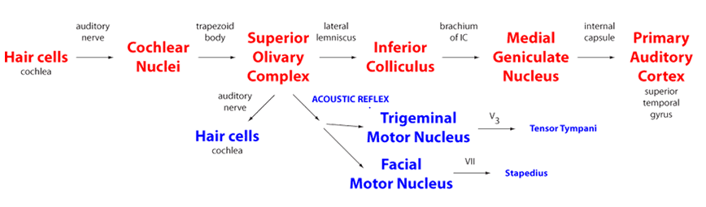

Slide 31
Frequency discrimination of sound
The movements of the footplate of the stapes set up a series of traveling waves in the perilymph of the scala vestibuli. High-pitched sounds generate waves that reach maximum height near the base of the cochlea; low-pitched sounds generate waves that peak near the apex.
So different portions of basilar membrane are activated by different frequencies of sound.

Slide 32




Slide 33
Determination of Sound Frequency—The “Place” Principle
There is spatial organization of the nerve fibers in the cochlear pathway, all the way from the cochlea to the cerebral cortex
Specific brain neurons are activated by specific sound frequencies
The major method used by the nervous system to detect different sound frequencies is to determine the positions along the basilar membrane that are most stimulated.
This is called the place principle or Travelling wave theory

Slide 34
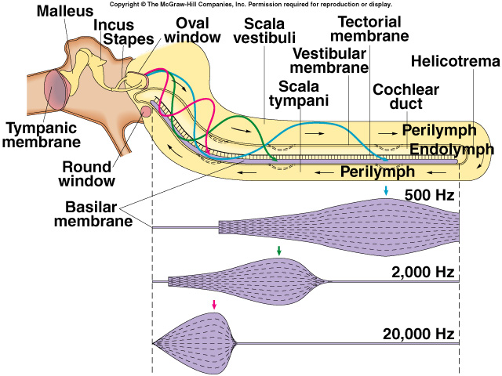

Slide 35
Determination of Loudness
Determined by the auditory system in at least three ways.
First, as the sound becomes louder, the amplitude of vibration of the basilar membrane and hair cells also increases, so that the hair cells excite the nerve endings at more rapid rates

Slide 36
Second, as the amplitude of vibration increases, it causes more and more of the hair cells on the fringes of the resonating portion of the basilar membrane to become stimulated, thus causing spatial summation of impulses.
Third, the outer hair cells do not become stimulated significantly until vibration of the basilar membrane reaches high intensity, and stimulation of these cells presumably apprises the nervous system that the sound is loud.

Slide 37
Terms to remember
Amplitude/intensity/loudness
Strength of the sound
Loudness denotes the appreciation of sound intensity
Frequency/Pitch/Tone
Number of cycles per second
Pitch /Tone denotes the appreciation of frequency
Impedence
Resistance offered by a medium to sound waves

Slide 38
AUDITORY DEFECTS
Auditory defects may be …..
  Complete
  Partial
Auditory defects are of two types:
  Conduction deafness
  Nerve deafness

Slide 39
CONDUCTION DEAFNESS
It occurs due to impairment in the transmission of sound in external ear or middle ear.
CAUSES :-
Obstruction of external auditory meatus
Thickness of ear drum due to repeated middle ear infection
Perforation of ear drum
Otosclerosis (fixation of foot plate of stapes against oval window.)

Slide 40
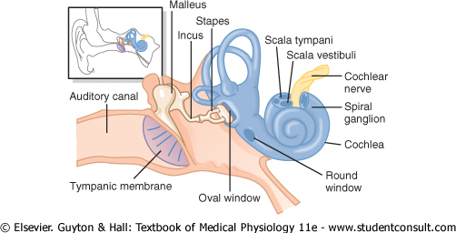

Slide 41
NERVE DEAFNESS
Damage of any structure of cochlea such as
hair cell ,
organ of corti ,
basilar membrane or
cochlear duct or
the lesion in auditory pathway produces the nerve deafness.

Slide 42
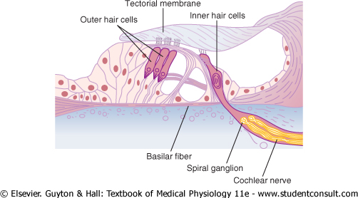

Slide 43
NERVE DEAFNESS
CAUSES:
Degeneration of hair cells due to some antibiotics like streptomycin and gentamycin (ototoxicity)
Damage of cochlea by prolonged exposure to loud noise (e.g. hearing music by ear phone)
Tumor affecting VII cranial nerve

Slide 44
TESTS FOR HEARING
BEDSIDE TESTS
Whispering Test
Tickling Watch Test
ROUTINE TESTS
Rinne’s Test
Weber’s Test
Audiometry

Slide 45
BEDSIDE TESTS
WHISPERING TEST
The examiner stands about 60 cm away from the subject at his side and whisper some words .
If the subject is not able to hear the whisper , hearing deficit is suspected.
TICKLING OF WATCH TEST
Wrist watch with tickling sound is kept near the ear of the subject.
The subject from hearing defects cannot hear the tickling sound of watch

Slide 46
ROUTINE TESTS FOR HEARING
They are of three types……………
The first two tests i.e. rinne`s test and weber`s test are done by using tuning fork with high frequency .
Tuning fork of 256 Hz / 512 Hz is used.
By these tests only the nature of auditory defects is determined.

Slide 47
RINNE `S TEST
Base of vibrating tuning fork is placed on mastoid process until the subject cannot feel the vibrations and cannot hear sound.
When subject does not hear the sound any more the tuning fork is held in air front of the ear of same side.
Normal person hears vibration in air even after the bone conduction ceases because in normal air conduction via ossicles is better than bone conduction.
NORMAL …AC > BC

Slide 48
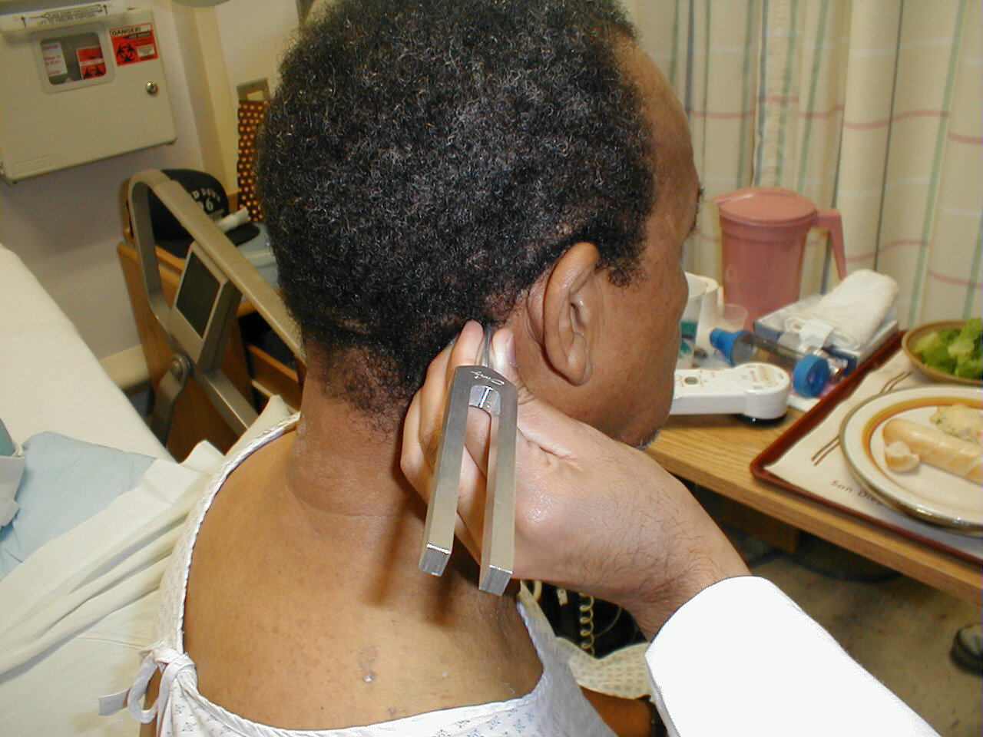

Slide 49
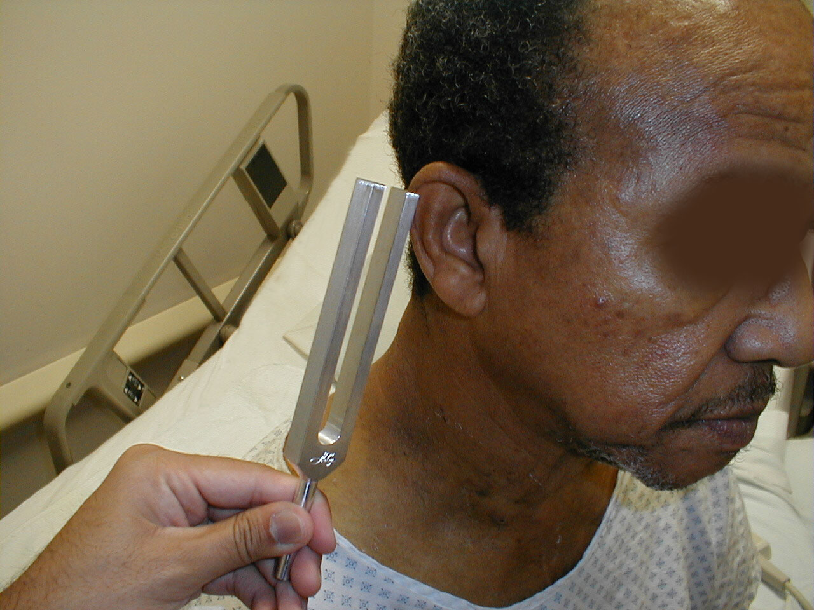

Slide 50
RINNE `S TEST
But in conduction deafness vibrations in air are not heard after cessation of bone conduction.
Conduction Deafness BC > AC
In nerve deafness BOTH air conduction and bone conduction are DIMINISHED

Slide 51
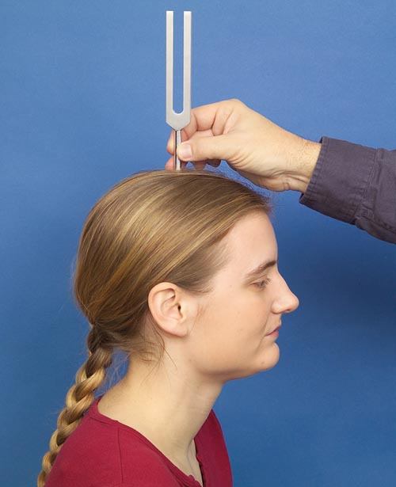
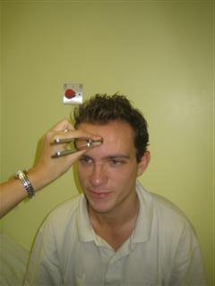
WEBER`S TEST
Base of the vibrating tuning fork is placed on the vertex of the skull or the middle of the forehead.
Normal person hears the sound equally on the both sides.

Slide 52
UNILATERAL CONDUCTION DEAFNESS
Unilateral conduction deafness (DEAFNESS IN ONE EAR) sound is heard LOUDER in DISEASED EAR.
In NORMAL ear there is masking effect of environment noise.
So the sound through bone conduction is not heard as clearly as on the affected side.

Slide 53
UNILATERAL NERVE DEAFNESS
UNILATERAL NERVE DEAFNESS
sound is heard louder
IN DISEASED EAR

Slide 54
AUDIOMETRY
It is technique used to determine the nature and severity of the auditory defect.
Instrument audiometer is used.
The instrument is capable of generating sound waves of different frequencies from lowest to highest which tests the hearing capability.

Slide 55
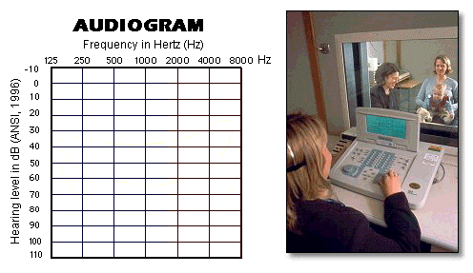
PURE TONE AUDIOMETRY (PTA)

Slide 56
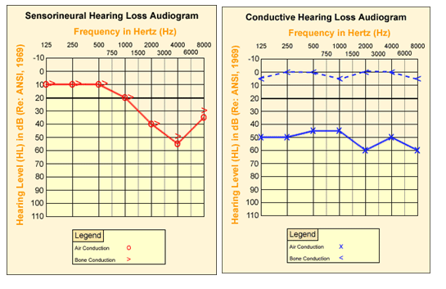

Slide 57
Other tests
BERA (Brainstem Evoked Response Audiometry)
Electro cochleography (E CoG)
Speech Audiometry
Impedance Audiometry

Slide 58
Endolymph
Is present in scala media
Is present in scala vestibula
Contain high Na+ Concentration
Is at lower potential

Slide 59
2. The Organ of Corti
Contain hair cells
Is based on Basilar membrane
Is supplied by Auditory Nerve
All of the above

Slide 60
Perception of sound first takes place in
A) Area 22,20
B) Area 21, 23
C) Area 41, 42
D) Area 23,20

Slide 61
4. Not a feature of Conductive Deafness
Complete loss of hearing
Rinne test negative
Hearing loss is fairly uniform throughout the frequency ranges
Subject’s bone conduction is better than examiner’s

Slide 62
5. Rinne’s Test result shows that Bone
Conduction > Air Conduction in one ear
…..So the Patient have
Normal ear
Conductive Deafness
Nerve Deafness
Mixed Deafness

Slide 63


Slide 64
Deafness
 | Conductive deafness | Nerve deafness
Site of lesion | External ear or middle ear | Internal ear (organ of corti) or auditory pathway
Causes | Excessive wax, foreign body, tumour in external ear | Degenerative (age induced changes in hair cells of organ of corti)
 | Otosclerosis | Acoustic trauma (loud sound)
 | Repeated otitis media (middle ear infection) | Acoustic neuroma
 |  | Tumour of cerebello-medullary junction
 |  | Meningitis & Drugs (Aminoglycosides, Quinine)

Slide 65
 |  | Conductive deafness |  | Nerve deafness
Patho-physiology |  | Air conduction (AC): ↓↓ Bone conduction (BC): N So, BC > AC |  | Air conduction (AC): ↓↓ Bone conduction (BC): ↓↓ Still, AC > BC
Clinical feature |  | ↓↓ hearing |  | ↓↓ hearing
Tests for diagnosis
Hearing tests | Watch tic test; Whispering |  | Abnormal | Abnormal
Tuning fork tests | Rinne’s |  | Negative (BC > AC) | Positive (AC > BC)
 | Weber’s |  | Lateralized towards affected side | Lateralized towards normal side
 | Schwabach’s |  | patient’s BC > examiner’s BC | pt’s BC < examiner’s BC

Slide 66
Rinne’s test:
  Vibrate the tuning fork → place the base of vibrating tuning fork on patient’s mastoid process → when he stops hearing (through bone conduction), bring the prongs of still vibrating tuning fork near ear canal → In normal circumstances or in case of sensory-neural deafness, patient will still hear the vibration of tuning fork (through air conduction).
  Result of Rinne’s test: Positive (AC > BC)

Slide 67
In above test, if patient cannot hear the vibrating tuning fork (through air conduction), perform the test again with keeping the prongs of vibrating tuning fork near ear first → when patient stops hearing (through air conduction), place the base of still vibrating tuning fork on the mastoid process → In case of conductive deafness, patient will still hear the sound of vibrating tuning fork (through bone conduction).
Result of Rinne’s test: Negative (BC > AC)

Slide 68
Weber’s test:
  Vibrate the tuning fork → place the base of vibrating tuning fork in the middle of the forehead → ask the patient if he hears more on right or left (ask for lateralization) → Normally, there should not be any lateralization.
  If there is lateralization on any side, it’s abnormal.
  Result of Weber’s test: Lateralization on any side → Conductive deafness on the same side or sensory-neural deafness on the opposite side

