Slide 1
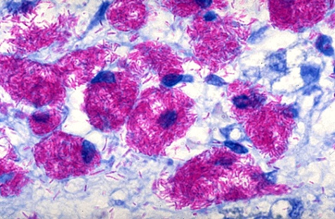
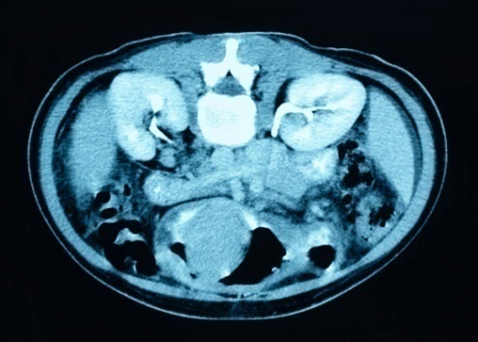
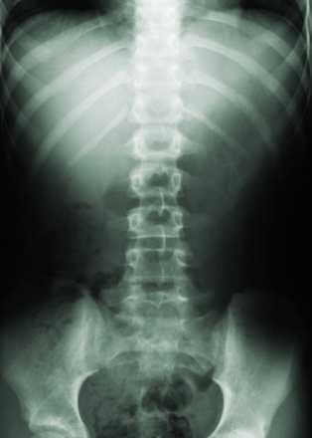

Extrapulmonary TB
Dr. Stani Francis
Respiratory Medicine

Slide 2


Background
Each year, tuberculosis (TB) results in the death of 3 million people globally.
In 2000-2020, an estimated 1 billion people will be infected, 200 million people will become sick, and 35 million will die from TB.
Overall, one third of the world's population is infected with the TB bacillus.

Slide 3
What is extrapulmonary TB? (EPTB)
Any tuberculosis infection in sites other than the lung parenchyma.
TB infection causing pleural effusion considered extrapulmonary in some studies, pulmonary in others.
Can occur in the presence or absence of pulmonary disease.

Slide 4
Who gets extrapulmonary TB?
Extrapulmonary infection with active pulmonary disease:
Extrapulmonary infection without active pulmonary disease:

Slide 5
Modes:
Inhalation
Aspiration
Hematogenous spread

Slide 6
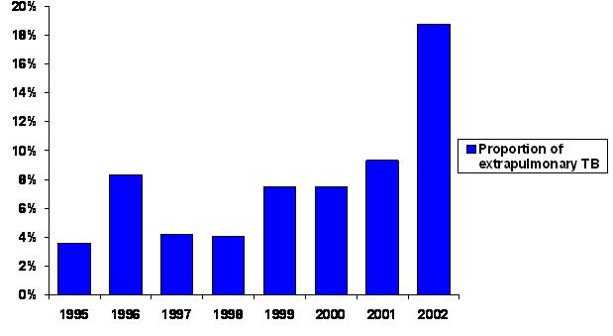
The Changing Face of TB…
15-25% of reported
cases.
frequent in children and people with HIV infection
Proportion of extrapulmonary TB.
Myanmar; 1995-2002
Notes:
From 1985 until 1992 there was a resurgence of tuberculosis in the United States that coincided with the epidemic of acquired immunodeficiency syndrome (AIDS).

Slide 7
The Changing Face of TB…
Disease patterns changed
Incidence of disseminated and extrapulmonary has incresed.
Extrapulmonary TB is more difficult to diagnose, often requiring invasive procedures to obtain diagnostic specimens and more sophisticated laboratory techniques than sputum microscopy.
As a result, extrapulmonary TB is often diagnosed on the basis of clinical experience which may lead to diagnostic errors, in either direction.
Notes:
No respose to tt eperical att stared

Slide 8
Where can EPTB occur?
Almost anywhere.
Notes:
?

Slide 9
Sites of Extrapulmonary TB
Pleural
Lymphatic
Bones and joint
Genitourinary
Miliary disease
CNS/Meningitis
Pericarditis
GI/Peritonitis
Skin

Slide 10
Lymphadenitis
Discrete, firm, nontender,
Multiple,matted & mobile nodes
Tuberculin skin test( Montoux test): Positive
Chest Xray PA View : May be normal
Fine-needle aspiration cytplogy (FNAC): Lymphocytes,epitheloid, giant cells and langerhans cells and casseating granumolatous changes may be seen
Biopsy of lymphnode
ZN Staning of FNAC slide- AFB may be seen
Gene xpert of FNAC/ Biopsy of LN
Untreated
Soft,fluctuant
Sinus tract formation
Treated
Resolution

Slide 11
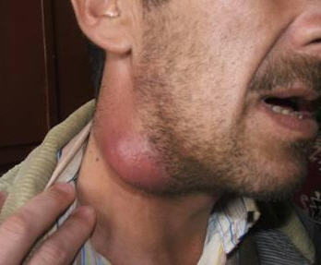

Slide 12
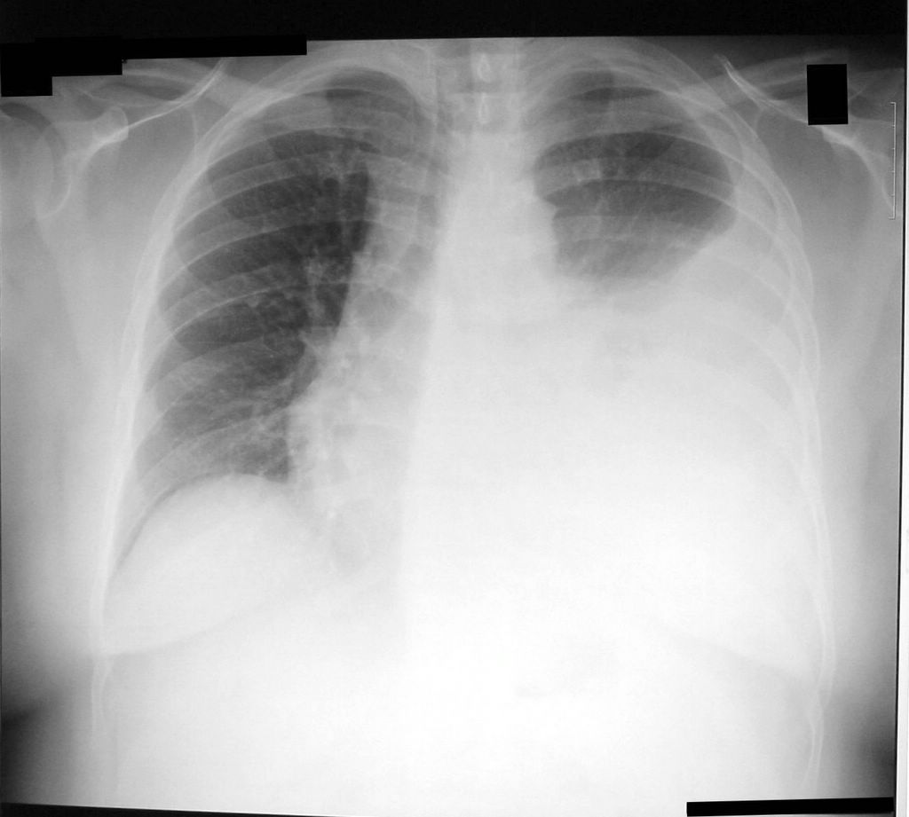

Slide 13
Pleural Effusion
.
Cough
Pleuritic chest pain
Fever
Dyspnea
INVESTIGATIONS
X-ray chest
Pleural fluid examination
  Exudative with a lymphocyte predominance
  Pleural fluid glucose and ph can be low or normal.
  Pleural fluid pcr for m. tuberculosis has a sensitivity of 80 percent and a specificity of 100 percent.

Slide 14
Skeletal Tuberculosis
Bone and joint tuberculosis - 35 %
Spinal tuberculosis (Pott's disease) most commonly involves the thoracic spine.
Paraspinal and psoas abscesses can develop, with extensions to the surface or adjacent tissues
Patients present with local pain, constitutional symptoms, or paraplegia secondary to cord compression.
Notes:
Skeletal tuberculosis most commonly involve..
Spine
Knee
Hip
Elbow
1 a 2 b 3 c 4 d

Slide 15
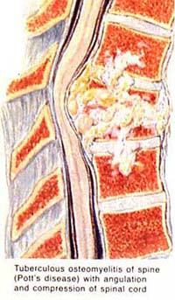
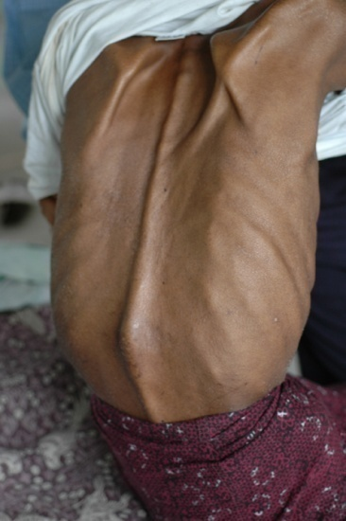

Slide 16
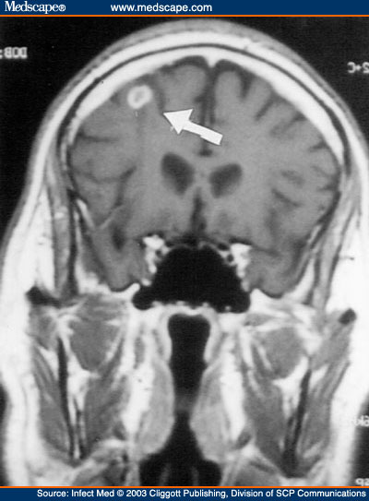
CNS Tuberculosis
Tuberculous meningitis
Intracranial tuberculomas
Spinal tuberculous
Symptoms & Signs
malaise,
headache,
fever,
personality change
vomiting,
confusion,
and focal neurologic findings.
If untreated, mental status deteriorates into stupor or coma.
MRI scan of the brain reveals an intracranial ring-enhancing lesion in the left frontoparietal subcortex with a small area of edema

Slide 17
CSF typically reveals:
  moderate lymphocytic pleocytosis.
  CSF protein levels range from 50 to 500 mg per dL. ( normal <45mg/dl)
  CSF glucose concentration usually is less than 45 mg per dL (Normal 40-85 mg/dl).
  AFB smears on CSF are positive.
  CSF culture for M. tuberculosis is positive.
  CSF PCR for M. tuberculosis.
  An elevated CSF(ADA) adenosine deaminase level supports the diagnosis in the appropriate clinical setting. 12

Slide 18
Empiric antituberculous.
Antituberculous therapy 9 to 12 months.
Adjunctive corticosteroid therapy with dexamethasone for the initial six to eight weeks.
Mortality is highest in patients younger than five years, those older than 50 years, and those in whom illness has been present for longer than two months.

Slide 19
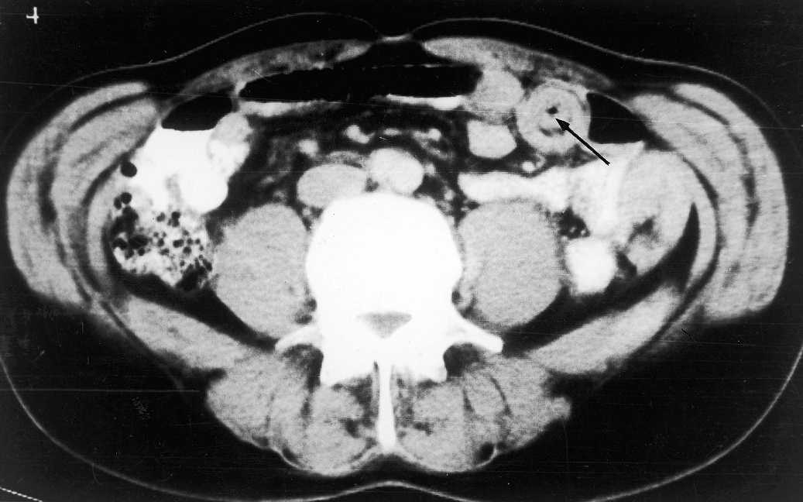
Tuberculosis in the GI Tract
Mouth to anus, peritoneum and pancreaticobilliary system.
Intussusception in TB of small bowel

Slide 20
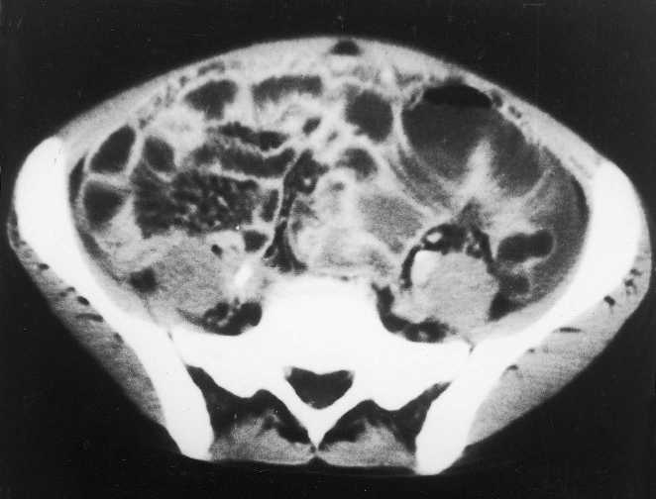
Intestinal Tuberculosis
intestinal obstruction
The intestinal lesions can be ulcerative
Symptoms include
  abdominal pain
  Diarrhea
  weight loss
  fever.
  Melena
  rectal bleeding, and
  abdominal tenderness.
A mass in the right lower quadrant is palpable in 25 to 50 percent of patients.
The most common site of gastrointestinal involvement with TB is the ileocecal region.
  .

Slide 21
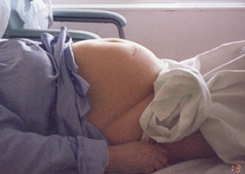
Peritoneal TB
Peritoneal TB occurs in 3 forms:
  Wet type with ascites,
  Dry type with adhesions, and
  Fibrotic type with omental thickening and loculated ascites.

Slide 22
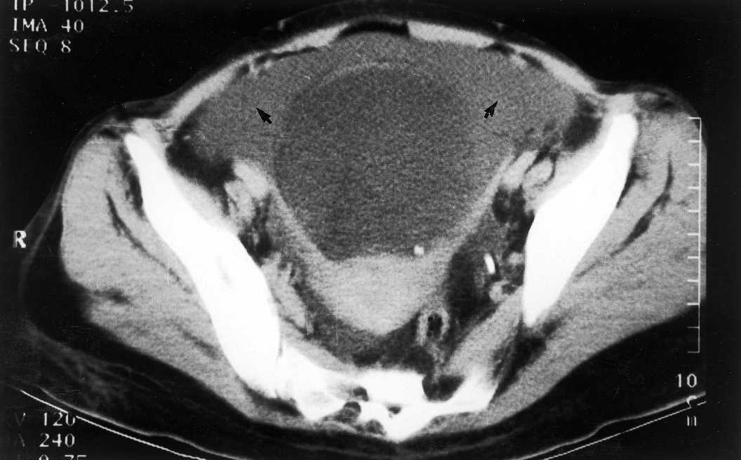
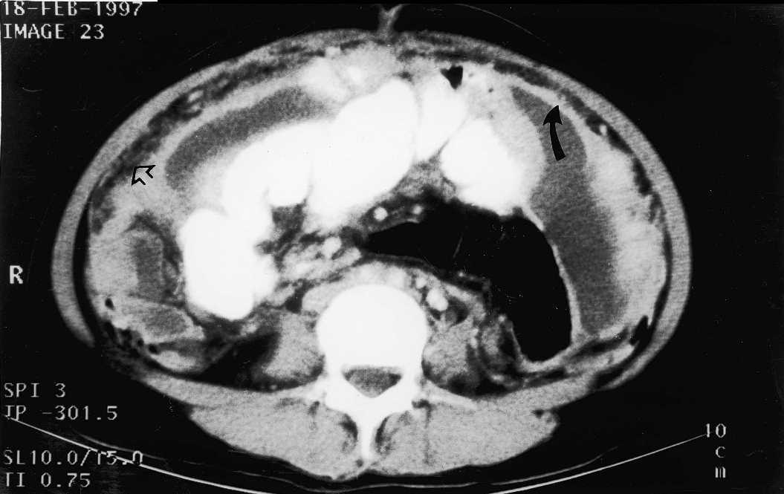
Peritoneal TB
Symptoms
abdominal swelling/ascites
pain, weight loss,
fever extending for weeks to months.
mild anemia,
positive tuberculin skin test,
ascites with a low albumin gradient.
computed tomography
ascites,
tethered or matted loops of bowel, mesenteric stranding, and peritoneal thickening.
Peritoneal fluid analysis reveals:
  Exudative
  serum-ascites albumin gradient of less than 1.1 g per dL (11 g per L).
  Peritoneal fluid lymphocytic predominance; a neutrophilic pleocytosis .
  Centrifugation of 1 L of peritoneal fluid enhances the yield of AFB smear and mycobacterial culture.
Dense Ascites in TB peritonitis
Peritoneal Enhancement in TB peritonitis

Slide 23
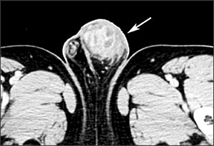
Renal
Direct infection of the kidney and lower urinary tract
Secondary amyloidosis.
SYMPTOMS
Dysuria, hematuria, or flank pain.
INVESTIGATIONS
Sterile pyuria with or without microscopic hematuria.
Intravenous pyelography - "moth-eaten calyx" or papillary necrosis.
Abdominal CT scan - reveal renal calcifications, calculi, scarring, hydronephrosis, or evidence of extrarenal disease (e.g., ureteral strictures; contracted bladder; calcifications in the vas deferens, seminal vesicles, or prostate).
Mycobacterial culture of three morning urine
Testicular tuberculosis. Computed tomographic scan of the pelvis showing a large, irregular, mixed solid and cystic left testicular mass

Slide 24
Genital Tuberculosis
Female genital tuberculosis begins in the endosalpinx and can spread to the peritoneum, endometrium, ovaries, cervix, and vagina.
  Patients present with pelvic pain, infertility, and vaginal bleeding.
  surgery in women is necessary for large tubo-ovarian abscesses.
Response to chemotherapy is excellent for all forms of genital tuberculosis
Male genital tuberculosis usually is associated with renal tuberculosis.
  It involves the prostate, seminal vesicles, epididymis, and testes, in order of incidence.
  Patients usually present with a scrotal mass and diagnosis is made by surgery.
  Oligospermia is common and may be persistent.

Slide 25
MILIARY TUBERCULOSIS
The term miliary tuberculosis refers to any progressive, disseminated form of tuberculosis; the disease can occur during primary dissemination or after years of untreated tuberculosis.
MORE IN HIV/AIDS
Presenting symptoms include fever, chills, night sweats, weight loss, and anorexia. Clinical manifestations depend on the organs involved.
Fulminant disease including septic shock, acute respiratory distress syndrome, and multiorgan failure has been described.
A chest radiograph or CT scan reveals numerous 2- to 3-mm nodules scattered throughout the lung in more than 85 percent of patients
A tuberculin skin test result is positive in less than 50 percent of patients.

Slide 26
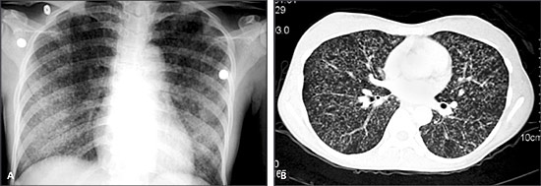

Slide 27
TUBERCULOUS PERICARDITIS
Tuberculous pericarditis develops secondary to contiguous spread from mediastinal nodes, lungs, spine, or sternum, or during miliary dissemination.
symptoms such as chest pain, dyspnea, and ankle edema.
Cardiomegaly, tachycardia, fever, pericardial rub, pulsus paradoxus, or distended neck veins may be found on examination.
Pericardial biopsy yields a definitive diagnosis more often than pericardial fluid alone.

Slide 28
Clinical Clues to Prompt Suspicion of Extrapulmonary Tuberculosis
Ascites with lymphocyte predominance and negative bacterial cultures
Chronic lymphadenopathy (especially cervical)
CSF lymphocytic pleocytosis with elevated protein and low glucose
Exudative pleural effusion with lymphocyte predominance, negative bacterial cultures, and pleural thickening
HIV infection
Joint inflammation (monoarticular) with negative bacterial cultures
Persistent sterile pyuria
Tuberculosis-endemic country of origin
Unexplained pericardial effusion, constrictive pericarditis, or pericardial calcification
Vertebral osteomyelitis involving the thoracic spine

Slide 29
Treatment of EPTB
Controversial
Few evidence based studies
WHO recommendations:
  Severe EPTB: 2 months of 4 drug therapy (rifampin, isoniazid, ethambutol, and pyrazinamide, followed by 4 months of rifampin and isoniazid)
  Mild EPTB: 2 months of 4 drug therapy
Addition of corticosteroids beneficial in meningea; and pericardial TB.
Notes:
Controversial.American Thoracic society 6 month tx regimen in all cases. No head to head studies comparing 2 vs 6 month regimens in mild EPTB

Slide 30
Conclusions
In conclusion, this case demonstrates a rare and serious manifestation of isolated peritoneal TB
Given the rising incidence of tuberculosis today, one can unfortunately expect to see greater numbers of peritoneal tuberculosis cases in the future.
As such, this case aptly illustrates the importance of having a high index of suspicion for peritoneal tuberculosis, especially among patients presenting with vague abdominal complaints.
TB peritonitis should part of the differential diagnosis in patients presenting with insidious onset of abdominal pain with associated fever, and weight loss.
Furthermore, it should be considered in all patients presenting with unexplained lymphocytic ascites with a serum-ascites albumin gradient of <1.1 g/dL.

Slide 31
Take home points
EPTB is difficult to diagnose because can mimic many diseases.
Respiratory isolation key until PTB ruled out.
Always get HIV test in patients w/ EPTB.
If in doubt, treat it like you would pulmonary TB.

Slide 32


REFERENCES
1. Centers for Disease Control and Prevention. Trends in tuberculosis-United States, 1998-2003 [published correction appears in MMWR Morb Mortal Wkly Rep 2004;53:246]. MMWR Morb Mortal Wkly Rep 2004;53:209-14.
2. Dye C, Scheele S, Dolin P, Pathania V, Raviglione MC. Consensus statement. Global burden of tuberculosis: estimated incidence, prevalence, and mortality by country. WHO Global Surveillance and Monitoring Project. JAMA 1999;282:677-86.
3. Rieder HL, Snider DE Jr, Cauthen GM. Extrapulmonary tuberculosis in the United States. Am Rev Respir Dis 1990;141:347-51.
4. Chaisson RE, Schecter GF, Theuer CP, Rutherford GW, Echenberg DF, Hopewell PC. Tuberculosis in patients with the acquired immunodeficiency syndrome. Clinical features, response to therapy, and survival. Am Rev Respir Dis 1987;136:570-4.
5. Shafer RW, Kim DS, Weiss JP, Quale JM. Extrapulmonary tuberculosis in patients with human immunodeficiency virus infection. Medicine (Baltimore) 1991;70:384-97.
6. Jones BE, Young SM, Antoniskis D, Davidson PT, Kramer F, Barnes PF. Relationship of the manifestations of tuberculosis to CD4 cell counts in patients with human immunodeficiency virus infection. Am Rev Respir Dis 1993;148:1292-7.
7. Horsburgh CR Jr, Feldman S, Ridzon R, for the Infectious Diseases Society of America. Practice guidelines for the treatment of turberculosis. Clin Infect Dis 2000;31:633-9.
8. American Thoracic Society, CDC, Infectious Diseases Society of America. Treatment of tuberculosis [published correction appears in MMWR Recomm Rep 2005;53:1203]. MMWR Recomm Rep 2003;52(RR-11):1-77.
9. Prasad K, Volmink J, Menon GR. Steroids for treating tuberculous meningitis. Cochrane Database Syst Rev 2000;(3):CD002244.
10. Mayosi BM, Ntsekhe M, Volmink JA, Commerford PJ. Interventions for treating tuberculous pericarditis. Cochrane Database Syst Rev 2002;(4):CD000526.
11. Dooley DP, Carpenter JL, Rademacher S. Adjunctive corticosteroid therapy for tuberculosis: a critical reappraisal of the literature. Clin Infect Dis 1997;25:872-87.
12. Blumberg HM, Leonard MK Jr, Jasmer RM. Update on the treatment of tuberculosis and latent tuberculosis infection. JAMA 2005;293: 2776-84.
13. Mert A, Tabak F, Ozaras R, Tahan V, Ozturk R, Aktuglu Y. Tuberculous lymphadenopathy in adults: a review of 35 cases. Acta Chir Belg 2002;102:118-21.
14. Ebdrup L, Storgaard M, Jensen-Fangel S, Obel N. Ten years of extrapulmonary tuberculosis in a Danish university clinic. Scand J Infect Dis 2003;35:244-6.
15. Jha BC, Dass A, Nagarkar NM, Gupta R, Singhal S. Cervical tuberculous lymphadenopathy: changing clinical pattern and concepts in management. Postgrad Med J 2001;77:185-7.
16. American Thoracic Society, CDC. Diagnostic standards and classification of tuberculosis in adults and children. Am J Respir Crit Care Med 2000;161(4 pt 1):1376-95.
17. Artenstein AW, Kim JH, Williams WJ, Chung RC. Isolated peripheral tuberculous lymphadenitis in adults: current clinical and diagnostic issues. Clin Infect Dis 1995;20:876-82.

Slide 33

REFERENCES
18. Shriner KA, Mathisen GE, Goetz MB. Comparison of mycobacterial lymphadenitis among persons infected with human immunodeficiency virus and seronegative controls. Clin Infect Dis 1992;15:601-5.
19. Seibert AF, Haynes J Jr, Middleton R, Bass JB Jr. Tuberculous pleural effusion. Twenty-year experience. Chest 1991;99:883-6.
20. Valdes L, Alvarez D, San Jose E, Penela P, Valle JM, Garcia-Pazos JM, et al. Tuberculous pleurisy: a study of 254 patients. Arch Intern Med 1998;158:2017-21.
21. Yilmaz MU, Kumcuoglu Z, Utkaner G, Yalniz O, Erkmen G. Computed tomography findings of tuberculous pleurisy. Int J Tuberc Lung Dis 1998;2:164-7.
22. Kataria YP, Khurshid I. Adenosine deaminase in the diagnosis of tuberculous pleural effusion. Chest 2001;120:334-6.
23. Light RW. Establishing the diagnosis of tuberculous pleuritis. Arch Intern Med 1998;158:1967-8.
24. Nagesh BS, Sehgal S, Jindal SK, Arora SK. Evaluation of polymerase chain reaction for detection of Mycobacterium tuberculosis in pleural fluid. Chest 2001;119:1737-41.
25. Grosskopf I, Ben David A, Charach G, Hochman I, Pitlik S. Bone and joint tuberculosis-a 10-year review. Isr J Med Sci 1994;30:278-83.
26. Watts HG, Lifeso RM. Tuberculosis of bones and joints. J Bone Joint Surg Am 1996;78:288-98.
27. Lifeso RM, Weaver P, Harder EH. Tuberculous spondylitis in adults. J Bone Joint Surg Am 1985;67:1405-13.
28. Five-year assessment of controlled trials of short-course chemotherapy regimens of 6, 9, or 18 months' duration for spinal tuberculosis in patients ambulatory from the start or undergoing radical surgery. Fourteenth report of the Medical Research Council Working Party on Tuberculosis of the Spine. Int Orthop 1999;23:73-81.
29. Rich AR, McCordock HA. The pathogenesis of tuberculous meningitis. Bull Johns Hopkins Hosp 1933;52:5-37. (Cited by Donald PR, Schoeman JF. Tuberculous meningitis. N Engl J Med 2004;351:1719-20. Accessed online April 1, 2005, at: http://content.nejm.org/cgi/content/full/351/17/1719.)
30. Molavi A, LeFrock JL. Tuberculous meningitis. Med Clin North Am 1985;69:315-31.
31. Kennedy DH, Fallon RJ. Tuberculous meningitis. JAMA 1979;241:264-8.
32. Pai M, Flores LL, Pai N, Hubbard A, Riley LW, Colford JM Jr. Diagnostic accuracy of nucleic acid amplification tests for tuberculous meningitis: a systematic review and meta-analysis. Lancet Infect Dis 2003;3:633-43.
33. Ribera E, Martinez-Vazquez JM, Ocana I, Segura RM, Pascual C. Activity of adenosine deaminase in cerebrospinal fluid for the diagnosis and follow-up of tuberculous meningitis in adults. J Infect Dis 1987;155: 603-7.
34. Thwaites GE, Nguyen DB, Nguyen HD, Hoang TQ, Do TT, Nguyen TC, et al. Dexamethasone for the treatment of tuberculous meningitis in adolescents and adults. N Engl J Med 2004;351:1741-51.
35. Marshall JB. Tuberculosis of the gastrointestinal tract and peritoneum. Am J Gastroenterol 1993;88:989-99.
36. Talwani R, Horvath JA. Tuberculous peritonitis in patients undergoing continuous ambulatory peritoneal dialysis: case report and review. Clin Infect Dis 2000;31:70-5.
37. Christensen WI. Genitourinary tuberculosis: review of 102 cases. Medicine (Baltimore) 1974;53:377-90.
38. Simon HB, Weinstein AJ, Pasternak MS, Swartz MN, Kunz LJ. Genitourinary tuberculosis. Clinical features in a general hospital population. Am J Med 1977;63:410-20.
39. Munt PW. Miliary tuberculosis in the chemotherapy era: with a clinical review in 69 American adults. Medicine (Baltimore) 1972;51:139-55.
40. Kim JH, Langston AA, Gallis HA. Miliary tuberculosis: epidemiology, clinical manifestations, diagnosis, and outcome. Rev Infect Dis 1990;12:583-90.
41. Trautner BW, Darouiche RO. Tuberculous pericarditis: optimal diagnosis and management. Clin Infect Dis 2001;33:954-61.
42. Keane J, Gershon S, Wise RP, Mirabile-Levens E, Kasznica J, Schwieterman WD, et al. Tuberculosis associated with infliximab, a tumor necrosis factor alpha-neutralizing agent. N Engl J Med 2001;345:1098-104.
43. Mohan AK, Cote TR, Block JA, Manadan AM, Siegel JN, Braun MM. Tuberculosis following the use of etanercept, a tumor necrosis factor inhibitor. Clin Infect Dis 2004;39:295-9.
44. Mehta JB, Dutt A, Harvill L, Mathews KM. Epidemiology of extrapulmonary tuberculosis: a comparative analysis with pre-AIDS era. Chest 1991;99:1134–1138.
45. Leder RA, Low VHS. Tuberculosis of the abdomen. Radiol Clin North Am 1995;33:691–705.
46. Marshall JB. Tuberculosis of the gastrointestinal tract and peritoneum. Am J Gastroenterol 1993;88:989–999.
47. Shakil AO, Korula J, Kanel GC, Murray NGB, Reynolds TB. Diagnostic features of tuberculous peritonitis in the absence and presence of chronic liver disease: a case control study. Am J Med 1996;100:179–185.
48. Dwivedi M, Misra SP, Misra V, Kumar R. Value of adenosine deaminase estimation in the diagnosis of tuberculous ascites. Am J Gastroenterol 1990;85:1123–1125.

Slide 34
1
How will you diagnose Tubercululosis of lymph nodes ?
A.Tuberculin test
B. FNAC
C. Biopsy
D. All of the above

Slide 35
2
Presenting complains pleural effusion are except
Cough with expectoration
Chest pain
Dry cough
Breathlessness

Slide 36
3
Commonest site of intestinal tuberculosis?
Iliocecal region
Small intestine
Large intestine
Appendix

Slide 37
4
Skeletal tuberculosis most commonly involve..
Spine
Knee
Hip
Elbow

Slide 38
5
Steroids are indicated in tuberculosis of following organs
a. Pericardial
b.CNS
C. Pleural
d. All of the above

Slide 39
The pleural fluid lactate dehydrogenase/adenosine deaminase ratio differentiates between tuberculous and parapneumonic pleural effusions.
Wang J¹, Liu J², Xie X¹, Shen P¹, He J², Zeng Y^{3,4}. | Although pleural fluid lactate dehydrogenase (LDH) and adenosine deaminase (ADA) levels are often used to distinguish between tuberculous pleural effusion (TPE) and parapneumonic pleural effusion (PPE), this can be challenging as the LDH level may vary from normal to severely increased in PPE and a significantly elevated ADA is frequently measured in both conditions. In this study, we evaluated use of the pleural fluid LDH/ADA ratio as a new parameter to discriminate TPE from PPE. | A retrospective study was conducted in patients with pathologically-confirmed TPE (n = 72) and PPE (n = 47) to compare pleuralfluid LDH and ADA levels and LDH/ADA ratios between the 2 groups. A receiver operating characteristic (ROC) curve was constructed for identifying TPE. Level III | The pleural fluid LDH/ADA ratio, which can be determined from routine biochemical analysis, is highly predictive of TPE at a cut-off level of 16.20. Measurement of this parameter may be helpful for clinicians in distinguishing between TPE and PPE.

Slide 40
Thank you…

