Slide 1
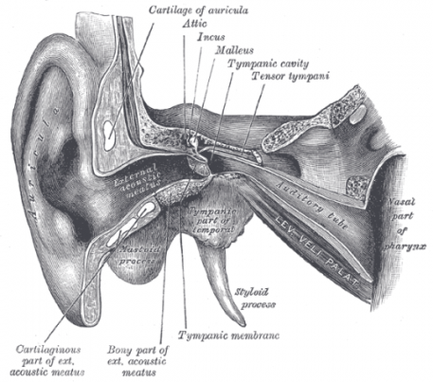
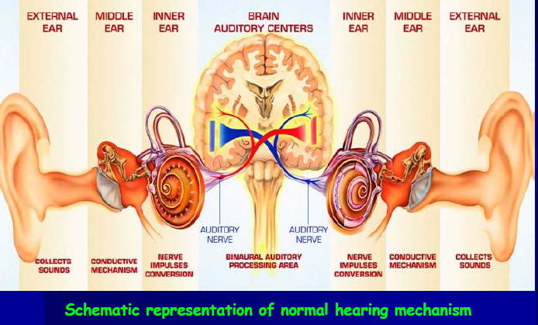
HEARING PHYSIOLOGY
SOUNDENERGY
MECHANICAL ENERGY
ELECTRICAL ENERGY

Slide 2
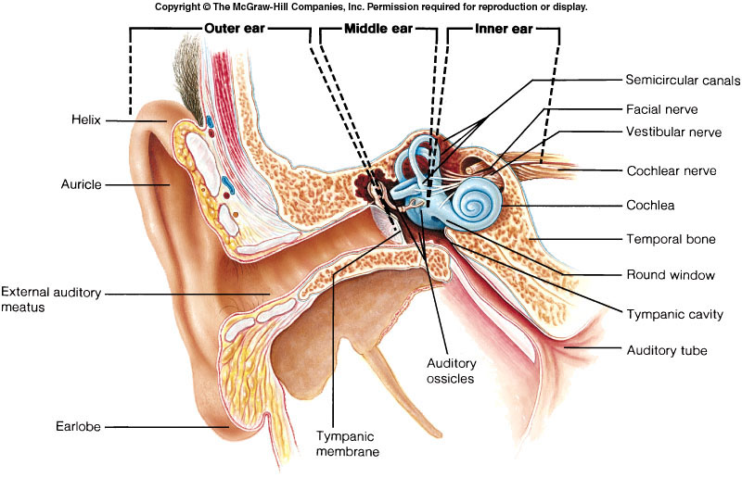

Slide 3
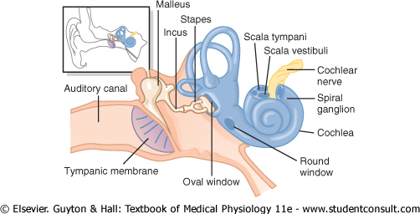

Slide 4
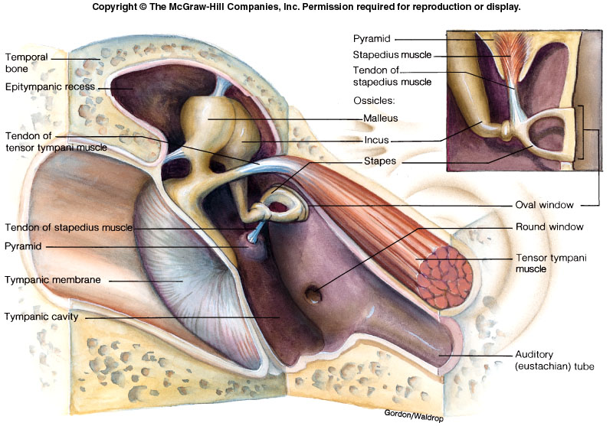

Slide 5
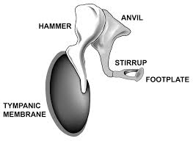
Ear ossicles
There are three minute bony (ear) ossicles
Malleus (hammer)
Incus (anvil)
Stapes (stirrup)
They extend across the cavity from the tympanic membrane to the oval window.

Slide 6
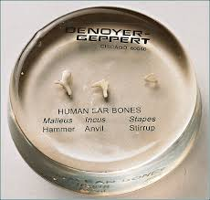
Ear ossicles
FUNCTIONS :-
It acts as pressure receiver i.e. it is extremely sensitive to pressure changes produced by sound waves on its external surface. Ossicles has main role in impedance matching.

Slide 7
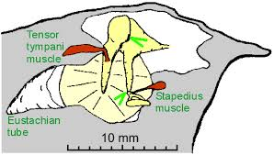
Middle Ear Muscles

Slide 8
TWO SKELETAL MUSCLES
TENSOR TYMPANI :- it is attached to the neck of malleus. Supplied by V CN. It attach with tympanic mem through malleus.
STAPEDIUS:- It is attached to the neck of the stapes. Supplied by VII CN.

Slide 9
FUNCTIONS OF MIDDLE EAR
IMPEDENCE MATCHING
ATTENUATION

Slide 10
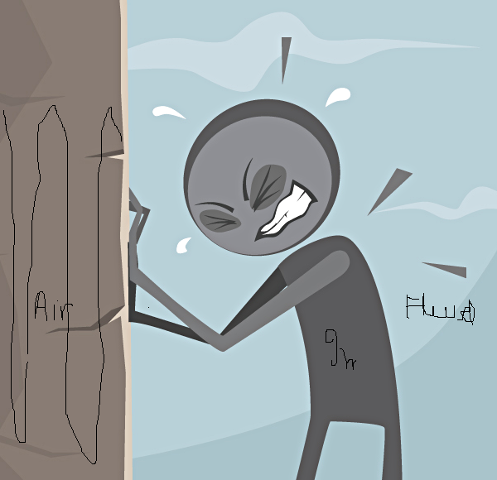
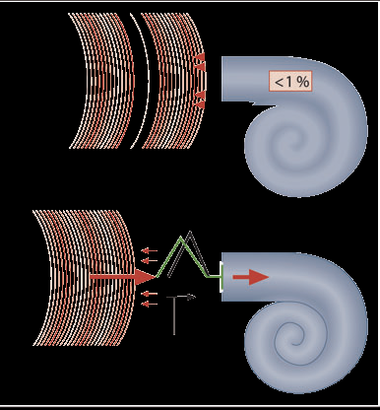
Impedance mismatch
if there was no middle ear system ,99% of sound waves would have reflected back from oval window as middle ear have air and inner ear have fluid. As fluid has got inertia, sound is not transmitted easily into inner ear.
MIDDLE EAR BY ITS IMPEDENCE MATCHING PROPERTY ALLOWS 60% OF SOUND ENERGY TO DISSIPATE IN INNER EAR

Slide 11
“IMPEDANCE MATCHING” by the middle ear System
Area of tympanic membrane relative to oval window
55 mm² is of tympanic membrane
3.2 mm² is of oval window
The lever action of middle ear ossicles
All osscicles combindly Act like a handle of the door
The shape of tympanic membrane
UMBO condense the sound waves to the osscicles

Slide 12
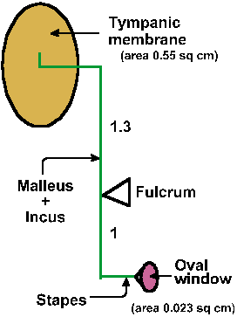
Role Of Tympanic Membrane In Impedance Matching
Total area of tympanic membrane 55mm²
Area of stapes footplate is 3.2mm²
Effective areal ratio is 17:1 at oval window thus by focusing sound pressure from large area of tympanic membrane to small area of oval window.

Slide 13
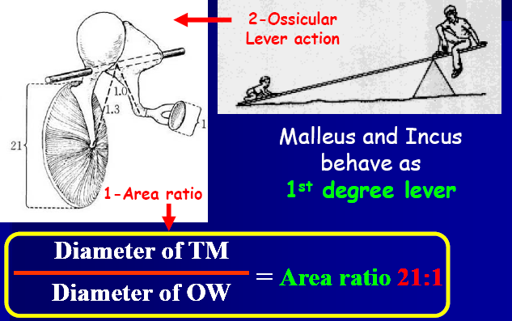
Lever action of ossicles
Ear ossicles move as a single unit. Handle of malleus is 1.3 times longer than long process of incus.
Overall this results in magnification of sound intensity by 1.2 -1.3 times.

Slide 14
HYDRAULIC ACTION of tympanic membrane and LEVER ACTION of ossicles increases the pressure within the middle ear by 22 times(17x1.3). This is referred as IMPEDANCE MATCHING
Thus when the stapes is pressed into the oval window, this pressure is transferred to the perilymph in the scala vestibuli (internal ear).

Slide 15
Attenuation or Acoustic reflex
Attenuation is a general term that refers to any reduction in the strength of a signal
When loud sounds are transmitted through the ossicular system
The tensor tympani muscle pulls the handle of the malleus inward while the stapedius muscle pulls the stapes outward.
These two forces cause the entire ossicular system to develop increased rigidity, thus greatly reducing the ossicular conduction of loud sound, this is k/as Attenuation reflex.
Reaction Time: This occurs after a latent period of only 40 to 80 ms to cause contraction of the middle ear muscles. Sudden loud sound like gut shot, bomb explosion can not protect the ear and causes deafness

Slide 16
Function of attenuation reflex
To protect the cochlea from damaging vibrations caused by excessively loud sound.
To mask low-frequency sounds in loud environments. This usually removes a major share of the background noise
To decrease a person’s hearing sensitivity to his or her own speech

Slide 17
Internal EAR

Slide 19
Vestibule and Cochlea: Two Sensory
Organs Of the Inner Ear
Fig 10.12
10-42

Slide 20
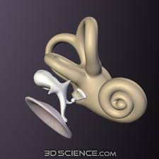
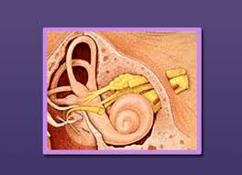
THE INTERNAL EAR
The internal ear or inner ear consists of the two parts
1)Bony labyrinth
2)Membranous labyrinth
Bony labyrinth is a series of channels in the temporal bone which enclose the membranous labyrinth.

Slide 21
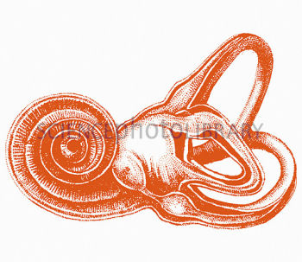
One cochlea
(resembles shell of a snail)
It is concerned with hearing.
One vestibule (utricle and saccule) & Three semicircular canals which communicates with the vestibule. Arranged in right angle to each other. Together is called the vestibular apparatus. It is concerned with equilibrium.

Slide 22
Membranous labyrinth (continued)
  Bony labyrinth is filled with perilymph
    Continuous with cerebrospinal fluid
  Filled with a clear fluid – endolymph
    Confined to the membranous labyrinth

Slide 23
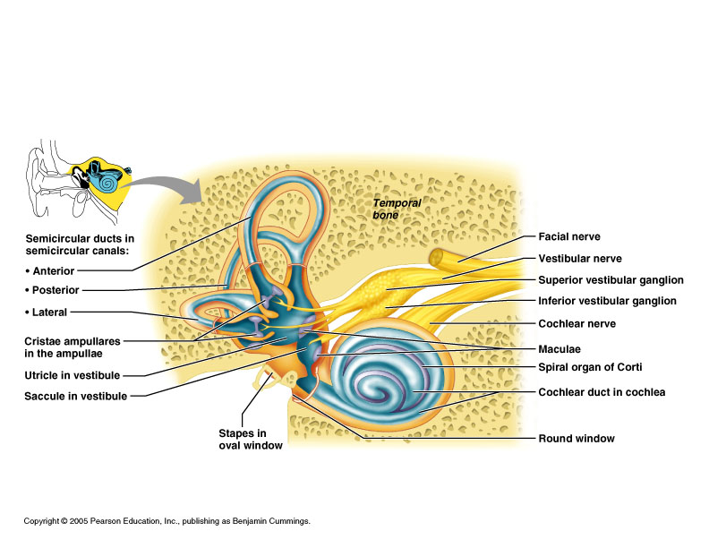
The Membranous Labyrinth
Figure 16.20

Slide 24
The Cochlea
A spiraling chamber in the bony labyrinth

Slide 25
The cochlea
It is coiled tube , 35 mm long.
Its lumen is divided throughout the length by two membranes.
Reissner`s and basilar membranes in to three compartments or scalae.
1)scala vestibuli
2)scala tympani
3)scala media.
Scala tympani and scala vestibuli communicates at the apex by a small opening called HELICOTREMA.

Slide 26
COCHLEA

Slide 27
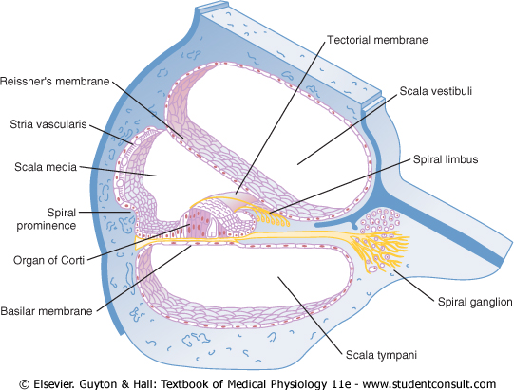
Hearing: ear structure

Slide 28
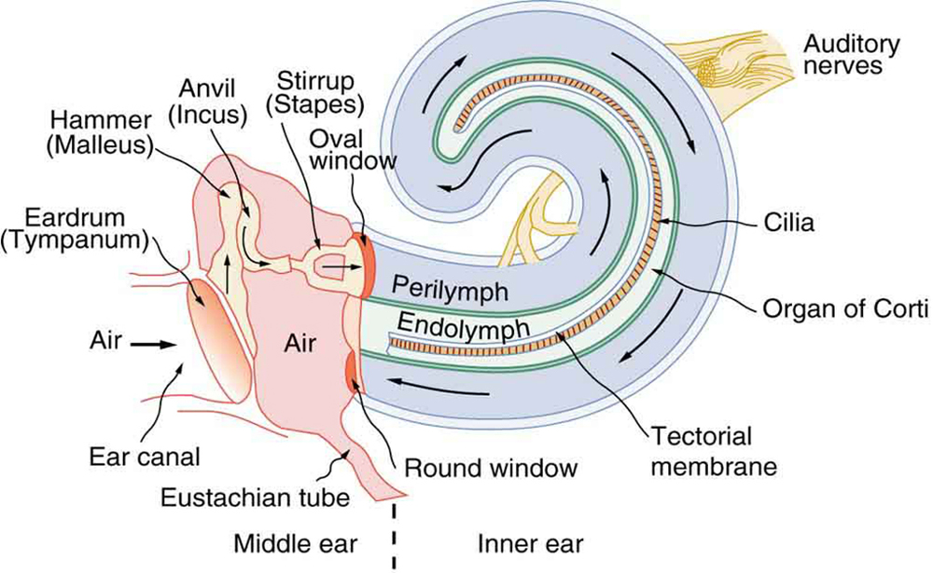

Slide 29
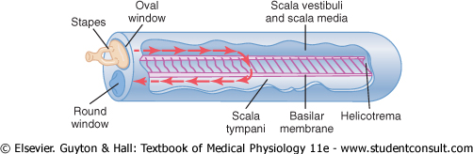
Hearing: cochlea

Slide 30
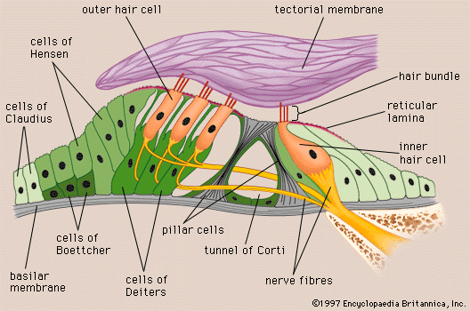

Slide 31
THE ORGAN OF CORTI
INNERVATION:-
AFFERENT ( SENSORY):-
The hair cells are innervated by nerve fibers of the cochlear division of VIII nerve.
EFFERENT (MOTOR):-
Efferent cholinergic fibers arise from both the ipsilateral and the contralateral SUPERIOR OLIVARY NUCLEUS via the OLIVOCOCHLEAR BUNDLE.

Slide 32
Receptor Of Hearing
THE ORGAN OF CORTI
The primary receptor of the hearing is the organ of corti which is located on the basilar membrane extending from the apex to base of the cochlea.
On this membrane stands TWO RODS (rods of corti )Which projects into the scala media.

Slide 33
THE ORGAN OF CORTI
In between the two rods is a tunnel of corti which is filled with perilymph.
Internal to the inner rod is a single row of inner hair cells and external to the outer rod are three or four rows outer hair cells.
The inner hair cells are supported by the phalangeal cells while the outer hair cells supported by the deiter`s cells.
From the upper surface of the hair cells projects tiny cilia also called stereocillia which passes through a thin dense granular reticular lamina and get embedded in the tectorial membrane.

Slide 34
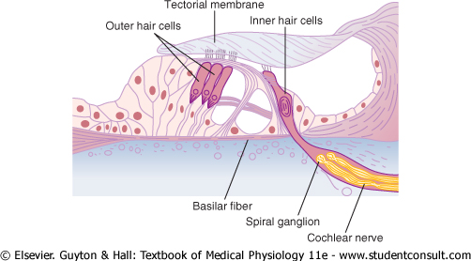

Slide 35
Fig 10.13
10-38

Slide 36
Function of Inner Hair Cells
The inner hair cells are the primary sensory cells that generate action potential in the auditory nerve and stimulated by the fluid moving between the tectorial membrane and hair cells .These cells are responsible for fine auditory discrimination.
Function of Outer Hair Cell:
The outer hair cells are responsible for detecting the presence of sound and they improve hearing by influencing the vibration patterns of the basilar membrane.

Slide 37
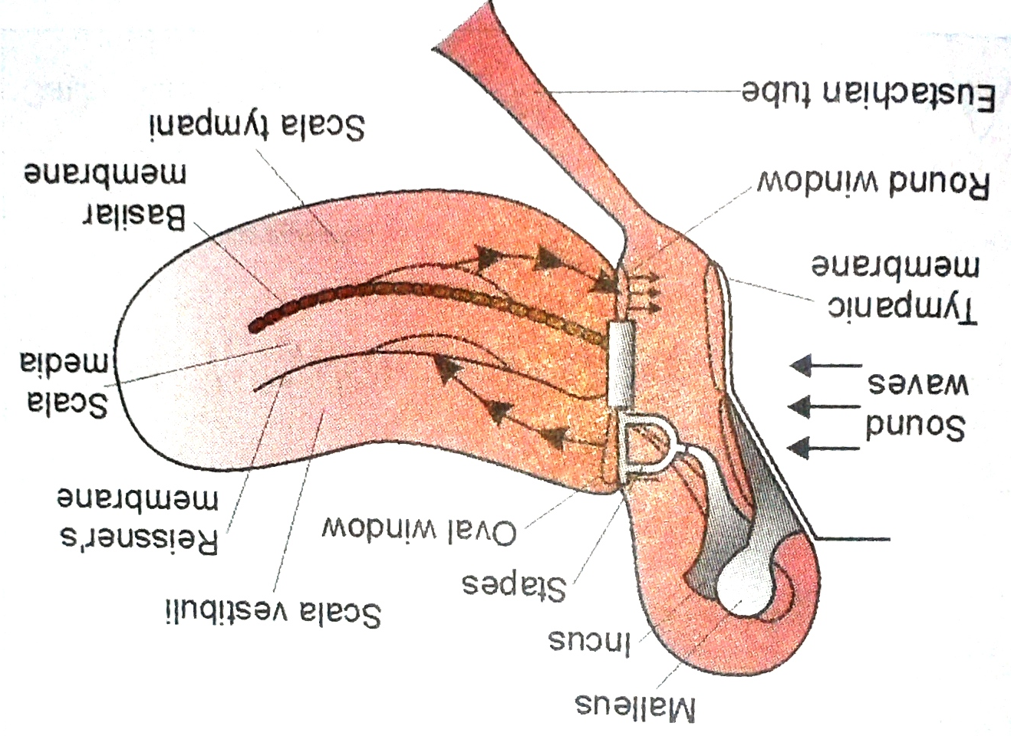

Slide 38
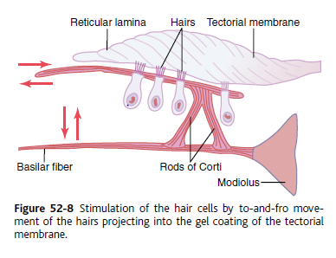

Slide 39
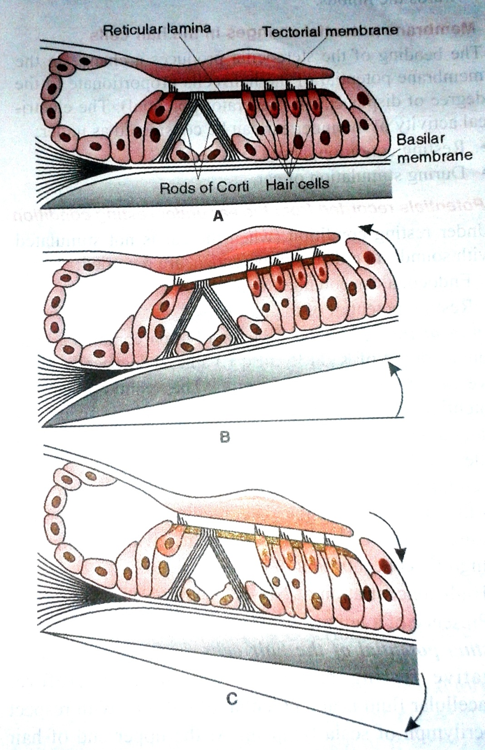

Slide 40
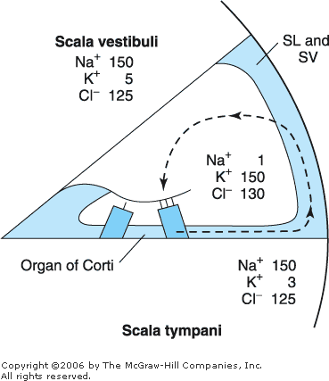
Electrophysiology of hearing
Potentials recorded from the ear under resting condition:-
  Endocochlear/endolymphatic Potential:-
    It is an electrical potential of about +80 mv which exists all the time between endolymph & perilymph, with positivity inside the scala media & negativity outside.
    It is generated by continual secretion of K⁺ ions into the scala media by the stria vascularis.

Slide 41
RMP of hair cells:-
  Lower bodies of hair cells have a negative intracellular potential of -70 mv with respect to the perilymph but -150 mv with respect to the endolymph. (Because endolymphatic potential is +80)
  This -150 mv potential difference at stereocilia make hair cells extremely sensitive to slightest of sound.

Slide 42
Resting potential of hair cells
Hair cell (-70mv)
Scala media (SV secretes K+ ion so it maintains the endochchlear potential (endolymph) of +80 mv
Scala vestibuli (perilymph)
At upper end of hair cell the potential difference between intracellular fluid and endolymph is (-150mV), which make the hair cell very sensitive

Slide 43
Potential recorded from the ear on stimulation:-
  Cochlear Microphonic potential-
    It is local potential developed at tip of inner hair cell at reticular lamina on stimulation.
    It is produced when mechanical energy is converted to electrical energy.
    It was discovered by wever & bray in 1930’s.
    It can be recorded by placing one electrode in scala media and one electrode in scala tympani (both side of basilar membrane).
    The cause of the development of cochlear microphonic potential is not very clear.
    It may be due to vibration in basilar membrane & tension on the hairs of hair cells.

Slide 44
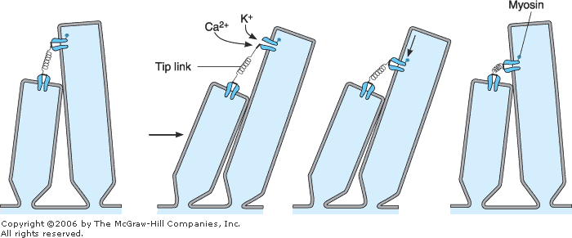
Tip links
The tops of the shorter stereocilia are attached by thin filaments to the back sides of their adjacent longer stereocilia

Slide 45
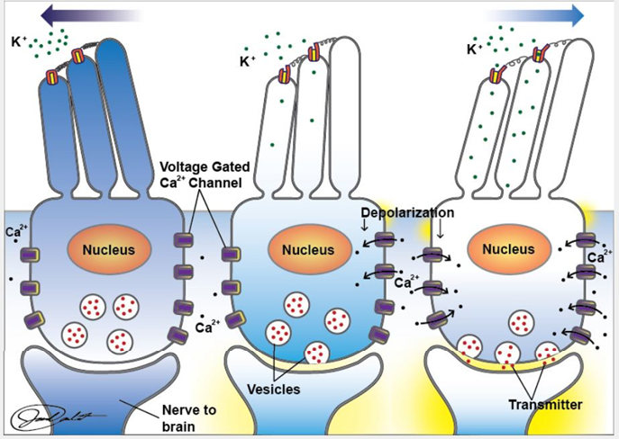

Slide 46
Action potential in 8th cranial nerve:-
  When the hair cell depolarizes a calcium channel opens allowing calcium to enter the cell.
  Calcium initiates the release of a synaptic transmitter, which activates receptor sites on the terminals of the afferent neurons and cause the generation of the action potential in the neuron.

Slide 47
THE ORGAN OF CORTI
INNERVATION:-
AFFERENT ( SENSORY):-
The hair cells are innervated by nerve fibers of the cochlear division of VIII nerve.
EFFERENT (MOTOR):-
Efferent cholinergic fibers arise from both the ipsilateral and the contralateral SUPERIOR OLIVARY NUCLEUS via the OLIVOCOCHLEAR BUNDLE.

Slide 48
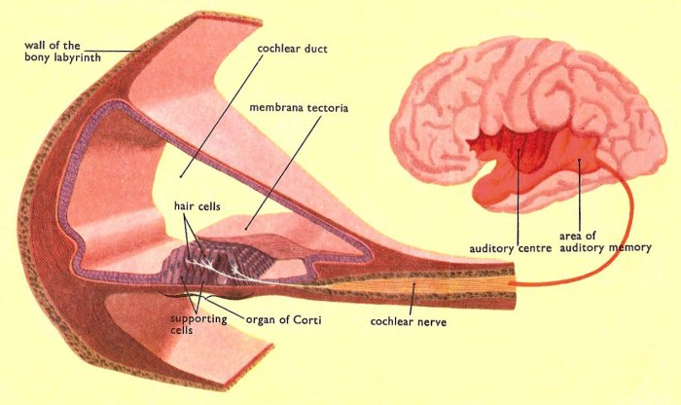
AUDITORY PATHWAY

Slide 49
AUDITORY PATHWAYS
The axons of the spiral ganglion of internal ear that innervates the hair cells from the cochlear division of the VII nerve.
The auditory nerve enters the medulla and ends in ventral and dorsal cochlear nuclei the sites of the first synapse.

Slide 50
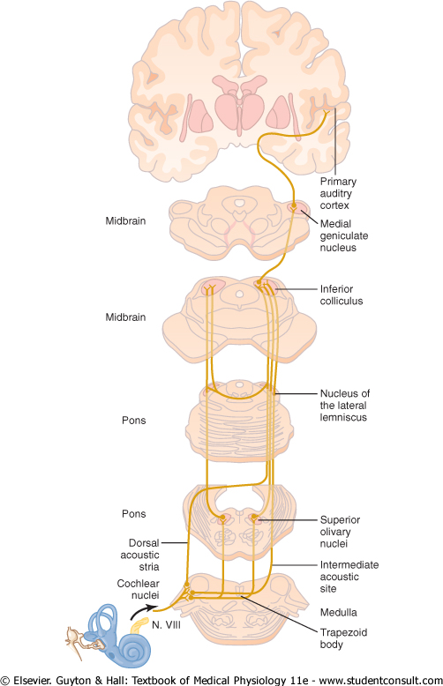

Slide 51
AUDITORY PATHWAYS
Second order neurons from the cochlear nuclei end in SUPERIOR OLIVE AND TRAPEZOID BODY on both sides of the brain stem from where third order neurons take origin.
Third order neurons pass up to the INFERIROR COLLICULI (center for auditory reflexes) of both sides.

Slide 52
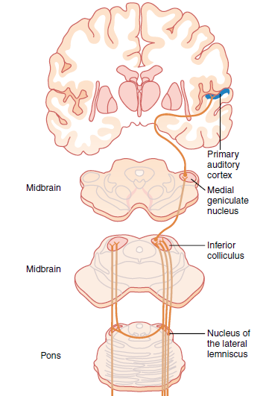
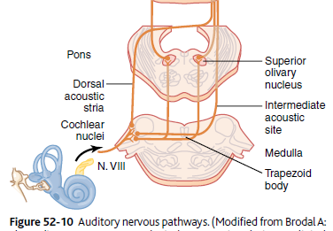

Slide 53
AUDITORY PATHWAYS
From the inferior colliculi many fibers projects and rely in the MEDIAL GENICULATE BODIES and finally projects to the primary auditory cortex.
Primary auditory cortex lies in the superior temporal lobe.
Here nerve impulses are perceived as sound i.e. it receives and perceives auditory information such as loudness , pitch , source and direction of sounds.

Slide 54
AUDITORY PATHWAYS
Auditory association area 22 , 21 , and 20
Area 22 : Wernicke's area.
It is located in superior temporal gyrus in the dominant hemisphere. It is concerned with comprehension i.e. interpretation and understanding of auditory and visual information.
AREA 21 and 20 :
These areas are located in the middle and inferior temporal gyrus and are concerned with interpretation and integration of auditory impulses.

Slide 56
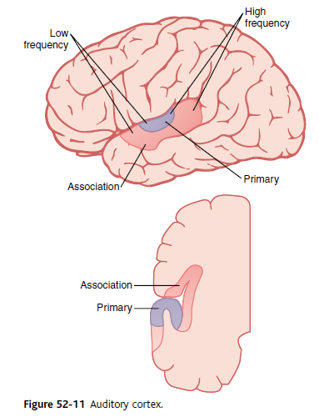

Slide 57
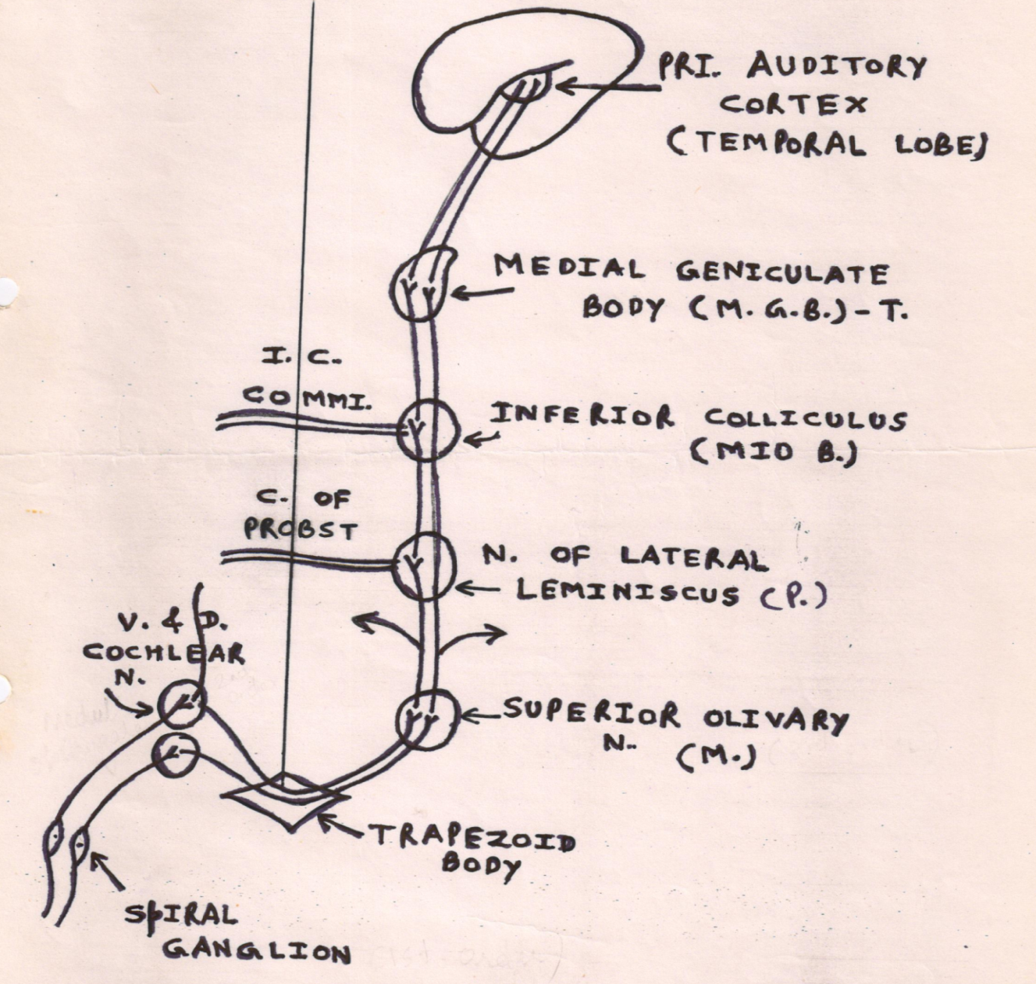

Slide 59
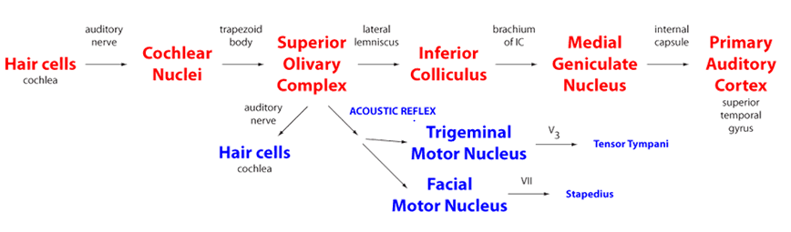

Slide 60
Terms to remember
Amplitude/intensity/loudness
Strength of the sound
Loudness denotes the appreciation of sound intensity
Frequency/Pitch/Tone
Number of cycles per second
Pitch /Tone denotes the appreciation of frequency
Impedence
Resistance offered by a medium to sound waves

Slide 61
AUDITORY DEFECTS
Auditory defects are of two types:
  Conduction deafness
  Nerve deafness

Slide 62
CONDUCTION DEAFNESS
It occurs due to impairment in the transmission of sound in external ear or middle ear.
CAUSES :-
Obstruction of external auditory meatus
Thickness of ear drum due to repeated middle ear infection
Perforation of ear drum
Otosclerosis (fixation of foot plate of stapes against oval window.)

Slide 64
NERVE DEAFNESS
Damage of any structure of cochlea such as
hair cell ,
organ of corti ,
basilar membrane or
cochlear duct or
the lesion in auditory pathway produces the nerve deafness.

Slide 66
NERVE DEAFNESS
CAUSES:
Degeneration of hair cells due to some antibiotics like streptomycin and gentamycin (ototoxicity)
Damage of cochlea by prolonged exposure to loud noise (e.g. hearing music by ear phone)
Tumor affecting VII cranial nerve

Slide 67
TESTS FOR HEARING
BEDSIDE TESTS
Whispering Test
Tickling Watch Test
ROUTINE TESTS
Rinne’s Test
Weber’s Test
Audiometry

Slide 68
BEDSIDE TESTS
WHISPERING TEST
The examiner stands about 60 cm away from the subject at his side and whisper some words .
If the subject is not able to hear the whisper , hearing deficit is suspected.
TICKLING OF WATCH TEST
Wrist watch with tickling sound is kept near the ear of the subject.
The subject from hearing defects cannot hear the tickling sound of watch

Slide 69
ROUTINE TESTS FOR HEARING
They are of three types……………
The first two tests i.e. rinne`s test and weber`s test are done by using tuning fork with high frequency .
Tuning fork of 256 Hz / 512 Hz is used.
By these tests only the nature of auditory defects is determined.

Slide 70
RINNE `S TEST
Base of vibrating tuning fork is placed on mastoid process until the subject cannot feel the vibrations and cannot hear sound.
When subject does not hear the sound any more the tuning fork is held in air front of the ear of same side.
Normal person hears vibration in air even after the bone conduction ceases because in normal air conduction via ossicles is better than bone conduction.
NORMAL …AC > BC

Slide 71
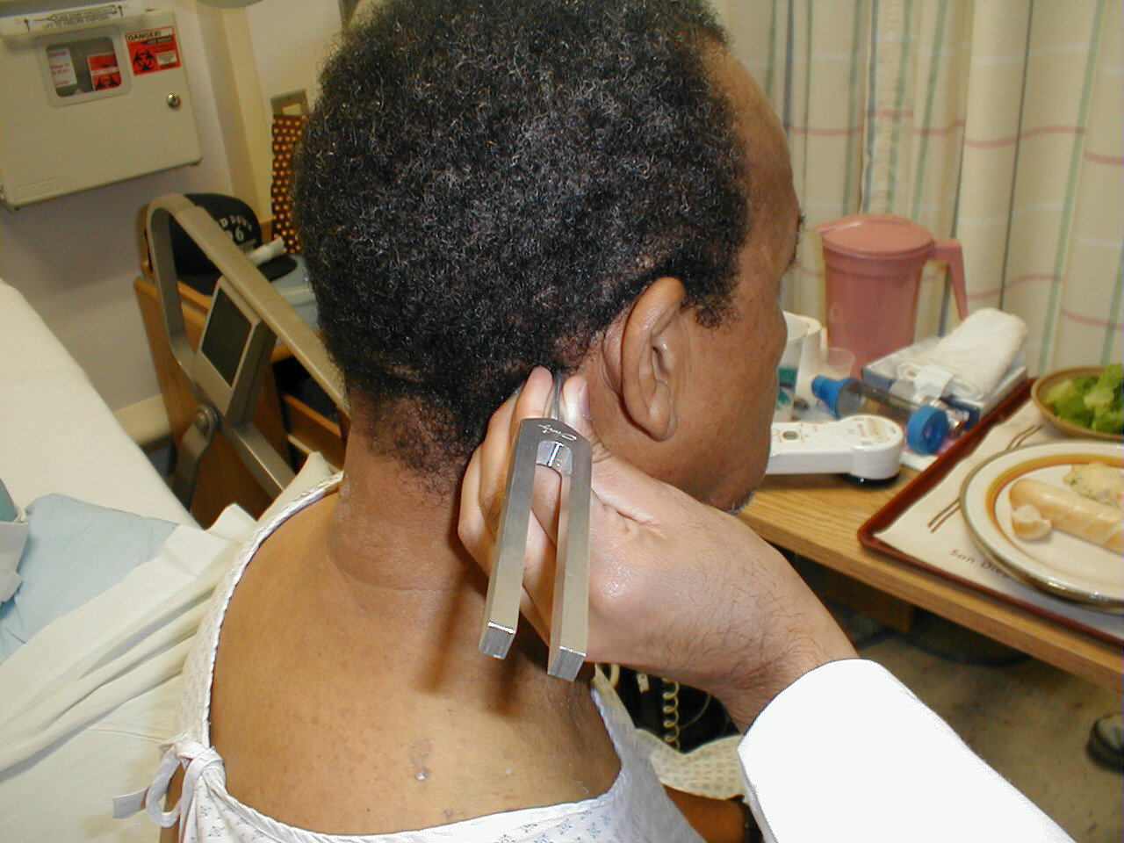

Slide 72
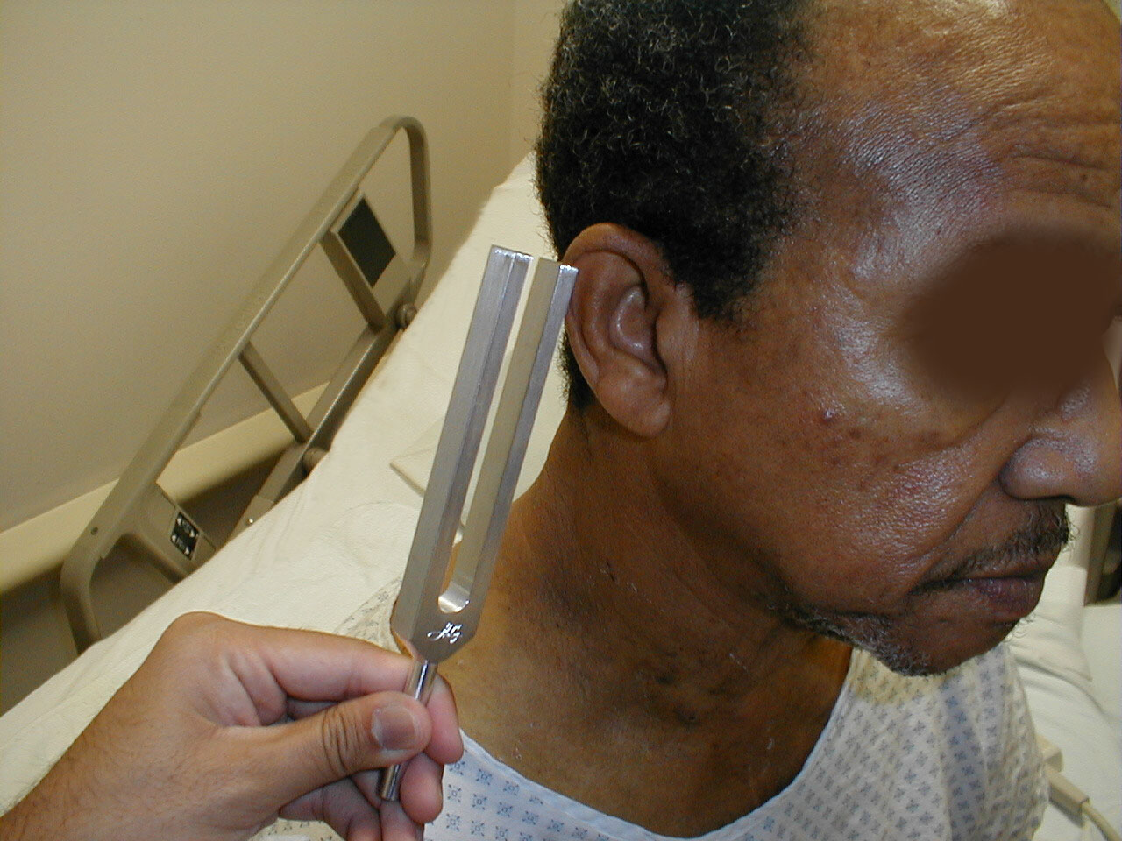

Slide 73
RINNE `S TEST
But in conduction deafness vibrations in air are not heard after cessation of bone conduction.
Conduction Deafness BC > AC
In nerve deafness BOTH air conduction and bone conduction are DIMINISHED

Slide 74
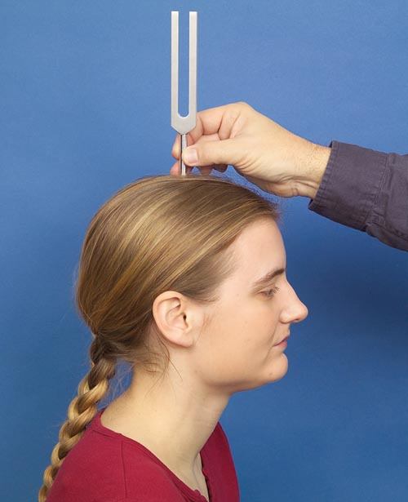
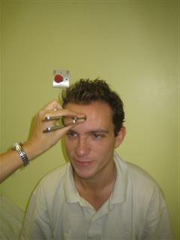
WEBER`S TEST
Base of the vibrating tuning fork is placed on the vertex of the skull or the middle of the forehead.
Normal person hears the sound equally on the both sides.

Slide 75
UNILATERAL CONDUCTION DEAFNESS
Unilateral conduction deafness (DEAFNESS IN ONE EAR) sound is heard LOUDER in DISEASED EAR.
In NORMAL ear there is masking effect of environment noise.
So the sound through bone conduction is not heard as clearly as on the affected side.

Slide 76
UNILATERAL NERVE DEAFNESS
UNILATERAL NERVE DEAFNESS
sound is heard louder
IN DISEASED EAR

Slide 77
AUDIOMETRY
It is technique used to determine the nature and severity of the auditory defect.
Instrument audiometer is used.
The instrument is capable of generating sound waves of different frequencies from lowest to highest which tests the hearing capability.

Slide 78
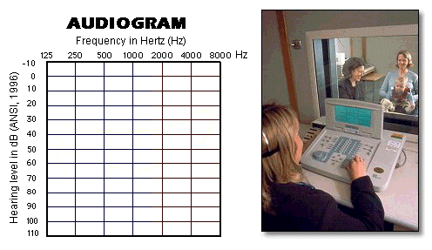
PURE TONE AUDIOMETRY (PTA)

Slide 79
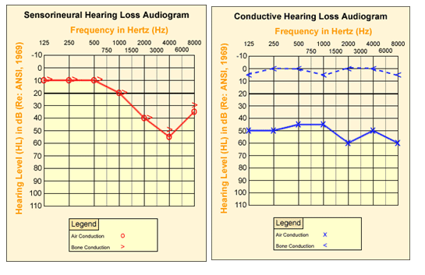

Slide 80
Other tests
BERA (Brainstem Evoked Response Audiometry)
Electro cochleography (E CoG)
Speech Audiometry
Impedance Audiometry

Slide 81


Slide 82
Endolymph
Is present in scala media
Is present in scala vestibula
Contain high Na+ Concentration
Is at lower potential

Slide 83
2. The Organ of Corti
Contain hair cells
Is based on Basilar membrane
Is supplied by Auditory Nerve
All of the above

Slide 84
Perception of sound first takes place in
A) Area 22,20
B) Area 21, 23
C) Area 41, 42
D) Area 23,20

Slide 85
4. Not a feature of Conductive Deafness
Complete loss of hearing
Rinne test negative
Hearing loss is fairly uniform throughout the frequency ranges
Subject’s bone conduction is better than examiner’s

Slide 86
5. Rinne’s Test result shows that Bone
Conduction > Air Conduction in one ear
…..So the Patient have
Normal ear
Conductive Deafness
Nerve Deafness
Mixed Deafness

Slide 88
CCES

Slide 89
The portion of the inner ear that detects sounds, is the _____.
semicircular canals
Osseous labyrinth
Vestibule
Cochlea

Slide 90
2. During transmission of sound pressure within the middle ear increases by :
1.2-1.3 times
12-13 times
17 times
22 times

Slide 91
3. Cells which are responsible for detecting the presence of sound :
A) Inner hair cells
B) Outer hair cells
C) Dieter’s cells
D) Claudius cells

Slide 92
4. Scala media is filled with
Fluid having electrolyte concentration very similar to that ECF
Perilymph
Endolymph
Fluid rich in Na and low in K

Slide 93
5. Damage to facial nerve leads to except
Paralysis of stapedius muscle
Hyperacusis
Deafness
Bell’s palsy

Slide 94


