Slide 1
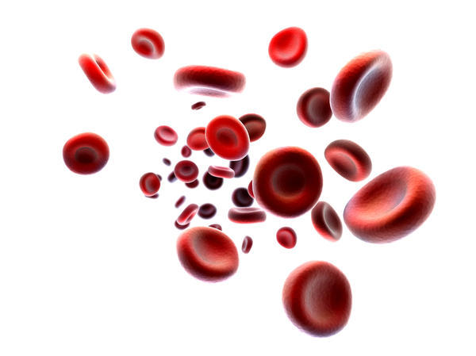
ERYTHROPOIESIS….
Dr. Geetanjali Purohit
PhD (Med Physiology)
Asso. Professor, Physiology
SBKS MI & RC

Slide 2

Scheme
Definition
Theories of Erythropoiesis
Sites of Erythropoiesis
Stages of Erythropoiesis
Factors affecting Erythropoiesis
Erythropoietin

Slide 3
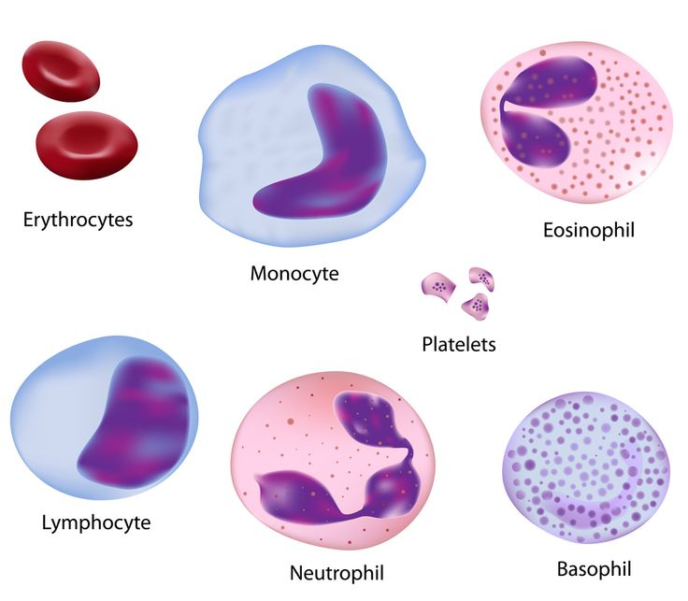
Hemopoiesis…
Hemo: Referring to blood cells
Poiesis: “The development or production of”
The word Hemopoiesis refers to the production & development of all the blood cells:
  Erythrocytes: Erythropoiesis
  Leucocytes: Leucopoiesis
  Thrombocytes: Thrombopoiesis.

Slide 4
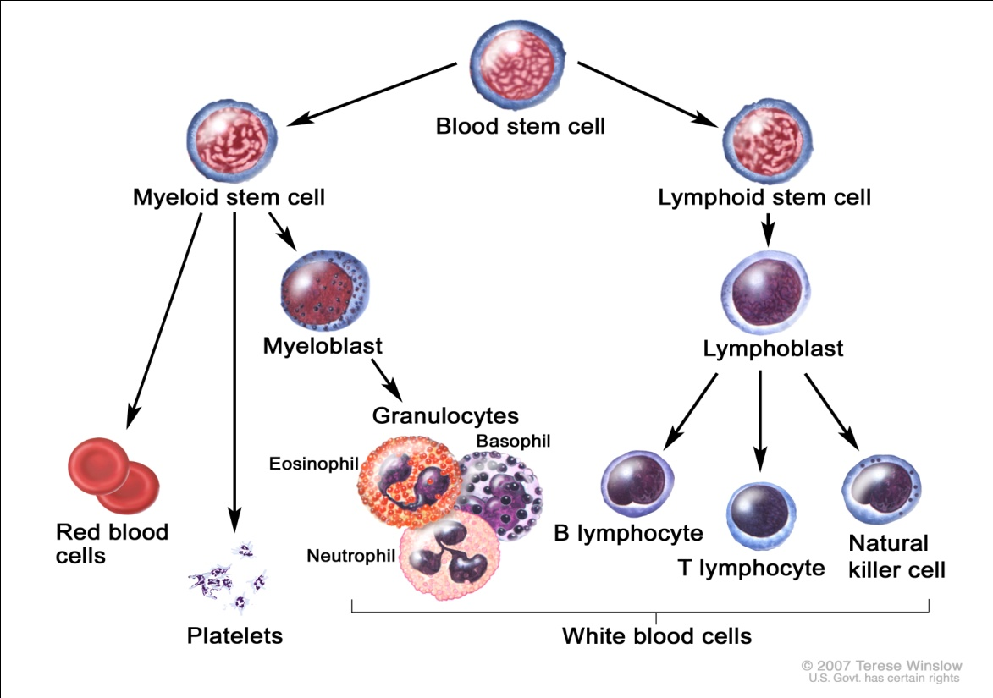
Erythropoiesis………..
It is the process of development, differentiation and maturation of RBCs from primitive stem cells

Slide 5
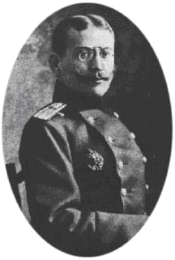
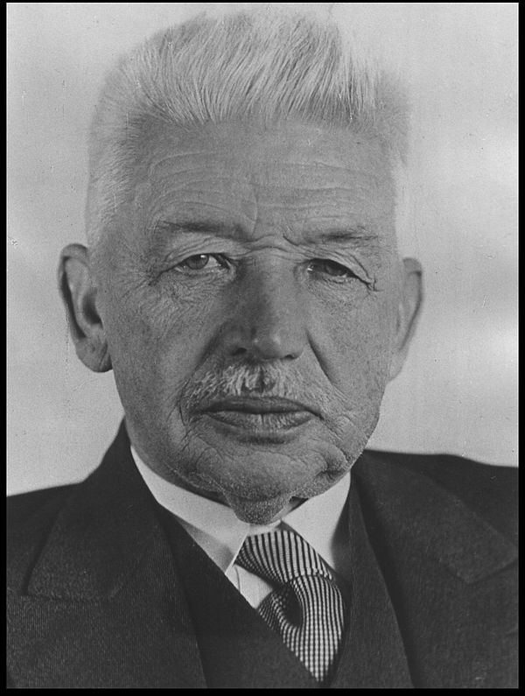
Theories of erythropoiesis……
Monophyletic theory
Also known as unitary theory.
There is a common parent cell of all formed elements of blood.
Polyphyletic theory
Also known as trialistic theory
Suggests different group of stem cells gives rise to different blood cells.
L. Aschoff
Alexander A. Maximow

Slide 6
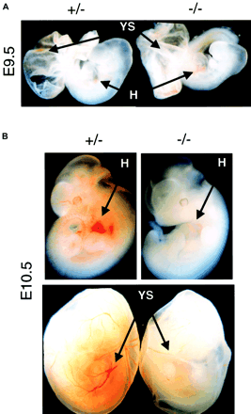
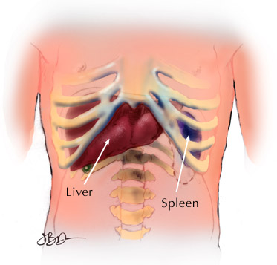
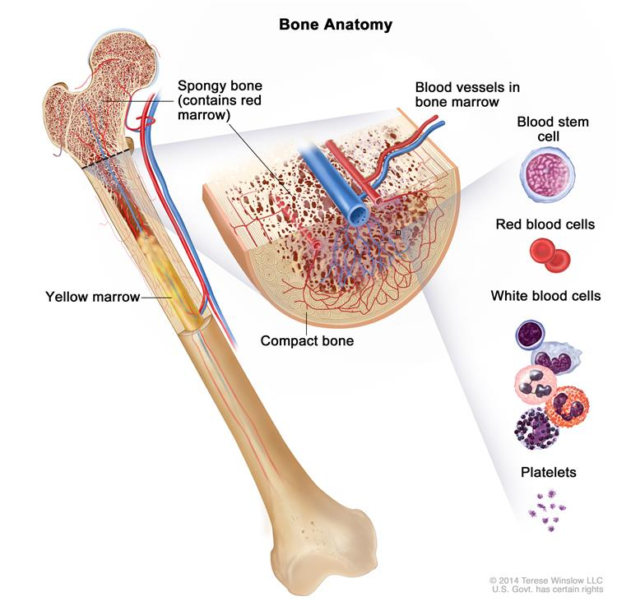
Site of Erythropoiesis……
A. During intrauterine life
  1. Mesoblastic stage (3rd week to 3 months): Intravascular
  2. Hepatic stage (after 3 months) : Liver
  3. Myeloid stage (3rd trimester): Bone Marrow
Yolk sac
Liver & spleen
Bone marrow

Slide 7
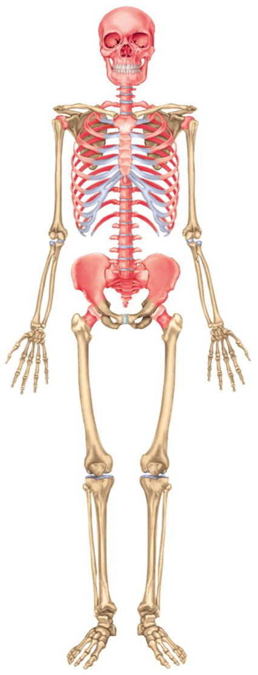
In children
All bones with red bone marrow
Liver & spleen
In adults (after 20yrs)
Ends of long bones like femur, humerus
Skull
Vertbrae
Ribs
Sternum
pelvis
Normally, 75% of the cells in the marrow belong to the WBC-producing myeloid series and only 25% are maturing red cells. There are over 500 times as many red cells in the circulation as there are white cells.
Notes:
The axial skeleton

Slide 8
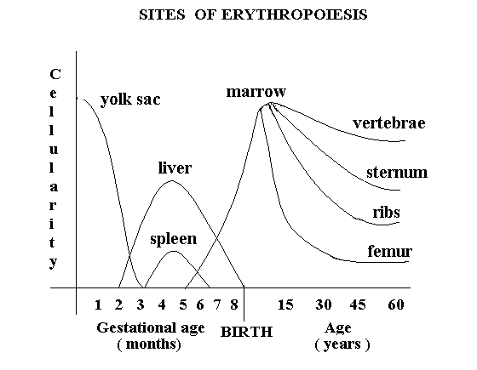

Slide 9
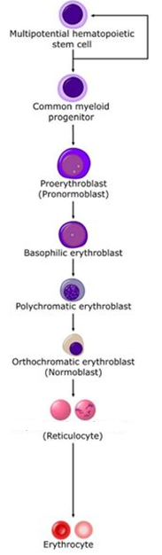
PHSC Pluripotent Hemopoietic stem cell
E
R
Y
T
H
R
O
P
O
I
E
S
I
S
IL-1,IL-6,IL-3
GM CSF erythro
BFU-E (Burst Forming Unit Erythrocyte)
CFU-E (Colony Forming Unit Erythrocyte)
GM CSF erythro
PROERYTHROBLAST
BASOPHILIC ERYTHROBLAST
POLYCHROMATOPHILIC ERYTHROBLAST
ORTHOCHROMATIC ERYTHROBLAST
RETICULOCYTE
ERYTHROCYTE
ERYTHROCYTE

Slide 10
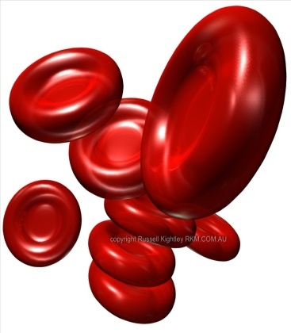
PHSC Pluripotent Hemopoietic stem cell
E
R
Y
T
H
R
O
P
O
I
E
S
I
S
IL-1,IL-6,IL-3
GM CSF erythro
BFU-E (Burst Forming Unit Erythrocyte)
CFU-E (Colony Forming Unit Erythrocyte)
GM CSF erythro
PROERYTHROBLAST
EARLY NORMOBLAST
INTERMEDIATE NORMOBLAST
LATE NORMOBLAST
RETICULOCYTE
ERYTHROCYTE
ERYTHROCYTE

Slide 11
1. STEM CELLS
These cells have extensive proliferative capacity and also the:
  Ability to give rise to new stem cells (Self Renewal)
  Ability to differentiate into any blood cells lines (Pluripotency)
Hematopoietic stem cells (HSCs) are bone marrow cells that are capable of producing all types of blood cells.
They differentiate into one or another type of committed stem cells (progenitor cells).
Notes:
Hematopoietic stem cells (HSCs) are bone marrow cells that are capable of producing all types of blood cells.
They differentiate into one or another type of committed stem cells (progenitor cells). These in turn form the various differentiated types of blood cells.
There are separate pools of progenitor cells for megakaryocytes, lymphocytes, erythrocytes, eosinophils, and basophils; neutrophils and monocytes arise from a common precursor.

Slide 12
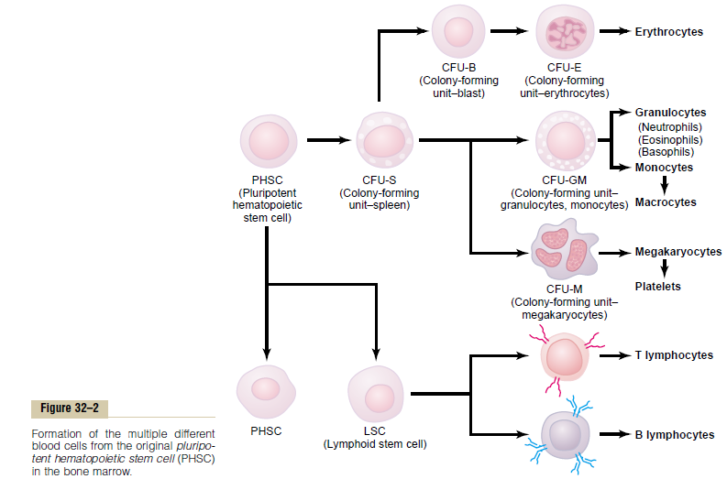

Slide 13
2. Progenitor cells - BFU-E & CFU-E
  BFU-E Give rise each to thousands of nucleated erythroid precursor cells.
  Undergo some changes to become the Colony Forming Units-Erythrocyte (CFU-E)
  Regulator: Burst Promoting Activity (BPA)
Committed stem cells lose their capacity for self-renewal.
They become irreversibly committed.
Notes:
Committed stem cells lose their capacity for self-renewal.
They become irreversibly committed.
These cells are termed as “Progenitor cells”
They are regulated by certain hormones or substances so that they can:
Proliferate
Undergo Maturation.

Slide 14
Burst forming unit BFU(E)
Unipotent progenitor cell
Less sensitive to erythropoietin
Responds to other stimulus forms
Colony forming unit CFU (e)
Highly sensitive and dependent on erythropoietin

Slide 15
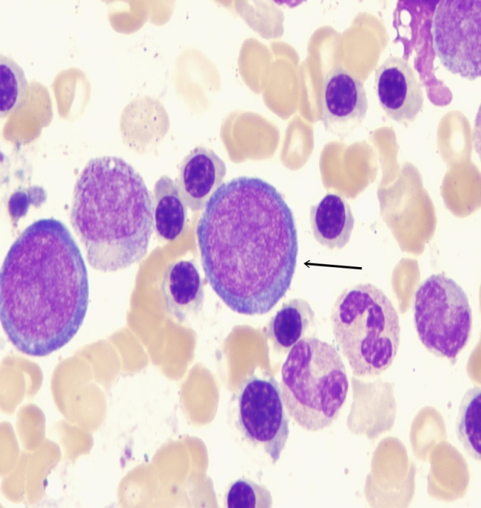
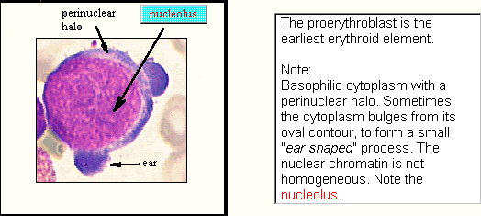
3. Proerythroblast
15-20 microns
Nucleus
Multiple nucleoli
Basophilic cytoplasm No hemoglobin
Mitosis present

Slide 16
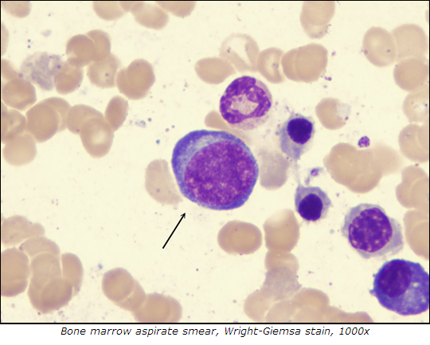
4. Basophilic/ early normoblast
Slight reduction in size 14-17µm
Large nucleus, nucleoli reduce in number
Basophilic cytoplasm
Active mitosis
Notes:
Smaller than Proerythroblast
Nuclear chromatin shows
sharp contrast between light
& dark areas
Cytoplasm is basophilic
reflecting protein & RNA contents

Slide 17
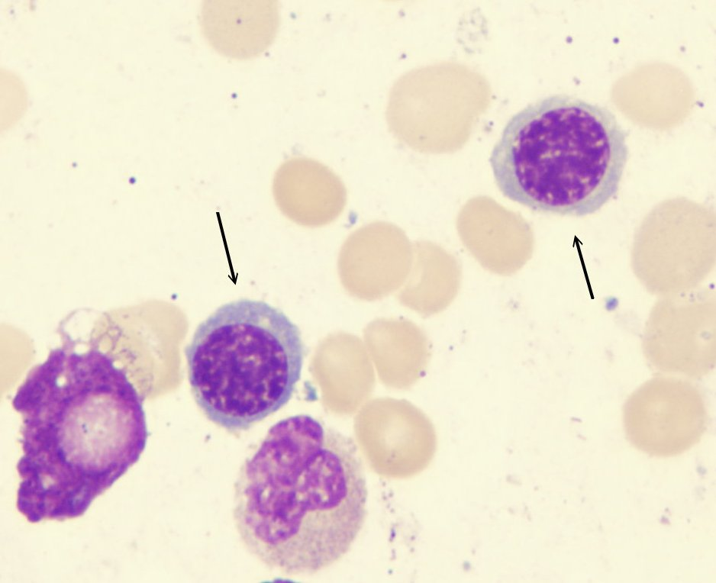
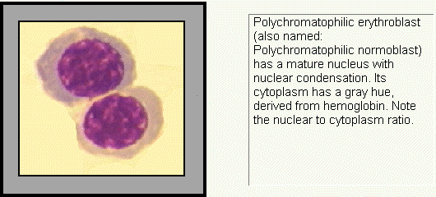
5. Polychromatophilic/ intermediate normoblast
10-15µm size
’POLYCHROMASIA’
Nucleus condenses Chromatin lumps
Hb starts appearing
Reduced mitoses
Notes:
Polychromasia means
having many colors
Nucleus mature & condensed
Cytoplasm has a gray hue
derived from Hb (Hemoglobin)

Slide 18
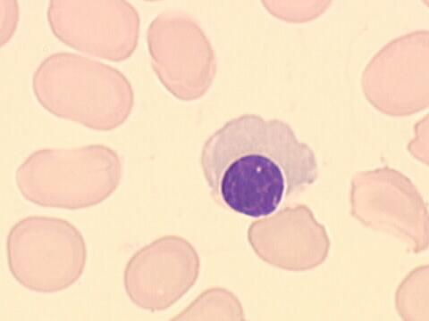
6. Late normoblast
7-10µm
Acidophilic erythroblast which is the last precursor with a nucleus.
Nucleus is compact & situated near the membrane pyknotic nucleus is extruded
Cytoplasm is like mature red cell, reflecting a high Hb content.
Mitosis absent

Slide 19
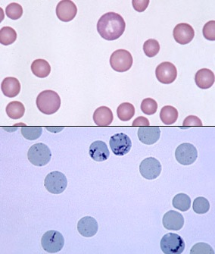
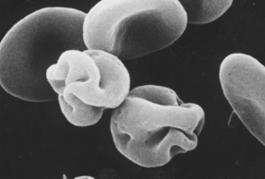
7. Reticulocyte
Reticular nuclear fragments
Nucleus extruded
Slightly larger than RBCs
Young erythrocytes with granular or reticular filamentous structures.
Makes up 1-2% of all erythrocytes
Reticulocytosis seen following hemolysis or acute blood loss

Slide 20
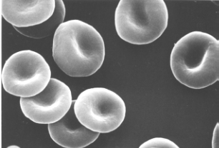
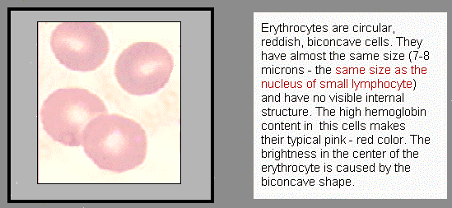
8. Mature erythrocyte
Reddish, circular, biconcave cells
7-8 µ
No visible internal structure
High Hb content
Bright at centre due to biconcave shape
7.2 µm

Slide 21
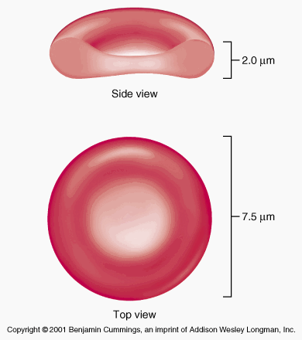

Slide 22

Definition
Theories of erythropoiesis
Sites of erythropoiesis
Stages of erythropoiesis
Mature Red Cell

Slide 23
1. Normal reticulocyte count at birth is
1-2%
2-6%
6-10%
30-40%

Slide 24
2. In normal Individual, erythropoiesis is completed in ……days
3
7
14
20

Slide 25
3. Hb starts to appear in
Late Normoblast
Early Normoblast
Intermediate Normoblast
Reticulocytes

Slide 26
4. Normal Myloid-erythroid ratio in bone marrow is.
1:1
1:2
3:1
3:2

Slide 27
5. The commonest site of hemopoiesis in a 3 month old fetus is
Liver
Spleen
Bone Marrow
Gut

