Slide 1
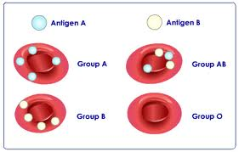
Blood group….
Dr. Geetanjali Purohit
Asst Professor
Physiology

Slide 2
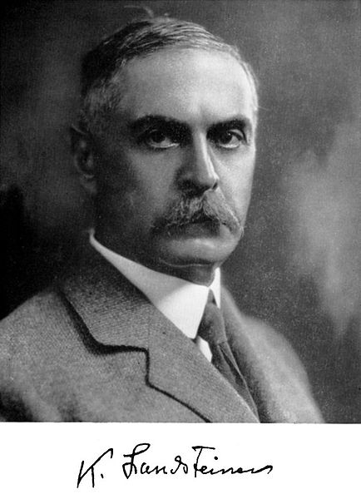
Karl Landsteiner- (June 14, 1868 – June 26, 1943)

Slide 3
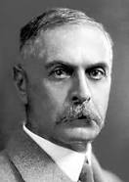
History…….
The ABO blood group system is widely credited to have been discovered by the Austrian scientist Karl Landsteiner, who identified the O, A, and B blood types in 1900.
Landsteiner originally described the O blood type as type "C", and in parts of Europe it is rendered as "0" (zero), signifying the lack of A or B antigen.

Slide 4


Blood Groups, Blood Typing and Blood Transfusions
The discovery of blood groups
Experiments with blood transfusions, the transfer of blood or blood components into a person's blood stream, have been carried out for hundreds of years. Many patients have died and it was not until 1901, when the Austrian Karl Landsteiner discovered human blood groups, that blood transfusions became safer.
Mixing blood from two individuals can lead to blood clumping or agglutination. The clumped red cells can crack and cause toxic reactions. This can have fatal consequences. Karl Landsteiner discovered that blood clumping was an immunological reaction which occurs when the receiver of a blood transfusion has antibodies against the donor blood cells.
Karl Landsteiner's work made it possible to determine blood types and thus paved the way for blood transfusions to be carried out safely. For this discovery he was awarded the Nobel Prize in Physiology or Medicine in 1930.
What are the different blood groups?
The differences in human blood are due to the presence or absence of certain protein molecules called antigens and antibodies.
The antigens are located on the surface of the RBCs and the antibodies are in the blood plasma.
Blood group 0
If you belong to the blood group 0 (null), you have neither A or B antigens on the surface of your red blood cells but you have both A and B antibodies in your blood plasma.

Slide 5
Blood Groups, Blood Typing and Blood Transfusions
The discovery of blood groups
Experiments with blood transfusions, the transfer of blood or blood components into a person's blood stream, have been carried out for hundreds of years. Many patients have died and it was not until 1901, when the Austrian Karl Landsteiner discovered human blood groups, that blood transfusions became safer.
Mixing blood from two individuals can lead to blood clumping or agglutination. The clumped red cells can crack and cause toxic reactions. This can have fatal consequences. Karl Landsteiner discovered that blood clumping was an immunological reaction which occurs when the receiver of a blood transfusion has antibodies against the donor blood cells.
Karl Landsteiner's work made it possible to determine blood types and thus paved the way for blood transfusions to be carried out safely. For this discovery he was awarded the Nobel Prize in Physiology or Medicine in 1930.
What are the different blood groups?
The clumping of RBCs due to binding of antibody with the corresponding antigen is called haemagglutination.
The blood group you belong to depends on what you have inherited from your parents.
Blood group 0
If you belong to the blood group 0 (null), you have neither A or B antigens on the surface of your red blood cells but you have both A and B antibodies in your blood plasma.

Slide 6
Agglutinogen……..
Exist on the surface of every red blood cell.
This agglutinogen will stimulate the production of agglutinin (antibody) in the plasma in case of incompatible blood transfusion.
Helps in determining the blood type of a person.

Slide 7
Classification Of Blood Groups..
There are more than 20 genetically determined blood group systems known today
Major Blood Grouping System: cause major transfusion reaction.
1-ABO blood group system
2-Rh blood group system
Minor Blood Grouping System: minor transfusion reaction
1-MNS blood group system
2-p blood group system
Familial Blood Grouping System:
Kell, Daffy, Lutheran, Lewis, Deigo, and Many more.

Slide 8
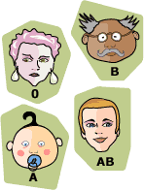
ABO blood grouping system……
According to the ABO blood typing system there are four different kinds of blood types: A, B, AB or O (null).

Slide 9
Landsteiner Law….
It was given by Karl Landsteiner in 1900.
It states that;
“If an agglutinogen is present on the RBC of an individual, the corresponding agglutinin must be absent in the plasma of that individual and vice-versa”
This law is only applicable to ABO blood grouping system.

Slide 10
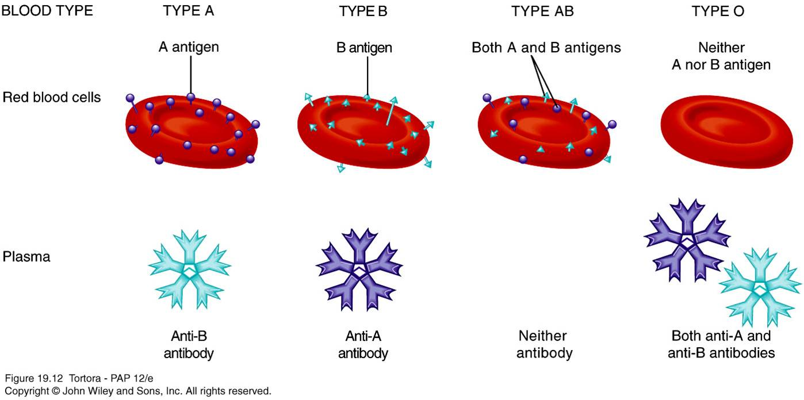
ABO blood group system

Slide 11


Blood group A:
If you belong to the blood group A, you have A antigens on the surface of your RBCs and B antibodies in your blood plasma.
Blood group B
If you belong to the blood group B, you have B antigens on the surface of your RBCs and A antibodies in your blood plasma.

Slide 12
Blood Groups, Blood Typing and Blood Transfusions
The discovery of blood groups
Experiments with blood transfusions, the transfer of blood or blood components into a person's blood stream, have been carried out for hundreds of years. Many patients have died and it was not until 1901, when the Austrian Karl Landsteiner discovered human blood groups, that blood transfusions became safer.
Mixing blood from two individuals can lead to blood clumping or agglutination. The clumped red cells can crack and cause toxic reactions. This can have fatal consequences. Karl Landsteiner discovered that blood clumping was an immunological reaction which occurs when the receiver of a blood transfusion has antibodies against the donor blood cells.
Karl Landsteiner's work made it possible to determine blood types and thus paved the way for blood transfusions to be carried out safely. For this discovery he was awarded the Nobel Prize in Physiology or Medicine in 1930.
What is blood made up of?
An adult human has about 4–6 liters of blood circulating in the body. Among other things, blood transports oxygen to various parts of the body.
Blood consists of several types of cells floating around in a fluid called plasma.
The red blood cells contain hemoglobin, a protein that binds oxygen. Red blood cells transport oxygen to, and remove carbon dioxide from, the body tissues.
The white blood cells fight infection.
The platelets help the blood to clot, if you get a wound for example.
The plasma contains salts and various kinds of proteins.
What are the different blood groups?
The differences in human blood are due to the presence or absence of certain protein molecules called antigens and antibodies. The antigens are located on the surface of the red blood cells and the antibodies are in the blood plasma. Individuals have different types and combinations of these molecules. The blood group you belong to depends on what you have inherited from your parents.
There are more than 20 genetically determined blood group systems known today, but the AB0 and Rh systems are the most important ones used for blood transfusions. Not all blood groups are compatible with each other. Mixing incompatible blood groups leads to blood clumping or agglutination, which is dangerous or individuals.
Nobel Laureate Karl Landsteiner was involved in the discovery of both the AB0 and Rh blood groups.
AB0 blood grouping system
Blood group AB
If you belong to the blood group AB, you have both A and B antigens on the surface of your RBCs and no A or B antibodies at all in your blood plasma.
Blood group O
If you belong to the blood group O (null), you have neither A or B antigens on the surface of your RBCs but you have both A and B antibodies in your blood plasma.

Slide 13
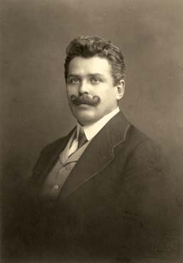
ABO blood group system
According to the ABO blood typing system there are four different kinds of blood types: O, A, B, AB.
I(O) - α,β (40%);
II(A) - β (39%);
III(B) - α (10-15%);
IY(AB) - (5%).
Czech serologist Jan Janský is credited with the first classification of blood into the four types (I, II, III, IV)

Slide 14
Blood Group
Antigens
Antibodies
Can give blood to
Can receive blood from
AB
A and B
None
AB
AB, A, B, O
A
A
B
A and AB
A and O
B
B
A
B and AB
B and O
O
None
A and B
AB, A, B, O
O

Slide 15
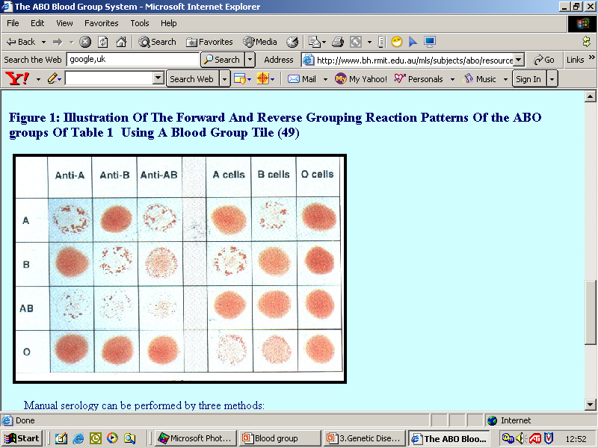
View Of Different Cells And Antibodies

Slide 16

Blood group O is called "universal donor" because it has no antigens on RBC.
Blood group AB are called "universal receivers“ because it has no anti- bodies in the plasma.

Slide 17
CDE blood group system
Out of C,D and E D is the strongest antigen.
Also called Rhesus(Rh) system
85% of the population is - Rh⁺
If Rh-D antigen is present in blood(RBC)
- Rh⁺
If Rh-D antigen is absent in blood(RBC),
- Rh⁻
It is determined by anti-Rh serum.

Slide 18
The Rhesus (Rh) System…
Landsteiner and Weiner in 1940 discovered other antigens in human RBCs and named rhesus antigens or Rh-antigen because the same antigens are present in monkey.
Rh antibodies are not natural i.e. they are not present at birth but are synthesized in Rh negative persons in response to the presence of Rh+antigens

Slide 19
The Rhesus (Rh) System (Cont.)
Rh antigens are trans-membrane proteins with loops exposed at the surface of red blood cells.
They appear to be used for the transport of carbon dioxide and/or ammonia across the plasma membrane.
85% of the population is Rh positive, the other 15% of the population is running around with Rh negative blood.

Slide 20
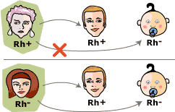
Rh Blood Group and Rh Incompatibility..
A person with Rh- blood develop Rh antibodies in the blood plasma if he or she receives blood from a person with Rh+ blood. If such a person is given Rh+ blood, its anti-Rh antibodies react with the donor’s Rh antigens and aggulate the blood.
A person with Rh+ blood can receive blood from a person with Rh- blood without any problems.

Slide 21
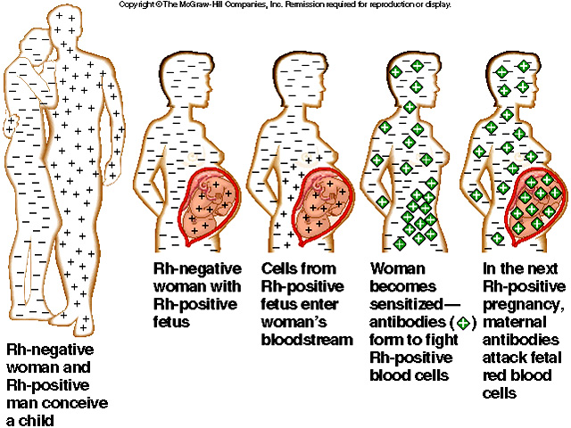
ERYTHROBLASTOSIS FOETALIS…

Slide 22
Erythroblastosis foetalis….
If a Rh⁻ mother carry a Rh⁺ fetus, due to placental barrier the blood doesn’t mix.
However
During delivery some Rh⁺ from fetus reaches mother. So,the mother will start producing antibodies against Rh⁺ .
During consecutive pregnancies, this may cause destruction of RBCs in the fetus causing haemolytic anaemia (erythroblastosis fetalis). So after
Each pregnancy, the mother will receive anti-RhD (prophylaxis) to prevent this incompatibility.

Slide 23
hemolytic disease of the newborn
  Hydrops foetalis: Grossly edematous
  Icterus gravis neonatorum:
  Kernicterus
  Erythroblastosis fetalis
  Treatment:
  Exchange blood transfusion soon after birth
  Prevention (Prophylaxis):
  Single dose of anti Rh antibodies soon after child birth

Slide 24
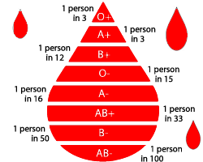
Ratio Of Blood Group In Society.

Slide 25
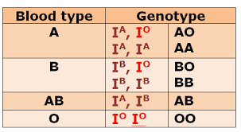
ABO Genotype

Slide 26
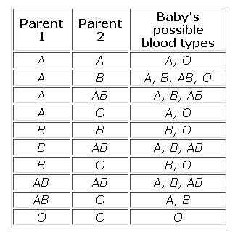
Inheritance of ABO blood group

Slide 27
CCES….
1. Blood group “O” the RBC are agglutinated by:
Aglutinin alpha
Aglutinin alpha
Aglutinin alpha and beta both
Neither alpha nor Beta

Slide 28
2. Absence of Anti-A and Anti-Rh in the plasma means that subject is
A positive or AB positive
A negative or AB negative
A positive,AB positive, A negative or AB negative
Type O positive

Slide 29
3. The least frequent blood group in India is
A
B
AB
O

Slide 30
4. Exception of Landsteiner law is
AB+
A+
B-
O-

Slide 31
5. Rh- individuals are those
Whose serum contain no Rh antibody
Whose RBC doesnot contain antigen D
Both
none

Slide 32
Thank You

