Slide 1
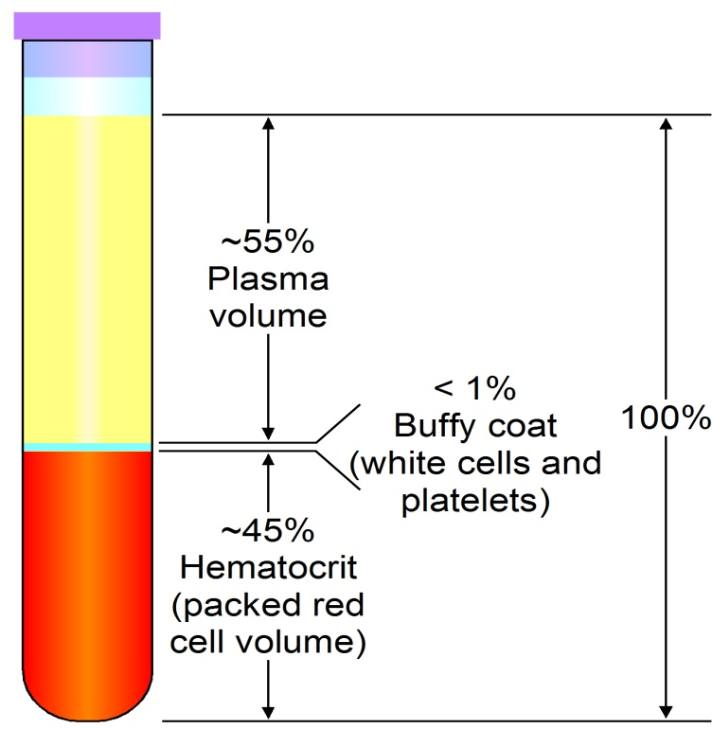
Blood…
Dr. Geetanjali Purohit
Asso. Professor
Physiology

Slide 2
Introduction
Composition
&
Functions

Slide 3
Learning objectives…
At the end of this session you will cum to know…
What is Blood
Functions of Blood
Composition of blood
Bone marrow examination
Properties of blood
Plasmapheresis

Slide 4
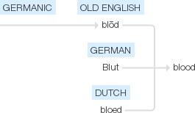
Definition and origin…
The red liquid that circulates in the arteries and veins of humans and other vertebrate animals, carrying oxygen to and carbon dioxide from the tissues of the body.
Connective tissue
Origin

Slide 5
Hematology: study of physiology of blood and blood disorders
Blood Physiology includes the study of blood components, their formation, their role and dysfunction
Study of blood disorders includes pathophysiology of diseases of blood and their management and pathological alterations in blood in other disorders (non hematological)

Slide 6
Blood- function
Blood is a type of liquid connective tissue.
The major function of blood is transport.

Slide 7
Subfunctions
Respiration :
-if oxygen and carbon dioxide are transported
Trophic :
-when the nutrient materials are delivered to the tissues
Excretive :
-when the metabolites are delivered from tissues to excretory organs
Regulative :
The hormones are transported

Slide 8
CONT…
Homeostatic :
- maintenance of water content and acid-base balance
Protective :
- immunity and non-specific resistance;
- blood coagulation
Maintenance of body temperature :
-as a result of a redistribution of blood volume between skin and the internal organs at high and low temperature of external environment.
Transport and storage

Slide 9
Blood
The total blood volume makes up about 6-8 percent of the body’s weight.
Accordingly, a 70-kilogram person will have 5 to 6 litres of blood.
Circulating blood volume will be lesser than total blood volume, because some amount of blood will be deposited in organs like liver.

Slide 10
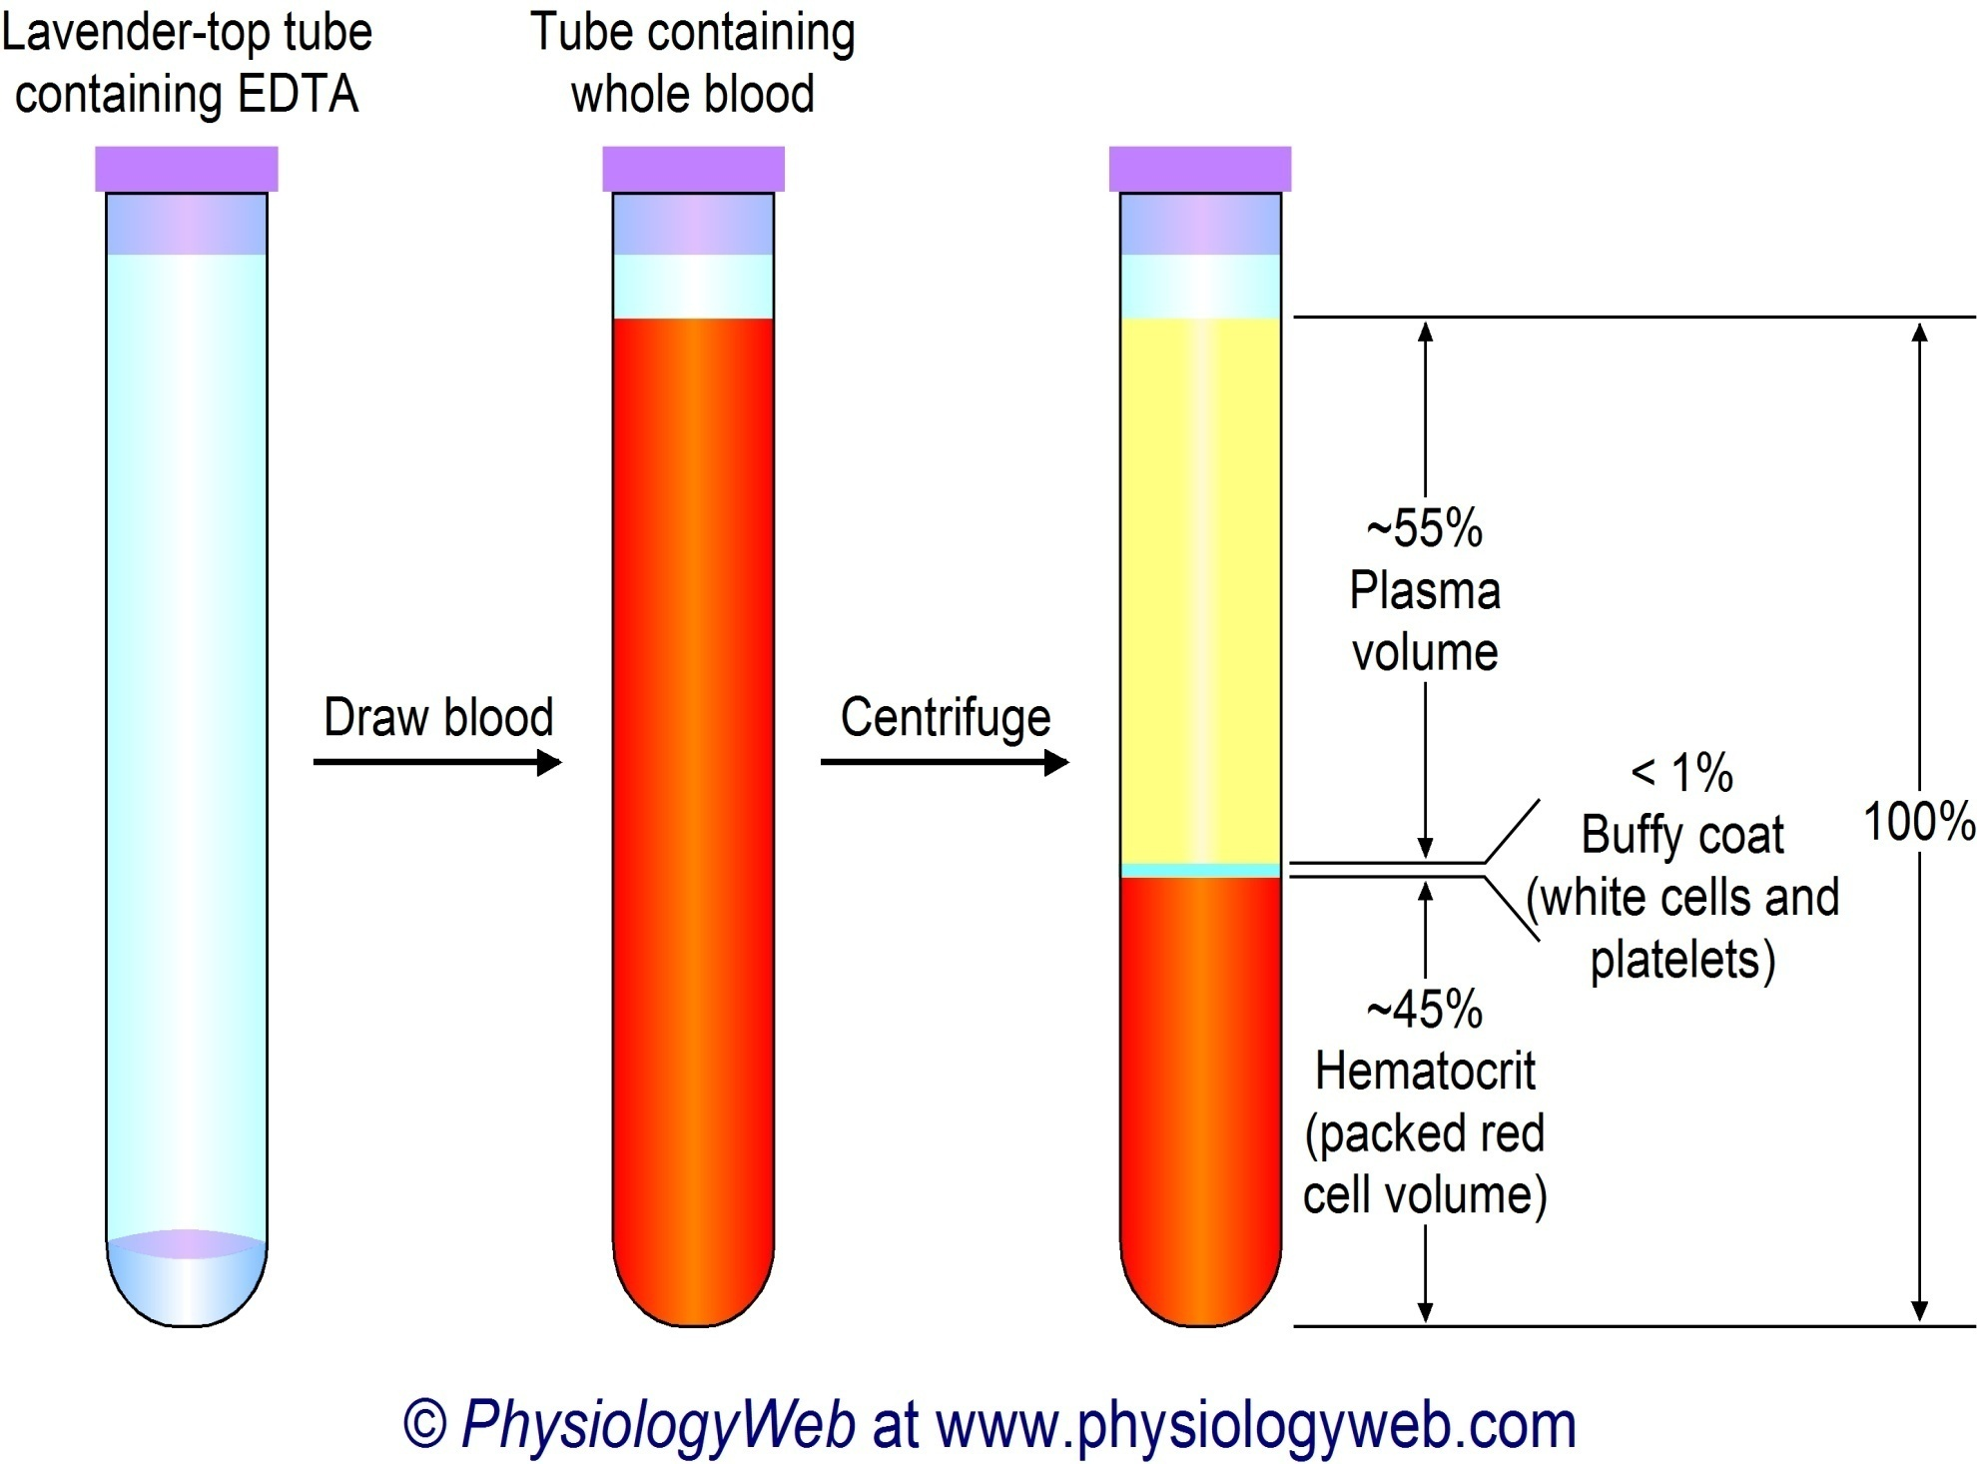

Slide 11
Blood composition
Blood consists of
Liquid plasma
(Volume-55-60%)
Formed elements (cells)
(volume-40-45%)

Slide 12
Blood
Formed elements include
Erythrocytes (red blood cells)
Leukocytes (white blood cells)
Thrombocytes (platelets)

Slide 13
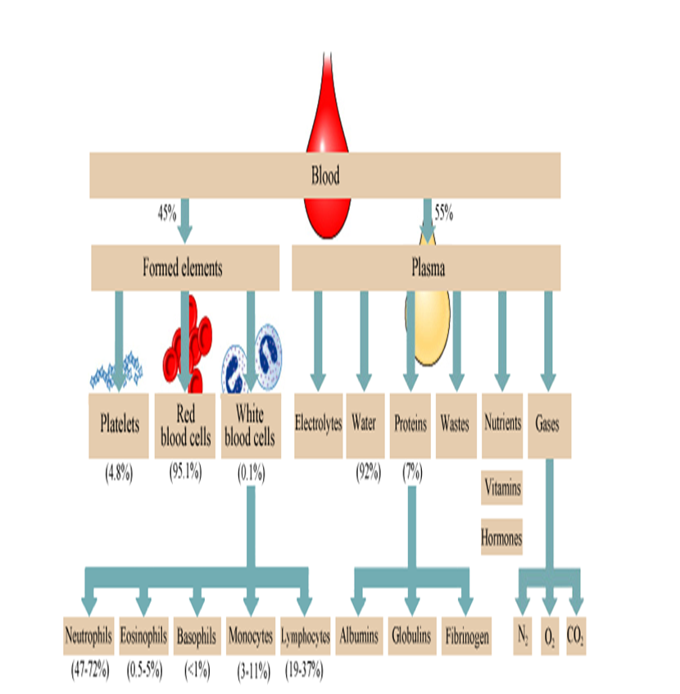

Slide 14
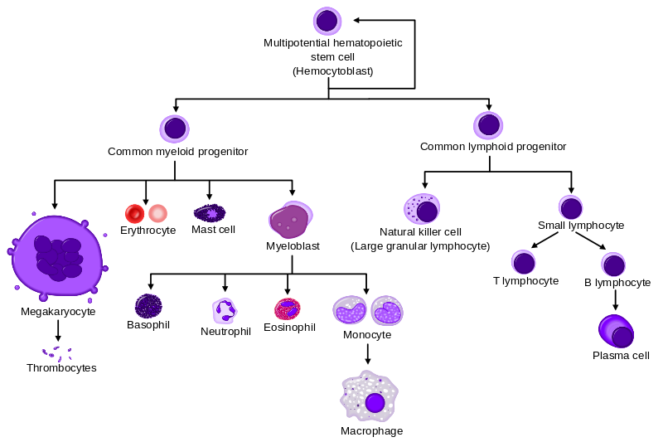
Hemopoiesis

Slide 15
Bone marrow examination
Bone marrow produces the cellular elements of the blood, including platelets, red blood cells and white blood cells.
Refers to the pathologic analysis of samples of bone marrow obtained by bone marrow biopsy (often called a trephine biopsy) and bone marrow aspiration.
Diagnosis of a number of conditions,including leukemia, multiple myeloma, lymphoma, anemia, and pancytopenia.
It is sometimes necessary to examine the source of the blood cells in the bone marrow to obtain more information on hematopoiesis

Slide 16
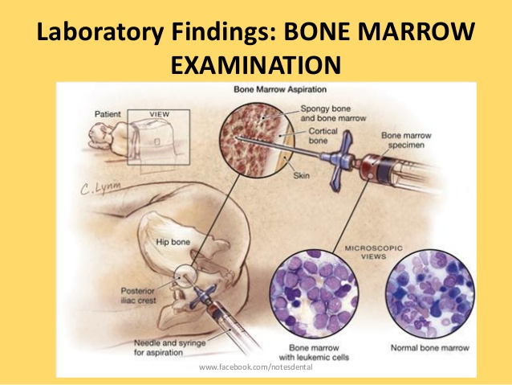

Slide 17
PROPERTIES OF BLOOD
Color -Bright red in arteries & dark red in veins
Mass 8% of the body mass
pH Slightly alkaline (pH = 7.35 – 7.45)
Taste Salty
Temperature- 38° C (100.4° F)
Viscosity 3-4 times more viscous than water
Volume 5-6 litre

Slide 18
Physico-chemical constants of blood
Osmotic pressure
Oncotic pressure/COP
Blood pH
Viscosity
Specific gravity

Slide 19
Osmotic pressure
Osmotic pressure is defined as the minimum amount of pressure needed to prevent osmosis.
Dissolved particles maintain the osmotic pressure.
Among them, the most active is
-NaCl (0.9 % isotonic)
- and also glucose (5% isotonic)

Slide 20
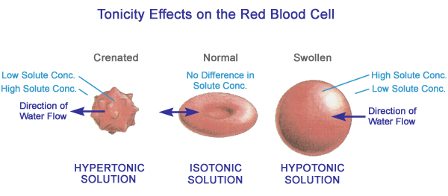
Osmotic pressure

Slide 21
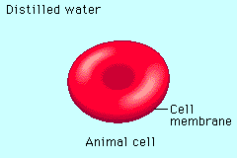
Vocab:
Hypertonic: More solutes than the other solution
Hypotonic: Less solutes than the other solution
Isotonic: Equal solutes as another solution

Slide 22
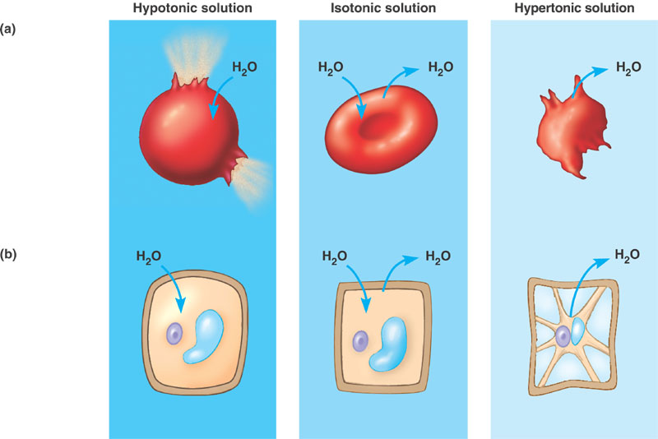
Turgid
Plasmolysed
Flaccid

Slide 23
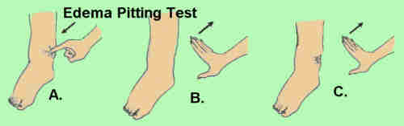
Colloidal Osmotic Pressure
Osmotic pressure created by colloid substances in body is known as Colloidal osmotic pressure.
Osmotic pressure created by colloid substances (Proteins)in body is known as Oncotic pressure.
It holds the water within tissue & prevents water movement across membrane
Applied Physiology : Edema

Slide 24
Oncotic pressure of blood
Oncotic pressure, or colloid osmotic pressure (COP), is a form of osmotic pressure exerted by blood plasma proteins.
It is the opposing force to hydrostatic pressure
Its normal value is :
0.03-0.04 atm
(or)
20-25 mm Hg

Slide 25
pH of blood
Normal pH of blood is :
Arterial blood- 7.45 – 7.35
Venous blood- 7.31-7.41
If pH is less than 7.3 , it is acidosis
If pH is more than 7.5, it is alkalosis
pH is maintained by :
The excretion of carbon dioxide by the lungs
The excretion of H⁺ or OH⁻ by the kidneys.
By the action of buffer system
A. Carbonate B. Phosphate C. Protein D. Haemoglobin

Slide 26
Viscosity
Blood viscosity can be described as the thickness and stickiness of blood and it’s a easure of the resistance of blood to flow.
Elevated blood viscosity is a strong independent predictor of cardiovascular events.
The viscocity of blood is 5 times more than that of water
The relationship between BP and viscosity is such that, given a constant systolic BP, if blood viscosity increases, then the total peripheral resistance (TPR) will necessarily increase, thereby reducing blood flow.
Conversely, when viscositydecreases, blood flow and perfusion will increase.

Slide 27
Specific gravity
Specific gravity is the ratio of the density of a substance to the density of a reference substance.
Specific gravity is also called relative density.
For whole blood it was found to be 1.0621 at 4 °C and 1.0506 at 37 °C.
Plasma specific gravity was 1.0310 at 4 °C and 1.0205 at 37 °C.
The higher the concentration of RBCs and plasma proteins, higher will be the specific gravity.

Slide 28
Whipple’s experiment
Standard plasma depleted dog
4gm/dl
To find out the rate of regeneration
After 15 min starts regeneration due to labile protein reserve
2-7 days normal level reached
Less than 2gm% will results in shock
Conclusion: Proteins of cells are of three types
Fixed
Dispensable
Labile

Slide 29
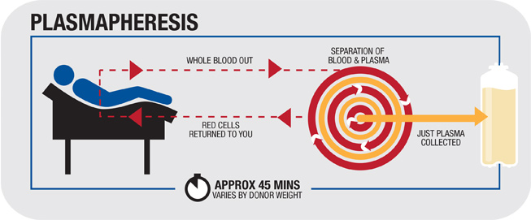
plasmapheresis…
Plasmapheresis is currently used as a therapeutic modality
Generally, it is used when a substance in the plasma, such as immunoglobulin, is acutely toxic and can be efficiently removed.

Slide 30
CCES
1. Specific gravity of blood ranging from
a. 1.5-1.6
b. 1.005- 2
c. 1.05-1.06
d. none of the above
2. Effect of hypertonic solution on RBC
a. shrinkage
b. swelling
c. bursting
d. none of the above

Slide 31
3. Normal pH of blood is :
a. 7.35-7.45
b. acidic
c. Neutral
d. 7.65-7.75
4. Viscosity of blood is
a. 10 times higer than water
b. 5 times higher than water
c. Lower than water
d. equal to water

Slide 32
5. Isotonic solution has ___ of Nacl concentration
a. 0.9%
b. 0.95%
c. 0.1%
d. 1.0%

Slide 33


Slide 34


