Slide 1
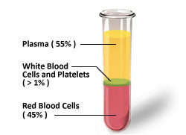
Plasma…..
Dr. Geetanjali Purohit
Associate Professor
Department of Physiology

Slide 2
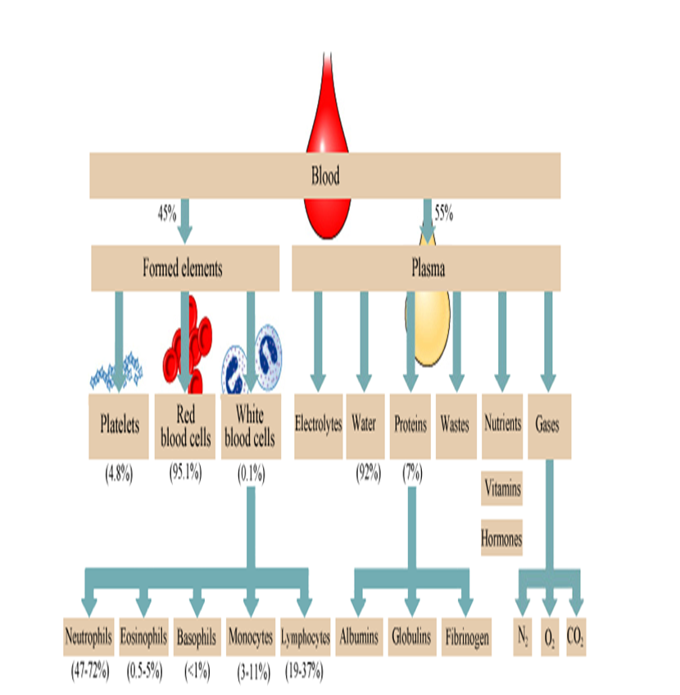

Slide 3
Case….
A 58 year-old woman was admitted to the hospital because of increasing edema.
She had been well until four months previously, when there was the onset of progressive edema of the feet and hands, puffiness under the eyes and swelling of the abdomen.
She noticed frothing of the urine, but no dysuria, oligouria or discoloration of the urine.
The blood pressure was 126/80 mmHg
The urine gave a +++ test for protein; the sediment contained 20 to 30 white cells and many hyaline and granular casts.

Slide 4
Plasma chemical composition
It consists of 90 % water and 10% solutes.
10% solutes.
Proteins ≈ 7 %
Inorganic salts ≈ 0.9%
The reminder consisting of diverse organic compounds other than proteins

Slide 5
Organic (Nonprotein) Constituents of Human Blood Plasma
Amino acids
Urea
Bilirubin
Creatin
Creatinine
Carbohydrates
Organic acids
Polysaccharides
Lipids

Slide 6
Inorganic Constituents of Human Blood Plasma
Anions
Bicarbonate
Chloride
Phosphate
Sulfate
Iodine
Cations
Calcium
Magnesium
Potassium
Sodium
Iron
Copper

Slide 7
Composition of plasma proteins
Fibrinogen
Prothrombin
Albumin
Globulins
Globulins α1
α2 Globulins
β Globulins
γ Globulins
Serum proteins

Slide 8
Separation of Plasma proteins
Salting-out methods-
Three major groups—fibrinogen, albumin, and globulins—by the use of varying concentrations of sodium or ammonium sulfate.
Electrophoresis- five major fractions
Albumin
α1 and α2 globulins
β globulins
γ globulins

Slide 9
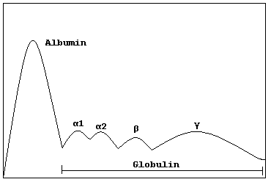
Separation of Plasma proteins by Electrophoresis

Slide 10
Albumin………
585 AA
69KDa/69000Da
3.4–4.7 g/dL (60% of the total plasma protein)
About 40% of albumin is present in the plasma, and the other 60% is present in the extracellular space.
Ellipsoidal shape, which means that it does not increase the viscosity of the plasma as much as an elongated molecule such as fibrinogen does.
Migrates fastest in electrophoresis at alkaline pH and precipitates last in salting out methods

Slide 11
Colloidal Osmotic Pressure
Osmotic pressure created by colloid substances in body is known as Colloidal osmotic pressure.
AKA Oncotic pressure.
It holds the water within tissue & prevents water movement across membrane

Slide 12
Functions of Albumin…
Colloidal Osmotic Pressure:
Albumin is responsible for 75–80% of the osmotic pressure of human plasma due to its low molecular weight and large concentration
AKA Oncotic pressure.
It is the opposing force to hydrostatic pressure
Its normal value is:
0.03-0.04atm
(or)
20-25 mmHg

Slide 13
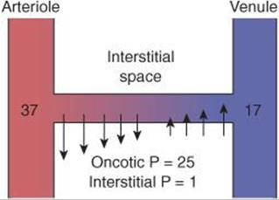
CAPILLARY FLIUD EXCHANGE…
Hypoalbuminemia leads to retention of fluid in the tissue spaces(Edema)

Slide 14
Transport: Free fatty acids (FFA),calcium and certain steroid hormones, bilirubin, copper A variety of drugs
Name | Compounds transported
Albumin | Fatty acids, bilirubin, hormones, calcium, heavy metals, drugs etc.
Prealbumin-(Transthyretin) | Steroid hormones thyroxin, Retinol
Retinol binding protein | Retinol (Vitamin A)
Thyroxin binding protein(TBG) | Thyroxin
Transcortin(Cortisol binding protein) | Cortisol and corticosteroids
Haptoglobin | Hemoglobin
Hemopexin | Free haem
Transferrin | Iron
HDL(High density lipoprotein) | Cholesterol (Tissues to liver)
LDL(Low density lipoprotein) | Cholesterol(Liver to tissues)

Slide 15
Nutritive Function:
Albumin serves as a source of amino acids for tissue protein synthesis to a limited extent, particularly in nutritional deprivation of amino acids.
Buffering Function-
Among the plasma proteins, albumin has the maximum buffering capacity due to its high concentration and the presence of large number of histidine residues, which contribute maximally towards maintenance of acid base balance.
Viscosity-
Exerts low viscosity

Slide 16
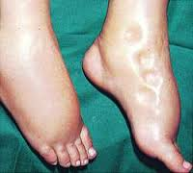
Applied….
Blood brain barrier-
Albumin- free fatty acid complex can not cross the blood brain barrier, hence fatty acids can not be utilized by the brain.
Loosely bound bilirubin to albumin can be easily replaced by drugs like aspirin. In new born if such drugs are given, the released bilirubin gets deposited in brain causing Kernicterus.
Edema-
Hypoalbuminemia results in fluid retention in the tissue spaces
seen in the following conditions-
Cirrhosis of liver
Malnutrition
Nephrotic syndrome
Burns
Malabsorption
Analbuminemia- congenital disorder

Slide 17
Globulins………..
Molecular weight ranges from 90,000 to 13,00,000
By electrophoresis globulins can be separated in to –
α₁-globulins
α₂-globulins
β-globulins
Y-globulins
Synthesis: α and β globulins are synthesized in the liver. Y globulins are synthesized in plasma cells and B-cells of lymphoid tissues (Reticulo- endothelial system)

Slide 18
α- Globulins…….
Based on electrophoretic mobility , they are sub classified in to α₁ and α₂ globulins
α₁ globulins
α₁antitrypsin:
Orosomucoid (α₁ acid glycoprotein)
α₁-fetoprotein (AFP)
α₂-globulins
Haptoglobin
Ceruloplasmin
α₂- macroglobulins

Slide 19
α₁ Antitrypsin (AAT)
The liver makes it.
Its primary function is to protect the lungs from neutrophil elastase.
If the AAT proteins aren't the right shape, they get stuck in the liver cells and can't reach the lungs.
Alpha-1 antitrypsin deficiency is an inherited disorder that may cause lung disease and liver disease
The most common clinical presentation is "Inherited Emphysema" or "Genetic COPD".

Slide 20
Haptoglobin-(Hp)
Binds extracorpuscular hemoglobin (Hb)
Prevent loss of free hemoglobin into the kidney and conserves the valuable iron
Hb is of 55 Kda while Hb-Hp complex has a molecular mass of approximately 155 kDa.
After a massive incompatible blood transfusion, when the capacity of haptoglobin to bind hemoglobin is grossly exceeded, Hb start to precipitate in kidney
Concentration rises in inflammatory conditions and decreases hemolytic anemia

Slide 21
Ceruloplasmin
α₂-Glycoprotein, carries 90% of the copper present in plasma.
Each molecule of ceruloplasmin binds six atoms of copper very tightly, so that the copper is not readily exchangeable.
Low levels of ceruloplasmin are found in Wilson disease (hepatolenticular degeneration), a disease due to abnormal metabolism of copper.

Slide 22
β Globulins…………..
β Globulins of clinical importance are –
Transferrin
C-reactive protein
Complement C1q
β Lipoprotein(LDL)

Slide 23
Transferrin
β₁-globulin, plays a central role iron metabolism
Transports iron in the circulation to sites where iron is required, eg, from the gut to the bone marrow and other organs.
Plasma concentration is approx 300 mg/dL and can bind 300 gm% of iron, so that this represents the TIBC of plasma.
In iron deficiency anemia, the protein is even less saturated with iron
Increased levels are seen in iron deficiency anemia and in last months of pregnancy

Slide 24
C- reactive protein
It reacts with C- polysaccharide of capsule of pneumococci
Synthesized in liver
Can stimulate complement activity and macrophages
Acute phase protein- Concentration rises in inflammatory conditions
Clinically important marker to predict the risk of coronary heart disease

Slide 25
Complement C1q
First complement factor to bind antibody (Fc region of IgG or IgM) and triggers the classical complement pathway
Decreased level is used as an indicator of circulating Ag –Ab complex.
High levels are found in chronic infections

Slide 26
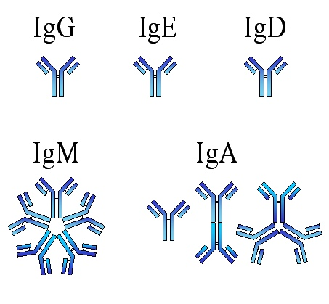
Y-Globulins…
They are immunoglobulins with antibody activity
They occupy the gamma region on electrophoresis
Immunoglobulins play a key role in the defense mechanisms of the body

Slide 27
Hypergammaglobulinemia
Chronic infections
Chronic liver diseases
Auto immune diseases
Multiple myeloma
Leukemia
Hypogammaglobulinemia
Transient neonatal
Primary genetic deficiency
Drug induced (Corticosteroid therapy), uremia, hematological disorders
AIDS(Acquired Immuno deficiency syndrome)

Slide 28
Fibrinogen……
Large asymmetric molecule with axial ratio of 20:1
Imparts maximum viscosity to blood
Synthesized in liver
Made up of 6 polypeptide chain and linked together by S-S linkages
Amino terminal end is highly negative due to the presence of glutamic acid
Negative charge contributes to its solubility in plasma and prevents aggregation due to electrostatic repulsions between the fibrinogen molecules.

Slide 29
Acute and negative acute phase proteins
Acute phase proteins: Increase in blood in response inflammatory and neoplastic conditions
Examples-
C- reactive proteins
Ceruloplasmin
α -1 antitrypsi
α 2 macroglobulins
α -1 acid glycoprotein
Negative acute phase protein: Decreased in blood in response to certain inflammatory processes.
Examples-
Albumin
Transthyretin
Retinol binding protein
Transferrin

Slide 30
Abnormal Proteins
1) Bence – Jone’s proteins
Monoclonal light chains
Present in the urine of a patient suffering from multiple myeloma (50% of patients)
Molecular weight 45,000
2)Cryoglobulins
These proteins coagulate when serum is cooled to very low temperature
Commonly monoclonal IgG or IgM or both
Increased in rheumatoid arthritis, multiple myeloma, lymphocytic leukemia, lymphosarcoma and systemic lupus erythematosus

Slide 31
Functions of plasma proteins
Nutritive
Fluid exchange
Buffering
Binding and transport
Enzymes
Hormones
Blood coagulation
Viscosity
Defense
Reserve proteins
Tumor markers

Slide 32
Clinical Significance of Plasma proteins
Hyperproteinemia- Levels higher than 8.0gm/dl
Causes-
Hemoconcentration- due to dehydration, albumin and globulin both are increased Albumin to Globulin ratio remains same. As in
Excessive vomiting
Diarrhea
Diabetes Insipidus
Pyloric stenosis or obstruction
Diuresis
Intestinal obstruction

Slide 33
Hypoproteinemia
Decease in total protein concentration
Hemodilution- Both Albumin and globulins are decreased, A:G ratio remains same, as in water intoxication
Hypoalbuminemia- low level of Albumin in plasma
Causes-
Nephrotic syndrome
Protein losing enteropathy
Severe liver diseases
Mal nutrition or malabsorption
Extensive skin burns
Pregnancy
Malignancy

Slide 34
MCQ……
1. What is true level for normal plasma level
Albumin: 2-3gm/dl
Globulin: 3-5gm/dl
Fibrinogen: 0.3gm/dl
Prothrmbin: 0.03gm/dl

Slide 35
2. Colloidal Osmotic pressore of plasma is due to
Albumin
Prealbumin
Electrolytes
Fibrinogen

Slide 36
3. If the COP reduced upto 10 mmHg in blood it will affect
Filteration at arterial end
Absorption at venous end
Both
None

Slide 37
4. Increase in gamma globulin is mainly seen in
Tissue destruction
Severe malnutrition
Fasting
Malabsorption

Slide 38
5. Which statement is not true for Plasmapheresis
It is a procedure of separation of plasma from the blood
It is done to exhaust the protein reserve
It is done to find out the rate of regeneration of plasma protein on a standard diet
It is the most commonly employed procedure during dialysis

