Slide 1
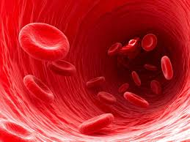
Red Blood Cell
Dr Geetanjali Purohit
PhD (Medical Physiology)
Asso. Professor,Physiology
SBKS MI & RC

Slide 2
Learning objectives ….
After the end of this session you will be able to understand..
Introduction of RBC
Morphology
Variations
Properties
Fate
Applied

Slide 3
Case study…
A 27-year-old Nigerian woman presented with mild anemia, jaundice, splenomegaly.
History of multiple blood transfusion.
Blood film showed about 70% spherocytes, reticulocytosis of 6.5%, increased osmotic fragility test.
She was managed conservatively on nutritional supplements and a significant regression of symptoms after 6 months was achieved.
Source:https://www.ncbi.nlm.nih.gov/pubmed/19763011

Slide 4
Erythrocytes
Disk shaped , Biconcave and nonnucleated
Able to change their shape when they pass through the capillaries.
The cells develop in the bone marrow and circulate for about 100–120 days in the body
Diameter : 7.2 μ (6.9 to 7.4 μ). Central portion is thinner than periphery.
Surface area: 140 sq μ.
Volume: 87 μm³ (78-94 μm³)

Slide 5
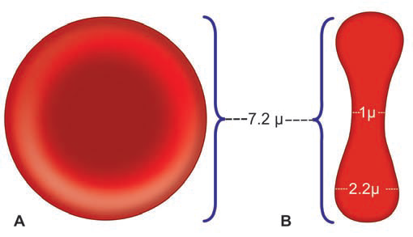

Slide 6
Advantages of Biconcave Shape of RBCs
Equal and rapid diffusion
Large surface area is provided for absorption or
removal
Osmotic fragility
RBCs squeeze through the capillaries very easily without getting damaged.

Slide 7
Composition
62.5% water
35% Hb (29.5±2.5pg/RBC)
Mature RBC has no Nucleus, no mitochondria and no ribosome…
Still life span is 120 days…
HOW
Glucose metabolism
Cytoplasm contain enzymes for glucose metabolism
Insulin independent glucose transport
Facilitated diffusion

Slide 8
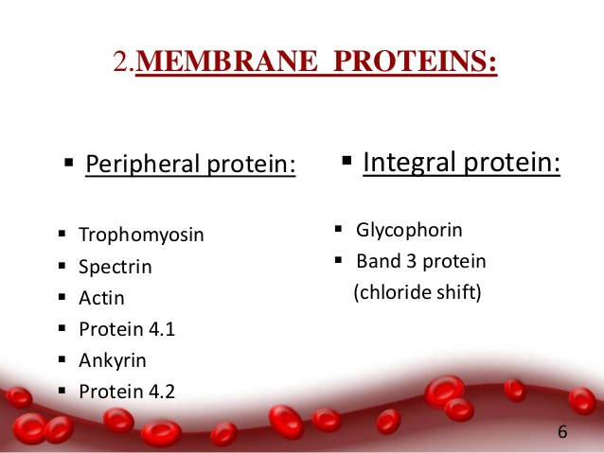
MEMBRANE PROTEINS

Slide 9
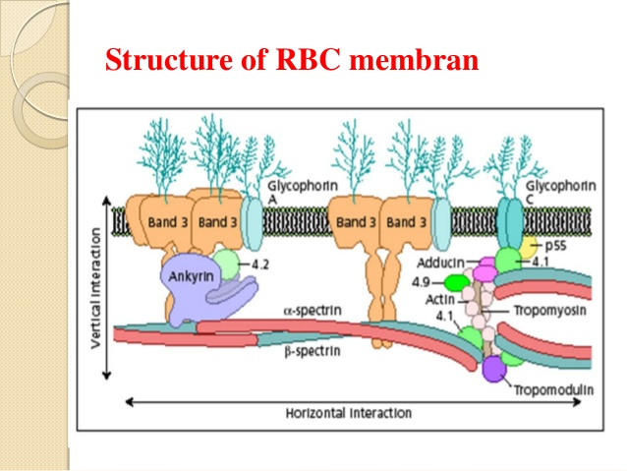
CYTOSKELETAL OF RBC

Slide 10
RBC has actin and spectrin (Lipoprotein)which are anchored to a trans membrane proteins band 3 by the protein ankyrin.
Absence of spectrin RBC become deformed, losses its biconcave shape and becomes globular (spherocytic) which is very fragile and easily ruptured (hemolyzed) in hypotonic solutions.
Hereditary Spherocytosis.
familial hemolytic disorder with marked heterogeneity of clinical features.
Asymptomatic condition to a fulminant hemolytic anemia

Slide 11
Osmotic fragility
Erythrocyte fragility refers to degree or proportion of hemolysis under stress.
The osmotic fragility test (OFT) is used to measure erythrocyte resistance to hemolysis while being exposed to varying levels of dilution of a saline solution.
Done for Thalasemia and heriditory spherocytosis
Normal range for RBC is 0.45% to 0.35% saline.

Slide 12
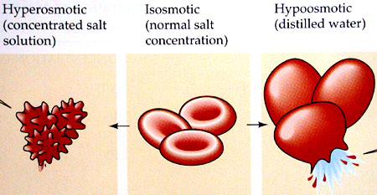

Slide 13
Variations in size of RBC
1. Microcytes (smaller cells)
2. Macrocytes (larger cells)
3. Anisocytes (cells with different sizes).

Variations in shape of RBC
1. Crenation: Shrinkage --hypertonic conditions.
2. Spherocytosis: Globular form --hypotonic
3. Elliptocytosis:
4. Sickle cell:
5. Poikilocytosis: Unusual shapes due to deformed
cell membrane.

Slide 14
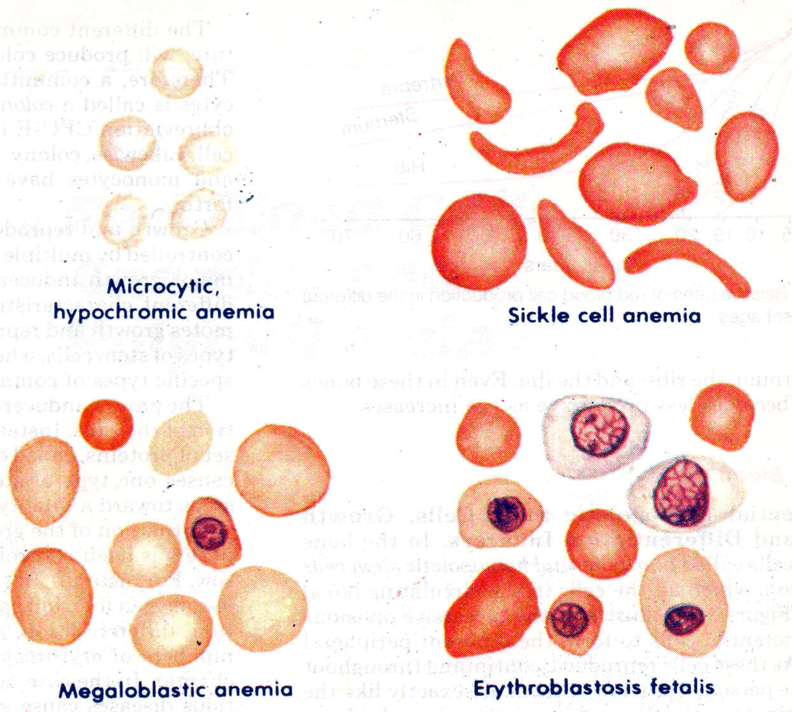

Slide 15
RBC COUNT………….
In an adult male: 5-6 (5.5) million/cumm
In adult females: 4.5-5.5 (4.8) million/cumm
In newborns: 6-7 million/cumm
In children: 3-5 million/ cumm
More in infants due to hemoconcentration. Intilly decreases rapidly and thanm raised up to adult level at the age of 10 years.
More in males due to testesteron

Slide 16
variations in RBC count….
Erythrocytosis Erythropenia
A. Physiological A. Physiological
B. Pathological B. Pathological

Slide 17
Physiological variation in RBC….
Erythrocytosis: Increase in RBC count than normal also known as Polycythemia.
1. Age: In Newborns
2. Sex: During reproductive period of females, the count is less than that of males (4.5 million/cu mm).
Testesteron stimulates the RBC production
3. High Altitude: Due to Hypoxia
4. Emotions:

Slide 18
Erythropenia: Decrease in RBC count than normal
A deficiency in number of RBCs or reduced haemoglobin levels in RBCs is known as Anemia
High barometric pressures
In deep sea, when the oxygen tension of blood is higher, the RBC count decreases.
2. During sleep
3. Pregnancy
In pregnancy, the RBC count decreases.
increases the plasma volume also resulting in hemodilutional anemia.

Slide 19
Pathological variation in RBC….
Erythrocytosis Erythropenia
Primary Primary
-Bone marrow disorder -Bone marrow disorder
- Blood loss
Secondary Secondary
-due to any CV or -kidney diseases
respiratory disease.
Polycythemia Vera :It’s a blood cancer Bone marrow makes too many red blood cells, which causes your blood to get too thick. That can make you more likely to have blood clots , stroke or a heart attack

Slide 20
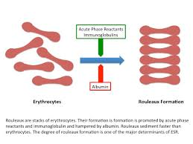
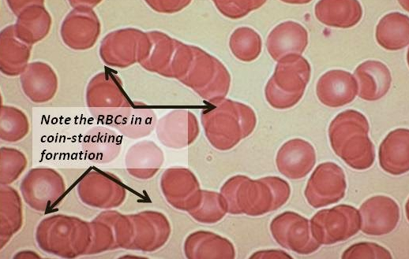
Properties of RBC….
1. Rouleaux formation: When blood is taken out of the blood vessel, the RBCs pile up one above another like the pile of coins. It is accelerated by plasma proteins globulin and fibrinogen.

Slide 21
Cont…
2. Specific gravity
Specific gravity of RBC is 1.092 to 1.101.

3. Packed cell volume/ hematocrit value :
The proportion of blood occupied by RBCs expressed in percentage.
It is 45% of the blood
4. Suspension stability:
During circulation, the RBCs remain suspended uniformly in the blood.
Life span is 120 days.

Slide 22
G6PD deficiency
Genetic disorder (recessive)
Deficiency of G6PD (glucose 6-phasphate dehydrogenase)
Initial step in the oxidation of glucose via HMP pathway.
Keep NADP in reduced state which inturn keep glutathione in reduced state.
Glutathione mop up free radicals that cause oxidative damage.
Increase in the suceptibility of RBC hemolysis during oxidative stress.
G6PD deficiency is most prevalent in Africa, where it can affect up to 20 percent of individuals.

Slide 23
RBCs - Functions
Transport of haemoglobin, which in turn carries oxygen from lungs to the issues
RBC contain carbonic anhydrase, which catalyzes the reaction between CO2 and water, that has a significance in transporting carbon dioxide (CO₂) from tissues to lungs.
The haemoglobin is an excellent acid-base buffer. Maintanence of acid-base balance.
Blood group determination.
Contributes 50% of blood viscosity

Slide 24
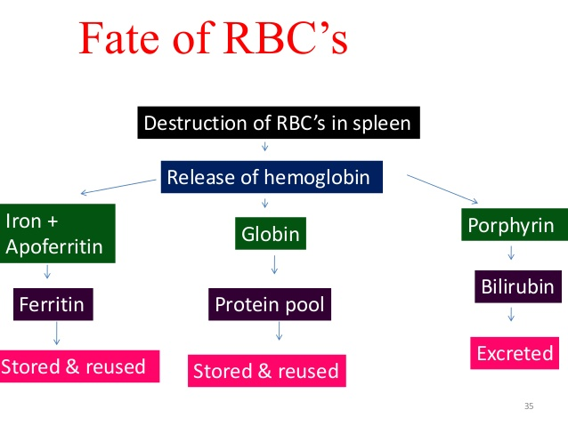
Fate of rbc’s

Slide 25
Mcq………..
Biconcave shape of RBC facilitates
RBC entry in capillary
Low osmotic fragility
Gaseaous exchange at RBC membrane
all

Slide 26
2. Life span of RBC is
100 days
120 minutes
120 days
2 days

Slide 27
3. Polycythemia vera is
Decrease in RBC
Increase in RBC cells
Cancer of RBC cells
Abnormal shape of RBC

Slide 28
4. Biconcave shape of the RBC is maintained by………. & deficiency will lead to………..
Glutathione, Anemia
Spectrin, Spherocytosis
G-6-P-D, microcytic anemia
Spectrin, Sickle cell anemia

Slide 29
5. RBC count in young Females is less than males of same age
Testesteron stimulates RBC formation
More muscle power of males
Menstruation in females
Pregnancy

