Slide 1
DISEASE OF GIT
GASTRITIS &
ACID PEPTIC DISEASE

Slide 2
What is gastritis ?
Gastric means stomach
Itis means inflammation
Gastritis means inflammation of stomach.

Slide 3
TYPES
ACUTE
CHRONIC
AUTOIMMUNE
OTHER
  EOSINOPHILIC
  ALLERGIC
  LYMPHOCYTIC
  GRANULOMATOUS
Notes:
The acute/chronic patterns of gastritis generally conform to the poly/mono principles we so often have referred to. The “other” category of gastritis are also histologically based.

Slide 4
ACUTE, HEMORRHAGIC
(NSAIDs), particularly aspirin
Excessive alcohol consumption
Heavy smoking
Uremia
Salmonella, CMV
Severe stress (e.g., trauma, burns, surgery)
Ischemia and shock
Suicidal attempts, as with acids and alkali
Gastric irradiation or freezing
Mechanical (e.g., nasogastric intubation)
Distal gastrectomy

Slide 5
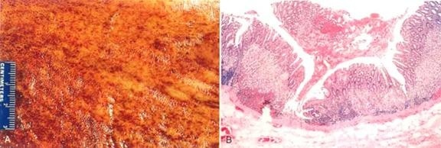
ACUTE, HEMORRHAGIC
HISTOLOGY: Erosion, Hemorrage, NEUTROPHILS

Slide 6
CHRONIC, NO EROSIONS, NO HEMORRHAGE
Chronic infection by H. pylori
Immunologic (autoimmune), e.g., PA
Toxic, as with alcohol and cigarette smoking
Postsurgical, reflux of bile
Motor and mechanical, including obstruction, bezoars (luminal concretions), and gastric atony
Radiation
Granulomatous conditions (e.g., Crohn disease)

Slide 7
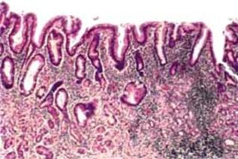
GASTRITIS
CHRONIC, NO EROSIONS, NO HEMORRHAGE
Perhaps some neutrophils
Lymphocytes, lymphoid follicles
REGENERATIVE CHANGES
  METAPLASIA, intestinal
  ATROPHY, mucosal hypoplasia, “thinning”
  DYS-PLASIA

Slide 8
GASTRITIS
AUTOIMMUNE (10%)
ANTIBODIES AGAINST→
  acid producing enzyme H⁺
  K⁺ -ATPase
  gastrin receptor
  and intrinsic factor
Notes:
Would an autoimmune gastritis be associated with megaloblastic anemia? Why? Answer: DECREASED intrinsic factor
No doubt achlorhydria is the common factor of chronic gastritis and B12 megaloblastic anemias

Slide 9
GASTRITIS
OTHER
  EOSINOPHILIC, middle aged women
  ALLERGIC, children (also eosinophils)
  LYMPHOCYTIC, T-Cells, body, DIFFUSE
  GRANULOMATOUS, Crohn’s, other granulomas
  GVH, in bone marrow transplants

Slide 10
Q1. Acute gastritis is caused by all except
NSAIDs
H. pylori
Uremia
CMV

Slide 11
Q1. Acute gastritis is caused by all except
NSAIDs
H. pylori
Uremia
CMV

Slide 12
Q2. Chronic gastritis is caused by all except
H. pylori
Autoimmune
Salmonella
Chron’s disease

Slide 13
Q2. Chronic gastritis is caused by all except
H. pylori
Autoimmune
Salmonella
Chron’s disease

Slide 14
Q3. Histological features of chronic gastritis are all except
Metaplasia
Atrophy
Hemorrhage
Dysplasia

Slide 15
Q3. Histological features of chronic gastritis are all except
Metaplasia
Atrophy
Hemorrhage
Dysplasia

Slide 16
Q4. Mechanism of autoimmune gastritis are all except:
Gastrin receptor
Intrinsic factors
K-ATPase
None of above

Slide 17
Q4. Mechanism of autoimmune gastritis are all except:
Gastrin receptor
Intrinsic factors
K-ATPase
None of above

Slide 18
Q5. Types of Micellenious gastritis are all except
Eosinophilic
Allergic
Lymphocytic
None of above

Slide 19
Q5. Types of Micellenious gastritis are all except
Eosinophilic
Allergic
Lymphocytic
None of above

Slide 20
ACID PEPTIC
DISEASES

Slide 21
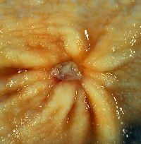
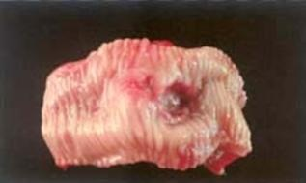
“PEPTIC” ULCERS
“PEPTIC” implies acid cause/aggravation
ULCER vs. EROSION (muscularis mucosa intact)
MUC→SUBMUC→MUSCULARIS→SEROSA
Chronic, solitary (usually), adults
80% caused by H. pylori
100% caused by H. pylori in
duodenum
NSAIDS
“STRESS”

Slide 22
Helicobacter pylori
Causes 80% of gastric peptic ulcers
Causes 100% of duodenal peptic ulcers
Causes chronic gastritis
Causes gastric carcinomas
Causes MALT lymphomas

Slide 23
SIGN & SYMPTOMS
Gnawing, burning, aching pain, epigastric
Fe deficiency anemia
Acute hemorrhage
Penetration, perforation:
  Pain in BACK
  Pain in CHEST
  Pain in LUQ
NOT felt to develop into malignancy

Slide 24
“PEPTIC” ULCERS
Bleedin
  Occurs in 15% to 20% of patients
  Most frequent complication
  May be life-threatening
  Accounts for 25% of ulcer deaths
  May be the first indication of an ulcer
Perforation
  Occurs in about 5% of patients
  Accounts for two thirds of ulcer deaths
  Rarely, is the first indication of an ulcer
Obstruction from edema or scarring
  Occurs in about 2% of patients
  Most often due to pyloric channel ulcers
  May also occur with duodenal ulcers
  Causes incapacitating, crampy abdominal pain
  Rarely, may lead to total obstruction with intractable vomiting
Notes:
Would this slide be seen in a REAL classroom to those sitting in the back row?

Slide 25
“ACUTE” ULCERS
NSAIDS
“STRESS” ULCERS
  ENDOGENOUS STEROIDS
    SHOCK
    BURNS
    MASSIVE TRAUMA
    INTRACRANIAL TRAUMA, INTRACRANIAL SURGERY
    SEPSIS
  EXOGENOUS STEROIDS
    CUSHING ULCER
Notes:
Please remember acute “stress” ulcers are highly related to an EXCESS of endogenous or exogenous steroids.

Slide 26
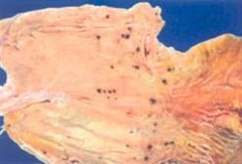
“ACUTE” ULCERS
Usually small (<1cm), superficial, MULTIPLE
Notes:
This type of acute “stress” ulcer is often confused with ulceration from gastric intubation, but intubation ulcers are usually more linear and less diffuse.

Slide 27
Name of journal and author | Abstract | Methodology | conclusion
Prevalence of Helicobacter pylori infection and the incidence of ureA and clarithromycin resistance gene 23S rRNA genotypes status in Saudi Arabia. Jazan University, Academic Campus for Girls, Jazan, PO Box: 755, Saudi Arabia. | To determine the prevalence of Helicobacter pylori ureA and clarithromycin resistance gene 23S rRNA genotypes among H. pylori in Saudi Arabia. | A total of 100 serum and fecal samples from 70 patients and 30 healthy volunteers, from patients who presented with symptoms suggestive of gastritis or peptic ulcer disease, were taken from the main hospital in the Southern region of Saudi Arabia from September 2010 C.E. to March 2011 C.E. corresponding to Shawwal 1431 A.H. to Rabi Al-Thani 1432 A.H. We cultured the samples for H. pylori and a polymerase chain reaction was carried out to check for the presence or absence of ureA gene and clarithromycin resistance gene 23S rRNA genotypes. | 23S rRNA gene was associated with clarithromycin resistance in H. pylori. There was a high prevalence of H. pylori resistance to clarithromycin in Saudi Arabia. H. pylori is a neutrophilic bacteria that has been able to colonize the human stomach by using a variety of acid-adaptive mechanisms as Urease activity that hydrolyzed the Urea producing 2 NH3 and H2CO3.

Slide 28
Q1. The most common cause of upper gastrointestinal hemorrhage (hematemesis or melena) is:
A. esophageal varices
B. gastric carcinoma
C. peptic ulcer
D. gastritis

Slide 29
Q1. The most common cause of upper gastrointestinal hemorrhage (hematemesis or melena) is:
A. esophageal varices
B. gastric carcinoma
C. peptic ulcer
D. gastritis

Slide 30
Q2. Helicobacter Pylori (H.Pylori) is a known cause of peptic ulcer disease. It was discovered in Australia in 1987.
Which of the following statements is not true regarding it
a) Its infectivity is highest in developed world.
b) Person to person transmission is common
c) It is seen in populations with low socio economic status
d)H. Pylori is a gram negative microaerophilic bacteria

Slide 31
Q2. Helicobacter Pylori (H.Pylori) is a known cause of peptic ulcer disease. It was discovered in Australia in 1987.
Which of the following statements is not true regarding it
a) Its infectivity is highest in developed world.
b) Person to person transmission is common
c) It is seen in populations with low socio economic status
d)H. Pylori is a gram negative microaerophilic bacteria

Slide 32
Q3. H. pylori causes all except:
Acute gastritis
Chronic gastritis
Gastric CA
MALT lymphoma

Slide 33
Q3. H. pylori causes all except:
Acute gastritis
Chronic gastritis
Gastric CA
MALT lymphoma

Slide 34
Q4. All are symptoms of peptic ulcer except:
A. Burning
B. Fe deficency anemia
C. Aching pain
D. Gnawing

Slide 35
Q4. All are symptoms of peptic ulcer except:
A. Burning
B. Fe deficency anemia
C. Aching pain
D. Gnawing

Slide 36
Q5. All are true about peptic ulcer except:
It is caused by NSAIDs
80% caused by H. pylori
80% caused by H. pylori in duodenum
All of above

Slide 37
Q5. All are true about peptic ulcer except:
It is caused by NSAIDs
80% caused by H. pylori
80% caused by H. pylori in duodenum
All of above

