Slide 1
Hypertension

Slide 2
Objectives
What is hypertention?
Classification of Hypertension
Factors effecting blood pressure
Clinical co-relation

Slide 3
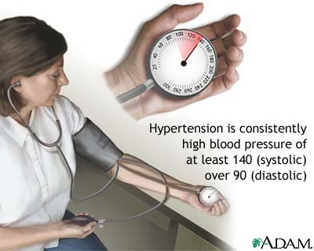
Hypertension

Slide 4
What is hypertension?
When the pressure exerted by the blood along the walls of the vessels remains elevated for a prolonged time, it gives rise to Hypertension or high blood pressure.
Normal B.P. : 120/80mmHg
Pre hypertension: 120/80-139/89mmHg
Hypertension :above 140/90mmHg
There are mainly two forms of hypertension:
-Essential(primary)
-Secondary

Slide 5
Essential (Primary) hypertension
It accounts for 95% of hypertension.
Its cause is multifactorial.
It is more common in some ethnic groups particularly in Americans, Africans and Japanese.
Causes of essential hypertension are:
-genetic factor
-racial
-risk factors modifying the course of hypertension
-environmental factors

Slide 6
Environmental factors include:
- high salt intake
- heavy consumption of alcohol
-obesity
-lack of exercise
- impaired intrauterine growth

Slide 7
Secondary hypertension
It accounts for 5% of hypertension
It can be shown as a consequence of a specific disease or abnormality leading to sodium retention or peripheral vasoconstriction.
Based on etiology it can be described as:
- Renal hypertension
- Endocrine hypertension
- Coarctation of aorta
- Neurogenic

Slide 8
The causes are:
-pregnancy
-renal disease
-endocrine disease
-drugs

Slide 9
Renal hypertension
It is a type of secondary hypertension.
It can be subdivided into two groups:
- Renal vascular hypertension
- Renal parenchymal hypertension
It can be produced by three mechanisms:
*activation of renin-angiotensin system
*sodium and water retention
*release of vasodepressor material
The important cause of renal hypertension is stenosis(narrowing) of the artery supplying blood to kidney.

Slide 10
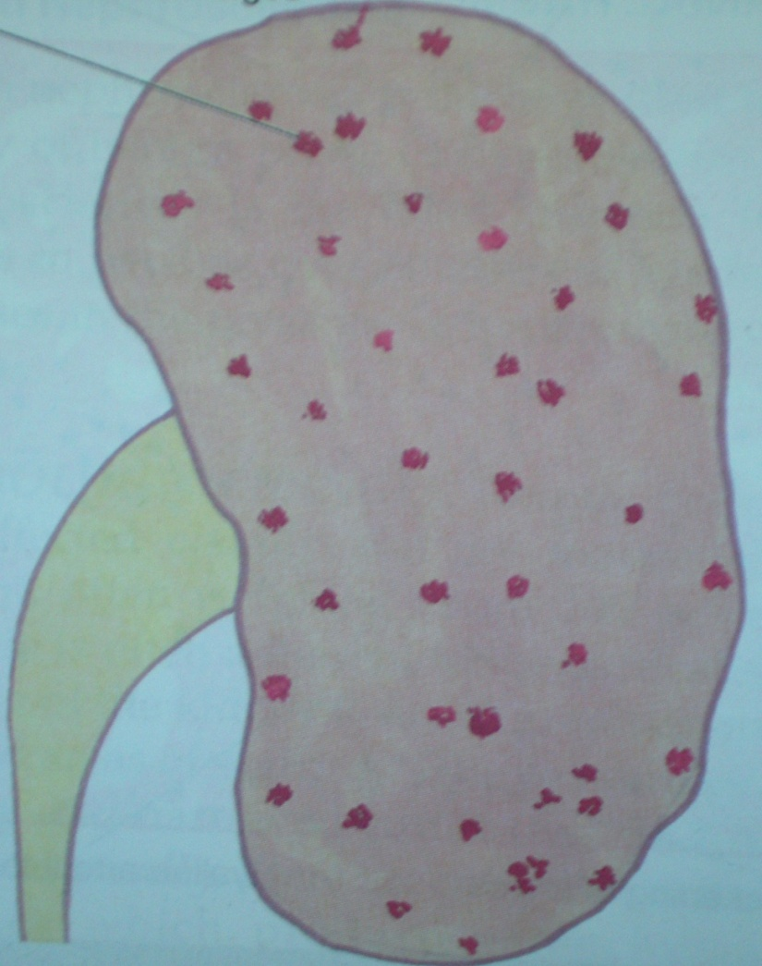
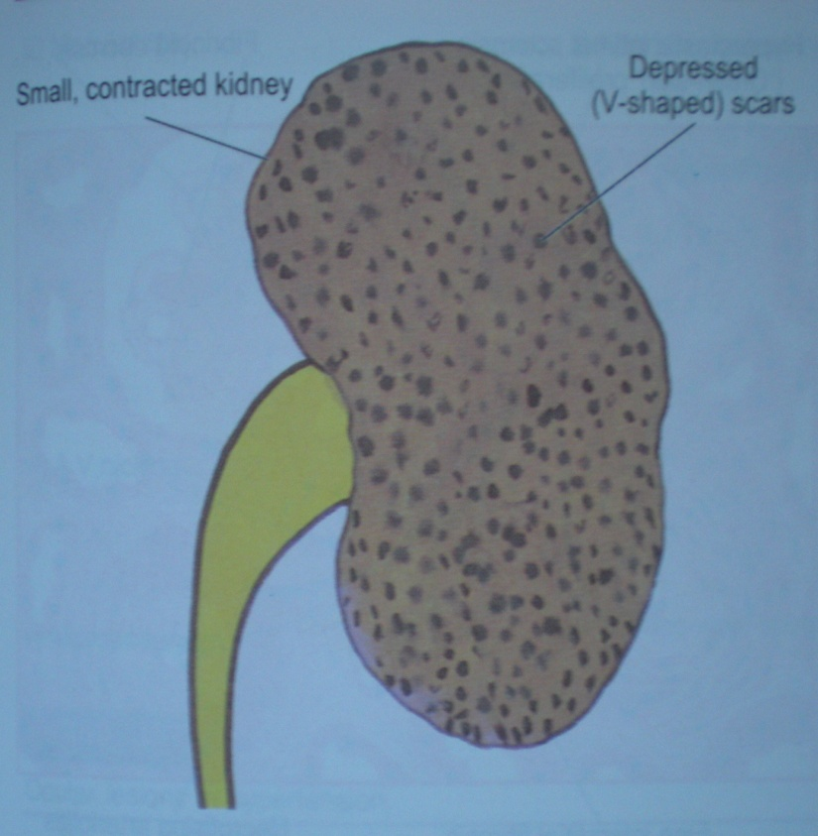
Renal effects of hypertension are in forms of nephrosclerosis:
- Benign nephrosclerosis
- Malignant nephrosclerosis
Small contracted kidney
Flea-bitten kidney

Slide 11
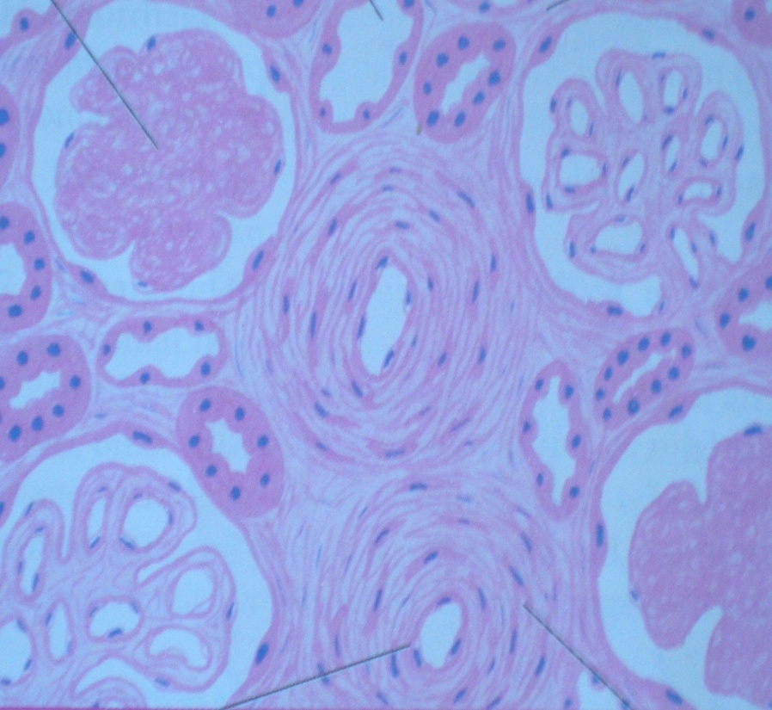
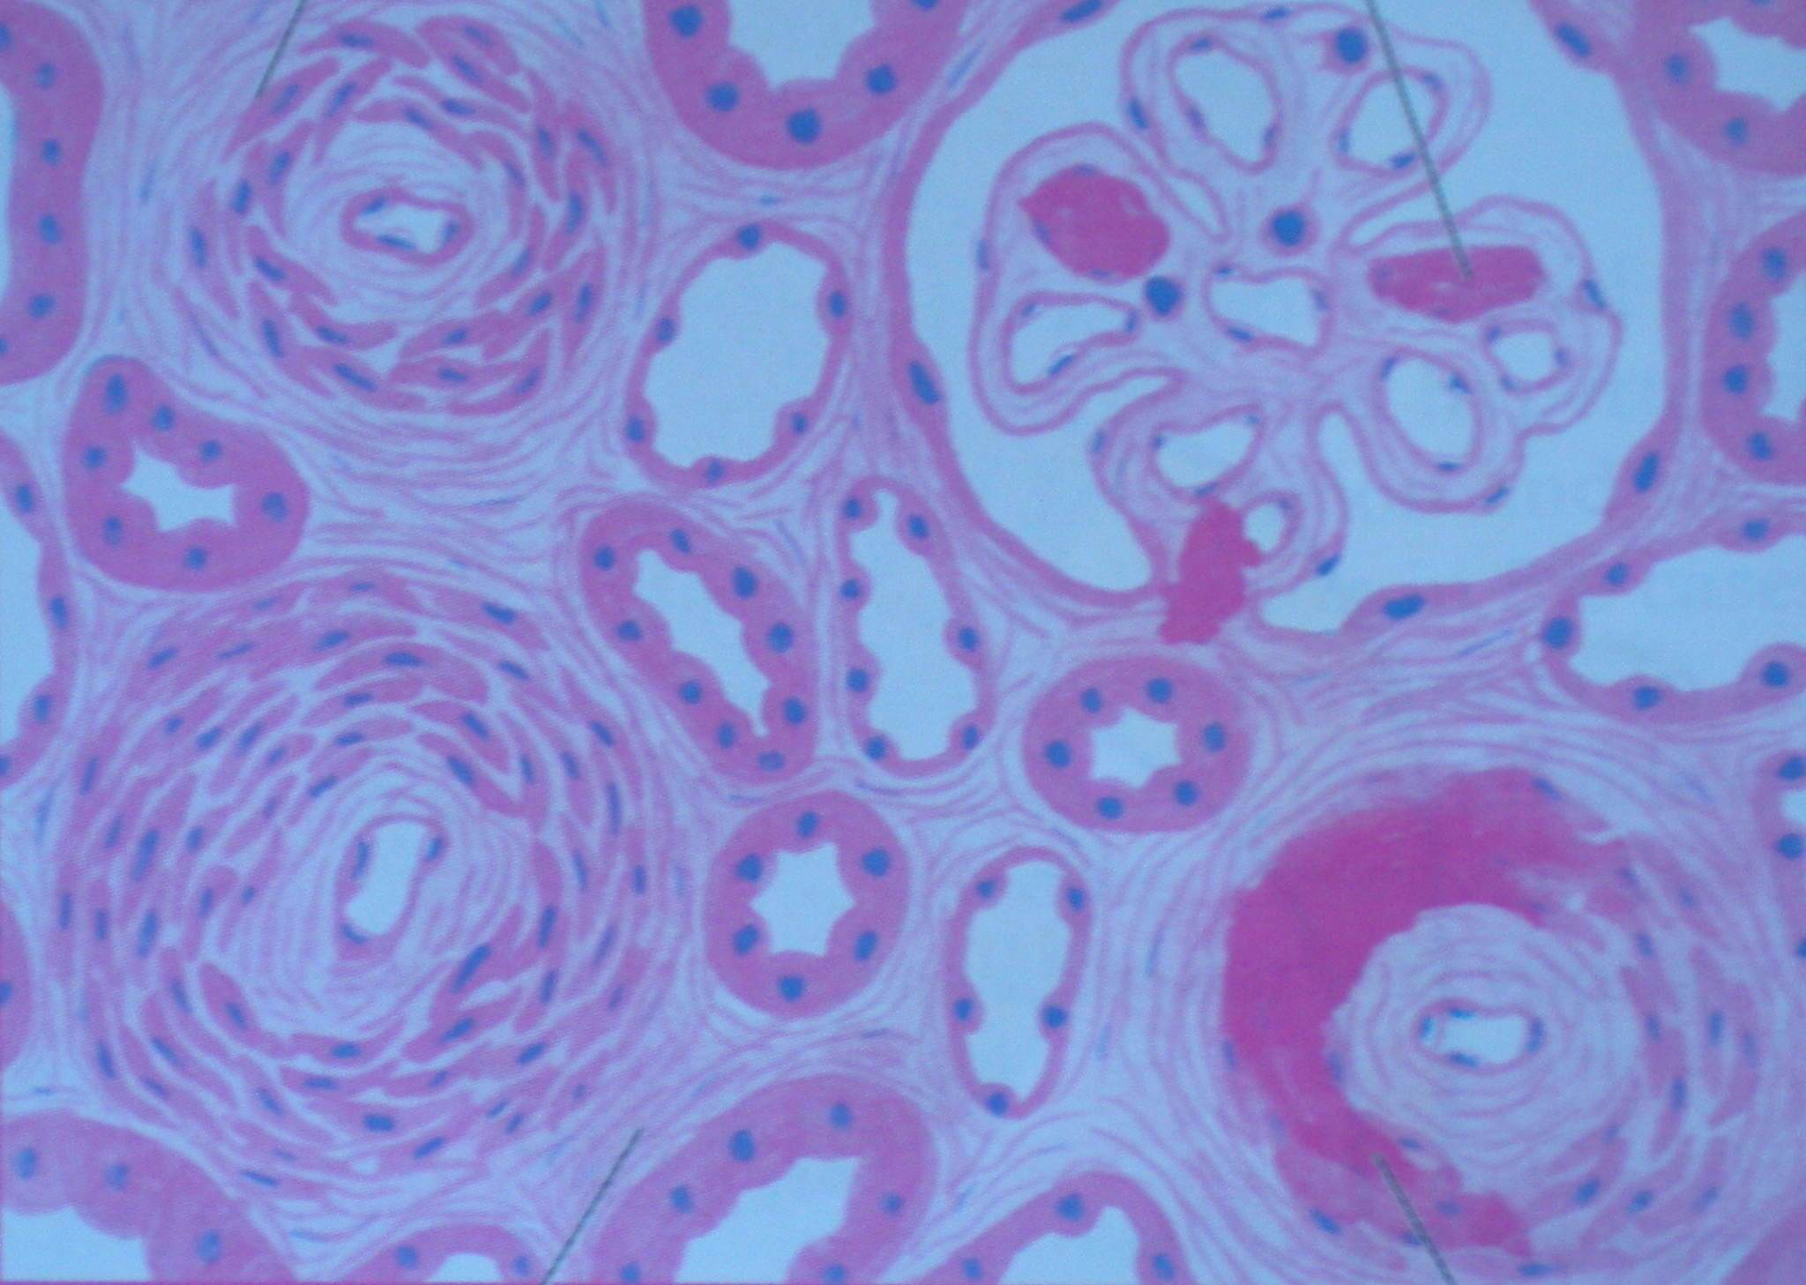
Benign nephrosclerosis
Malignant nephrosclerosis

Slide 12
Endocrine hypertension
It is a type of secondary hypertension
It may be produced by secretions of many glands like :
-adrenal gland
-parathyroid gland
It may also be produced by oral contraceptive.

Slide 13
Borderline hypertension
It is defined as mildly elevated blood pressure higher than 140/90mmHg at sometimes and lower than that at other times.
The blood pressure has to be measured on several occasions.
Patients with this type of hypertension have a tendency as they grow older to develop higher blood pressure.
They have an increased risk of developing cardiovascular diseases.

Slide 14
Isolated systolic blood pressure
It is a systolic pressure which is above 140mmHg but the diastolic pressure is still below 90mmHg.
As the systolic pressure increases, pulse pressure increases. So there is a risk of myocardial infarction, stroke and even death.
More common in older patients.

Slide 15
White coat high blood pressure
Visit to physician’s office is the often the cause of artificial high blood pressure.
It may disappear with repeated testing after rest.

Slide 16
Signs and symptoms
The commonly occuring symptoms are:
-Chest pain
-Confusion
-Ear noise or buzzing
-Irregular heartbeat
-Nosebleed
-Tiredness
-Vision changes
Essential hypertension is asymptomatic.
Accelerated hypertension is associated with headache, , confusion, visual disturbances, and nausea and vomiting.

Slide 17
Pathophysiology
Three theories have been proposed to explain this:
Inability of the kidneys to excrete sodium, resulting in natriuretic factors such as Atrial Natriuretic Factor being secreted to promote salt excretion with the side effect of raising total peripheral resistance.
An overactive Renin-angiotensin system leads to vasoconstriction and retention of sodium and water. The increase in blood volume leads to hypertension.
An overactive sympathetic nervous system, leading to increased stress responses

Slide 18
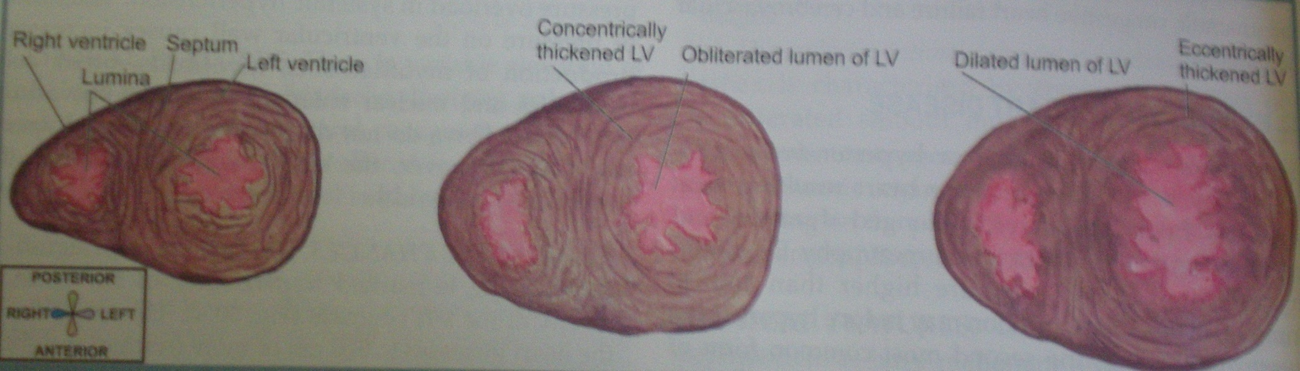
Organs affected
Heart- high b.p. places pressure on the heart and may lead to left ventricular hypertrophy. Atrail fibrillation is common. Severe hypertension can cause left ventricular failure.
Left ventricular hypertrophy

Slide 19
Brain- stroke is a common complication of hypertension and may be due to cerebral haemorrhage or cerebral infarction.
Blood vessels- the internal lamina of large arteries become thickened and fibrous issue is deposited. In smaller arteries, hyaline arteriosclerosis occurs in the wall and the lumen becomes narrow.

Slide 20
Eye- high b.p. can cause damage to the blood vessels supplying retina. This results in bleeding in the eye, blurring of vision and sometimes complete blindness.
Kidney- persistant blood pressure can lead to proteinuria and progressive renal failure by damaging the renal blood vessels.

Slide 21
Diagnosis
Initial assessment of the hypertensive patient should include a complete history and physical examination to confirm a diagnosis of hypertension.
Most patients with hypertension have no specific symptoms referable to their blood pressure elevation. Although popularly considered a symptom of elevated arterial pressure, headache generally occurs only in patients with severe hypertension.
Characteristically, a "hypertensive headache" occurs in the morning and is localized to the occipital region.
Other nonspecific symptoms that may be related to elevated blood pressure include dizziness, palpitations, easy fatiguability, and impotence.

Slide 22
Prevention
Adults over 18 should have their blood pressure checked routinely.
Lifestyle changes may help control blood pressure:
Excess weight adds to strain on the heart. In some cases, weight loss may be the only treatment needed.
Exercise regularly. If possible, exercise for 30 minutes on most days.
A diet should be rich in fruits, vegetables, and low-fat dairy products while reducing total and saturated fat intake
Avoid smoking.
Blood sugar level must be under control.
Do not consume more than 1 or 2 alcoholic drinks per day.
Stress should be under control.

Slide 23
Depression and the risk for cardiovascular diseases: systematic review and meta analysis
Koen Van der Kooy ,Hein van Hout , Harm Marwijk ,Haan Marten, Coen Stehouwer, Aartjan Beekman ,
Article first published online: 19 JAN 2007
Koen Van der Kooy, Hein van Hout, Harm Marwijk, Haan Marten, Coen Stehouwer , Aartjan Beekman | Depression and the risk for cardiovascular diseases: systematic review and meta analysis HIGH LEVEL OF EVIDENCE | Depression and cardiovascular diseases are both common among elderly. Depression is suspected to be an independent risk factor for the onset of coronary heart disease, yet it is not clear to what extent and if depression also is associated with the onset of other diseases of the circulatory system. Aims To estimate the risk of depression as an independent risk factor for various cardiovascular diseases (CVD) and explore the effects of heterogeneity and methodological quality. | Method Meta-analyses and meta-regression analyses of longitudinal cohort and case-control studies reporting depression at baseline and CVD outcomes at follow-up. | Conclusions Depression seems to be an independent risk factor for the onset of a wide range of CVDs, although this evidence is related to a high level of heterogeneity. Copyright © 2007 John Wiley & Sons, Ltd.

Slide 24
Relative effectiveness of clinic and home blood pressure monitoring compared with ambulatory blood pressure monitoring in diagnosis of hypertension: systematic review
J Hodgkinson research fellow1, J Mant professor2, U Martin clinical reader in clinical pharmacology3, B Guo research fellow 4, F D R Hobbs professor 1, J J Deeks professor 4, C Heneghan reader in evidence based medicine 5, N Roberts information specialist 6, R J McManus professor 1 | Systematic review with meta-analysis with hierarchical summary receiver operating characteristic models. Methodological quality was appraised, including evidence of validation of blood pressure measurement equipment. | Objective: To determine the relative accuracy of clinic measurements and home blood pressure monitoring compared with ambulatory blood pressure monitoring as a reference standard for the diagnosis of hypertension. | Results: The reported prevalence of hypertension varied around the world, with the lowest prevalence in rural India (3.4% in men and 6.8% in women) and the highest prevalence in Poland (68.9% in men and 72.5% in women). Awareness of hypertension was reported for 46% of the studies and varied from 25.2% in Korea to 75% in Barbados; treatment varied from 10.7% in Mexico to 66% in Barbados and control (blood pressure < 140/90 mmHg while on antihypertensive medication) varied from 5.4% in Korea to 58% in Barbados. | Conclusion: Hypertension is an important public health challenge in both economically developing and developed countries. Significant numbers of individuals with hypertension are unaware of their condition and, among those with diagnosed hypertension, treatment is frequently inadequate. Measures are required at a population level to prevent the development of hypertension and to improve awareness, treatment and control of hypertension in the community.

Slide 25
Short questions
Define Hypertension
Classification of Hypertension
Etiopathogenesis of Hypertension
Risk factors for Hypertension
Which are other organ and systems can involved in Hypertension ??
Complications of Hypertension

Slide 26
Thank you

