Slide 1
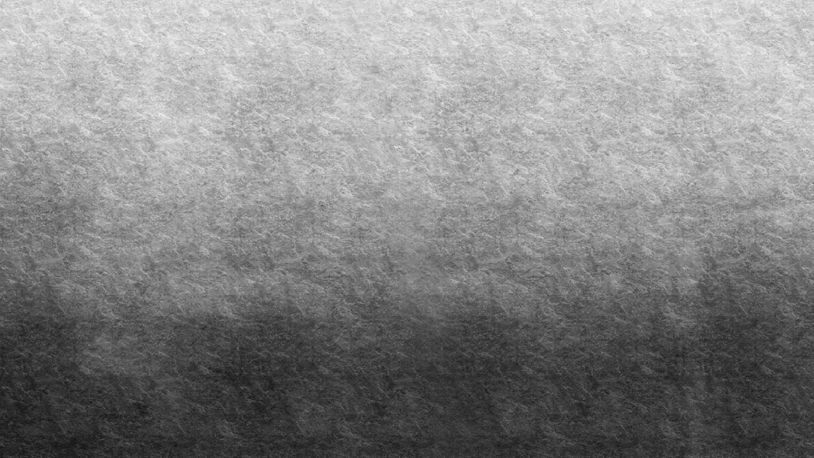
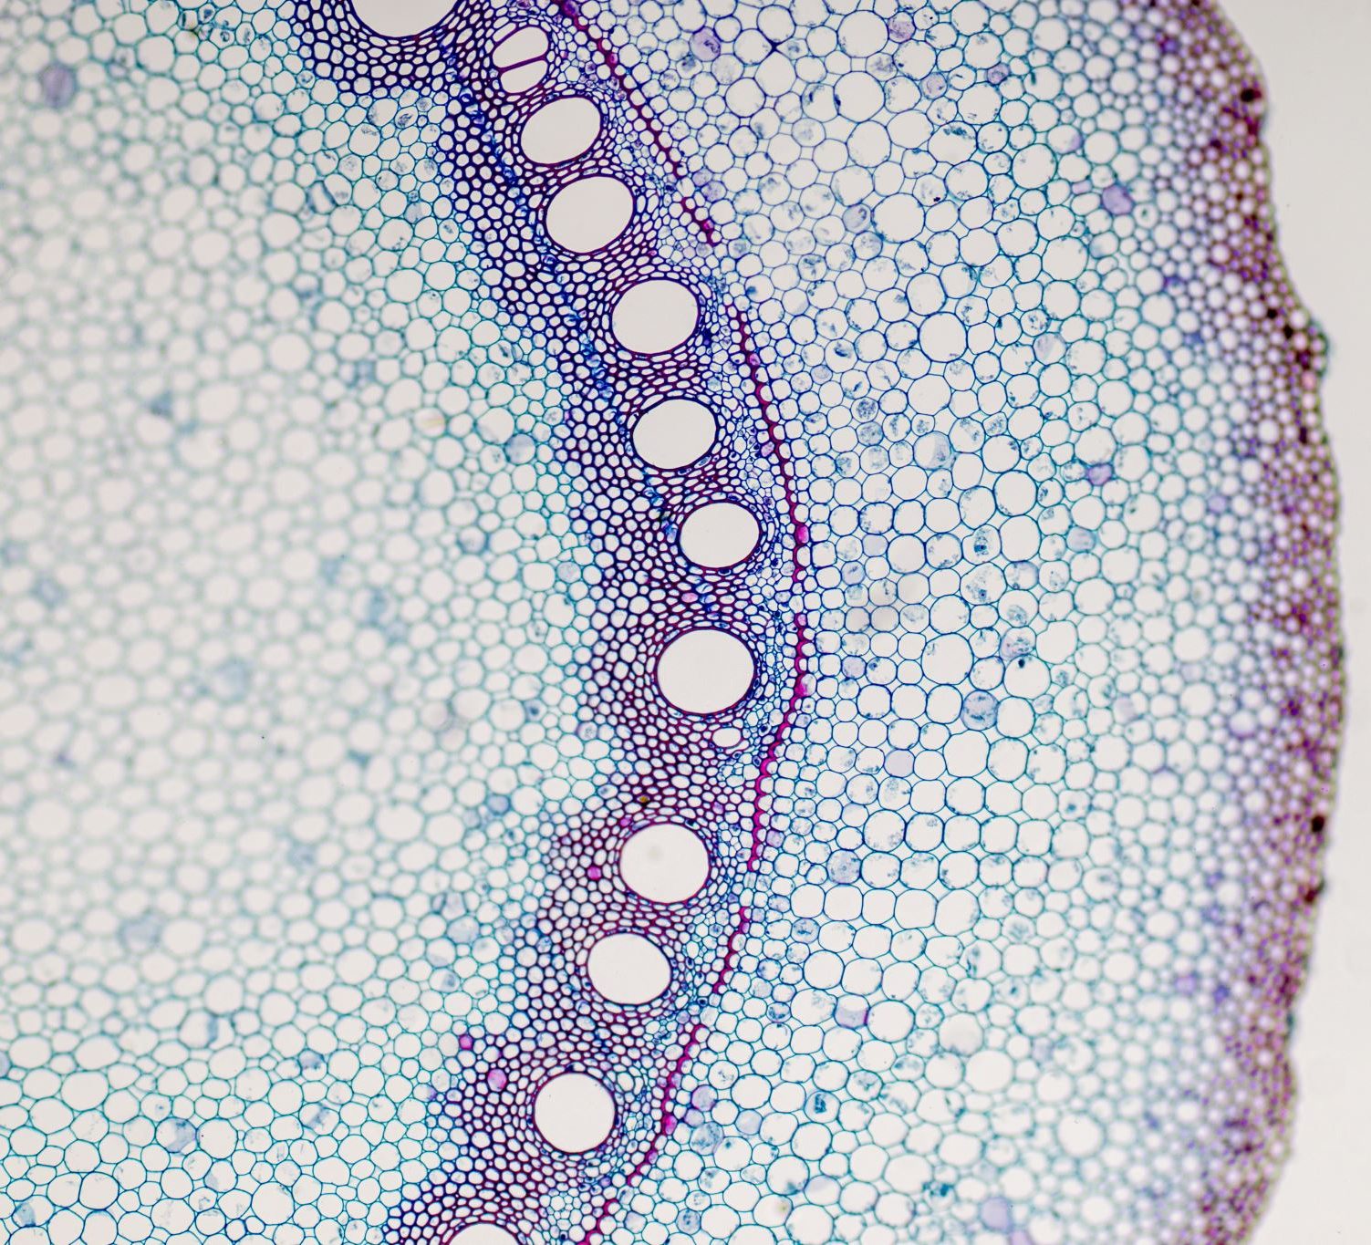
Anatomy of liver and hepatobiliary system
PREPARED BY
Dr. Chinar Patel
Professor
Dept. of Anaesthesiology
S.B.K.S. M.I.R.C., PIPARIA

Slide 2

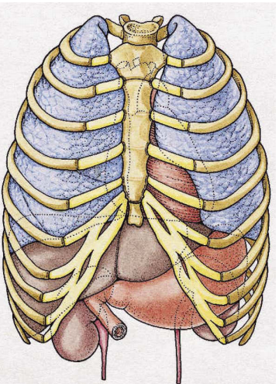
Hepatic Anatomy
Macroscopic Anatomy:
The liver is a reddish brown boomerang-shaped gland that occupies the right hypochondrium, most of the epigastrium, and a variable portion of the left hypochondrium.
In the right midaxillary line, the liver spans from the 7th to the 11th ribs
The liver is highly vascular, friable, and easily lacerated. Because of its sponginess, it conforms to the contours of less malleable, adjacent structures. Based on postmortem studies using chemicals to harden the liver in situ—the organ is shaped like a right-angled triangular prism (wedge), with a rounded right angle. The three faces of this prism are the superior, inferior, and posterior surfaces of the liver; they provide frames of reference for gross anatomy

Slide 3
The hepatic ligaments are connective tissue bands that attach the liver to adjacent tissues. The hepatic ligaments are connective tissue bands that attach the liver to adjacent tissues. Most of these bands are overlapping folds of peritoneal membranes
Several factors maintain the liver in proper anatomic position.
the diaphragm, via the coronary and triangular ligaments and the matrix of connective tissue on the bare area, and
the inferior vena cava, hepatic veins, and embedded connective tissue. The superior surface of the liver is form-fitted to the underside of the diaciform ligament does little to anchor the liver, although it may limit its lateral displacement.

Slide 4
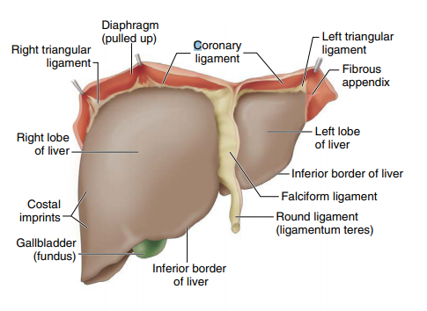
Traditional Anatomy
Traditional or classic liver anatomy uses topologic landmarks to partition the liver into four lobes: the left, right, caudate, and quadrate.
On the superior hepatic surface, the falciform ligament separates the left and right lobes
Demarcations on posterior-inferior hepatic surfaces
Superior hepatic surface: frontal view. The anterior hepatic edge (i.e., the inferior border of the liver) delineates the superior and inferior surfaces of the liver. A sickle-shaped peritoneal fold (falciform ligament) divides the liver into two parts of unequal size, the right lobe and the left lobe. Within the free margin or base of the falciform are paraumbilical veins and the round ligament (ligamentum teres), the latter being the remnant of the obliterated umbilical vein

Slide 5
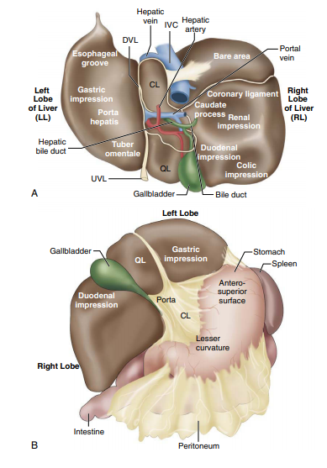
Traditional Anatomy
Demarcations on posterior-inferior hepatic surfaces
the left sagittal fossa (ligamenta venosum and teres hepaticus), which separates left and right lobes
The transverse fissure (porta hepatis), which is a shared border of quadrate and caudate lobes
fossae for the umbilical vein and gallbladder, which border the quadrate lobe
fossae for the ductus venosus (ligamentum venosum) and inferior vena cava fossa, which further delineate the caudate lobe.

Slide 6
Posterior and inferior hepatic surfaces showing the relationship between four hepatic lobes: left lobe (LL), caudate lobe (CL), quadrate lobe (QL), right lobe (RL).
They are delineated by five structures: the ductus venosus ligament (DVL), umbilical vein ligament (UVL), porta hepatis (PH), inferior vena cava (IVC), and gallbladder (GB).
These structures can be envisaged as forming the letter H: • The two-part, left vertical bar (DVL in the back, UVL in the front) separates the LL from all the other lobes.
The three-part, right vertical bar (IVC in the back, caudate process in the middle, GB in the front) separates the RL from the other lobes.
The caudate process, which connects the RL and CL, forms the upper boundary of the epiploic foramen (of the peritoneum).
The crossbar is the PH (or transverse fissure), which separates the CL in the back from the QL in the front.
Notable anatomic features (left to right) are the narrow LL but broad and rounded RL. Protuberances and impressions (imp) on the hepatic surfaces result from contiguous viscera: the LL has an esophageal groove, gastric impression, and tuber omentale
the RL has duodenal, suprarenal, renal, and colic impressions. The vertebral column and crura of the diaphragm produce the deep concavity to the left of IVC. The omental bursa (upper part) lies between the papillary process (an elevation of the CL) and diaphragm.
The surfaces of the liver are covered by peritoneum, with a few exceptions. Uncovered areas include
(1) the GB attachment site; (2) the porta hepatis, with vessels and ducts splitting the two layers of the lesser omentum; (3) the right suprarenal impression; and (4) nonperitoneal surface (bare area of the liver) bounded by the coronary ligament (upper and lower lines of reflection), which is in direct contact with the diaphragm. B, Inferior (visceral) hepatic surface. The gastric impression on the liver molds to the convex, anterosuperior gastric surface. The tuber omentale (hepatic protuberance) fits in the concave, lesser curvature of stomach; it lies superficial to the anterior layer of lesser omentum and connects to the duodenum via the hepatogastric ligament.

Slide 7
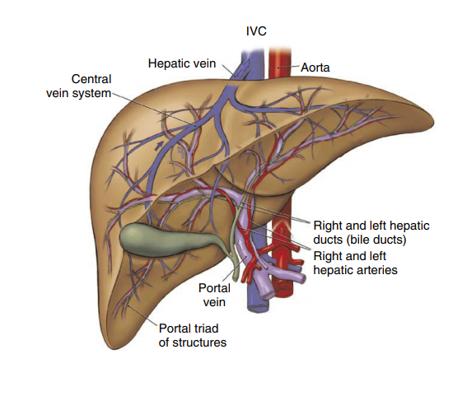
Internal anatomy of the liver.
After ascending to the porta hepatis (hilum), the portal vein and proper hepatic artery divide into their first-order branches—the left and right portal veins and the left and right hepatic arteries.
These vessels enter the liver and travel in parallel as they ramify within the organ (Fig. 17-4). Their terminal branches drain into sinusoids of liver (i.e., the hepatic capillaries).
Blood egresses from the sinusoids through intralobular (central) veins; it is conveyed via a series of larger conduits (i.e., the sublobular, interlobular, and lobular veins) to the right, middle, or left hepatic veins.
The hepatic veins connect to the inferior vena cava (see Fig. 17-4). The intrahepatic flow of bile occurs in a direction opposite the flow of afferent blood within the liver. Hepatic parenchymal cells produce bile; they secrete it into canaliculi that connect to bile ductules of the portal areas.
Bile egresses from the portal canals and flows via a series of ducts to the left or right hepatic bile duct. These ducts unite to form the common hepatic bile duct, which descends from the porta hepatis and gives rise to the cystic duct and the common bile duct

Slide 8
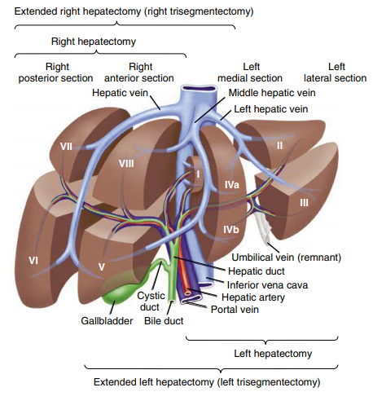
Physiologic Anatomy also called functional, segmental, modern, or surgical anatomy—focuses on singular, independent segments of the liver (Fig. 17-5). Each independent segment has its own afferent blood supply and routes for venous and biliary drainage,
allowing it to remain functionally intact after surgical resection of neighboring segments. Owing to the manifold variations in branching patterns of the portal vein, hepatic artery, and hepatic bile duct, there is no universally accepted classification of segmental anatomy.4 The most widely used classifications—such as those of Couinaud or Bismuth—are based on the anatomy of the portal and hepatic veins. The Couinaud system, for example, uses
third-generation branches of the portal vein to partition the liver into eight physiologically independent segments (Fig. 17-5).4 The geometry of dividing the liver into sectors and segments in accord with Bismuth’s method is shown in Figure 17-6. 4 Physiologic anatomy facilitates both planning and performance of hepatic surgery. For example, surgical incisions through the center of a segment would be likely to devitalize the
Schematic depiction of Couinaud segmental liver anatomy and the normal portal venous structures. Bracketed text shows hepatic segments resected during partial hepatectomies. (Reproduced from Functional segments of the liver (Segmental anatomy_of_liver). Management of potentially resectable colorectal cancer liver metastases.

Slide 9
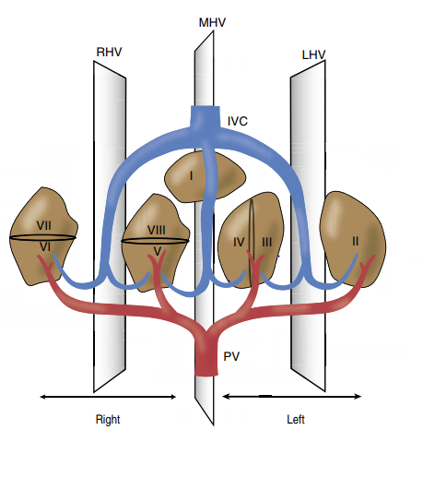
Physiologic Anatomy
Also called functional, segmental, modern, or surgical anatomy—focuses on singular, independent segments of the liver (Fig. 17-5). Each independent segment has its own afferent blood supply and routes for venous and biliary drainage,
Allowing it to remain functionally intact after surgical resection of neighboring segments. Owing to the manifold variations in branching patterns of the portal vein, hepatic artery, and hepatic bile duct, there is no universally accepted classification of segmental anatomy.4 The most widely used classifications—such as those of Couinaud or Bismuth—are based on the anatomy of the portal and hepatic veins. The Couinaud system, for example, uses
Third-generation branches of the portal vein to partition the liver into eight physiologically independent segments (Fig. 17-5).4 The geometry of dividing the liver into sectors and segments in accord with Bismuth’s method is shown in Figure 17-6. 4 Physiologic anatomy facilitates both planning and performance of hepatic surgery. For example, surgical incisions through the center of a segment would be likely to devitalize the entire segment because therein lies the portal triads (portal vein, hepatic artery, bile duct). By contrast, incisions along the periphery of segments minimize unintentional injuries of major hepatic veins, which generally run in parallel to the segmental borders. If surgical disease affects any part of a segment, the goal is usually to remove the entire segment without disrupting its healthier neighbors. Clinical studies have shown lower rates of perioperative morbidity and mortality when liver surgery (resection of tumors, repair of traumatic injuries) is guided by the principles of physiologic anatomy
Figure 17-6 Physiologic liver anatomy: Bismuth classification. Three parallel planes host a single hepatic vein (right, RHV; middle, MHV; or left, LHV); each plane is split by a transverse plane (not shown) cutting through the right or left main portal veins (PV); this creates four sectors with portal pedicels (i.e., portal sectors). MHV divides the liver into a left and right hemiliver: LHV splits the former (into one lateral (II) and two medial (III, IV) segments) and RHV splits the latter (into two anterior (VI, VII) and two posterior (V, VIII) segments). In contrast to any other segment, segment I (the caudate lobe) gets its blood supply from both left and right main portal veins; and, its venous outflow—instead of entering a major hepatic vein—drains directly into the inferior vena cava (IVC). (The authors are grateful to Jennifer Mushlin for designing and crafting this figure.)

Slide 10
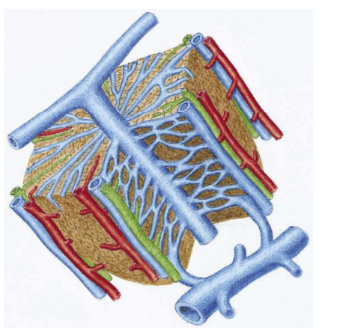
Real Anatomy
Because the human liver has so many anatomic variations, knowledge of an individual’s real physiologic anatomy derives from advanced imaging techniques, such as contrast-enhanced helical computed tomography scans. These scans provide accurate information on the relationships of surface landmarks and internal hepatic anatomy. In fact, such scan data, when superimposed on normalized computer images of Couinaud segments, yield a data set with enough information to construct a three-dimensional model of a patient’s liver. Accurate, see-through constructs can impart an instantaneous grasp of a patient’s physiologic anatomy by detailing anatomic variants and precise locations of hepatic lesions. In addition, recent advances in ultrasonography have enabled real p
Idealized representation of a classic liver lobule.

Slide 11
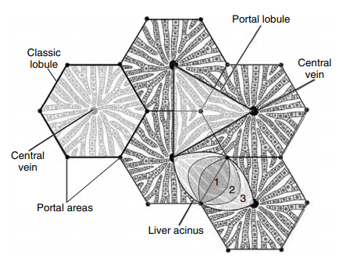
Microanatomy
Classic Liver Lobule The basic unit of the liver can be viewed as a classic lobule, a portal lobule, or a liver acinus; Figure 17-7 shows how these arbitrary units relate to one another. An idealized classic liver lobule is a hexagonal prism with a central vein at its center and six vertically aligned portal canals (Fig. 17-8). Each portal canal includes a connective tissue matrix, surrounding nerve fibers, lymphatic vessels, and a portal triad. The latter contains terminal branches of the portal vein and hepatic artery and a bile ductule. A transverse section of a liver lobule shows an array of anastomosing cords of cuboidal hepatocytes separated by vascular channels (lacunae) that radiate from the portal areas and converge on the central vein (see Fig. 17-8). The lacunar labyrinth permeates the entire lobule; it is confined, however, at the periphery of the lobule by a limiting plate of hepatocytes that form a nearly continuous wall. This wall separates the interior of the lobule from the portal canals. Only the tiniest branches of the hepatic artery, portal vein, and bile duct are able to penetrate fenestrae within the limiting plate. Microscopic examination of the human liver, however, shows a lack of well-defined classic lobules because of a dearth of well-developed connective tissue between lobules. Indeed, the search for lobular boundaries led to the discovery of circumferential terminal hepatic arterioles, portal venules, and bile ductules (Fig. 17-9). This finding is fundamental to the acinar lobe concept, which posits that vessels encircling lobar peripheries, rather than those within portal canals, are the most immediate source of afferent blood to hepatocytes (Fig. 17-10; also see Fig. 17-7). In other words, blood flow to lobules originates along shared borders of classic lobules, which lie between two central veins (see Fig. 17-10).
Figure 17-7 Schematic classifications of liver units: liver lobule, portal lobule, and liver acinus. Lobular units have well demarcated central structures (central vein or portal canal), whereas the liver acinus (zones 1, 2, 3; see Fig. 17-10) contains a central axis derived from two adjacent classic lobules. (From Henrickson R, Kaye GI, Mazurkiewicz J: Liver and gallbladder. In Henrickson R, Kaye GI, Mazurkiewicz [eds]

Slide 12
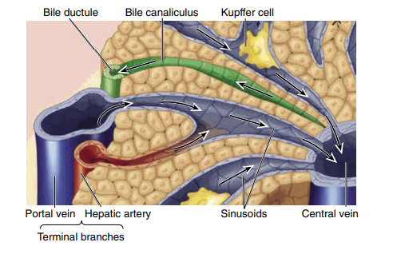
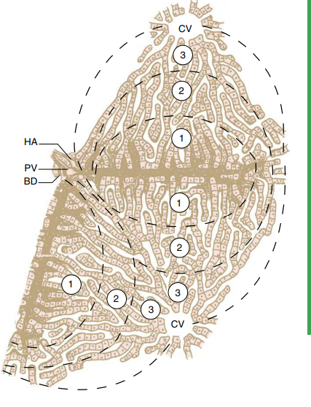
Microanatomy
Classic Liver Lobule The basic unit of the liver can be viewed as a classic lobule, a portal lobule, or a liver acinus; Figure 17-7 shows how these arbitrary units relate to one another.
An idealized classic liver lobule is a hexagonal prism with a central vein at its center and six vertically aligned portal canals (Fig. 17-8). Each portal canal includes a connective tissue matrix, surrounding nerve fibers, lymphatic vessels, and a portal triad. The latter contains terminal branches of the portal vein and hepatic artery and a bile ductule.
A transverse section of a liver lobule shows an array of anastomosing cords of cuboidal hepatocytes separated by vascular channels (lacunae) that radiate from the portal areas and converge on the central vein (see Fig. 17-8). The lacunar labyrinth permeates the entire lobule; it is confined, however, at the periphery of the lobule by a limiting plate of hepatocytes that form a nearly continuous wall.
This wall separates the interior of the lobule from the portal canals. Only the tiniest branches of the hepatic artery, portal vein, and bile duct are able to penetrate fenestrae within the limiting plate. Microscopic examination of the human liver, however, shows a lack of well-defined classic lobules because of a dearth of well-developed connective tissue between lobules. Indeed, the search for lobular boundaries led to the discovery of circumferential terminal hepatic arterioles, portal venules, and bile ductules (Fig. 17-9).
This finding is fundamental to the acinar lobe concept, which posits that vessels encircling lobar peripheries, rather than those within portal canals, are the most immediate source of afferent blood to hepatocytes (Fig. 17-10; also see Fig. 17-7). In other words, blood flow to lobules originates along shared borders of classic lobules, which lie between two central veins (see Fig. 17-10).

Slide 13
Thank you

