Slide 1



MANAGEMENT OF HEAD INJURY
PREPARED BY
Dr. Sara Mary Thomas
Asso. Professor,
Dept. of Anaesthesiology
S.B.K.S. M.I.R.C., PIPARIA

Slide 2

HEAD INJURY
Any degree of injury to the head ranging from scalp laceration to LOC to focal neurological deficits

Slide 3
Traumatic brain injury (TBI)
Traumatic
brain injury
(TBI)
is a
to the
nondegenerative,
noncongenital
insult
brain from an
external
mechanical
force,
possibly leading
to
permanent
or temporary
impairment of psychosocial functions,
cognitive,
physical, and
with an associated
diminished or altered state of consciousness

Slide 4

ETIOLOGY
Motor vehicle accidents
Falls
Assaults
Sports-related injuries
Firearm-related injuries

Slide 5



Highest among adolescents, young
adults, and those older than 75
50% of major trauma deaths are due to TBI
Vehicle crashes are the leading cause of brain injury. Falls are the second leading cause

Slide 6

Motor Vehicle Crashes - 44%
Falls - 26%
Other/Unknown - 13%
Assaults- 9%
Firearms- 8%

Slide 7
High potential for poor outcome
Deaths occur at three points in time after injury:
  Immediately after the injury
  Within 2 hours after injury
  3 weeks after injury

Slide 8
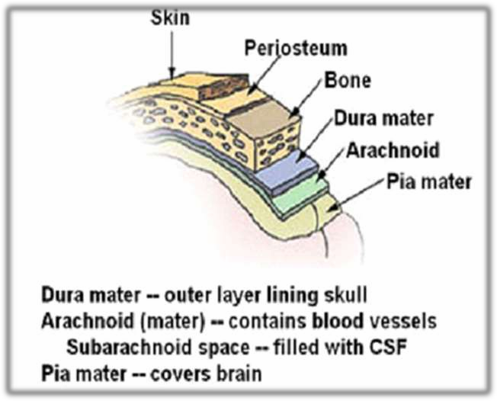
LAYERS

Slide 9
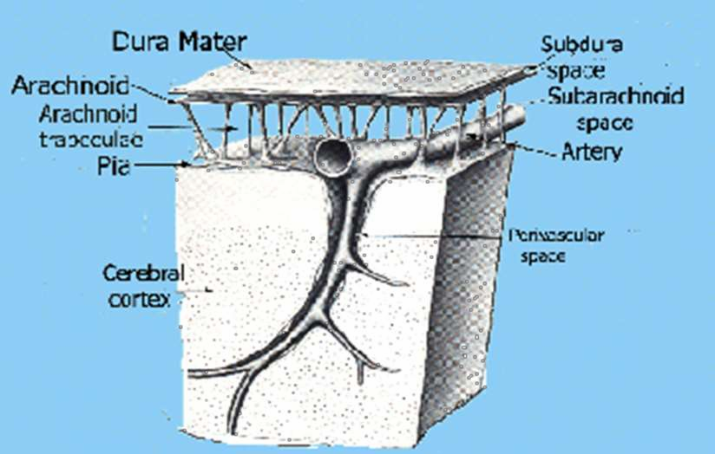

Slide 10





TYPES
TYPES OF HEAD INJURY
SCALP
LACERATIONS
SKULL FRACTURE
MINOR HEAD
TRAUMA
MAJOR HEAD
TRAUMA

Slide 11
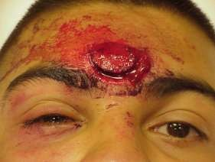
LACERATIONS
Easily recognized
  The most minor type of head trauma
  Scalp is highly vascular → profuse bleeding
  Major complication is infection

Slide 12
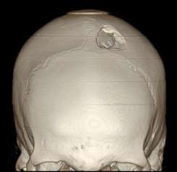
SKULL FRACTURES
LINEAR
break in the continuity of bone without alteration of relationship of parts
cause- Low velocity injuries
DEPRESSED
Inward indentation of skull
cause- powerful blow

Slide 13
Comminuted
multiple linear fractures with fragmentation of bones into pieces
Compound
Depressed skull fractures and scalp laceration communicating intracranial cavity

Slide 14
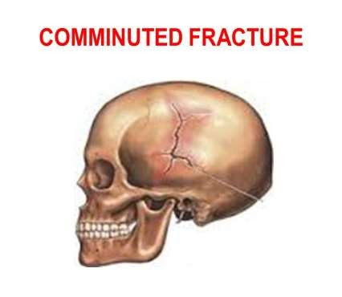
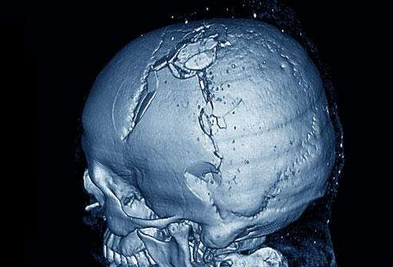
compound fracture

Slide 15
ACCORDING TO LOCATION
Frontal fracture
Temporal fracture
Parietal fracture
Posterior fossa fracture
Orbital fracture
Basilar skull fracture

Slide 16
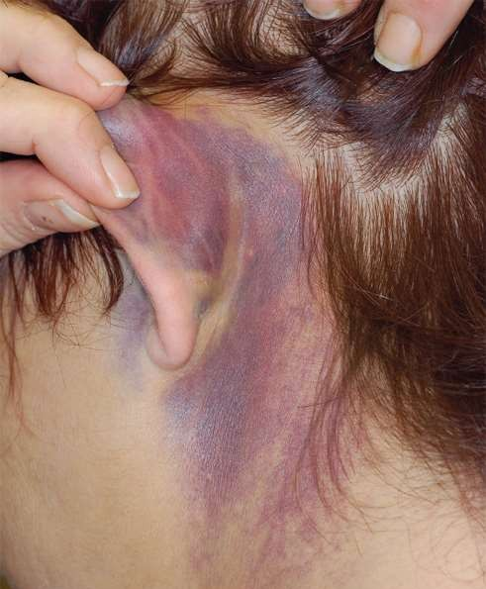
Temporal bone fracture
Boggy temporal muscle because extravasation of blood
Oval shaped bruise behind the ear in mastoid region (battle sign)
Otorrhoea

Slide 17
Parietal bone fracture
Deafness
CSF otorrhoea
Bulging of tympanic membrane by blood or CSF
Facial paralysis

Slide 18
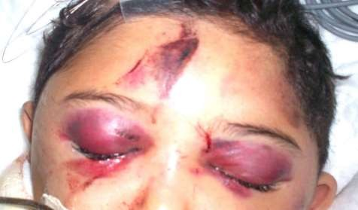

Orbital fracture
Periorbital ecchymosis(RACCOON EYES)
Optic nerve injury

Slide 19
Basilar skull fracture
Otorrhoea, rhinorrhoea
Bulging of tympanic membrane
Battle’s sign
Facial paralysis
Tinnittis , vertigo

Slide 20
Test to determine CSF leakage
Method 1
Check for presence of glucose
Dextrostrip/ Tes-Tape strip
If blood is present in the fluid
The test become unreliable
Go for 2nd method

Slide 21
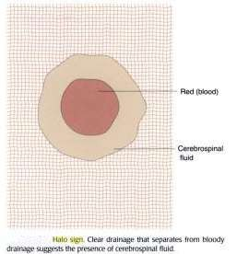
Method 2( halo ring sign)
Allow leaking fluid drip onto a white pad/towel
Observes the drainage
Within a few minutes the blood coalesces into center and a yellowish ring encircles the blood

Slide 22
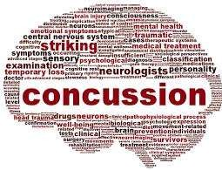
MINOR HEAD TRAUMA
CONCUSSION
A sudden transient mechanical head injury with disruption of neuronal activity and a change in the LOC
It occurs When the brain suddenly shifts inside the skull and knocks against the skulls bony surface

Slide 23



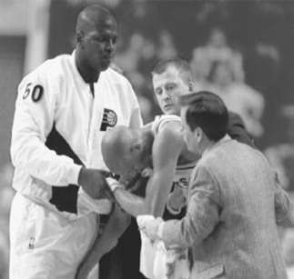
TYPICAL SIGNS
Brief disruption of LOC Concussions can last from a few
moments, to an unconscious state for over 3 min
Amnesia regarding event
Headache

Slide 24
MAJOR HEAD TRAUMA
CONTUSION
It is the bruising of the brain tissue within a focal area
It is usually associated with a closed head injury

Slide 25
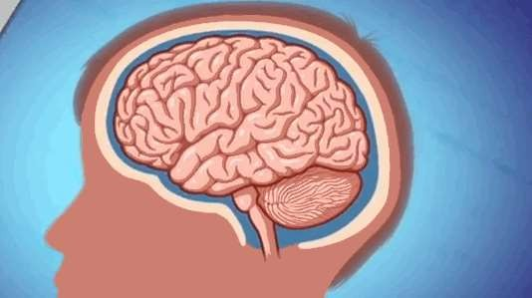
COUP-COTRECOUP IS OFTEN NOTED

Slide 26
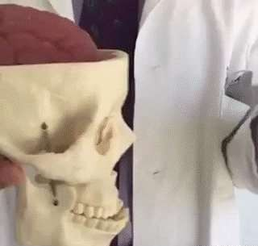

Slide 27
In this type of injury contusion occur both at the site of direct impact of the brain on the skull( coup) and at the a secondary area of damage on the opposite side away from injury ( contrecoup) leading to multiple contusion areas

Slide 28
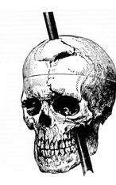
LACERATIONS
It involve actual tearing of brain tissue and often occur in association with depressed ,open fractures and penetrating injuries
Intracerebral hemorrhage commonly associated

Slide 29
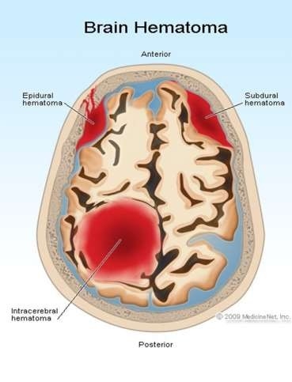
COMPLICATIONS
INTRACRANIAL HAEMORRHAGES
Extra- axial hemorrhage
Epidural hematoma
Subdural hematoma-
Acute Chronic
Subarachnoid hemorrhage
Intra-axial hemorrhage
Intra-parenchymal hemorrhage
Intra-ventricular hemorrhage

Slide 30
EPIDURAL HEMORRHAGE
A neurologic emergency
Most common type of intracranial hemorrhage
Results from bleeding between the dura and the inner surface of the skull
Blow to the temporal, parietal bone
Commonly bleeding by arterial origin- breakage to middle meningeal artery
Venous- dural venous sinus

Slide 31
Clinical manifestation- EDH
The patient is initially unconscious after the trauma
The patient then awakens and has a lucid interval followed by a decrease in LOC
Headache
Nausea and vomiting

Slide 32
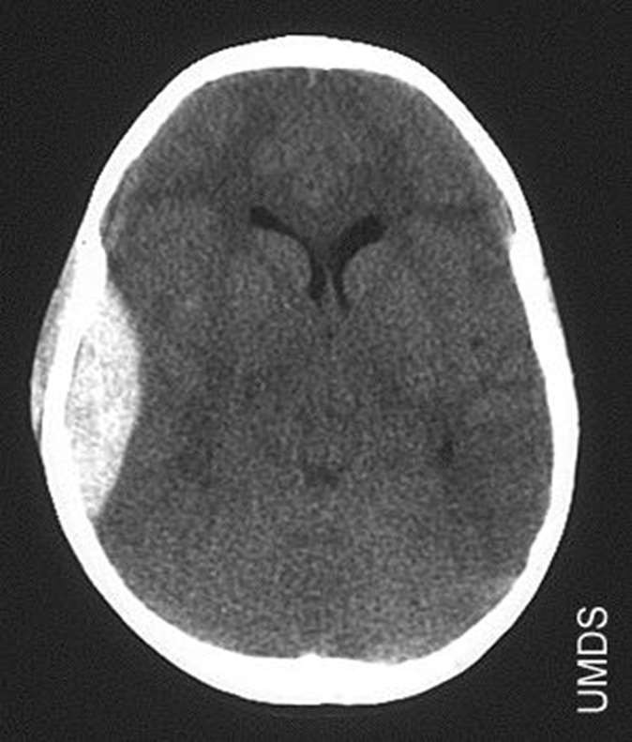
On head CT the clot is bright, biconvex shaped clot and has a well-defined border that usually respects cranial suture lines

Slide 33
A rapid Open craniotomy for evacuation of the congealed clot and hemostasis is indicated for EDH
Prevention of cerebral herniation can dramatically improve outcome

Slide 34
SUB-DURAL HEMATOMA
Subdural hematoma occurs from bleeding between the dura matter and the arachnoid layer of the meninges
Types
  acute subdural hematoma
  subacute subdural hematoma
  Chronic subdural hematoma

Slide 35
SDH usually results from venous bleeding, usually from tearing of a bridging vein running from the cerebral cortex to the dural sinuses.
Hematoma may be slower to develop

Slide 36
Acute subdural hemorrhage
It develop 24-48 hrs after the severe head trauma
Commonly related to acceleration- deceleration injury
Clinical manifestations as same as elevated ICP

Slide 37
The size of hematoma determines the patient clinical presentation
Decreasing LOC from drowsy and confused to unconsciousness
Headache
Ipsilateral pupil dilation
Motor signs

Slide 38
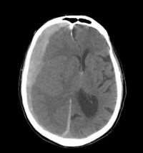
On head CT scan, the clot is bright or mixed-density, crescent-shaped (lunate), may have a less distinct border

Slide 39
Open craniotomy for evacuation of the clot and decompression is indicated for any acute SDH more than 1 cm in thickness, or smaller hematomas that are symptomatic

Slide 40
SUBACUTE SUBDURAL HEMATOMA
Usually occurs within 2-14 days of the injury
The alteration in mental status as hematoma develops
Progression depends on the size and location of hematoma

Slide 41
CHRONIC SUBDURAL HEMATOMA
It develops over weeks or months after seemingly minor head injury
The peak incidence of chronic SDH is in 50-60 Years of age
Clinical manifestations is progressive alteration in LOC

Slide 42


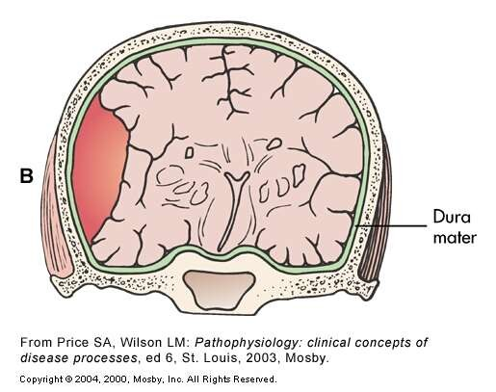
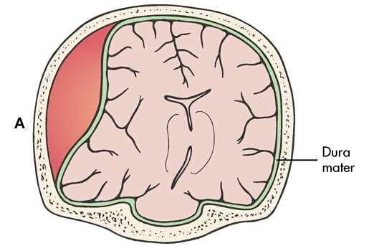
Epidural and Subdural Hematomas
Epidural Hematoma
Subdural Hematoma
Fig. 55-15

Slide 43

Epidural and Subdural Hematomas
Hematoma type | Epidural | Subdural
Location | Between the skull and the dura | Between the dura and the arachnoid
Involved vessel | Temperoparietal (most likely) - Middle meningeal artery Frontal - anterior ethmoidal artery Occipital - transverse or sigmoid sinuses Vertex - superior sagittal sinus | Bridging veins
Symptoms | Lucid interval followed by unconsciousness | Gradually increasing headache and confusion
CT appearance | Biconvex lens- limited by suture lines | Crescent shaped- crosses suture lines Fig. 5
5-15

Slide 44
SUB ARACHNOID HEMORRHAGE
Bleeding occurs between the arachnoid and pia mater
CAUSES
Rupture of Berry aneurism
Trauma (fracture at the base of the skull leading to internal carotid aneurysm)

Slide 45
Clinical Features:
•
Explosive headache,
“worst headache of my life”,
nausea and vomiting, decreased LOC or coma.
Signs of meningeal irritation
•
•

Slide 46
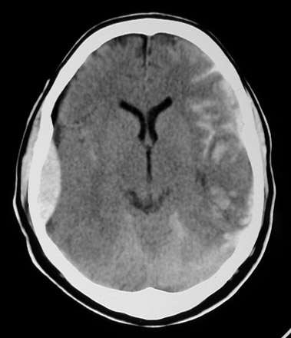
Increased attenuation is seen in the CSF Spaces over the cerebr hemisphere
al

Slide 47
Intracerebral Hemorrhage
(ICH)
Intraaxial hemorrhage is hemorrhage that occurs within the brain tissue itself
Two main types:
Intraparencymal hemorrahge- ICH extending
into brain parenchyma;
Intra-ventricular hemorrhage- ICH extending into ventricles;

Slide 48
CAUSES
Hypertensive vasculopathy (70-80%) Ruptured Aneurism
Trauma- 16%

Slide 49
Clinical presentation:
Rapidly progressive severe headache, building over several minutes, often accompanied by focal neurological deficits, nausea and vomiting, decreased level of consciousness.

Slide 50
S/S depend site of hemorrhage:
Basal ganglia/internal capsule
- hemiparesis,dysphasia
ataxia, vertigo
cranial nerve deficits,coma
Cerebellum Pons
Cerebral cortex
- hemiparesis, hemisensory
loss, hemianopsia, dysphasia

Slide 51
Diagnostic measures
History collection and physical examination
Computerised tomography
Magnetic resonance imaging
Positron emission tomography
X-RAY

Slide 52
Taking a history in head injury
■ Mechanism of injury
■ Loss of consciousness or amnesia
■ Level of consciousness at scene and on transfer
■ Evidence of seizures
■ History of vomiting
■ Pre-existing medical conditions
■ Medications (especially anticoagulants)
■ Illicit drugs and alcohol

Slide 53
Physical examination
■ Glasgow Coma Score
■ Pupil size and response
■ Signs of skull fracture
Bilateral periorbital edema (raccoon eyes) Battle’s sign (bruising over mastoid) Cerebrospinal fluid rhinorrhoea or otorrhoea Haemotympanum or bleeding from ear
■ Full neurological examination: tone, power, sensation, reflexes

Slide 54
Computerised tomography
CT scan is considered the best diagnostic test to evaluate for cranio-cerebral trauma because it allows rapid diagnosis and intervention in the setting
The National Institute for Health and Clinical Excellence (NICE) has published some guidelines for when to carry out a CT scan in a patient with head injury

Slide 55
NICE guidelines for (CT) in head injury
Glasgow Coma Score (GCS) < 13 at any point
■ GCS 13 or 14 at 2 hours
■ Focal neurological deficit
■ Suspected open, depressed or basal skull fracture
■ Seizure
■ Vomiting > one episode
Urgent CT head scan if none of the above but:
■ Age > 65
■ Coagulopathy (e.g. on warfarin)
■ Dangerous mechanism of injury (CT within 8
hours)
■ Antegrade amnesia > 30 min (CT within 8 hours)

Slide 56
An MRI scan is more sensitive than CT scan in detecting small lesions
A cervical spine X-ray indicated to detect any cervical injury
Transcranial doppler allow the mesurement of CBF

Slide 57
Management
Severe head injury is best managed in a neurointensive care setting
The patient should be positioned with the head up 30 degree
It is important to ensure that the cervical immobilisation collar does not obstruct venous return from the head

Slide 58
Airway and ventilation
patient in traumatic coma is unable to protect their airway and is at risk for aspiration
Maintain a normocapnia

Slide 59
Circulation and cerebral perfusion pressure
Hypotension and hypoxia as a major cause of secondary brain injury.
A systolic BP < 90 mmHg worse outcome in traumatic coma
Cerebral perfusion pressure should be maintained at > 65 mmHg in severely head-injured patients.

Slide 60
Control of intracranial pressure
Position head up 30º
Avoid obstruction of venous drainage from head
Sedation +/– muscle relaxant
Normocapnia
Diuretics: furosemide, mannitol
Seizure control
Normothermia
Barbiturates

Slide 61
MEDICATIONS
Osmotic diuretics
Anticonvulsants
Barbiturates
Calcium Channel Blockers

Slide 62
OSMOTIC DIURETICS
MANNITOL 25%
1.5-2 g/kg IV infused over 30-60 minutes

Slide 63
ANTICONVULSANTS
PHENYTOIN
where it may inhibit spread of seizure activity in motor cortex
DOSAGE-
Load 10-15 mg/kg THEN
Maintenance: 100 mg IV/PO q6-8hr PRN

Slide 64
BARBITURATES
PENTOBARBITAL
It will reduce the brain metabolic rate and helps reduce ICP.
Dosage- 100 mg IV OR 150-200 mg IM

Slide 65
Surgical management
No surgical intervention if collection
<10ml
Indication of surgical decompression:
The GCS score decreases by 2 or more points between the time of injury and hospital evaluation
The patient presents with fixed and dilated pupils
The intracranial pressure (ICP) exceeds 20 mm Hg

Slide 66
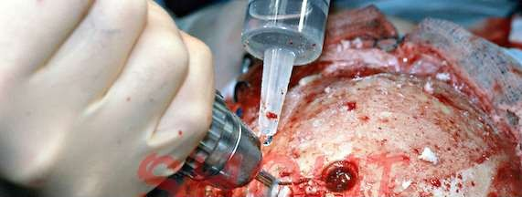
Types:
Burr-hole-
opening into cranium with a drill
Craniotomy-
bone flap is temporarily removed from the skull to access the brain

Slide 67
Craniectomy –
Excision into the cranium to cut away a bone flap
Cranioplasty -
surgical repair of a defect or deformity of a skull

Slide 68
Nursing management
Nursing assessment ABC
GCS Score
Neurologic examination Signs of elevated ICP Signs of CSF leakage

Slide 69
Nursing diagnosis
Ineffective tissue perfusion (cerebral) related to interruption of CBF associated with cerebral hemorrhage and edema
Acute pain (headache) related to trauma and cerebral edema
Hyperthermia related to increased metabolism, and loss of cerebral integrative function secondary to possible hypothalamus injury

Slide 70
Impaired physical mobility related to decreased LOC and treatment –imposed bedrest
Anxiety related to abrupt change in health status, hospital environment and uncertain future
Risk for complication related cerebral edema and hemorrhage

Slide 71
Preventive Measures
Health Promotion
Prevent car and motorcycle accidents
To Wear safety helmets

Slide 72
Rehabilitation
Ambulatory and Home Care
Nutrition
Bowel and bladder management
Seizure disorders
Family participation and education

Slide 73
Unconscious stages
Stupor is a state of partial or near complete unconsciousness in which the patient is lethargic, immobile, and has a reduced response to stimuli.
Coma is a state in which the patient is totally unconscious and cannot be aroused even with strong stimuli.

Slide 74
Persistent vegetative state
It is a condition in which awake patients are unconscious and unaware of their surroundings and the cerebral cortex is not functioning. A vegetative state can result from diffuse injury to the cerebral hemispheres of the brain without damage to the lower brain and brainstem. The vegetative state is considered permanent if it persists for 12 months after TBI

Slide 75
THANK YOU

