Slide 1
POSTERIOR FOSSA TUMOUR
By-
Dr Akhilesh chhaya
Asso. Professor
Anaesthesia Dept.
S.B.K.S. M.I.R.C., PIPARIA

Slide 2
ANATOMY
The floor of the cranial cavity is divided into 3 distinct depressions/ cranial fossas
Anterior
Middle
Posterior - acommodates the brainstem and cerebellum
BOUNDARIES:-
Anteriorly and medially -- dorsum sellae of the sphenoid bone, Clivus
Anteriorly and laterally -- superior border of the petrous part of the temporal bone.
Posteriorly -- squamous part of the occipital bone.
Laterally -- the mastoid part and the squamous of the temporal bone, condylar and basilar parts of the occipital bone.
Superiorly - Tentorium Cerebelli (tent shaped dura matter fold)
Inferiorly - Foramen Magnum

Slide 3
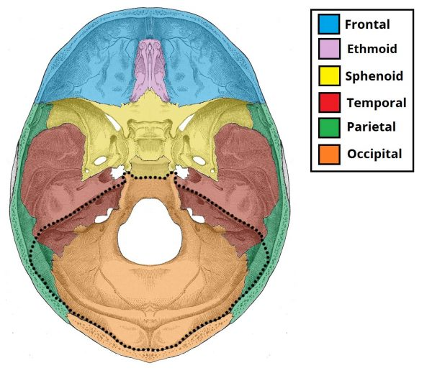
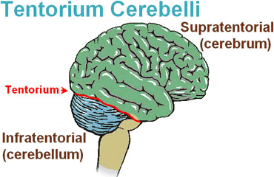
Blood Supply – Vertebrobasilar artery system

Slide 4
Contents
The cerebellum
The brainstem --- medulla oblongata, pons and (lower)midbrain and continues down through the foramen magnum to become the spinal cord
important role in co-ordination and fine motor control
associated arteries & nerves
cranial nerves, afferent and efferent fibres
CN nuclei

Slide 5
Foramina
present in the posterior cranial fossa (a foramen is simply a hole that allows the passage of a structure – usually a blood vessel or nerve).
Temporal Bone
The internal acoustic meatus - oval opening in the posterior aspect of petrous part of the temporal bone. transmits - facial nerve (CN 7th)
- vestibulocochlear nerve(CN 8th)
- labyrinthine artery.
Occipital Bone
foramen magnum, lies centrally in the floor of the posterior cranial fossa. the largest foramen in the skull, transmits- medulla of the brain,meninges
- vertebral arteries, dural veins, anterior & posterior spinal arteries.
- spinal accessory nerve(11th) (ascending)

Slide 6
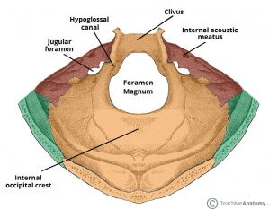
Anteriorly an incline, known as the clivus, connects the foramen magnum with the dorsum sellae.
Jugular foramina are situated either side of the foramen magnum - transmits
the glossopharyngeal nerve (9th),
vagus nerve(10th),
spinal accessory nerve (11th) (descending), internal jugular vein,
inferior petrosal sinus, sigmoid sinus and meningeal branches of the ascending pharyngeal and occipital arteries.
hypoglossal canal - Immediately superior to the anterolateral margin of the foramen magnum --transmits the hypoglossal nerve(12th)
cerebellar fossae - bilateral depressions that house the cerebellum.
-Posterolaterally to the foramen magnum
-divided medially by a ridge of bone, the internal occipital crest

Slide 7
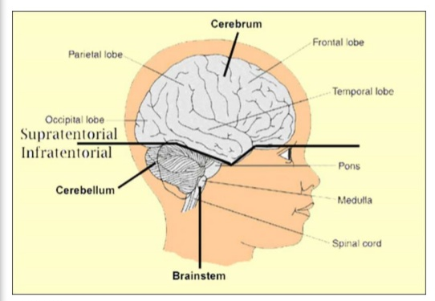
supratentorial tumors
-Tumors arising from structures
above tentorium cerebelli
-(80%)
- more common in adults
infratentorial tumors
-arising from below
-(20%)
- more common in children

Slide 8
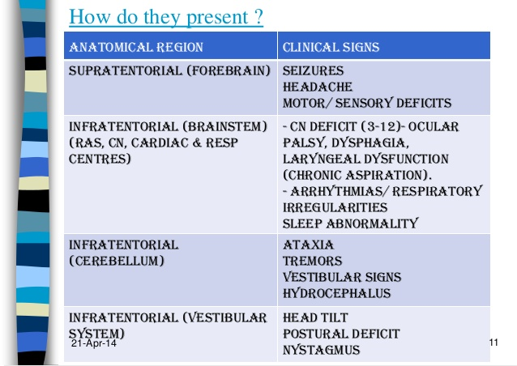

Slide 9
TYPES OF BRAIN TUMORS
ASTROCYTOMA
– Gliomas - well diiferentiated, low grade
- new onset seizures
- t/t- Sx and radiation
- Pilocytic astrocytoma-from cerebellum, cerebral hemisperes, hypothalamus, optic pathways
- affect children amd young adults
- good prognosis & t/t- Sx resection
- Anaplastic Astrocytoma – poorly differentiated
- radio or chemotherapy
- evolve into GBM , intermediate prognosis
- GBM (Glioblastomamultiformae)- grade IV glioma
- accounts for 30% of all 1º brain tumors
- imaging- central necrosis and surrounding oedema
- t/t- Sx debulking + chemo + radio
- life expectancy in weeks

Slide 10
TYPES OF BRAIN TUMORS Cont…..
OLIGODENDROGLIOMA- from oligodendrocytes (myelin producing cells)
- mostly mix of oligo & astrocytic cells
- 6% of all 1º brain tumors
- calcifications +nt.
- radioresistant- only t/t - Sx resection

Slide 11
TYPES OF BRAIN TUMORS Cont…..
EPENDYMOMA - from cells lining the ventricles & central canal of spinal cord in floor of 4th ventricle
- in childhood and adulthood
- s/s- obstructive hydrocephalus, N/V , ataxia, headache
- t/t- Sx resection (prognosis depends upon Sx)
PRIMITIVE NEUROECTODERMAL TUMOR- Retinoblastoma, medulloblastoma, pineoblastoma, neuroblastoma
- Medulloblastoma- m/c paediatric 1º malignant brain tumor
- spread via CSF to spinal cord
- s/s- obstructive hydrocephalus, N/V , ataxia, headache, like ependymoma
- t/t- resection n radio (highly radiosensitive)
- good prognosis

Slide 12
TYPES OF BRAIN TUMORS Cont…..
MENINGIOMA- extra-axial (outside brain)
- slow growing, well circumscribed, benign tumor from arachnoid cells n not dura.
- common near sagittal sinus, falx cerebri, cerebral convexity
- CT- calcifications, excellent prognosis.
PITUITARY(TUMOR)ADENOMAS -from pituitary gland alone, MEN- 1- parathyroid gland, pancreatic islet cells
- can b- Functional- harmone secreting
- < 1cm = microadenomas
- Non Functional- >1cm =macroadenomas
- headache, visual changes, hypopituiatrism
- pituitary apoplexy- headache, visual changes, ophthalmoplegia,
altered mental status.
- tumor invade cavernous sinus, ICA, compress CN
- t/t- bromocriptine, Sx resection via transsphenoidal approach

Slide 13
TYPES OF BRAIN TUMORS Cont…..
ACOUSTIC NEUROMA
- benign Schwannoma
- involve vestibular component of CN 8th in internal auditory canal n may reach CP angle
- mostly U/L, in neurofibromatosis its B/L
- s/s- hearing loss, tinnitus, disequilibrium, may compress 7th CN, brainstem
- t/t- Sx resection, radio , brainstem auditory evoked potentials, good prognosis
CNS LYMPHOMA
-aka microglioma, commonly in supratentorial
- a/w SLE, slogren, RA, EBV
- diagnosis by biopsy, its steroid sensitive (done after biopsy)
- t/t- chemo n whole brain radio, poor prognosis.

Slide 14
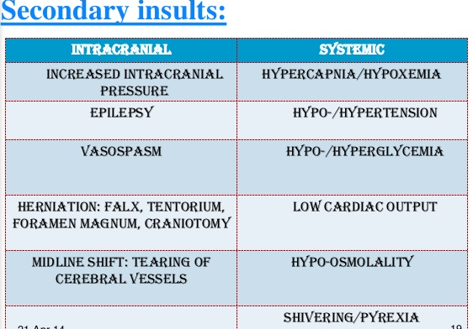
ANAESTHETIC MANAGEMENT
GOALS:-
Maintaining adequate cerebral perfusion & oxygenation of normal brain
Optimizing operative conditions to facilitate resection
Ensuring rapid emergence from anaesthesia at conclusion of procedure to facilitate neurologic assessment
Accomodating intraoperative electrophysiologic monitoring
Preserving both injured & uninjured cerebral territories by maintaining cerebral homeostasis
Avoiding secondary brain insults

Slide 15
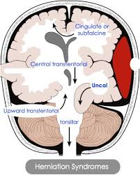
Herniations d/t increase ICT
  Uncal
  Cingulate
  Tonsillar
  transtentorial

Slide 16
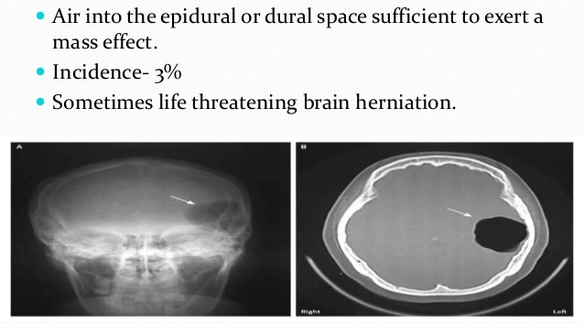
POTENTIAL PROBLEMS DURING CRANIOTOMY
Obstructive hydrocephalus
Injury to vital brainstem centres
Unusual positioning
Pneumocephalus
Postural hypotension
Venous air embolism

Slide 17
PREOPERATIVE MANAGEMENT
Evaluation of ICP- s/s of ICP headache, Seizures
N/V
altered level of consciousness
mydriasis
reactivity of pupils to light, nystagmus
bradycardia
sys HTN
breathing disturbances
midline shift >0.5cm
obstructive hydrocephalus
Hydration- fluid intake , NBM status, diuretics
H/O drug intake- steroid (hyperglycemia, supress HPO axis)
diuretics (electrolyte disbalance)
antiepileptics (inc req of NMJ blockers)
H/O CN palsies – dysphagia, voice change, laryngeal dysfunction, speech
Evaluation for resp pattern, pre-exist HTN, patent foramen ovale, cardiac disease, HypoTN, pul oedema
H/O cerebellar ataxia, wide based gait

Slide 18
INVESTIGATION
CBC, RBS (DI, steroids), RFT, SE (d/t diuretics, SIADH), Coagulation Profile, CXR, ECG.
MONITORING
Noninvasive-
    Pulse oximetry
    sudden variations d/t ICT, brainstem nuclei injury (RS, CVS)
    NIBP,
    ECG, --reflect inc atrial press, bifid P wave, cardiac dyssrythmias , VT, VF
    EtCO2, --useful for m/n of PaCO2 n detect venous air embolism
    Temp,
    Neuromuscular monitoring – via electromyography (to prevent facial N damage), PNS,
    Visual/auditory evoked potentials– to prevent optic N & 8th N damage

Slide 19
Invasive-
    CVP –
        to measure CVP for fluid status
        To have large bore acess
        To aspirate air- specially when tip is multiorificed n placed @ junction SVC n RA
    IBP –
        Zero of transducer is done @ ext auditory meatus instead @ heart to measure CPP
    Pulmonary A Catheter – if cardiac disease +nt
    TEE –
        confirm tip of central line
        Detect air (min 0.25ml)
    urinary output—
        Osmotic diuretics used intra-op
        For long durations of Sx
        Guidance f fluid therapy
        Pt may have SIADH/DI
    ABG – to measure PaCO2

Slide 20
PREMEDICATION
Inj glycopyrolate 0.004mg/kg i.v.
Inj ondansetron 0.1mg/kg I.v.
Inj midazolam 0.05mg/kg i.v. depending upon level of consciousness and resp evaluation
opiods n sedatives depress CNS n may cause drug induced hypoventilation
which may increase CO2 that may inc ICP
Inj fentanyl 1ug/kg i.v.
Cont antiepileptics on morning of Sx
Cont Steroids with RBS monitoring
Cont diuretics if SE are N
Antibiotics

Slide 21
INDUCTION
Inj. Thiopentone sodium 5-7mg/kg i.v.
    Barbiturate
        -Maintain CPP (CPP = MAP – ICT)
        -Decrease CMRO2
        Decrease CBF & CBV ----- so decrease ICT
        -Potent vasoconstrictor
        -Also anticonvulsant action
        -So cerebral protection
        -Shows robbin hood or reverse steel phenomenon– d/t vasoconstriction redistribute blood from normal to ischaemic areas.
        But has antanalgesic action
Inj. Propofol 2mg/kg i.v.
  Rapid onset
  Same as thiopentone
  Decrease in CBF > CMRO2
  m/c induction agent for neuroanaesthesia

Slide 22
Muscle relaxant
Inj succinylcholine –
  Depolarizing muscle relaxant
  May increase ICT temporarily & modestly
  But still agent of choice for difficult airway & RSI
NDMR—
  Used for tracheal intubation
    by precurarization (1/5th dose) to decrease fasciculation of Sch
    Or directly by priming(1/10th dose) and then induction dose after 3min.
  f/b mechanical hyperventilation to decrease ICT
  & maintain PaCO2 35-45 mmHg
f/b laryngoscopy
To blunt stress
    inj lignocaine 1.5mg/kg i.v.
    Inj esmolol 0.5-1.0 mg/kg
    Short acting opioids
    Inj dexmed
    Inj propofol
    Sevoflourane
    Non pharmacological method – using mc-coy instead mc-intosh blade

Slide 23
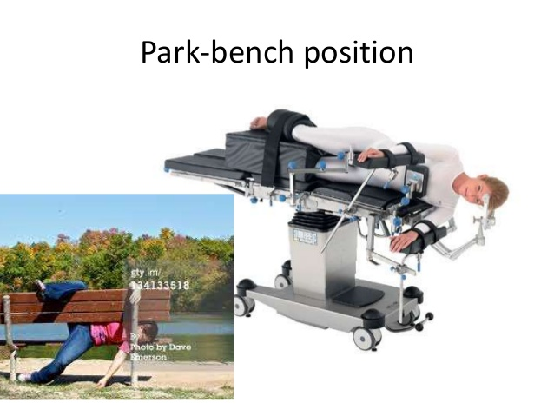
Positioning
Supratentorial :
  supine position
  10-15 degree head elevation
  Increases cerebral venous drainage
  But excessive flexion or rotation of neck
      impairs drainage
      Causes
            increases ICT
            Upp airway swelling
            Rarely quadriplegia
Infratentorial
  Sitting semirecumbent position
  Prone position
  Park bench position

Slide 24
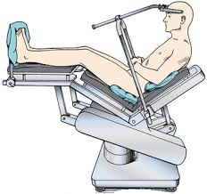
Sitting semirecumbent position
Indication:
  Post fossa tumor
  Aneurysmal clipping
  Cranial nerves decompression
  Cerebellar stimulation
Position:
  -legs elevated
  -Knees flexed
  -Arms side
  -Hands on lap
  -Back 60 degrees raised
Advantage:
  Excellent surgical exposure
  Increase venous drainage
  Increase CSF drainage
  Minimize blood loss
  Decrease ICT
Disadvantage:
  Venous air embolism
  pnemocephalus

Slide 25
Maintainance:
NM blockade via NDMR
Fluid status – mannitol – 0.25- 0.5 g/kg i.v. for 15-30 min removes minimal 100ml of water from brain
Inhalational:
  Maintain adequate depth to prevent increase in ICT
  Low dose conc req. = 0.6 – 1.0 MAC
  Causes vasodilatation = impairs autoregulation
  Sevoflurane is best as it causes least vasodilatation
Gases:
  N20 :
    Controversial
    Increase venous in embolism in sitting position
    Causes pneumocephalus after closure of dura – air bubbles size increase
    Tendency to expand in close cavity

Slide 26
Extubation:
  Mostly can b extubated, if neurological function intact
  If remain intubated shd b sedated
  Bucking on tube avoided:
    Increase bleeding
    Increase cerebral oedema
  During skin closure:- spontaneous respiration
  During dressing + full acess to pt + back to original position = Nmblock reversed
  Rapid awakening = early neurological assessment
  Delayed awakenig - d/t opioids & high volatile

Slide 27
VENOUS AIR EMBOLISM:
Causes:
  Intracranial tumour sx
  Head n neck Sx
  Open heart Sx
  Patent foramen ovale (R to L shunt)– paradoxical air embolism
  Ortho Sx
  Liver transplant
  Haemodialysis
  Venous catheterization
mechanism:-
  Negative press inside vein > atm press
  Head/wound above heart
  Air enter pulmonary circulation
  Small gets absorbed
  Large increases pul A press increase pul resistance decrease CO circulatory failure
N2O increases vol of bubbles

Slide 28
Monitoring:
TEE:- 0.25ml
Doppler USG:- 0.5ml, swishing sound = blood
roaring noise = air
CVP:- also to aspirate
Pul A Catheter
EtCO2:- decrease d/t deacrease physiological dead space
Esophageal stethoscope:- mill wheel murmur
S/S:-
  Hypotension
  Tachycardia
  Dec EtCO2
  Hypoxia
  Dec SPO2
  Bronchoconstriction
  Acute cor pulmonale

Slide 29
Treatment:
  Surgeon notified:- Sx field flooded with saline, wet gauze, bone wax
  Stop N2O + 100% O2
  Aspirate through central line
  Increase intrvascular volume
  Use vasopressor if hypotension
  Compress B/L IJV- inc cerebral pressure, helps identify entry point
  Valsalva manoeuvre
  Head low
  Hyperbaric O2
  L lat position
  CVS resuscitation

Slide 30
THANK YOU

