Slide 1
Cartilage histology
Dr. kinjal jethva
Associate Professor
Department of anatomy
S.B.K.S.M.I. & R.C.

Slide 2
Competency
AN71.2 Identify cartilage under the microscope & describe various types and
structure- function correlation of the same

Slide 3
Cartilage
It is specialised type of tissue that develop from mesenchyal cells
Tensile strength
Structural support
Flexibility
Resilient to compression

Slide 4
Characteristic
Not supplied with blood vessels and nerves
Surround by perichondrium which is rich in blood vessels.
Perichondrium absent in fibrous cartilage.

Slide 5
3 types
Hyaline cartilage
Elastic cartilage
fibrocartilage

Slide 6
Hyaline cartilage
Abundant type of cartilage in human body
Homogenous ,transparent and amorphous intracellular matrix.
It is surrounded by perichondrium except articular cartilage.

Slide 7
Hyaline cartilage
Cells – Chondrocyte
Matrix
  Fibers-(collagen, elastic)
  Ground substance
  Perichondrium-fibrovascular membrane

Slide 8
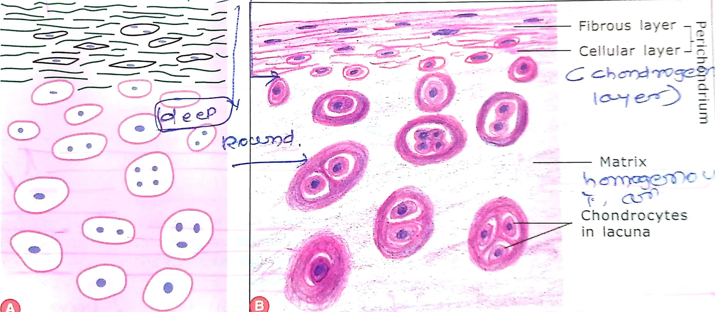

Slide 9
perichondrium
Outer fibrous layer-
Made up of dense irregular connective tissue.
Mesenchymal cell surrounds cartilage differentiate into fibroblast
Fibroblast form collagen fibre ,they form fibrous layer of perichondrium.

Slide 10
Inner cellular layer –mesenchymal cell differentiate into chondroblast.
Made up of predominantly cells which convert to chondrocyte when cartilage is growing.
In adult only fibrous layer is present .
Fibrous layer has blood capillaries which provide nutrition to cartilage cells which diffuse through matrix.

Slide 11
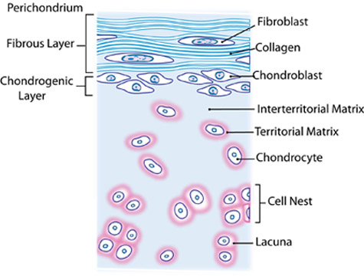

Slide 12
Blood supply
lymphatics
Nerves
Perichondrium absent in
fibrocartilage
Articular cartilage
Where direct contact with bone(costal cartilage)

Slide 13
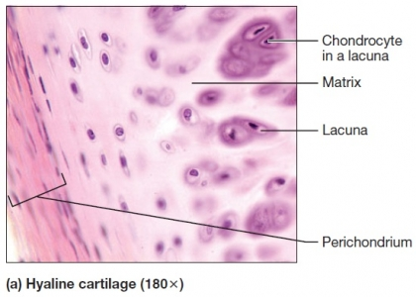

Slide 15
Cells
Chondroblast- they are present in peripheral part of cartilage
They are the precursor of chondrocyte.
Only one type of cell seen in cartilage is chondrocyte.

Slide 16
Chondrocyte
Chondrocyte present in space called lacunae
In H & E stain slide there is gap between chondrocyte and lacunae because chondrocyte is shrunken
Inner part of cartilage cells arranged in cluster called cell nest
Chondrocyte synthesise and secrete extracellular matrix(fibers +ground substance)

Slide 18
Ground substance
It is featureless (homogenous) gel like substance that stains blue with basic dyes(haematoxylin)
Sulphated Proteoglycans
Basophilia is due to prescnece of chondroitin and keratin sulphate(acidic in nature)
Highest concentration is around lacuna(territorial matrix)
Interterritorial matrix

Slide 19
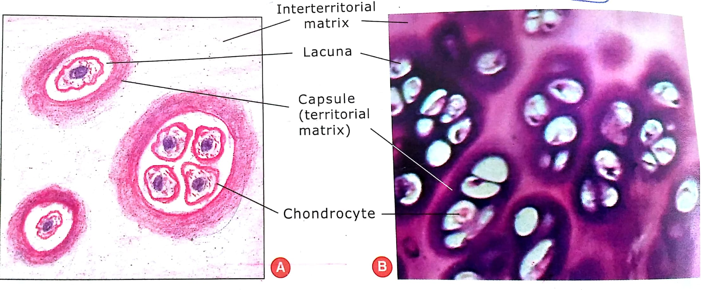
Matrix
Territorial –surrounds lacunae(capsule)
Interterritorial-remaining matrix

Slide 21
Ground substance
Supports cells provide medium through which substance are exchanged between blood and cells
In cartilage ,it is well hydrated that provide resiliency to the cartilage
Provide flexible support to the tissue

Slide 22
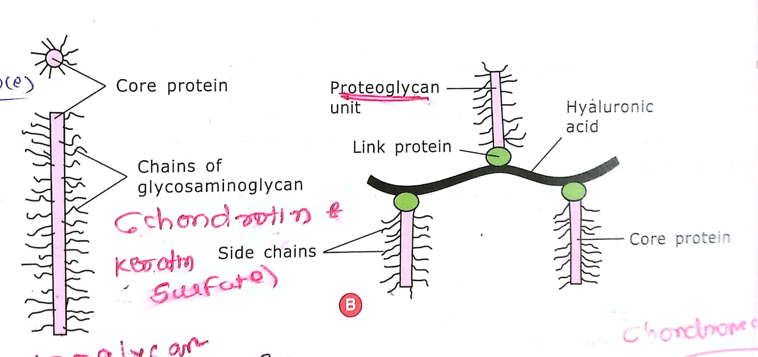

Slide 23
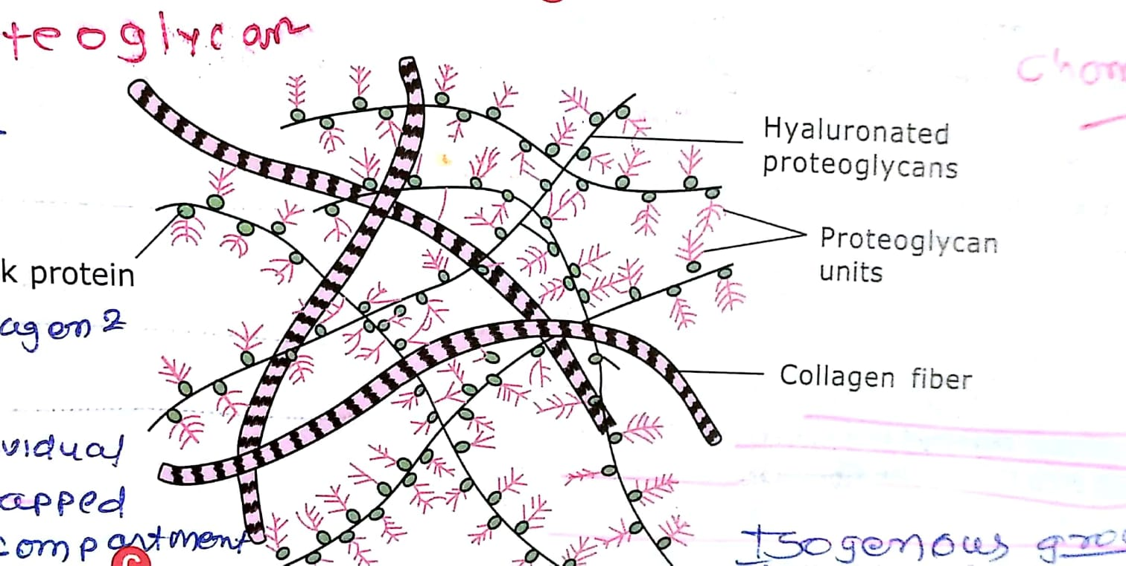

Slide 24
Fibre
It contains collagen fibre (type 2)
These fibers constitute 40% of the dry weight of cartilage
But it should not be distinguished because refractive index of collagen fibers and ground substance are same.

Slide 26
Hyaline cartilage
Most abundant type of cartilage
Location-
Fetal skeleton
Ends of long bones
Nose
Costal cartilage
Trachea
Bronchi
larynx

Slide 27
Hyaline cartilage
Function
Articular cartilage provides cushioning and smooth surface for movements of joints.
Although it provides support because of its frimness.
Firmness of cartilage keeps the lumen of trachea and bronchi patent.

Slide 28
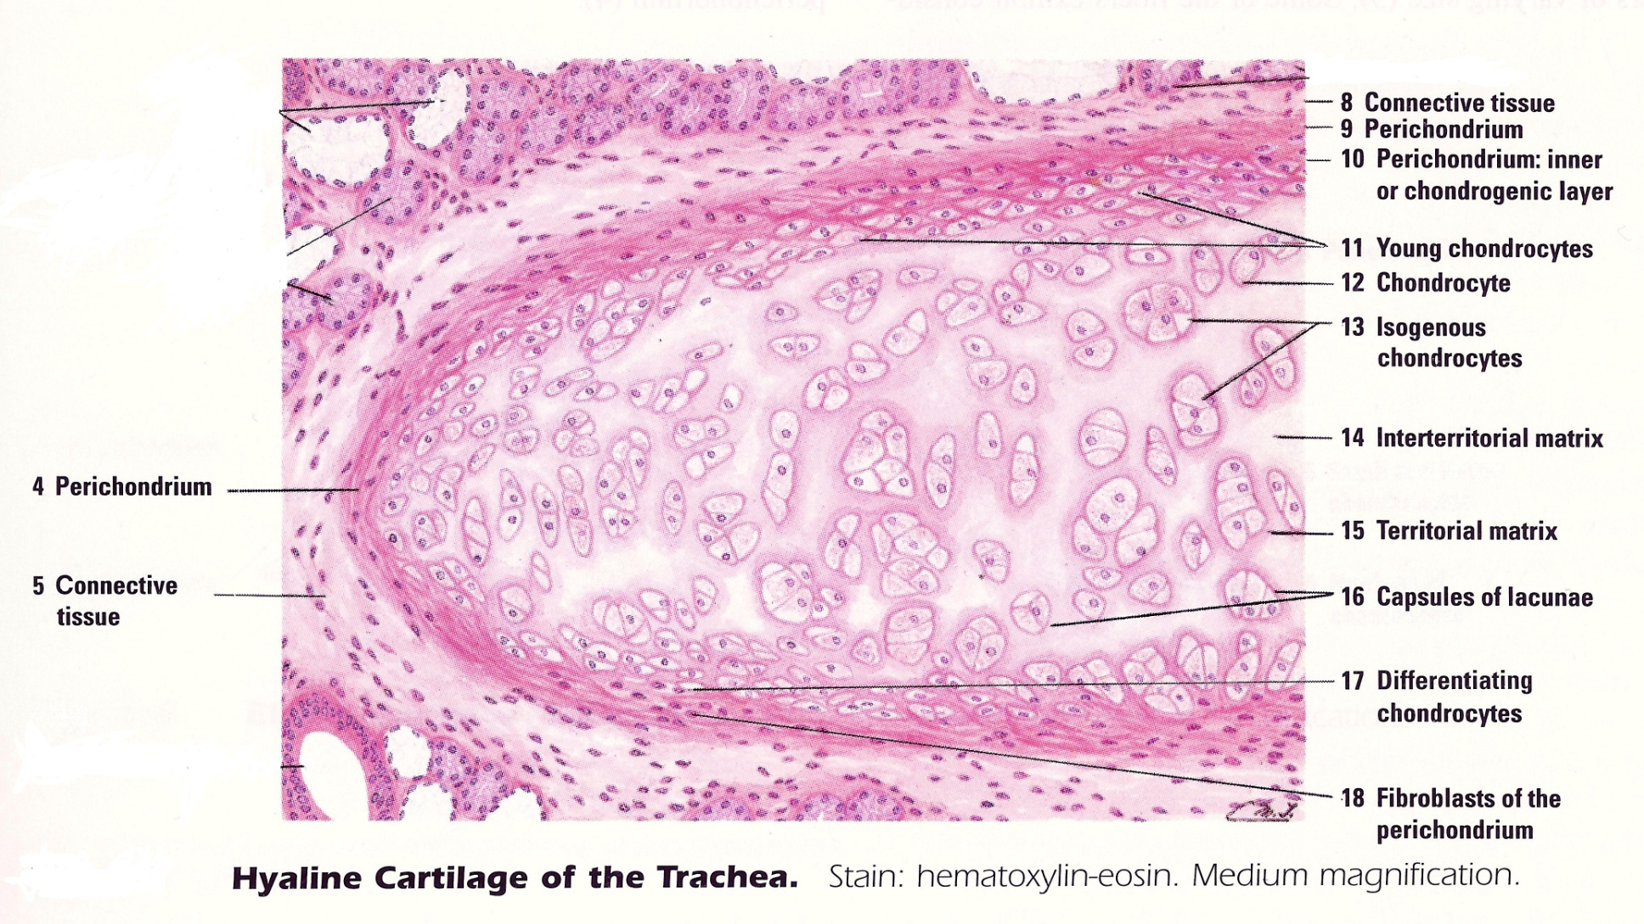
H

Slide 29
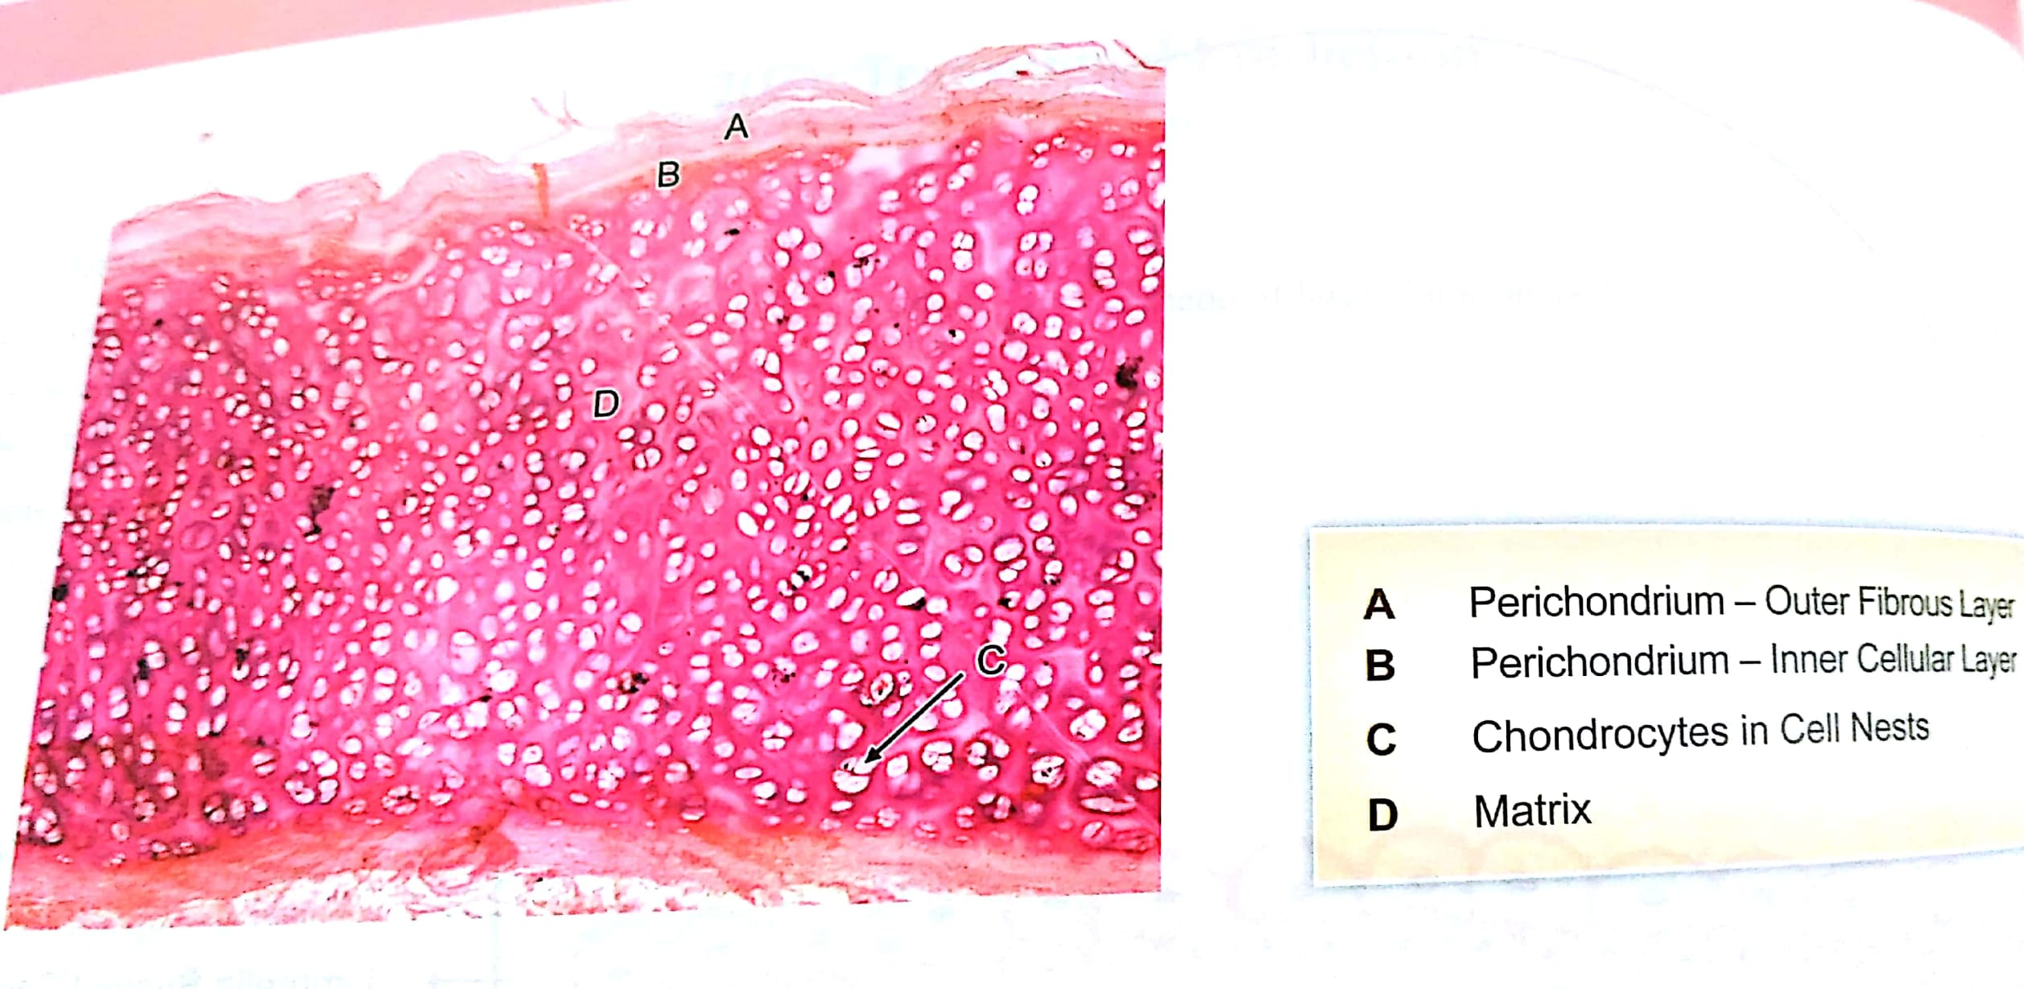

Slide 30
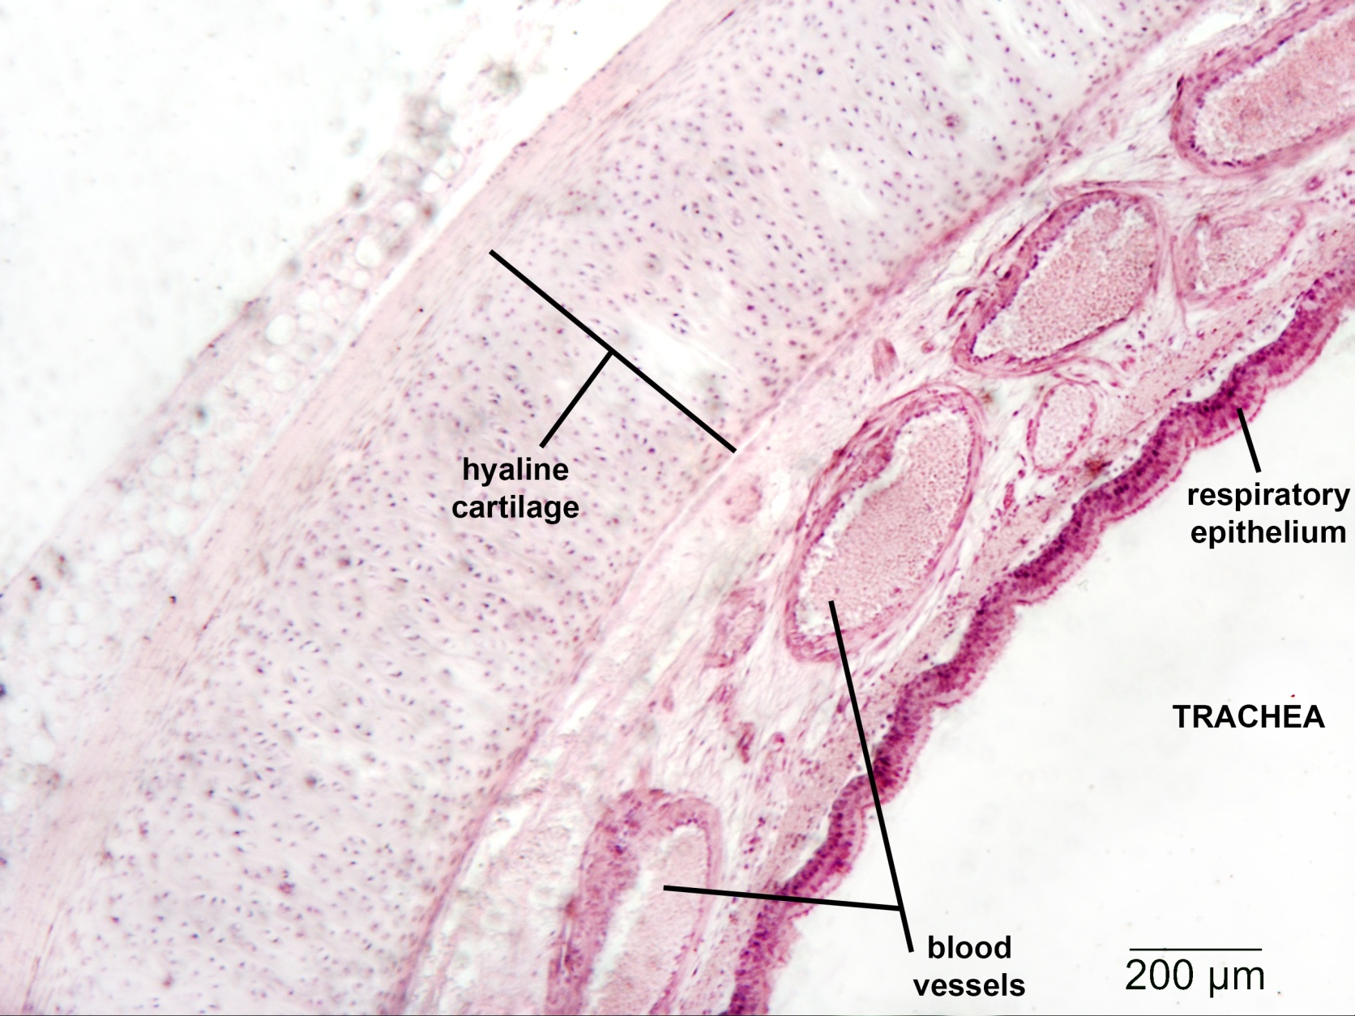

Slide 31
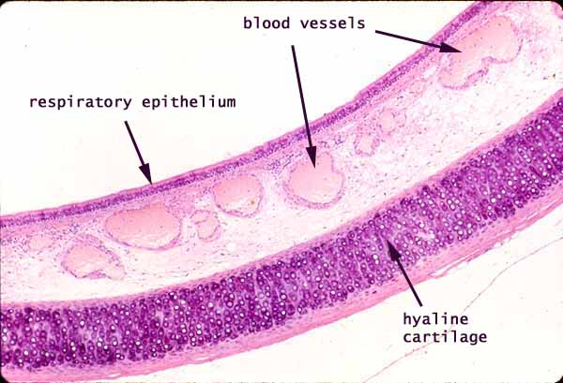

Slide 32
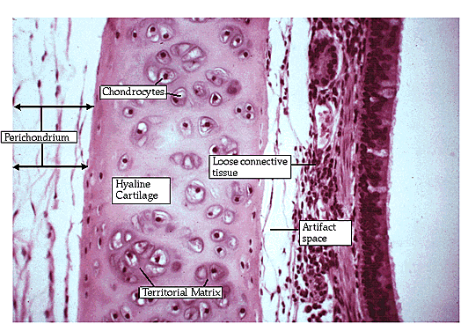

Slide 33
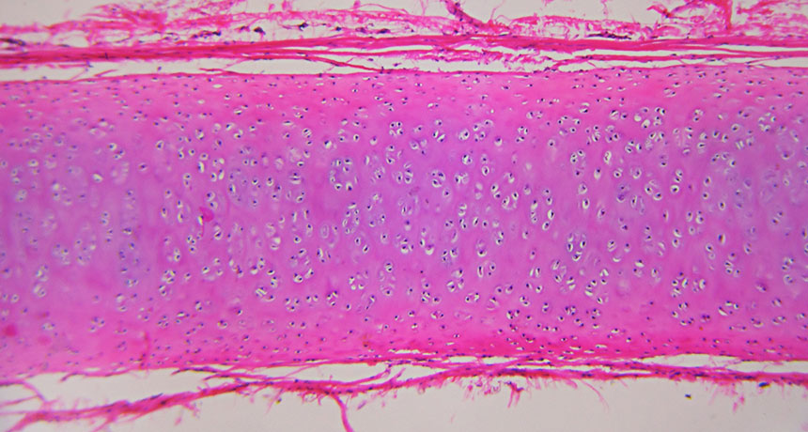

Slide 34
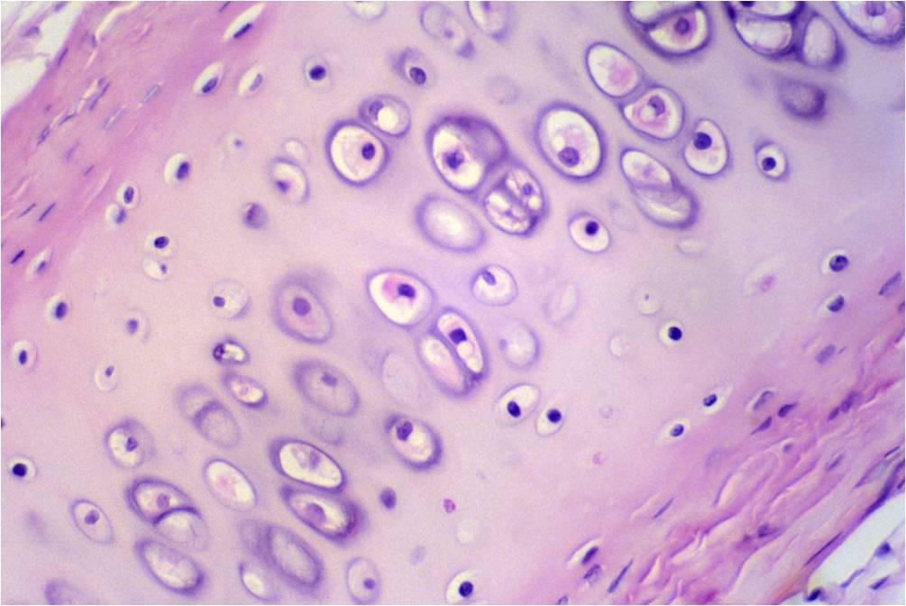

Slide 35
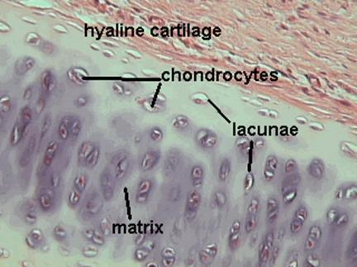

Slide 36
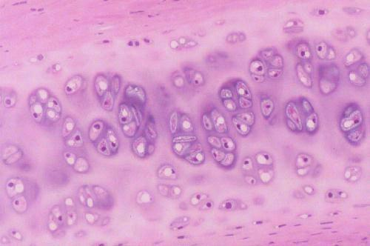

Slide 37
Elastic cartilage
Elastic cartilage present at the site where there is more need of flexibility.
Location
Pinna of the ear
Wall of external auditory meatus
Eustachian tube
Epiglottis

Slide 38
Yellow on gross appearance(FRESH STATE)
Pink on H & E stain
Black on van gieson stain

Slide 39
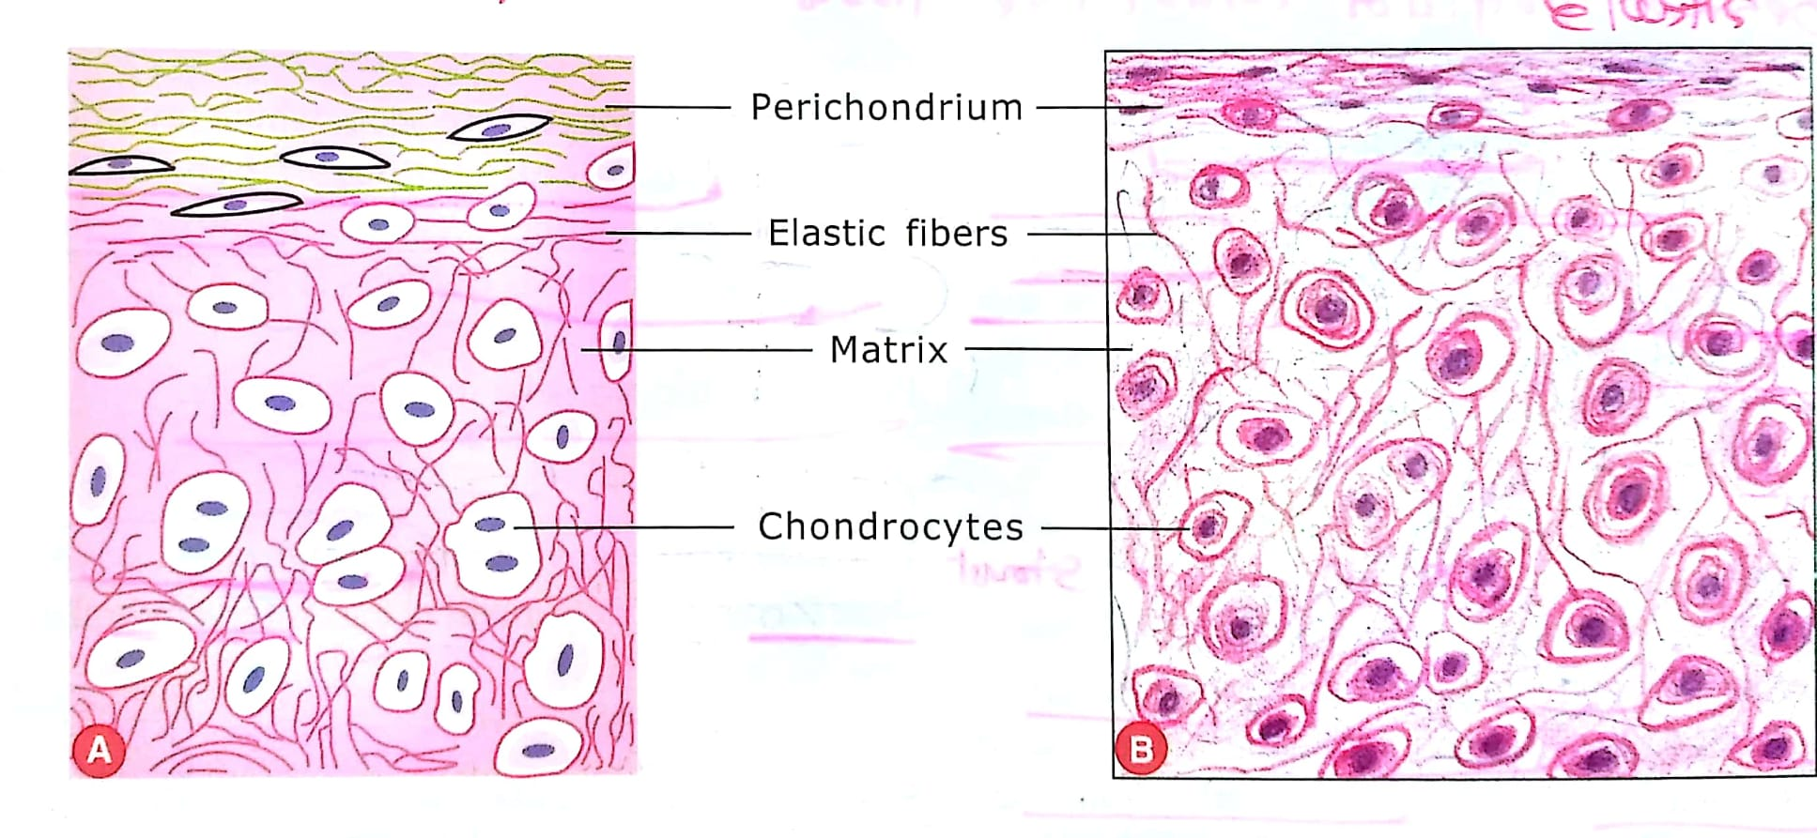
Elastic cartilage

Slide 40
Features
1)Cells-
chondrocyte closely packed.
Cells are bigger than cells present in hyaline cartilage.
Number of chondrocyte is more than amount of matrix compared to hyaline cartilage.
No cell nest like hyaline cartilage

Slide 41
Fibres –collagen(type 2) + elastic fibre (more amount)
Elastic fiber not seen in H&E stain
Meshwork of branching and anastomosing elastic fiber ,heavily concentrated in centre
Ground substance –same as hyaline cartilage
Perichondrium –present at all sites

Slide 42
Elastic cartilage

Slide 43
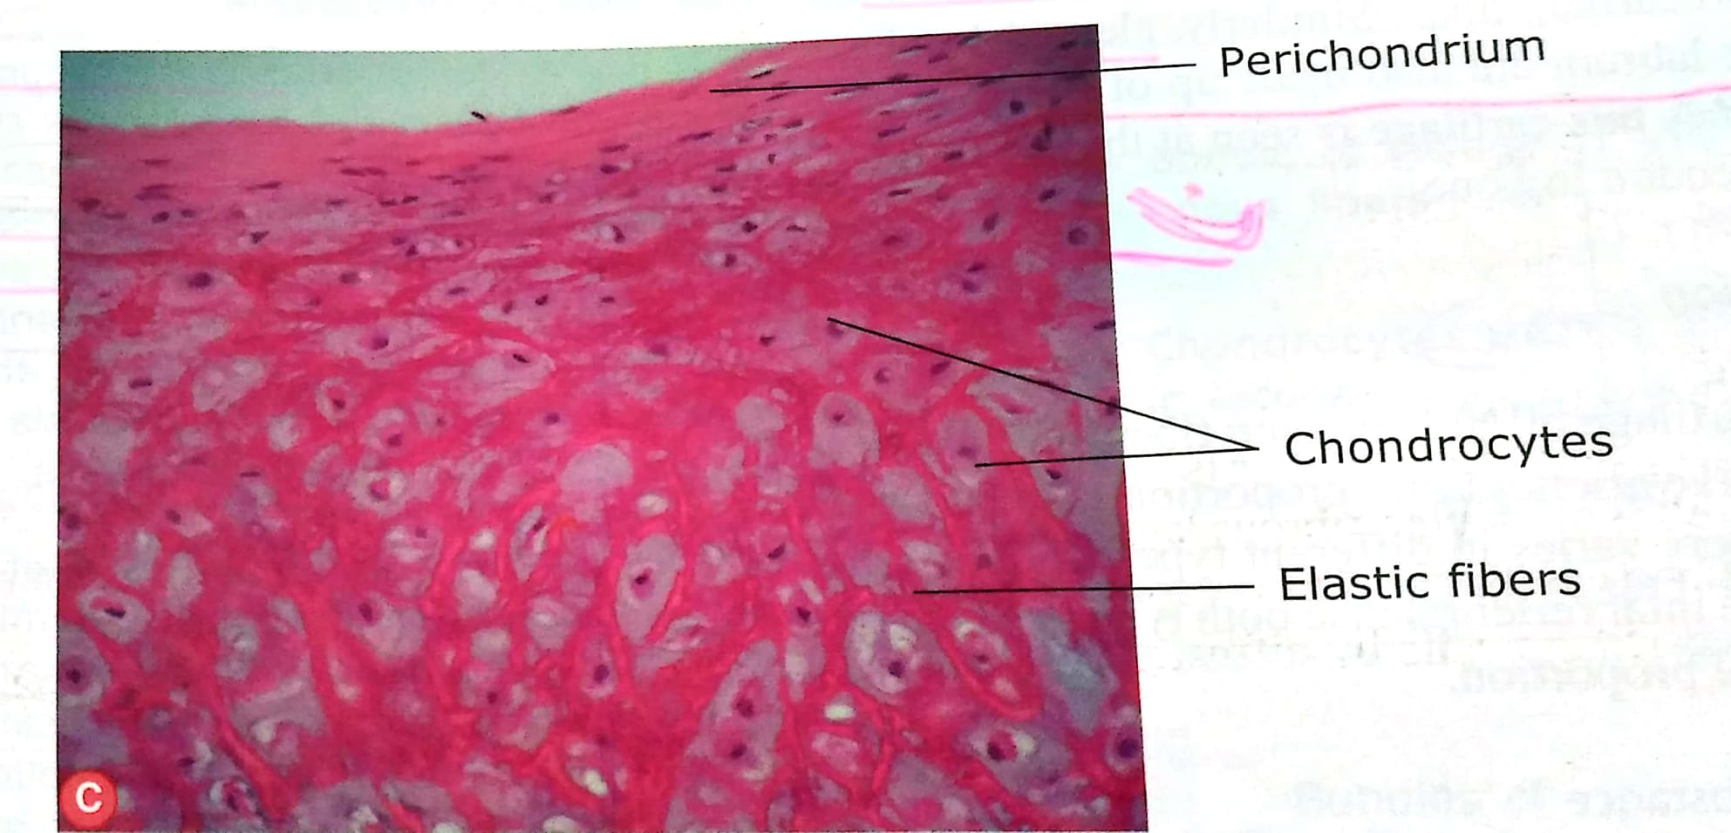

Slide 44
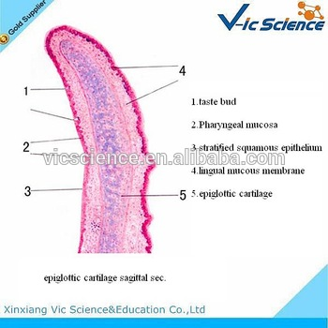

Slide 45
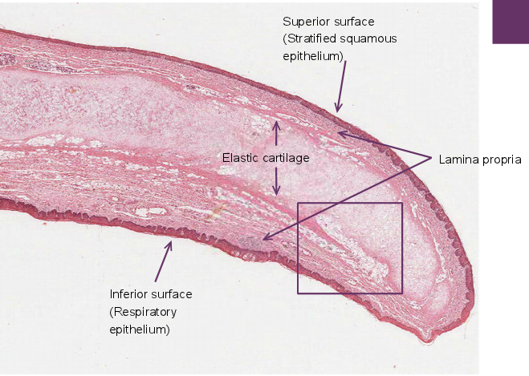

Slide 46
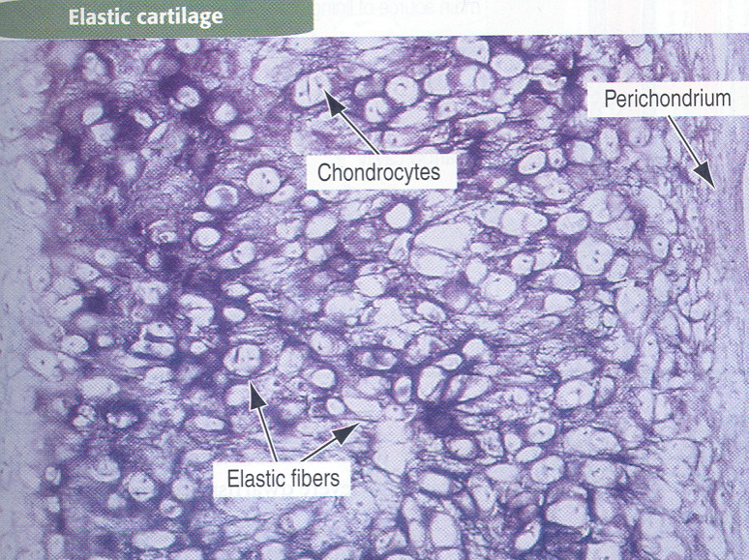

Slide 47
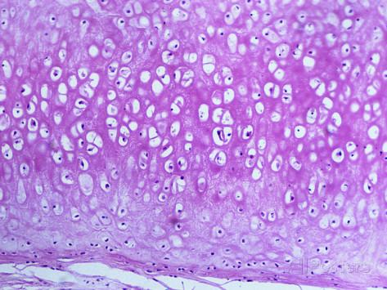

Slide 48
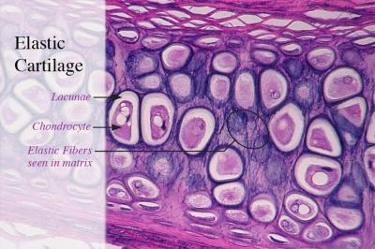

Slide 49
Fibrocartilage
It provide tensile strength in the region where it is located.
location-
intervertebral disc
Articular cartilage in pubic symphysis
Similar to slide of tendon

Slide 50
features
Cells –Chondrocytes are arranged in rows between layers of collagen within lacunae of matrix.
Fibres-
Bundles of thick collagen fiber (type 1 and type 2) are oriented in direction of stress.
Proportion of type 1 and type 2 fibers is varies according to site

Slide 51
Ground substance –minimal amount of basophilic substance is seen around chondrocyte.
Perichondrium - absent

Slide 52
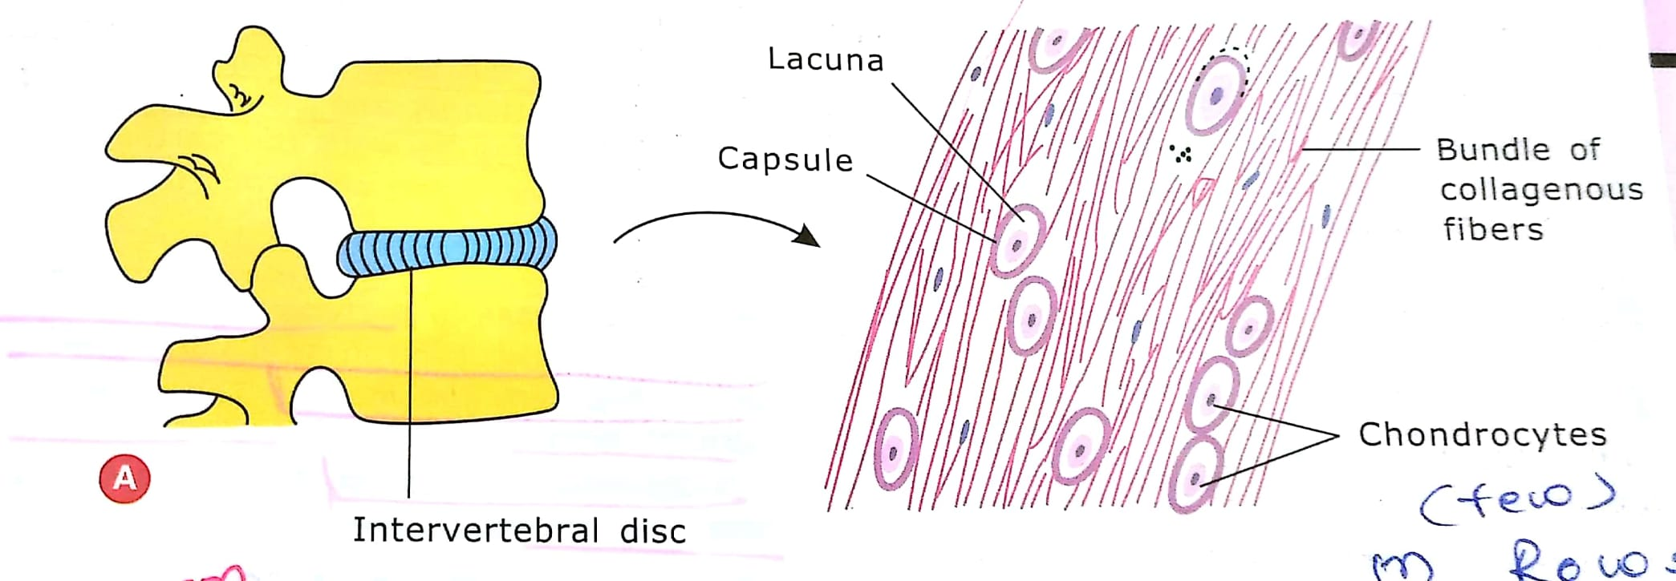

Slide 53
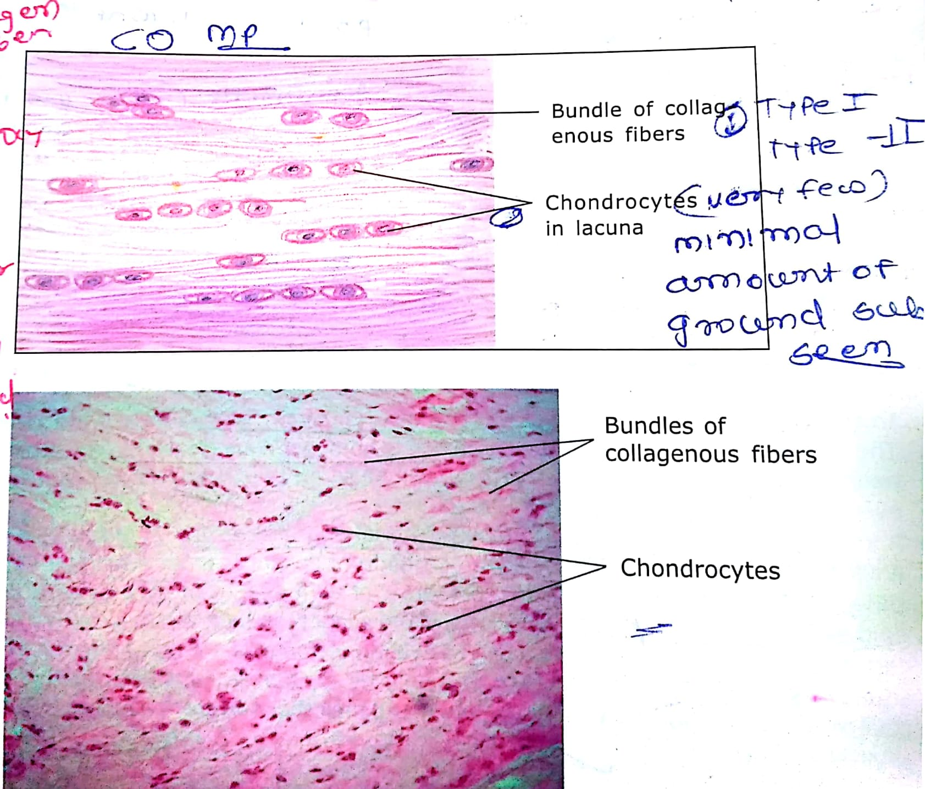

Slide 54
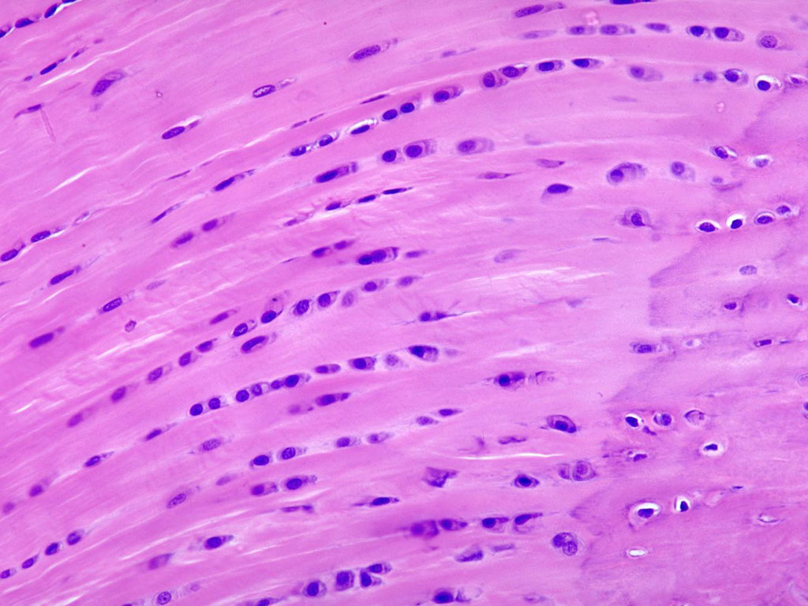

Slide 55
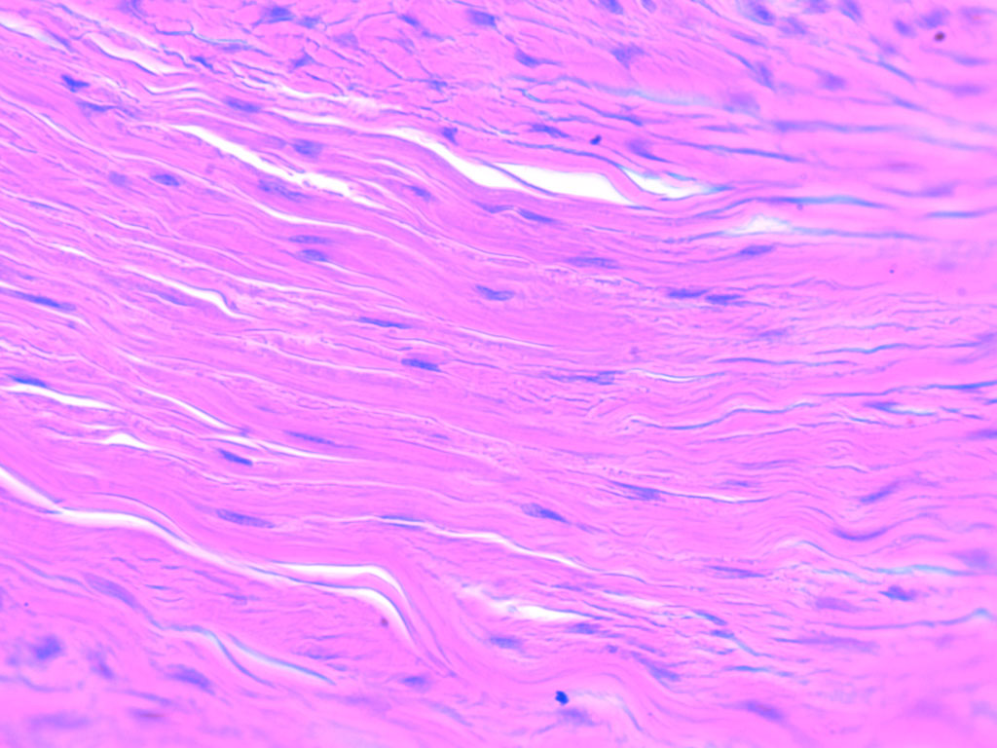

Slide 56
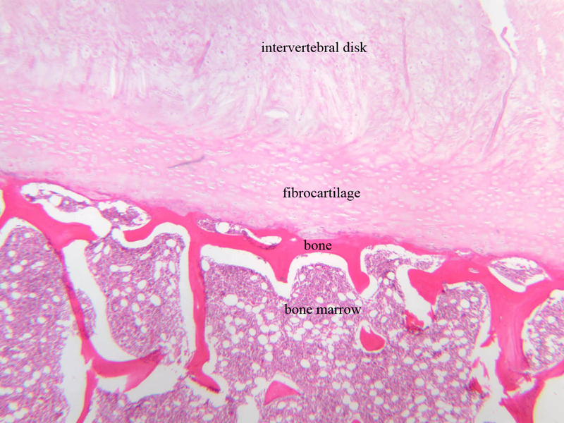

Slide 57
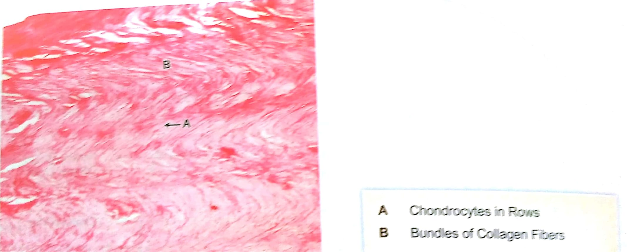

Slide 58
osteoarthritis
In this articualr cartilage is damged so it exposes bone beneath it.
Pseudoachondropalsia
In this condition reduced proliferation of cartilage cells at epiphyseal plate of long bone
Short stature

Slide 59
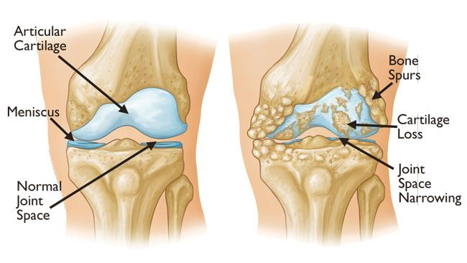

Slide 60
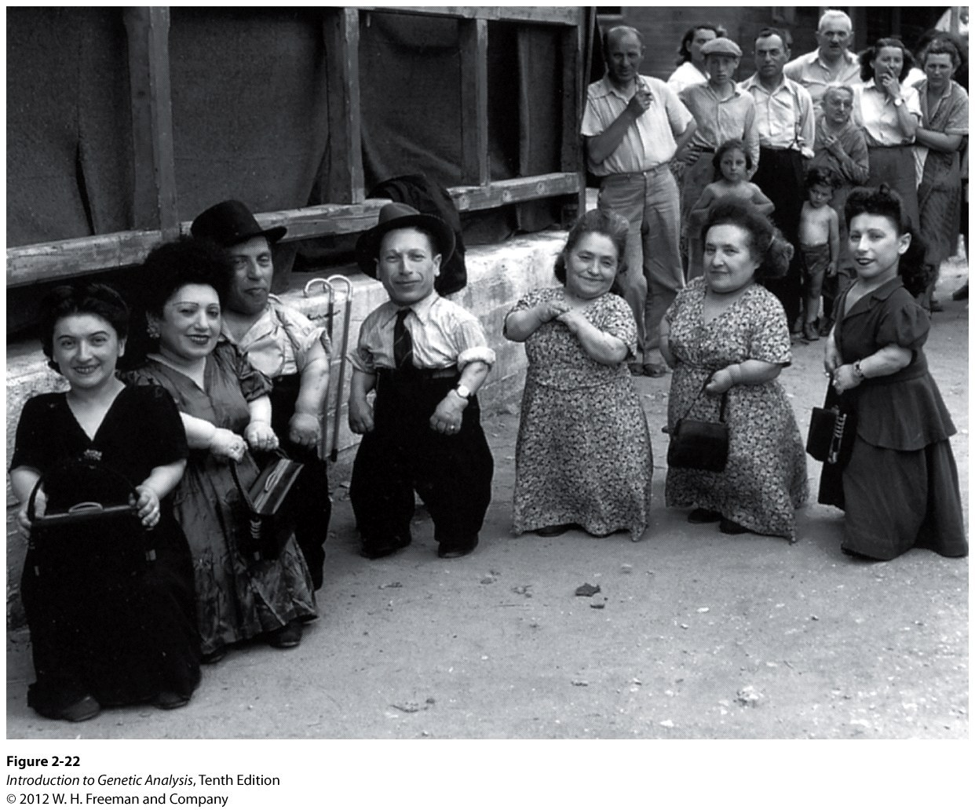

Slide 61
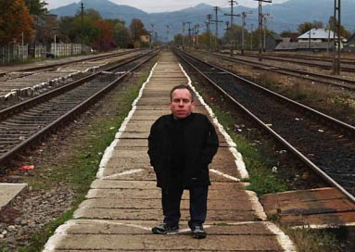

Slide 62
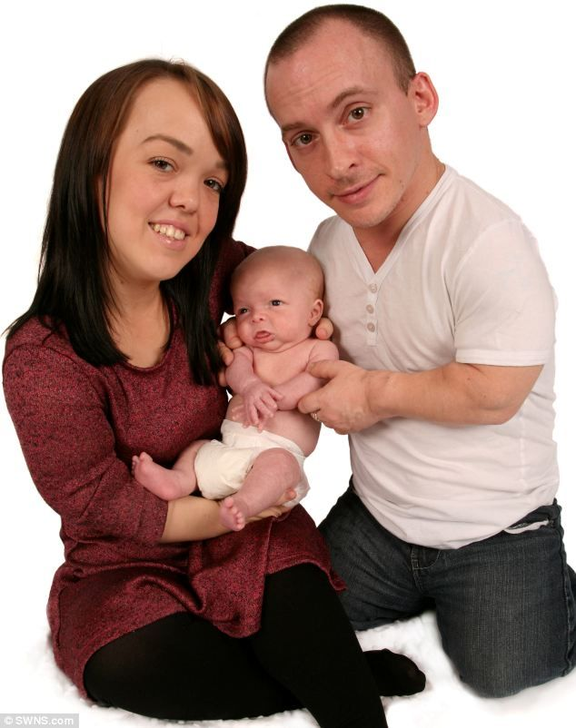

Slide 63
1)Trachea contain which type of cartilage
Hyaline
Fibrous
Elastic
A and b both

Slide 64
2)Epiglottis contain which type of cartilage
Hyaline
Fibrous
Elastic
A and b both

Slide 65
3. Holocrine type of secretion is a feature of:
a) Mammary gland
b) Parotid gland
c) Sebaceous gland
d) Pancreas

Slide 66
4)Pseudostratified epithelium seen in
Ureter
trachea
Skin
Oesophagus

Slide 67
2)Trachea identified by which features
Pseudostratified epithelium
Hyaline cartilage
A and b both
Elastic cartilage

Slide 68
A.Cronström, Osteoarthritis and Cartilage Open
Volume 2, Issue 2, June 2020, 100056, https://doi.org/10.1016/j.ocarto.2020.100056
Author | Title | Method | Result | Conclusion
A.Cronström | On the waiting list for joint replacement for knee osteoarthritis: Are first-line treatment recommendations implemented? | All patients on the waiting list ≥ three months for knee replacement due to knee OA (n = 229) at a public hospital in Sweden were invited to participate in this cross-sectional survey study. 136 individuals (mean age 70 ± 9 years, 59% women) answered self-reported questionnaires including demographics, physical activity level, knee function and treatments before and during their time on the waiting list. | Before being referred to the waiting list, 40% had participated in guideline-based OA management (Better management of patients with OsteoArthritis (BOA)), 53% in physiotherapy, 67% in either BOA or physiotherapy whilst 23% of those overweight (BMI≥25) had received weight-management advice. Women had participated in BOA and physiotherapy twice as often as men (51% vs. 25%, p = 0.002 and 66% vs. 34%, p < 0.001) prior to waiting list referral. During their time on the waiting list, only 10% were recommended BOA, 30% physiotherapy and 15% weight-management. 38% of the patients that had never participated in BOA indicated that they were interested in participating while waiting for their knee replacement. | Our results suggest that recommended treatment guidelines for OA may not be adequately implemented in Swedish health-care. Further exploration of implementation barriers and lack of equality of care appears warranted.

