Slide 1
PHARYNGEAL APPARATUS
Dr.Hetal Vaishnani
Professor
Department of anatomy
S.B.K.S.M.I. & R.C.

Slide 2
Competency
AN 43.4 - development branchial apparatus

Slide 3
Specific learning objective
Define pharyngeal arches, and give their number and source of development
Enumarate the components of a pharyngeal appartus
Describe component of each pharyngeal arches
Describe skeletal, muscle, nerve and arterial derivatives of each pharyngeal arch

Slide 4
PHARYNGEAL APPARATUS
The embryonic pharynx is rostral foregut surrounded by mesenchyme and ectoderm
The pharyngeal apparatus begins to develop early in 4th week on the either side of developing pharynx as the neural crest cells migrate to the future head and neck region

Slide 5
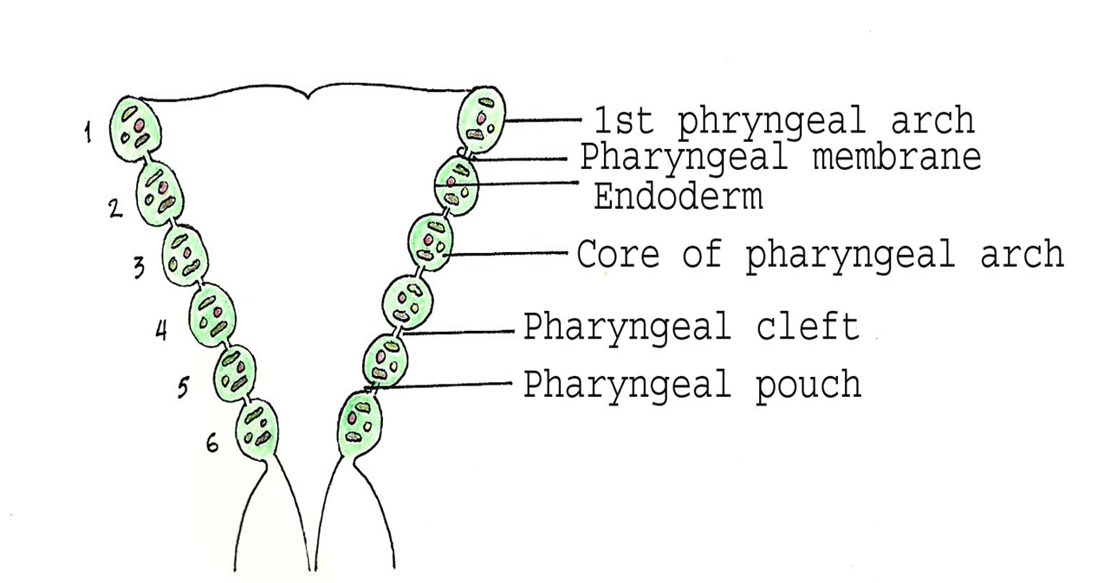
Pharyngeal apparatus contributes to the formation of head and neck
The pharyngeal apparatus consists of
1) Pharyngeal arches
2) Pharyngeal pouches
3) Pharyngeal grooves
4) Pharyngeal membranes

Slide 6
1) PHARYNGEAL ARCHES
Six pairs of pharyngeal arches develop out of which 1st to 4th arches cause surface elevations and rest are not visible externally
1st arch is circumoral (surrounds the oral cavity)
The 5th pair is rudimentary and disappears
The 6th arch projects slightly into pharynx

Slide 7
The pharyngeal arches are numbered cranio-caudally
The pharyngeal arches are obliquely placed
The dorsal ends of pharyngeal arches are at a higher level than ventral ends
1st and 2nd arches are named viz. 1st called mandibular arch and 2nd called hyoid arch

Slide 8
The pharyngeal arches are separated from each other by pharyngeal membranes
The primitive pharynx is separated from stomodeum by oropharyngeal membrane
The oropharyngeal membrane ruptures on 26th day as a result fore gut communicates with amniotic cavity through stomodeum

Slide 9
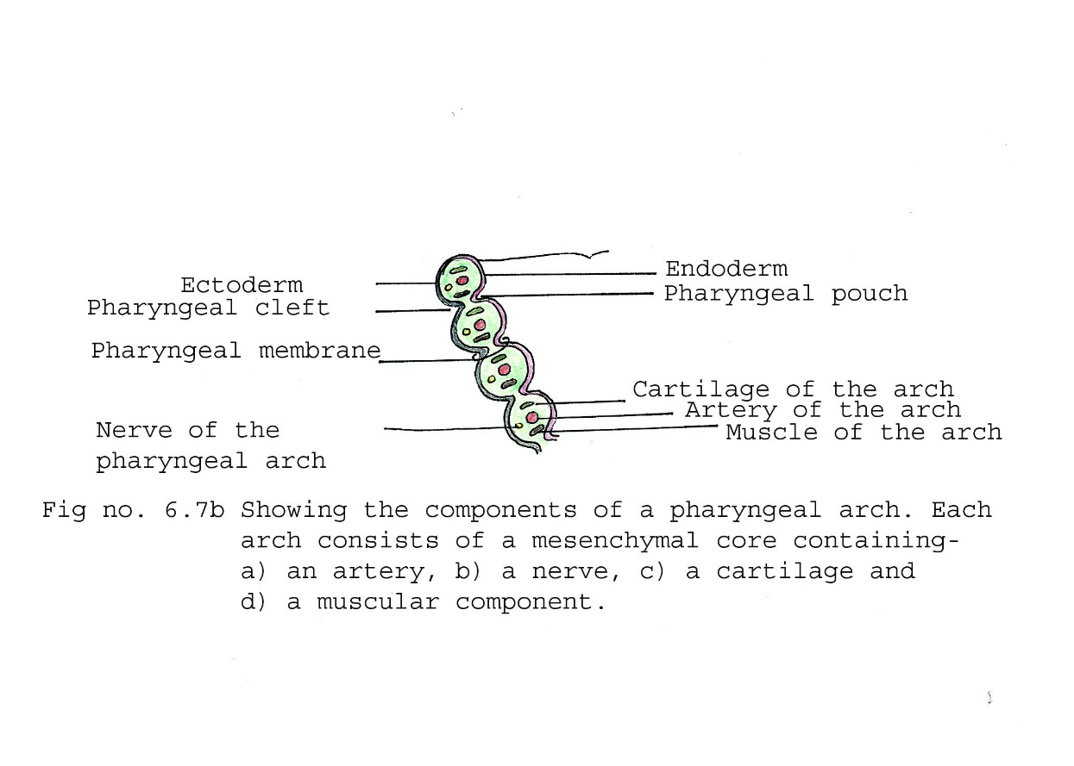
COMPONENTS OF PHARYNGEAL ARCHES
1) Externally covered by ectoderm
2) Internally lined by endoderm
3) Core is made up of mesenchyme

Slide 10
The mesenchyme is originally derived from mesoderm in 3rd week which gives rise to skeletal, muscle and vascular elements
During 4th week most of the mesenchyme is derived from neural crest cells which give rise to mandibular and maxillary prominences (1st arch)

Slide 11
CONTENTS
1) An aortic arch artery which arises from truncus arteriosus of primordial heart
The artery passes around the primitive pharynx to enter dorsal aorta
2) A cartilage which forms the skeleton of the arch
3) A muscular component which forms the muscles of head and neck
4) A nerve derived from neuroectoderm which grows into the arch to supply the muscles and mucosa derived from the arch

Slide 12
DERIVATIVES OF THE PHARYNGEAL ARCH COMPONENTS
Aortic arches (arteries)
3rd, 4th and 6th arch arteries give rise to major arteries of thorax, head and neck.

Slide 13
2) PHARYNGEAL ARCH CARTILAGE
a) 1st arch cartilage (Meckel’s)
Dorsal end related to developing ear and forms:
i) Malleus
ii) Incus
Middle part – The cartilage regresses and perichondrium forms:
i) Anterior ligament of malleus
ii) Sphenomandibular ligament
Ventral part is horse shoe shaped primordium of mandible.
The cartilage disappears and is formed by intra membranous ossification

Slide 14
b) 2nd arch cartilage (Reichert)
Dorsal end forms stapes and styloid process
Middle part – Cartilage regresses.
Perichondrium forms stylohyoid ligament
Ventral part ossifies to form –
i) Lesser cornu of hyoid
ii) Superior part of body of hyoid

Slide 15
c) 3rd arch cartilage
  Located only on ventral part
  It forms –
i) Greater cornu of hyoid
ii) Inferior part of body of hyoid

Slide 16
d) 4th and 6th arch cartilages
  They fuse to form laryngeal cartilages except epiglottis
  e) 5th arch cartilage
  It is rudimentary and has no derivatives

Slide 17
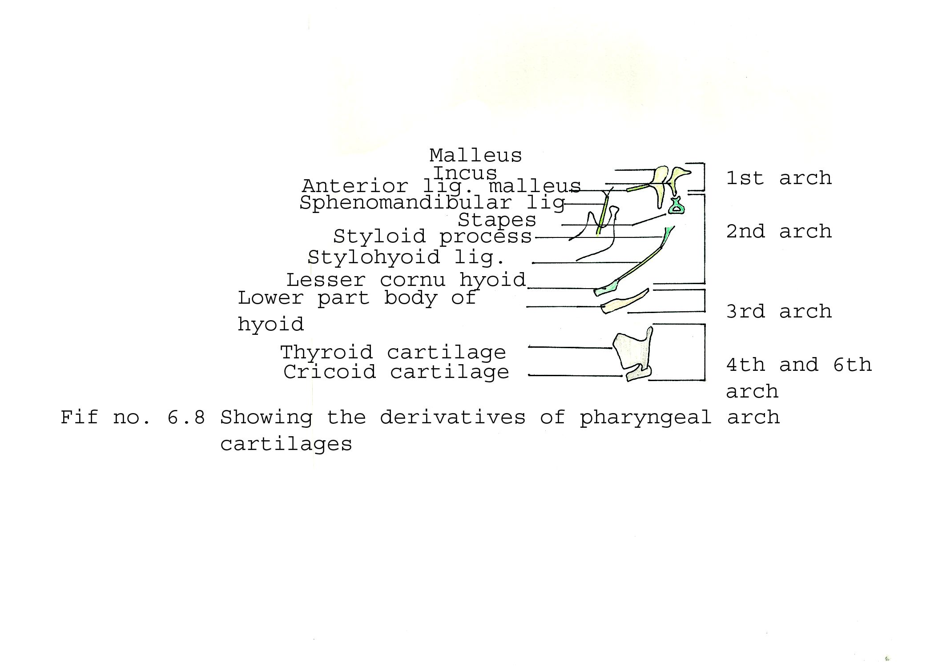
DERIVATIVES ARCH CARTILAGES

Slide 18
1ST PHRYNGEAL ARCH MUSCLES
First arch
Nerve – Mandibular nerve
Muscles supplied by it are –
i) Muscles of mastication 1) Temporalis 2) Masseter
3) Medial pterygoid 4) Lateral pterygoid
ii) Mylohyoid
iii) Anterior belly digastric
iv) Tensor tympani
v) Tensor veli palatini

Slide 19
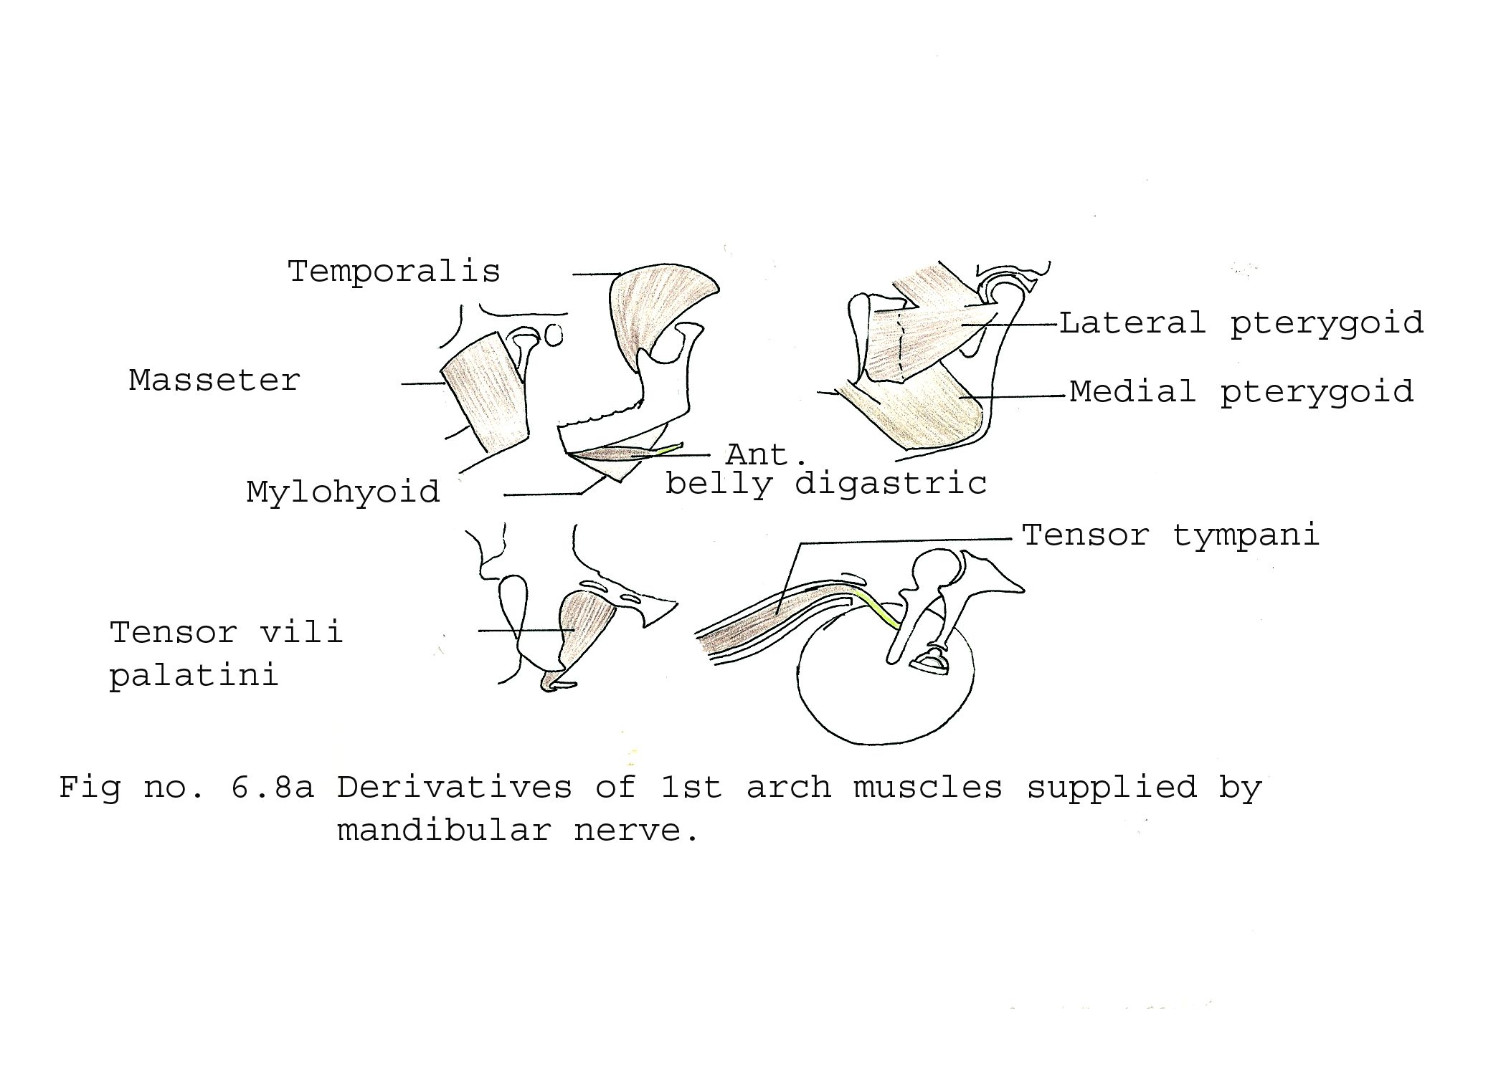
1ST PHRYNGEAL ARCH MUSCLES

Slide 20
2ND PHRYNGEAL ARCH MUSCLES
Nerve– Facial nerve
Muscles supplied by it are –
i) Muscles of facial expression including
-- Buccinator
-- Occipito-frontalis
-- Orbicularis oris
-- Orbicularis oculi
-- Platysma
ii) Stapedius
iii) Stylohyoid
iv) Posterior belly of digastric

Slide 21
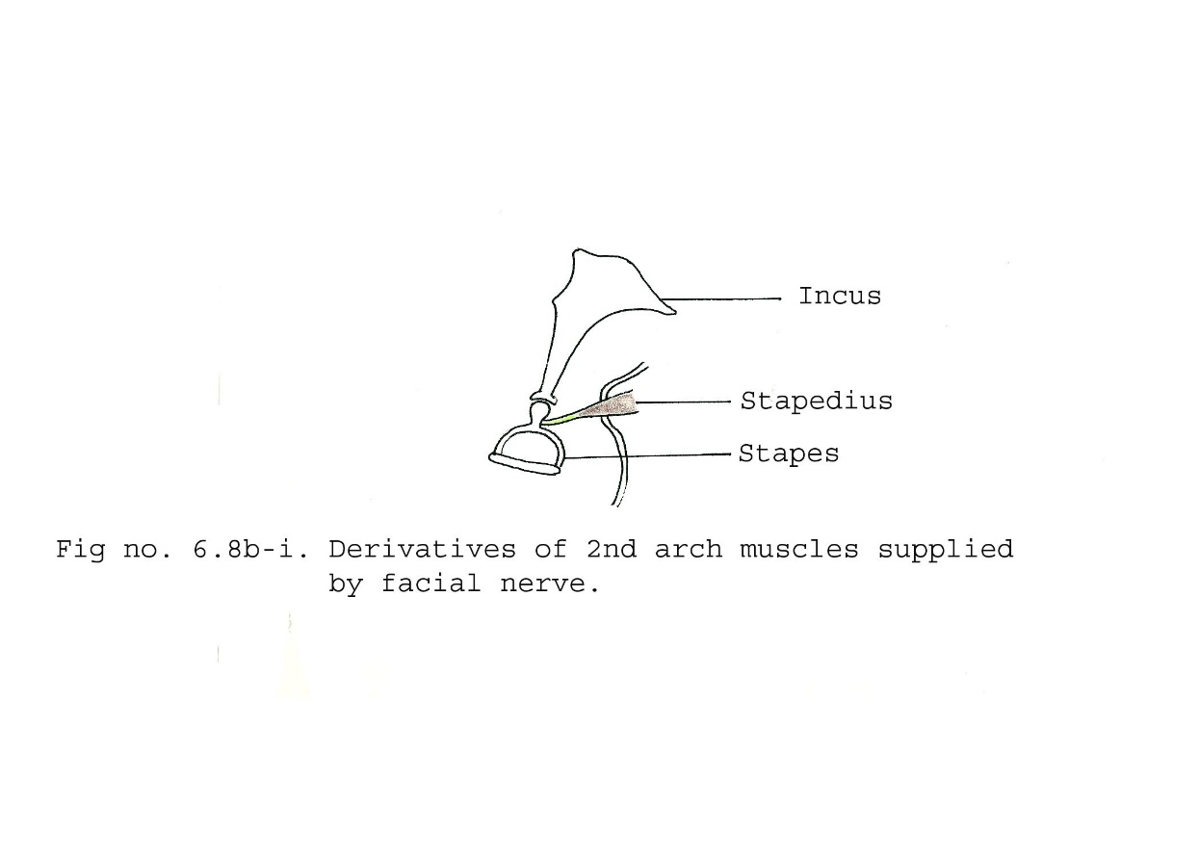
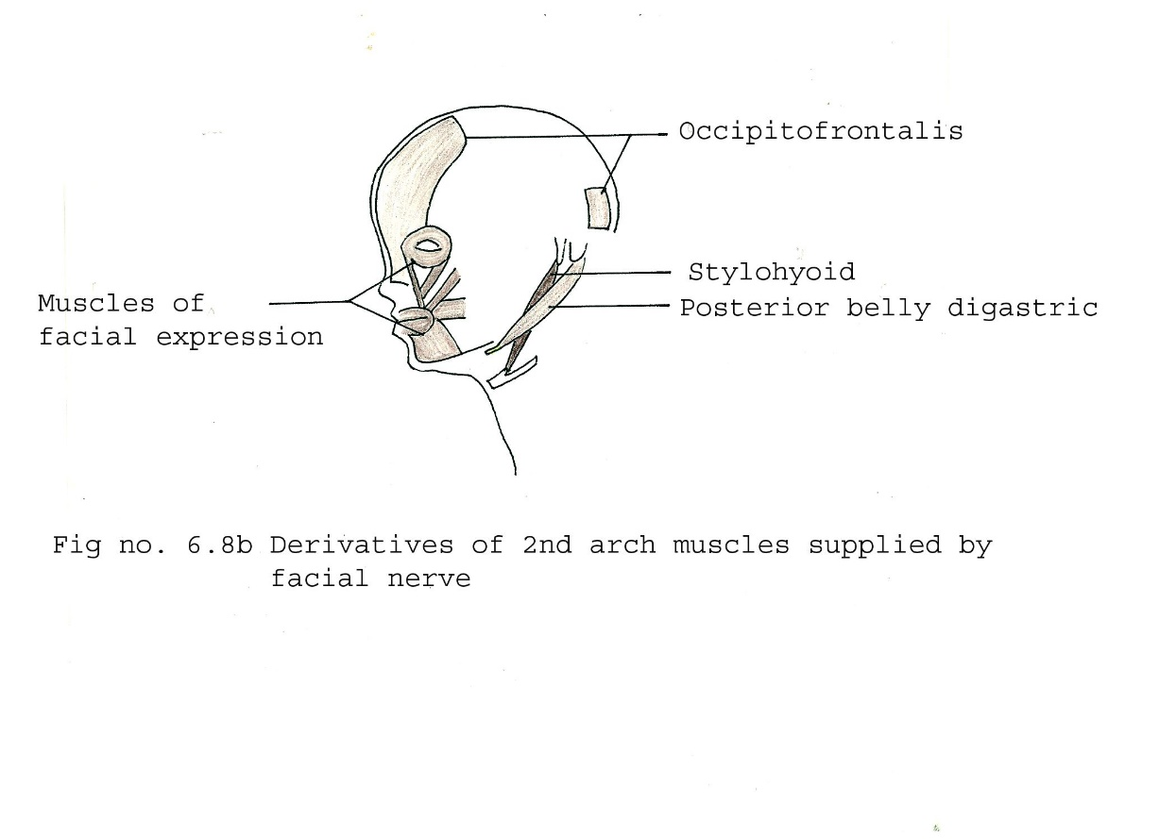
2ND PHRYNGEAL ARCH MUSCLES

Slide 22
3RD / 4TH PHRYNGEAL ARCH MUSCLES
Third arch
Nerve – Glossopharyngeal nerve
Muscle supplied by it –
i) Stylopharyngeus
Fourth arch
Nerve – Superior laryngeal nerve
Muscle supplied by it –
i) Cricothyroid

Slide 23
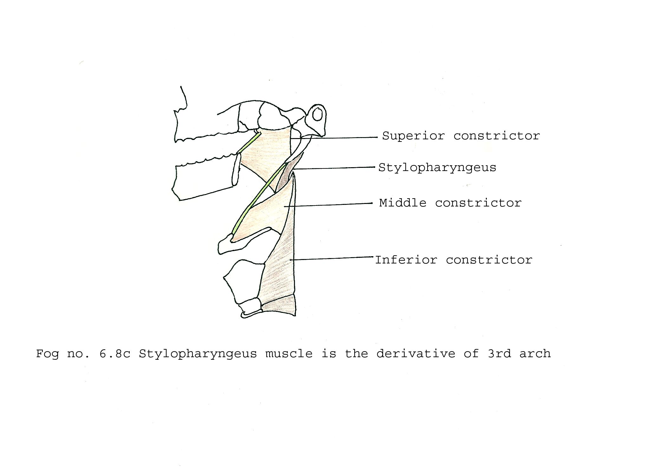
3RD PHRYNGEAL ARCH MUSCLES

Slide 24
6TH PHRYNGEAL ARCH MUSCLES
Sixth arch
Nerve – Recurrent laryngeal nerve
Muscles supplied by it –
i) All intrinsic muscles of larynx
ii) Levator veli palatini
iii) Constrictors of pharynx
iv) Striated muscles of oesophagus

Slide 25
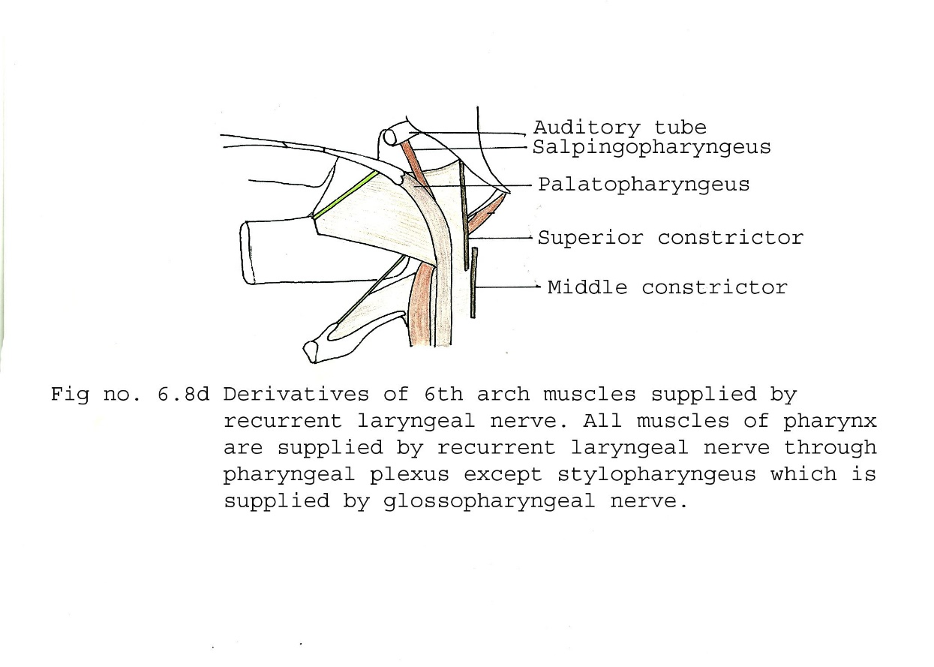
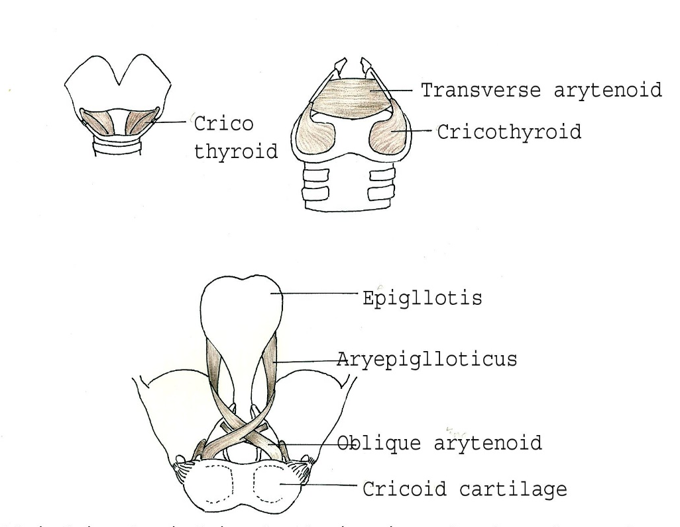
4TH & 6TH PHRYNGEAL ARCH MUSCLES

Slide 26
Title | Author/ Journal | Material | Result | Conclusion
Management of congenital third branchial arch anomalies: A systematic review | KeyvanNicoucarMDªRolandGigerMDªThomasJaecklinMD, MSc^{b}Harrison G.PopeJrMD^{c}PavelDulguerovMDª Otolaryngology - Head and Neck Surgery Volume 142, Issue 1, January 2010, Pages 21-28.e2 | To systematically review the existing literature on third branchial arch anomalies and suggest guidelines for their management. | We found 202 cases of third arch anomalies; they presented primarily on the left side (89%), usually as neck abscess (39%) or acute suppurative thyroiditis (33%). Barium swallow, direct laryngoscopy, and magnetic resonance imaging were the most useful diagnostic tools. The recurrence rate varied among the treatment options: incision and drainage, 94 percent; endoscopic cauterization of the sinus tract opening, 18 percent; open-neck surgery and tract excision, 15 percent; and partial thyroidectomy during open-neck surgery, 14 percent. Complications after surgery appeared somewhat more frequently in children eight years of age or younger. | . Third arch anomalies are more common than previously reported. They appear to be best treated by complete excision of the cyst, sinus, or fistula during a quiescent period. Repeated incision and drainage yields high rates of recurrence and should be avoided. Complications might be minimized by first initiating antibiotic treatment, delaying surgical treatment until the inflammatory process is maximally resolved, and by using endoscopic cauterization.

Slide 27
MCQ
Q. 1 Pharyngeal membrane is made up of
Ectoderm
Ectoderm and endoderm
Ectoderm, mesoderm and endoderm
None of the above

Slide 28
MCQ
Q. 2 Which pharyngeal arch is circumoral?
1st
2nd
3rd
4th

Slide 29
MCQ
Q. 3 Which is not a component of typical pharyngeal arch?
Cartilage
Muscle
Artery
Bone

Slide 30
MCQ
Q. 4 Meckel's cartilage does not give rise to
Stapes
Incus
Malleus
Mandible

Slide 31
MCQ
Q. 5 Which muscle is not supplied by 1st arch nerve?
Anterior belly of digastric
Stylohyoid
Mylohyoid
Masseter

Slide 32
MCQ - KEY
Q. 1 - c
Q. 2 - a
Q. 3 - d
Q. 4 – a
Q. 5 - b

