Slide 1
PLANES,REGIONS & QUADRANTS OF ABDOMEN
Dr. Nirali Chavda
Tutor
Department of anatomy
S.B.K.S.M.I. & R.C.

Slide 2
COMPETENCY
AN44.1
Describe & demonstrate the Planes (transpyloric, transtubercular ,subcostal, lateral vertical, linea alba, linea semilunaris), regions & Quadrants of abdomen.

Slide 3
S L O:
At the end of session phase 1 MBBS students should be able to
Identify the Planes (transpyloric, transtubercular ,subcostal, lateral vertical, linea alba, linea semilunaris), regions & Quadrants of abdomen.

Slide 4

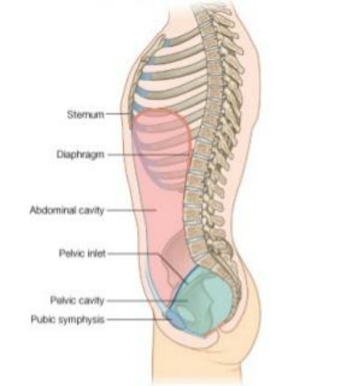
ABDOMEN
•
Lower half of trunk
below the diaphragm.
• Divided into two part
•
Abdomen Proper: from
diaphragm to pelvic
inlet.
•
Pelvis: below the pelvic
inlet.

Slide 5
NINE REGIONS OF THE ABDOMINAL
CAVITY
•
The clinicians divide the abdominal cavity into
nine regions to describe the location of
abdominal organs and the pain associated
with them during physical examination.
•
The abdominal cavity is divided into nine
regions by four imaginary planes two vertical
and two horizontal on the anterior abdominal
wall.

Slide 6
1.Transpyloric Plane
Transpyloric Plane of Addison passes midway
between the suprasternal notch & pubic
symphasis.
It lies below xiphisternal joint.
Anteriorly:it passes through tip of the ninth
costal cartilage.
Posteriorly: through lower border of L1
vertebra.

Slide 7
2.Subcostal Plane
•
Occasionally the subcostal plane is used in
preference to the transpyloric plane.
•
It passes through the lower borders of the
10th costal cartilages and the body of
vertebra L3 near its upper border.

Slide 8
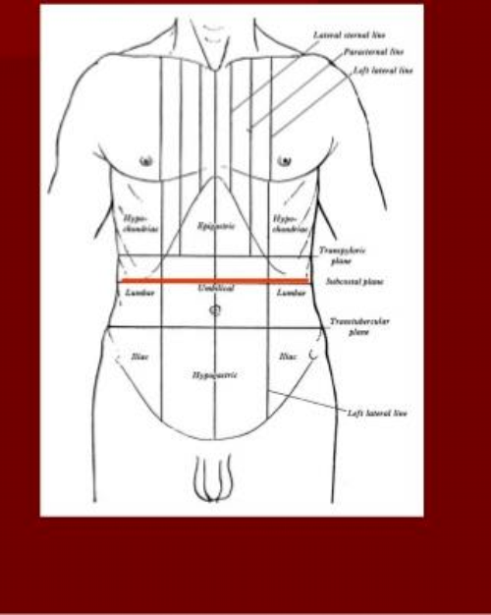
SUBCOSTAL PLANE

Slide 9
3.Transtubercular Plane (Intertubercular
Plane)
•
It passes through the tubercle of illac crest &
lies at the level of upper border of L5 vertebra.

Slide 10
4. Right and left vertical planes
(midclavicular planes):
Each vertical plane passes vertically
downward from the midpoint of the clavicle to
the midinguinal point (a point midway
between the anterior superior iliac spine and
the pubic symphysis).

Slide 11
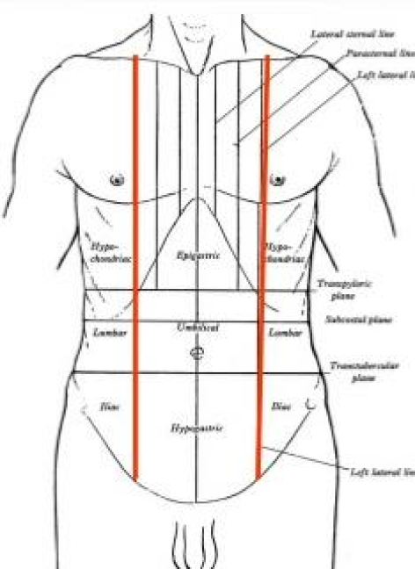
VERTICAL PLANE

Slide 12
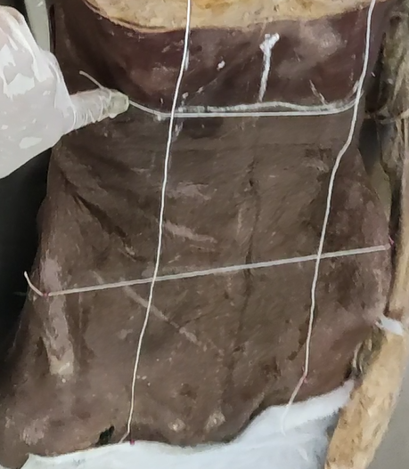

Slide 13
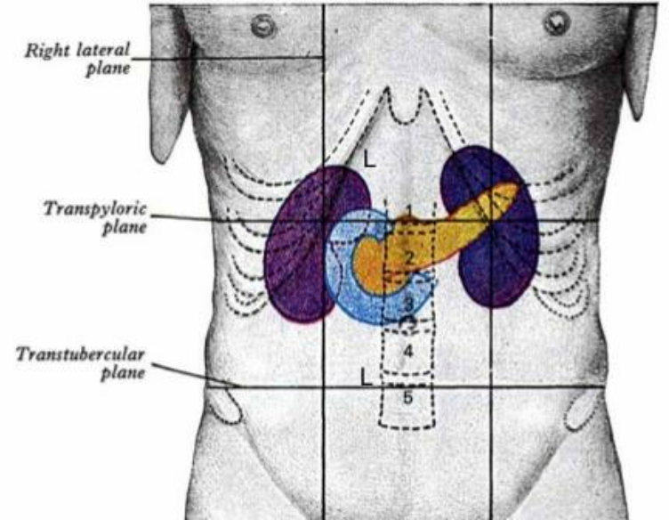

Slide 14
• Nine regions thus marked out are arranged into three
horizontal zones of abdomen:
upper, middle, and lower.
•
From right to left, in the upper abdomen they are
designated as right hypochondrium, epigastric region,
and left hypochondrium.
•
In the middle abdomen they are designated as right
lumbar region, umbilical region, and left lumbar
region.
•
In the lower abdomen they are designated as right
iliac fossa, hypogastric region, and left iliac fossa.

Slide 15
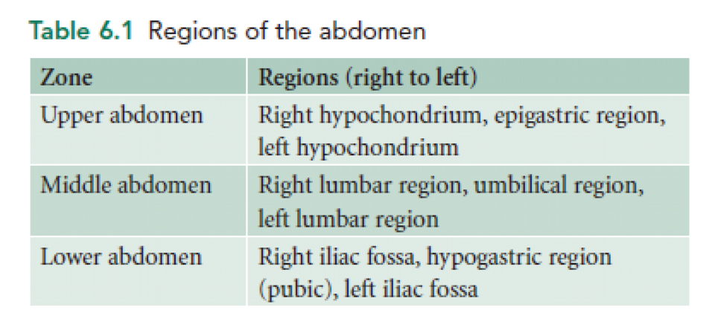

Slide 16
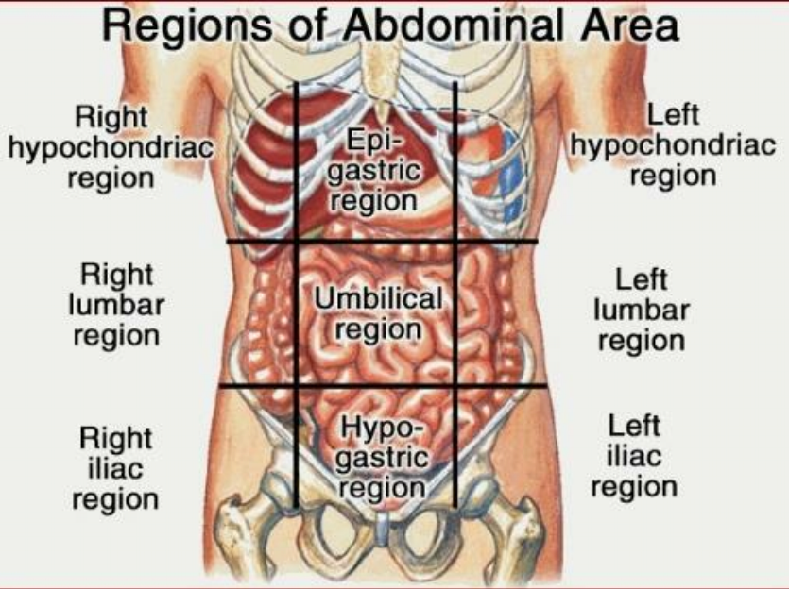

Slide 17
Regions of abdomen
•
Epigastric region: medial to right & left lateral
planes above transpyloric plane.
•
Umbilical region: medial to right and left
lateral planes below transpyloric plane and
above transtubercular plane.
•
Hypogastric region: medial to right and left
lateral planes and below transtubercular
plane.

Slide 18
Regions of abdomen
•
Left Hypochondric region : lateral to left lateral
plane and above transpyloric plane.
•
Left lumbar region: lateral to left lateral plane
and below transpyloric plane and above
transtubercular plane.
• Left iliac region: lateral to left lateral plane and
below transtubercular plane.

Slide 19
Regions of abdomen
Right Hypochondriac region : lateral to right
lateral plane and above the transpyloric plane.
Right lumbar region: lateral to right lateral plane
and below the transpyloric plane and above
transtubercular plane.
Right iliac region: lateral to right lateral plane
and below transtubercular plane.

Slide 20
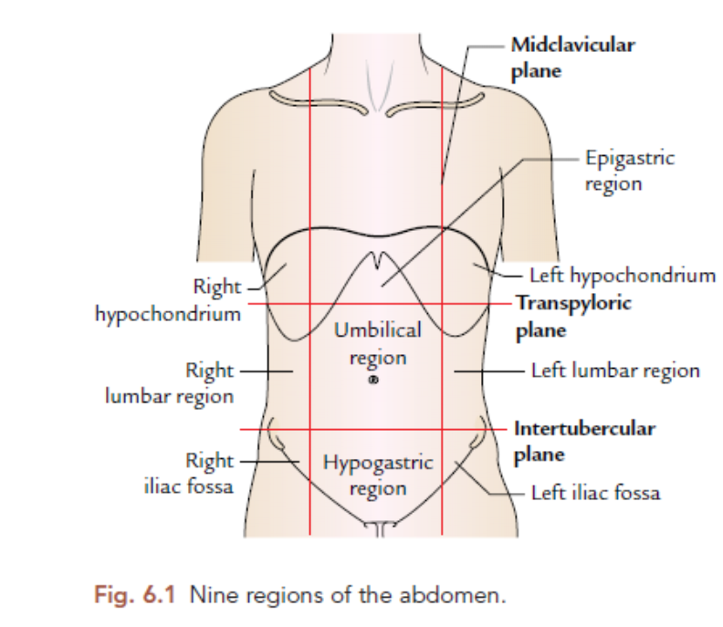

Slide 21
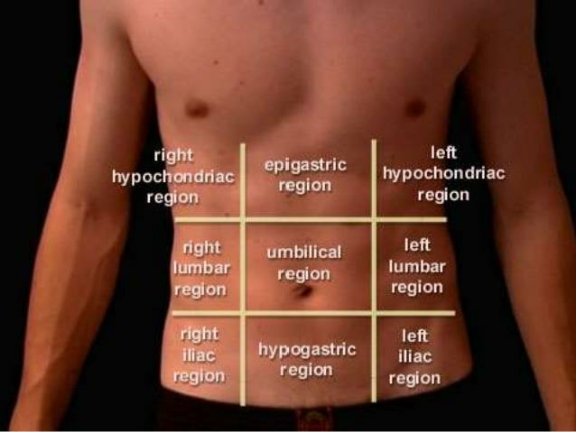

Slide 22
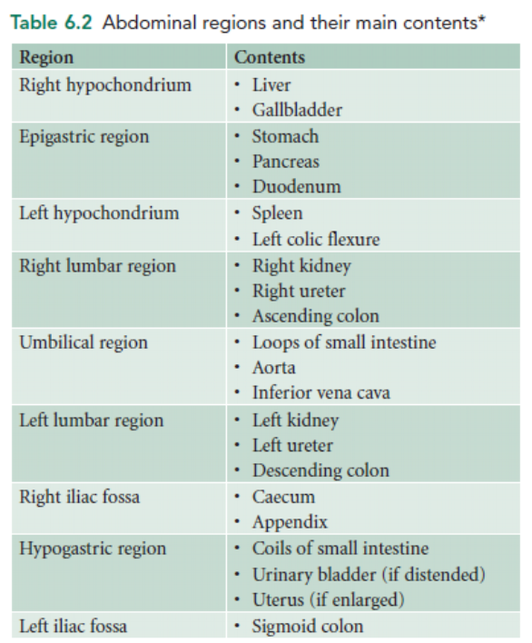

Slide 23
• Clinical significance of nine regions of the abdomen:
The knowledge of structures present in the nine regions
helps the clinician to know the source of pain.
1. Pain in the right hypochondrium comes from the
gallbladder and biliary ducts.
2. Pain in the epigastric region comes from the stomach
and duodenum.
3. Pain in the left hypochondrium comes from the
pancreas.
4. Pain in the right lumbar region comes from the right
kidney.
5. Pain in the umbilical region comes from the small
intestine.

Slide 24
6. Pain in the left lumbar region comes from the left
kidney.
7.Pain in the right iliac fossa comes from the vermiform
appendix.
8.Pain in the hypogastrium comes from the urinary
bladder and uterus.
9. Pain in the left iliac fossa comes from the sigmoid
colon.
•
It is important to note that pain in the abdomen
usually occurs due to two reasons: (a) inflammation,
and(b) obstruction of conducting muscular tubes such
as the bowel or the ureter.

Slide 25
FOUR QUADRANTS OF THE ABDOMINAL CAVITY.
For more general clinical descriptions, the abdominal
cavity is divided into four quadrants by a horizontal
transumbilical plane passing through the umbilicus and
a vertical median plane intersecting the horizontal plane
at the umbilicus.
The four quadrants thus formed are:
1. Right upper quadrant.
2. Left upper quadrant.
3. Right lower quadrant.
4. Left lower quadrant.

Slide 26
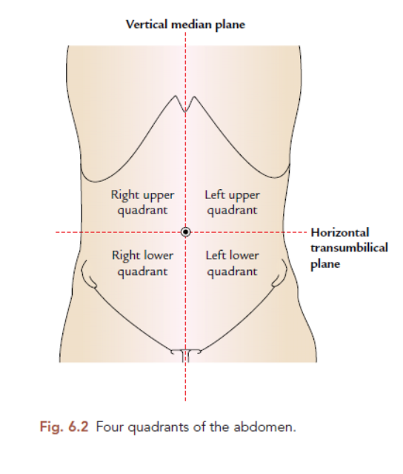

Slide 27
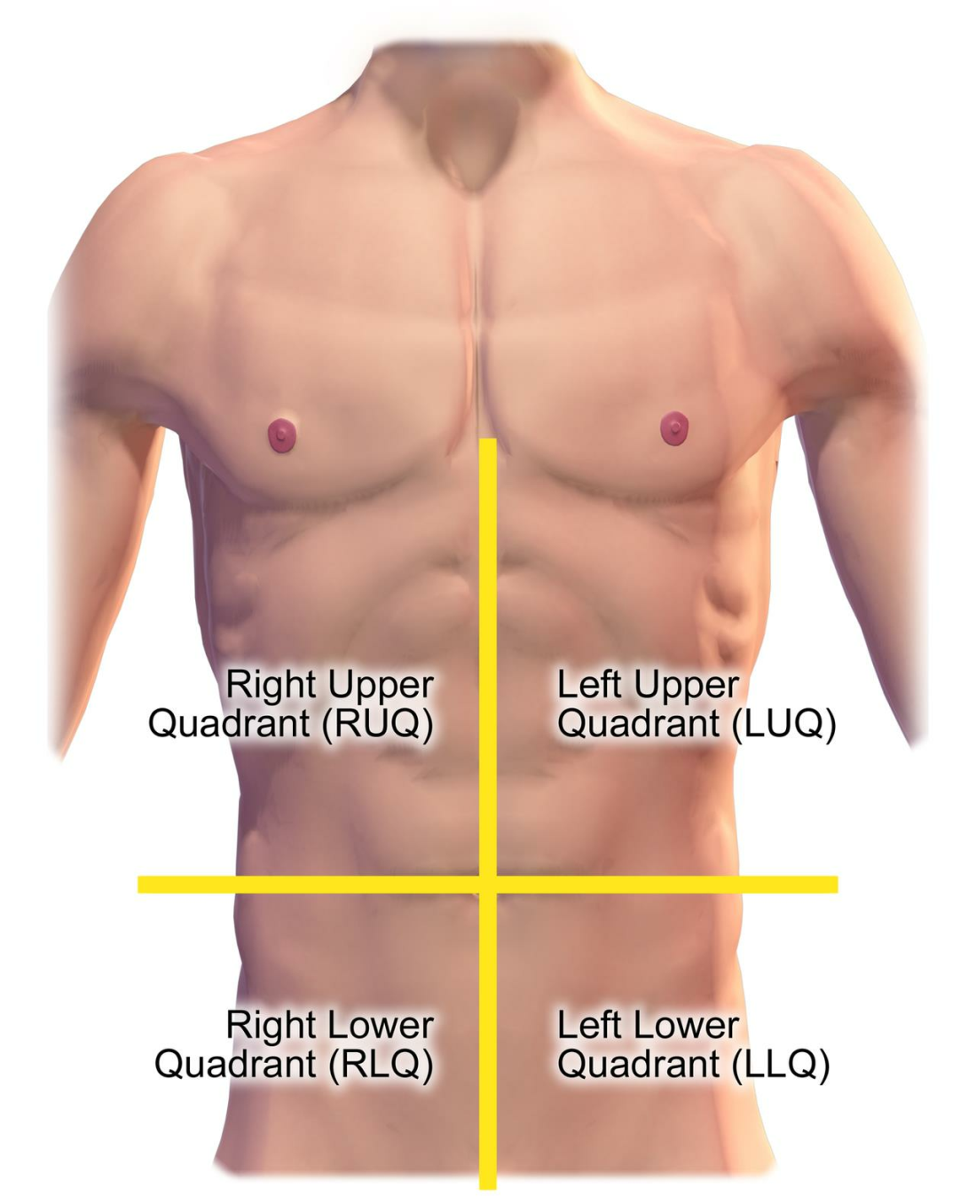

Slide 28
1. Right upper quadrant
Extends from the median plane to the right of the
paitent,and from the umbilical plane to rib cage.
Important organ here.
• Liver
• Gall bladder with biliary tree
• Duodenum
• Head of pancreas
• Right kidney & adrenal gland.
• Hepatic flexor of colon.

Slide 29
2. Left upper quadrant.
Extends from the median plane to the left of
paitent,and from the umbilical plane to left rib
cage. Important organ here.
Stomach
Spleen
Left lobe of liver.
Body of pancreas.
Left kidney & adrenal gland.
Splenic flexor of colon.
Parts transverse & decending colon.

Slide 30
3. Right lower quadrant.
•
Extends from the median plane to the right of
the patient and from the umbilical plane to the
right inguinal ligament. Important organ here.
• Cecum
• Appendix
•
Ascending colon
• Right ovary & fallopian tube.
• Right ureter

Slide 31
4. Left lower quadrant.
Left lower quadrant of the human abdomen is
the area left of the midline and below the
umbilicus. Important organ here.
Decending colon
Sigmoid colon
Left ovary & fallopian tube.
Left ureter.

Slide 32
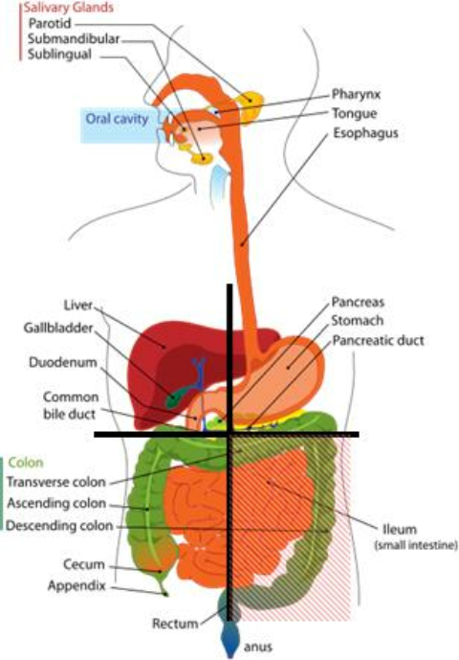

Slide 33
TITLE | AUTHOR / JOURNAL | MATERIAL | RESULT | CONCLUSION
Transcript for Anatomy: Abdominal quadrants, regions, and planes | Ursula Florjanczyk, MS, Rachel Yancey, Royce Rajan, MD, MBA, Viviana Popa, MD | abdomen is a part of the body sometimes casually referred to as the trunk | the abdomen is often divided into anatomical quadrants, of which there are four, or regions, of which there are nine. | To get those four quadrants, imagine a line running from the down from the xiphoid process, or tip of the sternum, all the way down to the pubic symphysis

Slide 34
Thank you.

