Slide 1
Pedigree Charts
The family tree of genetics
Dr. Kinjal Jethva
Associate Professor
Dept. of Anatomy
S.B.K.S.M.I. & R.C.

Slide 2
COMPETENCY
AN 74.2- Pedigree chart for various types inheritance & give examples of diseases of each mode of inheritance

Slide 3
INTEGRATION
With department of pediatrics and internal medicine

Slide 4
Specific learning objective
Draw a pedigree charts for the various types of inheritance
Give examples of diseases of each mode of inheritance

Slide 5
Objectives
  Definition a pedigree
  Uses of pedigree chart
  Constructing a pedigree chart
  Study the symbols
  Connecting the symbols
  Interpreting a pedigree

Slide 6
Quick Review
Genotype = what genes someone has
Genes are usually represented by a letter, a capital letter for the dominant trait, a small case for the recessive.
Example: Tongue Rolling is dominant, so we use R to represent the tongue rolling
Inablility to roll your tongue is recessive so we use r to represent the non-rolling gene
For every trait, you get a gene from each parent

Slide 7
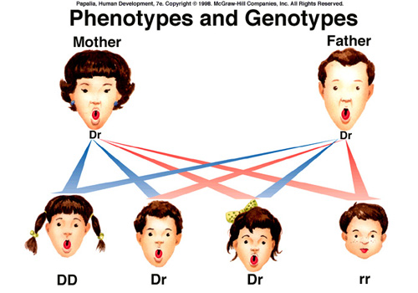
Genotypes and Phenotypes
Mom and Dad are Rr-that is their genotype, they can also be described as heterozygous-they have 1 of each gene
What is their PHENOTYPE? (Roller or non-roller?)
The youngest son has a genotype of rr-he is Homozygous recessive-2 copies of the recessive gene
His phenotype?
Rr
Rr
Rr
Rr
Rr
rr

Slide 8
What is a pedigree chart?
Pedigree charts show a record of the family of an individual
They can be used to study the transmission of a hereditary condition
They are particularly useful when there are large families and a good family record over several generations.

Slide 9
Studying human genetics
Pedigree charts offer an ethical way of studying human genetics (Because you cannot make certain individuals breed in order to study genetics.)
Today genetic engineering has new tools to offer to doctors studying genetic diseases
A genetic counsellor will still use pedigree charts to help determine the distribution of a disease in an affected family

Slide 10
Symbols used in pedigree charts
A marriage with five children, two daughters and three sons. The next to eldest son is affected by the condition.
Normal male
Affected male
Normal female
Affected female
Marriage
Eldest child ↔ Youngest child

Slide 11
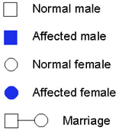
Symbols
Shaded individuals have the trait you’re studying
Boys = squares
Girls = circles

Slide 12

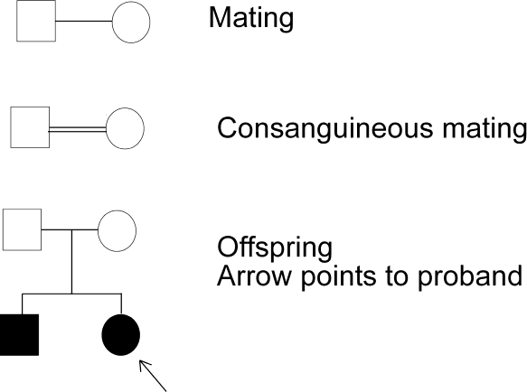

Slide 13
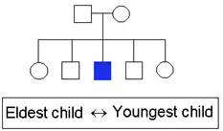
Married-connected at side
Siblings-connected at TOP not at the side (hopefully not siblings AND married)
Oldest child-to the left
Question-if shaded individuals in this pedigree have blue eyes, what is the GENOTYPE of the parents?

Slide 14
Organising the pedigree chart
  Generations are identified by Roman numerals
I
II
III
IV

Slide 15
Organising the pedigree chart
Individuals in each generation are identified by Arabic numerals numbered from the left
Therefore the affected individuals are II3, IV2 and IV3
I
1
2
3
4
5
6
7
II
III
IV

Slide 16
Connecting Pedigree Symbols
Examples of connected symbols:
Fraternal twins
Identical twins

Slide 17
Connecting Pedigree Symbols
Examples of connected symbols:
Married Couple
Siblings

Slide 18
Example
What does a pedigree chart look like?

Slide 19
Symbols in a Pedigree Chart
Affected
X-linked
Autosomal carrier
Deceased

Slide 20
Autosomal means inherited on chromosome 1-22 while sex-
linked means inherited on either X orY chromosome.
Autosomal recessive
  e.g., PKU, Tay-Sachs, albinism
Autosomal dominant
  e.g., Huntington’s Disease
X-linked recessive (meaning this allele is found on only the X chromosome: can be in males or females)
  e.g., color-blindness, hemophilia
X-linked dominant (meaning this allele is found on X chromosomes; can be in males or females)
  e.g., hypophosphatemia
Y-linked (meaning the allele is found on the Y chromosome and can only be in males.

Slide 21
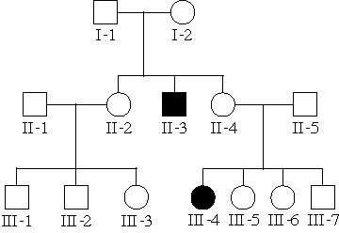
Trait is rare in the pedigree
Trait often skips generations (hidden in heterozygous carriers)
Trait affects males and females equally
Possible diseases include: Cystic fibrosis, Sickle cell anemia, Phenylketonuria (PKU), Tay-Sachs disease

Slide 22
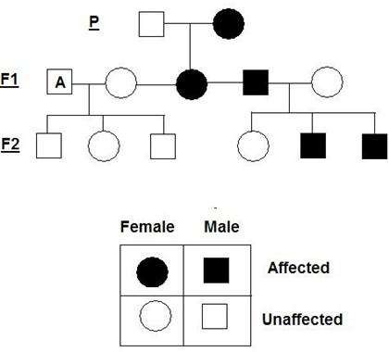
Trait is common in the pedigree
Trait is found in every generatio
Affected individual also transmit the trait to about 1/2 of their children (regardless of sex).
There are few autosomal domina human diseases but some rare traits have this inheritance patter
For example: achondroplasia (a sketelal disorder causing dwarfism)
n
nt n.

Slide 23
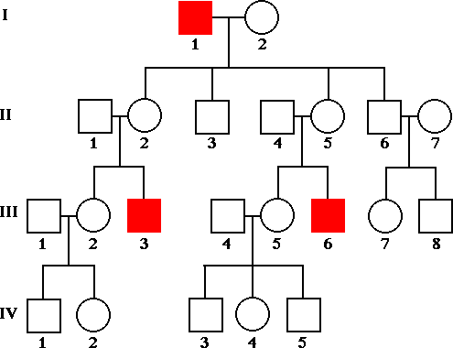
Trait is rare in pedigree
Trait skips generations
Affected fathers DO NOT pass to their sons
Males are more often affected than females
Females are carriers (passed from mom to son)

Slide 24
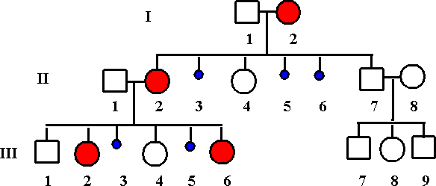
Trait is common in pedigree
Affected fathers pass to ALL of their daughters
Males and females are equally likely to
be affected
X-linked dominant diseases are extremely unusual
Often, they are lethal (before birth) in males and only seen in females ex. incontinentia pigmenti (skin lesions)
ex. X-linked rickets (bone lesions)
12

Slide 25
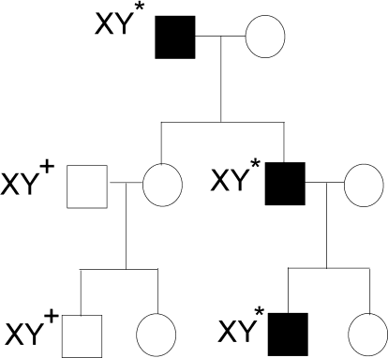
Traits on the Y chromosome are only found in males, never in females.
The father’s traits are passed to all sons.
Dominance is irrelevant: there is only 1 copy of each Y-linked gene (hemizygous).
13

Slide 26
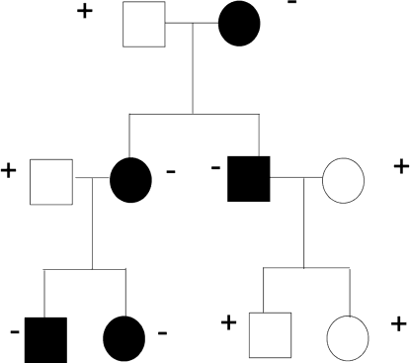
Mitochondria are only inherited from the mother.
If a female has a mitochondrial trait, all of her offspring inherit it.
If a male has a mitochondrial trait, none of his offspring inherit it.
14

Slide 27
1. If two affected people have an unaffected child, it must be a dominant pedigree: D is the dominant mutant allele and d is the recessive wild type allele. Both parents are Dd and the normal child is dd.
2. If two unaffected people have an affected child, it is a recessive pedigree: R is the dominant wild type allele and r is the recessive mutant allele. Both parents are Rr and the affected child is rr.
3. If every affected person has an affected parent it is a dominant pedigree.

Slide 28
Interpreting a Pedigree Chart
Determine if the pedigree chart shows an autosomal or X-linked disease.
  If most of the males in the pedigree are affected the disorder is X-linked
  If it is a 50/50 ratio between men and women the disorder is autosomal.

Slide 29
Example of Pedigree Charts
Is it Autosomal or X-linked?

Slide 30
Answer
Autosomal

Slide 31
Interpreting a Pedigree Chart
Determine whether the disorder is dominant or recessive.
  If the disorder is dominant, one of the parents must have the disorder.
  If the disorder is recessive, neither parent has to have the disorder because they can be heterozygous.

Slide 32
Example of Pedigree Charts
Dominant or Recessive?

Slide 33
Answer
Dominant

Slide 34
Example of Pedigree Charts
Dominant or Recessive?

Slide 35
Answer
Recessive

Slide 36
Summary
Pedigrees are family trees that explain your genetic history.
Pedigrees are used to find out the probability of a child having a disorder in a particular family.
To begin to interpret a pedigree, determine if the disease or condition is autosomal or X- linked and dominant or recessive.

Slide 37
THANK YOU

