Slide 1
Pericardium and
External features of heart
Dr. K.M. Parmar
Associate Professor
Department of anatomy
S.B.K.S.M.I. & R.C.

Slide 2
1. AN22.1 Describe & demonstrate subdivisions, sinuses in pericardium, blood supply and nerve supply of pericardium
2. AN22.2 Describe & demonstrate external and internal features of each chamber of heart

Slide 3
S L O
At the end of the session First MBBS Student Should be able to :
- Write short notes on : (a) transverse sinus of the serous pericardium, (b) oblique sinus of serous pericardium
- Explain external features of heart
- Explain term : Precordium, Third coronary artery, and Mitral stenosis

Slide 4
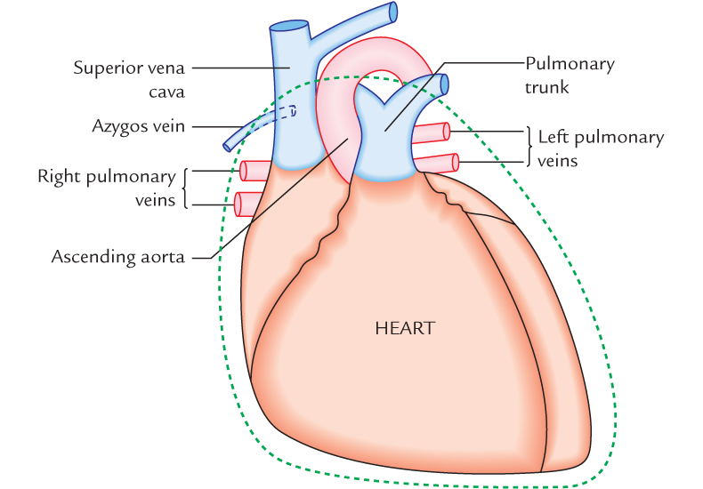
Pericardium and External features of heart
Sub division of pericardium
Fibrous Pericardium
Serous Pericardium
Sinuses of Pericardium
Blood and Nerve Supply of Pericardium
External features of Heart

Slide 5
PERICARDIUM
The pericardium (G. around heart) is a fibroserous sac which
encloses the heart and the roots of its great blood vessels.
The pericardium lies within the middle mediastinum, posterior
to the body of the sternum and 2nd–6th costal cartilages and
anterior to the middle four thoracic vertebrae (i.e., from T5
to T8).
The functions of the pericardium are:
(a) restricts excessive movements of the heart,
(b) serves as a lubricated container in which heart can contract and relax smoothly, and
(c) limits the cardiac distension

Slide 6
SUBDIVISIONS
The pericardium consists of two components:
(a) an outer single layered fibrous sac called fibrous
pericardium, and
(b) inner double layered serous sac called serous
pericardium.
A little description of embryology makes it easier to
understand the formation of different layers of the
pericardium.

Slide 7
The heart and great vessels lie inside the fibrous sac and
invaginate the serous sac from behind during development.
As a result, the external surface of the heart and internal
surface of the fibrous pericardium are covered by a layer of serous pericardium.
The layer covering the surface of the heart is called visceral pericardium or epicardium and the layer covering the inner aspect of the fibrous pericardium is
called parietal pericardium.
The intervening potential space between the two serous layers is called pericardial cavity

Slide 8
The pericardium thus consists of three layers .
From outside to inwards these are:
1. Fibrous layer of the pericardium.
2. Parietal layer of the serous pericardium.
3. Visceral layer of the serous pericardium (epicardium).

Slide 9

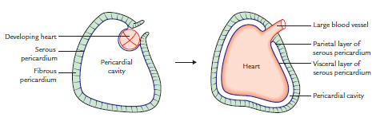

Slide 10
FIBROUS PERICARDIUM
The fibrous pericardium is strong fibrous sac which supports the delicate parietal layer of the serous pericardium with which it is firmly adherent.

Slide 11
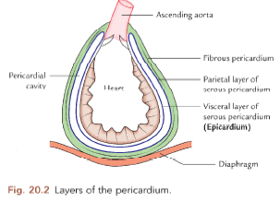

Slide 12
Features
The features of fibrous pericardium are as follows:
It is conical in shape.

Slide 13
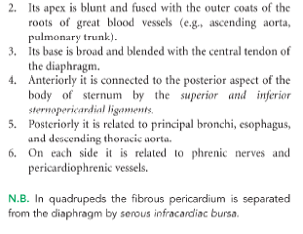

Slide 14
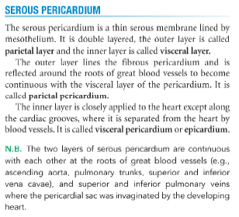

Slide 15
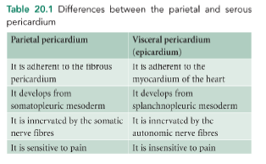

Slide 16
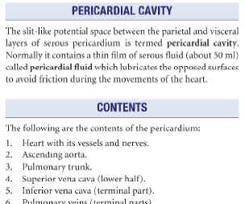

Slide 17
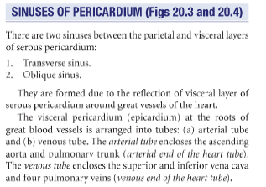

Slide 18
Transverse Sinus of Pericardium - -
It is transverse recess behind the ascending aorta and pulmonary trunk and in front of superior vena cava and superior pulmonary veins.
It deveop due to degeneration of dorsal mesocordium.
It is a horizontal passage between the two pericardial
tubes.
On each side it communicates with the general
pericardial cavity.

Slide 19

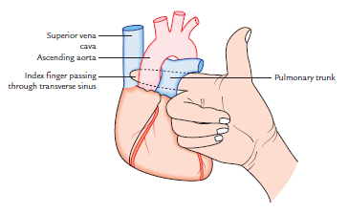

Slide 20
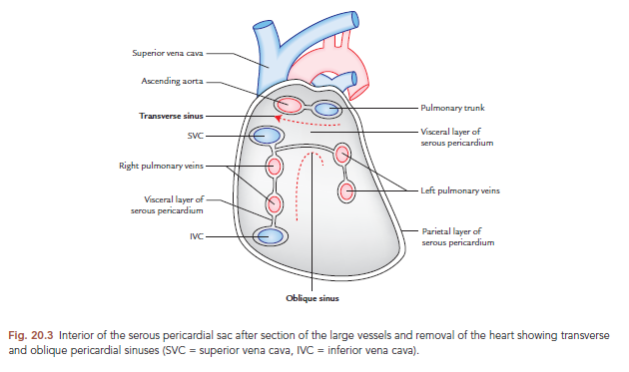

Slide 21
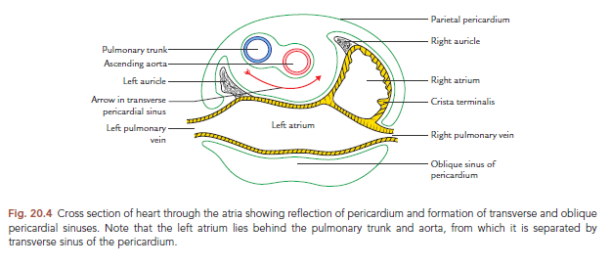

Slide 22
It is a horizontal passage between the two pericardial
tubes.
On each side it communicates with the general
pericardial cavity.
Oblique Sinus of Pericardium
It is a recess of serous pericardium behind the base of the heart (actually left atrium).
It is enclosed by ‘J-shaped’ sheath of visceral layer of serous pericardium enclosing six veins (i.e., 2 vena cavae and 4 pulmonary veins).

Slide 23
The oblique sinus is akin to lesser sac behind the stomach and develops as a result of absorption of four pulmonary veins into the left atrium.
The oblique sinus permits the distension of left atrium during return of oxygenated blood in it from the lungs.

Slide 24
Boundaries
Oblique sinus of pericardium is bounded in the following
way:
Anteriorly: by left atrium.
Posteriorly: by parietal pericardium.
On right side: by reflection of visceral pericardium along
the right pulmonary veins and inferior vena cava.
On the left side: by reflection of visceral pericardium along the left pulmonary veins.
Superiorly: by reflection of visceral pericardium along
the right and left superior pulmonary veins.
Inferiorly: it is open.

Slide 25
Applied --
Surgical significance of transverse pericardial sinus:
During cardiac surgery, after the pericardial sac is opened anteriorly, a finger is passed through the transverse sinus of pericardium, posterior to the aorta and pulmonary trunk.
A temporary ligature is passed through the transverse
sinus around the aorta and pulmonary trunk.
The tubes of heart-lung machine are inserted into these vessels and ligature is tightened.

Slide 26
ARTERIAL SUPPLY
The fibrous pericardium and parietal layer of visceral
pericardium is supplied by the branches of the following arteries:
1. Internal thoracic artery.
2. Musculophrenic arteries.
3. Descending thoracic aorta.
The visceral layer of serous pericardium is supplied by the coronary arteries.

Slide 27
NERVE SUPPLY
1. The fibrous pericardium and parietal layer of the serous
pericardium are supplied by the phrenic nerves (somatic
nerve fibres).
2. The visceral layer of the serous pericardium is supplied
by the branches of sympathetic trunks and vagus nerves
(autonomic nerve fibres).
Thus fibrous pericardium and parietal layer of the visceral pericardium are sensitive to pain whereas visceral layer of pericardium is insensitive to pain.
Consequently pain of pericarditis originates from parietal pericardium.

Slide 28
Applied --
• Pericarditis and cardiac tamponade:
The inflammation of the serous pericardium is called pericarditis which causes accumulation of serous fluid in the pericardial cavity, the pericardial effusion.
The excessive accumulation of serous fluid in the pericardial cavity may compress the thin-walled atria and interfere with the filling of the heart during diastole and consequently the cardiac output is diminished.
This condition is clinically termed cardiac tamponade.
The pericarditis is the terminal event in uremia.

Slide 29
• Pericardiocentesis: Excessive pericardial fluid can be
aspirated from the pericardial cavity by two routes:
– Sternal approach: The needle is inserted through the
left 5th or 6th intercostal space immediately adjacent to
the sternum.
– Subxiphoid approach: The needle is inserted in the left
costoxiphoid angle and passed in an upward and
backward direction at an angle of 45° to the skin.
• Pericardial friction rub: The roughening of parietal and
visceral layers of the serous pericardium by inflammatory
exudate can cause friction between the two layers called
pericardial friction rub which can be felt on palpation and
heard through the stethoscope.

Slide 30
HEART
The heart (syn. Gk. Kardia/Cardia; L. Cor/Cordis) is a hollow muscular organ situated in the mediastinum of the thoracic cavity, enclosed in the pericardium.
It is somewhat pyramidal in shape and placed obliquely behind the sternum and adjoining parts of costal cartilages so that one-third of the heart is to the right of median plane and two-third of the heart is to the left of the median plane.
The heart consists of four chambers—right atrium and
right ventricle, and left atrium and left ventricle.
On the surface the atria are separated from the ventricles by the atrioventricular groove (also called coronary sulcus) and ventricles from each other by interventricular grooves.

Slide 31
Shape and Measurements
Shape: Pyramidal or conical.
Measurements: Length = 12 cm.
Width = 9 cm.
Weight = 300 g in males; 250 g in females.

Slide 32
EXTERNAL FEATURES --
The heart presents the following external features:
1. Apex.
2. Base.
3. Three surfaces (sternocostal, diaphragmatic, and left)
4. Four borders (right, left, upper, and inferior).

Slide 33
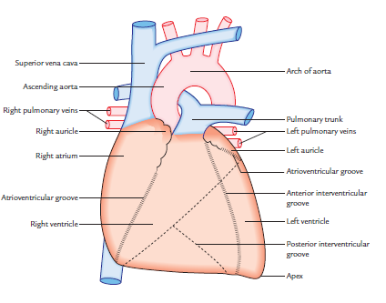

Slide 34
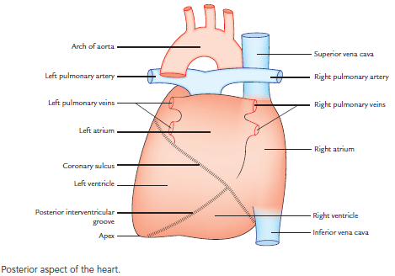

Slide 35
APEX OF THE HEART
The apex of the heart is a conical area formed by left ventricle.
It is directed downwards and forwards, and to the left.
It lies at the level of the 5th left intercostal space, 3.5 inches (9 cm) from the midline and just medial to the mid clavicular line.

Slide 36
BASE OF THE HEART
The base (or posterior surface) of the heart is formed by two atria, mainly by the left atrium.
Strictly speaking two-third of the base is formed by the posterior surface of the left atrium and one-third by the posterior surface of the right atrium.
It is directed backwards and to the right (i.e., opposite to the apex).

Slide 37
Characteristic features of the base are as follows:
1. It lies opposite to the apex.
2. It lies in front of the middle four thoracic vertebrae (i.e., T5–T8) in the lying-down position and descends one vertebra in the erect posture (T6–T9).
3. The base is separated from vertebral column by the
oblique pericardial sinus, esophagus, and aorta.
N.B. Clinically, base is the upper border of the heart where great blood vessels (superior vena cava, ascending aorta, and pulmonary trunk) are attached.

Slide 38
SURFACES OF THE HEART
The heart has the following three surfaces:
1. Sternocostal (anterior).
2. Diaphragmatic (inferior).
3. Left surface.
Sternocostal surface: It is formed mainly by the right atrium and right ventricle, which are separated from each other by the anterior part of atrioventricular groove.
The sternocostal surface is also partly formed by the left auricle and left ventricle.
The right ventricle is separated from left ventricle by the anterior interventricular groove.

Slide 39
N.B.
• The left atrium is hidden on the front by the ascending
aorta and pulmonary trunk.
• The part of sternocostal surface is uncovered by the left
lung (cardiac notch) forming an area of superficial cardiac
dullness.
Diaphragmatic surface: This surface is flat and rests on the central tendon of the diaphragm.
It is formed by the left and right ventricles which are separated from each other by the posterior interventricular groove.
The left ventricles form left two-third of this surface and right ventricle forms only right one-third of this surface.

Slide 40
Left surface: It is formed mainly by the left ventricle and partly by the left atrium and auricle. It is directed upwards, backwards, and to the left.
BORDERS OF THE HEART
The heart has the following four borders:
1. Right border.
2. Left border.
3. Inferior border.
4. Upper border.

Slide 41
Right border: It is more or less vertical and is formed by the right atrium. It extends from the right side of the opening of SVC to that of IVC and separates the base from the sternocostal surface.
Left border: It is curved and oblique.
It is formed mainly by the left ventricle and partly by the left auricle.
It extends from left auricle to the apex of the heart and separates sternocostal and left surfaces.

Slide 42
Inferior border: It is nearly horizontal and extends from the
opening of IVC to the apex of the heart.
It is formed by the right ventricle.
The right atrium also forms a part of this border.
The inferior border separates the sternocostal surface from the diaphragmatic surface.
Near the apex it presents a notch called incisura apicis cordis.
Upper border: It is slightly oblique and is formed by the right
and left atria, mainly by the latter.
The upper border is obscured from the view on the sternocostal surface because ascending aorta and pulmonary trunk lie in front of it.
On the surface of the body it can be marked by a line joining a
point on the lower border of the 2nd left costal cartilage, 1.5
in from the median plane to a point on the upper border of
3rd right costal cartilage, 1 inch away from the median plane.

Slide 43
CHAMBERS OF THE HEART
The heart consists of four chambers, viz.
1. Right atrium.
2. Right ventricle.
3. Left atrium.
4. Left ventricle.
The two atrial chambers are separated from each other by a vertical septum—the interatrial septum and the two ventricular chambers are separated from each other by a vertical septum—the interventricular septum.

Slide 44
The right atrium communicates with the right ventricle
through right atrioventricular orifice, which is guarded by
three cusps.
The left atrium communicates with the left ventricle
through the left atrioventricular orifice, which is guarded by two cusps.
The walls of the chambers of the heart are made up of
cardiac muscle—the myocardium, which is covered
externally by the serous membrane—the epicardium and
lined internally by endothelium— the endocardium.
The atria are thin walled as compared to the ventricles
and have little contractile power.

Slide 45
Demarcation of Chambers of the Heart on the Surface On the surface the chambers of the heart are demarcated or delineated by the following three sulci/grooves:
1. Coronary sulcus (atrioventricular groove).
2. Anterior interventricular sulcus.
3. Posterior interventricular sulcus.

Slide 46
Coronary sulcus (atrioventricular groove): It encircles the
heart and separates the atria from the ventricles.
It is deficient anteriorly due to the root of pulmonary trunk.
The atrioventricular groove is divided into anterior and
posterior parts.
The anterior part consists of right and left halves.
The right half of the anterior part runs downwards and to
the right between the right atrium and right ventricle and
lodges right coronary artery.

Slide 47
The left anterior part of AV groove intervenes between the left auricle and left ventricle. It lodges circumflex branch of left coronary artery.
The posterior part of AV groove intervenes between the base and the diaphragmatic surface of the heart. It lodges coronary sinus.

Slide 48
Anterior and posterior interventricular sulci: They separate the right and left ventricles.
The anterior interventricular sulcus is on the sternocostal surface of the heart and lodges anterior interventricular artery and great cardiac vein.
The posterior interventricular groove is on the diaphragmatic surface and lodges posterior interventricular artery and middle cardiac vein.
N.B. The meeting point of interatrial groove, posterior interventricular groove, and posterior part of atrioventricular groove is termed crux of the heart.

Slide 49
Circulation of Blood
Functionally, the heart is made up of two muscular pumps— the right and left (Fig. 20.9).
The right pump consists of right atrium and right ventricle while the left pump consists of left atrium and left ventricle.
The right pump is responsible for pulmonary circulation and the left pump is responsible for systemic circulation as follows:

Slide 50
The right atrium receives deoxygenated blood from the
whole body through superior and inferior venae cavae.
The blood flows from right atrium into right ventricle
through right atrioventricular orifice.
The blood is prevented from regurgitating back to the atrium by means of right atrioventricular valve.
The right ventricle contracts and propels the blood into the pulmonary trunk, pulmonary arteries, and finally into the lung where blood is oxygenated (pulmonary circulation).
The left atrium receives the oxygenated blood from lungs through four pulmonary veins.

Slide 51
The blood from left atrium flows into left ventricle through left atrioventricular orifice.
The blood is prevented from regurgitating back to the atrium by means of left atrioventricular valve.
The left ventricle strongly contracts and propels the blood into the ascending aorta and then into the systemic circulation.

Slide 52
atrium flows into left ventricle through left atrioventricular
orifice. The blood is prevented from regurgitating back to
the atrium by means of left atrioventricular valve. The left
ventricle strongly contracts and propels the blood into the
ascending aorta and then into the systemic circulation.

Slide 53
N.B. The right ventricle is required to pump the blood through a relatively low-resistance vascular bed, whereas the left ventricle is required to pump the blood through a relatively high resistance peripheral vascular bed.
The muscular wall of the left ventricle is, therefore, much thicker than that of the right ventricle.

Slide 54
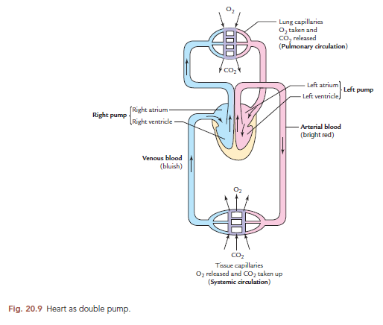

Slide 55
PHRENIC NERVE
Origin
It arises from ventral rami of C3, C4, and C5 but chiefly from C4.
Course
It runs vertically downwards on the anterior surfaceof the scalenus anterior, which it crosses obliquely from lateral to medial side.
Then it runs downwards on the cervical pleura to enter the thorax behind first costal cartilage.

Slide 56
Distribution
The phrenic nerve provides:
(a) sole motor supply to the diaphragm (muscle of
respiration), and
(b) sensory innervation to diaphragmatic pleura, pericardium, and subdiaphragmatic pleura.

Slide 57
Accessory phrenic nerve
It is the branch from nerve to subclavius containing C5 fibres.
It runs lateral to phrenic nerve and descends behind or
sometimes in front of the subclavian vein to join the main
phrenic nerve near the 1st rib.
N.B. In case of accessory phrenic nerve, the fibres of C5
nerve inspite of joining the phrenic nerve at its
commencement runs through, nerve to subclavius and then leaves it as accessory nerve to join the main phrenic nerve at the thoracic inlet.

Slide 58
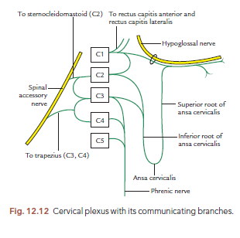

Slide 59
Q. 1 All sentences are correct for pericardium EXCEPT
(a) Fibrous pericardium is single layer
(b) Serous pericardium is double layer
(c) Pericardium of heart made up of three layer
(d) Fibrous pericardium is also known as epicardium
Q. 2 All following are contents of pericardium EXCEPT
(a) Ascending aorta (b) Pulmonary trunk
(b) Entire superior vena cava
(d) Terminal part of inferior vena cava

Slide 60
Q. 3 Apex of heat lies in ....
(a) Left intercostal space 9 cm from midline
(b) Right intercostal space 9 cm from midline
(c) Left intercostal space 11 cm from midline
(d) Right intercostal space 11 cm from midline
Q.4 All sentences are correct for base of heart EXCEPT
(a) It lies opposite to the apex.
(b) It is also known as posterior surface of heart
(c) Rt. And Lt. Pulmonary arteries attached tobase
(d) Two-third part of base formed by left attrium

Slide 61
Q. 5 All following sentences are correct EXCEPT
(a) Heart present in middle mediastinum
(b) Atrioventricular groove also known as coronary sulcus
(c) Base of is most fixed part of heart
(d) Visceral layer of pericardium is sensitive to pain

Slide 62
TITLE | AUTHOR / JOURNAL | MATERIAL | RESULT | CONCLUSION
Pericardial Disease: Diagnosis and Management. | Masud H. Khandaker, MD, PhD, Raul E. Espinosa, MD, Rick A. Nishimura, MD, Lawrence J. Sinak, MD, Sharonne N. Hayes, MD, Rowlens M. Melduni, MD, and Jae K. Oh, MD. Mayo Clin Proc. 2010 Jun; 85(6): 572–593. | pericardial diseases can present clinically as acute pericarditis, pericardial effusion, cardiac tamponade, and constrictive pericarditis. Patients can subsequently develop chronic or recurrent pericarditis. | Structural abnormalities including congenitally absent pericardium and pericardial cysts are usually asymptomatic and are uncommon. | This review represents the currently available evidence and the experiences from the pericardial clinic at our institution to help guide the clinician in answering difficult diagnostic and management questions on pericardial diseases.

