Slide 1
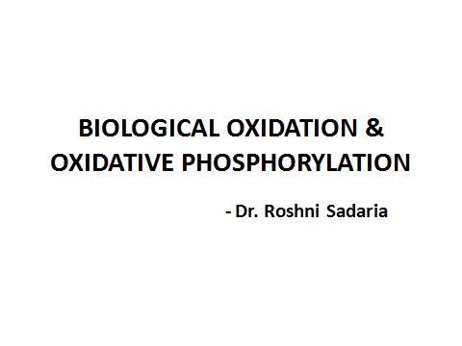

Slide 2
COMPLEX- III
Cytochrome Reductase

Slide 3
This is a cluster of iron sulphur proteins, cytochrome b and cytochrome c1- contain heme prosthetic group.
During this process of transfer of electrons, the iron in heme group shuttles Fe3+ and Fe2+ forms.
The free energy change is – 10 kcal/mol: and 4 protons are pumped out.

Slide 4
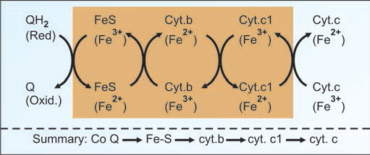

Slide 5
CYTOCHROME C
It contains one heme prosthetic group.
It is one of highly conserved proteins among different species.
Cytochrome C collects electrons from complex III and delivers them to complex IV.
Cytochrome C is mediator of apoptosis (programmed cell death).

Slide 6
COMPLEX –IV
Cytochrome Oxidase

Slide 7
It contains different proteins, including cytochrome a and cytochrome a3.
This complex IV is tightly bound to mitochondrial membrane.
4 electrons are accepted from cytochrome-c and passed on to molecular oxygen to form 2 molecules of water.
2 protons are pumped out to the intermembrane space.

Slide 8
Cytochrome oxidase contains two heme group- cyt a,cyt a3 and 2 copper ions- CuA and CuB.
The functional unit of the enzyme is single protein - cytochrome a + a3.
Cytochrome a + a3 complex is the only electron carrier in which the heme iron has an available coordination site that can react directly with O2, and so also is called cytochrome oxidase.

Slide 9
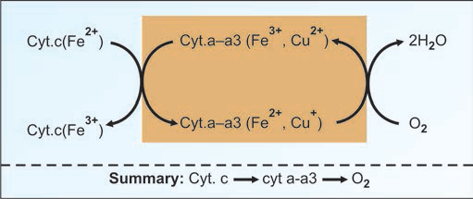

Slide 10
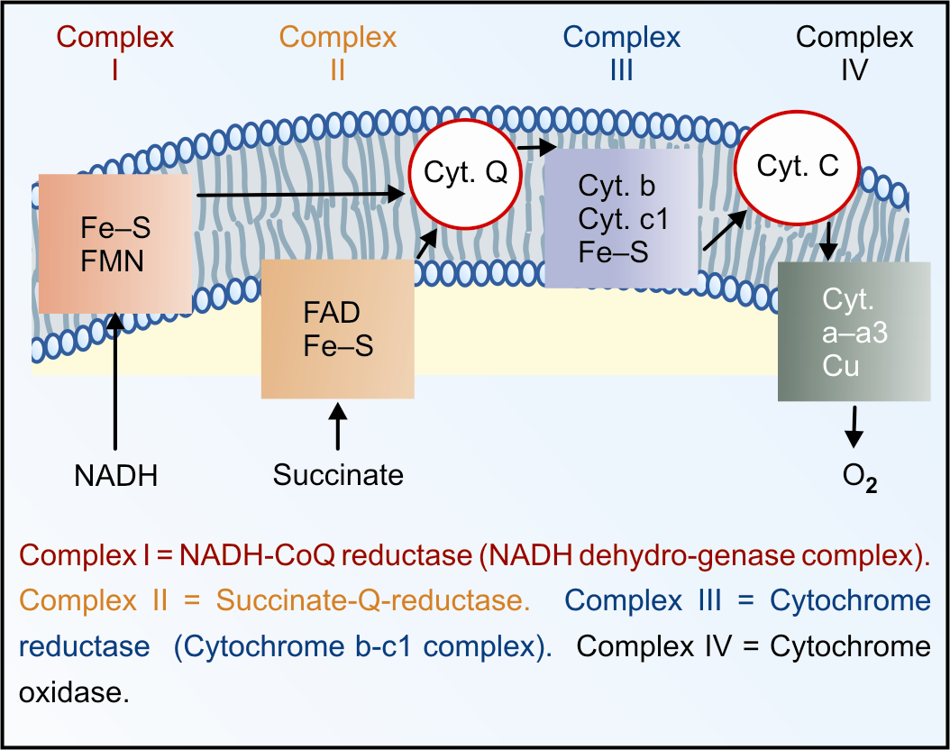

Slide 11
Complex I: NADH → FMN → Fe-S → CoQ →
Complex II: Succinate → FAD → Fe-S → CoQ →
Complex III: CoQ → Fe-S → cyt.b → cyt.c1 → cyt. c
Complex IV: Cyt. c → cyt a-a3 → O2

Slide 12
ATP synthase ( Complex V)
Proton pumping ATP synthase (otherwise called F1-Fo ATPase) is a multisubunit transmembrane protein.
It is sometimes referred to as fifth complex.
It has two units F1,Fo units.
It looks like a lollipop since the membrane embedded Fo component and F1 are connected by a protein stalk.

Slide 13
Fo Unit: The o stands for oligomycin, as Fo inhibited by oligomycin.
Fo unit spans inner mitochondrial membrane. It serves as proton channel, through which protons enter into mitochondria.
Fo unit has 4 polypeptides chains and is connected to F1.

Slide 14
F1 unit: it projects into the matrix . It catalyses the ATP synthesis.
F1 has 9 polypeptides chains,(3 alpha, 3 beta, 1 gamma, 1 sigma, 1 epsilon).
The alpha chains have binding sites for ATP and ADP and beta chains have catalytic sites.
ATP synthesis requires Mg++ions.

Slide 15
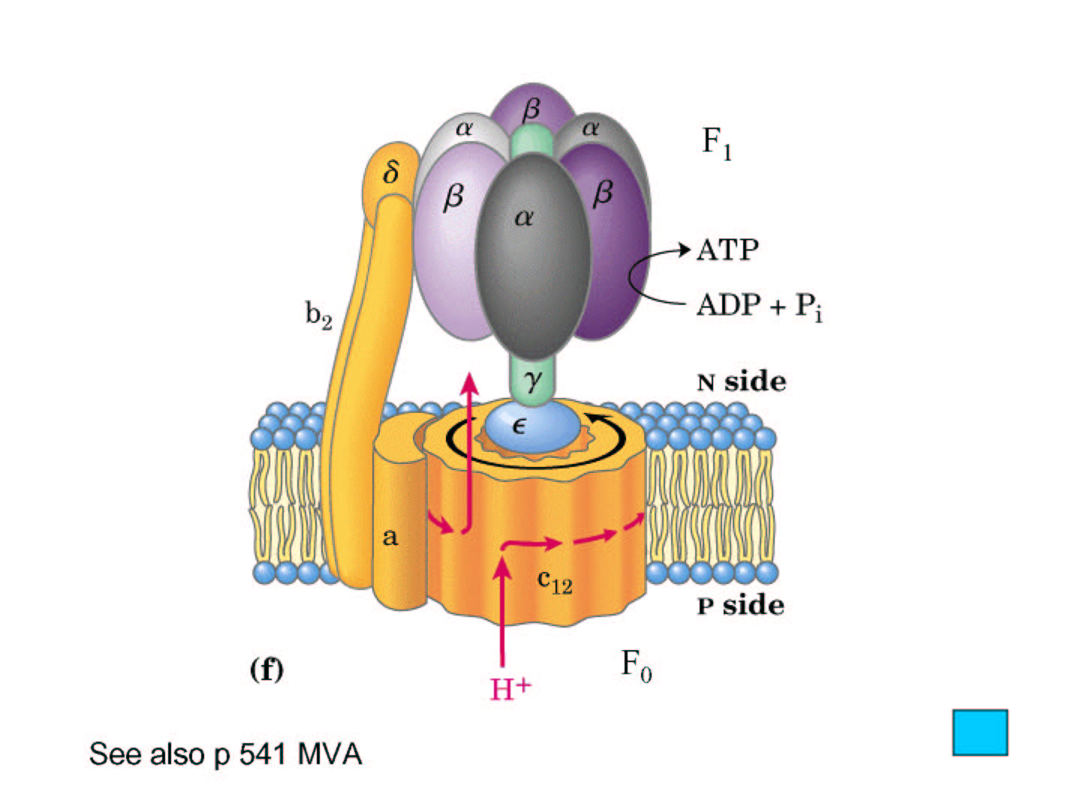

Slide 16
Chemi -osmotic theory
The transport of electrons from inside to outside of inner mitochondrial membrane is accompanied by generation of a proton gradient across the membrane.
Protons accumulate outside the membrane creating an electrochemical potential difference.
This proton force drives the synthesis of ATP by ATP synthase complex.

Slide 17
The pH outside the mitochondrial inner membrane is 1.4 units lower than inside. Further, outside is positive relative to the inside (+0.14 V).
The proton motive force (PMF) is 0.224 V corresponding to a free energy change of 5.2 kcal/mol of protons.

Slide 18
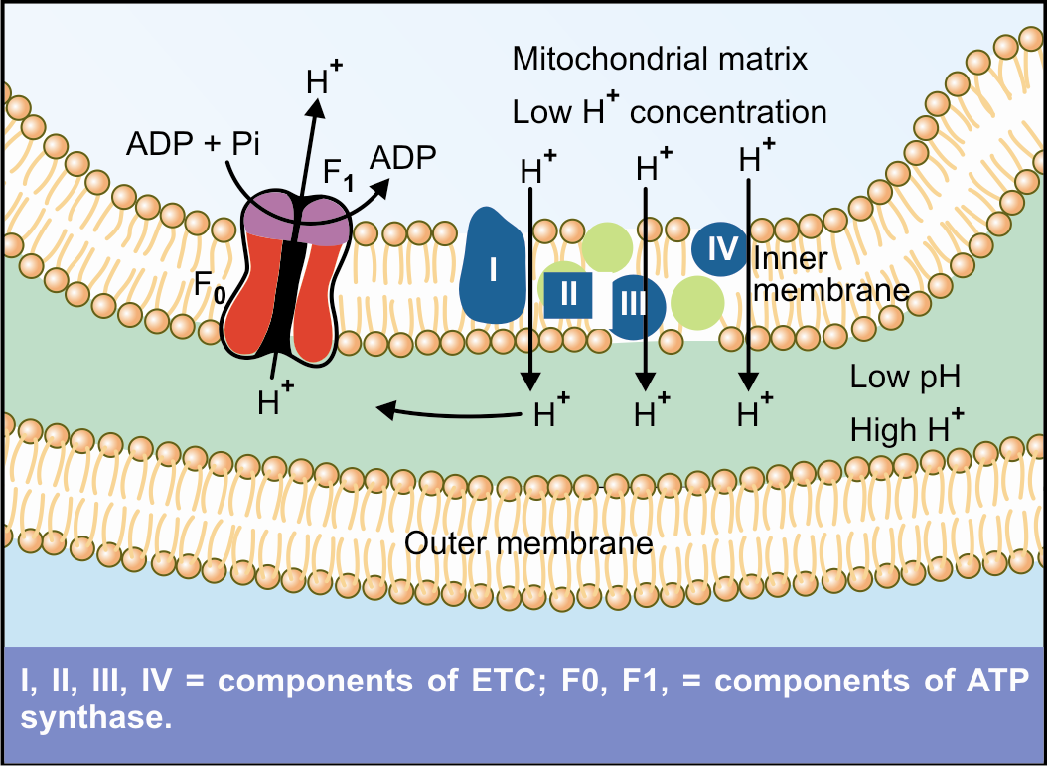
ATP

Slide 19
Binding change – mechanism :
The ATP synthase is a molecular machine, comparable to a water-driven hammer.
Fo is the wheel: flow of protons is the waterfall and the structural changes in F1 lead to ATP coin being minted for each turn of the wheel.
According to this theory, the 3 beta subunits (catalytic sites) , are in three functional states:
O form is open and has no affinity for substrates.
L form binds substrate with sluggish affinity.
T form binds substrate tightly and catalyses ATP synthesis.

Slide 20
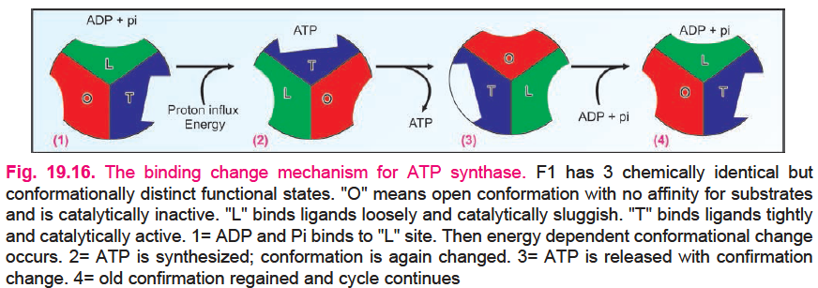

Slide 21
Energetics of ATP Synthesis
The free energy released by electron transport through complex I to IV must be conserved in a form that ATP synthase can perform energy coupling.
The energy of electron transfer is used to drive protons out of the matrix by the complexes I, III and IV that are proton pumps.
The proton gradient thus created is maintained across the inner mitochondrial membrane till electrons are transferred to oxygen to form water.
The electrochemical potential of this gradient is used to synthesize ATP.

Slide 22
The synthesis of one ATP molecule is driven by the flow of 3 protons through the ATP synthase.
When NADH is oxidized, 10 hydrogen ions (protons) are pumped out and for FADH2, 6 protons.
ATP synthesis actually occurs when the proton gradient is dissipated, and not when the protons are pumped out.
According to recent findings, one NADH may generate only 2.5 ATP; and one FADH2 may generate only 1.5 ATP.

Slide 24
P:O Ratio
Defined as the number of inorganic phosphate molecules incorporated into ATP for every atom of oxygen consumed.
When a pair of electrons from NADH reduces an atom of oxygen (½ O2), 2.5 mol of ATP are formed.

Slide 25
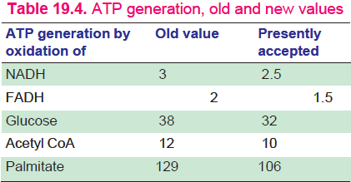

Slide 26
Regulation of ATP Synthesis
The availability of ADP regulates the process.
When ATP level is low and ADP level is high, oxidative phosphorylation proceeds at the rapid rate. This is called respiratory control or acceptor control.
The major source of NADH and FADH2 is the citric acid cycle, the rate of which is regulated by the energy charge of the cell.

Slide 27
Inhibitors of ATP synthesis
A. Site specific inhibitor
1. Complex I to Co-Q specific inhibitors
i. Alkylguanides (guanethide), hypotensive drug
ii. Rotenone, insecticide and fish poison
iii. Barbiturates (amobarbital), sedative
iv. Chlorpromazine, tranquilizer
v. Piericidin, antibiotic
2. Complex II to Co-Q
i. Carboxin
3. Complex III to cytochrome c inhibitors
i. BAL (British anti lewisite), antidote of war gas
ii. Naphthoquinone
iii. Antimycin

Slide 28
4. Complex IV inhibitors
i. Carbon monoxide, inhibits cellular respiration
ii. Cyanide (CN–)
iii. Azide (N3–)
iv. Hydrogen sulphide (H2S)
5. Site between succinate dehydrogenase and Co-Q
i. Carboxin, inhibits transfer of ions from FADH2
ii. Malonate, competitive inhibitor of succinate DH

Slide 29
B. Inhibitors of oxidative phosphorylation
i. Atractyloside, inhibits translocase
ii. Oligomycin, inhibits flow of protons through Fo
iii. Ionophores, e.g. Valinomycin allows potassium to permeate mitochondria and dissipate the proton gradient.

Slide 30
Uncouplers of oxidative phosphorylation
They will allow oxidation to proceed, but the energy instead of being trapped by phosphorylation is dissipated as heat.
This is achieved by removal of proton gradient.
Sometimes the uncoupling is helpful biologically. In hibernating animals and in newborn human infants, the liberation of heat energy is required to maintain body temperature.
In Brown adipose tissue, thermogenesis is achieved by this process.

Slide 31
Uncouplers of oxidative phosphorylation
1.Uncouplers
-2,4-dinitro phenol
- CCCP (chlorocarbonylcyanide phenyl hydrazone)
2.Physiological uncouplers
-Thyroxine –in high doses
-Thermogenin –in brown adipose tissue

Slide 32
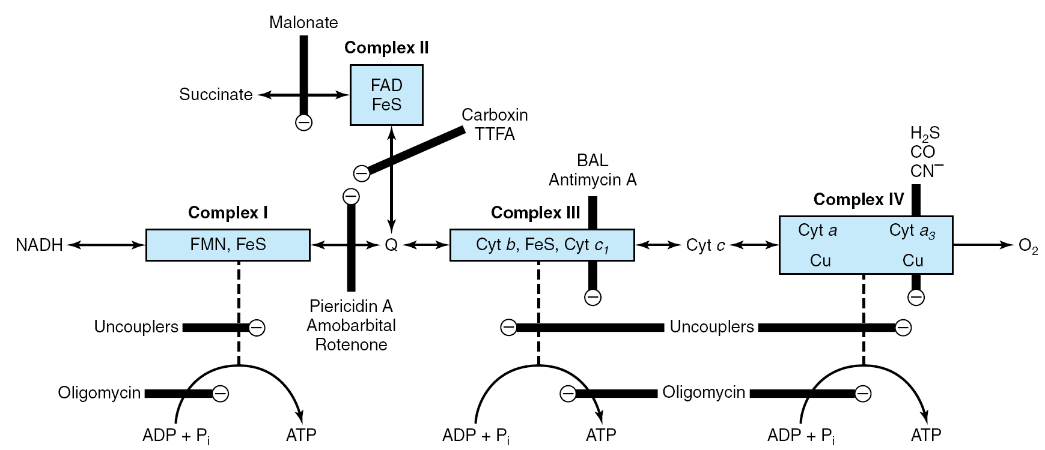

Slide 33
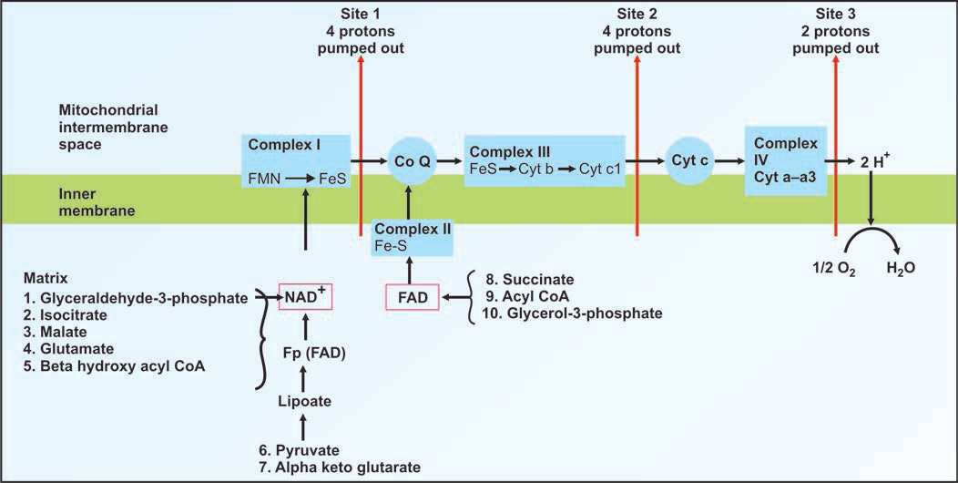

Slide 34
Inherited defects in oxidative phosphorylation
Mutations in mtDNA are responsible for several diseases-
1. Lethal infantile mitochondrial ophthalmoplegia
2. Leber's hereditary optic neuropathy (LHON)
3. Myoclonic epilepsy
4. Mitochondrial encephalomyopathy lactic acidosis stroke like episodes (MELAS)

