Slide 1
Update on Ebstein's Anomaly
- Dr. Chandra Raychaudhari

Slide 2
Objectives
Review the pathophysiology of the condition
2. Discuss the wide range of clinical presentations
3. Treatment options

Slide 3
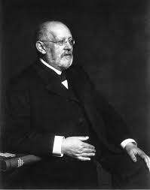
Ebstein's anomaly
Ebstein’s anomaly was named after Wilhelm Ebstein, who in 1866 described the heart of the 19 year old Joseph Prescher.
It is rare: incidence of 1.2-6 patients/100,000 born

Slide 4
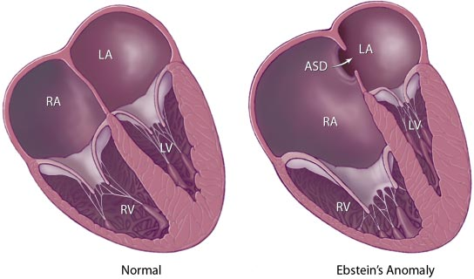
Ebstein’s anomaly is the anterior-inferior displacement of the
septal & posterior leaflets of the TV
Image source: Google images: bandbacktogether.org

Slide 5
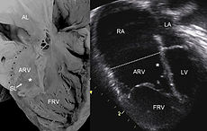
Displacement of the TV causes ‘atrialization of the RV”
Image source: Wikipedia

Slide 6
Associated lesions or issues
ASD
Pulmonary valve stenosis
LV failure due to RV dilation and failure
PDA
Wolff-Parkinson-White arrhythmia
Atrial arrhythmias
Mild to severe cyanosis
Exercise intolerance
Chest pain, syncope, tachyarrhythmias
Stroke risk

Slide 7
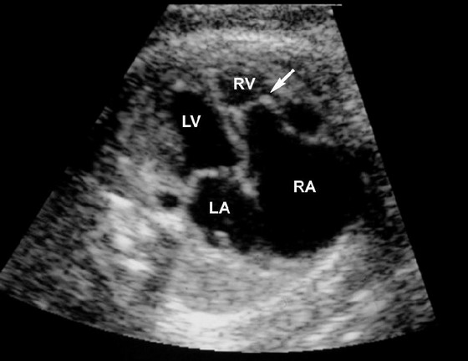
Fetal imaging

Slide 8
Neonatal presentation
Pulmonary vascular resistance is high immediately after birth
Severe TR
Right to left shunt across ASD
Severe cyanosis
Dysfunctional RV

Slide 9
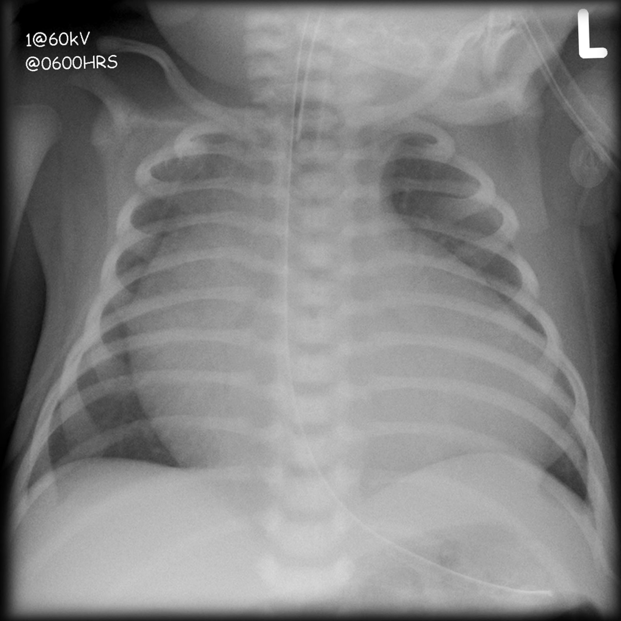
“Wall to Wall Heart on CXR”
Image source: (Google images) radiopaedia.org

Slide 10
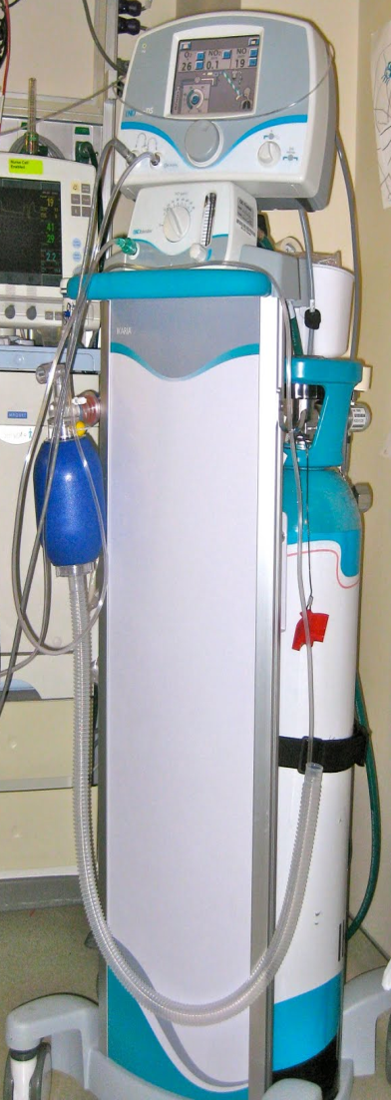
Use of nitric oxide: NO
NO has been used in the treatment of pulmonary hypertension of the newborn, meconium aspiration, congenital heart disease, chronic lung diseases or acute pulmonary insults where ventilation is challenging
NO is made by endothelial cells and causes vasodilation
Mechanism of action: cyclic gMP-dependent pathway, which also inhibits platelet formation and smooth muscle proliferation
Must be given inhaled and continuously
Caution needed at end of wean in case of rebound pulm HTN
Image source: careforanabella.blogspot.com

Slide 11
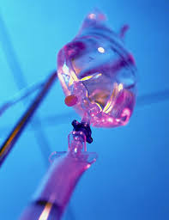
PGE
PGE is a native prostaglandin derived from endothelial cells.
Given as a continuous infusion, it is given to maintain patency of the PDA
By keeping the PDA open, retrograde blood flow from the aorta can go to the main pulmonary arteries and into the lungs to relieve cyanosis from low pulm blood flow
Anticipate apnea and hypotension

Slide 12
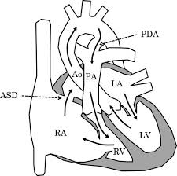
“Circle of Death”
Image source: icvts.oxfordjournals .org

Slide 13
Childhood presentation
Murmur of tricuspid regurgitation or extra clicks
Palpitations, chest pain or syncope due to tachyarrhythmias (WPW)
Echo would show mild Ebstein’s anomaly, TR
Treatment: medically treat or ablate WPW pathway (when>20kg)
Follow conservatively with echo

Slide 14
Adult presentation
Similar to childhood presentation
Fatigue with exercise
Mild cyanosis due to ASD shunt (R→L)
Murmur of tricuspid regurgitation or S1 clicks
Tachyarrhythmias (WPW)
Usually echo and MRI and an electrophysiology (EP) study are utilized
A-fib or stroke leading up to cardiac work-up

Slide 15
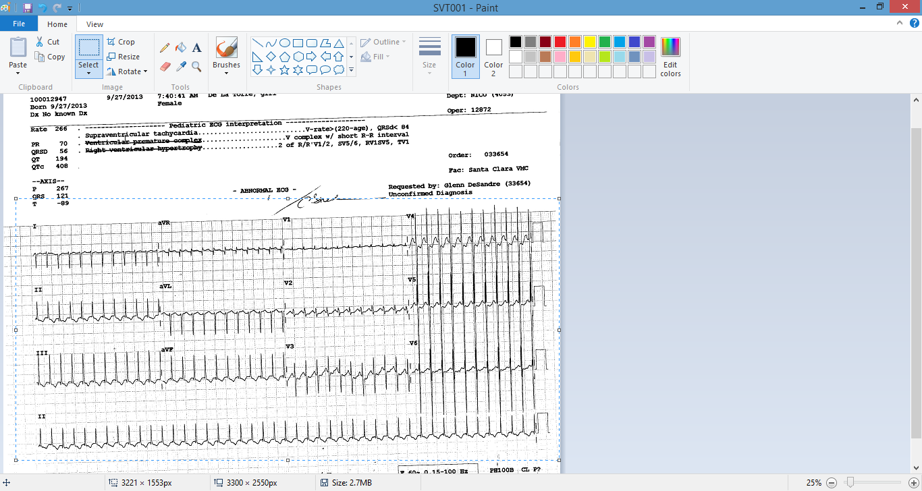
Narrow complex SVT 266bpm

Slide 16
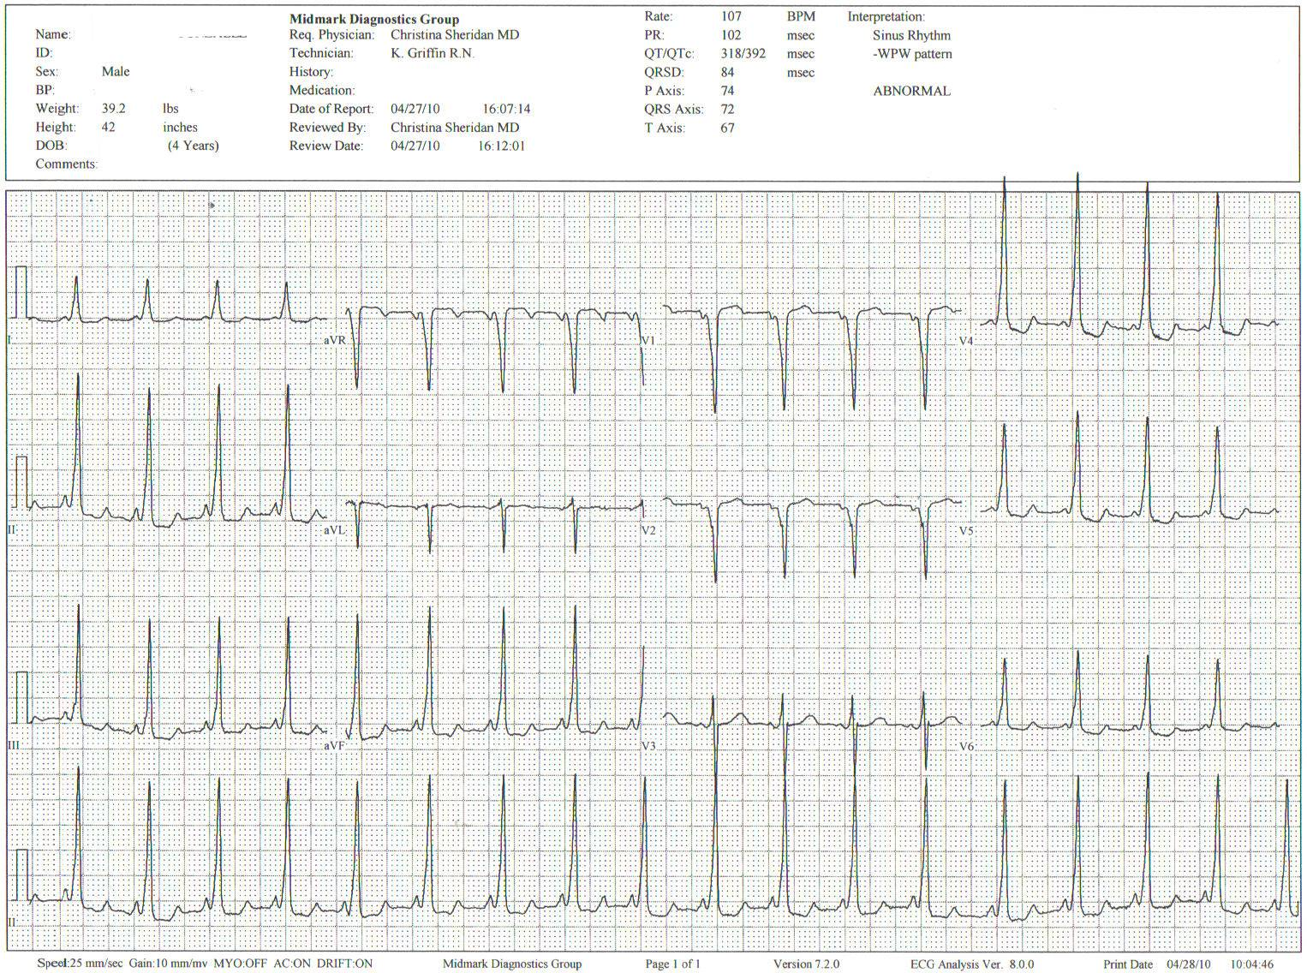
Baseline ECG shows a delta wave
Delta waves (aka pre-excitation) indicate a Wolff-Parkinson-White pathway

Slide 17
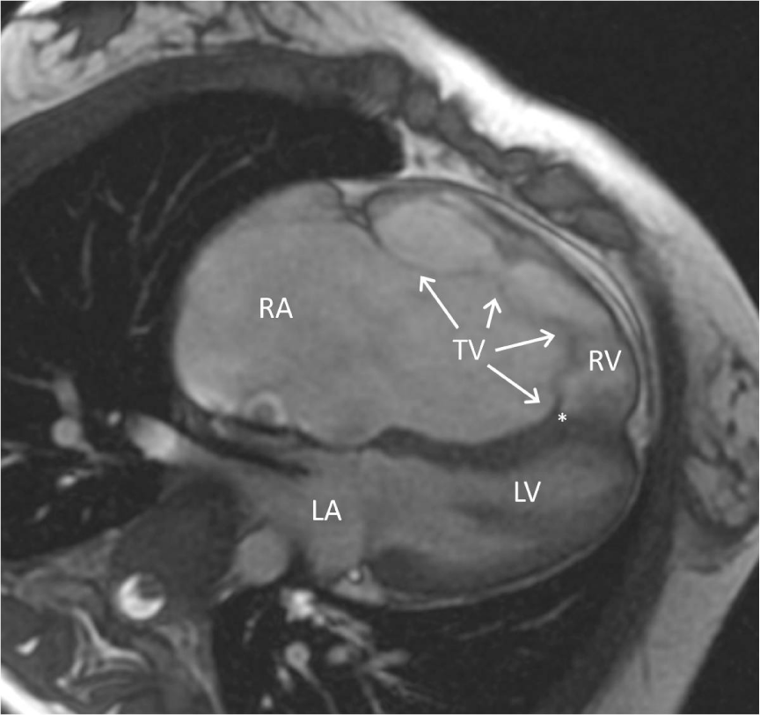
Cardiac MRI
Image source:omnicsonline.org

Slide 18
New York Heart Association Classification (NYHC)
I Cardiac disease, but no symptoms and no limitations with normal daily activities
II Mild symptoms (SOB, angina) and mild limitations with activities
III Marked limitation in activity due to symptoms, even during simple activities like walking. Comfortable only at rest.
IV Severe limitations. Experiences symptoms even at rest. Mostly bedbound.

Slide 19
Recommendations for
Surgical Treatment
New York Heart Association (NYHA) class I-II heart failure with worsening symptoms or with a cardiothoracic ratio of 0.65 or greater^{[8]}
NYHA class III-IV heart failure
History of paradoxical embolism
Significant cyanosis with arterial O₂ saturation of 80% or less and/or polycythemia with hemoglobin of 16 g/dL or more
Arrhythmias refractory to medical and radiofrequency ablation

Slide 20
Surgical options
Tricuspid valve repair
Tricuspid valve replacement
Atrial septal defect (ASD) closure
Bidirectional Glenn procedure (“1.5 repair”)
Atrial reduction
Ablation of accessory pathways
Maze procedure to disconnect any atrial pathways
Heart transplant

Slide 21
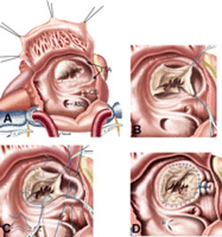
Cone technique of TV repair
Image source:www.ebsteinsanomaly.org

Slide 22
LPCH’s novel approach to surgical repair of Ebsteins (Dr. Frank Hanley)
15 year experience (6/1993 to 12/2008). 57 pts
Reduce TV annulus to 2.5cm or indexed for patient’s size
Native TV leaflets are not detached or reimplanted
Portion of the atrialized RV closest to the RV apex are plicated, with care to avoid distorting right coronary branches near the AV groove
Selective Right Ventricular Unloading and Novel Technical Concepts in Ebstein's Anomaly, Malhotra, Et Al. Ann Thorac Surg, 2009, 88:1975-81.

Slide 23
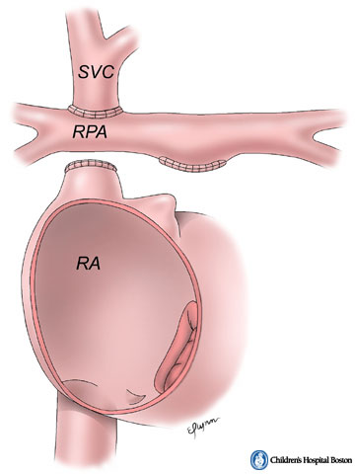
LPCH’s novel approach, cont.
Use of the Bidirectional Glenn procedure (BDG) to effectively create a 1.5 ventricle repair
Off loads the work and volume load of the RV
Not considered if no ASD present or if ASD shunts left to right
Image source: www.childrenshospital.org

Slide 24
Bidirectional Glenn is performed if:
  Documented cyanosis at rest
  Cyanosis with mild exercise
  RA pressure > 1.5 times LA pressure in the OR with the chest open
  After annuloplasty, the effective TV annulus is stenotic and RA pressures are high

Slide 25
Stanford’s outcomes
54/57 patients underwent valve sparing operation
4 needed re-operations for recurring TR
2 needed prosthetic valves at 1.5 and 5.6 years after TV valve repair
31 patients underwent BDG due to the criteria mentioned. No complications from BDG, but the biggest increase in O2 sat achieved in this group

Slide 26
Patient #1
Referred to cardiology as a young infant for a click heard on exam. Otherwise normal child.
No symptoms, no surgeries
No WPW on baseline ECG, only increased RV forces
He is followed conservatively every 6 months with echo

Slide 27
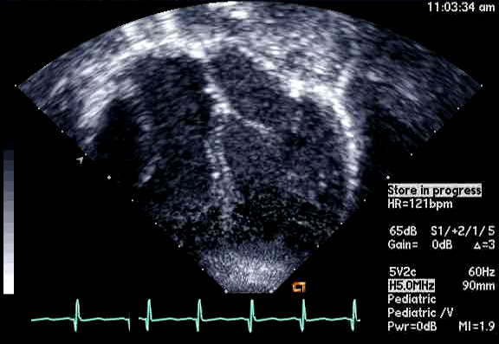

Slide 28
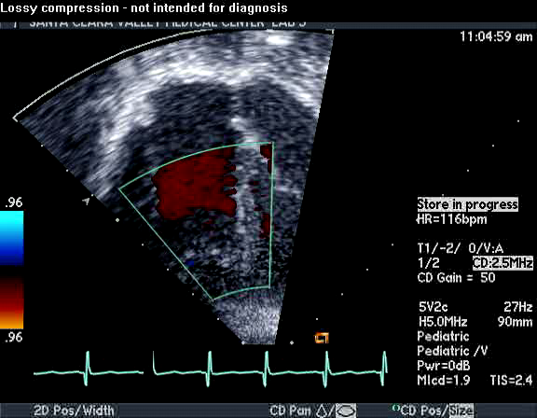
Mild Ebsteins with only mild tricuspid valve regurgitation. +RVH

Slide 29
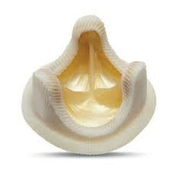
Patient #2
Is now 8 years old
Underwent a Glenn shunt, ASD closure, atrial reduction and 29mm prosthetic valve at age 2
Has 1.5 ventricular physiology. O2 sats 98%
Meds: aspirin daily and antibiotic prophylaxis before dental visits
Playful, but ‘can’t run far’

Slide 30
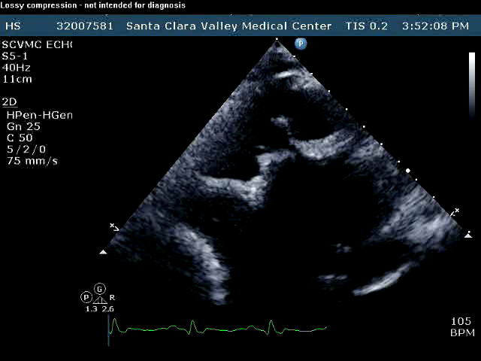
Patient #2
29mm bioprosthetic valve placed in the TV location

Slide 31
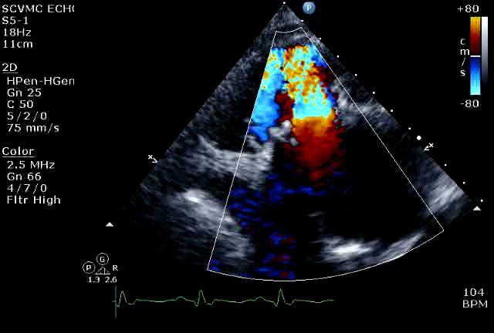
Patient#2

Slide 32
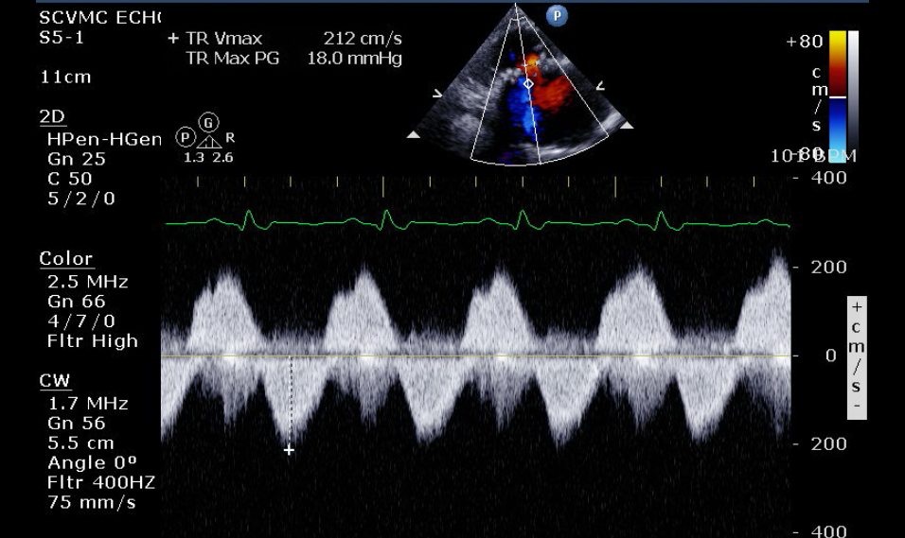
Doppler signal show free TR with low-normal RV pressures

Slide 33
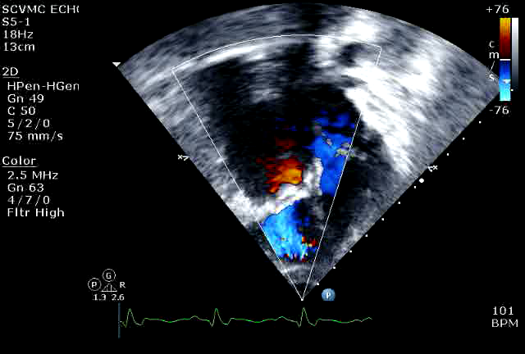
Patient#2
4 chamber view

Slide 34
Patient# 3
Currently almost 12 years old
At 9.5 years old age, he underwent ablation of a WPW pathway and then 2 weeks later, TV pericardial patch and TV annuloplasty, PFO closure
Sedentary, secondary to obesity
On no meds

Slide 35
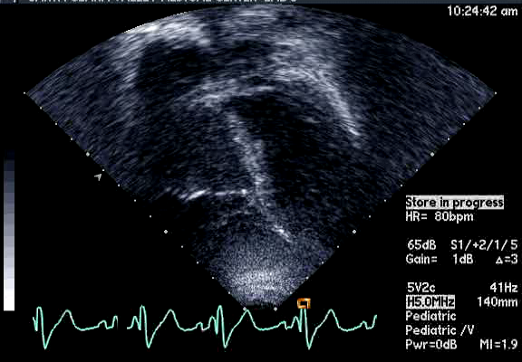
Patient #3

Slide 36
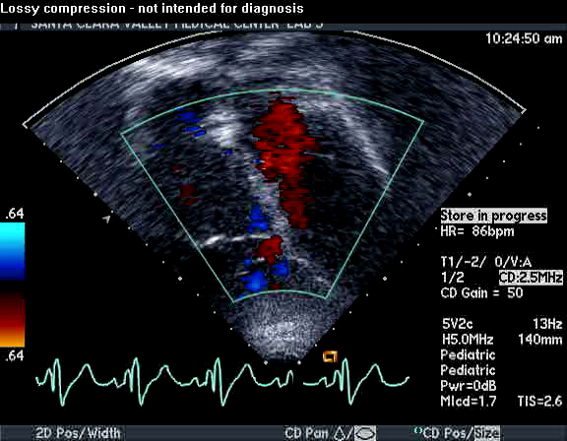
Patient #3

Slide 37
In summary
Epstein's anomaly of the TV is rare and the clinical presentation is variable
Treatment is aimed towards alleviating cyanosis, tachyarrhythmias, improving RV function for forward flow
Neonates with severe Epstein's require early surgical care with higher rates of re-operation
Asymptomatic children/adults can be monitored and expect normal life expectancies and low-normal exercise ability

