Slide 1
RING ENHANCING LESIONS
- Dr. Mayur Khandhedia

Slide 2
Most commonly encountered abnormalities on neuroimaging.
These lesions appear as hypodense or isodense mass lesions on non-contrast computed (plain) tomography studies.

Slide 3
After contrast administration, there is a ring- or a homogeneous disk-like enhancement within the region of hypodensity. The enhancing lesions are often of variable size and are usually surrounded by a varying amount of perifocal vasogenic edema.

Slide 4
Typically, the ring-enhancing lesions are located at the junction of the gray and white matter, but they could be located in the sub-cortical area, deep in the brain parenchyma or may even be superficial.

Slide 5
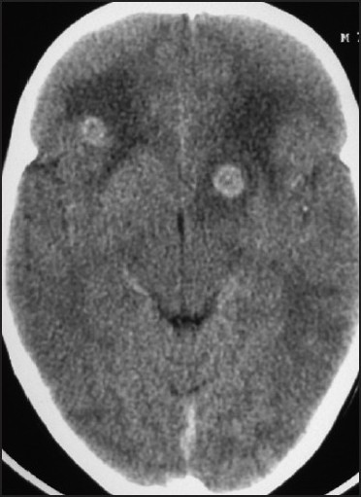
Contrast-enhanced computed tomography showing two enhancing lesions

Slide 6
Clinically, they manifest as recurrent seizures, visual impairment, focal neurological deficit and raised intracranial pressure (severe headache, vomiting and papilledema).

Slide 7
If cerebral edema is severe, patients may develop loss of sensorium and posturing of limbs because of transtentorial brain herniation. Intractable headache, focal neurological deficits and vision loss are long-term sequelae in few of the surviving patients.

Slide 8
ETIOLOGY
Causes of multiple ring-enhancing lesions of the brain

Slide 9
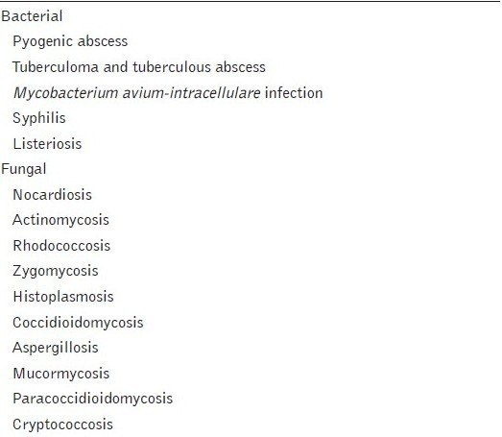

Slide 10
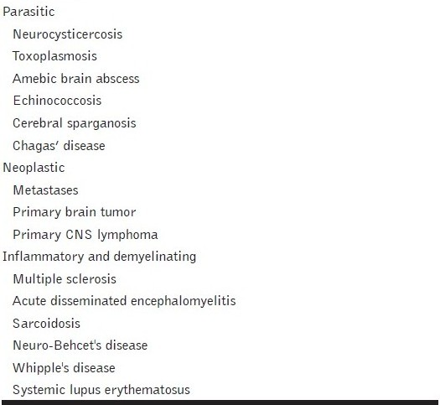

Slide 11
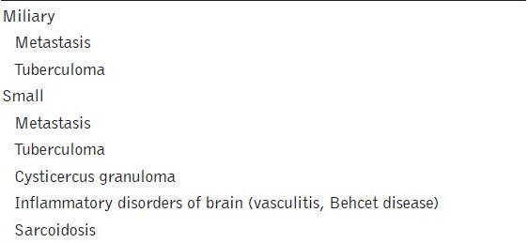
DDs of Multiple Ring Enhancing Lesions

Slide 12
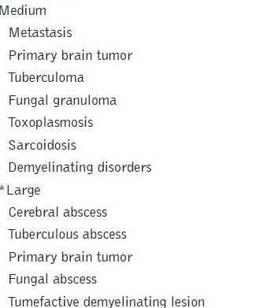

Slide 13
Fig
a)Contrast-enhanced magnetic resonance imaging showing multiple enhancing lesions of variable sizes;
b)X-ray chest of the same patient showing a cannon ball shadow and diffuse carcinomatous lung infiltration

Slide 14
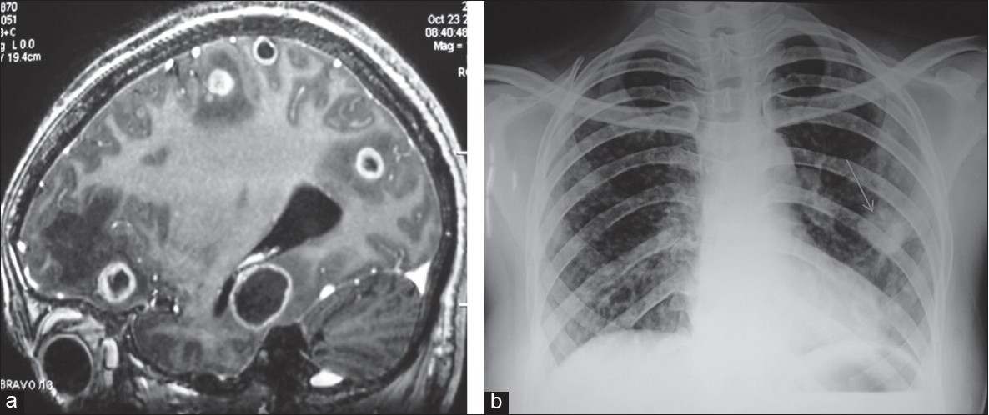
(

Slide 15
Metastatic lesions are typically subcortical, occurring in or near the gray matter-white matter junction, and are usually associated with severe perilesional edema.
Primary brain tumors frequently cross the midline. For example, glioblastoma multiforme frequently crosses the midline by infiltrating the white matter tracts of the corpus callosum.

Slide 16
Pyogenic Brain Abscesses
Multiple brain abscesses are often caused by hematogenous spread of bacteria from a primary source and are frequently found in the territory of the middle cerebral artery.

Slide 17
The enhancing ring lesions caused by pyogenic brain abscesses are commonly located at the gray-white matter junction.
The capsule of abscess is difficult to visualize via conventional imaging techniques and double-contrast computed tomography is needed to clearly define the capsule of the abscess.

Slide 18
However, greater thickness, irregularity and nodularity of the wall of the lesions are often suggestive of tumor or a fungal infection.

Slide 19
Tuberculoma
Tuberculomas are frequently encountered brain lesions in tropical countries.
Intracranial tuberculoma can occur with or without tuberculous meningitis.
Numerous small tuberculomas are common in patients with miliary pulmonary tuberculosis.

Slide 20
A non-caseating tuberculoma usually appears hyperintense on T2-weighted and slightly hypointense on T1-weighted images.
A caseating tuberculoma appears iso- to hypointense on both T1-weighted and T2-weighted images, with an iso- to hyperintense rim on T2-weighted images.

Slide 21
Tuberculomas on contrast administration appear as nodular or ring-like enhancing lesions.
The diameter of these enhancing lesions usually ranges from 1 mm to 5 cm.
Tuberculomas frequently show varied types of enhancement, including irregular shapes, ring-like shapes, open rings and lobular patterns. Target-like lesions are common.

Slide 22
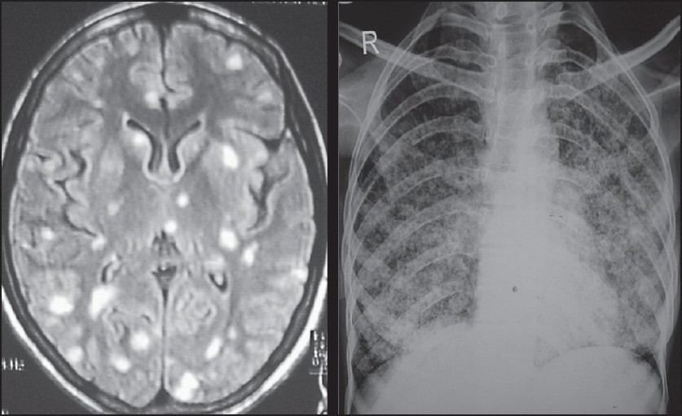
Contrast-enhanced magnetic resonance imaging showing multiple enhancing lesions and X-ray chest of the same patient showing miliary pulmonary tuberculosis

Slide 23
Cysticercus Granuloma
Neurocysticercosis - most common parasitic disease of the CNS and is a major cause of seizures worldwide.
After reaching inside the brain parenchyma, the cysticercus larva passes through several stages of evolution

Slide 24
. Initially, the cyst consists of a protoscolex surrounded by a bladder wall. This stage of viable cyst is known as vesicular cyst stage.
At this stage, the scolex usually is identified as an eccentric nodule within the cyst.

Slide 25
colloid cyst stage- the cyst wall gets thickened and hyaline degeneration and mineralization of the cyst take place. The cyst fluid becomes opaque . These degenerating cysts are called colloid cyst stage
In this stage, there is an intense inflammatory reaction in the surrounding brain tissue.

Slide 26
In this stage, neuroimaging reveals contrast enhancing ring or disc lesions.
Granular nodular stage- the cysticercus is no longer viable & the bladder wall collapses to form a small granuloma.
Calcific stage. Months to years later, some of these dead cysts get calcified into small nodules. This stage is called calcific stage.

Slide 27
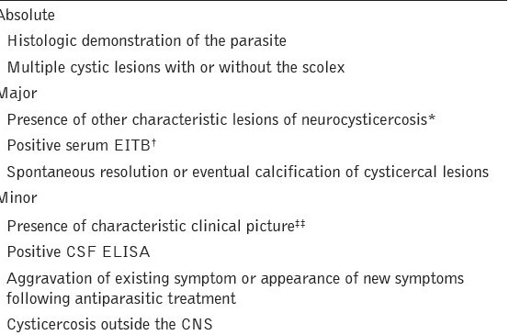
Modified diagnostic criteria for neurocysticercosis

Slide 28
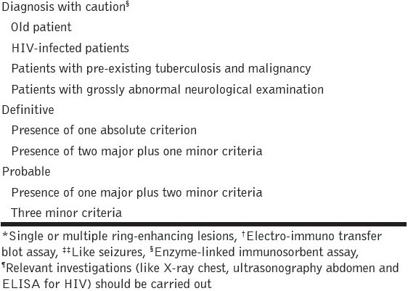

Slide 29
Cysticercus granuloma shows a ring pattern of enhancement after contrast medium administration.
Usually, the lesions are <20 mm in diameter.
Calcified eccentric scolex is often seen in a cysticercal lesion.
The lesions are often multiple and most often do not have extensive edema.

Slide 30
Demyelinating Disorders
Demyelinating lesions, including both classic multiple sclerosis and tumefactive demyelination, may also create an open ring or incomplete ring sign.

Slide 31
Multiple Enhancing Lesions in HIV-infected Patients
categories –
1 opportunistic infections,
2 neoplasms and
3 cerebrovascular diseases.
The common causes include toxoplasmosis, tuberculoma and primary CNS lymphoma and, rarely, brain abscess and fungal granuloma.

Slide 32
The lesions of primary CNS lymphoma on computed tomography are hyperintense or isointense with homogeneous contrast enhancement and variable surrounding edema.
They are often multifocal and periventricular in location. Leptomeningeal involvement may be seen.

Slide 33
Lymphomatous lesions are frequently periventricular and have indistinct borders.
The lymphomas rarely invade the basal ganglia and have a tendency to occur in the white matter adjacent to an ependymal surface.

Slide 34
Methods used for establishing the diagnosis in patients with multiple enhancing lesions of the brain

Slide 35
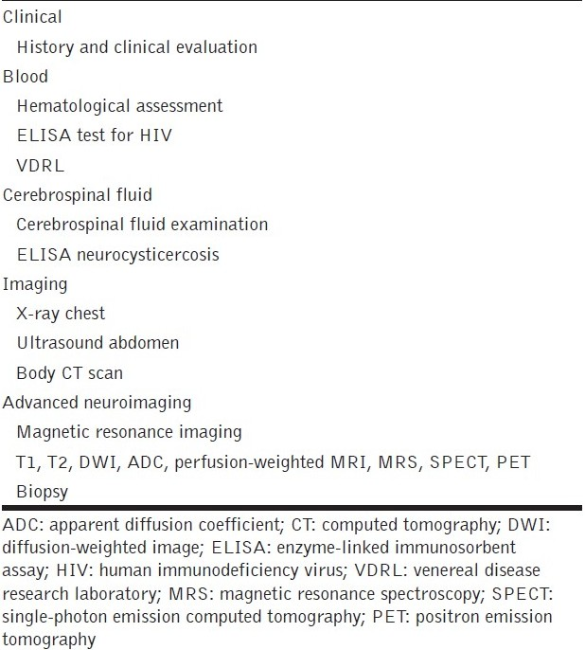

Slide 36
Differential diagnosis of multiple ring-enhancing lesions of the brain

Slide 37
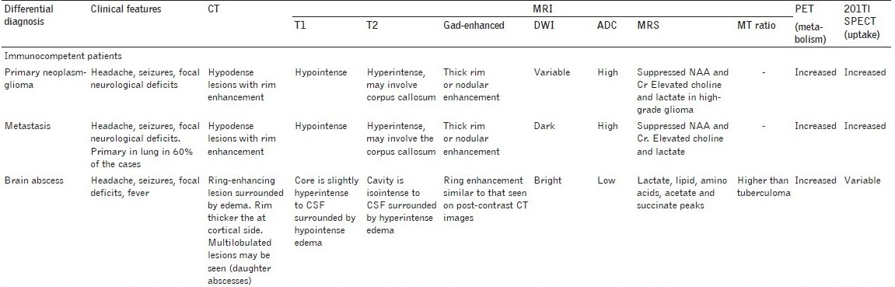

Slide 38
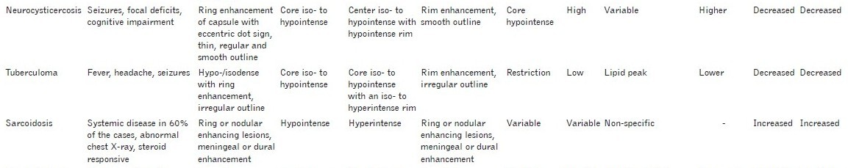

Slide 39
THANK YOU

