Slide 1
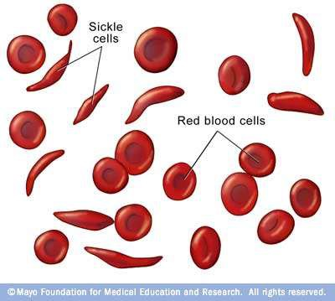
SICKLE CELL ANAEMIA
Dr. Prasad Muley
Associate Professor
Department of Paediatrics
SBKS MIRC

Slide 2
What is Sickle Cell Anemia?
Sickle cell disease (SCD) is a life threatening autosomal recessive genetic disorder resulting from inheritance of abnormal genes from both parents.
Normal red blood cells (RBCs) are biconcave disc shaped and move smoothly through the blood capillaries.

Slide 3
Haemoglobinopathy
Hemoglobin is a tetrameric protein composed of two pairs of globin chains, each with its own heme group.
Normal adult red cells contain mainly HbA (α₂β₂), along with small amounts of HbA₂
(α₂δ₂) and fetal hemoglobin (HbF; α₂γ₂).

Slide 4
Sickle cell disease is caused by a point mutation in the sixth codon of β-globin that leads to the replacement of a glutamate residue with a valine residue.
The abnormal physiochemical properties of the resulting sickle hemoglobin (HbS) are responsible for the disease.

Slide 5
The life span of RBCs in SCD patients is only about 10 to 20 days and the bone marrow can't replace them fast enough.
As a result there is decrease in number of RBCs in the body and the RBCs don’t contain sufficient amount of haemoglobin.
In SCD the RBCs become sickle or crescent shaped which are stiff &sticky and tend to block the blood flow in small capillaries. Blocked blood flow causes ischemia leading to severe pain and gradual damage to organs

Slide 6
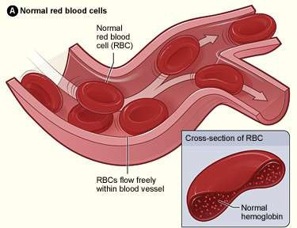
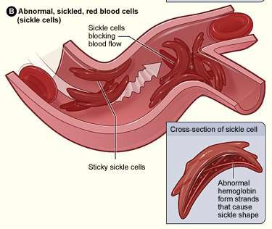
Normal and Sickled Red Blood Cells in Blood Vessels
Figure B shows abnormal, sickled red blood cells clumping and blocking the blood flow in a blood vessel. The inset image shows a cross-section of a sickled red blood cell with abnormal strands of hemoglobin.
Figure A shows normal red blood cells flowing freely in a blood vessel. The inset image shows a cross-section of a normal red blood cell with normal hemoglobin.
Source from http://www.nhlbi.nih.gov/health/dci/Diseases/Sca/SCA_WhatIs.html

Slide 7
Sickle Cell Anemia vs. Sickle Cell Trait
People who have sickle cell anemia are born with it; means inherited, lifelong condition.
They inherit two copies of sickle cell gene, one from each parent.
Sickle cell trait is different from sickle cell anemia. People with sickle cell trait don’t have the condition, but they have one of the genes that cause the condition.
People with sickle cell anemia and sickle cell trait can pass the gene on when they have children.

Slide 8
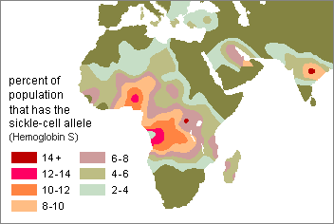
Who Is At Risk?
Most common in people whose families come from Africa, South or Central America (especially Panama), Caribbean islands, Mediterranean countries (such as Turkey, Greece, and Italy), India, and Saudi Arabia.

Slide 9
IN INDIA
In India,
the sickle cell gene is distributed across the country, predominantly in Chhattisgarh, Madhya Pradesh, Orissa, Jharkhand, Maharashtra, Gujarat, Andhra Pradesh, Kerala, Karnataka, Tamil Nadu and some Northeastern states.

Slide 10
Inheritence
Autosomal recessive

Slide 11
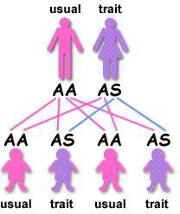
If one parent has sickle cell trait (HbAS) and the other does not carry the sickle hemoglobin at all (HbAA) then none of the children will have sickle cell anemia.
There is a one in two (50%) chance that any given child will get one copy of the HbAS gene and therefore have the sickle cell trait.
It is equally likely that any given child will get two HbAA genes and be completely unaffected.
Inheritance of Sickle Cell Anemia
Source from http://www.sicklecellsociety.org/education/inherit.htm#anchor298279

Slide 12
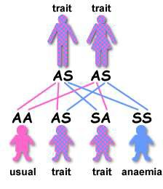
If both parents have sickle cell trait (HbAS) there is a one in four (25%) chance that any given child could be born with sickle cell anemia.
There is also a one in four chance that any given child could be completely unaffected.
There is a one in two (50%) chance that any given child will get the sickle cell trait.
Inheritance of Sickle Cell Anemia
Source from http://www.sicklecellsociety.org/education/inherit.htm#anchor298279

Slide 13
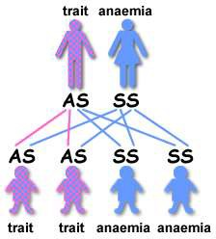
If one parent has sickle cell trait (HbAS) and the other has sickle cell anaemia (HbSS) there is a one in two (50%) chance that any given child will get sickle cell trait and a one in two (50%) chance that any given child will get sickle cell anemia.
No children will be completely unaffected.
Inheritance of Sickle Cell Anemia
Source from http://www.sicklecellsociety.org/education/inherit.htm#anchor298279

Slide 14
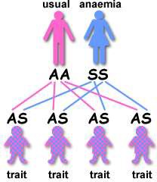
If one parent has sickle cell anaemia (HbSS) and the other is completely unaffected (HbAA) then all the children will have sickle cell trait.
None will have sickle cell anemia.
The parent who has sickle cell anemia (HbSS) can only pass the sickle hemoglobin gene to each of their children.
Inheritance of Sickle Cell Anemia
Source from http://www.sicklecellsociety.org/education/inherit.htm#anchor298279

Slide 15
PATHOGENESIS
HbS molecules undergo polymerization when deoxygenated.
Initially the red cell cytosol converts from a freely flowing liquid to a viscous gel as HbS aggregates form.
With continued deoxygenation aggregated HbS molecules assemble into long needle- like fibers within red cells, producing a distorted sickle or holly-leaf shape.

Slide 16
The presence of HbS underlies the major pathologic manifestations:
Chronic hemolysis,
Microvascular occlusions and Tissue damage.

Slide 17
Several variables affect the rate and degree of sickling
In heterozygotes with sickle cell trait, about 40% of the hemoglobin is HbS and the rest is HbA, which interferes with HbS polymerization. As a result, red cells in heterozygous individuals do not sickle except under conditions of profound hypoxia.
HbF inhibits the polymerization of HbS even more than HbA; hence, infants do not become symptomatic until they reach 5 or 6 months of age, when the level of HbF normally falls.

Slide 18
Mean cell hemoglobin concentration (MCHC). Higher HbS concentrations increase the probability that aggregation and polymerization will occur during any given period of deoxygenation. Thus, intracellular dehydration, which increases the MCHC, facilitates sickling.
Conversely, conditions that decrease the MCHC reduce the disease severity. This occurs when the individual is homozygous for HbS.

Slide 19
Intracellular pH.
A decrease in pH reduces the oxygen affinity of hemoglobin, thereby increasing the fraction of deoxygenated HbS at any given oxygen tension and augmenting the tendency for sickling.

Slide 20
HOW RED CELLS RE DAMAGED
As HbS polymers grow, they herniate through the membrane skeleton and project from the cell ensheathed by only the lipid bilayer.
This severe derangement in membrane structure causes the influx of Ca^{[2]+}ions, which induce the cross-linking of membrane proteins and activate an ion channel that permits the efflux of K⁺ and H₂O.

Slide 21
CONTD..
With repeated episodes of sickling, red cells become increasingly dehydrated, dense, and rigid .
Eventually, the most severely damaged cells are converted to end-stage, nondeformable, irreversibly sickled cells, which retain a sickle shape even when fully oxygenated.

Slide 22
CONTD..
The severity of the hemolysis correlates with the percentage of irreversibly sickled cells, which are rapidly sequestered and removed By mononuclear phagocytes (extravascular hemolysis).
Sickled red cells are also mechanically fragile, leading to some intravascular hemolysis as well.

Slide 23
MICROVASCULAR OCCLUSSIONS
May be dependent upon more subtle red cell membrane damage and other factors, such as inflammation, that tend to slow or arrest the movement of red cells through microvascular beds .
Sickle red cells express higher than normal levels of adhesion molecules and are sticky.
Mediators released from granulocytes during inflammatory reactions up-regulate the expression of adhesion molecules on endothelial cells and further enhance the tendency for sickle red cells to get arrested during transit through the microvasculature.

Slide 24
The stagnation of red cells within inflamed vascular beds results in extended exposure to low oxygen tension, sickling, and vascular obstruction.
Once started, it is easy to envision how a vicious cycle of sickling, obstruction, hypoxia, and more sickling ensues.
Depletion of nitric oxide (NO) may also play a part in the vascular occlusions.
Free hemoglobin released from lysed sickle red cells can bind and inactivate NO, which is a potent vasodilator and inhibitor of platelet aggregation. Thus, reduced NO increases vascular tone (narrowing vessels) and enhances platelet aggregation, both of which may contribute to red cell stasis, sickling, and (in some instances) thrombosis

Slide 25
MORPHOLOGY
In full-blown sickle cell anemia, the peripheral blood demonstrates variable numbers of irreversibly sickled cells, reticulocytosis, and target cells which result from red cell dehydration.
Howell-Jolly bodies (small nuclear remnants) are also present in some red cells due to the asplenia .
The bone marrow is hyperplastic as a result of a compensatory
erythroid hyperplasia.
Expansion of the marrow leads to bone resorption and secondary new bone formation, resulting in prominent cheekbones and changes in the skull that resemble a crew-cut in x-rays.
Extramedullary hematopoiesis can also appear. The increased breakdown of hemoglobin can cause pigment gallstones and hyperbilirubinemia.

Slide 26
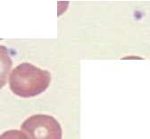

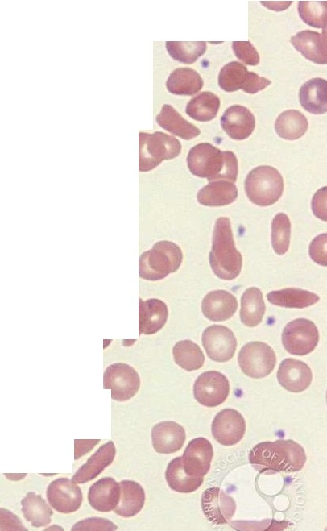


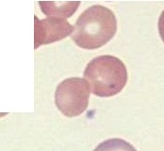

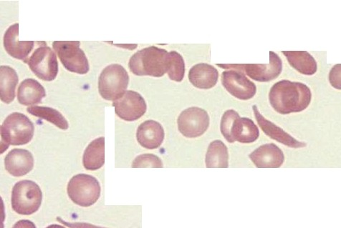


.•. -,.. . . -
.
. • o
.
a. 0
•
0
tP
.
I o •
•
•
-
,... .,
.
0
..
•
•
O •
•

Slide 27
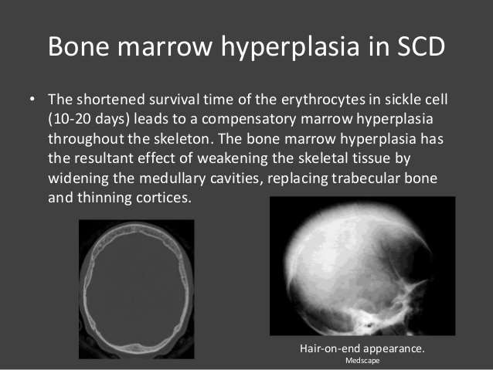

Slide 28
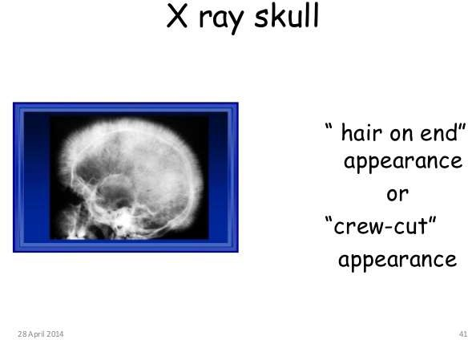

Slide 29
In early childhood, the spleen is enlarged up to 500 gm by red pulp congestion, which is caused by the trapping of sickled red cells in the cords and sinuses
With time, the chronic erythrostasis leads to splenic infarction, fibrosis, and progressive shrinkage, so that by adolescence or early adulthood only a small fibrous splenic tissue is left; this process is called autosplenectomy .

Slide 30
Infarctions caused by vascular occlusions can occur in many other tissues as well, including the bones, brain, kidney, liver, retina, and pulmonary vessels.
In adult patients, vascular stagnation in subcutaneous tissues often leads to leg ulcers; this complication is rare in children.

Slide 31
CLINICAL FEATURES
Sickle cell disease causes a moderately severe hemolytic anemia (hematocrit 18% to 30%) that is associated with -
reticulocytosis,
hyperbilirubinemia,
and the presence of irreversibly sickled cells.

Slide 32
Its course is punctuated by a variety of “crises.” Vaso-occlusive crises, also called pain crises, are episodes of hypoxic injury and infarction that cause severe pain in the affected region.

Slide 33
Although infection, dehydration, and acidosis (all of which favor sickling) can act as triggers, in most instances no predisposing cause is identified.
The most commonly involved sites are the bones, lungs, liver, brain, spleen, and penis.
In children, painful bone crises are extremely common and often difficult to distinguish from acute osteomyelitis. These frequently manifest as the hand-foot syndrome or dactylitis of the bones of the hands or feet, or both.

Slide 34
Acute chest syndrome is a particularly dangerous type of vaso-occlusive crisis involving the lungs, which typically presents with fever, cough, chest pain, and pulmonary infiltrates. Pulmonary inflammation causes blood flow to become sluggish and “spleenlike,” leading to sickling and vaso-occlusion.
This compromises pulmonary function, creating a potentially fatal cycle of worsening pulmonary and systemic hypoxemia, sickling, and vaso-occlusion.
Other forms of vascular obstruction, particularly stroke, can take a devastating toll. Factors proposed to contribute to stroke include the adhesion of sickle red cells to arterial vascular endothelium and vasoconstriction caused by the depletion of NO by free hemoglobin

Slide 35
Sequestration crises occur in children with intact spleens.
Massive entrapment of sickle red cells leads to rapid splenic enlargement, hypovolemia, and sometimes shock.

Slide 36
Aplastic crises stem from the infection of red cell progenitors by parvovirus B19, which causes a transient cessation of erythropoiesis and a sudden worsening of the anemia.

Slide 37
Chronic hypoxia
It is responsible for a generalized impairment of growth and development, as well as organ damage affecting spleen, heart, kidneys, and lungs. Sickling provoked by hypertonicity in the renal medulla causes damage that eventually leads to hyposthenuria (the inability to concentrate urine), which increases the propensity for dehydration and its attendant risks.

Slide 38
Increased susceptibility to infection with encapsulated organisms.
This is due in large part to altered splenic function, which is severely impaired in children by congestion and poor blood flow, and completely absent in adults because of splenic infarction.
Pneumococcus pneumoniae and Haemophilus influenzae septicemia and meningitis, common causes of death, particularly in children.

Slide 39
DIAGNOSIS
The diagnosis is suggested by the clinical findings and the presence of irreversibly sickled red cells and is confirmed by various tests for sickle hemoglobin.

Slide 40
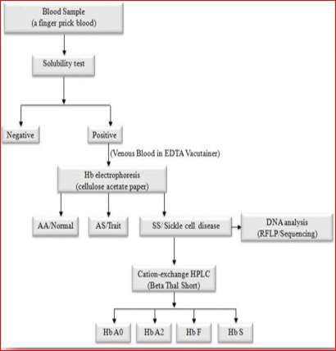
FLOW CHART FOR LAB DIAGNOSIS

Slide 41
SOLUBILITY TEST
It is based on the relative insolubility of haemoglobin S in the reduced state in high phosphate buffer solution (metabisulfite is a reducing agent).
When whole blood is mixed with the reducing agent, the haemoglobin S forms liquid crystals and give a cloudy appearance to the phosphate buffer solution.

Slide 42
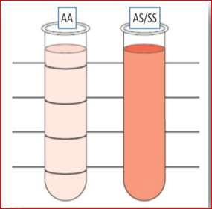
SOLUBILITY TEST
A transparent solution is seen with other haemoglobins that are more soluble in the reducing agent.
A positive result is indicated by a turbid suspension through which the ruled lines are not visible. A negative result is indicated by a transparent suspension through which the ruled lines are visible .

Slide 43
SICKLING TEST
In the Sickling test we create the conditions at which oxygen tension decline to induce the Sickling process of HbS in RBCs.

Slide 44
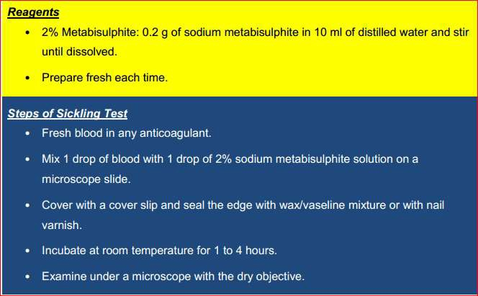

Slide 45
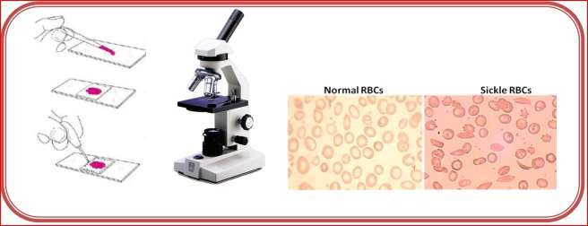

Slide 46
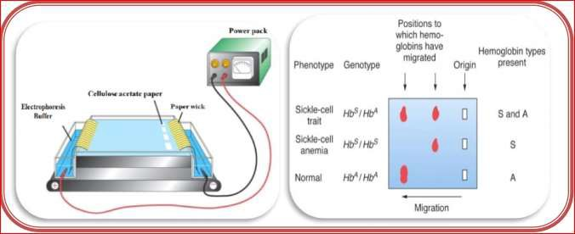
ELECTROPHORESIS

Slide 47
HPLC
High-performance liquid chromatography (HPLC) is an excellent, powerful diagnostic tool for the direct identification of haemoglobin variants with a high degree of precision in the quantification of normal and abnormal haemoglobin fractions.
Cation-exchange HPLC has the advantage of quantifying HbF and HbA2 along with haemoglobin variant screening in a single, highly reproducible system, making it an excellent technology to screen for haemoglobin variants. In cation- exchange HPLC,hemolysate is injected into a chromatography column containing a negatively charged resin onto which the positively charged haemoglobins are adsorbed.

Slide 48
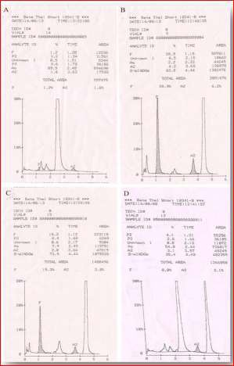

Slide 49
MOLECULAR DIAGNOSTICS
RFLP
DNA Sequencing

Slide 50
THANK YOU

