Slide 1
Antiemetic - I
Dr.Jayant Patharkar

Slide 2
Emesis – vomiting
It is unpleasant but protective reflex
Antiemetics – drugs which prevent vomiting or relieve nausea & vomiting
Stimulation of Vomiting centre in medulla oblongata
Chemoreceptor trigger zone (CTZ) – Area postrema
Nucleus tractus solitarius (NTS)
These two are relay stations for afferent impulses
Afferent impulses arise from g.i.t, throat & other viscera

Slide 3
Physiology of vomiting:
It is complex series of movements
It is controlled by vomiting centre
It receive afferent impulses from
Higher centres in brain
Chemoreceptor trigger zone (CTZ)
Vestibular apparatus
Peripheral structures including GI tract

Slide 4
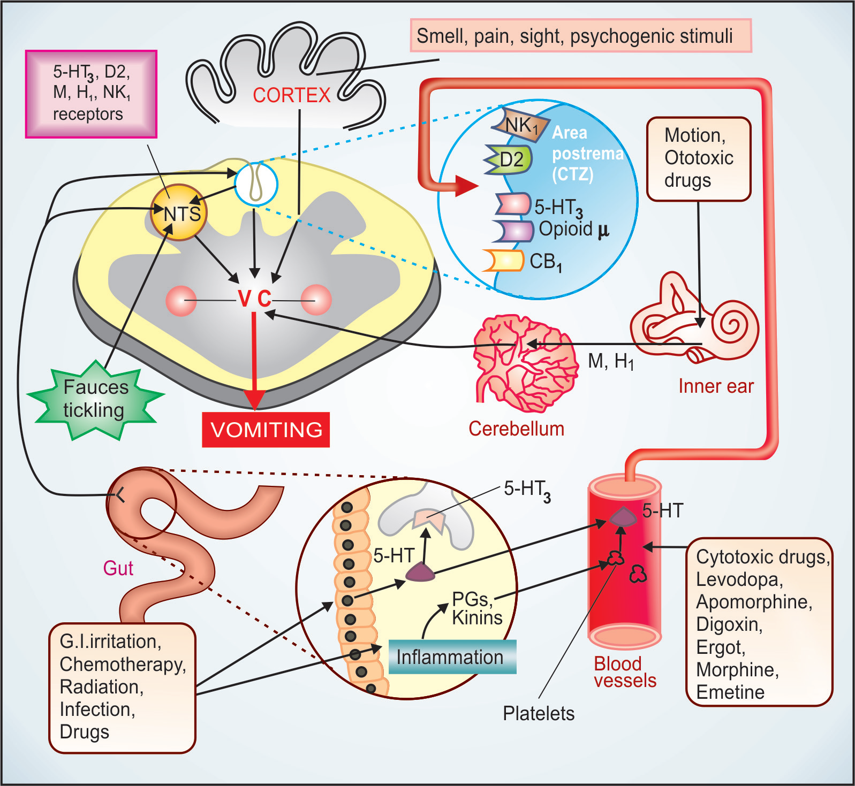

Slide 5
Chemoreceptor trigger zone (CTZ) :
It is major sensory relay station in the afferent vomiting pathway
It is purely a sensory relay station, hence is incapable of initiate vomiting in absence of vomiting centre
It is situated in the lateral border of the area postrema of medulla oblongata

Slide 6
It is outside the BBB, hence in direct contact with circulating blood
Drugs stimulating CTZ → vomiting
Morphine, apomorphine, alkylating agents, digitalis
Drugs inhibiting CTZ like phenothiazines, certain antihistaminics

Slide 7
Vagal afferents:
Vomiting due to irritation, overdistension of GI tract, delayed gastric emptying → stimulation of vomiting centre via visceral vagal afferents
Cytotoxic drugs, radiation & g.i. irritants – release of 5-HT from enterochromaffin cells

Slide 8
5-HT acts on 5-HT₃ receptors present on extrinsic primary afferent neurons
These primary afferent neurons are part of enteric nervous system
These neurons send impulses to NTS & CTZ by vegal & spinal visceral afferents
Large amount of 5-HT – Spill into circulation – CTZ

Slide 9
Vomiting of vestibular origin:
Impulses generated body rotated or equilibrium disturbed or due to ototoxic drugs
They acts on muscarinic or Histaminergic receptors
motion sickness → vestibular apparatus → vestibular nucleus → cerebellum → CTZ → vomiting centre
Also vomiting of central origin due to emotions, nauseous odour, ghastly sight, severe pain
This dose not involve CTZ

Slide 10
Role of neurotransmitters in vomiting:
5-HT (serotonin)
Dopamine (DA)
Neurokinis (NK)
substance P
Neurokinin A
Neurokinin B
Histamine

Slide 11
CTZ & NTS express receptors:
Histamine H₁
Dopamine D2
Serotonin 5-HT₃
Cholinergic M
Neurokinin NK₁
Cannabinoid CB₁
Opioid μ receptors
Through theses receptors emetic signals relayed to vomiting centre
Antiemetic drugs acts on these receptors

Slide 12
Emetics:
Drugs that produce vomiting
I. centrally acting emetics:
apomorphine
morphine
II. Peripherally acting emetics:
mustard
antimony- potassium tartrate
hypertonic sodium chloride
III. Both peripherally & centrally acting emetics
ipecacuanha

Slide 13
Therapeutic uses of emesis:
In certain cases of poisoning where facilities for gastric lavage are not available.
It should be avoided in caustic poisoning – gastric perforation
Emetics avoided in;
Children & elderly
Pregnant women
Patient with cardiac decompensation, hypertension, hernia, peptic ulcer & pulmonary tuberculosis

Slide 14
Drug therapy of vomiting:
Treatment of vomiting consists of
Treatment of cause;
Relief of pain, treatment of GI infection, obstruction & colic
Reduction in the intracranial tension
Correction of metabolic acidosis
Symptomatic treatment with antiemetics
Supportive therapy i.e. correction of dehydration & electrolyte disturbances

Slide 15
Classification of antiemetic drugs:
H₁ Antihistaminic;
Promethazine
Diphenhydramine
Dimenhydrinate
Doxylamine
cyclizine, meclizine

Slide 16
II. Neuroleptics (D2 blockers)
chlorpromazine
Triflupromazine
Prochlorperazine
III. 5HT3 antagonists;
ondansetron, granisetron, dolasetron, palonosetron

Slide 17
III. Prokinetic drugs:
Metoclopramide
Domperidone
Cisapride
Mosapride
Itopride
Levosulpiride
Cinitapride

Slide 18
IV. Antimuscarinic / Anticholinergics;
scopolamine (Hyoscine), Dicyclomine
V. Antagonists of NK1 receptors for substance P;
Aprepitant, Fosaprepitant
VI. Adjuvant antiemetics;
Dexamethasone
Benzodiazepines
Dronabinol

Slide 19
Clinically antiemetics classified according to the potency;
Most potent:
ondansetron, granisetron, high dose metoclopramide
Moderately potent:
Low dose metoclopramide, phenothiazines, butyrophenones ( droperidol), cannabinoids
Weak:
anticholinergics, antihistaminics, benzodiazepines (lorazepam)
Glucocorticoids: dexamethasone – resistant nausea & vomiting in cancer chemotherapy

Slide 20
Antihistaminic – antiemetic drugs:
i.e. Dimenhydrinate, cyclizine, promethazine, meclizine
Act on vomiting centre
Mild sedative effect
Used in the vomiting due to,
Labyrinthine disorders – vestibular neuoronitis, Meniere disease
Vomiting during pregnancy

Slide 21
Phenothiazines:
Chlorpromazine, prochlorperazine
Dopamine D 2 receptor antagonists
They selectively depress CTZ
They dose not have any action on vomiting centre
Used in the nausea & vomiting due to uremia, carcinomatosis, radiation sickness & due to drugs
They are preferred in severe vomiting , short period i.e. postoperative vomiting

Slide 22
Prokinetics:
Metoclopramide, domperidone
These drugs promote coordinated GI motility maintaining physiological pattern & rhythm
These are D2 receptor antagonists
Dopamine in the upper GI tract – inhibitory effect on gastric motility & intragastric pressure
Inhibition carried out by suppression of ACh release from the primary motor neurons in the myenteric plexus.

Slide 23
Metoclopramide & domperidone are prokinetic drugs
Central action: They inhibit D2 receptor in CTZ & acts as central antiemetic
Action as 5HT4 agonists: metoclopramide & cisapride acts on 5HT4 receptor
5HT has important action on gastric motility present in the neurons of myenteric plexus

Slide 24
Metoclopramide:
It is prokinetic drug
It acts as dopamine antagonist
It also acts as 5HT4 agonist.
Its antiemetic effect has two component;
Peripheral action: It increases forward propulsive action of upper GI tract - 5HT4 action.
It also enhance the action of ACh at the muscarinic receptors
Central action: it blocks D2 receptor in CTZ – inhibits vomiting

Slide 25
Pharmacological actions:
↑ tone of the gastroesophageal sphincter
↑ coordinated gastric motility
↑ activity of pyloric antrum & duodenal peristalsis
Thus transit of gastric content through small intestine accelerated.
It has no prominent action on biliary tract & large bowel motility
It also stimulates prolactin secretion due to inhibition of dopamine action.
Through its central action it inhibits postop & vomiting due to morphine & pethidine

Slide 26
ADRs :
Drowsiness, muscle dystonia, diarrhoea
Hyperprolactenaemia, galactorrhoea, gynaecomastia
Skin rash, lassitude
Sodium retention & hypokalaemia in patients with edema
Extrapyramidal reactions, malignant neuroleptic syndrome – dose related ( daily intake should not exceed 0.5 mg/kg.
Dose: 5-10 mg TDS orally,
10-20 mg i.m. or i.v.

Slide 27
Therapeutic uses:
Antiemetic – postoperative vomiting; low dose 10 mg i.m. or i.v. three times in a day
2) Cancer chemotherapy – before & during cancer chemotherapy in high doses. dose: 0.5-3 mg/kg i.v. over 15 min
3) before induction of general anaesthesia for emergency surgery as prokinetic
4) To assist passage of tubes in the duodenum
5) To treat gastroparesis & GERD i.e. in vagotomy, diabetes, gastritis & gastric ulcers

Slide 28
Domperidone:
It is prokinetic drug action in upper GI tract
It is D2 receptor antagonist
It blocks D2 receptor in CTZ – antiemetic action
It dose not have ACh like action
It dose not cross blood brain barrier
Thus, it has fewer extrapyramidal side effects
Infrequently it causes hyperprolactinaemia & galactorrhoea
Dose: 10-20 mg 3-4 times a day.

Slide 29
Cisapride:
It is prokinetic drug
It increases gastric motility by acting as 5HT4 agonist
It has action on upper GI as well as colon
It dose not have direct antiemetic

Slide 30
ADRs:
Cardiac arrhythmias : prolongation of QT interval
The toxicity increases when taken with drugs which also prolongs QT interval.
Increased urinary frequency, abdominal cramps & diarrhoea
Mosapride : selective 5HT4 agonists with fewer side effects

Slide 31
Actions of Prokinetic drugs:
Action | Metoclopramide | Domperidone | Cisapride
5HT 4 agonist | +++ | - | +++
Antidopaminergic | ++ | +++ | -
CNS | ++ | + | -
Hyperprolactinaemia | ++ | +++ | -
Antiemetic | ++ | ++ | -
Prokinetic | Upper GI tract | Upper GI tract | Upper GI & Colon

Slide 32
MCQs

Slide 33
Q 1. Vomiting centre receives afferent impulses from
Chemoreceptor trigger zone (CTZ)
Vestibular apparatus
Higher centers
All of the above

Slide 34
Q 2. It is untrue about CTZ
It is sensory relay station for afferent impulses
It is situated in the area postrema of medulla oblongata
It is protected by blood brain barrier
It is stimulated by morphine, apomorphine

Slide 35
Q 3. Antihistaminics produce their antiemetic action by acting on
Neurokinin receptors (NK1)
Histamine receptors (H1)
Dopamine receptors (D2)
Cannabinoid receptors (CB1)

Slide 36
Q 4. Metoclopramide acts by following mechanisms except
Inhibition of peripheral D2 receptors
Inhibition of central D2 receptors
Agonists on 5HT-4 receptors
Inhibition of action of ACh on muscarinic receptors

Slide 37
Q 5. Following is common about metoclopramide & domperidone except
Antidopaminergic action
Hyperprolactinaemia
Prokinetic action in upper GI
Prominent CNS action

