Slide 1
Antiemetic II
Dr.Jayant Patharkar

Slide 2
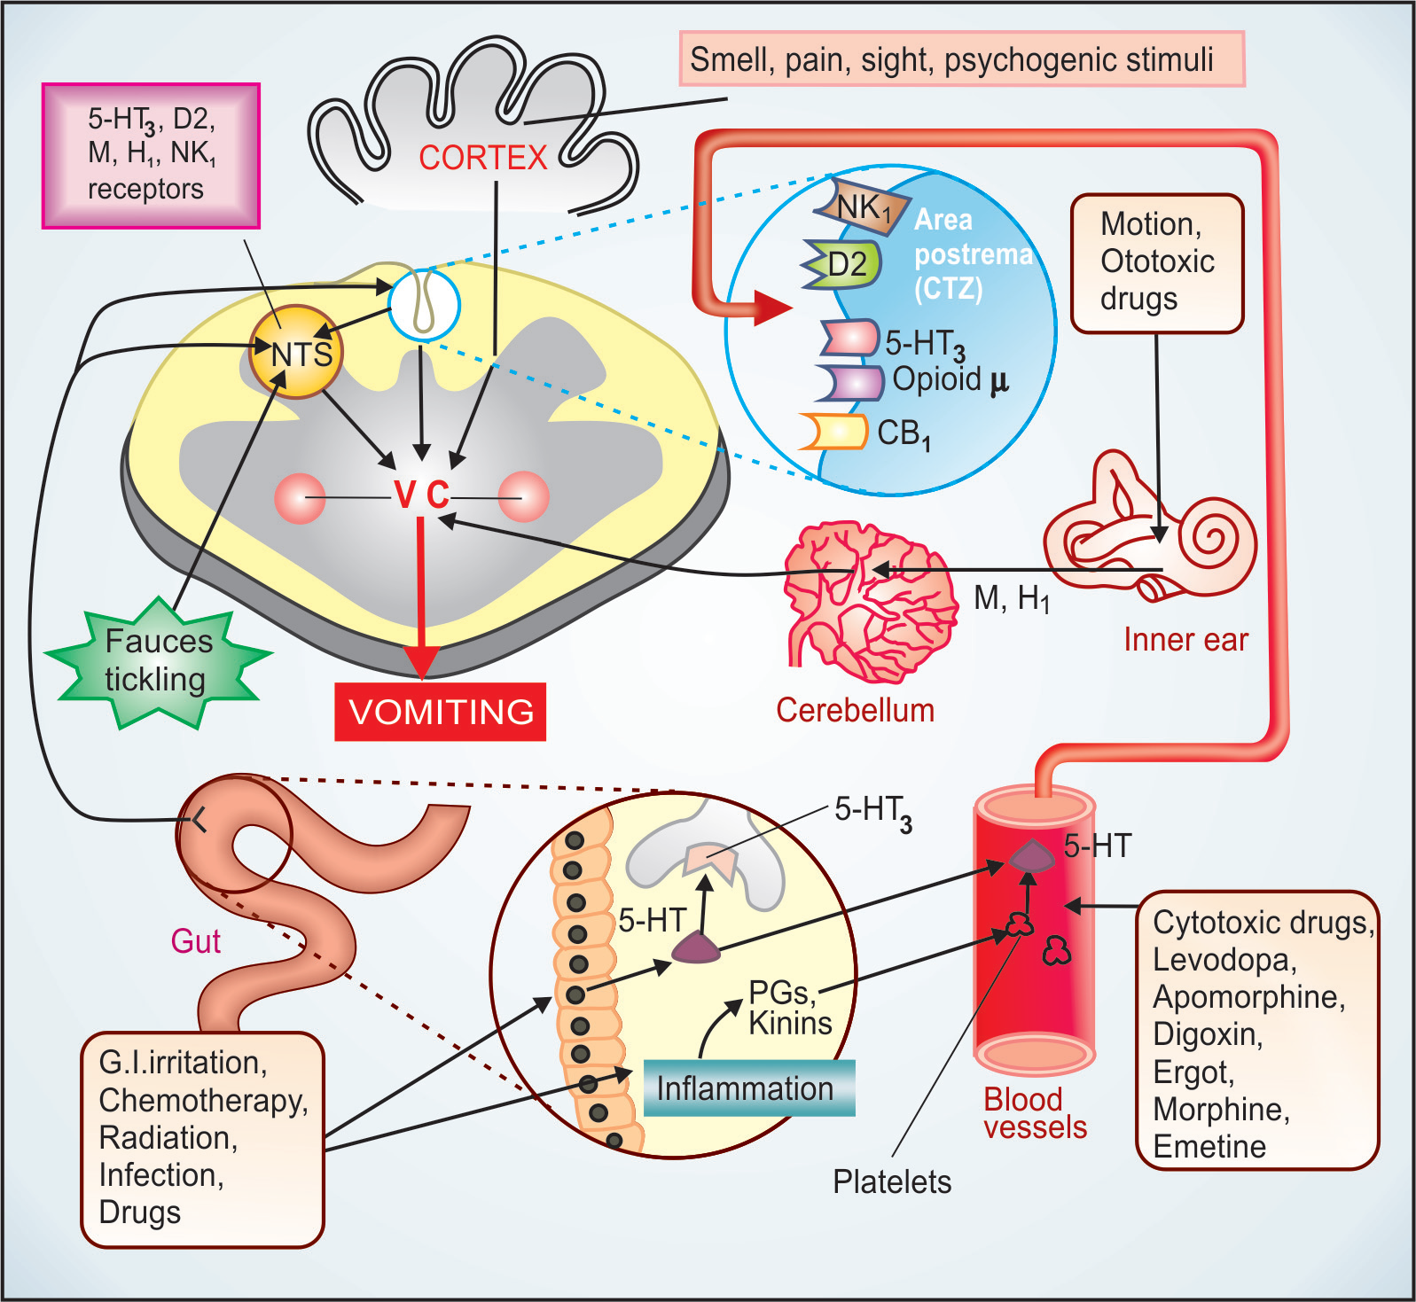

Slide 3
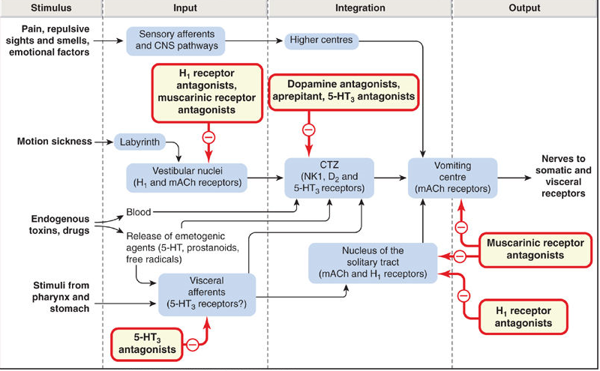

Slide 4
5HT3 antagonists:
Ondansetron:
It is 5HT3 antagonists
It blocks stimulatory effect of 5HT on 5HT3 receptors on vagal afferent in g.i.t , NTS & CTZ
Cytotoxic drugs/radiation → cell damage → release of 5HT from intestinal mucosa → activation of the vagal afferents in g.i.t. → stimulation of NTS, CTZ
Ondansetron blocks these emetogenic impulses

Slide 5
It dose not block dopamine receptors
It dose not block vomiting induced due to apomorphine or motion sickness
It is used as antiemetic drug to control chemotherapy/radiotherapy induced vomiting
It is also used in postoperative nausea & vomiting
It is also used in disease & drug induced vomiting.

Slide 6
Dose: For cisplatin & highly emetogenic drugs –
8 mg i.v. by slow injection over 15 min ½ hr before chemotherapeutic infusion followed by two similar doses 4 hours apart
Other regimen single 24 mg i.v. dose on first dose.
For post operative nausea & vomiting 4-8 mg given i.v. before induction , repeated 8 hrly.
For less emetogenic drugs, oral dose 8 mg 1-2 hour before procedure & repeated twice 8 hrly

Slide 7
It is first choice antiemetic before surgery
Due to its efficacy, lack of side effects & drug interaction as compared to metoclopramide & phenothiazines
ADRs:
headache , dizziness
Hypotension, bradycardia, chest pain & allergic reaction after i.v. injection in few patients.

Slide 8
Granisetron:
It is more potent than ondansetron
It is more effective in repeat cycle of chemotherapy
As compared to ondansetron, it will not block 5HT₄ receptors
Dose: 1-3 mg diluted in 20-50 ml saline & infused i.v. over 5 min before chemotherapy & repeated after 12 hr.

Slide 9
Palonosetron:
Longest acting 5HT₃ antagonist
Highest affinity for 5HT₃ receptors
Useful in suppressing delayed CINV
Elimination t_{1/2} 40 hours
ADRs: Headache, fatigue, dizziness, abdominal pain
Q-T prolongation with moxifloxacin, erythromycin, antipsychotics, antidepressants
Blurring of vision on rapid i.v. injection
Dose: 250 μg by slow i.v. injection 30 min before chemotherapy
For PONV 75 μg i.v. single injection before induction.

Slide 10
Anticholinergics:
Hyoscine :
It is effective antiemetic for motion sickness.
It acts by blocking nerve conduction across the cholinergic pathway between vestibular apparatus & vomiting centre.
ADRs: sedation, dry mouth
Dose: 0.2-0.4 mg oral or i.m. for motion sickness ½ an hour before starting the journey
Transdermal patch containing 1.5 mg of hyoscine applied behind pinna
It delivers drug for 3 days
It produces only mild side effects

Slide 11
Dicycolomine:
It is anticholinergic antiemetic
It is effective in prophylaxis of motion sickness as well as morning sickness
It has no teratogenic side effects.
Dose: 10-20 mg orally

Slide 12
H1 antihistaminics:
Promethazine
Diphenhydramine
Dimenhydrinate
These are antihistaminics with antiemetic effect
They exert their antiemetic effect through anticholinergic, antihistaminic, weak dopaminergic properties.

Slide 13
They are useful in motion sickness & morning sickness
They are used in combination of other antiemetics in chemotherapy induced nausea & vomiting
They block metoclopramide induced extrapyramidal side effect by their central anticholinergic action
ADRs: sedation & dry mouth

Slide 14
Doxylamine :
It is sedative H1 antihistaminic with prominent anticholinergic property
It is available in combination with pyridoxine
It is useful in morning sickness
ADRs: drowsiness, dry mouth, vertigo & abdominal upset
Dose: 10-20 mg at bed time

Slide 15
Cinnarizine:
It is H1 antihistaminic with weak antimuscarinic property
It also has anti-5HT, sedative & vasodilator properties
It modulates Ca 2+ fluxes & thus blocks vasoconstrictor effects of many endogenous mediators

Slide 16
It exerts its antivertigo property by blocking Ca channel
Thus it inhibits vestibular sensory nuclei in the inner ear
By blocking influx of Ca 2+ from endolymph into vestibular sensory nuclei
It is useful in Meniere’s disease & other type of vertigo
ADRs: sedation & mild gastrointestinal upset
Dose: 25-50 mg orally

Slide 17
Neuroleptics:
Phenothiazine
Haloperidol
They have antiemetic & sedative property
They also have anticholinergic as well as H 1 antihistaminic property
They acts by blocking D2 receptors in CTZ

Slide 18
They are called as broad spectrum antiemetics
As they are effective in drug induced & post operative nausea & vomiting
Disease induced vomiting : gastroenteritis uremia, liver disease, migraine
Malignancy associated & cancer chemotherapy induced vomiting

Slide 19
Prochlorperazine:
It is D2 blocking phenothiazine
It is labyrinthine suppressant
It has selective antivertigo & antiemetic property
ADRs: muscle dystonia, extrapyramidal side effects
Muscle dystonia common in children after i.m. injection hence parenteral use in children avoided
Dose: 5-10 mg BD/TDS orally
12.5-25 mg deep i.m. injection

Slide 20
NK1 receptor antagonists:
NK1 receptor activation in CTZ & NTS by substance P released during chemotherapy & other stimuli.
NK1 receptor antagonists blocks these receptors & exert antiemetic effect
Aprepitant:
It is selective, high affinity NK1 receptor antagonists.
It blocks the emetic action of substance P.
It is useful against delayed vomiting than against acute vomiting

Slide 21
It is combined with ondansetron & dexamethasone
It is particularly useful in the patients undergoing multiple cycles of chemotherapy.
Dose: For CINV – 125 mg before chemotherapy + 80 mg on 2nd & 3rd day all orally along with i.v. ondansetron & dexamethasone.
For PONV – 40 mg single dose oral before abdominal or other surgery

Slide 22
Adjuvant antiemetics:
Corticosteroids
Benzodiazepine
Cannabinoids
Corticosteroids:
It is used to enhance antiemetic effect of metoclopramide, ondansetron etc.
They also reduce certain side effects of primary antiemetic
It is useful in acute as well as delayed vomiting
Dose: dexamethasone 8-20 mg i.v. before chemotherapy
For delayed vomiting dexamethasone 8 mg/day orally from 2-5th day of chemotherapy

Slide 23
Benzodiazepine:
They have weak antiemetic property
Diazepam, lorazepam oral or i.v. given before chemotherapy
Adjuvant to ondansetron or metoclopramide
They help by relieving psychogenic component
Cannabinoids:
Dronabinol : It is tetrahydrocannabinol synthetically produced or extracted from Cannabis
It exert antiemetic property by acting on CB1 receptors in CTZ or vomiting centre
It used as alternative antiemetic in moderately emetogenic chemotherapy or in patients who can not tolerate other antiemetics
ADRs: hallucinogenic, disorienting, some patients experience “High”- addiction

Slide 24
Therapy of vomiting during pregnancy:
It is ideal to avoid drugs in first trimester.
In some patients with sever nausea & vomiting drugs used are;
Doxylamine 40 mg + pyridoxine 40 mg BD
It is safe and effective
Dimenhydrinate : 50-100 mg orally
It can also used as suppository
Prochlorperazine: 5-10 mg i.v. in severe cases
Ginger along with sugar in mild cases as home remedy

Slide 25
Therapy of motion sickness:
Hyoscine (Scopolamine) :
It effective for prophylactic use in motion sickness.
0.3-0.6 mg single oral dose ½ an hour before journey
Drug action remain for 2-3 hrs
For prolonged journey 0.1-0.2 mg given after 2 hrs.
Hyoscine 1.5 mg transdermal patch applied behind pinna release drug at uniform rate for 72 hours

Slide 26
Therapy of Vertigo:
Drugs used in vertigo:
Vestibular suppressants:
phenothiazine – prochlorperazine
antihistaminics
Central sedatives: scopolamine, benzodiazepines
Betahistine
Diuretics
Glucocorticoids

Slide 27
Antihistaminics:
Cinnarizine 5 mg TDS
It is highly effective antivertigo agent
Other antihistaminics used are cyclizine, meclizine, dimenhydrinate, promethazine
Phenothiazine :
Prochlorperazine; dose: 5-10 mg BD/TDS orally
12.5-25 mg by deep i.m. injection
Central anticholinergics ; scopolamine ( hyoscine)
Dose : 0.3-0.6 mg orally
Benzodiazepine: To treat anxiety Diazepam 5-10 mg orally

Slide 28
Betahistine:
It is vasodilator H1 selective histamine analogue.
It is used to control vertigo in patients with Meniere’s disease
Dose: 8 mg ½ to 1 tablet QID
Meniere’s disease initially treated with low salt diet(1 g/day) & thiazide diuretics.
Glucocorticoids: Methylprednisolone 40-80 mg/day for 4-5 days followed by 20 mg/day for 4 days.
It used to suppress intralabyrinthine edema due to viral infection.

Slide 29
              MCQs

Slide 30
Q1. Ondansetron acts by following mechanism:
Blocking D 2 receptors
Blocking NK1 receptors
Blocking 5HT3 receptors
Blocking H1 receptors

Slide 31
Q 2. Therapeutic uses of ondansetron are except
Motion sickness
Drug induced nausea & vomiting
Chemotherapy induced nausea & vomiting
Post operative nausea & vomiting

Slide 32
Q 3. This is drug of choice for motion sickness
Scopolamine
Prochlorperazine
Diphenhydramine
Granisetron

Slide 33
Q 4. These drugs can be used for vomiting in pregnancy except
Prochlorperazine
Doxylamine + pyridoxine
Dimenhydrinate
Dronabinol

Slide 34
Q 5. Drug used in vertigo
Betahistine
Cinnarizine
Prochlorperazine
All of the above

