Slide 1
Non-Cardiac Surgery and Coronary Drug-Eluting Stents
Dr Tejas Shah
Assistant Professor
Dept of Cardiology
SBKS MI & RC

Slide 2
Conflict of Interest Disclosure
Manish Parikh, MD
  None
  Off-label use will be discussed

Slide 3
Clinical Variables to Consider
Timing of surgery relative to when the stent was placed
  Can surgery be delayed?
What type of surgery is planned?
What type of stent was previously placed?
What type of DAPT is the patient taking?

Slide 4
Impact of Therapies on Outcomes
Surgical Bleeding
Ischemic events:
MI/CKMB↑
Stent Thrombosis

Slide 5
Reasons for Discontinuation of Antiplatelet Treatment
Reasons Associated With Discontinuation in 56 Patients
Percent of Discontinuations
Iwata Y, et al. Circ J. 2008;72:340-341.
Notes:
Iwata, 2008, p341, Table 2

Slide 6
Timing of Stent Thrombosis after BMS Implantation
1.0
0.8
Ticlopidine
No Ticlopidine
0.6
Percent with ST
0.4
0.2
0
0
4
8
12
16
20
24
28
Days from procedure
Major benefit of ticlopidine with BMS was
prevention of SAT in first 2 weeks after stenting
Cutlip DE et al. Circulation. 2001;103:1967.
Notes:
With bare metal stents, stent thrombosis was confined to the first month after the procedure with non-Ticlid regimens, but to the first 2 weeks with Ticlid, leading to the initial recommendation for first the 4 weeks and then ultimately just 2 weeks of Ticlid or Plavix therapy.
Cutlip DE, Baim DS, Ho KK et al. Stent thrombosis in the modern era: a pooled analysis of multicenter coronary stent clinical trials. Circulation. 2001;103:1967-71.

Slide 7
Estimated Risks of Subacute ST
Based upon historical data with BMS
Lack of DAPT can be catastrophic!
Schatz et al, Circulation 1991
Fischman et al NEJM 1994
Leon et al, NEJM 1998

Slide 8
Independent Predictors of Stent Thrombosis: Dutch Registry (n=21,009 with DES or BMS)
Definite stent thrombosis occurred in 437 (2.1%) pts
HR
95% CI
P Value
Clopidogrel stop <30 days
36.53 [7.96-167.77] P<0.0001
Undersizing
13.39 [5.27-34.04] P<0.0001
Clopidogrel stop 180-365 days
5.87 [1.74-19.80] P=0.004
Clopidogrel stop 30-180 days
4.63 [1.40-15.35] P=0.01
Malignancy
4.50 [2.14-9.49] P<0.0001
CAD >50% proximal of culprit
4.40 [2.71-7.16] P<0.0001
TIMI flow post-PCI <3
3.77 [2.09-6.80] P<0.0001
Dissection
2.88 [1.67-5.00] P=0.0002
Bifurcation Stenting
2.27 [1.48-3.47] P=0.0002
LVEF >30%
2.27 [1.43-3.60] P=0.0005
PAD
2.13 [1.01-4.51] P=0.048
CAD >50% distal of culprit
1.98 [1.32-2.95] P=0.0009
No ASA
1.91 [1.01-3.88] P=0.049
Any DES
1.88 [1.21-2.94] P=0.005
DM
1.66 [1.02-2.70] P=0.04
Age (per 10 years)
0.80 [0.68-0.94] P=0.007
0
4
8
12
16
20
24
28
32
36
40
HR [95%CI]
van Werkum JW, et al. J Am Coll Cardiol. 2009;53:1399-1409.

Slide 9
Impact of premature thienopyridine discontinuation: PREMIER Registry
500 pts with AMI undergoing primary PCI with DES at 19 U.S. medical centers, alive and well at 30 days
68 (13.6%) were no longer taking prescribed thienopyridines at 30 days
Propensity adjusted for reasons to d/c thien: HR = 9.02 (1.3-60.6), P=0.02
P<0.0001
Spertus JA et al. Circulation 2006;113:2803-9.

Slide 10
Predictors of Stopping Thienopyridines
Multivariable logistic regression model
Over 35 variables considered→ no clearcut strong predictors
Implications: Targeting specific patients for interventions to improve compliance probably not worthwhile
No HS diploma
Cost avoidance
Pre-existing CAD
No D/C instructions
No rehab referral
Spertus JA et al. Circulation 2006;113:2803-9

Slide 11
(Recent) Stents and Surgery:
Not a good Combination!!!
Perioperative thrombotic risk increases
  ⬆platelet aggregation, ⬇fibrinoloysis
  Catecholamine release
  Hypotension
Cessation of antiplatelet Rx often occurs
  Surgeons/staff are just used to it!
Abualsaud and Eisenberg, JACC: CV Intv 2010

Slide 12
Outcomes According to Time Delay Between Stent Implantation and Non-Cardiac Surgery
 | <42 Days | 42 Days to 1 Year | >1 Year | P
BMS Death/any IHD event Death MI | n=40 18 (45) 2 (5) 3 (7.5) | n=477 65 (13.6) 5 (1) 3 (0.6) | n=866 101 (11.7) 1 (0.1) 4 (0.5) | <0.001 <0.0001 <0.0001
DES Death/any IHD event Death MI | n=19 7 (36.8) 1 (5.3) 2 (10.5) | n=255 41(16.1) 2 (0.8) 2 (0.8) | n=282 35 (12.4) 1 (0.4) 3 (1.1) | 0.017 0.049 0.001
Cruden NL, et al. Circ Cardiovasc Interv. 2010;3:236-242.

Slide 13
Prior Coronary Stenting & Cardiac Events in Patients Undergoing Non-Cardiac Surgery
Length of time between stenting & surgery evaluated in 1,953 patients
In-Hospital Outcomes | < 42 Days | 42 Days to 1 Year | > 1 Year | P Value*
Death/Any Ischemic Event | 42.4% | 14.5% | 11.7% | <0.0001
Death | 5.1% | 0.9% | 0.2% | <0.0001
MI | 8.5% | 0.7% | 0.6% | <0.0001
*Comparison of < 42 days with both later time periods.
Conclusion: More in-hospital deaths and ischemic events occurred when non-cardiac surgery was performed within 42 days of stenting vs. when it was done later. The findings support current recommendations.
Cruden NL, et al. Circ Cardiovasc Interv.
2010;3:236-242.

Slide 14
Outcomes According to Time Delay Between Stent Implantation and Noncardiac Surgery
Surgery Performed After DES vs. BMS, and <42 days vs >42 Days
 | <42 Days | 42 Days to 1 Year | >1 Year | P*
All Death/any IHD event Death MI | n=59 25 (42.4) 3 (5.1) 5 (8.5) | n=732 106 (14.5) 7 (0.9) 5 (0.7) | n=1148 134 (11.7) 2 (0.2) 7 (0.6) | <0.0001 <0.0001 <0.0001
BMS Death/any IHD event Death MI | n=40 18 (45)† 2 (5)‡ 3 (7.5)§ | n=477 65 (13.6)† 5 (1)‡ 3 (0.6)§ | n=866 101 (11.7)† 1 (0.1)‡ 4 (0.5)§ | <0.001 <0.0001 <0.0001
DES Death/any IHD event Death MI | n=19 7 (36.8)† 1 (5.3)‡ 2 (10.5)§ | n=255 41(16.1)† 2 (0.8)‡ 2 (0.8)§ | n=282 35 (12.4)† 1 (0.4)‡ 3 (1.1)§ | 0.017 0.049 0.001
Data are presented as n (%), unless otherwise indicated.
*2 test for events (n) by time from stent implantation to surgery.
†P=0.7, 2 test for rate per 100 population (BMS vs DES); ‡P=1.0; §P=1.0, Fisher exact test for rate per 100 population (BMS vs DES).
Cruden NL, et al. Circ Cardiovasc Interv. 2010;3:236-242.

Slide 15
Outcome of Patients Undergoing Non-Cardiac Surgery Following Coronary Stenting
Eight patients (4.0%) died or suffered a myocardial infarction or stent thrombosis.
All 8 patients were among the 168 patients (4.8%, 95% CI 2.1 to 9.2) undergoing surgery 6 weeks after stent placement.
The frequency of these events ranged from 3.8% to 7.1% per week during each of the 6 weeks.
No events occurred in the 39 patients undergoing surgery seven to nine weeks after stent placement (0%, 95% CI 0.0 to 9.0).
Wilson SH et al. J Am Coll Cardiol 2003;42:234

Slide 16
The one thing to remember when it comes to freshly stented patients:
TO AVOID Thrombosis:
DON’T STOP DAPT!

Slide 17
Bleeding Risk in Various Surgeries
Bleeding Risk | Clinical Severity | Type of Surgery
Low | Transfusions rare | Peripheral: plastic/general, biopsies Minor orthopedic, ENT general Endoscopy Eye: anterior chamber Dental
Intermediate | Transfusions may be frequent More re-op, LOS | Visceral Cardiovascular surgery Major orthopedic, ENT Urologic reconstructive
High | Bleeding into a closed space | Intracranial Spinal Eye: posterior chamber
Adapted from Abualsaud and Eisenberg, JACC: CV Intv 2010

Slide 18
What about Longer Delays to Surgery in Patients with Stents?

Slide 19
Historical Perspective
DES
ASA and Oral Anticoagulation
ASA and Ticlopidine
Stent Thrombosis (%)
ASA and Clopidogrel
New DES
Prasugrel
Ticagrelor

Slide 20
Stent Thrombosis and Restenosis During Extended Follow-up of Pts Treated With BMS (n=4503)
 | 1 Year % (95% CI) | 5 Years % (95% CI) | 10 Years % (95% CI)
All stent thrombosis | 0.8 (0.6-1.1) | 1.3 (1.0-1.7) | 2.0 (1.5-2.5)
On-label patients | 0.6 (0.2-0.9) | 1.0 (0.5-1.2) | 1.4 (0.9-2.0)
Off-label patients | 1.1 (0.7-1.5) | 1.7 (1.2-2.2) | 2.5 (1.7-3.3)^{b}
%Stent Thrombosis
%MI Due to Restenosis
↑ Mortality Risk: HR=22, P<0.001
↑ Mortality Risk: HR=2.4, P<0.001
Doyle B, et al. Circulation. 2007;116:2391-2398.
Notes:
Doyle and coworkers performed a retrospective study of 4503 consecutive patients treated with at least 1 bare-metal stent (BMS) and dual antiplatelet therapy between 1994 and 2000.
The cumulative incidence of stent thrombosis was 0.5% at 30 days (95% CI, 0.3% to 0.7%), 0.8% at 1 year (95% CI, 0.6% to 1.1%), and 2.0% at 10 years (95% CI, 1.5% to 2.5%). For patients treated with a single stent in a native artery for a de novo lesion (on label), the cumulative incidence of stent thrombosis at 30 days was 0.2% (95% CI, 0.0% to 0.4%), at 1 year was 0.6% (95% CI, 0.2% to 0.9%), at 5 years was 1.0% (95% CI, 0.5% to 1.2%), and at 10 years was 1.4% (95% CI, 0.9% to 2.0%). For all other patients (off label; n=2295), the cumulative incidence of stent thrombosis at 30 days was 0.7% (95% CI, 0.4% to 1.1%), at 1 year was 1.1% (95% CI, 0.7% to 1.5%), at 5 years was 1.7% (95% CI, 1.2% to 2.2%), and at 10 years was 2.5% (95% CI, 1.7% to 3.3%). Mortality was markedly increased after late and very late BMS thrombosis, particularly during the first 30 days (hazard ratios, 22 [95% CI, 3.1 to 159] and 40 [95% CI, 15 to 107], respectively.
The cumulative incidence (95% CI) of at least 1 restenosis was 9.6% (8.8% to 10.5%) at 1 year, 13.9% (12.8% to 14.9%) at 5 years, and 18.1% (16.5% to 19.7%) at 10 years. The 10-year incidence of restenosis by mode of presentation was stable angina 9.0% (95% CI, 8.0% to 10.0%), unstable angina 7.4% (95% CI, 6.3% to 8.6%), MI 2.1% (95% CI, 1.6% to 2.6%), and other unstable presentation such as decompensated heart failure or ventricular arrhythmia 0.4% (95% CI, 0.2% to 0.6%). Restenosis presented as an asymptomatic positive stress test in 1.4% (95% CI, 0.7% to 2.2%). Restenosis presenting with MI was associated with increased mortality compared with no restenosis (hazard ratio, 2.37; P<.001) and with restenosis with a non-MI presentation (hazard ratio, 2.42; P<.001).
Doyle B, Rihal CS, O’Sullivan CJ, et al. Outcomes of stent thrombosis and restenosis during extended follow-up of patients treated with bare-metal coronary stents. Circulation. 2007;116:2391-2398.

Slide 21
Optimal Duration of Anti-platelet Therapy Post DES Still Unclear
AHA/ACC/SCAI
Updated Guidelines
2005
Cypher Stent®
Launch
2003
CURE
(PCI-CURE)
2001¹
(TAXUS stent 6 months post PCI)
(Cypher stent 3 months post PCI)
1 year
BMS Era
DES Era
AHA/ACC
Guidelines
2001
TAXUS®
Express^{2TM} Stent
Launch
2004
ESC PCI
Updated Guidelines
2005
FDA, ACC/AHA/SCAI Recommendations
2006
(1 year post PCI in pts at low risk of bleeding
(9-12 months post PCI)
(6-12 months post PCI)
Notes:
While the TAXUS stent is labeled for 6 months of dual anti-platelet therapy, and the CYPHER stent is labeled for 3 months of dual anti-platelet therapy, this is based solely on WHAT WAS USED IN THE PIVOTAL APPROVAL TRIALS, and not any scientific evidence of what is optimal

Slide 22

Milan/Siegburg Experience
Centro
Cuore
Columbus
Stent thrombosis after DES (SES or PES) occurred in 29/2229 pts (1.3%) at 9 mos (45% mortality)
Unstable
angina
Thrombus
Diabetes
Unprot.
left main
Bifurcation
Renal
failure
Prior
brachyRx
Premature
Plavix d/c
Iakovou I et al. JAMA 2005;293:2126-2130

Slide 23
Duke Database Death/MI Analysis
Adjusted death/MI rates at 24 months
in patients without events at 6 months
Clopidogrel status at 6 months
Overall P value = 0.07; P_{int} = 0.12
Clopidogrel status at 12 months
Overall P value <0.001; P_{int} = 0.003
N=637
N=579
N=417
N=1976
N=252
N=276
N=346
N=1644
Eisenstein EL et al. JAMA 2007;297: on line

Slide 24
Consequences of Premature Discontinuation of Oral Antiplatelet Therapy
1358 consecutive patients successfully implanted with DES
Patients were followed for 36 months, 8.8% discontinued aspirin or clopidogrel within 1 year (early discontinuation)
P<0.001
P<0.001
Percent With Event
P=0.038
P=0.007
Rossini R, et al. Am J Cardiol. 2011;107:186-194.
Notes:
Rossini, 2011, p186, para1

Slide 25
Optimal Duration of Dual Antiplatelet Therapy After Drug-Eluting Stents Implantation: The REAL-LATE and ZEST-LATE RCTs (Pooled)
2701 pts MACE-free 1 year after DES (SES, PES or ZES)
Consecutive pts, all-comers
26% diabetes; 62% ACS
Mean 1.4 stents/pt
R
Clopidogrel
continuation
Clopidogrel
discontinuation
Primary endpoint: Death or MI at additional 2 year FU
Secondary endpoints: Stent thrombosis, MACCE, major bleeding
80% power for a 50% reduction from 5% control rate
Park SJ, et al. N Engl J Med. 2010;362:1374-1382.

Slide 26
REAL-LATE and ZEST-LATE RCT
Definite Stent Thrombosis
100
4
HR (95%CI) =
1.23 (0.33, 4.58)
P=0.76
3
80
2
Aspirin
Alone
Clopidogrel +
Aspirin
60
1
Definite Stent Thrombosis (%)
0.2
0.4
40
0
0.4
0.1
0
365
730
20
0
0
365
730
Days After Randomization
No. at Risk
Continuation group 1357 1124 301
Discontinuation group 1344 1102 303
Park SJ, et al. N Engl J Med. 2010;362:1374-1382.
Notes:
25
OK

Slide 27
HR (95%CI)=
1.65 (0.80, 3.36)
P=0.17
Aspirin
Alone
1.8
Clopidogrel +
Aspirin
0.7
1.2
0.5
No. at Risk
Continuation group 1357 1122 299
Discontinuation group 1344 1100 301
Notes:
26
OK

Slide 28
What about Newer Stents?

Slide 29
E - Pooled: ARC Def/Prob ST at 1 yr
Low in Patients On or Off DAPT
ARC Def/Prob ST ( %)
(N=2007)
(N=73)
(N=1499)
(N=374)
(N=790)
(N=744)

Slide 30
SENS - MACE
Early Surgery vs Late Surgery
P < 0.001
3/34
8.9%
2 Death
1 MI
1/159
0.6%
1 MI
Early Surgery Group
Late Surgery Group

Slide 31
OPTIMIZE
RCT: Endeavor 3 months DAPT vs. 12 months
All comers (excluding STEMI)
Reference Vessel Diameter 2.25 mm-4.0 mm
Endeavor Stent
3 months DAPT
n=1,600
N = 3,200 patients
15 sites
Brazil
Endeavor Stent
12 months DAPT
n=1,600
Clinical/MACE
30d
6mo
12mo
15 mo
Primary Endpoint: Death/MI/stroke/major bleeding at 12 months
Secondary Endpoints: MI, Cardiac Death, ARC def/prob ST at 30 days, 6 months and 15 months
Drug Therapy: ASA and Clopidogrel 3 or 12 months
PIs: F. Feres
Notes:
30
First International DES Pivotal Trial.
First pivotal trial to include 2.25mm small
vessel size
8 month angio, 9 month clinical follow-up

Slide 32
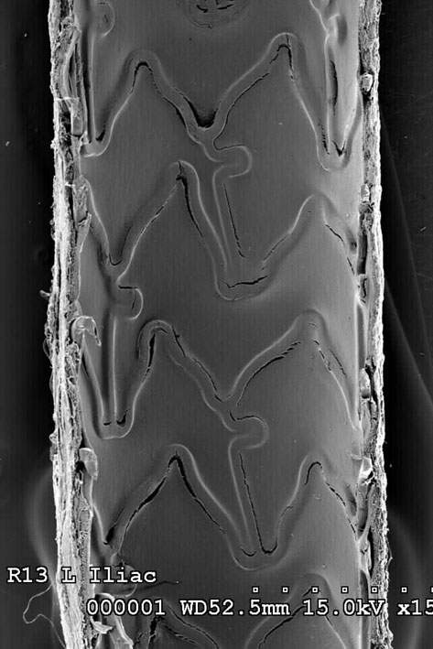
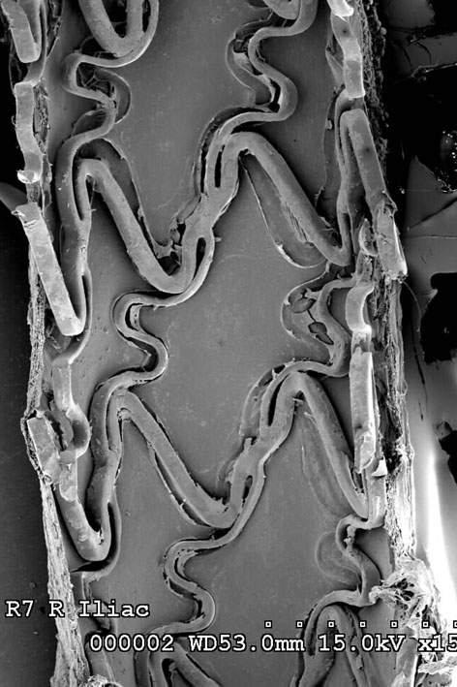
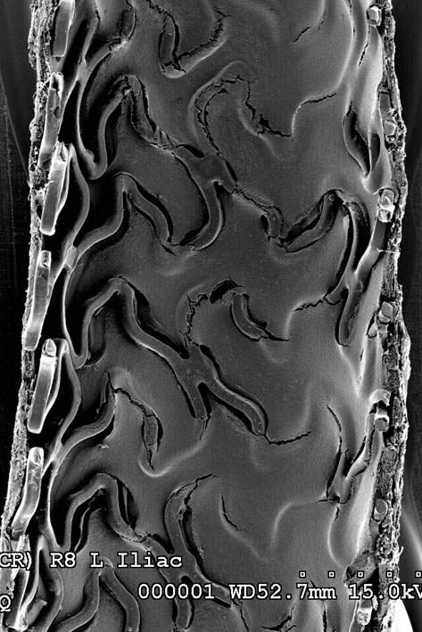
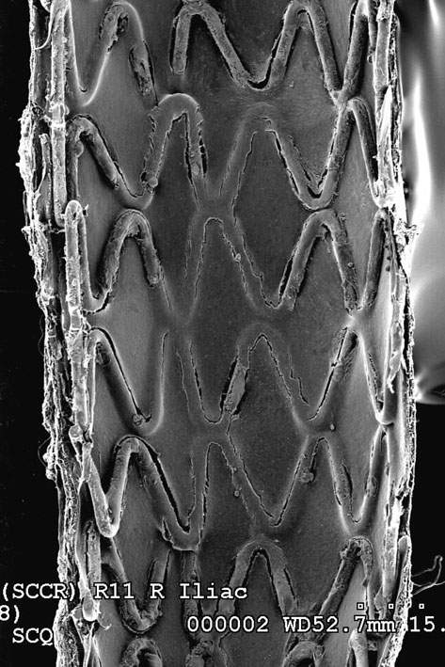
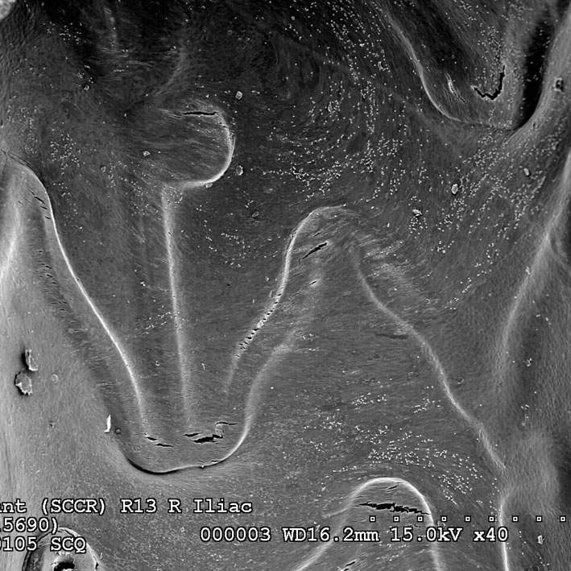
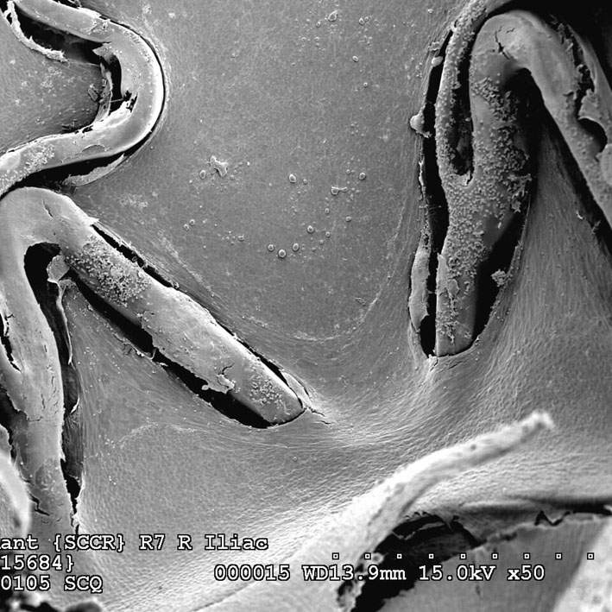
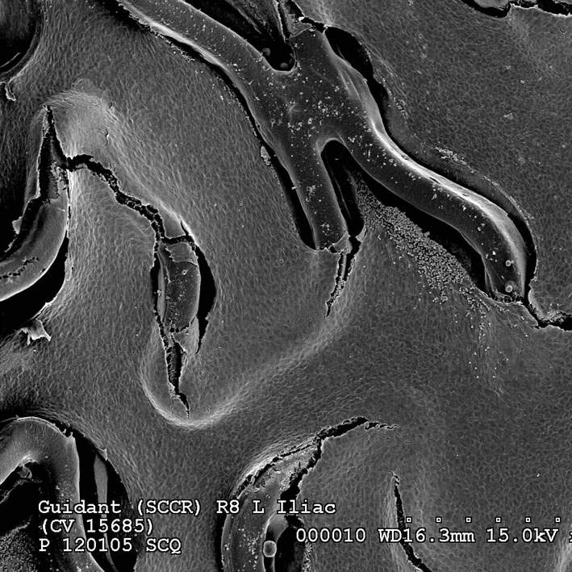
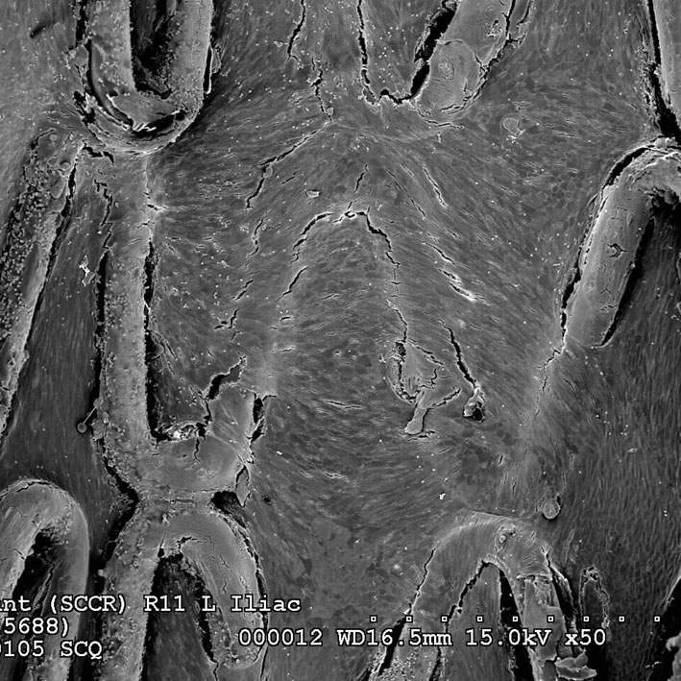
14 Day Endothelialization: Rabbit Iliac Model
XIENCE™ V
CYPHER®
TAXUS®
ENDEAVOR™
Joner M et al. JACC 2008;52:333-42

Slide 33
Xience V USA Registry (n=5,054):
1 Year ST Rate (ARC Def/Prob)
3.0%
p = 0.002
0.84%
0.7%
XIENCE V
XIENCE V
TAXUS
XIENCE V USA
COMPARE¹
32
¹ Kedhi E. et al Lancet. 2010; 375 (9710): 174-6
Hermiller JE. EuroPCR 2010
Notes:
Denominator RULE: 41 ST/4887 patients = 0.84%
32

Slide 34
Xience V USA Registry:
Late ST Rates After DAPT Interruption
Overall
Standard Risk
Subsequent Late ST (ARC Def/Prob) (%)
13/3500
2/1272
2/435
0/157
1/378
0/147
0/292
0/120
No Interruption
Interruption
After 30 Days*
Interruption
After 90 Days*
Interruption
After 180 Days*
*Out to 1 year
Hermiller JE. EuroPCR 2010.
33
Notes:
Time to first interruption. Late ST.
33

Slide 35
ENDEAVOR Pooled DAPT Analysis
3 Year Outcomes for 6-Month Event-Free Patients Relative to DAPT Duration: 6 Months vs. ≥12 Months
 | DAPT Off at 12 Months N=700 | DAPT On at 12 Months N=648 | P Value
Death | 2.7 | 2.2 | 0.48
Cardiac Death | 1.0 | 0.3 | 0.05
MI (all) | 0.3 | 1.1 | 0.19
Q wave | 0.1 | 0 | 0.32
Non Q wave | 0.1 | 1.1 | 0.08
ARC Def/Prob stent thrombosis | 0.3 | 0 | 0.19
*According to propensity score model. Values expressed as percent.
Kandzari et al. JACC Intv 2011

Slide 36
RESOLUTE All Comers
Dual Anti-Platelet Therapy
% patients on DAPT at | Resolute ZES n = 1121 | Xience V EES n = 1128 | P value
30 days | 93.8 | 94.6 | 0.42
180 days | 93.1 | 93.3 | 0.93
360 days | 84.1 | 83.8 | 0.91
720 days | 18.6† | 18.1† | 0.78
* Aspirin and (Clopidogrel or Ticlopidine)
† Majority on DAPT considered complex or ACS at time of procedure.
Serruys PW. ACC 2011

Slide 37

RESOLUTE All Comers
Definite or Probable Stent Thrombosis at 2 Years
15%
Resolute ZES (N = 1140)
Log rank P = 0.07
Xience V EES (N = 1152)
10%
Cumulative Incidence of Events
5%
1.9%
1.0%
0%
0
6
12
18
24
Time after Initial Procedure (Months)
Silber S, et al. Lancet. 2011;377:1241-47
Error bars indicate a point-wise two-sided 95% confidence interval (±1.96*SE). Standard Error based on the Greenwood Formula.
RESOLUTE All Comers was not specifically designed or powered to individually compare stent thrombosis.

Slide 38
What is the ‘Optimal’ Trial for the ‘Optimal’ DAPT Duration?
DAPT duration trials and inclusion of DES
 | Inclusion Group, N | DAPT Duration | DES Type | 1° Endpoint | 2° Endpoint(s)
DAPT | 20,645 12-month event free | 12 vs 30 months | All DES, BMS | D/MI/Stroke at 33 mos Def/prob ST at 33 mos | GUSTO Bleeding
ISAR-SAFE | 6,000 6-month event free | 6 vs 12 months | All DES | D/MI/Stroke/TIMI major bleed at 15 mos | Individual component endpoints
DES-LATE | 2,701 12-month event free | 12 vs 24 months | SES, PES, ZES | 2-yr D/MI | ARC ST, Bleeding
PRODIGY | 1,700 | 6 vs 24 months | ZES, PES, EES, BMS | 2y cardiac D/MI/stroke | D/MI, ST at 2 years
OPTIMIZE | 3,120 non-STEMI | 3 vs. 12 months | ZES | 1-yr D/MI/Stroke/TIMI major bleed | ARC ST
SEASIDE | 900 non-ACS | 6 months | ZES | 1-yr D/MI/Stroke | GUSTO Bleeding CYP2C19
DATE | 823 non-ACS | 3 months | ZES | 1y cardiac D/MI/ST | Individual component endpoints, TLR
Kandzari et al. JACC Int 2009; www.clinicaltrials.gov

Slide 39
Safety of Long-Term Clopidogrel
3 Placebo Controlled Trials
P=0.07
P=0.001
P<0.001
N=12,563
1 year FU
CURE major bleed
N=2,116
1 year FU
TIMI major bleed
N=15,603
2.5 year FU
GUSTO major
+ moderate bleed
NEJM 2001;345;494-502
JAMA 2002;288:2411-20
NEJM 2006;354:1706-17

Slide 40
P2Y₁₂ Receptor Antagonists
Agent | Class | IPA (20 uM ADP) mean | Time to peak onset | Reversibility (d/c before CABG)
Ticlopidine 250 mg bid | thienopyridine (pro-drug) | 25% | 48 hrs | non reversible 5 days
Clopidogrel 300 mg LD Clopidogrel 600 mg LD Clopidogrel 75 mg qd Clopidogrel 150 mg qd | thienopyridine(pro-drug) | 30% - 40% 35% - 50% 30% - 35% 45% - 50% | 12 hrs 6 hrs - - | non reversible 5 days
Prasugrel 60 mg LD* Prasugrel 10 mg qd* Prasugrel 5 mg qd* | thienopyridine(pro-drug) | 80% 60% 40% | 1-2 hrs - - | non reversible 7 days
Ticagrelor 180 mg LD* Ticagrelor 90 mg bid* | cyclo-pentyl-triazolo-pyrimidine† | 80% 70% | 1-2 hrs - | reversible 2-5 days
*Less affected by genetic polymorphisms and drug interactions (eg, PPIs)
†Not a pro-drug

Slide 41
US FDA Labeling Recommendations on D/C of DAPT Prior to Surgery
Clopidogrel: 5 days
Ticagrelor: 5 days
Prasugrel: 7 days

Slide 42
Association of Post-OP Blood Loss
With Pre-OP Tx Time of Clopidogrel
P<0.0001
Blood loss, mL
Chu MWA et al. Ann Thorac Surg 2004;78:1536

Slide 43
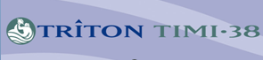
TRITON-TIMI-38
CABG-Related Bleeding
CABG related TIMI major or minor bleed (%)
30%
HR [95%CI] =
3.50 [1.53, 7.99]
P=0.002
Clopidogrel
Prasugrel
20%
10%
0%
1
2
3
4
5
6
7
8
9
10
11
12
13
Days from drug d/c to CABG
FDA briefing doc

Slide 44
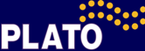
Major Fatal or Life-threatening Bleeding by Days from Last Dose of Treatment to CABG Procedure
100
90
Clopidogrel
Ticagrelor
80
70
60
% of Patients who had
an Event Following CABG
50
40
30
20
10
0
1
2
3
4
5
6
7
≥8 Days
T
C
T
C
T
C
T
C
T
C
T
C
T
C
T
C
Ticagrelor
55/84
50/106
56/114
39/84
22/79
29/91
25/74
53/228
Clopidogrel
52/88
42/86
33/73
29/69
27/96
45/110
40/107
73/274
FDA slides for the July 28, 2010 Meeting of the Cardiovascular and Renal Drugs Advisory Committee
http://www.fda.gov/AdvisoryCommittees/CommitteesMeetingMaterials/Drugs/CardiovascularandRenalDrugsAdvisoryCommittee/ucm221382.htm

Slide 45
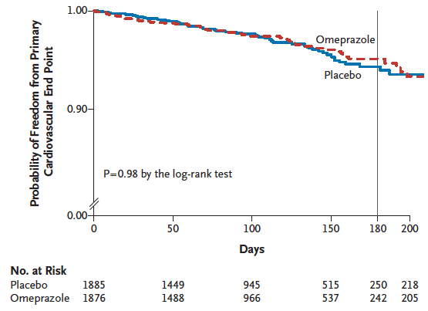
COGENT: CV Events
Bhatt et al, N Engl J Med 2010;363:1909-17

Slide 46
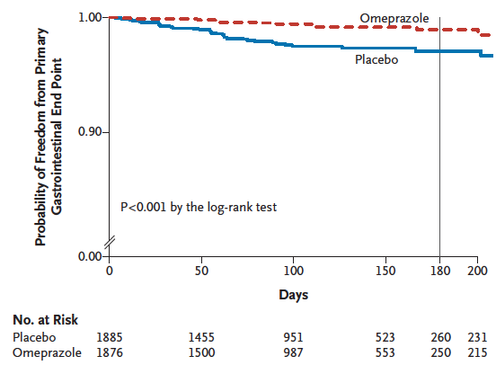
COGENT: GI Events
Bhatt et al, N Engl J Med 2010;363:1909-17

Slide 47
Rebound CV Events After Clopidogrel Discontinuation
3137 pts with ACS were discharged from 127 VA hospitals on clopidogrel (50% after PCI, 50% medical Rx)
Clopiodgrel was subsequently d/c’d and Pts were then followed ~6 months off clopidogrel
Instantaneous Rate of Death or MI per Person-Day
0.001
PCI Patients
0.001
Medically Treated Patients
0.0008
0.0008
0.0006
0.0006
0.0004
0.0004
0.0002
0.0002
0
0
0
90
180
270
360
450
0
90
180
270
360
450
Days Since Stopping Clopidogrel
Days Since Stopping Clopidogrel
Ho PM, et al. JAMA. 2008;299:532-539.

Slide 48
Absence of Rebound After Abrupt Clopidogrel Discontinuation
69 pts on steady state clopidogrel were randomized to a 4-week taper vs 4-week maintenance followed by abrupt d/c
ADP induced platelet aggregation measured by LTA
Primary EP: Peak level weeks 5-8
73.0 ± 2.5% vs. 69.3 ± 1.5%, P=0.21
80
70
60
50
ADP (5µM)-induced
Aggregation (%)
40
30
20
Off group (n=34)
Tapering group (n=35)
10
0
0
2
3
4
5
6
7
8
No. of patients
Weeks After Randomization
Off group 34 32 33 32 34 34 33 34
Tapering group 35 34 30 33 34 33 33 33
Sibbing D, et al. J Am Coll Cardiol 2010;55:558-565.

Slide 49
Strategies for Upcoming Surgery
If at all possible, delay surgery!
  Ideally 6 weeks for BMS*
    Maybe 2 weeks?
  Ideally 6 months to 1 yr for DES*
    Likely 3-6 months with 2nd gen DES
If surgery is needed and bleeding risk acceptable, continue DAPT through surgery

Slide 50
Strategies for Upcoming Surgery
If bleeding risk is high, continue ASA and restart P2Y12 inhibitor ASAP
  Could consider IIbIIIa bridging
If no AP therapy, consider IIbIIIa bridge

Slide 51
Bridging Strategies
Stop aspirin and continue P2Y12 inhibitor
If bleeding risk is too high and necessitates dicontinuation of DAPT, continue ASA and minimize time off the P2Y12 inhibitor
  Use a shorter-acting P2Y12 inhibitor
  Use platelet reactivity testing to measure platelet inhibition?
If no AP therapy can be used at all perioperatively, consider IIbIIIa bridge

Slide 52
Data on Bridging Strategies
Study | Type | Findings
Savonitto 2010 | Prospect-ive Series | 30 pts with recently implanted DES bridged with tirofiban before urgent major or eye surgery No death, MI, ST or surgical reexploration; 2 postop bleeds
Bigalke 2009 | Case Series | 7 pts undergoing early noncardiac surgery bridged with eptifibatide No increased perioperative hemorrhage or CV complications
Chou 2009 | Case Series | 8 pts successfully bridged with GP IIb/IIIa inhibitors No adverse cardiac outcomes or bleeding complications
Khair 2011 | Survey | 50% of physicians would offer GP IIb/IIIa bridge 49% would try to identify a surgeon who would operate on DAPT
Wessler JD et al, Cardiovasc Revasc Med 2011

Slide 53
The Bleeding Patient
Most bleeding can be managed while on dual-antiplatelet therapy
  All bleeding eventually stops!
If cessation is required, the risk of subacute ST depends upon:
  Time since PCI / Duration of cessation
  Risk of initial PCI (ACS vs. non-ACS, etc)
  NOT on BMS vs. DES in the first 2 wks

Slide 54
Strategies to Deal With Bleeding
Hemodynamic resuscitation is critical
Continue DAPT if at all possible
Continue ASA alone while P2Y12 inhibitor is off
  Minimize time off P2Y12 inhibitor
  Most IV bridging strategies are not applicable here

Slide 55
DES and Surgery: Scope of the Problem
DES needs long-term combination antiplatelet therapy (ASA+clopidogrel for at least 1 year)
Surgery has bleeding complications
  Hence, surgeons are used to stopping all blood-thinners pre-op
Premature stopping of antiplatelet Rx after DES may risk stent thrombosis
  The cardiologist needs to know if antiplatelet Rx is to be altered in a patient with DES.
Therefore, both specialties have to communicate provided that they know what this entails

Slide 56
Bleeding vs. SAT Risk in Surgery
Peri-operative Bleeding
  In certain surgeries more than others
  Increased length of stay, Wound complications, Transfusion
  Rarely life-threatening

Slide 57
Peri-operative Practicalities
No bleeding data on non-cardiac surgery post DES and on/off clopidogrel
Almost all surgeons will complain
Some (Many??) surgeons will operate on cardio-protective medications with acceptance of a risk of some more bleeding
  CHOOSE THE RIGHT SURGEON
  DO NOT ACCEPT MEDICATION CHANGES WITHOUT ASKING FOR A SPECIFIC REASON
  EXPLAIN DIRE RISKS OF CARELESS STOP (AND NON-RESTART) OF THESE DRUGS
  MINIMIZE STOP TIME PRE+POST OP
We can review literature mainly from cardiac surgical bleeding and try to do our best in order to help surgeons with their bleeding problem

Slide 58
Incidence of Re-Operation
According to Pre-OP Antiplatelets
P=0.006
Patients, %
Yende S et al. Crit Care Med 2001;29:2271

Slide 59
No Association of Cardiac Complications
With Use of Pre-OP Clopidogrel
 | Clopidogrel (N=48) | No clopidogrel (N=1580) | p
Chest tube output (ml) | 719 ± 265 | 612 ± 350 | NS
Re-OP for bleeding | 0 | 1 % | NS
PRBC (U/patient) | 0.5 ± 0.9 | 0.4 ± 0.9 | NS
FFP (U/patient) | 1.1 ± 1.2 | 0.9 ± 1.1 | NS
ICU stay (h) | 20.1 ± 2.9 | 21.9 ± 13.5 | NS
Hospital stay (days) | 5.5 ± 1.7 | 5.4 ± 2.1 | NS
Karabulut H et al. Eur J Caridiothrac Surg. 2004;25:419

Slide 60
Multivariate Predictors of Post-OP Bleeding after Off-Pump CABG in 1572 Pts
Predictors | OR | 95% CI | p
Re-OP for bleeding
Clopidogrel | 5.1 | 2.47 – 10.47 | <0.01
Blood transfusion
Clopidogrel | 2.6 | 1.94 – 3.60 | <0.01
Age | 1.0 | 1.02 – 1.04 | <0.01
Female | 1.9 | 1.43 – 2.52 | <0.01
Weight | 1.0 | 0.98- 1.00 | <0.01
African ancestry | 1.6 | 1.16 – 2.23 | <0.01
Renal failure | 2.5 | 1.20 – 5.34 | 0.02
4-6 vessels grafted | 1.4 | 1.11 – 1.81 | <0.01
Kapetanakis EI et al. Circulation 2006;113:1667

Slide 61
Multivariate Predictors of Adverse Outcomes after CABG in 2359 Pts
Predictors | OR | 95% CI | p
Re-OP for bleeding
Clopidogrel | 5.7 | 1.81 – 18.15 | <0.01
Blood transfusion
Clopidogrel | 1.9 | 1.38 – 2.52 | <0.01
Pre-OP hamatocrit | 0.8 | 0.80 – 0.87 | <0.01
Renal failure | 3.4 | 0.99 – 11.89 | 0.05
OP mortality
Clopidogrel | 1.5 | 0.36 – 6.51 | 0.56
Renal failure | 11.7 | 1.99 – 68.42 | <0.01
Kapetanakis EI et al. Eur Heart J 2005; 26:576

Slide 62
Meta-analysis of
Clopidogrel Use Before CABG
 | No. of Clop. | No. of No-clop. | OR | 95% CI
Blood loss | 427 | 2636 | 323.6 | 137-510*
Overall transfusion risk | 767 | 2021 | 4.9 | 2.79-8.59*
Mortality | 333 | 1005 | 1.01 | 0.41-2.48
Adverse events | 296 | 874 | 1.53 | 1.02-2.32*
Length of stay | 229 | 1994 | 1.18 | 0.24-2.12
Re-OP rate | 445 | 2649 | 6.76 | 3.37-13.6*
Ventilation requirement | 210 | 597 | 2.81 | 1.63-4.86*
*p<0.05
Purkayastha S et al. Heart 2006;92:531

Slide 63
Influence of Early CABG (< 5days) after Discontinuation of Clopidogrel in NSTEMI
 | No clopidogrel (N=1826) | Clopidogrel (N=739)
Any RBC transfusion * | 56.9 % | 65.0 %
RBC transfusion > 4U * | 18.4 % | 27.7 %
RBC units transfused * | 1.0 (0, 3) | 2.0 (0, 4)
Death | 2.9 % | 3.5 %
Death or re infarction | 5.7 % | 5.0 %
Cardiogenic shock | 4.2 % | 3.8 %
Hospital stay (days) | 9.0 (7, 13) | 9.0 (7, 12)
Shock | 1.4 % | 1.6 %
* p<0.05
Mehta RH et al. J Am Coll Cardiol 2006;48:281

Slide 64
Early Clopidogrel Use (< 4h) after Off-Pump CABG
 | No clopidogrel (N=171) | Clopidogrel (N=193)
Re-OP for bleeding | 1.8% | 0
Chest tube drain (ml)
8 h | 558 ± 317 | 629 ± 347
24 h | 942 ± 501 | 1024 ± 563
Blood transfusion | 43 % | 41 %
PRBC (units) | 1.8 ± 2.6 | 1.8 ± 2.2
CVA at 30 days | 0 | 0.6 %
Cardiac events at 30 days | 0.7 % | 0
All p=NS
Halkos ME et al. Ann Thorc Surg 2006;81:815

Slide 65
ADD Schouten et al, JACC

Slide 66
ADD Erasmus et al, AJC

Slide 67
Management After
PCI with DES
Has been completed
Dangas G, Treatment with DES
In Antman’s
Cardiovascular Therapeutics,
A Companion to
Braunwald’s Heart Disease
Fig 7-8
_{First Month Management}
Clopidogrel 75mg po QD
Consider BID for 1 month
in exceptionally high-risk cases,
STEMI, platelet resistance
Ticlopidine 250mg po BID
For clopidogrel Allergy
Or
Cilostazol 100mg po BID for
A to both thienopyridines
plus
or
GPIIb/IIIa Inhibitor
Infusion
Continue for 12-18 hrs
Enteric-coated
aspirin 325mg
After the first month
Clopidogrel for 1 year
Afterwards continue
Unless there are side-effects,
Enteric-coated
aspirin 81mg
Consider cilostazol
for 1 year
Elective non-cardiac surgery
Postpone after 6-12 months.
Discontinue (only if needed)
either aspirin or clopidogrel
5 days pre-op and restart
dual antiplatelet therapy ASAP
Urgent surgery
Stop both antiplatelets reluctantly and with understanding of possible stent thrombosis and a set-up to handle this complication. Post-op restart dual antiplatelet therapy ASAP
Non-urgent surgery
At 2-6 month window
Necessitating stopping both antiplatelet agents 5 days pre-op
Initiate Enoxaparin 1mg/kg SQ BID 5 days pre-op and restart dual antiplatelet therapy
post-op ASAP

Slide 68
Conclusions
Much of clinical decision-making in this area can be empiric, with limited prospective data
To avoid thrombosis, don’t stop DAPT
Communication between patients and (several) providers is critical!

Slide 69
Stent Thrombosis and Restenosis During Extended Follow-up of Pts Treated With BMS (n=4503)
 | 1 Year % (95% CI) | 5 Years % (95% CI) | 10 Years % (95% CI)
All stent thrombosis | 0.8 (0.6-1.1) | 1.3 (1.0-1.7) | 2.0 (1.5-2.5)
On-label patients | 0.6 (0.2-0.9) | 1.0 (0.5-1.2) | 1.4 (0.9-2.0)
Off-label patients | 1.1 (0.7-1.5) | 1.7 (1.2-2.2) | 2.5 (1.7-3.3)^{b}
%Stent Thrombosis
%MI Due to Restenosis
↑ Mortality Risk: HR=22, P<0.001
↑ Mortality Risk: HR=2.4, P<0.001
Doyle B, et al. Circulation. 2007;116:2391-2398.
Notes:
Doyle and coworkers performed a retrospective study of 4503 consecutive patients treated with at least 1 bare-metal stent (BMS) and dual antiplatelet therapy between 1994 and 2000.
The cumulative incidence of stent thrombosis was 0.5% at 30 days (95% CI, 0.3% to 0.7%), 0.8% at 1 year (95% CI, 0.6% to 1.1%), and 2.0% at 10 years (95% CI, 1.5% to 2.5%). For patients treated with a single stent in a native artery for a de novo lesion (on label), the cumulative incidence of stent thrombosis at 30 days was 0.2% (95% CI, 0.0% to 0.4%), at 1 year was 0.6% (95% CI, 0.2% to 0.9%), at 5 years was 1.0% (95% CI, 0.5% to 1.2%), and at 10 years was 1.4% (95% CI, 0.9% to 2.0%). For all other patients (off label; n=2295), the cumulative incidence of stent thrombosis at 30 days was 0.7% (95% CI, 0.4% to 1.1%), at 1 year was 1.1% (95% CI, 0.7% to 1.5%), at 5 years was 1.7% (95% CI, 1.2% to 2.2%), and at 10 years was 2.5% (95% CI, 1.7% to 3.3%). Mortality was markedly increased after late and very late BMS thrombosis, particularly during the first 30 days (hazard ratios, 22 [95% CI, 3.1 to 159] and 40 [95% CI, 15 to 107], respectively.
The cumulative incidence (95% CI) of at least 1 restenosis was 9.6% (8.8% to 10.5%) at 1 year, 13.9% (12.8% to 14.9%) at 5 years, and 18.1% (16.5% to 19.7%) at 10 years. The 10-year incidence of restenosis by mode of presentation was stable angina 9.0% (95% CI, 8.0% to 10.0%), unstable angina 7.4% (95% CI, 6.3% to 8.6%), MI 2.1% (95% CI, 1.6% to 2.6%), and other unstable presentation such as decompensated heart failure or ventricular arrhythmia 0.4% (95% CI, 0.2% to 0.6%). Restenosis presented as an asymptomatic positive stress test in 1.4% (95% CI, 0.7% to 2.2%). Restenosis presenting with MI was associated with increased mortality compared with no restenosis (hazard ratio, 2.37; P<.001) and with restenosis with a non-MI presentation (hazard ratio, 2.42; P<.001).
Doyle B, Rihal CS, O’Sullivan CJ, et al. Outcomes of stent thrombosis and restenosis during extended follow-up of patients treated with bare-metal coronary stents. Circulation. 2007;116:2391-2398.

